Slide 1
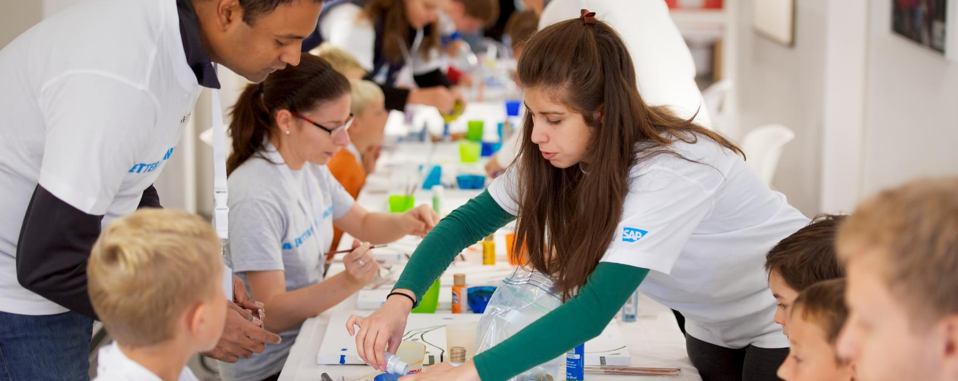

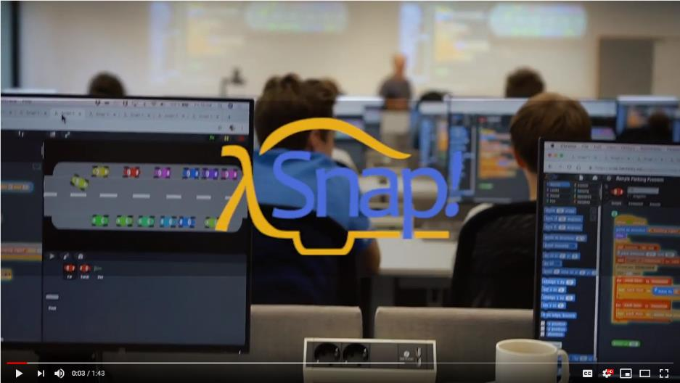
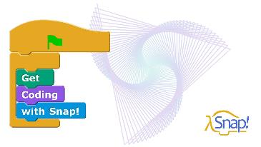
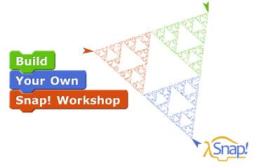
Snap!
Snap!
SAP is committed to supporting the 17 United Nations Sustainable Development Goals. As part of our contribution to goal 4, Quality Education, SAP has partnered with UC Berkeley to evolve the visual programming language, Snap!
Snap! is a visual programming language. You code by stacking together graphical blocks rather than typing words. Your program is always alive, ready to be tried, tested and changed as your ideas evolve. Snap! supports imperative, functional and object-oriented programming paradigms.
At SAP, Snap! is part of openSAP University. If you’d like to learn how to use Snap!, sign up to openSAP’s free online courses to get started.
About Snap! | Students | Educators and Parents | Researchers and Developers
Snap! was originally created as part of UC Berkeley’s “The Beauty and Joy of Computing” curriculum and has been adopted by colleges and high schools to teach computer science. Students use Snap! to create games, interactive stories, artwork and simulations, to analyze data, drill down on media, control robots and to invent new forms of expressing themselves.

