Slide 1
Summary of models and results
4/16/19

Slide 2
Three fitting conditions
Unity judgement task (number of saccades)
Localization task (location of A and V saccades, if one saccade A = V )
Joint task (maximize sum of log likelihood of both using same parameter values)
For joint fit, paired Bayesian unity judgement with 3 possible localization strategies
Bayesian reweighting (using posterior probability from unity judgement)
Model selection (weight = 1 or 0, threshold is Pr(C=1) >0.5)
Probabilistic fusion - null (fixed weight = prior common)
Binning saccade locations in 1 degree bins
Numerically integrating from -50 to +50 for each condition

Slide 3
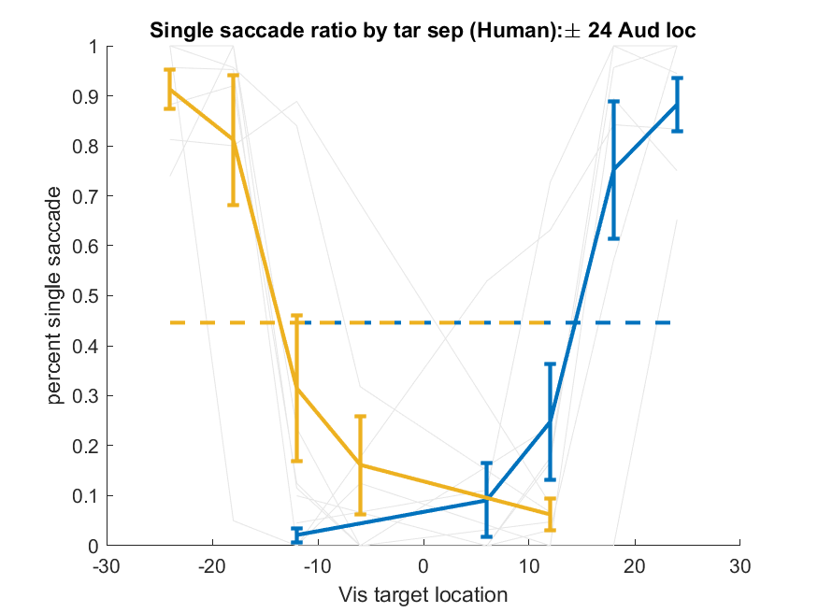
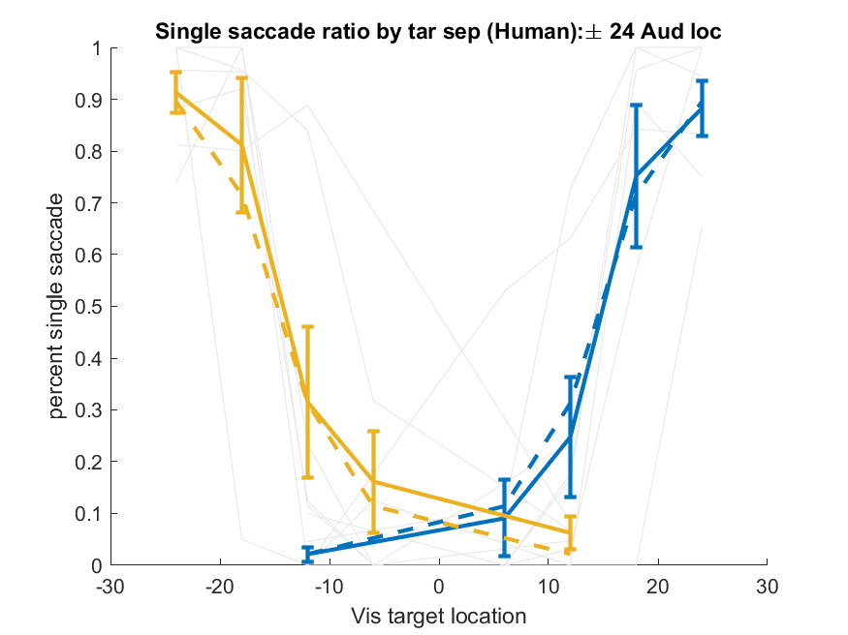
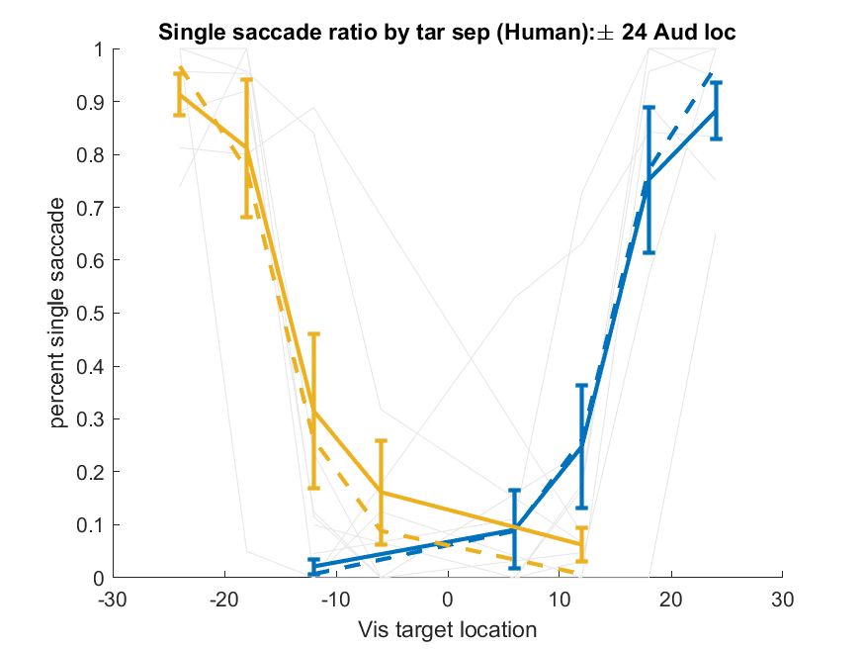
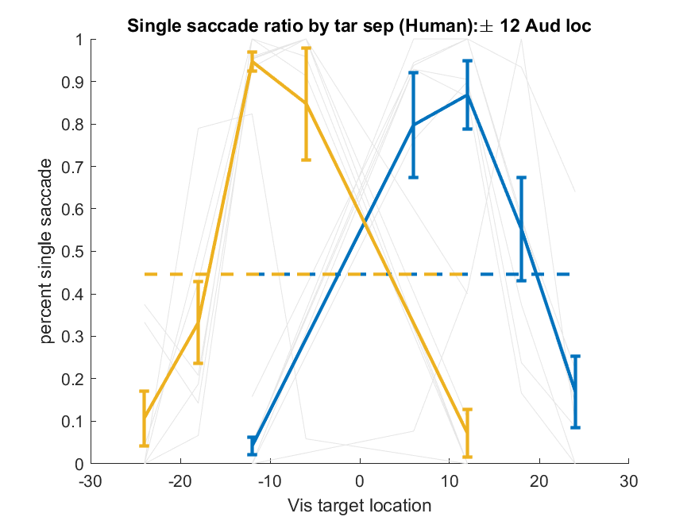
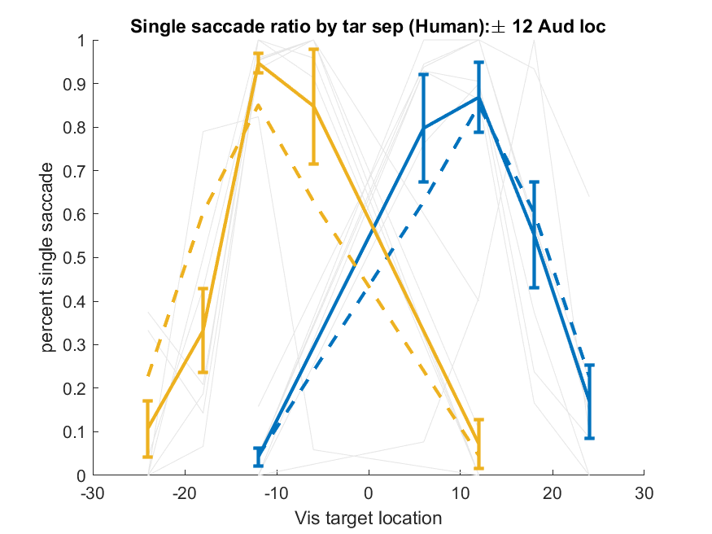
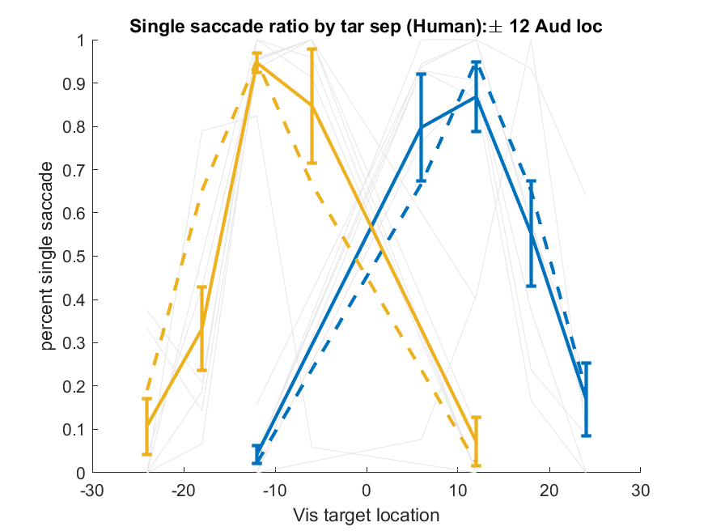
Unity judgement [p(C|xa,xv)] – human (n=7)
Probabilistic Fusion
Bayesian Unity
Bayes - Bayes Joint

Slide 4
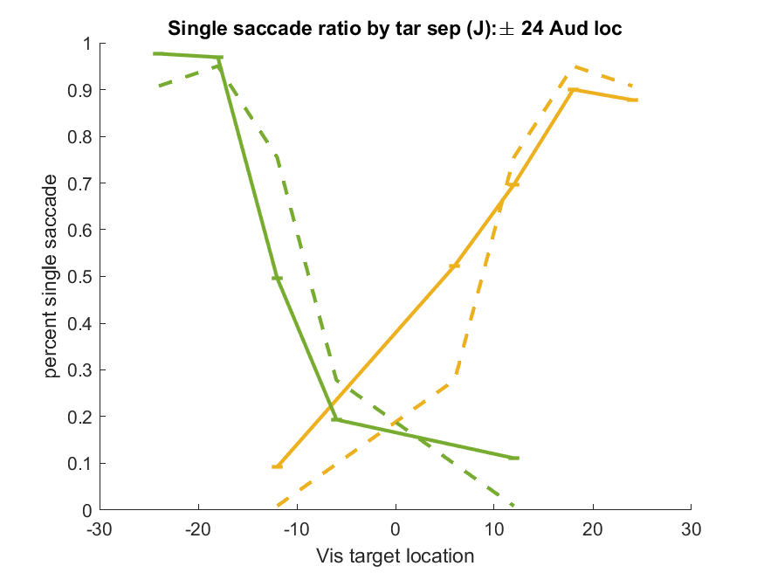
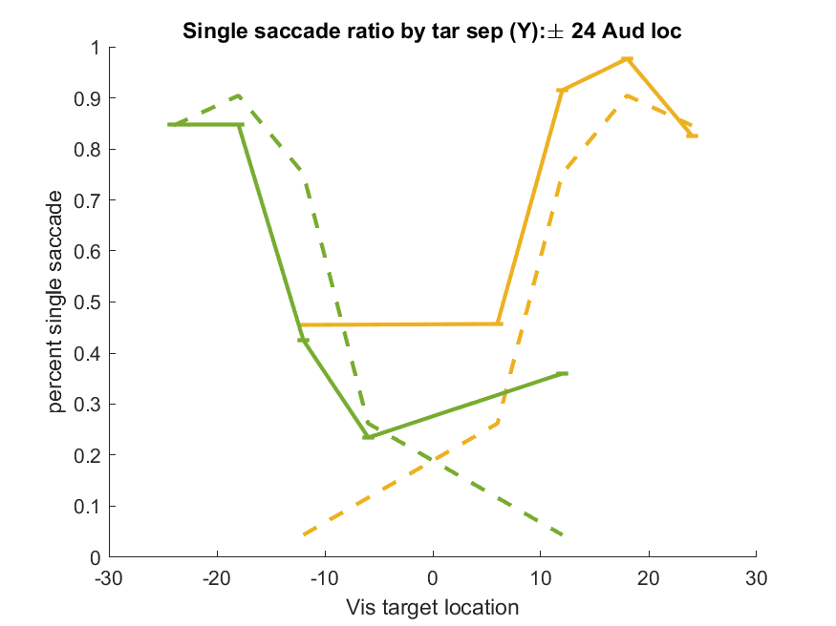
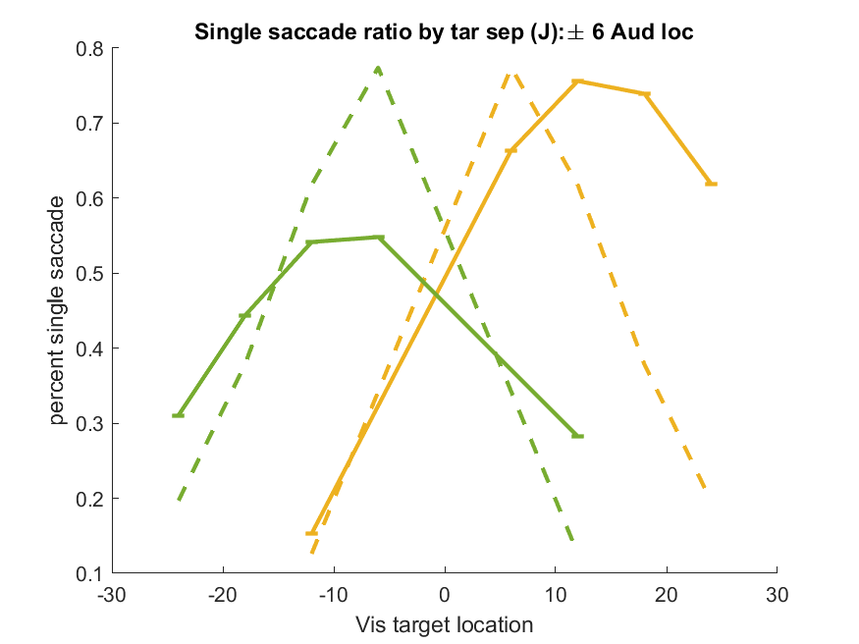
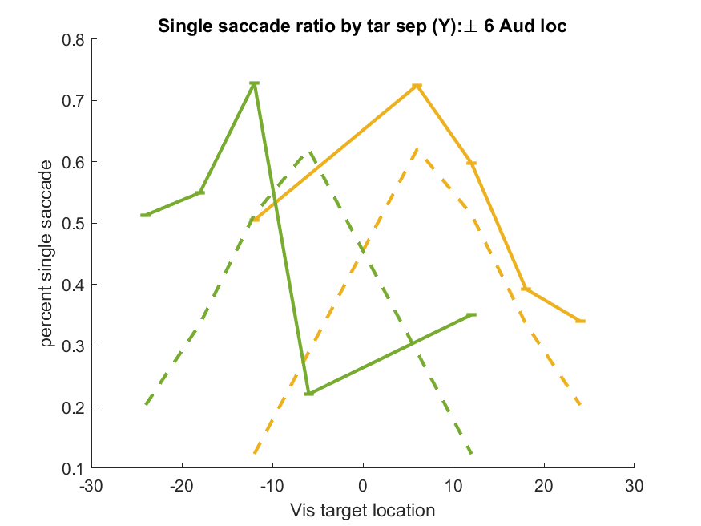
Unity Judgement - monkey
Bayes – Bayes Joint
Monkey J
Monkey Y
Data collapsed across 10 randomly selected days
Monkey Y has a stereotyped behavior on -6A -6V that includes a mostly vertical saccade. Deciding if I want to discard this.

Slide 5
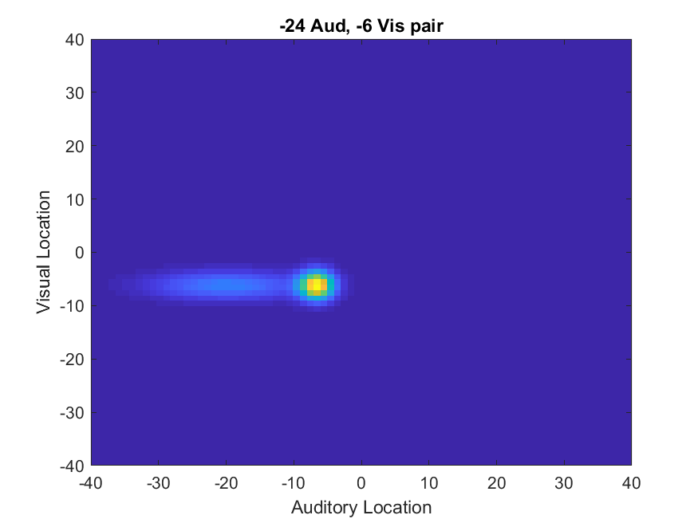
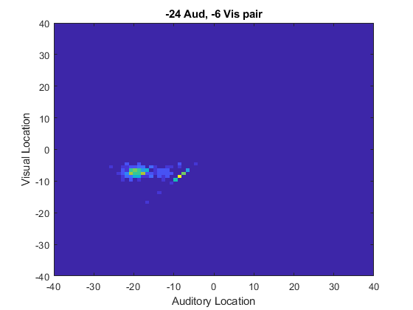
Localization posterior
Can get a posterior distribution for p(sa,sv|xa,xv,C) [left], but in task I actually only get both sa and sv when two saccades are made, in the one saccade case sa = sv, which restricts responses to the diagonal.
MAP estimated distribution
Data

Slide 6
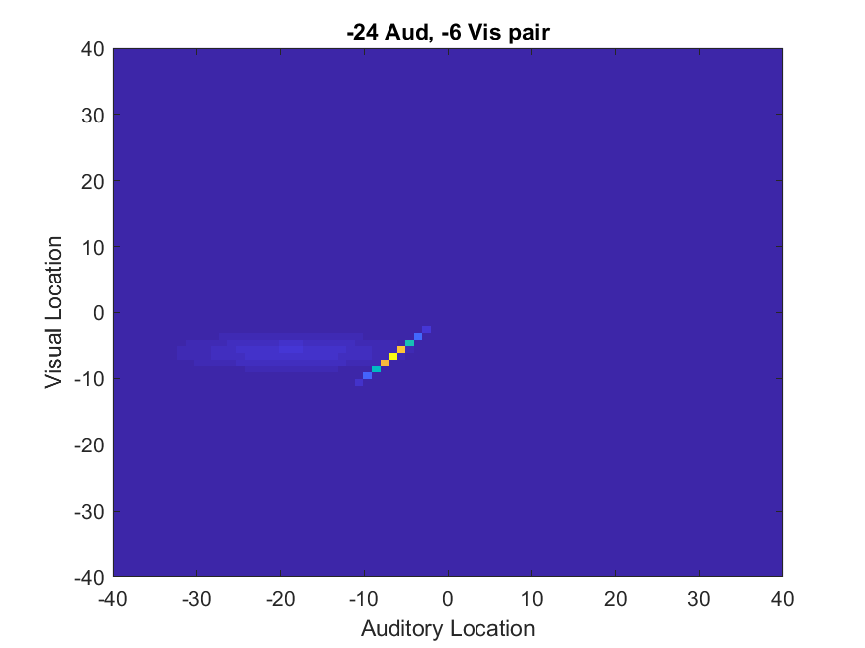

New posteriors
Calculate posterior under C=1 and C=2 conditions completely separately, reweight and sum according to posterior probability Pr(C=1).
MAP estimated distribution
Data

Slide 7
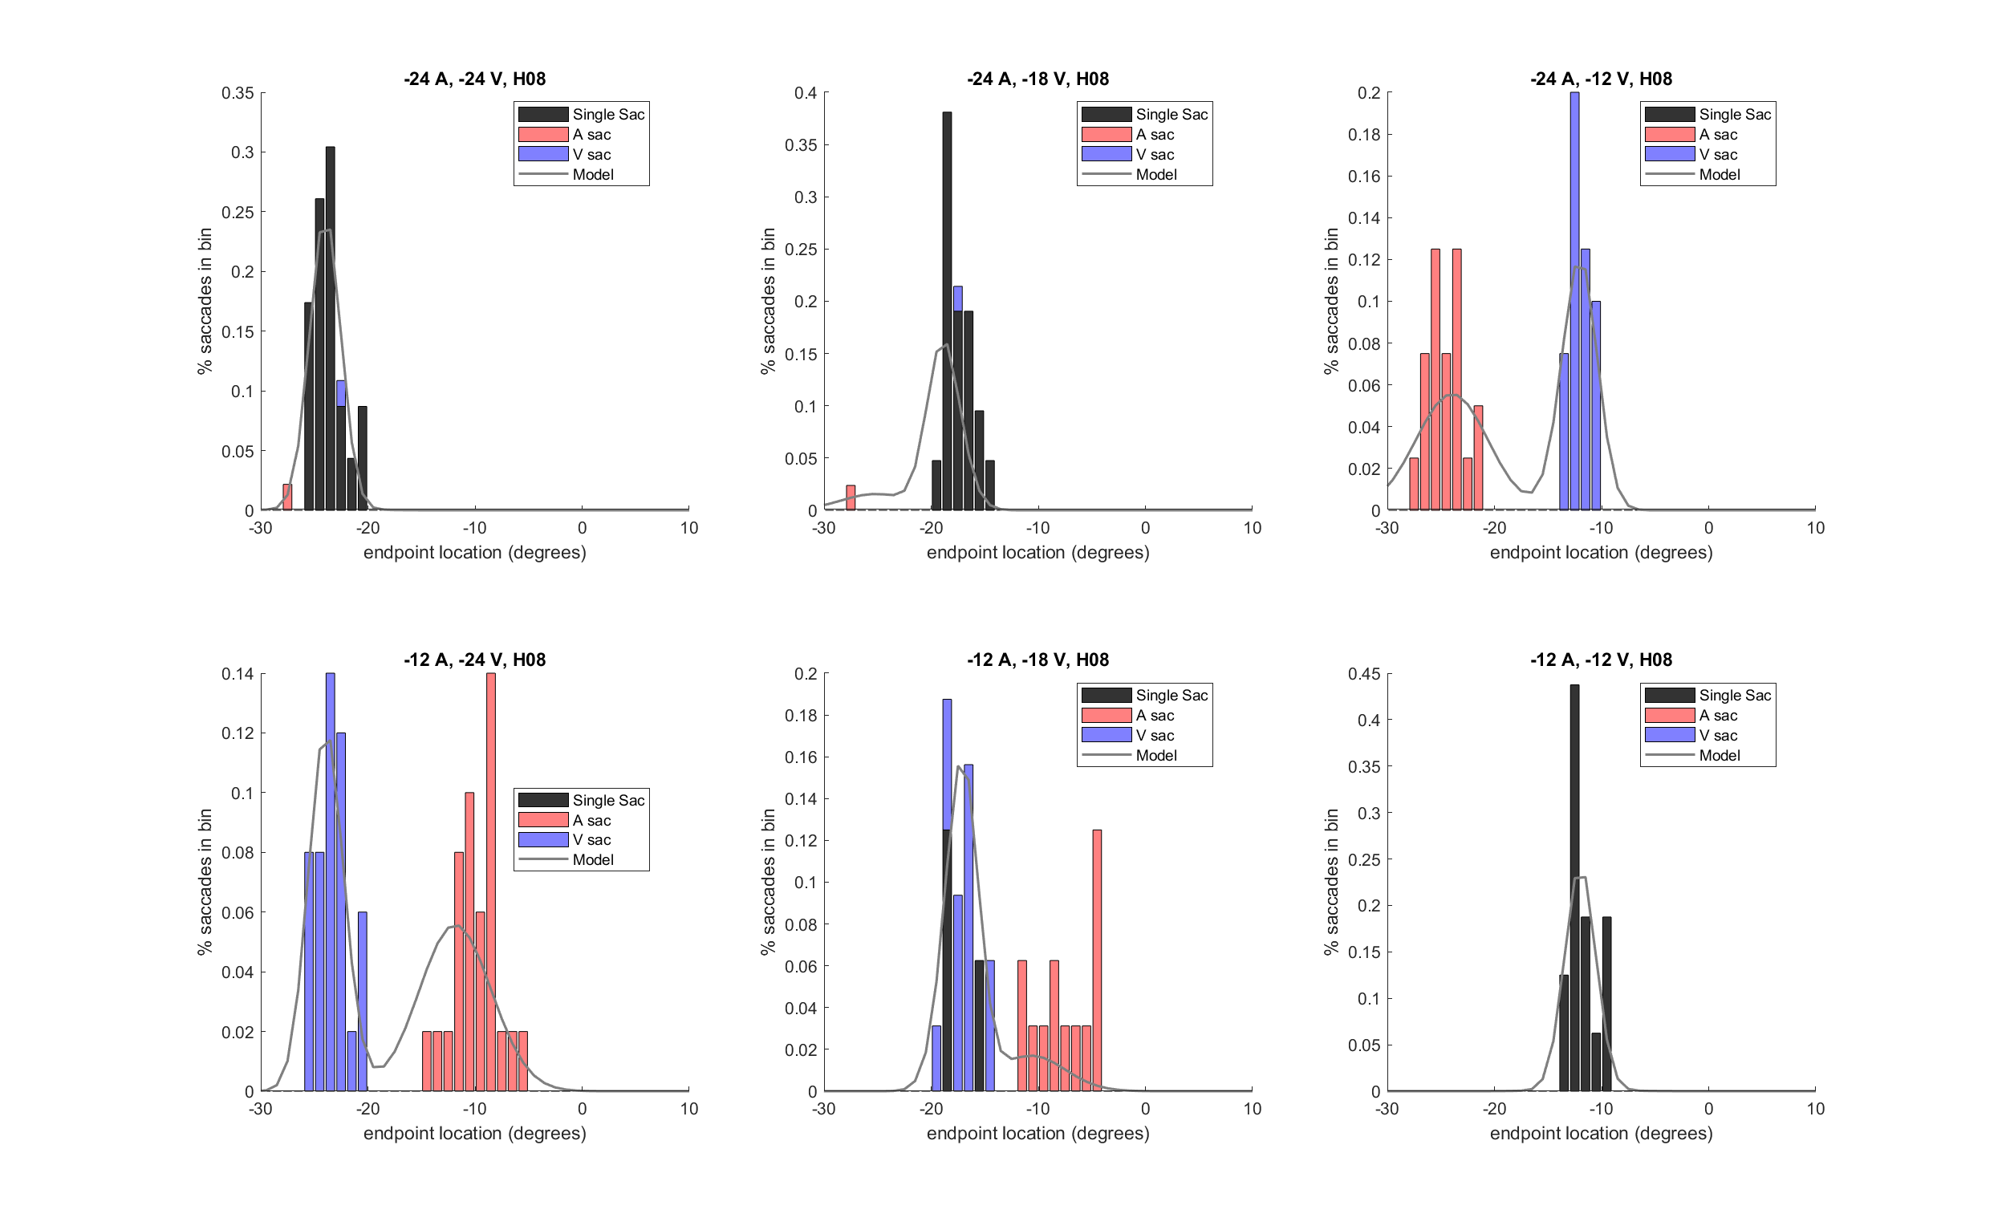
B_B_J

Slide 8
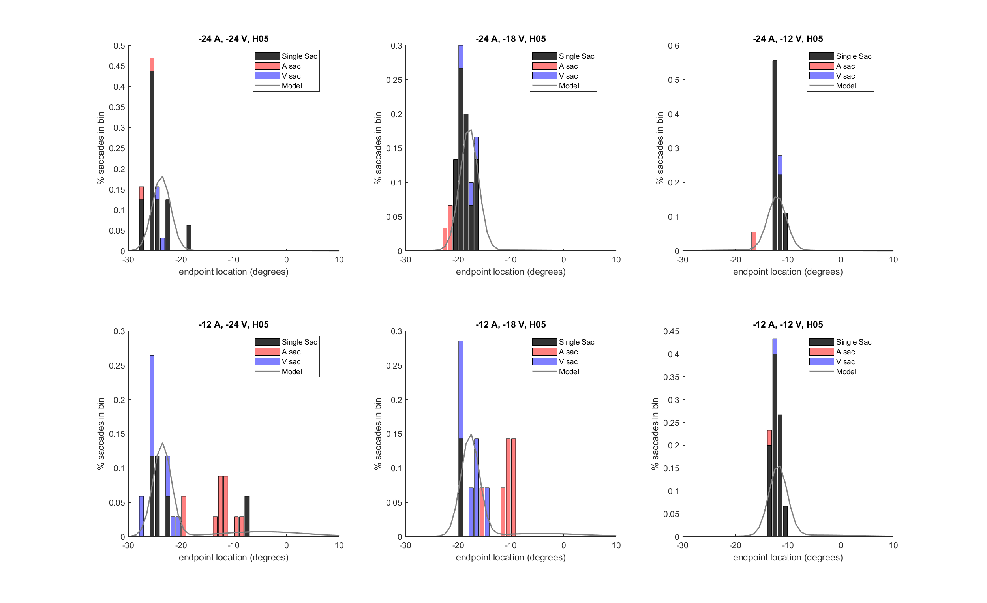

Slide 9
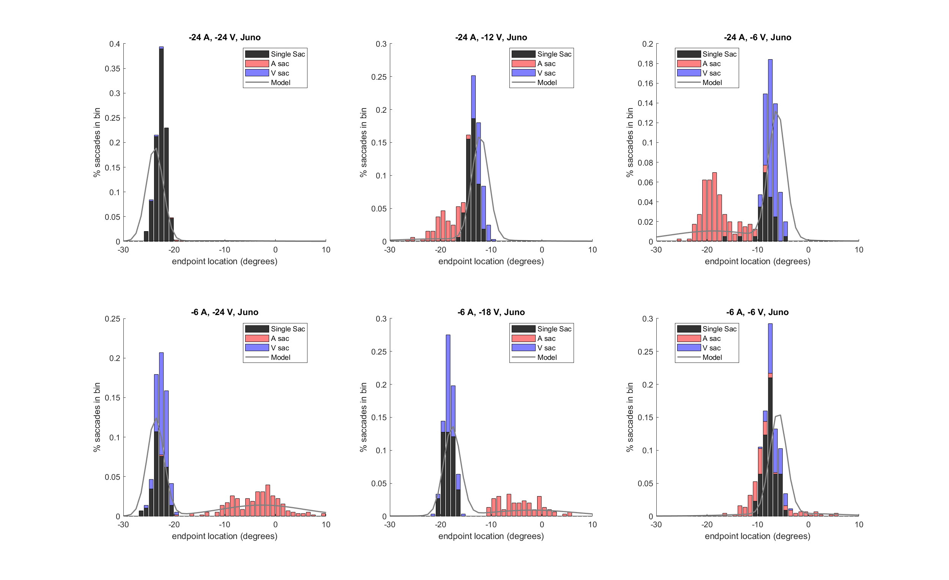

Slide 10
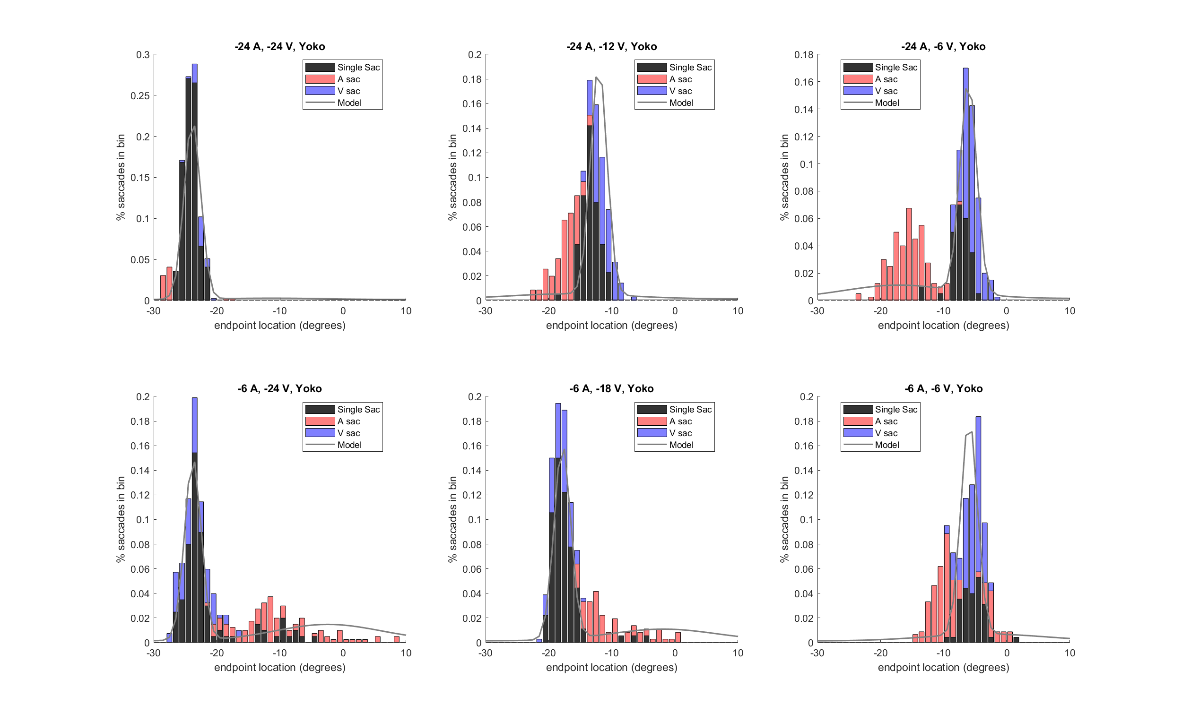

Slide 11
Model comparison and fit parameters
Subject | Bayes BIC - Model Selection BIC | Bayes BIC - Probabilistic Fusion BIC
Monkey J | -557.1 | -1840.7
Monkey Y | -557.1 | -479.6
H02 | -3.7 | -417.4
H03 | -9.8 | -457.5
H04 | -63.8 | -471.8
H05 | -64.0 | -141.9
H06 | -30.5 | -144.8
H07 | -58.22 | -332.5
H08 | +10.2 | -423.2
 | V_sig | A_sig | P_sig | P_common | lambda
Monkey J | 1.19 | 7.99 | 12.34 | 0.47 | 0.02
Monkey Y | 0.93 | 8.54 | 11.53 | 0.41 | 0.09
Humans | 0.99 +- .19 | 3.60 +- 2.3 | 15.04 +- 11.32 | 0.52 +- 0.24 | 0.02 +- 0.015
Unimodal trials – mean normfit
Juno V_sig = 1.22, A_sig = 5.32
Yoko V_sig = 1.33, A_sig = 5.12

Slide 12
Issues

Slide 13
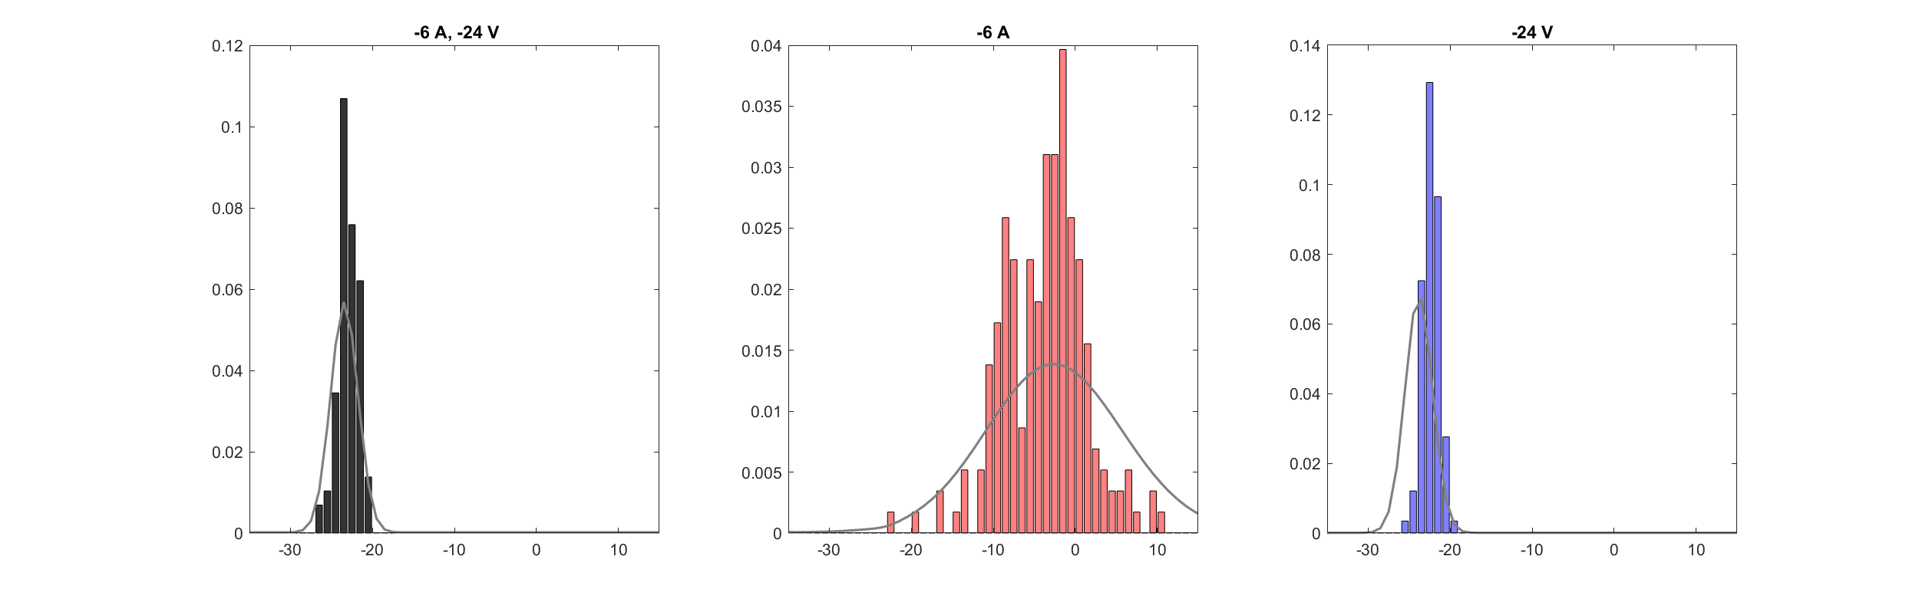
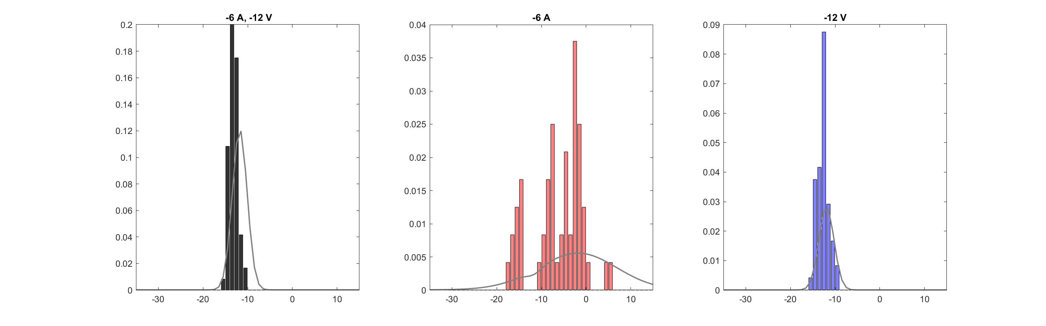
Aud variance greatly overestimated, ex from Monkey J AV trials
Notes:
Juno

Slide 14
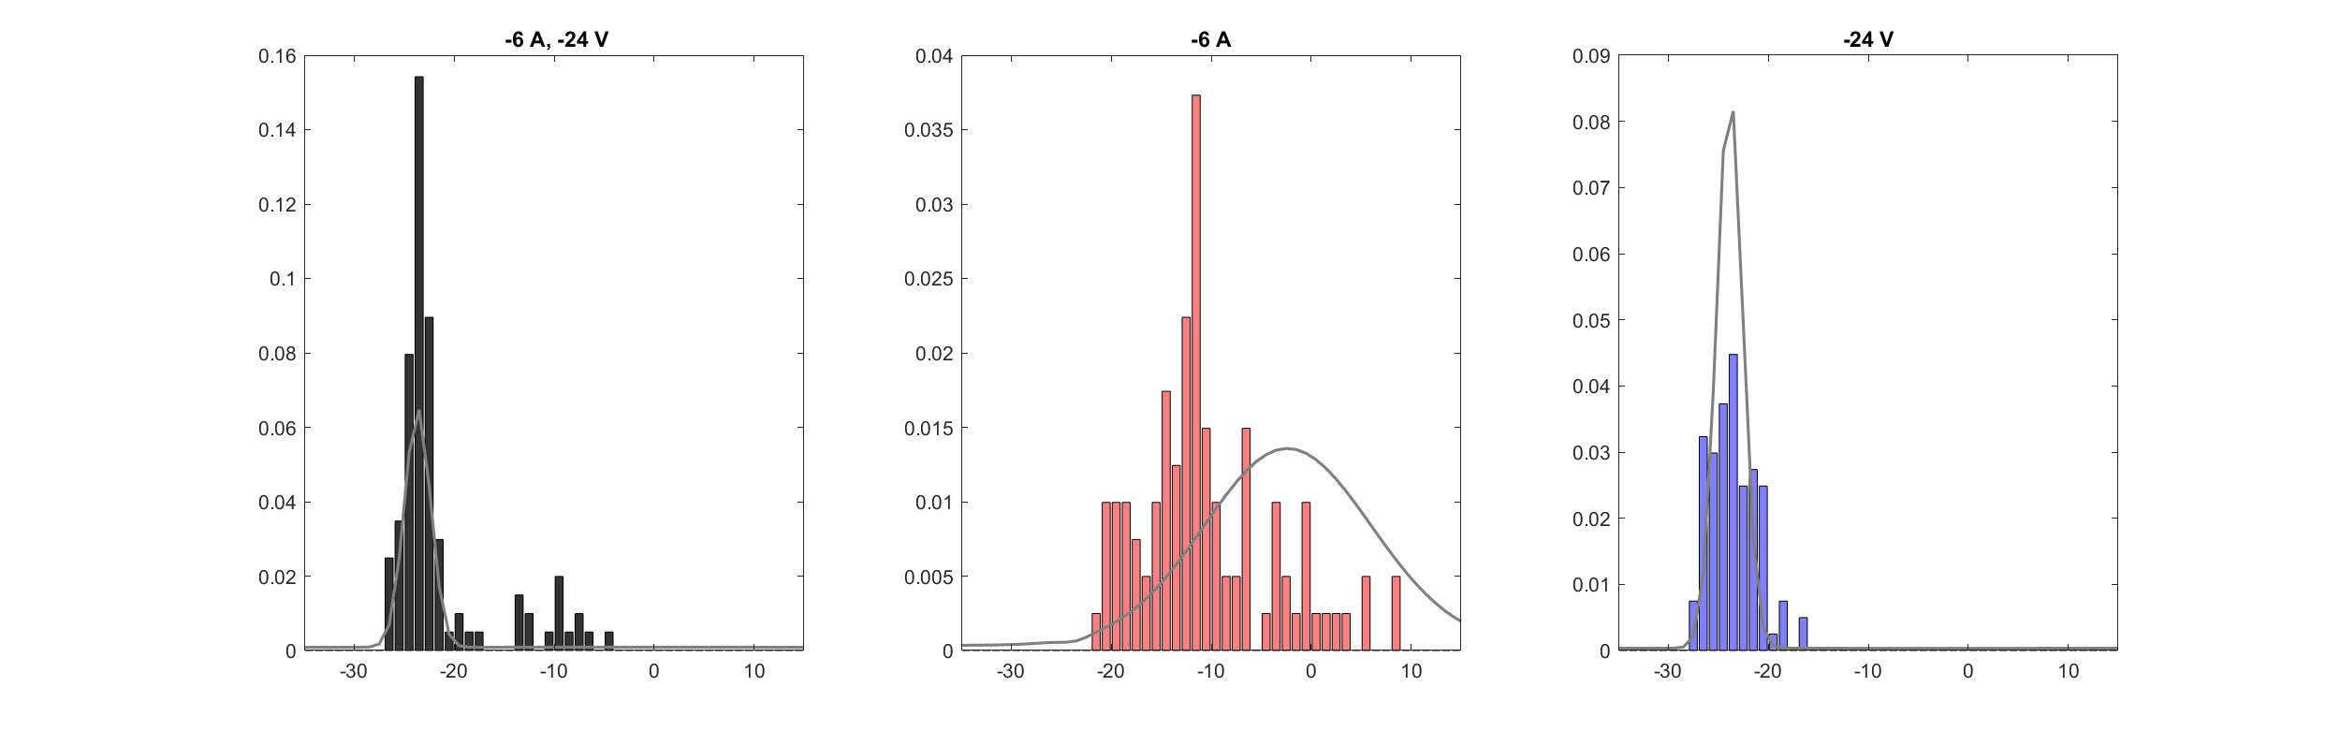
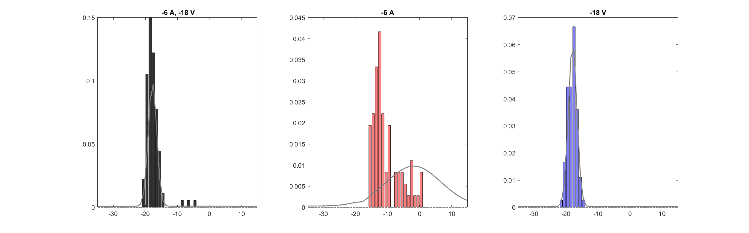
Monkey Y trials

Slide 15
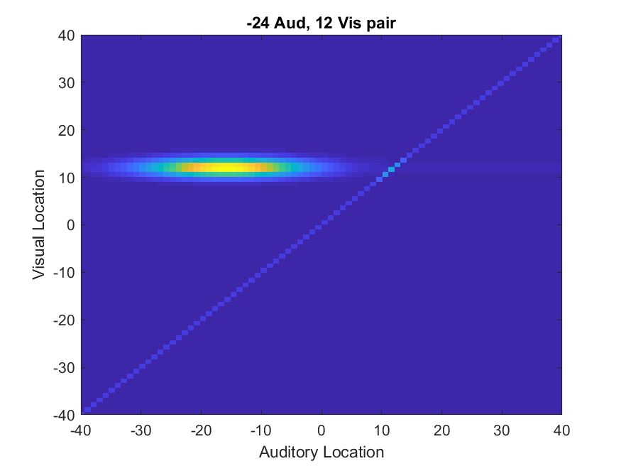
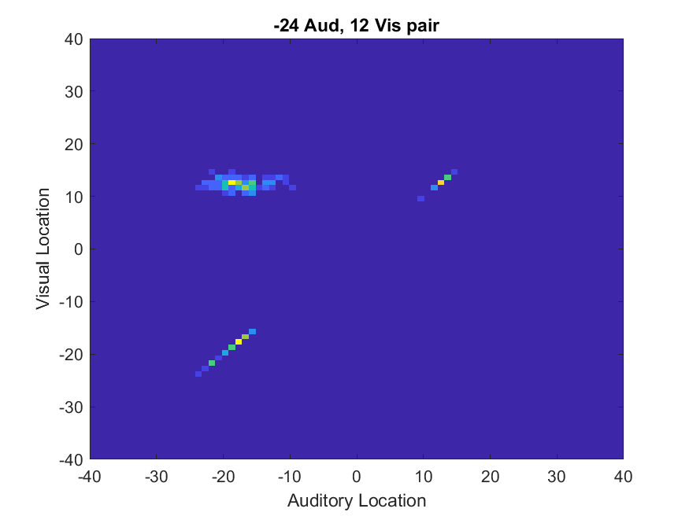
Yoko single saccade lapses

