Slide 1
Summary of models and results
4/16/19

Slide 2
Three fitting conditions
Unity judgement task (number of saccades)
Localization task (location of A and V saccades, if one saccade A = V )
Joint task (maximize sum of log likelihood of both tasks using same parameter values)
For joint fit, paired Bayesian unity judgement with 3 possible localization strategies
Bayesian reweighting (using posterior probability from unity judgement)
Model selection (pick most likely case using posterior probability)
Probabilistic fusion - null (randomly choose with fixed probability = prior common)
Binning saccade locations in 1 degree bins
Numerically integrating from -60 to +60 for each condition

Slide 3
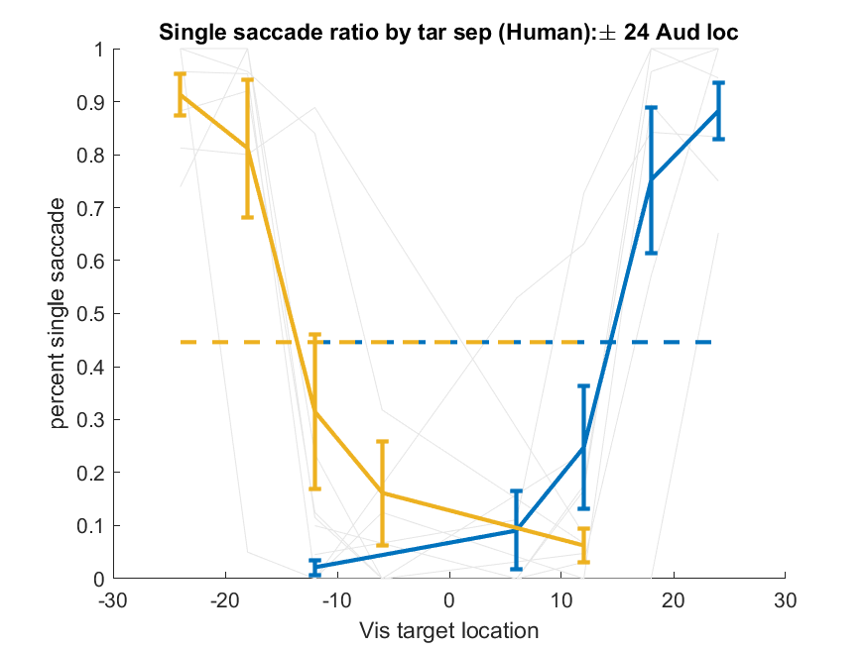
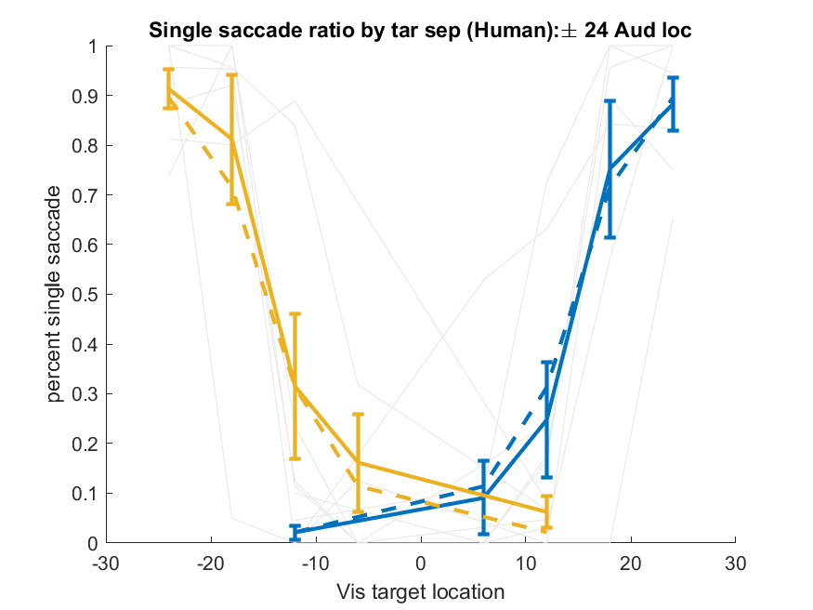
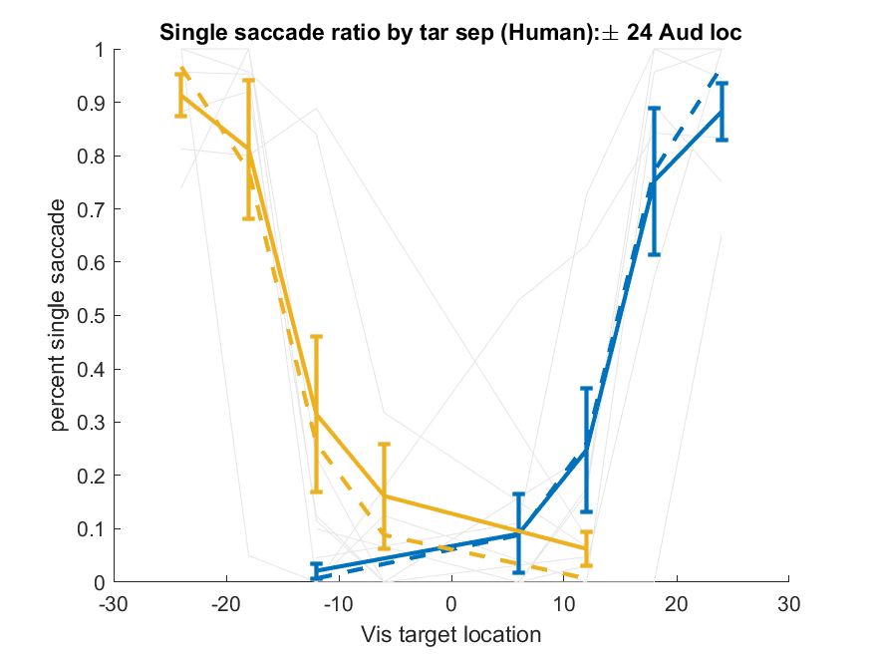
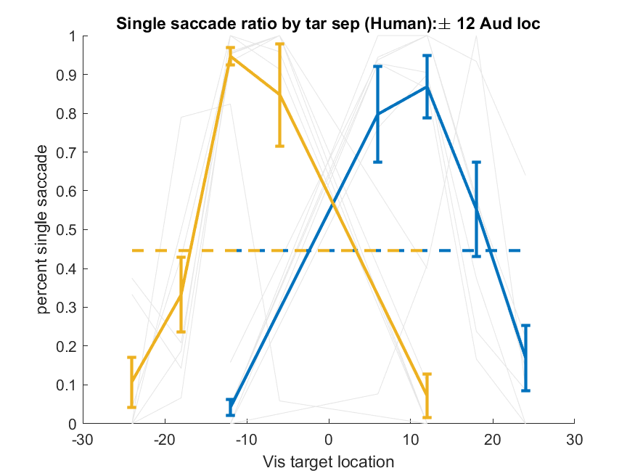
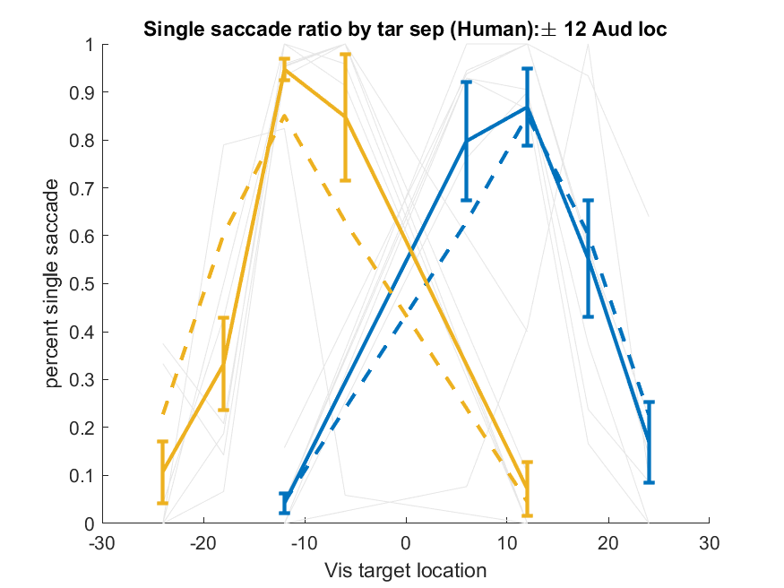
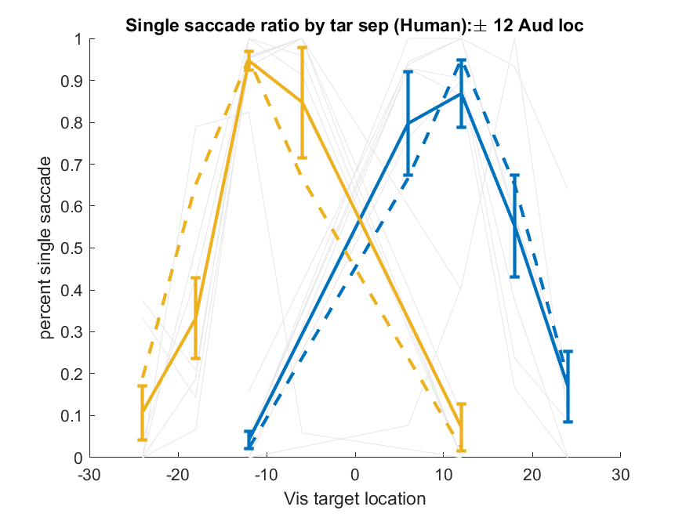
Unity judgement - human
Probabilistic Fusion
Bayesian Unity
Bayes - Bayes Joint

Slide 4
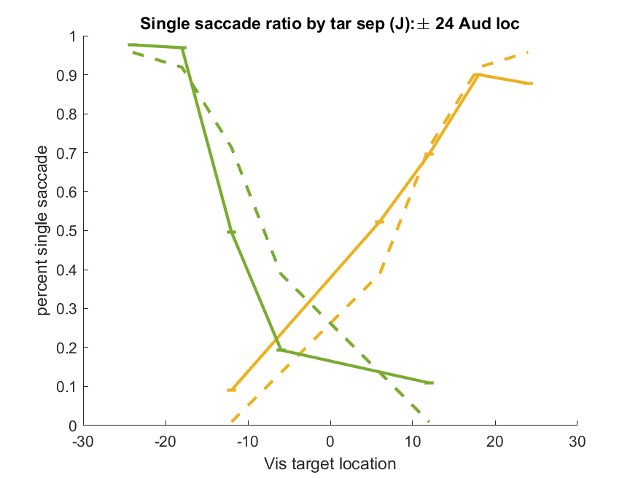
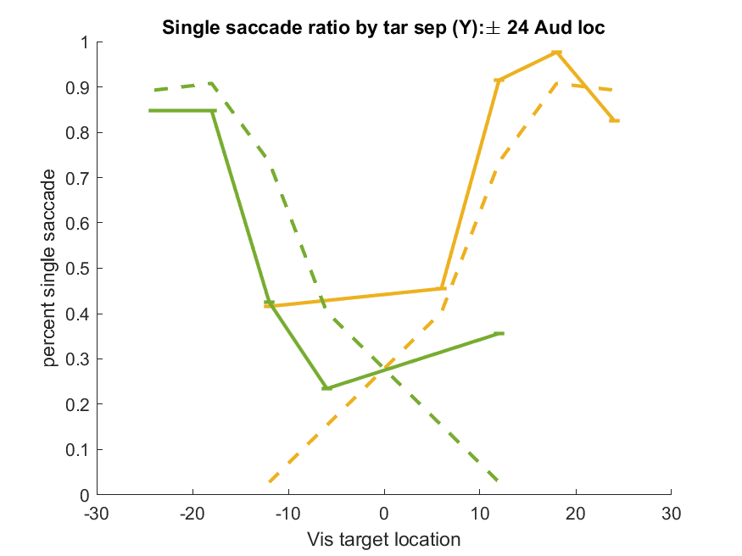
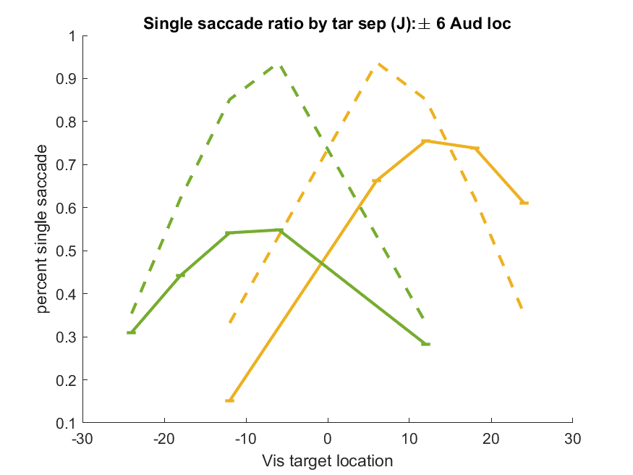
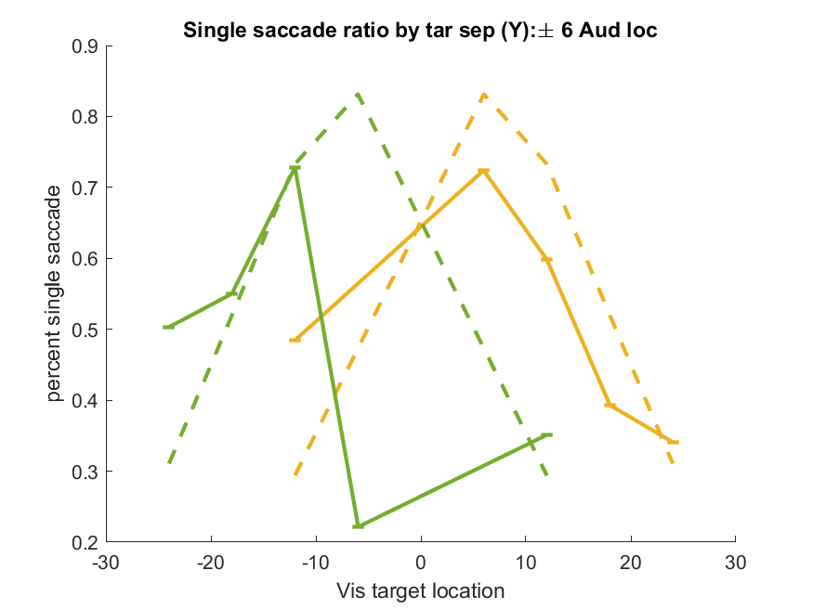
Unity Judgement - monkey
Bayes – Bayes Joint
Monkey J
Monkey Y
Data collapsed across 10 randomly selected days
Monkey Y has a stereotyped behavior on -6A -6V that includes a mostly vertical saccade. Deciding if I want to discard this.

Slide 5
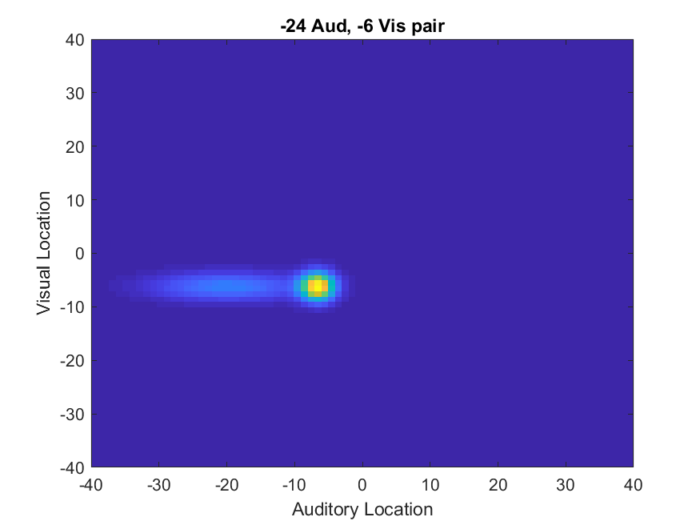
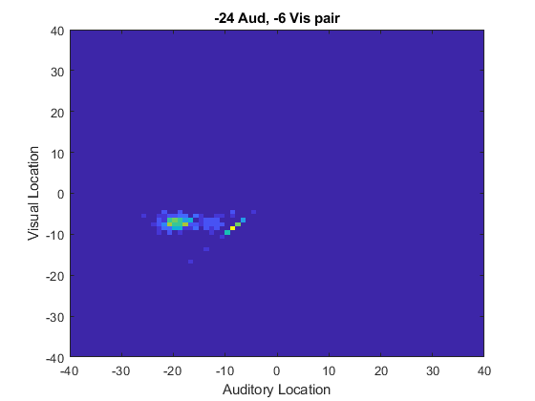
Posterior distribution question
Dot on right side should be concentrated on the diagonal (because it is mostly impossible for me to get a response of like [-6A,-7V], for instance).
MAP estimated distribution
Data

Slide 6
Comparing Fit parameters with unimodal trials
 | V_sig | A_sig | P_sig | P_common | lambda
Monkey J | 1.24 | 8.04 | 12.82 | 0.57 | 0.01
Monkey Y | 1.01 | 10.23 | 13.68 | 0.49 | 0.01
Humans | 1.02 +- .19 | 3.66 +- 2.4 | 18.09 +- 12.04 | 0.60 +- 0.24 | 0.01 +- 0.004
If fitting the A or V distributions directly, allowing mean to vary:
Juno V_sig = 1.22, A_sig = 5.32
Yoko V_sig = 1.33, A_sig = 5.12
This doesn’t account for the prior though, and after combining the prior variance with A_sig you will end up with something kindof close to this

