Slide 1

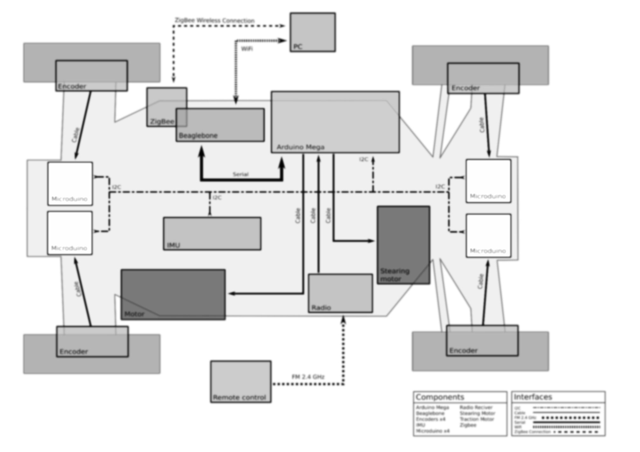
eRumby
Autonomous RC electric vehicle
Jacopo Molinaroli
Son Tran

Slide 2
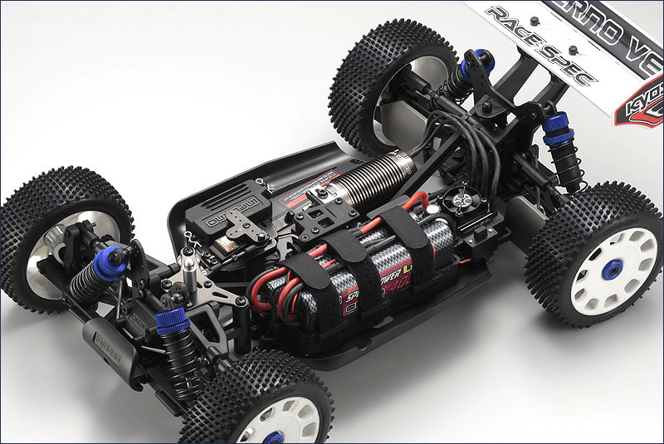
Introduction
The eRumby is an autonomous RC electric vehicle based on the Kyosho INFERNO VE Race car.
Objects of this study:
definition and development of:
- hardware architecture;
- software architecture;
calibration of the sensors;
development of an obstacle avoidance algorithm.
16/11/2016
Department of Industrial Engineering
2

Slide 3
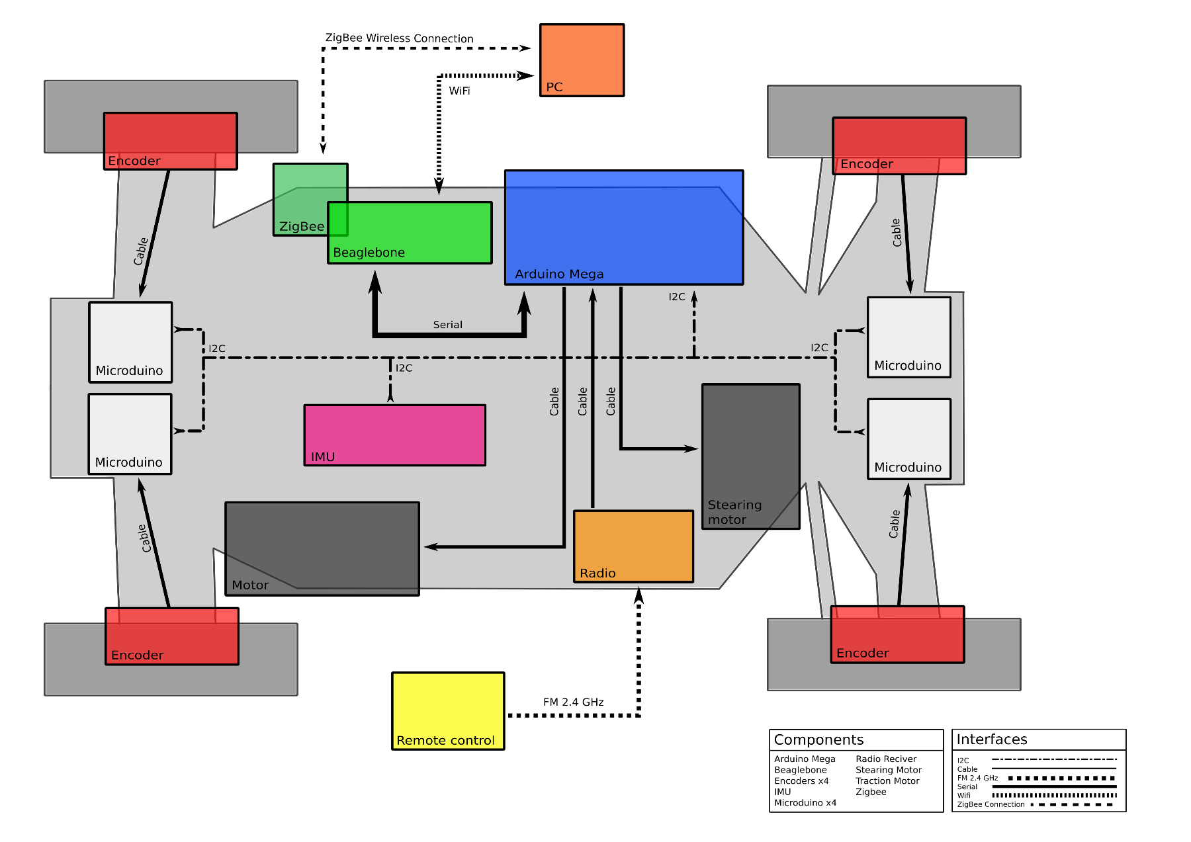
Components
On the car there is:
Arduino Mega x1
Beaglebone x1
Encoder x4
GPS x1
IMU x1
Microduino x4
Radio Receiver x1
Stearing Motor x1
Traction Motor x1
ZigBee x1
16/11/2016
Department of Industrial Engineering
3

Slide 4
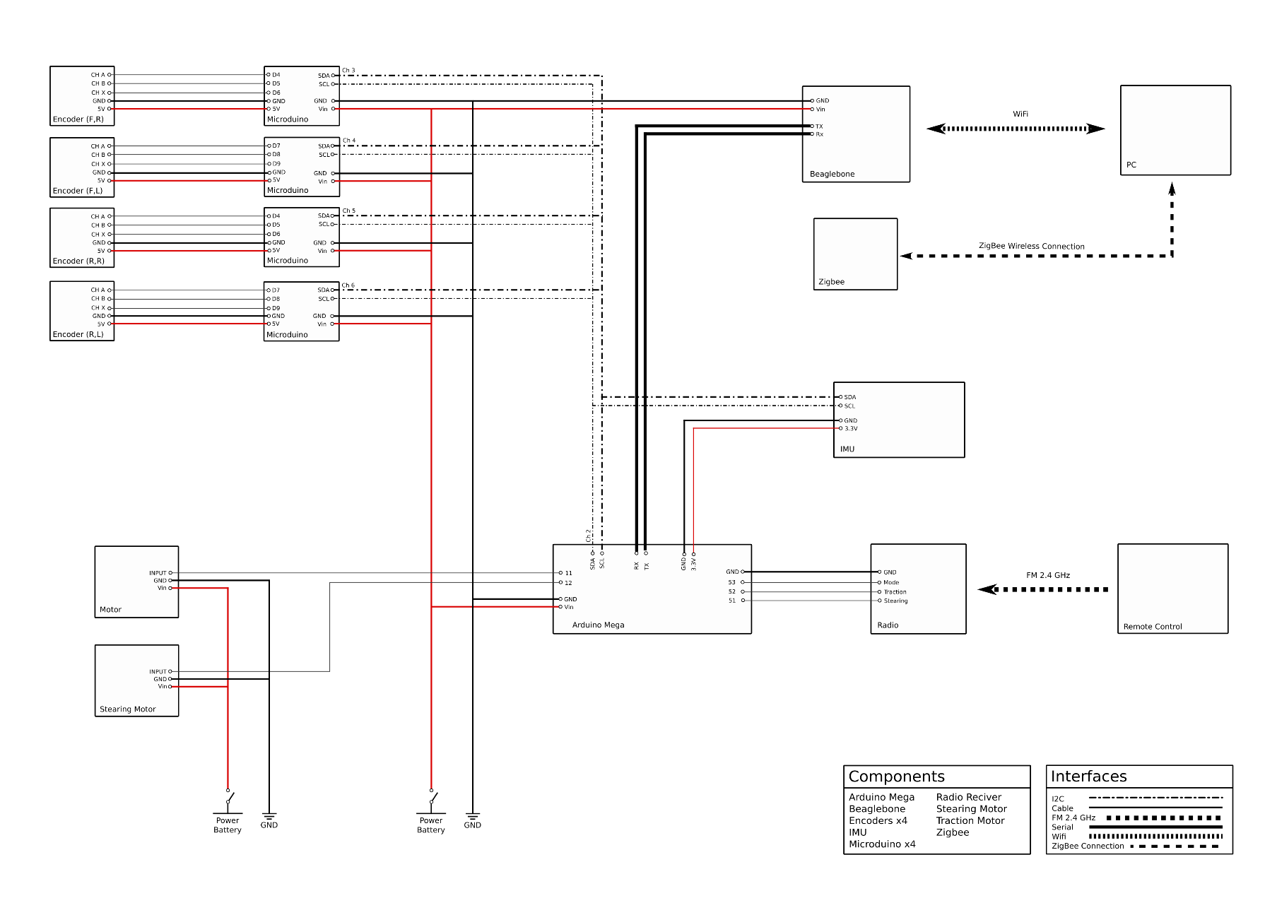
Connections Scheme
Model for eRumby with all electric buses and signals interfaces:
I2C protocol between Microduino – Arduino Mega – IMU with Arduino Mega as Master;
serial communications between Arduino Mega and Beaglebone;
radio communications between remote controller and car receiver;
WiFi communications between Beaglebone board and PC;
wireless communications over ZigBee between Beaglebone board and PC.
16/11/2016
Department of Industrial Engineering
4

Slide 5
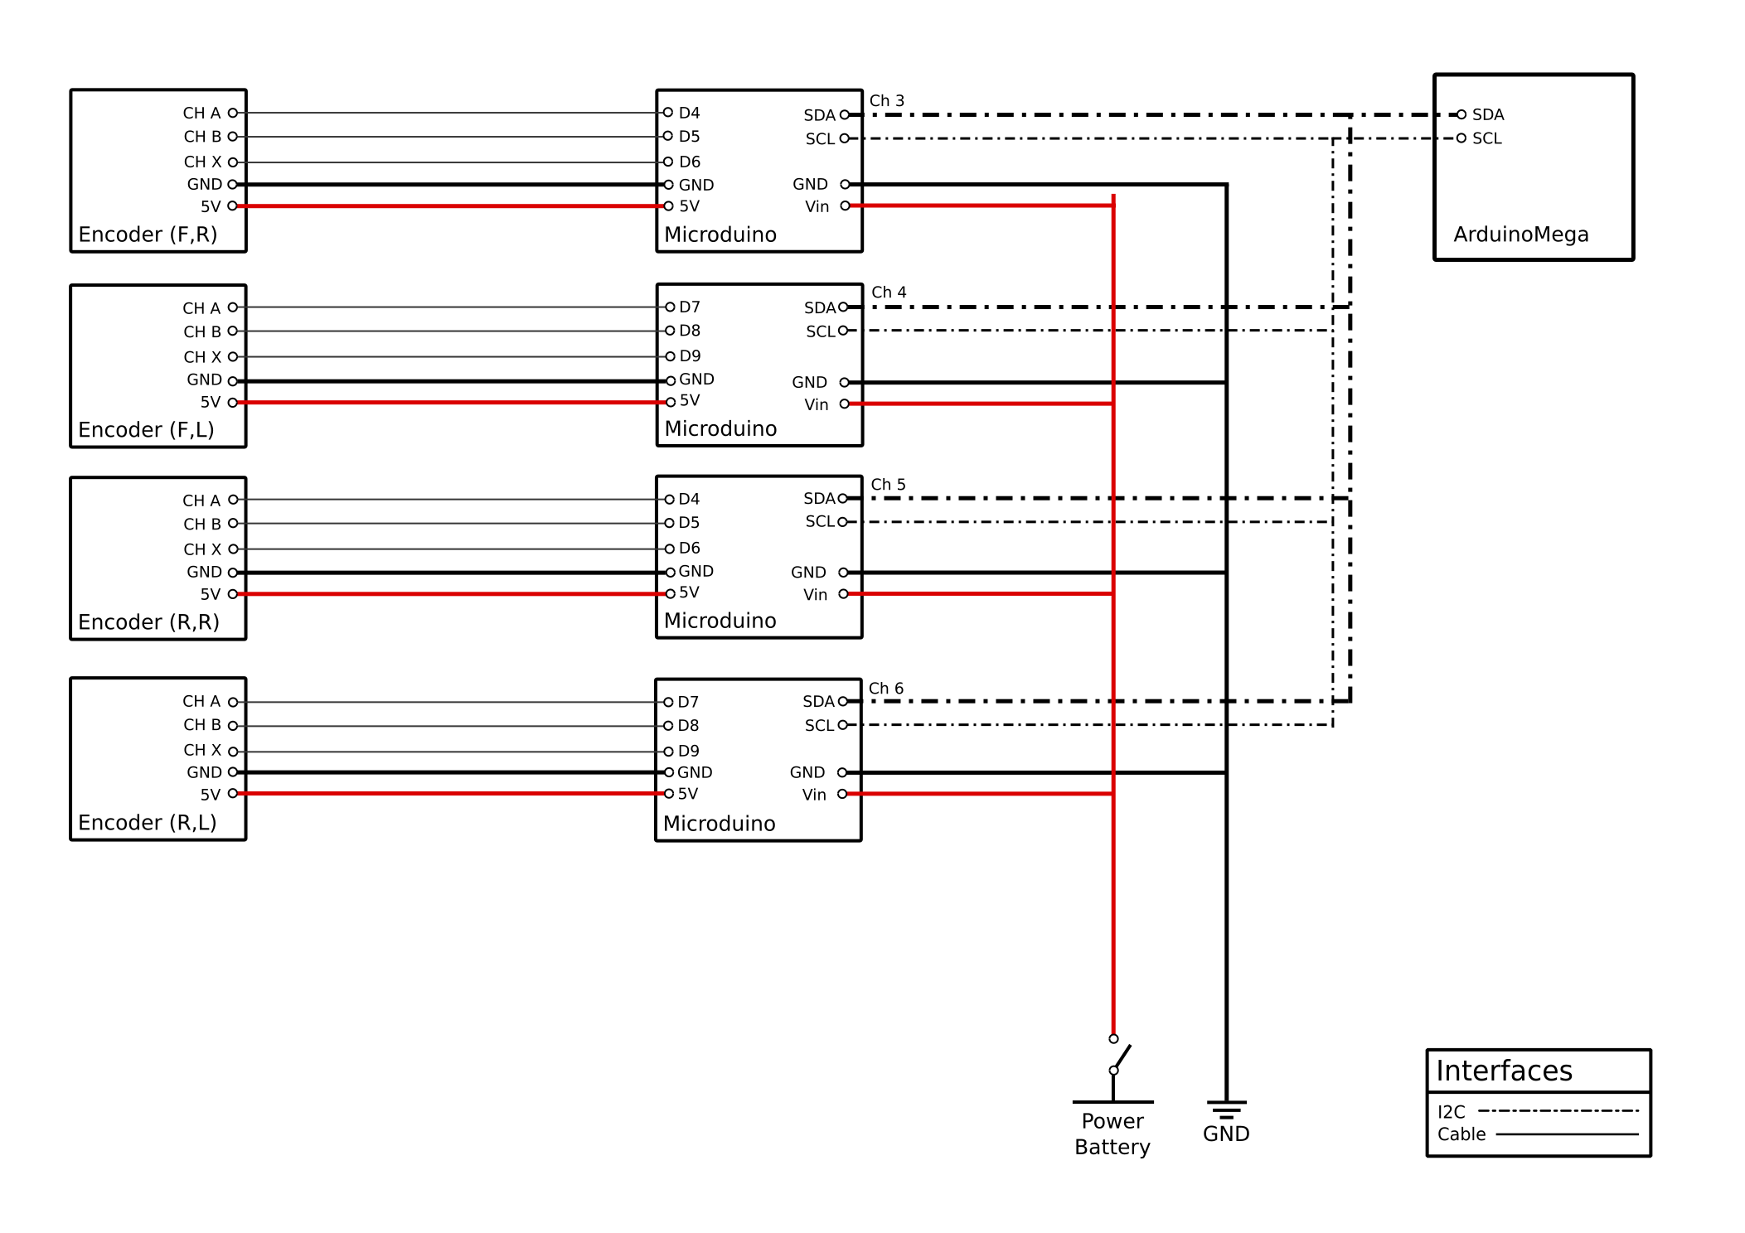
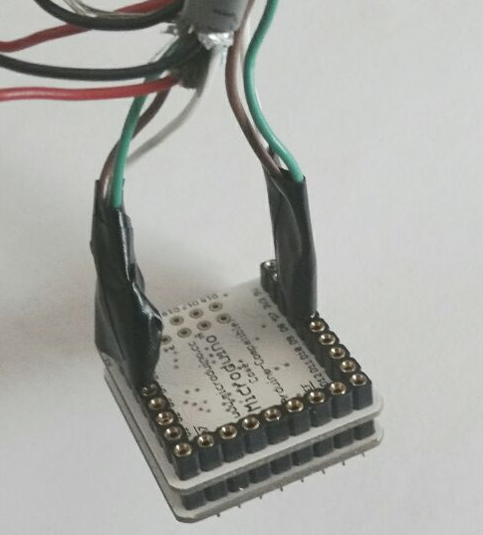
Microduino
On the car we have four Microduino as slaves. Each one reads the input signal from one encoder, that elaborates, collects and sends data to the Master Arduino Mega by I2C protocol.
16/11/2016
Department of Industrial Engineering
5

Slide 6

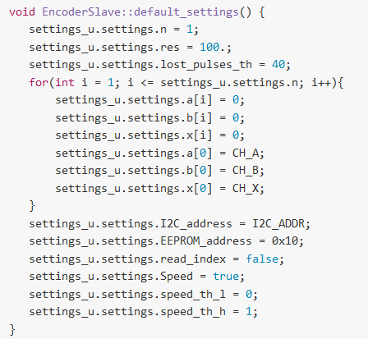
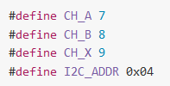
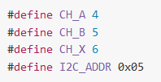

Microduino
Based on arduino-encoder-board project, we fixed the configuration settings of the microduino boards in EncoderSlave.cpp:
Where in EncoderSlave.h for the encoder on the front-right wheel we have:
for the encoder on the front-left wheel:
for the encoder on the rear-right wheel:
for the encoder on the rear-left wheel:
16/11/2016
Department of Industrial Engineering
6

Slide 7
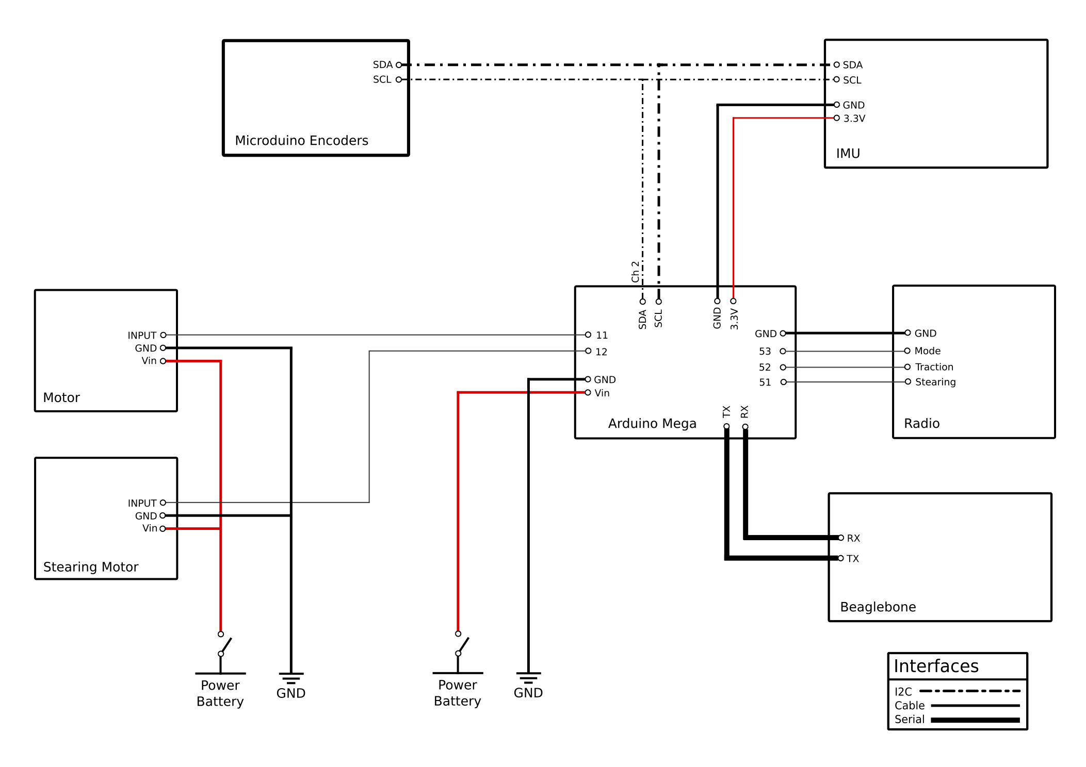
Arduino Mega
The Arduino Mega is used for low level control:
takes the input signal from the Radio Receiver and sends the controlled input to Traction and Stearing Motors;
elaborates data from IMU and Microduinos;
transmits all the data to the Beaglebone.
16/11/2016
Department of Industrial Engineering
7

Slide 8
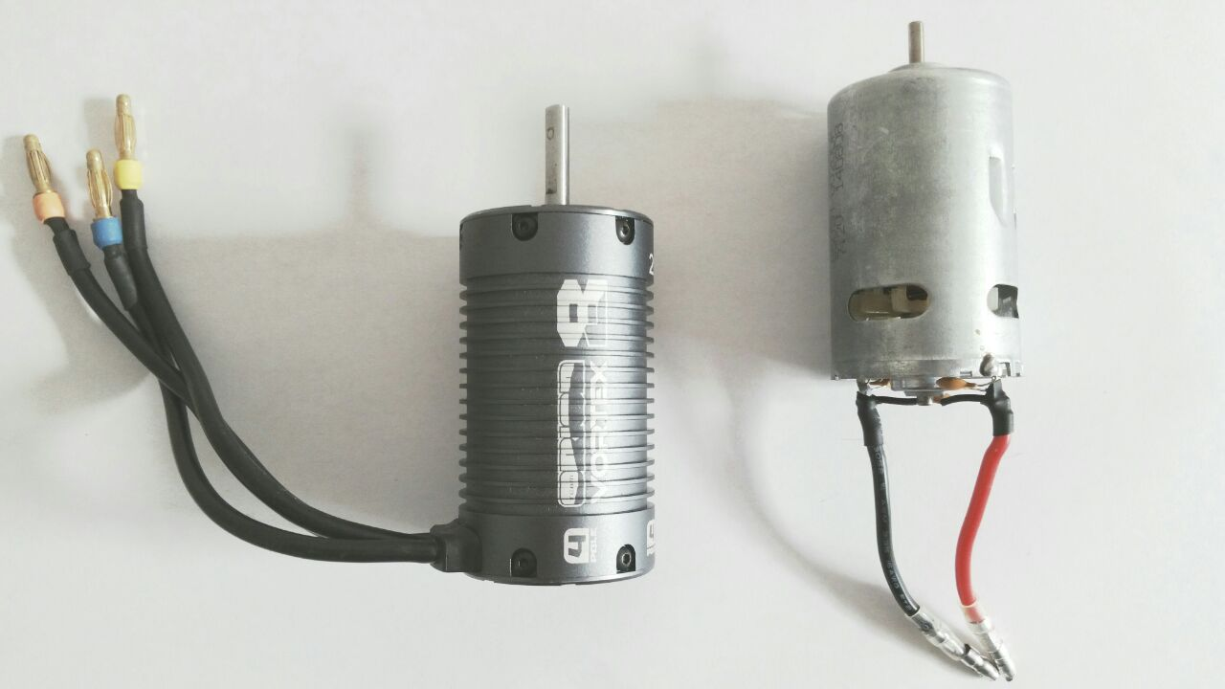
Traction Motor
On the car we had the Team Orion Vortex 8 Evo Motor. This brushless motor was too fast and really difficult to control, that’s why we changed it with the brushed motor RC 550 with permanent magnets. This motor gives to us:
high torque;
less rpm;
longer battery life.
16/11/2016
Department of Industrial Engineering
8

Slide 9
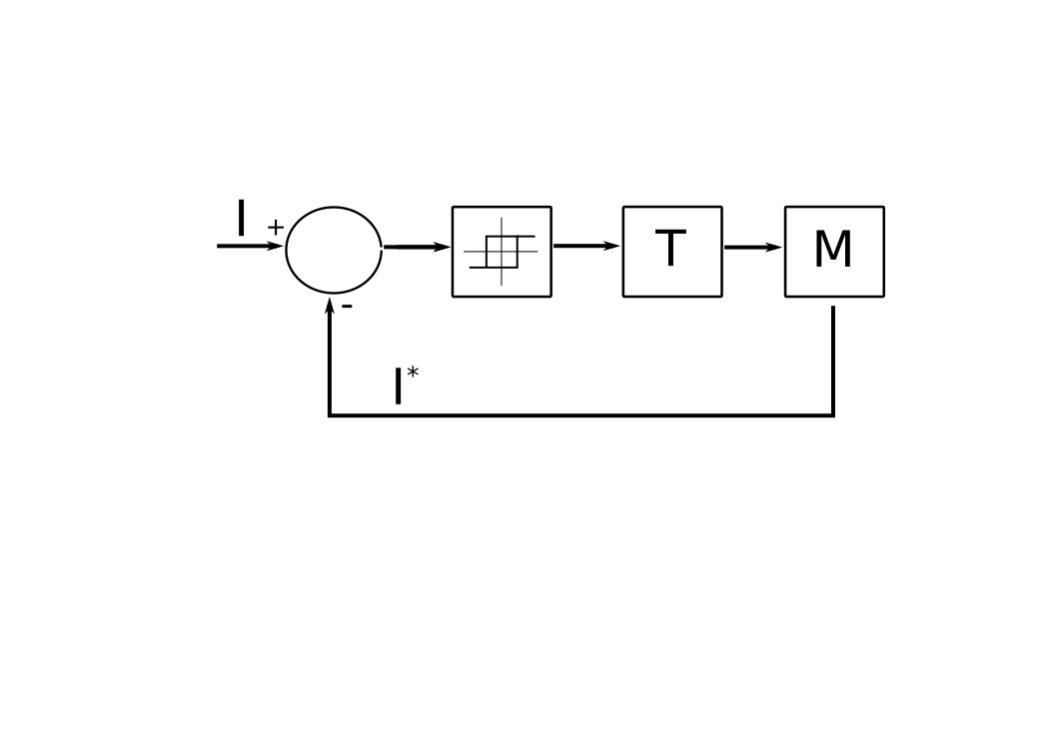
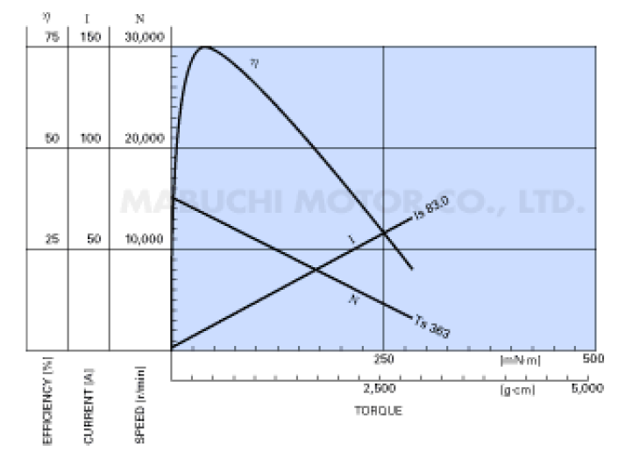
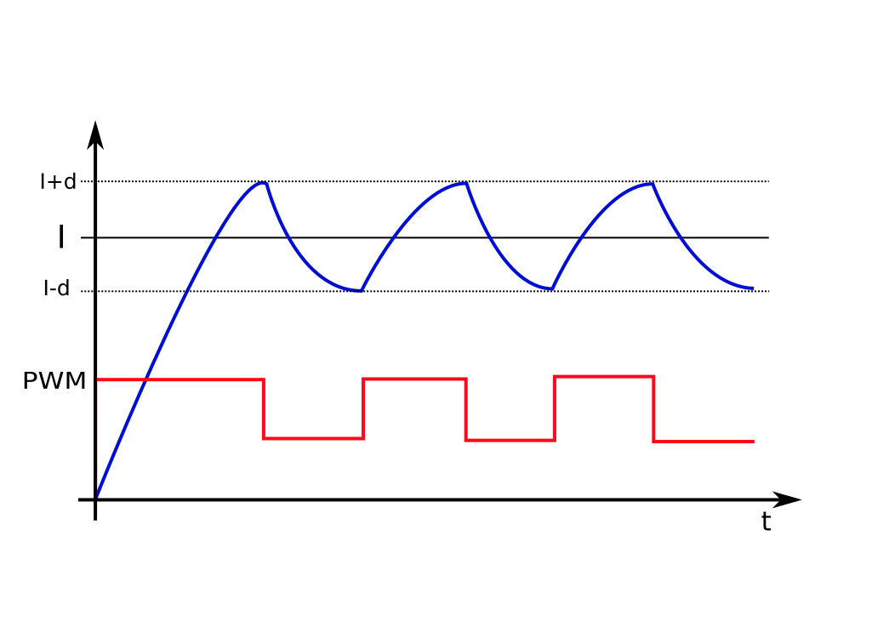
Traction Motor
The RC 550 motor is slow but easier to control than the previous one. The basic idea is that the torque is proportional to the current and that let us control the motor using the concept of hysteresis with the following control loop:
I T
ᴕ
16/11/2016
Department of Industrial Engineering
9

Slide 10
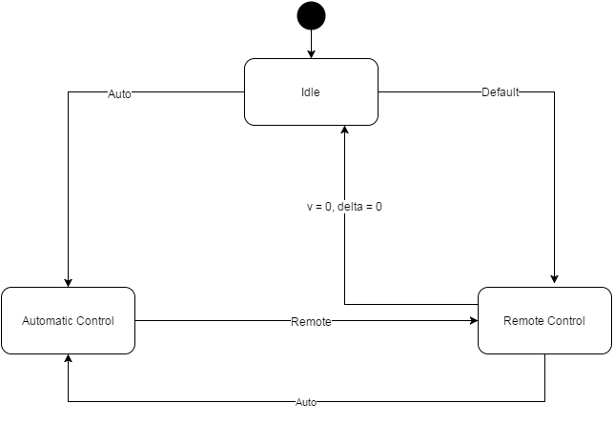
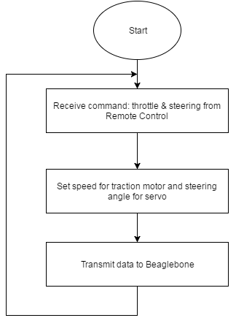
Logic Flow Chart
16/11/2016
Department of Industrial Engineering
10

Slide 11
Overview of System
16/11/2016
Department of Industrial Engineering
11

Slide 12
Next Steps
Beaglebone code: - sensor fusion; - PC communications;
Sensors calibration;
Development of path traking using PID/MPC;
Development of path planning and obstacle avoidance algorithm.
16/11/2016
Department of Industrial Engineering
12

Slide 13
THANKS

