Slide 1
Wordlemaxxers
Izaak White, Matt Taylor, Josh Moner
&
Conner Casey

Slide 2
Team Information
Everyone on the team is using Windows 11.
Each member has a personal laptop to access code.
Our team meets every Saturday at 14:00 EST.

Slide 3
Project Info:
Description:
Recreate the game Wordle
Create an AI that solves the games’ puzzles.
Goals:
Fully implement the game and webapp design.
Have an AI that works efficiently.

Slide 4
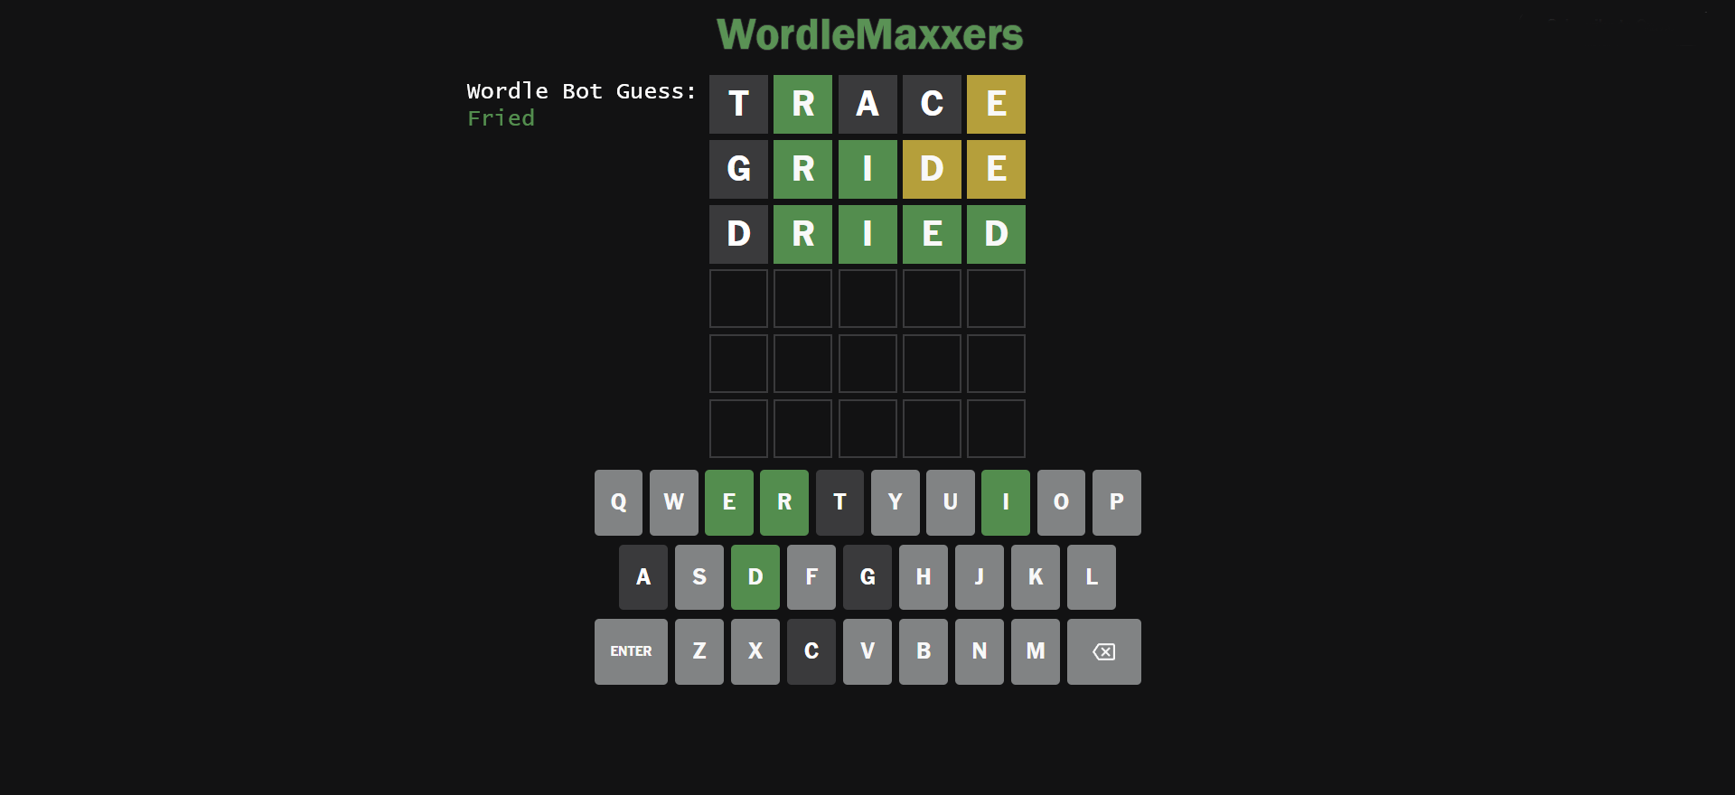
GUI Mockup

Slide 5
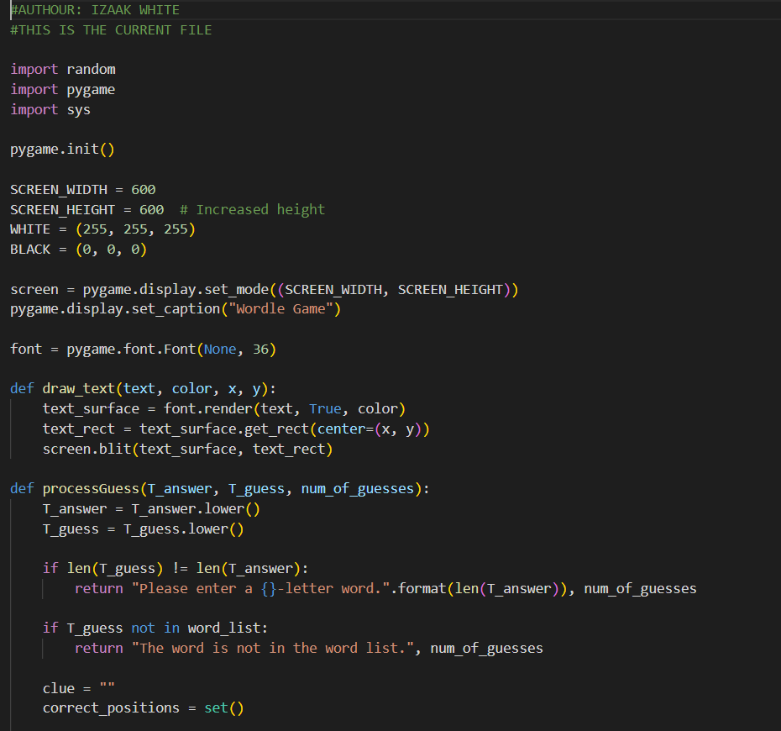
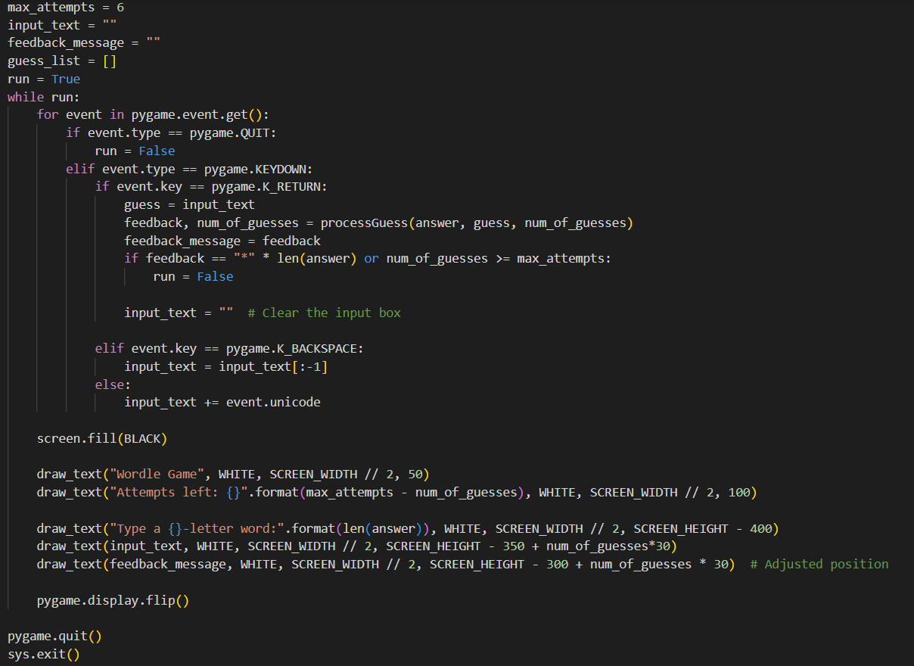
Initial Code Base:

Slide 6
Projected Tool Stack:
Potential Candidates:
VScode in Windows - Python with Pygame - Django Web API (current)
VScode in WSL - HTML - Tailwind CSS - React - Next.js - REST API with Supabase

Slide 7
Work Summary:
Previous work:
Initial code base for game written by Izaak, testing of code base done by Matt
Recreation of current code base using different tool stack written by Josh
Future projections:
We will decide as a team what Tool stack will work best moving forward
we will work on refining the AI

