Slide 1
Wordlemaxxers
Team Wordle-Fibble 5
Izaak White, Matt Taylor, Josh Moner
&
Conner Casey

Slide 2
Team Information
Everyone on the team is using Windows 11.
Each member has a personal laptop to access code.
Our team meets every Saturday at 14:00 EST.

Slide 3
Project Info:
Description:
Recreate the game Wordle
Create an AI that solves the games’ puzzles.
Goals:
Fully implement the game and webapp design.
Have an AI that works efficiently.

Slide 4
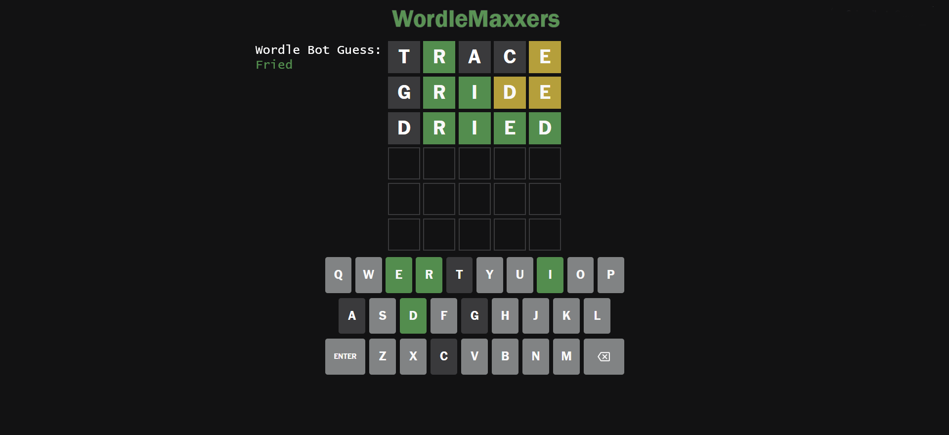
GUI Mockup

Slide 5
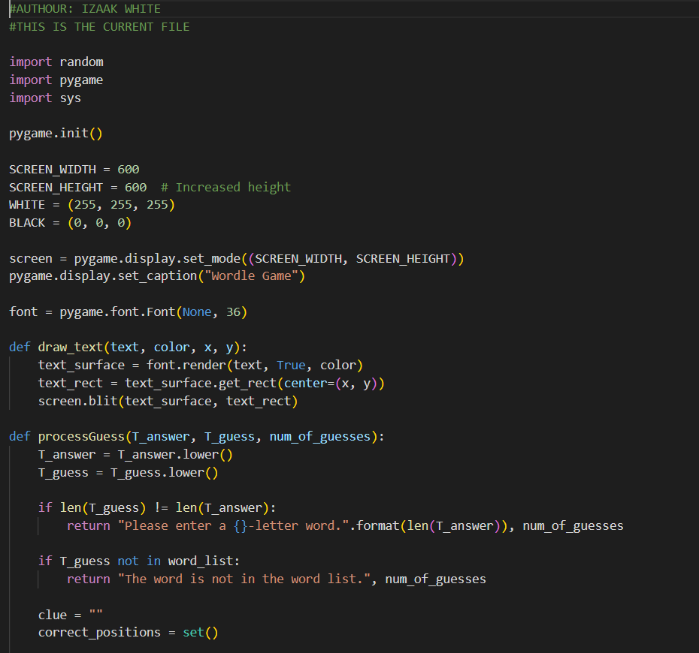
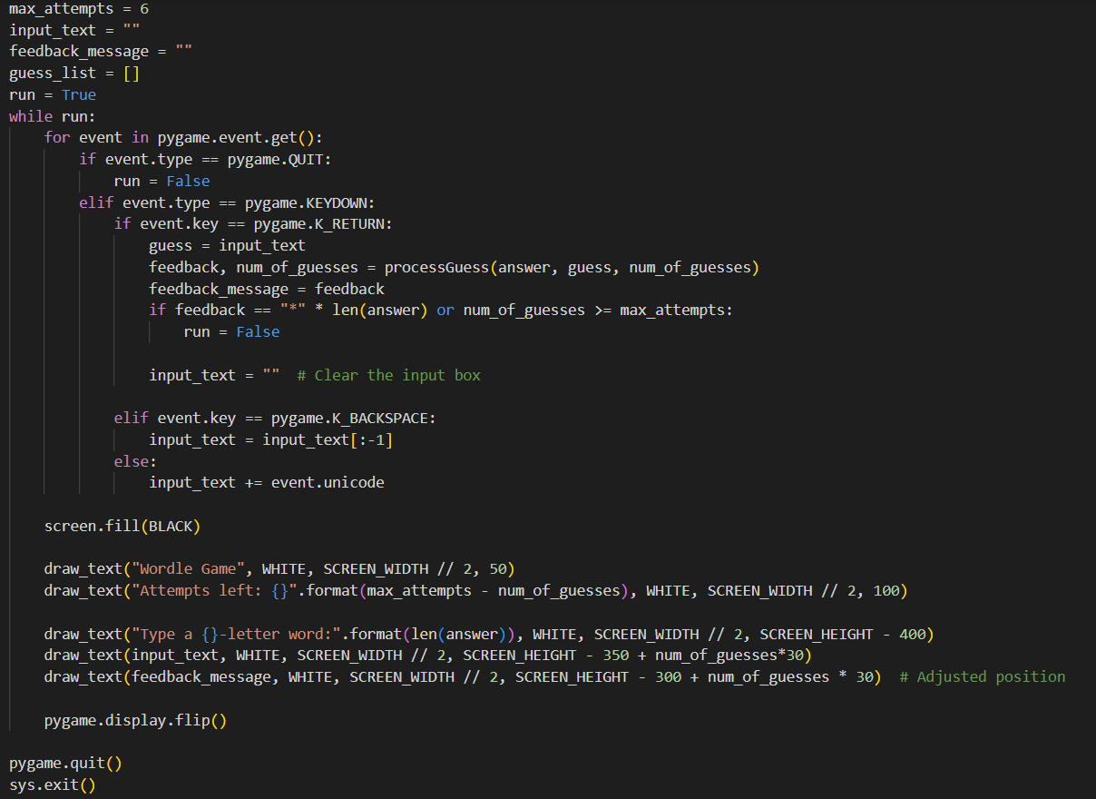
Initial Code Base:

Slide 6
Projected Tool Stack:
Potential Candidates:
VScode in Windows - Python with Pygame - Django Web API (current)
VScode in WSL - HTML - Tailwind CSS - React - Next.js - REST API with Supabase

Slide 7
Work Summary:
Previous work:
Initial code base for game written by Izaak, testing done by Matt
Recreation of current code base using different tool stack written by Josh
Conner began learning and using python and researched AI strategies
Future projections:
We will decide as a team what Tool stack will work best moving forward
we will work on refining the AI

Slide 8
Grading Items

Slide 9
Meeting Attendance Sheet
2/10/2024 - All members attended

Slide 10
Izaak White (ww655421/izaakwhite) - Summary
Wrote proof of concept python code
Made GUI mock-up

Slide 11
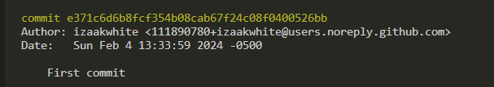
Izaak White (ww655421/izaakwhite) - Commit 1
https://github.com/OU-CS3560/s24-wordle-fibble-5/commit/e371c6d6b8fcf354b08cab67f24c08f0400526bb

Slide 12
Conner Casey (cc257720) - Summary
Began working with python and java
Researched AI strategies

Slide 13
Matthew Taylor (MTaylor03) - Summary
Worked with Izaak White to test the code base of our game.
Suggested further functions to deal with special cases.
Organized team meeting.

