Slide 1
DRAFT
R Workshop
December 2016

Slide 2
Course Rubric
DAY 1:
8:00 – Introduction to the Course and the History of R
9:00 – R Programming Control Structures, Scoping Rules, and Functions
12:00 – Lunch
1:15 - Looping and Debugging
3:00 – Programming assignment
5:00 - Dinner
6:30 – Study Groups: Basic R Programming
DAY 2:
8:00 – Getting and Cleaning Data
12:00 – Lunch
1:15 – Data Visualization in R
4:30 - Break and Dinner
6:30 – Study Group: Data Visualization in R
Day 3:
8:00 – Modeling Statistical Data in R
12:00 – Lunch
1:15 – Machine Learning in R
4:00 – Workshop Assessment
Graduation Ceremony and Celebration Dinner

Slide 3
Introduction

Slide 4
History of R
R is an implementation of the S programming language combined with lexical scoping semantics inspired by Scheme.
S was created by John Chambers while at Bell Labs.
There are some important differences, but much of the code written for S runs unaltered.
R was created by Ross Ihaka and Robert Gentleman at the University of Auckland, New Zealand, and is currently developed by the R Development Core Team, of which Chambers is a member.
R is named partly after the first names of the first two R authors and partly as a play on the name of S.
The project was conceived in 1992, with an initial version released in 1995 and a stable beta version in 2000.
Notes:
• Slide title should be Garamond or Times New Roman
• Subhead should be Helvetica or Trade Gothic.
• Text can be in Garamond, Times New Roman, Helvetica or Trade Gothic as you wish
• Captions, if used, should be in Trade Gothic or Helvetica
• Size of headings/subheads/text/captions should be consistent from one slide to the next
• Use bold or change case and formatting as appropriate
• Move text blocks around to accommodate images as appropriate
• Use Library Orange (RGB: 252/175/23) as an accent color if you wish

Slide 5
Meet R
The facts:
R is a language and environment for statistical computing and graphics
Freely available and maintained by volunteers
R is extensible; can be expanded by installing “packages”
How to get it:
http://www.r-project.org/ (or Google “Download R”)
Available for Windows, Mac, Linux
Free to install, no catches
Also highly recommended:
R Studio: a free IDE for R
http://www.rstudio.com/
If you install R and R Studio, then you only need to run R Studio
Notes:
• Slide title should be Garamond or Times New Roman
• Subhead should be Helvetica or Trade Gothic.
• Text can be in Garamond, Times New Roman, Helvetica or Trade Gothic as you wish
• Captions, if used, should be in Trade Gothic or Helvetica
• Size of headings/subheads/text/captions should be consistent from one slide to the next
• Use bold or change case and formatting as appropriate
• Move text blocks around to accommodate images as appropriate
• Use Library Orange (RGB: 252/175/23) as an accent color if you wish

Slide 6
Use R
R is command-line driven (very little point-and-click)
You use “functions” to work with data
Most analyses require writing a script, which is sourced into the R console
R Studio makes this process easier
What’s so special about R?
Free
Over 4000 packages that add functionality (about 25 come with R)
Produces nice print-ready graphics
Open-source (you can see how it does what it does)
Easy to install and non-invasive
Notes:
• Slide title should be Garamond or Times New Roman
• Subhead should be Helvetica or Trade Gothic.
• Text can be in Garamond, Times New Roman, Helvetica or Trade Gothic as you wish
• Captions, if used, should be in Trade Gothic or Helvetica
• Size of headings/subheads/text/captions should be consistent from one slide to the next
• Use bold or change case and formatting as appropriate
• Move text blocks around to accommodate images as appropriate
• Use Library Orange (RGB: 252/175/23) as an accent color if you wish

Slide 7
Assumptions, Goals and Expectations
Assumptions
No experience with R
Familiarity with basic statistical concepts
Goals
Get you comfortable enough to start using R
Give you with example code you can use and resources to learn more
Expectations
You will not be an expert after a 3 day workshop
You must use R to learn R
Notes:
• Slide title should be Garamond or Times New Roman
• Subhead should be Helvetica or Trade Gothic.
• Text can be in Garamond, Times New Roman, Helvetica or Trade Gothic as you wish
• Captions, if used, should be in Trade Gothic or Helvetica
• Size of headings/subheads/text/captions should be consistent from one slide to the next
• Use bold or change case and formatting as appropriate
• Move text blocks around to accommodate images as appropriate
• Use Library Orange (RGB: 252/175/23) as an accent color if you wish

Slide 8
Workshop Plan
Once you have R and R Studio installed, please do the following:
Download R script (the file with .R extension):
Go to https://github.com/jmonroe252/R_Workshop
Download the files with a .R extension
Save the files to an easily accessible location.
Open R Studio only (do not need to open R)
Open R script in R Studio. File…Open File…
Follow along with presentation
Let’s go use R!
Notes:
• Slide title should be Garamond or Times New Roman
• Subhead should be Helvetica or Trade Gothic.
• Text can be in Garamond, Times New Roman, Helvetica or Trade Gothic as you wish
• Captions, if used, should be in Trade Gothic or Helvetica
• Size of headings/subheads/text/captions should be consistent from one slide to the next
• Use bold or change case and formatting as appropriate
• Move text blocks around to accommodate images as appropriate
• Use Library Orange (RGB: 252/175/23) as an accent color if you wish

Slide 9
R Programming

Slide 10
Arithmetic Operators
Operator | Description
+ | addition
- | subtraction
* | multiplication
/ | division
^ or ** | exponentiation
x %% y | modulus (x mod y) 5%%2 is 1
x %/% y | integer division 5%/%2 is 2

Slide 11
Logical Operators
Operator | Description
< | less than
<= | less than or equal to
> | greater than
>= | greater than or equal to
== | exactly equal to
!= | not equal to
!x | Not x
x | y | x OR y
x & y | x AND y
isTRUE(x) | test if x is TRUE

Slide 12
Built in Functions
R has many built in functions that compute different statistical procedures.
Functions in R are followed by ( ).
Inside the parenthesis we write the object (vector, array, matrix, dataframe) to which we want to apply the function.
Notes:
Talk about useful packages included in the CD.

Slide 13
Numeric Functions
Function | Description
abs(x) | absolute value
sqrt(x) | square root
ceiling(x) | ceiling(3.475) is 4
floor(x) | floor(3.475) is 3
trunc(x) | trunc(5.99) is 5
round(x, digits=n) | round(3.475, digits=2) is 3.48
signif(x, digits=n) | signif(3.475, digits=2) is 3.5
cos(x), sin(x), tan(x) | also acos(x), cosh(x), acosh(x), etc.
log(x) | natural logarithm
log10(x) | common logarithm
exp(x) | e^x

Slide 14
Character Functions
Function | Description
substr(x, start=n1, stop=n2) | Extract or replace substrings in a character vector. x <- "abcdef" substr(x, 2, 4) is "bcd" substr(x, 2, 4) <- "22222" is "a222ef"
grep(pattern, x , ignore.case=FALSE, fixed=FALSE) | Search for pattern in x. If fixed =FALSE then pattern is a regular expression. If fixed=TRUE then pattern is a text string. Returns matching indices. grep("A", c("b","A","c"), fixed=TRUE) returns 2
sub(pattern, replacement, x, ignore.case =FALSE, fixed=FALSE) | Find pattern in x and replace with replacement text. If fixed=FALSE then pattern is a regular expression. If fixed = T then pattern is a text string. sub("\\s",".","Hello There") returns "Hello.There"
strsplit(x, split) | Split the elements of character vector x at split. strsplit("abc", "") returns 3 element vector "a","b","c"
paste(..., sep="") | Concatenate strings after using sep string to seperate them. paste("x",1:3,sep="") returns c("x1","x2" "x3") paste("x",1:3,sep="M") returns c("xM1","xM2" "xM3") paste("Today is", date())
toupper(x) | Uppercase
tolower(x) | Lowercase

Slide 15
Statistics/Probability Functions
The following tables describe functions related to probability distributions. For random number generators below, you can use set.seed(1234) or some other integer to create reproducible pseudo-random numbers.

Slide 16
Function | Description
dnorm(x) | normal density function (by default m=0 sd=1) # plot standard normal curve x <- pretty(c(-3,3), 30) y <- dnorm(x) plot(x, y, type='l', xlab="Normal Deviate", ylab="Density", yaxs="i")
pnorm(q) | cumulative normal probability for q (area under the normal curve to the right of q) pnorm(1.96) is 0.975
qnorm(p) | normal quantile. value at the p percentile of normal distribution qnorm(.9) is 1.28 # 90th percentile
rnorm(n, m=0,sd=1) | n random normal deviates with mean m and standard deviation sd. #50 random normal variates with mean=50, sd=10 x <- rnorm(50, m=50, sd=10)
dbinom(x, size, prob) pbinom(q, size, prob) qbinom(p, size, prob) rbinom(n, size, prob) | binomial distribution where size is the sample size and prob is the probability of a heads (pi) # prob of 0 to 5 heads of fair coin out of 10 flips dbinom(0:5, 10, .5) # prob of 5 or less heads of fair coin out of 10 flips pbinom(5, 10, .5)
dpois(x, lamda) ppois(q, lamda) qpois(p, lamda) rpois(n, lamda) | poisson distribution with m=std=lamda #probability of 0,1, or 2 events with lamda=4 dpois(0:2, 4) # probability of at least 3 events with lamda=4 1- ppois(2,4)
dunif(x, min=0, max=1) punif(q, min=0, max=1) qunif(p, min=0, max=1) runif(n, min=0, max=1) | uniform distribution, follows the same pattern as the normal distribution above. #10 uniform random variates x <- runif(10)

Slide 17
Function | Description
mean(x, trim=0, na.rm=FALSE) | mean of object x # trimmed mean, removing any missing values and # 5 percent of highest and lowest scores mx <- mean(x,trim=.05,na.rm=TRUE)
sd(x) | standard deviation of object(x). also look at var(x) for variance and mad(x) for median absolute deviation.
median(x) | median
quantile(x, probs) | quantiles where x is the numeric vector whose quantiles are desired and probs is a numeric vector with probabilities in [0,1]. # 30th and 84th percentiles of x y <- quantile(x, c(.3,.84))
range(x) | range
sum(x) | sum
diff(x, lag=1) | lagged differences, with lag indicating which lag to use
min(x) | minimum
max(x) | maximum
scale(x, center=TRUE, scale=TRUE) | column center or standardize a matrix.

Slide 18
Other Functions
Function | Description
seq(from , to, by) | generate a sequence indices <- seq(1,10,2) #indices is c(1, 3, 5, 7, 9)
rep(x, ntimes) | repeat x n times y <- rep(1:3, 2) # y is c(1, 2, 3, 1, 2, 3)
cut(x, n) | divide continuous variable in factor with n levels y <- cut(x, 5)

Slide 19
R as a Calculator
> 1250 + 1000
[1] 2250
or various calculations in the same row
> 1+1; 4*5; 6-2
[1] 2
[1] 20
[1] 4
Notes:
To the minimum R can be used as a calculator.
The prompt sign means the active line where you are allowed to enter code.
The number in brackets is the result.
When you enter a line in R, you don’t need to end it with a period as opposed to other software such as the syntax in spss.

Slide 20
Numbers in R: NAN and NA
NAN (not a number)
NA (missing value)
Basic handling of missing values
> x
[1] 1 2 3 4 5 6 7 8 NA
> mean(x)
[1] NA
> mean(x,na.rm=TRUE)
[1] 4.5
Notes:
Missing values are noise to statistical estimations.
We are going to learn a basic command for handling missing values.

Slide 21
String Characters
In R, string variables are defined by double quotation marks.
> letters
"a" "b" "c"
Notes:
In this slide. Go to R code and practice creating objects and vectors.

Slide 22
Objects in R
Objects in R obtain values by assignment.
This is achieved by the gets arrow, <-, and not the equal sign, =.
Objects can be of different kinds.

Slide 23
Vectors
A vector is a sequence of data elements of the same basic type. Members in a vector are officially called components.
Here is a vector containing three numeric values 2, 3 and 5.
> c(2, 3, 5) [1] 2 3 5

Slide 24
Arrays
Arrays are numeric objects with dimension attributes.
The difference between a matrix and an array is that arrays have more than two dimensions.
The following example creates an array of two 3x3 matrices each with 3 rows and 3 columns.
# Create two vectors of different lengths.
> vector1 <- c(5,9,3)
> vector2 <- c(10,11,12,13,14,15)
# Take these vectors as input to the array.
> result <- array(c(vector1,vector2),dim = c(3,3,2))
result
, , 1
[,1] [,2] [,3]
[1,] 5 10 13
[2,] 9 11 14
[3,] 3 12 15
, , 2
[,1] [,2] [,3]
[1,] 5 10 13
[2,] 9 11 14
[3,] 3 12 15

Slide 25
Matrices
A matrix is a collection of data elements arranged in a two-dimensional rectangular layout.
The following is an example of a matrix with 2 rows and 3 columns.
> A = matrix( + c(2, 4, 3, 1, 5, 7), # the data elements + nrow=2, # number of rows + ncol=3, # number of columns + byrow = TRUE) # fill matrix by rows > A # print the matrix [,1] [,2] [,3] [1,] 2 4 3 [2,] 1 5 7

Slide 26
Subscripts
Select only one or some of the elements in a vector, a matrix or an array.
We can do this by using subscripts in square brackets [ ].
In matrices or dataframes the first subscript refers to the row and the second to the column.
R has several ways to subscript (that is, extract specific elements from a vector). The most common way is directly, using the square bracket operator:
> x[4]
[1] 4
In this example, the user has said "give me the fourth element," and R has said, "you get a vector whose first (and only) element is 4."
Here's a similar question: "what are the second and fifth elements of x?"
> x[c(2, 5)]
[1] 2 5
Here the c(), of course, constructs the vector (2,5) to be used as the index; then we extract the second and fifth entries of x.

Slide 27
Dataframe
A data frame is used for storing data tables. It is a list of vectors of equal length. For example, the following variable df is a data frame containing three vectors n, s, b.
> n = c(2, 3, 5) > s = c("aa", "bb", "cc") > b = c(TRUE, FALSE, TRUE) > df = data.frame(n, s, b) # df is a data frame
n s b
2 aa TRUE
3 bb FALSE
5 cc TRUE

Slide 28
Tips
R is case-sensitive
Comment your code so you remember what it does; comments are preceded with #
R scripts are simply text files with a .R extension
Use Ctrl + R to submit code
Use the Tab key to let R/R Studio finish typing commands for you
Use Shift + down arrow to highlight lines or blocks of code
In R Studio: Ctrl + 1 and Ctrl + 2 switches between script and console
Use up and down arrows to cycle through previous commands in console
Don’t be afraid of errors; you won’t break R
If you get stuck, Google is your friend
Notes:
• Slide title should be Garamond or Times New Roman
• Subhead should be Helvetica or Trade Gothic.
• Text can be in Garamond, Times New Roman, Helvetica or Trade Gothic as you wish
• Captions, if used, should be in Trade Gothic or Helvetica
• Size of headings/subheads/text/captions should be consistent from one slide to the next
• Use bold or change case and formatting as appropriate
• Move text blocks around to accommodate images as appropriate
• Use Library Orange (RGB: 252/175/23) as an accent color if you wish

Slide 29
Review
Create a vector of 0.295,0.300,0.250,0.287,0.215
Calculate the mean of the above vector
Write a function to show if the above mean is greater than 0.3
Transform the vector created in Q1 as a data frame.
Add a column to the dataframe in Q4, titled “PlusOne”, adding 1 to the q1 column.
Notes:
• Slide title should be Garamond or Times New Roman
• Subhead should be Helvetica or Trade Gothic.
• Text can be in Garamond, Times New Roman, Helvetica or Trade Gothic as you wish
• Captions, if used, should be in Trade Gothic or Helvetica
• Size of headings/subheads/text/captions should be consistent from one slide to the next
• Use bold or change case and formatting as appropriate
• Move text blocks around to accommodate images as appropriate
• Use Library Orange (RGB: 252/175/23) as an accent color if you wish

Slide 30
Control Structures, Scoping Rules, and Functions

Slide 31
Control Structures
These allow you to control the flow of execution of a script typically inside of a function. Common ones include:
if, else
for
while
repeat
break
next
return
We don't use these while working with R interactively but rather inside functions.

Slide 32
Control Structures
If
if (condition) { # do something } else { # do something else }
e.g.
x <- 1:15 if (sample(x, 1) <= 10) { print("x is less than 10") } else { print("x is greater than 10") }
Vectorization with ifelse
ifelse(x <= 10, "x less than 10", "x greater than 10")
Other valid ways of writing if/else
if (sample(x, 1) < 10) { y <- 5 } else { y <- 0 } y <- if (sample(x, 1) < 10) { 5 } else { 0 }
for
A for loop works on an iterable variable and assigns successive values till the end of a sequence.
for (i in 1:10) { print(i) } x <- c("apples", "oranges", "bananas", "strawberries") for (i in x) { print(x[i]) } for (i in 1:4) { print(x[i]) } for (i in seq(x)) { print(x[i]) } for (i in 1:4) print(x[i])
Nested loops
m <- matrix(1:10, 2) for (i in seq(nrow(m))) { for (j in seq(ncol(m))) { print(m[i, j]) } }
While
i <- 1 while (i < 10) { print(i) i <- i + 1 }
Be sure there is a way to exit out of a while loop.
Repeat and break
repeat { # simulations; generate some value have an expectation if within some range, # then exit the loop if ((value - expectation) <= threshold) { break } }
Next
for (i in 1:20) { if (i%%2 == 1) { next } else { print(i) } }
This loop will only print even numbers and skip over odd numbers. Later we'll learn other functions that will help us avoid these types of slow control flows as much as possible (mostly the while and for loops).

Slide 33
Functions
Functions are created using the function() directive and are stored as R objects just like anything else. In particular, they are R objects of class “function”.
f <- function()
{ ## Do something interesting }
Functions in R are “first class objects”, which means that they can be treated much like any other R object. Importantly,
Functions can be passed as arguments to other functions
Functions can be nested, so that you can define a function inside of another function
The return value of a function is the last expression in the function body to be evaluated.

Slide 34
Function Arguments
Functions have named arguments which potentially have default values.
The formal arguments are the arguments included in the function definition
The formals function returns a list of all the formal arguments of a function
Not every function call in R makes use of all the formal arguments
Function arguments can be missing or might have default values

Slide 35
Argument Matching
R functions arguments can be matched positionally or by name. So the following calls to sd are all equivalent
> mydata <- rnorm(100)
> sd(mydata)
> sd(x = mydata)
> sd(x = mydata, na.rm = FALSE)
> sd(na.rm = FALSE, x = mydata)
> sd(na.rm = FALSE, mydata)

Slide 36
Argument Matching
You can mix positional matching with matching by name. When an argument is matched by name, it is “taken out” of the argument list and the remaining unnamed arguments are matched in the order that they are listed in the function definition.
> args(lm)
function (formula, data, subset, weights, na.action, method = "qr", model = TRUE, x = FALSE, y = FALSE, qr = TRUE, singular.ok = TRUE, contrasts = NULL, offset, ...)
The following two calls are equivalent.
> lm(data = mydata, y ~ x, model = FALSE, 1:100)
> lm(y ~ x, mydata, 1:100, model = FALSE)

Slide 37
Argument Matching
Named arguments are useful on the command line when you have a long argument list and you want to use the defaults for everything except for an argument near the end of the list
Named arguments also help if you can remember the name of the argument and not its position on the argument list (plotting is a good example).
Function arguments can also be partially matched, which is useful for interactive work. The order of operations when given an argument is
Check for exact match for a named argument
Check for a partial match
Check for a positional match

Slide 38
Defining a Function
> f <- function(a, b = 1, c = 2, d = NULL) {
}
In addition to not specifying a default value, you can also set an argument value to NULL.

Slide 39
Lazy Evaluation
Arguments to functions are evaluated lazily, so they are evaluated only as needed.
> f <- function(a, b) {
a^2
}
f(2) This function never actually uses the argument b, so calling f(2) will not produce an error because the 2 gets positionally matched to a.
> f <- function(a, b) {
print(a)
print(b) }
> f(45)
> [1] 45 Error in print(b) : argument "b" is missing, with no default
Notice that “45” got printed first before the error was triggered. This is because b did not have to be evaluated until after print(a). Once the function tried to evaluate print(b) it had to throw an error.

Slide 40
The “ . . . “ Argument
The ... argument indicate a variable number of arguments that are usually passed on to other functions.
... is often used when extending another function and you don’t want to copy the entire argument list of the original function
myplot <- function(x, y, type = "l", ...) { plot(x, y, type = type, ...)
}
Generic functions use ... so that extra arguments can be passed to methods (more on this later).
> mean
function (x, ...)
UseMethod("mean")
The ... argument is also necessary when the number of arguments passed to the function cannot be known in advance.
> args(paste)
function (..., sep = " ", collapse = NULL) > args(cat) function (..., file = "", sep = " ", fill = FALSE, labels = NULL, append = FALSE)

Slide 41
Arguments coming after the “ . . . “ Argument
One catch with ... is that any arguments that appear after ... on the argument list must be named explicitly and cannot be partially matched.
> args(paste)
> function (..., sep = " ", collapse = NULL)
> paste("a", "b", sep = > paste("a", "b", se = ":")

Slide 42
Binding Values to Symbol
How does R know which value to assign to which symbol? When I type
> lm <- function(x) { x * x }
> lm
function(x) { x * x }
how does R know what value to assign to the symbol lm? Why doesn’t it give it the value of lm that is in the stats package?
When R tries to bind a value to a symbol, it searches through a series of environments to find the appropriate value. When you are working on the command line and need to retrieve the value of an R object, the order is
Search the global environment for a symbol name matching the one requested.
Search the namespaces of each of the packages on the search list The search list can be found by using the search function.
> search()
[1] ".GlobalEnv" "package:stats" "package:graphics" [4] "package:grDevices" "package:utils" "package:datasets" [7] "package:methods" "Autoloads" "package:base"

Slide 43
Binding Values to Symbol
The global environment or the user’s workspace is always the first element of the search list and the base package is always the last.
The order of the packages on the search list matters!
User’s can configure which packages get loaded on startup so you cannot assume that there will be a set list of packages available.
When a user loads a package with library the namespace of that package gets put in position 2 of the search list (by default) and everything else gets shifted down the list.
Note that R has separate namespaces for functions and non-functions so it’s possible to have an object named c and a function named c.

Slide 44
Scoping Rules
The scoping rules for R are the main feature that make it different from the original S language.
The scoping rules determine how a value is associated with a free variable in a function
R uses lexical scoping or static scoping. A common alternative is dynamic scoping.
Related to the scoping rules is how R uses the search list to bind a value to a symbol
Lexical scoping turns out to be particularly useful for simplifying statistical computations

Slide 45
Lexical Scoping
Consider the following
> f <- function(x, y) {
x^2 + y / z
}
This function has 2 formal arguments x and y. In the body of the function there is another symbol z. In this case z is called a free variable.
The scoping rules of a language determine how values are assigned to free variables. Free variables are not formal arguments and are not local variables (assigned insided the function body).
Lexical scoping in R means that the values of free variables are searched for in the environment in which the function was defined.
What is an environment?
An environment is a collection of (symbol, value) pairs, i.e. x is a symbol and 3.14 might be its value.
Every environment has a parent environment; it is possible for an environment to have multiple “children”
the only environment without a parent is the empty environment
A function + an environment = a closure or function closure.

Slide 46
Lexical Scoping
Searching for the value for a free variable:
If the value of a symbol is not found in the environment in which a function was defined, then
the search is continued in the parent environment. The search continues down the sequence of parent environments until we hit the top-level environment; this usually the global environment (workspace) or the namespace of a package.
After the top-level environment, the search continues down the search list until we hit the empty environment.
If a value for a given symbol cannot be found once the empty environment is arrived at, then an error is thrown.
Why does all this matter? Typically, a function is defined in the global environment, so that the values of free variables are just found in the user’s workspace
This behavior is logical for most people and is usually the “right thing” to do
However, in R you can have functions defined inside other functions Languages like C don’t let you do this
Now things get interesting — In this case the environment in which a function is defined is the body of another function!

Slide 47
Lexical Scoping
> make.power <- function(n)
{ pow <- function(x) {
x^n
}
pow
}
This function returns another function as its value.
> cube <- make.power(3)
> square <- make.power(2)
> cube(3)
> square(3)

Slide 48
Exploring a Function Closure
What’s in a function’s environment?
> ls(environment(cube))
> get("n", environment(cube))
> ls(environment(square))
> get("n", environment(square))

Slide 49
Lexical vs. Dynamic Scoping
y <- 10
f <- function(x) {
y <- 2
y^2 + g(x)
}
g <- function(x) {
x * y
}
What is the value of
f(3)
With lexical scoping the value of y in the function g is looked up in the environment in which the function was defined, in this case the global environment, so the value of y is 10.
With dynamic scoping, the value of y is looked up in the environment from which the function was called (sometimes referred to as the calling environment).
In R the calling environment is known as the parent frame
So the value of y would be 2.

Slide 50
Lexical vs. Dynamic Scoping
When a function is defined in the global environment and is subsequently called from the global environment, then the defining environment and the calling environment are the same. This can sometimes give the appearance of dynamic scoping.
> g <- function(x) {
+ a <- 3
+ x + a + y
+ }
> g(2)
Error in g(2) : object "y" not found
> y <- 3 >
g(2)
[1] 8

Slide 51
Getting and Cleaning Data

Slide 52
Useful Functions
length(object) # number of elements or components
str(object) # structure of an object
class(object) # class or type of an object
names(object) # names
c(object,object,...) # combine objects into a vector
cbind(object, object, ...) # combine objects as columns
rbind(object, object, ...) # combine objects as rows
ls() # list current objects
rm(object) # delete an object
newobject <- edit(object) # edit copy and save a
newobject
fix(object) # edit in place

Slide 53
Importing Data
Importing data into R is fairly simple.
For Stata and Systat, use the foreign package.
For SPSS and SAS the Hmisc package is recommended for ease and functionality.
Example of importing data follows.

Slide 54
From a comma delimited text file
# first row contains variable names, comma is separator
# assign the variable id to row names
# note the / instead of \ on mswindows systems mydata <- read.table("c:/mydata.csv", header=TRUE, sep=",", row.names="id")

Slide 55
From Excel
The best way to read an Excel file is to export it to a comma delimited file and import it using the method above.
On windows systems you can use the RODBC package to access Excel files. The first row should contain variable/column names.
# first row contains variable names
# we will read in workSheet mysheet
library(RODBC) channel <- odbcConnectExcel("c:/myexel.xls") mydata <- sqlFetch(channel, "mysheet") odbcClose(channel)

Slide 56
Keyboard Input
Usually you will obtain a dataframe by importing it from SAS, SPSS, Excel, Stata, a database, or an ASCII file. To create it interactively, you can do something like the following.
# create a dataframe from scratch age <- c(25, 30, 56) gender <- c("male", "female", "male") weight <- c(160, 110, 220) mydata <- data.frame(age,gender,weight)

Slide 57
Keyboard Input
You can also use R's built in spreadsheet to enter the data interactively, as in the following example.
# enter data using editor
mydata <- data.frame(age=numeric(0), gender=character(0), weight=numeric(0)) mydata <- edit(mydata)
# note that without the assignment in the line above,
# the edits are not saved!

Slide 58
Exporting Data
There are numerous methods for exporting R objects into other formats .
For SPSS, SAS and Stata. you will need to load the foreign packages. For Excel, you will need the xlsReadWrite package.

Slide 59
Exporting Data
To A Tab Delimited Text File
write.table(mydata, "c:/mydata.txt", sep="\t")
To an Excel Spreadsheet
library(xlsReadWrite) write.xls(mydata, "c:/mydata.xls")
To SAS
library(foreign) write.foreign(mydata, "c:/mydata.txt", "c:/mydata.sas", package="SAS")

Slide 60
Viewing Data
There are a number of functions for listing the contents of an object or dataset.
# list objects in the working environment ls()
# list the variables in mydata names(mydata)
# list the structure of mydata str(mydata)
# list levels of factor v1 in mydata levels(mydata$v1)
# dimensions of an object dim(object)

Slide 61
Viewing Data
There are a number of functions for listing the contents of an object or dataset.
# class of an object (numeric, matrix, dataframe, etc) class(object)
# print mydata mydata
# print first 10 rows of mydata head(mydata, n=10)
# print last 5 rows of mydata tail(mydata, n=5)

Slide 62
Variable Labels
R's ability to handle variable labels is somewhat unsatisfying.
If you use the Hmisc package, you can take advantage of some labeling features.
library(Hmisc) label(mydata$myvar) <- "Variable label for variable myvar" describe(mydata)

Slide 63
Variable Labels
Unfortunately the label is only in effect for functions provided by the Hmisc package, such as describe().
Your other option is to use the variable label as the variable name and then refer to the variable by position index.
names(mydata)[3] <- "This is the label for variable 3" mydata[3] # list the variable

Slide 64
Value Labels
To understand value labels in R, you need to understand the data structure factor.
You can use the factor function to create your own value lables.
# variable v1 is coded 1, 2 or 3
# we want to attach value labels 1=red, 2=blue,3=green mydata$v1 <- factor(mydata$v1, levels = c(1,2,3), labels = c("red", "blue", "green"))
# variable y is coded 1, 3 or 5
# we want to attach value labels 1=Low, 3=Medium, 5=High

Slide 65
Value Labels
mydata$v1 <- ordered(mydata$y, levels = c(1,3, 5), labels = c("Low", "Medium", "High"))
Use the factor() function for nominal data and the ordered() function for ordinal data. R statistical and graphic functions will then treat the data appropriately.
Note: factor and ordered are used the same way, with the same arguments. The former creates factors and the later creates ordered factors.

Slide 66
Missing Data
In R, missing values are represented by the symbol NA (not available) . Impossible values (e.g., dividing by zero) are represented by the symbol NaN (not a number).
Unlike SAS, R uses the same symbol for character and numeric data.
Testing for Missing Values
is.na(x) # returns TRUE of x is missing
y <- c(1,2,3,NA)
is.na(y) # returns a vector (F F F T)

Slide 67
Missing Data
Recoding Values to Missing
# recode 99 to missing for variable v1
# select rows where v1 is 99 and recode column v1
mydata[mydata$v1==99,"v1"] <- NA
Excluding Missing Values from Analyses
Arithmetic functions on missing values yield missing values.
x <- c(1,2,NA,3)
mean(x) # returns NA
mean(x, na.rm=TRUE) # returns 2

Slide 68
Missing Data
The function complete.cases() returns a logical vector indicating which cases are complete.
# list rows of data that have missing values mydata[!complete.cases(mydata),]
The function na.omit() returns the object with listwise deletion of missing values.
# create new dataset without missing data newdata <- na.omit(mydata)

Slide 69
Missing Data
Advanced Handling of Missing Data
Most modeling functions in R offer options for dealing with missing values. You can go beyond pairwise of listwise deletion of missing values through methods such as multiple imputation. Good implementations that can be accessed through R include Amelia II, Mice, and mitools.

Slide 70
Date Values
Dates are represented as the number of days since 1970-01-01, with negative values for earlier dates.
# use as.Date( ) to convert strings to dates
mydates <- as.Date(c("2007-06-22", "2004-02-13"))
# number of days between 6/22/07 and 2/13/04 days <- mydates[1] - mydates[2]
Sys.Date( ) returns today's date.
Date() returns the current date and time.

Slide 71
Date Values
The following symbols can be used with the format( ) function to print dates.
Symbol | Meaning | Example
%d | day as a number (0-31) | 01-31
%a %A | abbreviated weekday unabbreviated weekday | Mon Monday
%m | month (00-12) | 00-12
%b %B | abbreviated month unabbreviated month | Jan January
%y %Y | 2-digit year 4-digit year | 07 2007

Slide 72
Date Values
# print today's date
today <- Sys.Date()
format(today, format="%B %d %Y") "June 20 2007"

Slide 73
Data Manipulation

Slide 74
Data Manipulation
Once you have access to your data, you will want to massage it into useful form. This includes creating new variables (including recoding and renaming existing variables), sorting and merging datasets, aggregating data, reshaping data, and subsetting datasets (including selecting observations that meet criteria, randomly sampling observation, and dropping or keeping variables).
Each of these activities usually involve the use of R's built-in operators (arithmetic and logical) and functions (numeric, character, and statistical). Additionally, you may need to use control structures (if-then, for, while, switch) in your programs and/or create your own functions. Finally you may need to convert variables or datasets from one type to another (e.g. numeric to character or matrix to dataframe).

Slide 75
Creating new variables
Use the assignment operator <- to create new variables. A wide array of operators and functions are available here.
# Three examples for doing the same computations mydata$sum <- mydata$x1 + mydata$x2 mydata$mean <- (mydata$x1 + mydata$x2)/2 attach(mydata) mydata$sum <- x1 + x2 mydata$mean <- (x1 + x2)/2 detach(mydata)
mydata <- transform( mydata, sum = x1 + x2, mean = (x1 + x2)/2 )

Slide 76
Recoding variables
In order to recode data, you will probably use one or more of R's control structures.
# create 2 age categories mydata$agecat <- ifelse(mydata$age > 70, c("older"), c("younger")) # another example: create 3 age categories attach(mydata) mydata$agecat[age > 75] <- "Elder" mydata$agecat[age > 45 & age <= 75] <- "Middle Aged" mydata$agecat[age <= 45] <- "Young" detach(mydata)

Slide 77
Recoding Variables
In order to recode data, you will probably use one or more of R's control structures.
# create 2 age categories mydata$agecat <- ifelse(mydata$age > 70, c("older"), c("younger")) # another example: create 3 age categories attach(mydata) mydata$agecat[age > 75] <- "Elder" mydata$agecat[age > 45 & age <= 75] <- "Middle Aged" mydata$agecat[age <= 45] <- "Young" detach(mydata)

Slide 78
Renaming Variables
You can rename variables programmatically or interactively.
# rename interactively fix(mydata) # results are saved on close # rename programmatically library(reshape) mydata <- rename(mydata, c(oldname="newname")) # you can re-enter all the variable names in order # changing the ones you need to change.the limitation # is that you need to enter all of them! names(mydata) <- c("x1","age","y", "ses")

Slide 79
Sorting
To sort a dataframe in R, use the order( ) function. By default, sorting is ASCENDING. Prepend the sorting variable by a minus sign to indicate DESCENDING order. Here are some examples.
# sorting examples using the mtcars dataset data(mtcars) # sort by mpg newdata = mtcars[order(mtcars$mpg),] # sort by mpg and cyl newdata <- mtcars[order(mtcars$mpg, mtcars$cyl),] #sort by mpg (ascending) and cyl (descending) newdata <- mtcars[order(mtcars$mpg, -mtcars$cyl),]

Slide 80
Merging
To merge two dataframes (datasets) horizontally, use the merge function. In most cases, you join two dataframes by one or more common key variables (i.e., an inner join).
# merge two dataframes by ID total <- merge(dataframeA,dataframeB,by="ID")
# merge two dataframes by ID and Country total <- merge(dataframeA,dataframeB,by=c("ID","Country"))

Slide 81
Merging
ADDING ROWS
To join two dataframes (datasets) vertically, use the rbind function. The two dataframes must have the same variables, but they do not have to be in the same order.
total <- rbind(dataframeA, dataframeB)
If dataframeA has variables that dataframeB does not, then either:
Delete the extra variables in dataframeA or
Create the additional variables in dataframeB and set them to NA (missing)
before joining them with rbind.

Slide 82
Aggregating
It is relatively easy to collapse data in R using one or more BY variables and a defined function.
# aggregate dataframe mtcars by cyl and vs, returning means # for numeric variables attach(mtcars) aggdata <-aggregate(mtcars, by=list(cyl), FUN=mean, na.rm=TRUE) print(aggdata)
OR use apply

Slide 83
Aggregating
When using the aggregate() function, the by variables must be in a list (even if there is only one). The function can be built-in or user provided.
See also:
summarize() in the Hmisc package
summaryBy() in the doBy package

Slide 84
Aggregating
Type conversions in R work as you would expect. For example, adding a character string to a numeric vector converts all the elements in the vector to character.
Use is.foo to test for data type foo. Returns TRUE or FALSE Use as.foo to explicitly convert it.
is.numeric(), is.character(), is.vector(), is.matrix(), is.data.frame() as.numeric(), as.character(), as.vector(), as.matrix(), as.data.frame)

Slide 85
Appendix

Slide 86
Installing R and R Studio

Slide 87
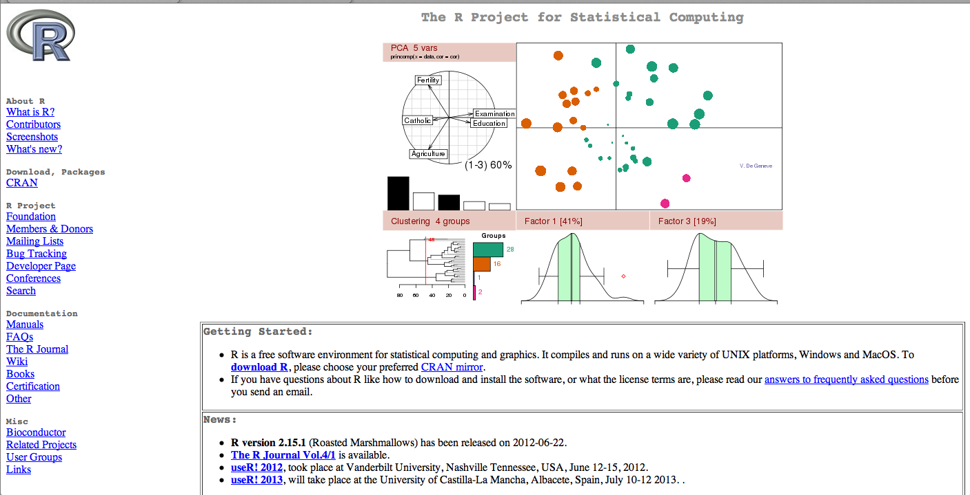
Getting Started
To install R on your MAC or PC you first need to go to http://www.r-project.org/.

Slide 88
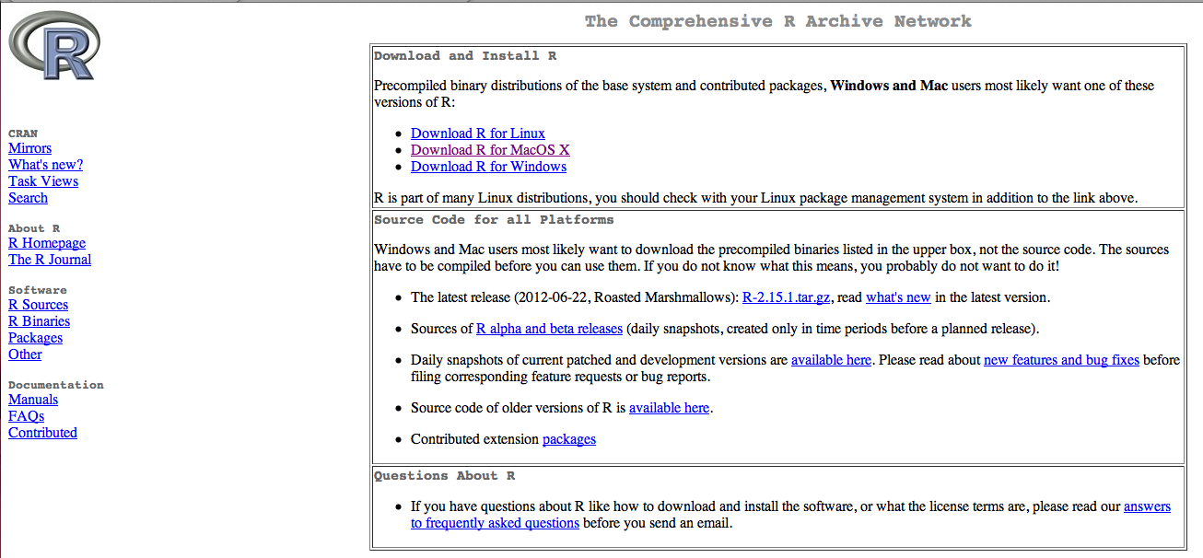
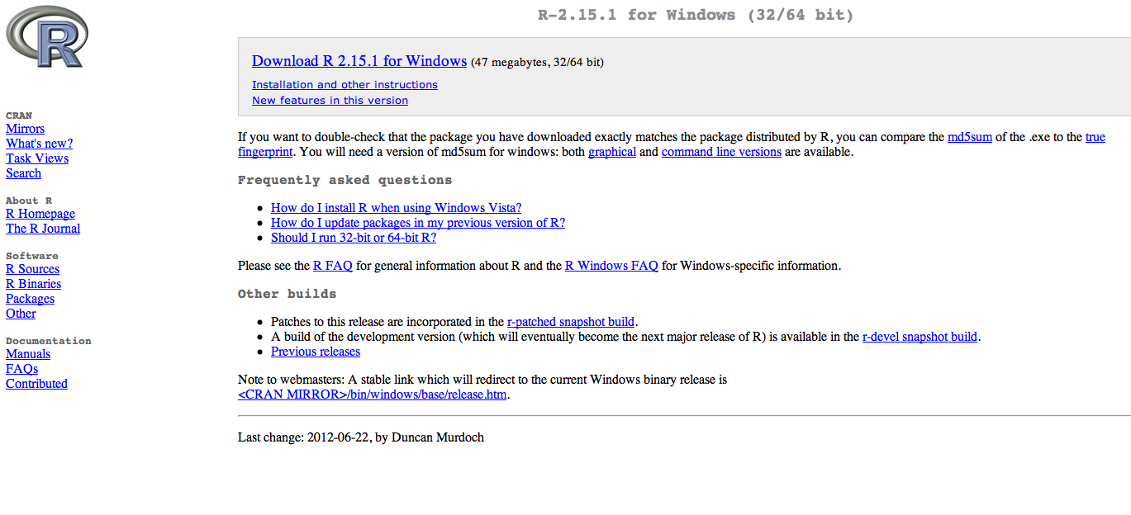
Notes:
Depending on if you are downloading for Windows or Mac click on your perspective thing…
Here we are going to go over windows so click on Download R for Windows
Then click download R

Slide 89
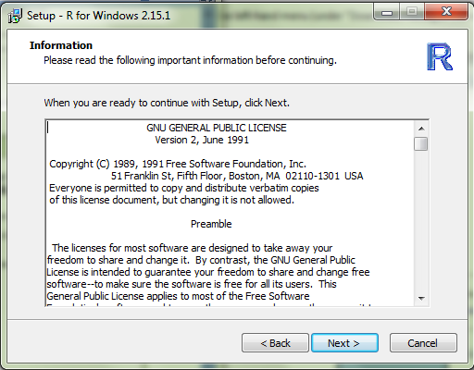
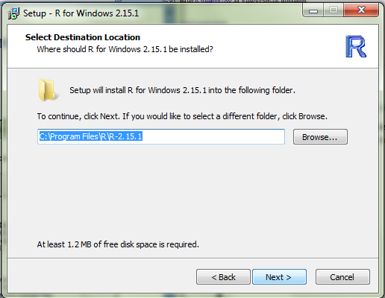
Notes:
This is the next screen that you will come to. Read the information and click next.
This is also where you need to set up you working directory…basically where you files are going to end up
Click where you want to put the file. This would be where if you wanted to put R on a flashdrive. Once you decide Click next.

Slide 90
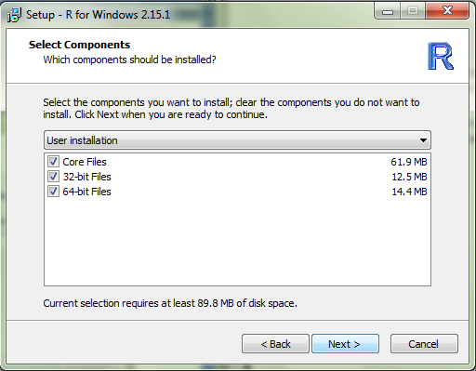
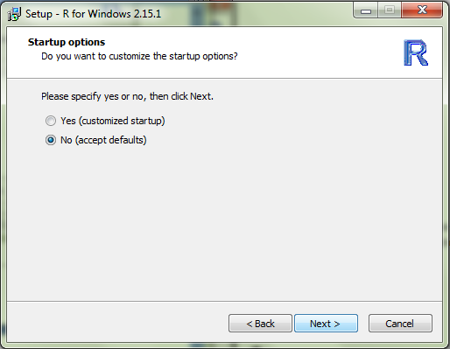
Notes:
Its always a good idea to download all the files.
MDI is when the windows will be contained within one large window. This is similar to how Excel is setup. SDI is a single document interface where every item will get its own window. This is similar to how SPSS is set up where it has separate data editor, viewer, and syntax windows. Once you choose which your prefer click next.

Slide 91
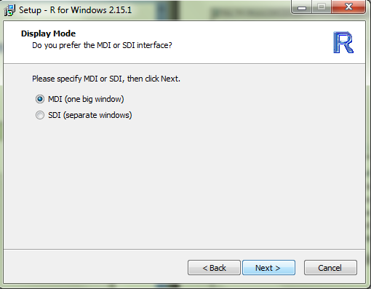
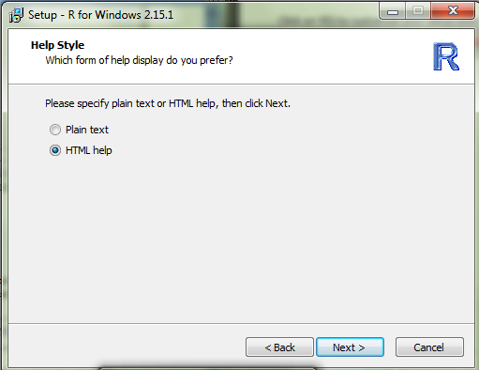

Slide 92
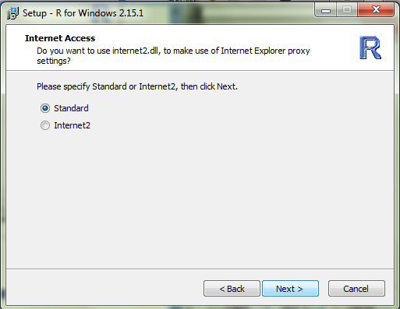
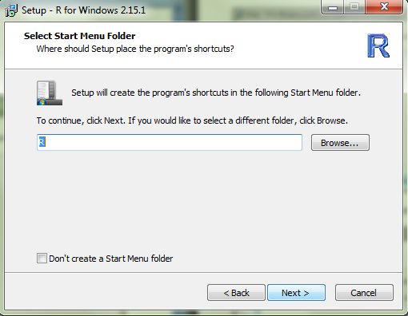
Notes:
Choose either html or plain text. Again, click next.
If you are installing R onto a flash drive click on Don’t create a start menu folder. Otherwise, you can leave it unchecked. Then click next.

Slide 93
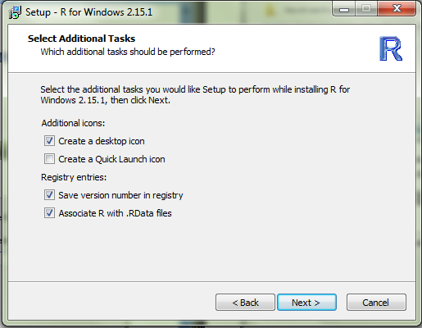
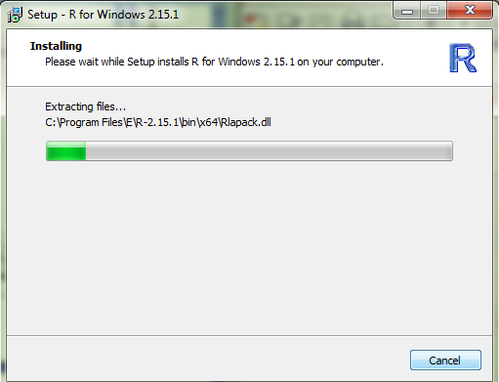
Notes:
Click next
The installation may take awhile

Slide 94
The R Studio User Interface

Slide 95
R Packages

Slide 96
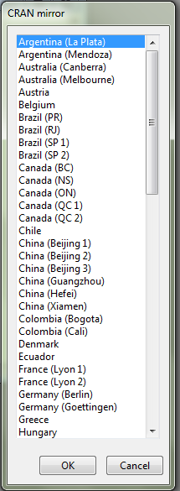
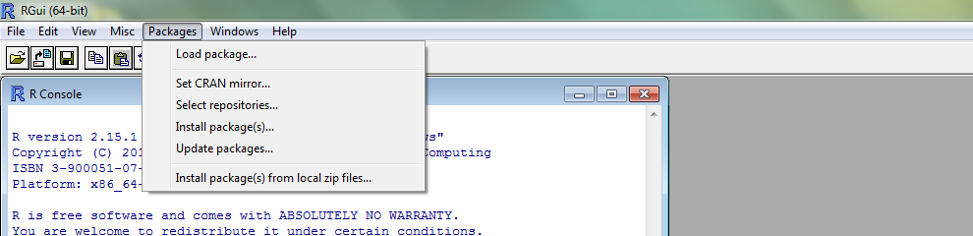
Installing Packages
Notes:
To install packages on Windows, click on packages and install packages.
Scroll down to USA and choose a “mirror” that is close to your physical location.

Slide 97
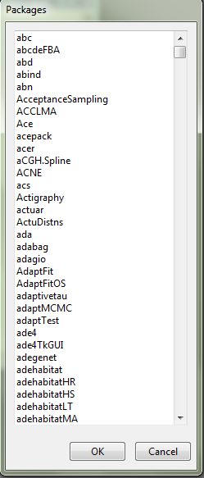
Notes:
Scroll down list until you find the package you are looking for. Keep in mind that R lists things in alphabetical order and by uppercase than lowercase. Once you click on a package to load, click ok. R will install not only the package but all of the packages needed to run your package.
To actually use the package, go back to the package tab and click on load package.

