Slide 1


R Immersion Workshop
Machine Learning with R
Deepak Venugopal
University of Memphis

Slide 2


Outline
Machine Learning Basics
Supervised Learning
K-Nearest Neighbor
Logistic Regression
Unsupervised Learning
K-Means Clustering

Slide 3


Why Machine Learning?
“A breakthrough in machine learning would be worth ten Microsofts” (Bill Gates, Microsoft)
“Machine learning is the next Internet” (Tony Tether, Former Director, DARPA)
Machine learning is the hot new thing” (John Hennessy, President, Stanford)
“Web rankings today are mostly a matter of machine learning” (Prabhakar Raghavan, Former Dir. Research, Yahoo)
“Machine learning is going to result in a real revolution” (Greg Papadopoulos, CTO, Sun)

Slide 4
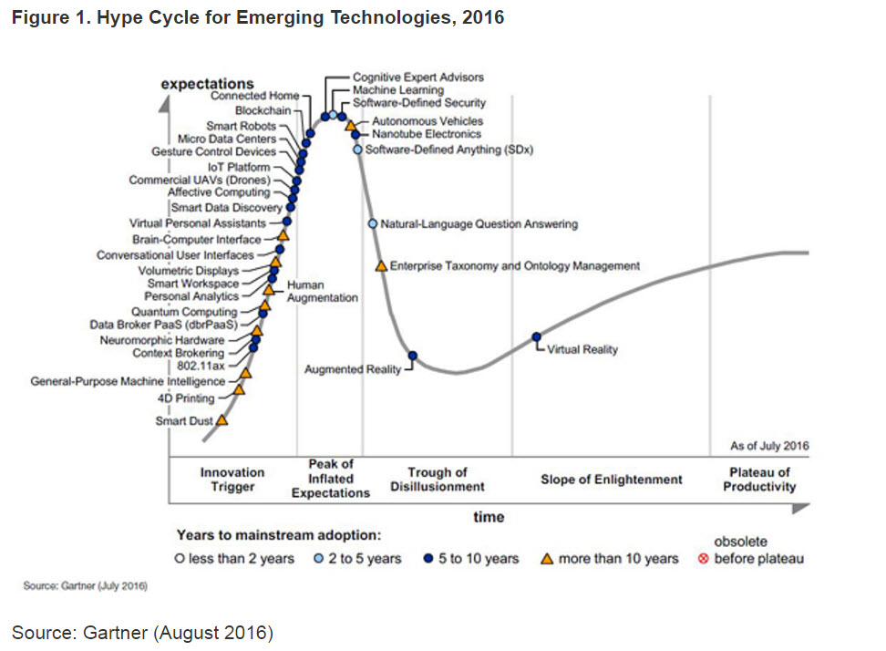

Slide 5
Getting computers to program themselves
Writing software is the bottleneck, let data do the work
Traditional Programming
Machine Learning
Requirements
Human
Program
Computer
Output
Data
Input
Requirements and data change often
Requirements
Machine Learning
Program
Computer
Output
Data
Input

Slide 6
Definition: Machine Learning!
T. Mitchell: Well posed machine learning
Improving performance via experience
Formally, A computer program is said to learn from experience E with respect to some class of tasks T and performance measure P, if its performance at tasks in T as measured by P, improves with experience.
H. Simon
Learning denotes changes in the system that are adaptive in the sense that they enable the system to do the task or tasks drawn from the same population more efficiently and more effectively the next time.
The ability to perform a task in a situation which has never been encountered before (Learning = Generalization)

Slide 7
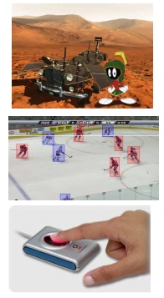
When to use Machine Learning?
Human expertise is absent
Example: navigating on mars
Humans are unable to explain their expertise
Example: vision, speech, language
Requirements and data change over time
Example: Tracking, Biometrics, Personalized fingerprint recognition
The problem or the data size is just too large
Example: Web Search

Slide 8
Types of Learning
Supervised learning (classification)
Training data includes desired outputs
Unsupervised learning
Training data does not include desired outputs
Find hidden/interesting structure in data
Semi-supervised learning
Training data includes a few desired outputs
Reinforcement learning
the learner interacts with the world via “actions” and tries to ﬁnd an optimal policy of behavior with respect to “rewards” it receives from the environment

Slide 9


Classification Example: Spam Filtering
Classify as “Spam” or “Not Spam”

Slide 10
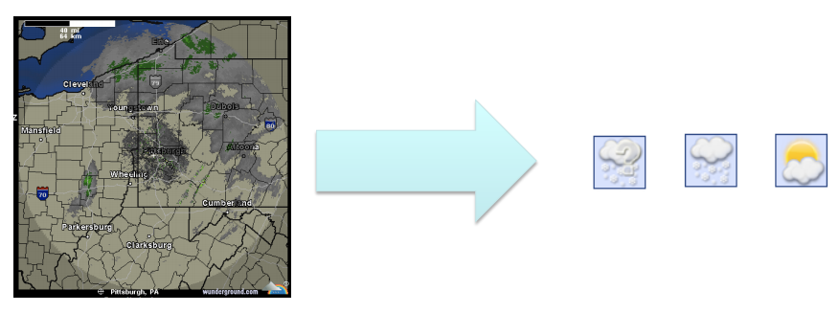
Classification Example: Weather Prediction

Slide 11
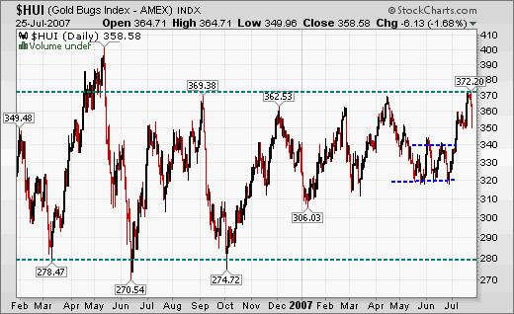
Regression example: Predicting Gold/Stock prices
Good ML can make you rich (but there is still some risk involved).
Given historical data on Gold prices, predict tomorrow’s price!

Slide 12

Similarity Determination

Slide 13
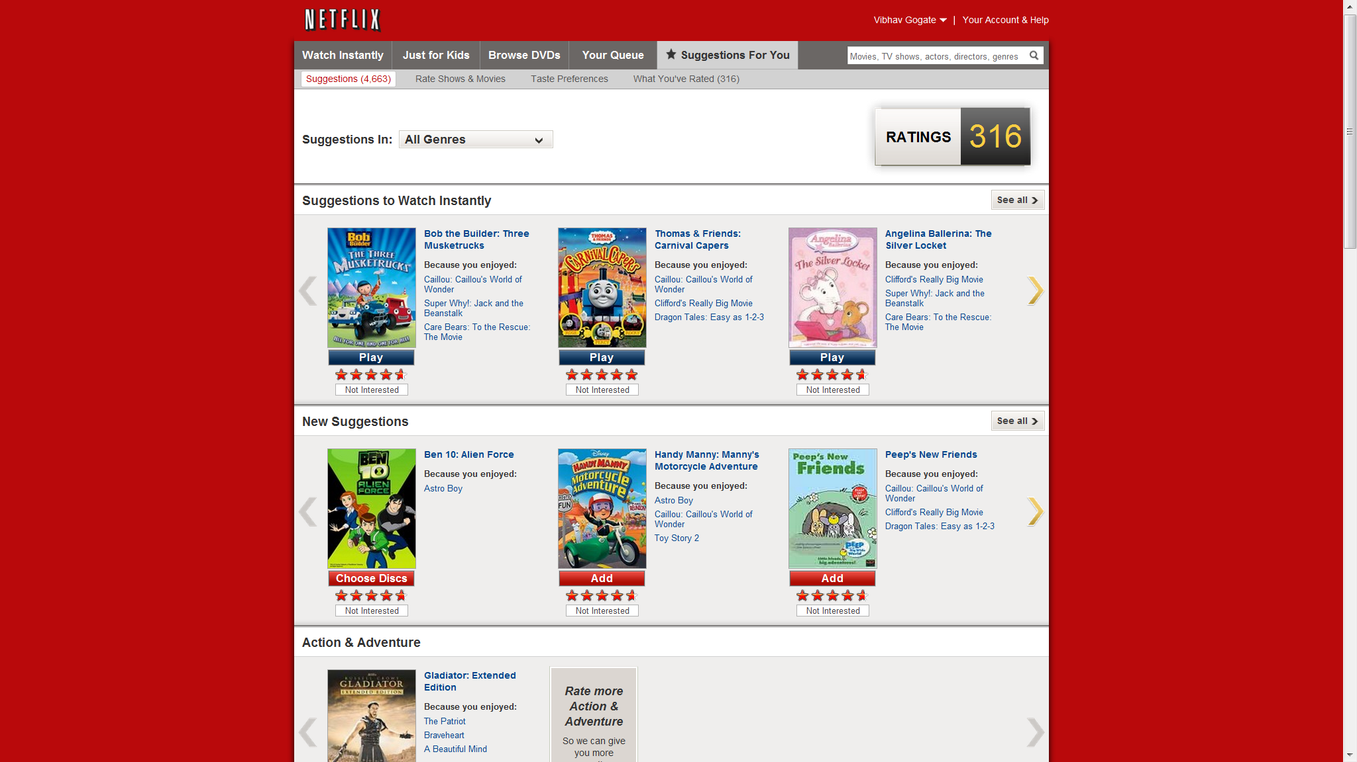
Collaborative Filtering

Slide 14
Steps in Supervised Learning
Determine the problem representation
Feature Engineering
Gather a data set (not all data is kosher)
Data Cleaning
Select a suitable evaluation method
Find a suitable machine learning algorithm among a plethora of available choices

Slide 15
Supervised Machine Learning
Training Example
Two
Classes:
{Yes,No}

Slide 16
Feature Engineering is the Key
Most effort in ML projects is constructing features
Black art: Intuition, creativity required
Understand properties of the task at hand
How the features interact with or limit the algorithm you are using.
ML is an iterative process
Try different types of features, experiment with each and then decide which feature set/algorithm combination to use

Slide 17
Evaluation
Evaluating Machine Learning methods is non-trivial
How can you verify if your method is going to make the right prediction for any future unknown situation??
Different evaluation criteria can make Machine learning methods look really good or really bad!

Slide 18
Machine Learning using R
Several packages are available in R that implement Machine Learning algorithms
CARET (Classification and Regression Training)
NNET (Neural Networks)
E1701,kenlab (SVMs, kernels,…)
Class (classification methods such as K-NN, Naïve Bayes, etc.)
NbClust (Clustering algorithms)
Stats (Generalized Linear Models such as Logistic Regression)
ROCR (Evaluation methods)

Slide 19
K-Nearest Neighbor
One of the most intuitive Machine Learning algorithms
Suppose, we want to predict whether a customer is likely to default on a loan or not
We collect data from several previous customers about whether they have defaulted or not
We predict if a new customer is likely to default by looking at the data of previous customers who are similar to him/her

Slide 20
K-Nearest Neighbor
Defaulters
Non-Defaulters
Income
Credit Score

Slide 21
K-Nearest Neighbor
Defaulters
Non-Defaulters
Income
?
Credit Score

Slide 22
K-Nearest Neighbor
Defaulters
Non-Defaulters
k=1
Income
x
Credit Score

Slide 23
K-Nearest Neighbor
Defaulters
Non-Defaulters
k=1
Income
k=5
x
common values for k: 3, 5
Outstanding loan amount

Slide 24

Distance Measure
Several possible measures can be used to compute the distance between data points to find the neighborhood
The most popular one is the Euclidean distance
${\left(\sum_{a=1}^{d}{{\left(x_{i,a}−x_{j,a}\right)}^{2}}\right)}^{1/2}$
$d=Number of Features$

Slide 25
K-NN: Practical Considerations
The (Euclidean) distance works fine when all the features are in the same scale
What happens when the scales of the feature are different?
Suppose one feature’s values correspond to yearly income and the other corresponds to credit-score (between 1 and 5)
Compare Distance[(100000,1) ; (100000,5)] and Distance[(100100,1) ; (100000,1)]

Slide 26
K-NN:Practical Considerations
Need to scale features uniformly
Standardizing the features
Subtract each feature value by the mean value for that feature
Divide each feature value by the standard deviation for that feature

Slide 27
K-NN:Curse of Dimensionality
K-NN determines classification based on ALL attributes
Some attributes may be more important than the others
Irrelevant attributes increase as the dimensionality increases

Slide 28
K-NN and irrelevant features
+
+
+
o
?
o
o
o
o
o
+
+
o
+
o
o
o
o
o
+
o
o
o
o
o
o
+

Slide 29
K-NN and irrelevant features
+
o
+
?
o
o
o
+
o
o
o
o
o
o
+
o
+
+
+
o
o
+
o
o
o
o
o

Slide 30
K-NN:Curse of Dimensionality
K-NN typically does not scale up very well with number of features
Imagine finding the nearest neighbors in a 500 dimensional space (i.e. 500 features)!
For large datasets, K-NN is vey slow
Find the nearest neighbor of an instance in a training dataset of 1 GB!
Specialized data structures are typically used that help improve scalability of KNN

Slide 31
Hands-On Exercise
Predict if a customer will be approved for a credit card or not (taken from a German credit card agency)
How to load the data?
How to build the classifier?
How to evaluate our classifier?

Slide 32
Hands-On Exercise
Load the data (.csv format) into a dataframe
df = read.csv(path, header = FALSE)
Inspect a few rows of the dataset
head(df)
Summary Statistics of the data
summary(df)

Slide 33
Data Standardization
Standardize the data to make the features commensurate
Can do this using a custom function
new_data = as.data.frame(lapply(dataset,function))
Easier method, use the caret library!
The caret package makes it very simple to pre-process data and also to evaluate performance

Slide 34
Data Standardization
Load the library
library(caret)
Do not standardize the class variable
pre<- preProcess(df[,-25], method=c('center', 'scale'))
Apply the pre-processing operation on the data
dfnew<-predict(pre, df)

Slide 35
Training-Test Split
Randomly shuffle the data and divide the instances into the training and test sets
trainIndex <- createDataPartition(df$C, p=splitpercent)
data_train <- df[ trainIndex,]
data_test <- df[ -trainIndex,]

Slide 36
Building the KNN classifier
Build the classifier with K=3
df_pred <- knn(train = data_train[,-25], test = data_test[,-25], cl = data_train$Class, k=3)
Outputs the predicted labels for each instance in data_test

Slide 37
Train test set split
It is simple
However,
You waste some portion of your data.
Chance/Coincidences: You may be lucky or unlucky with your test data
Solution
Recycle the data using cross-validation

Slide 38
K-fold cross validation
test
train
Test
Train on (k
-
1) splits
k-fold
In 3 fold cross validation, there are 3 runs.
In 5 fold cross validation, there are 5 runs.
In 10 fold cross validation, there are 10 runs.
the error is averaged over all runs

Slide 39
Hands-On Exercise
How can we better evaluate our model?
Cross-validation: Use a single training set to generate several training/testing datasets
Leave-one-Out
5-Fold
3-Fold
…
The caret library makes this simple!

Slide 40
K-Fold Cross Validation
Setup a control object that specifies the number of folds for cross-validation
control <- trainControl(method="cv", number=10)
Call KNN on each fold
model <- train(class~., data=df, method=“knn", trControl=control)

Slide 41
Parameter Tuning
Tuning parameters is essential to achieve good performance
What should be the ideal value of K in K-NN?
Important to do this systematically
People often make mistakes in this step!
Wrong method of tuning parameters
Select the value of K which gives us best accuracy for the training data
Tuning parameters on the training data leads to a phenomena called “overfitting”
The parameters are optimal for the given training data but generalize poorly for any other data

Slide 42
Repeated Cross-Validation
Can repeat the cross-validation a number of times using the control object
control <- trainControl(method="repeatedcv", number=10, repeats=3)

Slide 43
Parameter Tuning
Select the parameters with best cross-validation accuracy
Avoids overfitting the training data
Search for the optimal parameters using a grid object
grid <- expand.grid(k=c(1,3,5,10))
Perform Cross-Validation for each parameter value
model <- train(class~., data=df, method=“knn", trControl=control,tunegrid=grid)

Slide 44

Logistic Regression
One way of performing classification is to consider the probability of a class given the features
Is $P\left(Approve | Age,Income,…\right)$> $P\left(¬Approve | Age,Income,…\right) ?$
Key task: compute the conditional probability of a positive (and negative) class given the feature values

Slide 45
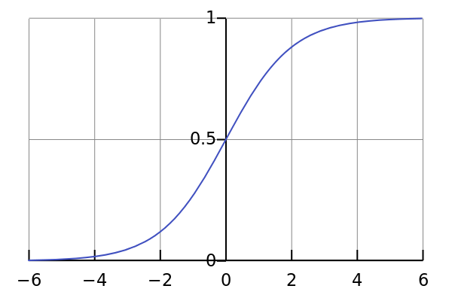
Logistic Regression
Assume that the conditional probability for the positive class has a specific form known as the Logistic function

Slide 46
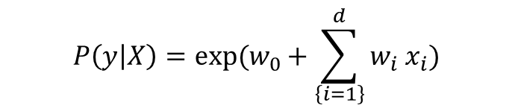
Logistic Regression
We learn the logistic function from training data such that all instances of the positive class have their conditional distribution > 0.5
$$P\left(y | X\right)=exp(w_{0}+\sum_{\left\{i=1\right\}}^{d}{w_{i}{ x}_{i}})$$

Slide 47
Logistic Regression
Input: Labeled Training Data
Learning algorithm: Find a set of d+1 weights (where d is the number of features) that maximizes the conditional log likelihood of the data
Search over the parameters that maximizes the log likelihood function

Slide 48

Logistic Regression
The learned logistic function acts as a classifier
If $log \left(exp\left(w_{0}+\sum_{\left\{i=1\right\}}^{d}{w_{i}{ x}_{i}}\right)\right)>t,$then label it as the positive class, else label as the negative class

Slide 49
Hands-On Exercise
Learn the logistic function parameters using the generalized linear models package in R
model = glm(C~.,data=training,family="binomial“,type=“response”)
predict <- predict(model, data=data_test,type = 'response')
We can set the threshold for the predicted probabilities
predict <- ifelse(predict > 0.5,1,0)
We can obtain confidence intervals for the learned model parameters
confint(pred)

Slide 50
When does logistic regression work well?
Load the dataset-lin.csv
Plot a scatter plot with this dataset
plot(df$D-0, df$D-1, pch=21, bg=c("red","green3")[unclass(df$C)], main="Separable Data")
The data is “linearly-separable”
Can separate the classes using a line (in 2D) or in general a hyper-plane (in n-dimensions)

Slide 51
When does Logistic Regression work well?
Try the same previous exercise with dataset-nlin.csv
What is the change that you observe?
Logistic Regression works very well when the data is linearly separable

Slide 52
Evaluation
Cross-validation as before
train_control <- trainControl(method=“cv", number=10)
model <- train(C~., data=df, trControl=train_control, method=“glm")

Slide 53
How can we measure classification accuracy?
Suppose I give you a dataset with 10,000 emails. Of these 100 are known to be spam.
Algorithm AllSpam: Any email the algorithm sees it will classify as spam
Accuracy for only the positive/spam class (the class we really care about) = 100/100 = 100%!!

Slide 54
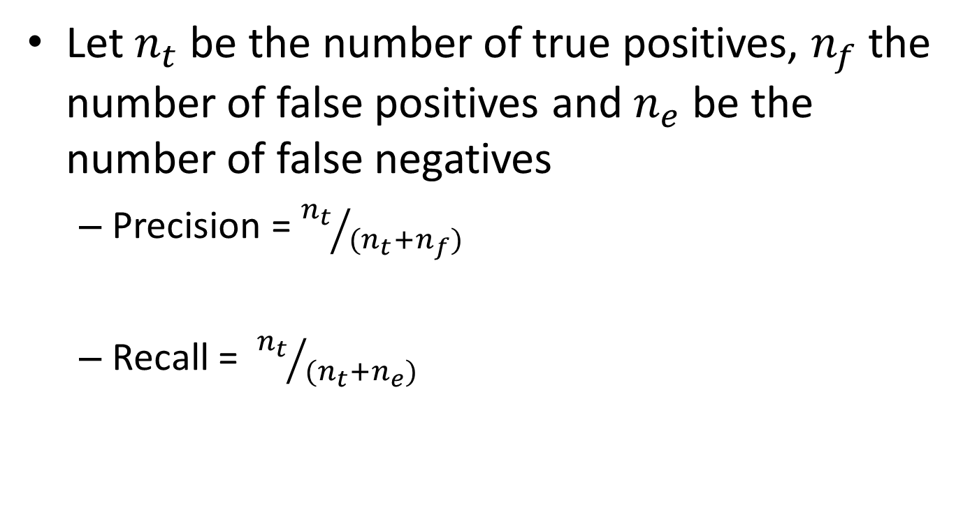
Precision and Recall
Let $n_{t}$ be the number of true positives, $n_{f}$ the number of false positives and $n_{e}$ be the number of false negatives
Precision = ${n_{t}}/{{(n}_{t}+n_{f})}$
Recall = ${n_{t}}/{{(n}_{t}+n_{e})}$

Slide 55
Computing Precision and Recall
Use the ROCR library
Load(ROCR)
Compare predicted vs actual outputs
pred <- prediction(predictions, true labels);
performance(pred, "prec", "rec");
Draw a precision/recall curve
plot(pred)

Slide 56
Computing Precision and Recall
Build the model
model = glm(C~.,data=training,family="binomial")
Predict “unseen” data
predicted <- predict(model, data=testing,type = 'response')
preds <- prediction(predicted, truelabels);
Compute the precision and recall
p1 = performance(pred, "prec", "rec");
Plot(p1)

Slide 57
ROC Curves
Another evaluation measure is using ROC curves
Idea: Compute the false positive and true positive ratios for several different thresholds
We would typically see an “elbow-shaped” curve, with the optimal threshold being the one with smallest false-positive and largest true-positive %.

Slide 58
ROC Curves
Library(ROCR)
ROCRpred <- prediction(predict, testing$C)
ROCRperf <- performance(ROCRpred, 'tpr','fpr')
plot(ROCRperf, colorize = TRUE, text.adj = c(-0.2,1.7))

Slide 59
ROC-AUC
Measure the area under the ROC curve
auc <- performance(pred, measure = "auc")
auc <- auc@y.values[[1]]
Gives a score that quantifies how well the model performs irrespective of the threshold that we choose

Slide 60
Confusion Matrix
A single matrix that shows all the relevant metrics of our results
True positives
False positives
True negatives
False negatives
confusionMatrix(data=pred, testing$Class)

Slide 61
Overview of Learning
 | Labeled Examples | Nothing
Discrete classes | Classification | Clustering
Continuous | Regression
What is Being Learned?
So far, we considered methods that perform classification. Now, let us consider clustering algorithms

Slide 62
Clustering
Clustering systems:
Requires data, but no labels
Detect patterns e.g. in
Group emails or search results
Customer shopping patterns
Program executions (intrusion detection)
Useful when don’t know what you’re looking for

Slide 63
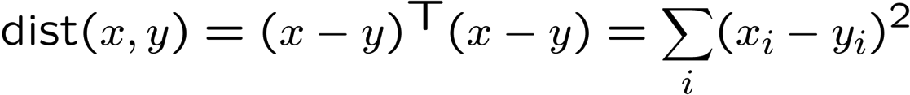
Clustering
Basic idea: group together similar instances
Example: 2D point patterns
What could “similar” mean?
One option: small (squared) Euclidean distance

Slide 64
K-Means: Algorithm
An iterative clustering algorithm
Pick K random points as cluster centers (means)
Alternate:
Assign data instances to closest cluster center
Change the cluster center to the average of its assigned points
Stop when no points’ assignments change

Slide 65
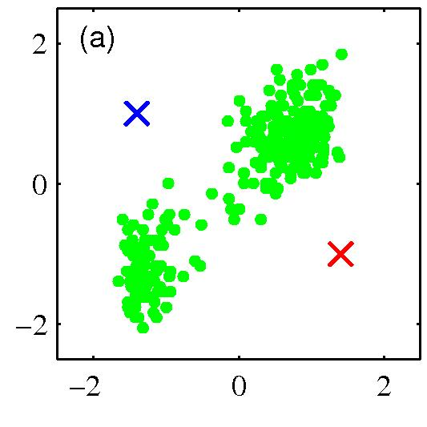
K-means clustering: Example
Pick K random points as cluster centers (means)

Slide 66
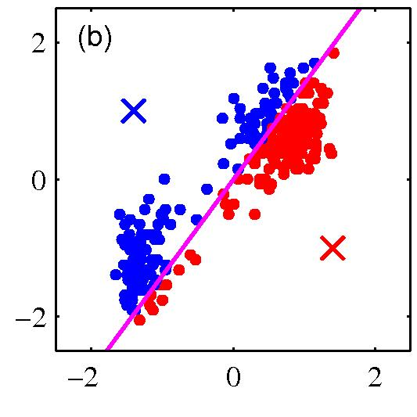
K-means clustering: Example
Iterative Step 1
Assign data instances to closest cluster center

Slide 67
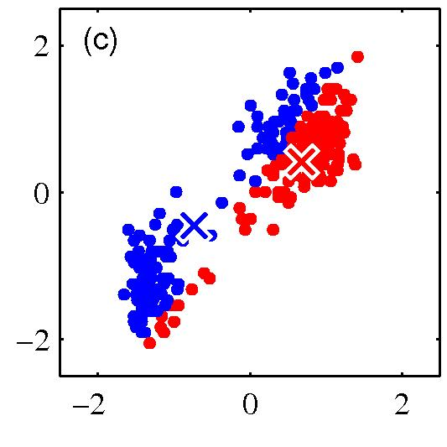
K-means clustering: Example
Iterative Step 2
Change the cluster center to the average of the assigned points

Slide 68
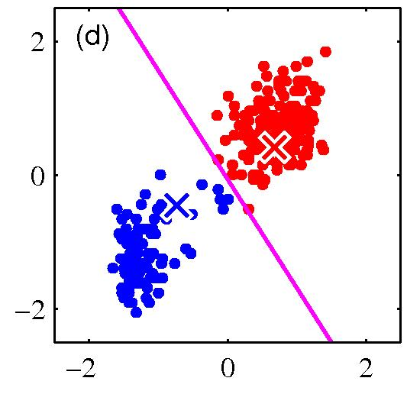
K-means clustering: Example
Repeat until convergence

Slide 69
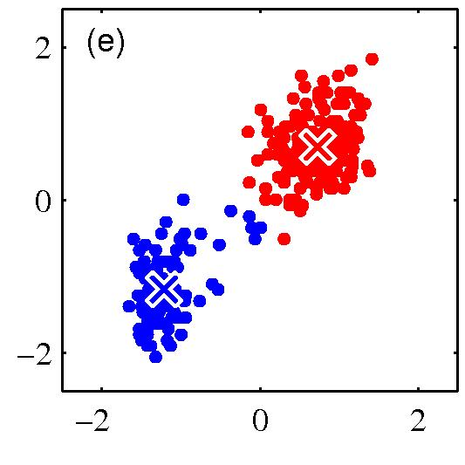
K-means clustering: Example

Slide 70
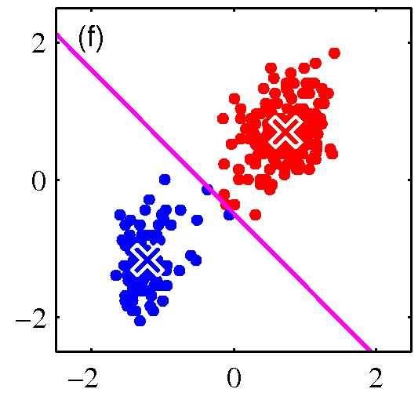
K-means clustering: Example

Slide 71
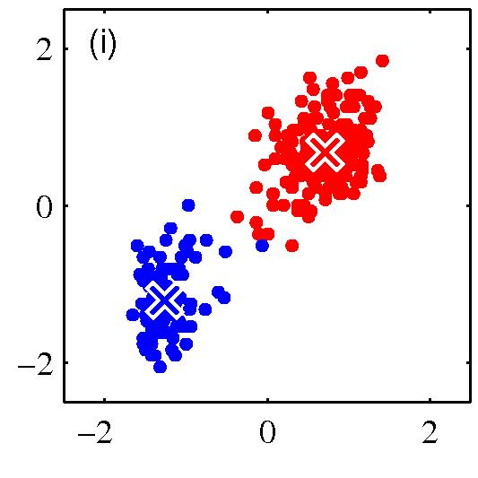
K-means clustering: Example

Slide 72
Hands-On Exercise
Load the clustering Library
library(NbClust)
Need to standardize the data just as in K-NN
Choose the number of cluster centers
Kmeansfit <- kmeans(df,numclusters)
Look at the generated clusters
Kmeansfit$cluster

Slide 73
Tuning the number of clusters
There are really no “labels” to validate the clustering
Cross-validation is not really applicable here
How to choose the “right” clustering?

Slide 74
Tuning the number of clusters
The NbClust package makes it easy to tune the number of clusters
nc <- NbClust(df, min.nc=minclusters, max.nc=maxclusters, method="kmeans")
By default, it uses several metrics (Ward, GAP, etc.) of clustering and shows for value of numclusters, how many metrics voted this value as the best choice
We can select the best choice as
table(nc$Best.n[1,])

Slide 75
Tuning the number of clusters
We can also specify a subset of indices to use (using all of them may be very expensive)
nc <- NbClust(df, min.nc=minclusters, max.nc=maxclusters, method="kmeans“,index=“gap”)
By default, it uses several indices of clustering and shows how many indices voted for “x” number of clusters
We can select the best choice as
table(nc$Best.n[1,])

Slide 76
Summary
K-NN
Good for small number of features
Logistic Regression
Works well when the data labels can be separated using a linear boundary
K-Means
Value of K is critical to determine the “Correct” clustering
Machine Learning
Largely experimental, try out different methods, and perform the right evaluation and parameter tuning (e.g. cross validation)

Slide 77
Instructor Information
Deepak Venugopal
Assistant Professor
Department of Computer Science
University of Memphis
Director of AI and Machine Learning Lab
Associate Director of the Data Science Center
Email: dvngopal@memphis.edu

