Slide 1


R Immersion Workshop
Machine Learning with R
Deepak Venugopal

Slide 2


Outline
Machine Learning Basics
Supervised Learning
K-Nearest Neighbor
Logistic Regression
Unsupervised Learning
K-Means Clustering

Slide 3


Why Machine Learning?
“A breakthrough in machine learning would be worth ten Microsofts” (Bill Gates, Microsoft)
“Machine learning is the next Internet” (Tony Tether, Former Director, DARPA)
Machine learning is the hot new thing” (John Hennessy, President, Stanford)
“Web rankings today are mostly a matter of machine learning” (Prabhakar Raghavan, Former Dir. Research, Yahoo)
“Machine learning is going to result in a real revolution” (Greg Papadopoulos, CTO, Sun)

Slide 4
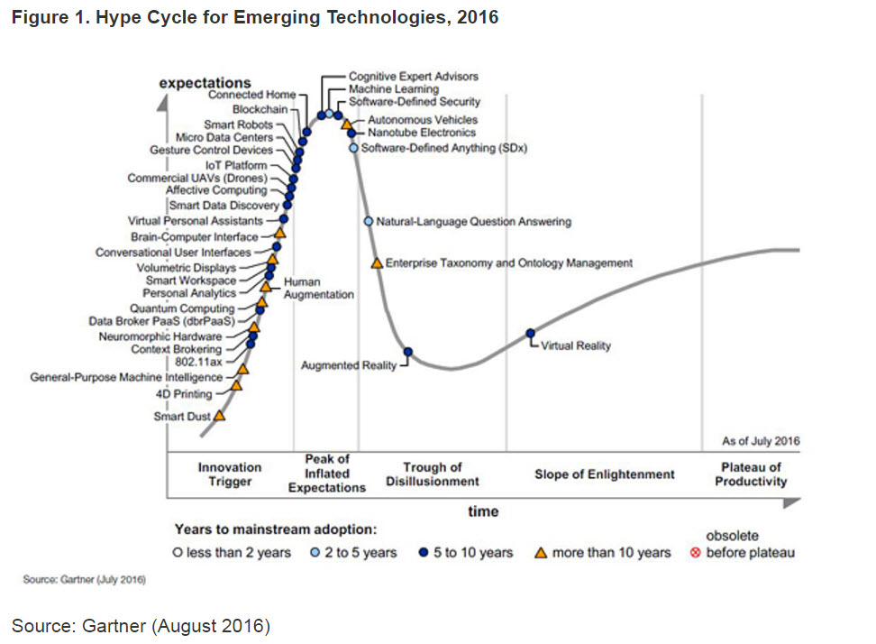

Slide 5
Getting computers to program themselves
Writing software is the bottleneck, let data do the work
Traditional Programming
Machine Learning
Requirements
Human
Program
Computer
Output
Data
Input
Requirements and data change often
Requirements
Machine Learning
Program
Computer
Output
Data
Input

Slide 6
Definition: Machine Learning!
T. Mitchell: Well posed machine learning
Improving performance via experience
Formally, A computer program is said to learn from experience E with respect to some class of tasks T and performance measure P, if its performance at tasks in T as measured by P, improves with experience.
H. Simon
Learning denotes changes in the system that are adaptive in the sense that they enable the system to do the task or tasks drawn from the same population more efficiently and more effectively the next time.
The ability to perform a task in a situation which has never been encountered before (Learning = Generalization)

Slide 7
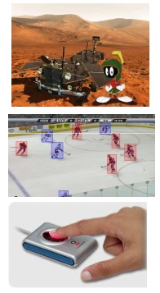
When to use Machine Learning?
Human expertise is absent
Example: navigating on mars
Humans are unable to explain their expertise
Example: vision, speech, language
Requirements and data change over time
Example: Tracking, Biometrics, Personalized fingerprint recognition
The problem or the data size is just too large
Example: Web Search

Slide 8
Types of Learning
Supervised learning (classification)
Training data includes desired outputs
Unsupervised learning
Training data does not include desired outputs
Find hidden/interesting structure in data
Semi-supervised learning
Training data includes a few desired outputs
Reinforcement learning
the learner interacts with the world via “actions” and tries to ﬁnd an optimal policy of behavior with respect to “rewards” it receives from the environment

Slide 9

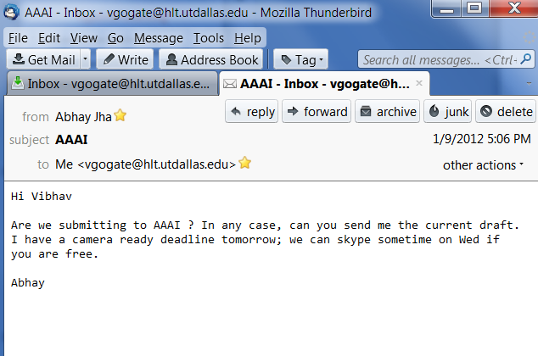
Classification Example: Spam Filtering
Classify as “Spam” or “Not Spam”

Slide 10
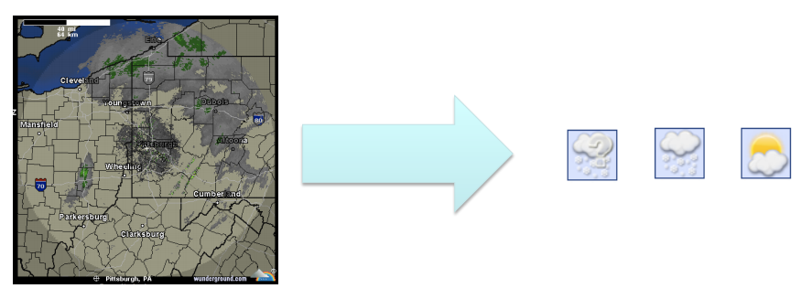
Classification Example: Weather Prediction

Slide 11
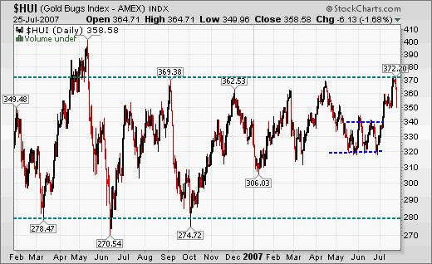
Regression example: Predicting Gold/Stock prices
Good ML can make you rich (but there is still some risk involved).
Given historical data on Gold prices, predict tomorrow’s price!

Slide 12

Similarity Determination

Slide 13
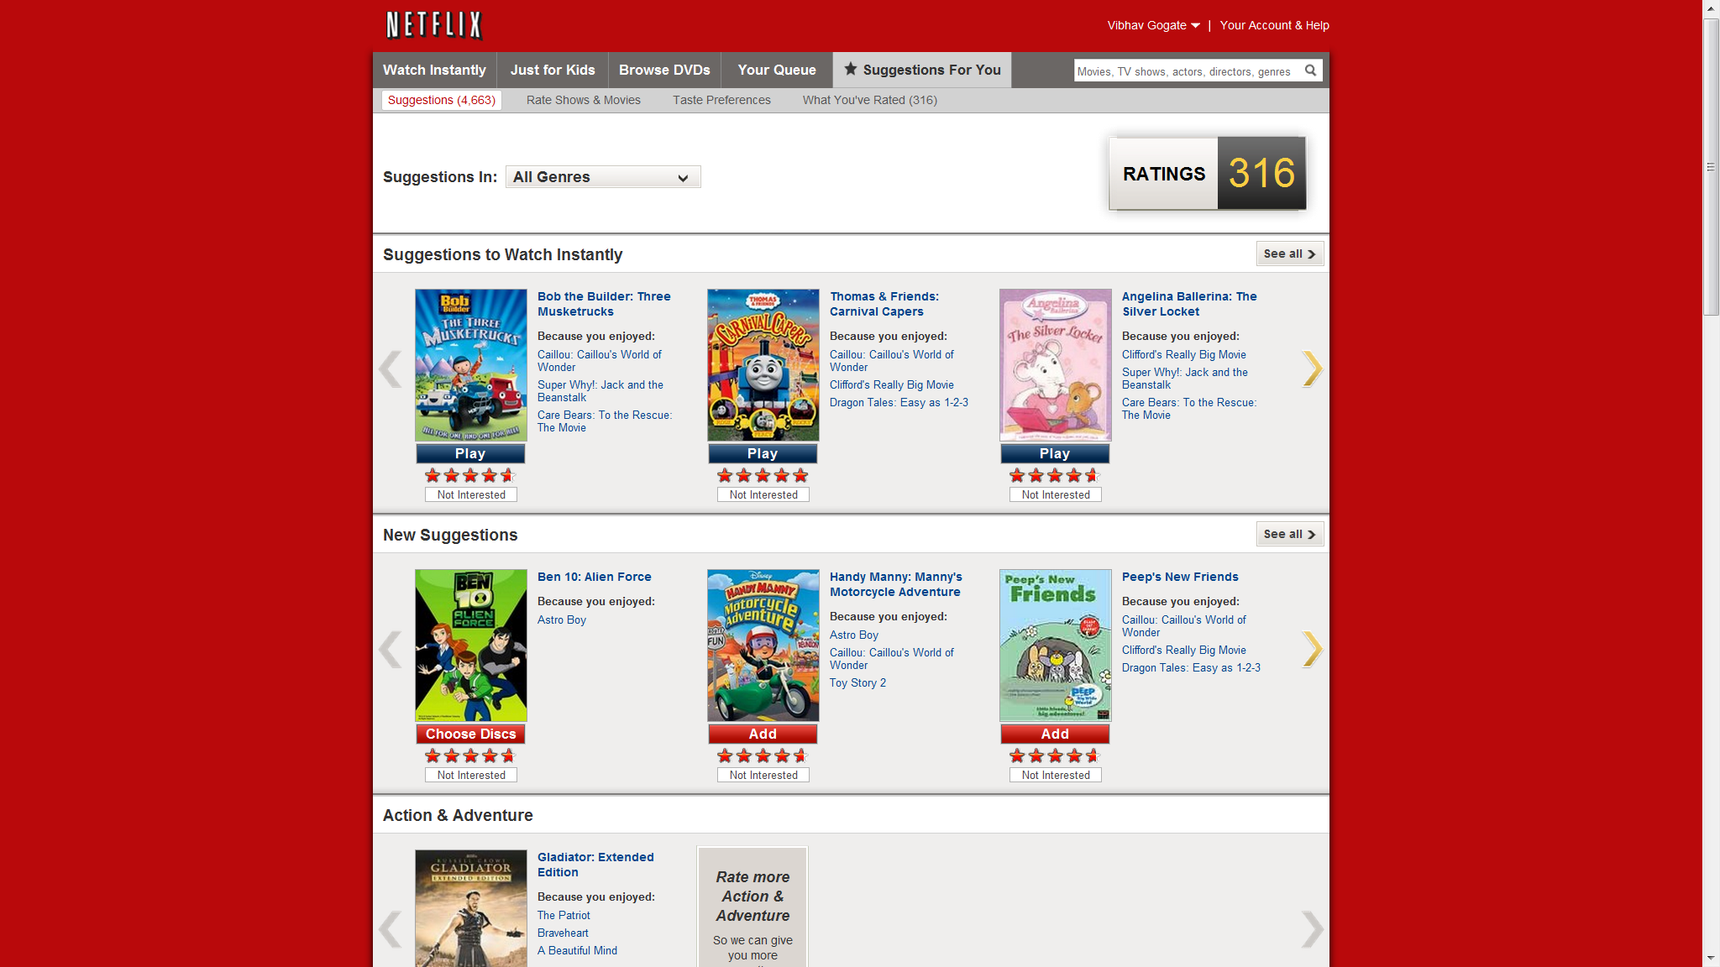
Collaborative Filtering

Slide 14
Steps in Supervised Learning
Determine the problem representation
Feature Engineering
Gather a data set (not all data is kosher)
Data Cleaning
Select a suitable evaluation method
Find a suitable machine learning algorithm among a plethora of available choices

Slide 15
Supervised Machine Learning
Training Example
Two
Classes:
{Yes,No}

Slide 16
Feature Engineering is the Key
Most effort in ML projects is constructing features
Black art: Intuition, creativity required
Understand properties of the task at hand
How the features interact with or limit the algorithm you are using.
ML is an iterative process
Try different types of features, experiment with each and then decide which feature set/algorithm combination to use

Slide 17
Evaluation
Evaluating Machine Learning methods is non-trivial
How can you verify if your method is going to make the right prediction for any future unknown situation??
Different evaluation criteria can make Machine learning methods look really good or really bad!

Slide 18
K-Nearest Neighbor
One of the most intuitive Machine Learning algorithms
Suppose, we want to predict whether a customer is likely to default on a loan or not
We collect data from several previous customers about whether they have defaulted or not
We predict if a new customer is likely to default by looking at the data of previous customers who are similar to him/her

Slide 19
K-Nearest Neighbor
Defaulters
Non-Defaulters
Income
Credit Score

Slide 20
K-Nearest Neighbor
Defaulters
Non-Defaulters
Income
?
Credit Score

Slide 21
K-Nearest Neighbor
Defaulters
Non-Defaulters
k=1
Income
x
Credit Score

Slide 22
K-Nearest Neighbor
Defaulters
Non-Defaulters
k=1
Income
k=5
x
common values for k: 3, 5
Outstanding loan amount

Slide 23

Distance Measure
Several possible measures can be used to compute the distance between data points to find the neighborhood
The most popular one is the Euclidean distance
${\left(\sum_{a=1}^{d}{{\left(x_{i,a}−x_{j,a}\right)}^{2}}\right)}^{1/2}$
$d=Number of Features$

Slide 24
K-NN: Practical Considerations
The (Euclidean) distance works fine when all the features are in the same scale
What happens when the scales of the feature are different?
Suppose one feature’s values correspond to yearly income and the other corresponds to credit-score (between 1 and 5)
Compare Distance[(100000,1) ; (100000,5)] and Distance[(100100,1) ; (100000,1)]

Slide 25
K-NN:Practical Considerations
Need to scale features uniformly
Standardizing the features
Subtract each feature value by the mean value for that feature
Divide each feature value by the standard deviation for that feature

Slide 26
K-NN:Curse of Dimensionality
K-NN determines classification based on ALL attributes
Some attributes may be more important than the others
Irrelevant attributes increase as the dimensionality increases
Possible solution: Weight the axes differently based on importance

Slide 27
K-NN and irrelevant features
+
+
+
o
?
o
o
o
o
o
+
+
o
+
o
o
o
o
o
+
o
o
o
o
o
o
+

Slide 28
K-NN and irrelevant features
+
o
+
?
o
o
o
+
o
o
o
o
o
o
+
o
+
+
+
o
o
+
o
o
o
o
o

Slide 29
Hands-On Exercise
Predict if a customer will be approved for a credit card or not (taken from a German credit card agency)
How to lead the data?
How to build the classifier?
How to evaluate our classifier?

Slide 30
Hands-On Exercise
Load the data (.csv format) into a dataframe
df = read.csv(path, header = FALSE)
Inspect a few rows of the dataset
head(df)
Summary Statistics of the data
summary(df)

Slide 31
Data Standardization
Standardize the data to make the features commensurate
Can do this using a custom function
new_data = as.data.frame(lapply(dataset,function))
Easier method, use the caret library!
The caret package makes it very simple to pre-process data and also to evaluate performance

Slide 32
Data Standardization
Load the library
library(caret)
Do not standardize the class variable
pre<- preProcess(df[,-25], method=c('center', 'scale'))
Apply the pre-processing operation on the data
dfnew<-predict(pre, df)

Slide 33
Training-Test Split
trainIndex <- createDataPartition(df$C, p=splitpercent)
data_train <- df[ trainIndex,]
data_test <- df[ -trainIndex,]

Slide 34
Build the KNN Classifier
Divide the data into training and testing portions
Sample 67% and 33% of the data randomly
ind <- sample(2, nrow(df), replace=TRUE, prob=c(0.67, 0.33))
Training <- df[ind==1, 1:24]
Testing <- df[ind==2, 1:24]
trainlabels <- df[ind==1, 25]
testlabels <- df[ind==2, 25]

Slide 35
Hands-On Exercise
Standardize the data to make the features commensurate
Can do this using a custom function
new_data = as.data.frame(lapply(dataset,function))
Easier method, use the caret library!
The caret package makes it very simple to pre-process data and also evaluate performance

Slide 36
Hands-On Exercise
Load the caret library
library(caret)
Which features do we want to standardize?
We do not want to standardize the class variable
Remove the class variable (say the 25th variable in our dataset) from being standardized
pre <- preProcess(df[,-25], method=c('center', 'scale'))

Slide 37
Hands-On Exercise
Train/test split of the data
70-30 split
The K-NN model
knn(train = iris.training, test = iris.test, cl = iris.trainLabels, k=3)

Slide 38
Building the KNN classifier
df_pred <- knn(train = training, test = testing, cl = trainLabels, k=3)

Slide 39
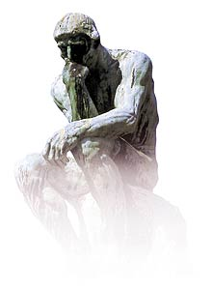
Train test set split
It is simple
What is the down side ?
1. You waste some portion of your data.

Slide 40
Train test set split
It is simple
What is the down side ?
You waste some portion of your data.
Chance/Coincidences: You may be lucky or unlucky with your test data

Slide 41

Cross Validation
Recycle the data!

Slide 42
LOOCV (Leave-one-out Cross Validation)
Let say we have N data points
k be the index for data points
k=1..N
Let (x_{k},y_{k}) be the k^{th} record
Temporarily remove (x_{k},y_{k})
from the dataset
Train on the remaining N-1
Datapoints
Test your error on (x_{k},y_{k})
Do this for each k=1..N and report the mean error.
Your single test data

Slide 43
K-fold cross validation
test
train
Test
Train on (k
-
1) splits
k-fold
In 3 fold cross validation, there are 3 runs.
In 5 fold cross validation, there are 5 runs.
In 10 fold cross validation, there are 10 runs.
the error is averaged over all runs

Slide 44
Hands-On Exercise
How can we better evaluate our model?
Cross-validation: Use a single training set to generate several training/testing datasets
Leave-one-Out
5-Fold
3-Fold
…
The carat library makes this simple!

Slide 45
K-Fold Cross Validation
Setup a control object that specifies the number of folds for cross-validation
control <- trainControl(method="cv", number=10)
Call KNN on each fold
model <- train(class~., data=df, method=“knn", trControl=control)

Slide 46
Parameter Tuning
Tuning parameters is essential to achieve good performance
What should be the ideal value of K in K-NN?
Important to do this systematically
Wrong method of tuning parameters
Select the value of K which gives us best accuracy for the training data
Tuning parameters on the training data leads to overfitting
The parameters are optimal for the training data but generalize poorly for unseen test data

Slide 47
Parameter Tuning
Select the parameters with best cross-validation accuracy
Avoids overfitting the training data
Search for the optimal parameters using a grid object
grid <- expand.grid(k=c(1,3,5,10))
Perform Cross-Validation for each parameter value
model <- train(class~., data=df, method=“knn", trControl=control,tunegrid=grid)

Slide 48
Repeated Cross-Validation
Can repeat the cross-validation a number of times using the control object
control <- trainControl(method="repeatedcv", number=10, repeats=3)

Slide 49
Quiz
Can K-NN be used without labels in the training data?
Is 3-NN guaranteed to be better than 1-NN
As we increase the number of attributes, does the accuracy of prediction always increase?
Can we tune parameters on the training data?

Slide 50
Outline
Supervised Learning
Logistic Regression

Slide 51

Logistic Regression
One way of performing classification is to consider the probability of a class given the features
Is $P\left(Approve | Age,Income,…\right)$> $P\left(¬Approve | Age,Income,…\right) ?$
Key task: compute the conditional probability of a class given the feature values

Slide 52
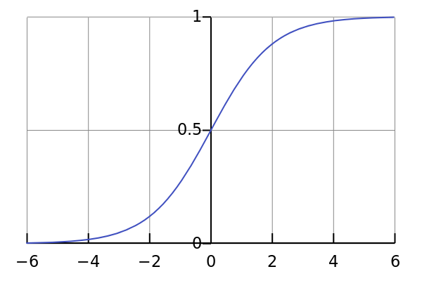
Logistic Regression
Assume that the conditional probability has a specific form known as the Logistic function

Slide 53
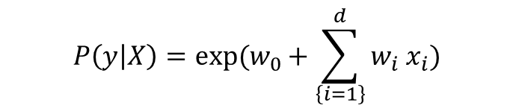
Logistic Regression
We learn the function from training data such that all instances of the positive class have their conditional distribution > 0.5
$$P\left(y | X\right)=exp(w_{0}+\sum_{\left\{i=1\right\}}^{d}{w_{i}{ x}_{i}})$$

Slide 54
Logistic Regression
Input: Labeled Training Data
Learning algorithm: Find a set of d+1 weights (where d is the number of features) that maximizes the conditional log likelihood of the data
Search over the parameters that maximizes the log likelihood function

Slide 55

Logistic Regression
The learned logistic function acts as a classifier
If $log \left(exp\left(w_{0}+\sum_{\left\{i=1\right\}}^{d}{w_{i}{ x}_{i}}\right)\right)>t,$then label it as the positive class, else label as the negative class

Slide 56
Hands-On Exercise
Learn the logistic function parameters
pred = glm(C~.,data=training,family="binomial")
We can obtain confidence intervals for the model parameters
confint(pred)

Slide 57
When does logistic regression work well?
Load the dataset-lin.csv
Plot a scatter plot with this dataset
plot(df$D-0, df$D-1, pch=21, bg=c("red","green3")[unclass(df$C)], main="Separable Data")
The data is “linearly-separable”
Can separate the classes using a line (in 2D) or in general a hyper-plane (in n-dimensions)

Slide 58
When does Logistic Regression work well?
Try the same previous exercise with dataset-nlin.csv
What is the change that you observe?

Slide 59
Evaluation
Cross-validation as before
train_control <- trainControl(method=“cv", number=10)
model <- train(C~., data=df, trControl=train_control, method=“glm")

Slide 60
Metric for Classification Accuracy
Suppose I give you a dataset with 10,000 emails. Of these 100 are known to be spam.
Algorithm AllSpam: Any email the algorithm sees it will classify as spam
Accuracy for only the positive/spam class (the class we really care about) = 100/100 = 100%!!

Slide 61
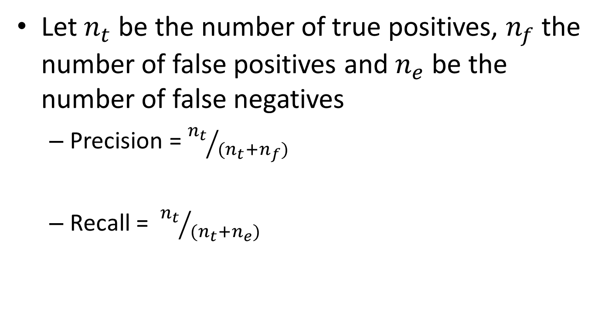
Precision and Recall
Let $n_{t}$ be the number of true positives, $n_{f}$ the number of false positives and $n_{e}$ be the number of false negatives
Precision = ${n_{t}}/{{(n}_{t}+n_{f})}$
Recall = ${n_{t}}/{{(n}_{t}+n_{e})}$

Slide 62
Computing Precision and Recall
Use the ROCR library
Load(ROCR)
Compare predicted vs actual outputs
pred <- prediction(predictions, true labels);
performance(pred, "prec", "rec");
Draw a precision/recall curve
plot(pred)

Slide 63
Computing Precision and Recall
Build the model
model = glm(C~.,data=training,family="binomial")
Predict “unseen” data
predicted <- predict(model, data=testing,type = 'response')
preds <- prediction(predicted, truelabels);
Compute the precision and recall
p1 = performance(pred, "prec", "rec");
Plot(p1)

Slide 64
ROC Curves
Another evaluation measure is using ROC curves
Idea: Compute the false positive and true positive ratios for several different thresholds
We would typically see an “elbow-shaped” curve, with the optimal threshold being the one with smallest false-positive and largest true-positive %.

Slide 65
ROC Curves
Library(ROCR)
ROCRpred <- prediction(predict, testing$C)
ROCRperf <- performance(ROCRpred, 'tpr','fpr')
plot(ROCRperf, colorize = TRUE, text.adj = c(-0.2,1.7))

Slide 66
ROC-AUC
Measure the area under the ROC curve
auc <- performance(pred, measure = "auc")
auc <- auc@y.values[[1]]
Gives a score that quantifies how well the model performs irrespective of the threshold that we choose

Slide 67
Confusion Matrix
A single matrix that shows all the relavant metrics for evaluation
True positives,
False positives
True negatives
False negatives
confusionMatrix(data=pred, testing$Class)

Slide 68
Quiz
How many parameters should we learn for a logistic regression classifier when we have d features in the data?
Does the logistic regression classifier output a class value?
When does logistic regression work well?

Slide 69
Overview of Learning
 | Labeled Examples | Nothing
Discrete classes | Classification | Clustering
Continuous | Regression
What is Being Learned?

Slide 70
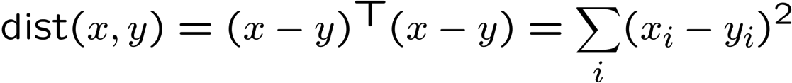
Clustering
Basic idea: group together similar instances
Example: 2D point patterns
What could “similar” mean?
One option: small (squared) Euclidean distance

Slide 71
K-Means: Algorithm
An iterative clustering algorithm
Pick K random points as cluster centers (means)
Alternate:
Assign data instances to closest cluster center
Change the cluster center to the average of its assigned points
Stop when no points’ assignments change

Slide 72
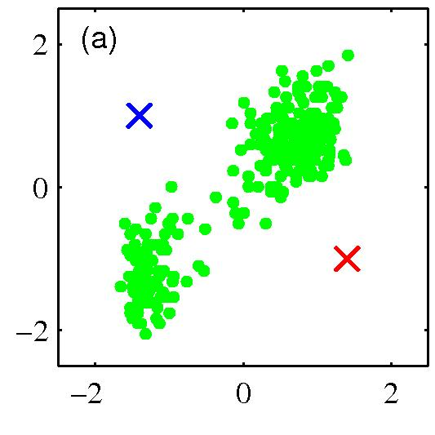
K-means clustering: Example
Pick K random points as cluster centers (means)

Slide 73
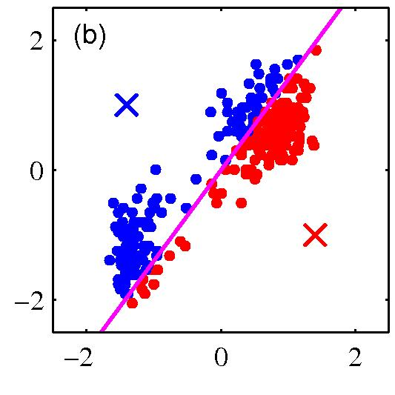
K-means clustering: Example
Iterative Step 1
Assign data instances to closest cluster center

Slide 74
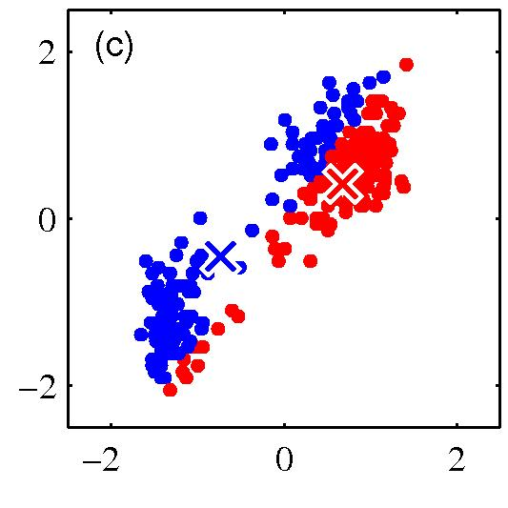
K-means clustering: Example
Iterative Step 2
Change the cluster center to the average of the assigned points

Slide 75
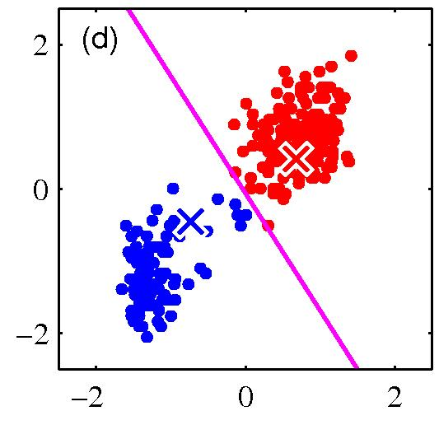
K-means clustering: Example
Repeat until convergence

Slide 76
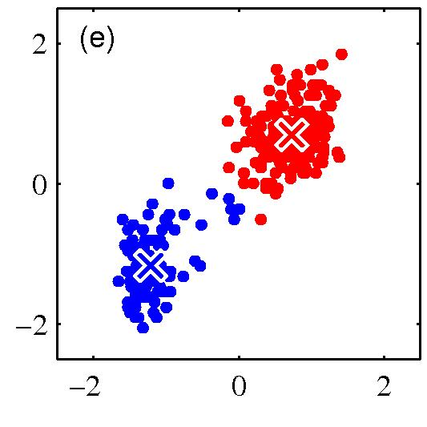
K-means clustering: Example

Slide 77
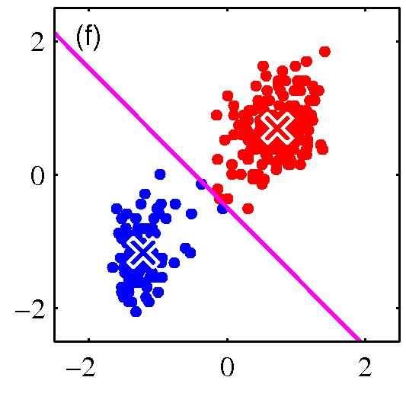
K-means clustering: Example

Slide 78
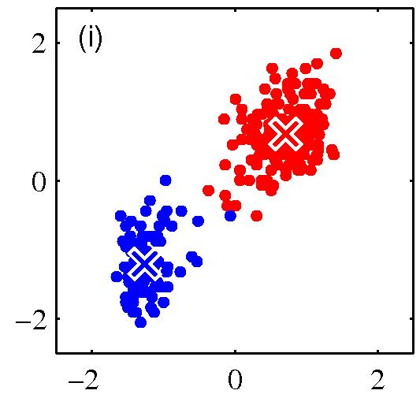
K-means clustering: Example

Slide 79
Hands-On Exercise
Load the clustering Library
library(NbClust)
Need to standardize the data just as in K-NN
Choose the number of cluster centers
Kmeansfit <- kmeans(df,numclusters)
Look at the generated clusters
Kmeansfit$cluster

Slide 80
Tuning the number of clusters
There are really no “labels” to validate the clustering
Cross-validation is not really applicable here
How to choose the “right” clustering?

Slide 81
Tuning the number of clusters
The NbClust package makes it easy to tune the number of clusters
nc <- NbClust(df, min.nc=minclusters, max.nc=maxclusters, method="kmeans")
By default, it uses several indices of clustering and shows how many indices voted for “x” number of clusters
We can select the best choice as
table(nc$Best.n[1,])

Slide 82
Tuning the number of clusters
We can also specify a subset of indices to use (using all of them may be very expensive)
nc <- NbClust(df, min.nc=minclusters, max.nc=maxclusters, method="kmeans“,index=“gap”)
By default, it uses several indices of clustering and shows how many indices voted for “x” number of clusters
We can select the best choice as
table(nc$Best.n[1,])

