Slide 1
R Workshop
December 2016

Slide 2
Introduction to the Course and the History of R

Slide 3
History of R
R is an implementation of the S programming language combined with lexical scoping semantics inspired by Scheme.
S was created by John Chambers while at Bell Labs.
There are some important differences, but much of the code written for S runs unaltered.
R was created by Ross Ihaka and Robert Gentleman at the University of Auckland, New Zealand, and is currently developed by the R Development Core Team, of which Chambers is a member.
R is named partly after the first names of the first two R authors and partly as a play on the name of S.
The project was conceived in 1992, with an initial version released in 1995 and a stable beta version in 2000.
Notes:
• Slide title should be Garamond or Times New Roman
• Subhead should be Helvetica or Trade Gothic.
• Text can be in Garamond, Times New Roman, Helvetica or Trade Gothic as you wish
• Captions, if used, should be in Trade Gothic or Helvetica
• Size of headings/subheads/text/captions should be consistent from one slide to the next
• Use bold or change case and formatting as appropriate
• Move text blocks around to accommodate images as appropriate
• Use Library Orange (RGB: 252/175/23) as an accent color if you wish

Slide 4
Meet R
The facts:
R is a language and environment for statistical computing and graphics
Freely available and maintained by volunteers
R is extensible; can be expanded by installing “packages”
How to get it:
http://www.r-project.org/ (or Google “Download R”)
Available for Windows, Mac, Linux
Free to install, no catches
Also highly recommended:
R Studio: a free IDE for R
http://www.rstudio.com/
If you install R and R Studio, then you only need to run R Studio
Notes:
• Slide title should be Garamond or Times New Roman
• Subhead should be Helvetica or Trade Gothic.
• Text can be in Garamond, Times New Roman, Helvetica or Trade Gothic as you wish
• Captions, if used, should be in Trade Gothic or Helvetica
• Size of headings/subheads/text/captions should be consistent from one slide to the next
• Use bold or change case and formatting as appropriate
• Move text blocks around to accommodate images as appropriate
• Use Library Orange (RGB: 252/175/23) as an accent color if you wish

Slide 5
Use R
R is command-line driven (very little point-and-click)
You use “functions” to work with data
Most analyses require writing a script, which is sourced into the R console
R Studio makes this process easier
What’s so special about R?
Free
Over 4000 packages that add functionality (about 25 come with R)
Produces nice print-ready graphics
Open-source (you can see how it does what it does)
Easy to install and non-invasive
Notes:
• Slide title should be Garamond or Times New Roman
• Subhead should be Helvetica or Trade Gothic.
• Text can be in Garamond, Times New Roman, Helvetica or Trade Gothic as you wish
• Captions, if used, should be in Trade Gothic or Helvetica
• Size of headings/subheads/text/captions should be consistent from one slide to the next
• Use bold or change case and formatting as appropriate
• Move text blocks around to accommodate images as appropriate
• Use Library Orange (RGB: 252/175/23) as an accent color if you wish

Slide 6
Assumptions, Goals and Expectations
Assumptions
No experience with R
Familiarity with basic statistical concepts
Goals
Get you comfortable enough to start using R
Give you with example code you can use and resources to learn more
Expectations
You will not be an expert after a 3 day workshop
You must use R to learn R
Notes:
• Slide title should be Garamond or Times New Roman
• Subhead should be Helvetica or Trade Gothic.
• Text can be in Garamond, Times New Roman, Helvetica or Trade Gothic as you wish
• Captions, if used, should be in Trade Gothic or Helvetica
• Size of headings/subheads/text/captions should be consistent from one slide to the next
• Use bold or change case and formatting as appropriate
• Move text blocks around to accommodate images as appropriate
• Use Library Orange (RGB: 252/175/23) as an accent color if you wish

Slide 7
Workshop Plan
Once you have R and R Studio installed, please do the following:
Download R script (the file with .R extension):
Go to https://github.com/jmonroe252/R_Workshop
Download the files with a .R extension
Save the files to an easily accessible location.
Open R Studio only (do not need to open R)
Open R script in R Studio. File…Open File…
Follow along with presentation
Let’s go use R!
Notes:
• Slide title should be Garamond or Times New Roman
• Subhead should be Helvetica or Trade Gothic.
• Text can be in Garamond, Times New Roman, Helvetica or Trade Gothic as you wish
• Captions, if used, should be in Trade Gothic or Helvetica
• Size of headings/subheads/text/captions should be consistent from one slide to the next
• Use bold or change case and formatting as appropriate
• Move text blocks around to accommodate images as appropriate
• Use Library Orange (RGB: 252/175/23) as an accent color if you wish

Slide 8
R environment and R Studio, Basic R concepts

Slide 9
Installing R and R Studio

Slide 10
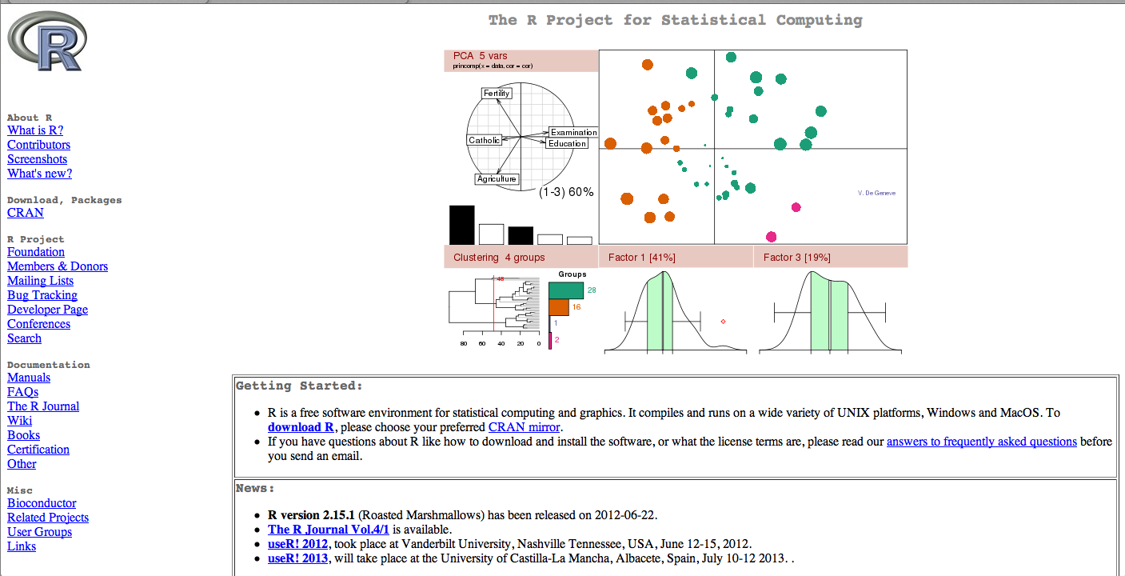
Getting Started
To install R on your MAC or PC you first need to go to http://www.r-project.org/.

Slide 11
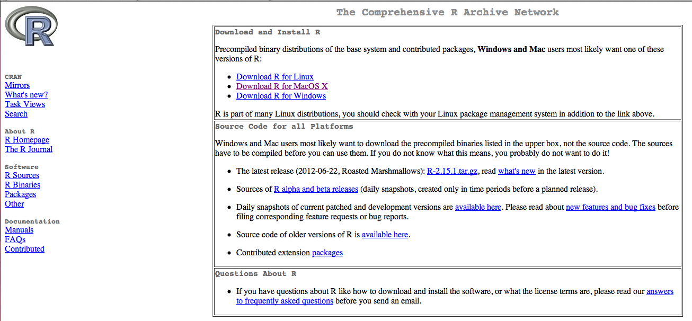
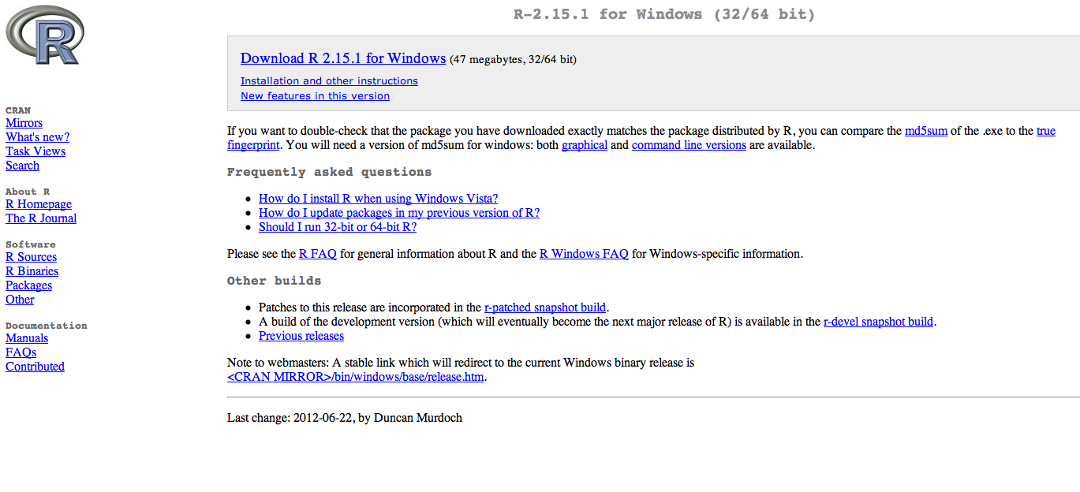
Notes:
Depending on if you are downloading for Windows or Mac click on your perspective thing…
Here we are going to go over windows so click on Download R for Windows
Then click download R

Slide 12
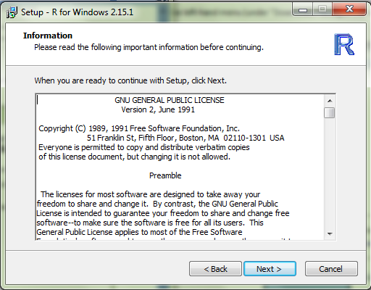
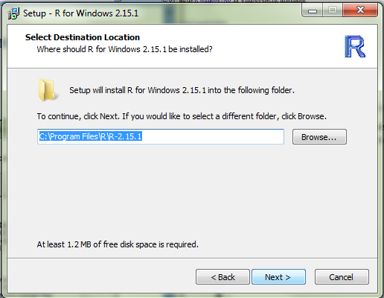
Notes:
This is the next screen that you will come to. Read the information and click next.
This is also where you need to set up you working directory…basically where you files are going to end up
Click where you want to put the file. This would be where if you wanted to put R on a flashdrive. Once you decide Click next.

Slide 13
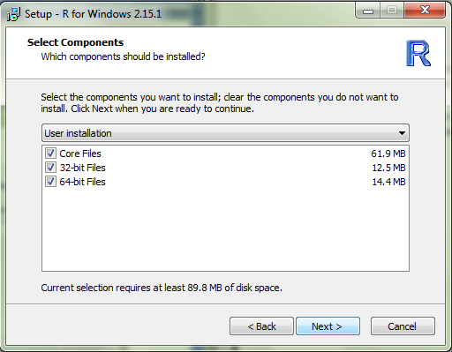
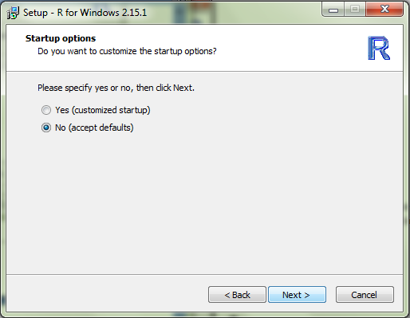
Notes:
Its always a good idea to download all the files.
MDI is when the windows will be contained within one large window. This is similar to how Excel is setup. SDI is a single document interface where every item will get its own window. This is similar to how SPSS is set up where it has separate data editor, viewer, and syntax windows. Once you choose which your prefer click next.

Slide 14
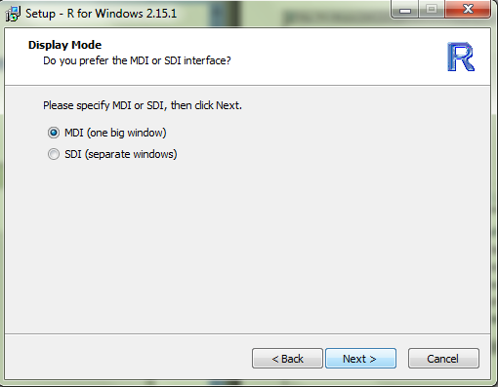
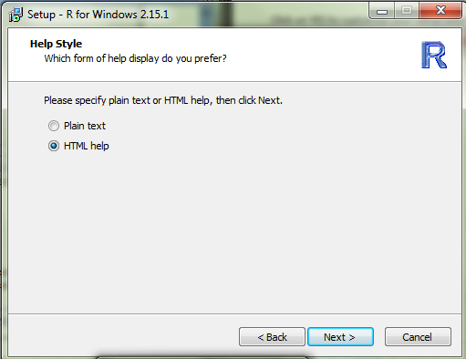

Slide 15
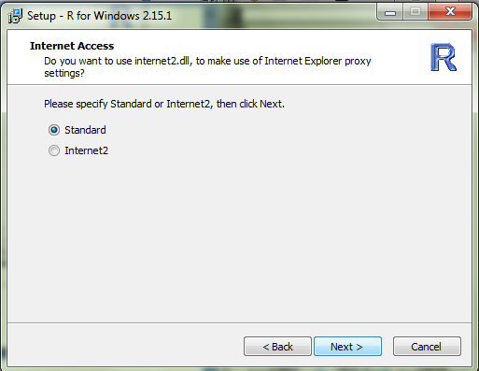
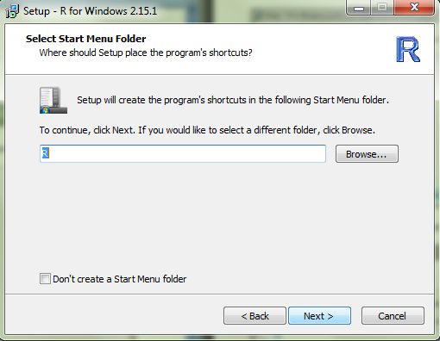
Notes:
Choose either html or plain text. Again, click next.
If you are installing R onto a flash drive click on Don’t create a start menu folder. Otherwise, you can leave it unchecked. Then click next.

Slide 16
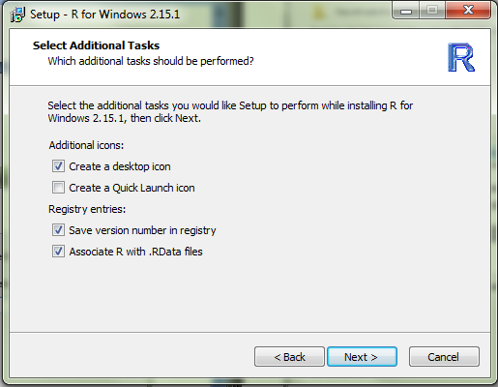
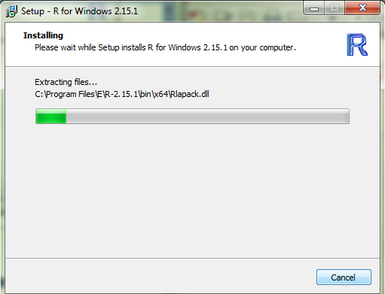
Notes:
Click next
The installation may take awhile

Slide 17
The R Studio User Interface

Slide 18
R Packages

Slide 19
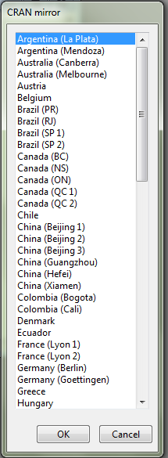
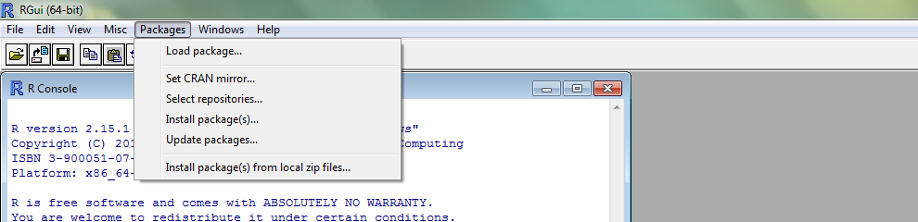
Installing Packages
Notes:
To install packages on Windows, click on packages and install packages.
Scroll down to USA and choose a “mirror” that is close to your physical location.

Slide 20
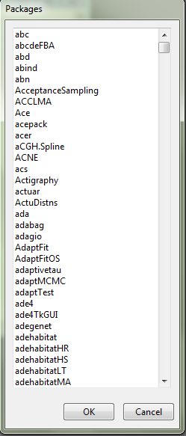
Notes:
Scroll down list until you find the package you are looking for. Keep in mind that R lists things in alphabetical order and by uppercase than lowercase. Once you click on a package to load, click ok. R will install not only the package but all of the packages needed to run your package.
To actually use the package, go back to the package tab and click on load package.

Slide 21
Arithmetic Operators
Operator | Description
+ | addition
- | subtraction
* | multiplication
/ | division
^ or ** | exponentiation
x %% y | modulus (x mod y) 5%%2 is 1
x %/% y | integer division 5%/%2 is 2

Slide 22
Logical Operators
Operator | Description
< | less than
<= | less than or equal to
> | greater than
>= | greater than or equal to
== | exactly equal to
!= | not equal to
!x | Not x
x | y | x OR y
x & y | x AND y
isTRUE(x) | test if x is TRUE

Slide 23
Built in Functions
R has many built in functions that compute different statistical procedures.
Functions in R are followed by ( ).
Inside the parenthesis we write the object (vector, array, matrix, dataframe) to which we want to apply the function.
Notes:
Talk about useful packages included in the CD.

Slide 24
Numeric Functions
Function | Description
abs(x) | absolute value
sqrt(x) | square root
ceiling(x) | ceiling(3.475) is 4
floor(x) | floor(3.475) is 3
trunc(x) | trunc(5.99) is 5
round(x, digits=n) | round(3.475, digits=2) is 3.48
signif(x, digits=n) | signif(3.475, digits=2) is 3.5
cos(x), sin(x), tan(x) | also acos(x), cosh(x), acosh(x), etc.
log(x) | natural logarithm
log10(x) | common logarithm
exp(x) | e^x

Slide 25
Character Functions
Function | Description
substr(x, start=n1, stop=n2) | Extract or replace substrings in a character vector. x <- "abcdef" substr(x, 2, 4) is "bcd" substr(x, 2, 4) <- "22222" is "a222ef"
grep(pattern, x , ignore.case=FALSE, fixed=FALSE) | Search for pattern in x. If fixed =FALSE then pattern is a regular expression. If fixed=TRUE then pattern is a text string. Returns matching indices. grep("A", c("b","A","c"), fixed=TRUE) returns 2
sub(pattern, replacement, x, ignore.case =FALSE, fixed=FALSE) | Find pattern in x and replace with replacement text. If fixed=FALSE then pattern is a regular expression. If fixed = T then pattern is a text string. sub("\\s",".","Hello There") returns "Hello.There"
strsplit(x, split) | Split the elements of character vector x at split. strsplit("abc", "") returns 3 element vector "a","b","c"
paste(..., sep="") | Concatenate strings after using sep string to seperate them. paste("x",1:3,sep="") returns c("x1","x2" "x3") paste("x",1:3,sep="M") returns c("xM1","xM2" "xM3") paste("Today is", date())
toupper(x) | Uppercase
tolower(x) | Lowercase

Slide 26
Statistics/Probability Functions
The following tables describe functions related to probability distributions. For random number generators below, you can use set.seed(1234) or some other integer to create reproducible pseudo-random numbers.

Slide 27
Function | Description
dnorm(x) | normal density function (by default m=0 sd=1) # plot standard normal curve x <- pretty(c(-3,3), 30) y <- dnorm(x) plot(x, y, type='l', xlab="Normal Deviate", ylab="Density", yaxs="i")
pnorm(q) | cumulative normal probability for q (area under the normal curve to the right of q) pnorm(1.96) is 0.975
qnorm(p) | normal quantile. value at the p percentile of normal distribution qnorm(.9) is 1.28 # 90th percentile
rnorm(n, m=0,sd=1) | n random normal deviates with mean m and standard deviation sd. #50 random normal variates with mean=50, sd=10 x <- rnorm(50, m=50, sd=10)
dbinom(x, size, prob) pbinom(q, size, prob) qbinom(p, size, prob) rbinom(n, size, prob) | binomial distribution where size is the sample size and prob is the probability of a heads (pi) # prob of 0 to 5 heads of fair coin out of 10 flips dbinom(0:5, 10, .5) # prob of 5 or less heads of fair coin out of 10 flips pbinom(5, 10, .5)
dpois(x, lamda) ppois(q, lamda) qpois(p, lamda) rpois(n, lamda) | poisson distribution with m=std=lamda #probability of 0,1, or 2 events with lamda=4 dpois(0:2, 4) # probability of at least 3 events with lamda=4 1- ppois(2,4)
dunif(x, min=0, max=1) punif(q, min=0, max=1) qunif(p, min=0, max=1) runif(n, min=0, max=1) | uniform distribution, follows the same pattern as the normal distribution above. #10 uniform random variates x <- runif(10)

Slide 28
Function | Description
mean(x, trim=0, na.rm=FALSE) | mean of object x # trimmed mean, removing any missing values and # 5 percent of highest and lowest scores mx <- mean(x,trim=.05,na.rm=TRUE)
sd(x) | standard deviation of object(x). also look at var(x) for variance and mad(x) for median absolute deviation.
median(x) | median
quantile(x, probs) | quantiles where x is the numeric vector whose quantiles are desired and probs is a numeric vector with probabilities in [0,1]. # 30th and 84th percentiles of x y <- quantile(x, c(.3,.84))
range(x) | range
sum(x) | sum
diff(x, lag=1) | lagged differences, with lag indicating which lag to use
min(x) | minimum
max(x) | maximum
scale(x, center=TRUE, scale=TRUE) | column center or standardize a matrix.

Slide 29
Other Functions
Function | Description
seq(from , to, by) | generate a sequence indices <- seq(1,10,2) #indices is c(1, 3, 5, 7, 9)
rep(x, ntimes) | repeat x n times y <- rep(1:3, 2) # y is c(1, 2, 3, 1, 2, 3)
cut(x, n) | divide continuous variable in factor with n levels y <- cut(x, 5)

Slide 30
R as a Calculator
> 1250 + 1000
[1] 2250
or various calculations in the same row
> 1+1; 4*5; 6-2
[1] 2
[1] 20
[1] 4
Notes:
To the minimum R can be used as a calculator.
The prompt sign means the active line where you are allowed to enter code.
The number in brackets is the result.
When you enter a line in R, you don’t need to end it with a period as opposed to other software such as the syntax in spss.

Slide 31
Numbers in R: NAN and NA
NAN (not a number)
NA (missing value)
Basic handling of missing values
> x
[1] 1 2 3 4 5 6 7 8 NA
> mean(x)
[1] NA
> mean(x,na.rm=TRUE)
[1] 4.5
Notes:
Missing values are noise to statistical estimations.
We are going to learn a basic command for handling missing values.

Slide 32
String Characters
In R, string variables are defined by double quotation marks.
> letters
"a" "b" "c"
Notes:
In this slide. Go to R code and practice creating objects and vectors.

Slide 33
Objects in R
Objects in R obtain values by assignment.
This is achieved by the gets arrow, <-, and not the equal sign, =.
Objects can be of different kinds.

Slide 34
Vectors
A vector is a sequence of data elements of the same basic type. Members in a vector are officially called components.
Here is a vector containing three numeric values 2, 3 and 5.
> c(2, 3, 5) [1] 2 3 5

Slide 35
Arrays
Arrays are numeric objects with dimension attributes.
The difference between a matrix and an array is that arrays have more than two dimensions.
The following example creates an array of two 3x3 matrices each with 3 rows and 3 columns.
# Create two vectors of different lengths.
> vector1 <- c(5,9,3)
> vector2 <- c(10,11,12,13,14,15)
# Take these vectors as input to the array.
> result <- array(c(vector1,vector2),dim = c(3,3,2))
result
, , 1
[,1] [,2] [,3]
[1,] 5 10 13
[2,] 9 11 14
[3,] 3 12 15
, , 2
[,1] [,2] [,3]
[1,] 5 10 13
[2,] 9 11 14
[3,] 3 12 15

Slide 36
Matrices
A matrix is a collection of data elements arranged in a two-dimensional rectangular layout.
The following is an example of a matrix with 2 rows and 3 columns.
> A = matrix( + c(2, 4, 3, 1, 5, 7), # the data elements + nrow=2, # number of rows + ncol=3, # number of columns + byrow = TRUE) # fill matrix by rows > A # print the matrix [,1] [,2] [,3] [1,] 2 4 3 [2,] 1 5 7

Slide 37
Subscripts
Select only one or some of the elements in a vector, a matrix or an array.
We can do this by using subscripts in square brackets [ ].
In matrices or dataframes the first subscript refers to the row and the second to the column.
R has several ways to subscript (that is, extract specific elements from a vector). The most common way is directly, using the square bracket operator:
> x[4]
[1] 4
In this example, the user has said "give me the fourth element," and R has said, "you get a vector whose first (and only) element is 4."
Here's a similar question: "what are the second and fifth elements of x?"
> x[c(2, 5)]
[1] 2 5
Here the c(), of course, constructs the vector (2,5) to be used as the index; then we extract the second and fifth entries of x.

Slide 38
Dataframe
A data frame is used for storing data tables. It is a list of vectors of equal length. For example, the following variable df is a data frame containing three vectors n, s, b.
> n = c(2, 3, 5) > s = c("aa", "bb", "cc") > b = c(TRUE, FALSE, TRUE) > df = data.frame(n, s, b) # df is a data frame
n s b
2 aa TRUE
3 bb FALSE
5 cc TRUE

Slide 39
Dataframe
A data frame is used for storing data tables. It is a list of vectors of equal length. For example, the following variable df is a data frame containing three vectors n, s, b.
> n = c(2, 3, 5) > s = c("aa", "bb", "cc") > b = c(TRUE, FALSE, TRUE) > df = data.frame(n, s, b) # df is a data frame
n s b
2 aa TRUE
3 bb FALSE
5 cc TRUE

Slide 40
Dataframe
Let’s create a sample data set, summarize the data and perform some basic manipulations.
#Create a vector
> d <- (1:20)
#Summarize the vector
> d2 <- summary(d)
#Calculate the mean and median and check if they are equal
> d3 <- mean(d)
> d4 <- median(d)
> d5 <- d3==d4
#Transform to a data frame
> d6 <- as.data.frame(d)
#Add a calculated column
> d6$New <- d6$d/2
#Rename the columns
> names(d6)[names(d6)=="d"] <- "Column1"
> names(d6)[names(d6)=="New"] <- "Column2"

Slide 41
Tips
R is case-sensitive
Comment your code so you remember what it does; comments are preceded with #
R scripts are simply text files with a .R extension
Use Ctrl + R to submit code
Use the Tab key to let R/R Studio finish typing commands for you
Use Shift + down arrow to highlight lines or blocks of code
In R Studio: Ctrl + 1 and Ctrl + 2 switches between script and console
Use up and down arrows to cycle through previous commands in console
Don’t be afraid of errors; you won’t break R
If you get stuck, Google is your friend
Notes:
• Slide title should be Garamond or Times New Roman
• Subhead should be Helvetica or Trade Gothic.
• Text can be in Garamond, Times New Roman, Helvetica or Trade Gothic as you wish
• Captions, if used, should be in Trade Gothic or Helvetica
• Size of headings/subheads/text/captions should be consistent from one slide to the next
• Use bold or change case and formatting as appropriate
• Move text blocks around to accommodate images as appropriate
• Use Library Orange (RGB: 252/175/23) as an accent color if you wish

Slide 42
Review
Create a vector of 0.295,0.300,0.250,0.287,0.215
Calculate the mean of the above vector
Write a function to show if the above mean is greater than 0.3
Transform the vector created in Q1 as a data frame.
Add a column to the dataframe in Q4, titled “PlusOne”, adding 1 to the q1 column.
Notes:
• Slide title should be Garamond or Times New Roman
• Subhead should be Helvetica or Trade Gothic.
• Text can be in Garamond, Times New Roman, Helvetica or Trade Gothic as you wish
• Captions, if used, should be in Trade Gothic or Helvetica
• Size of headings/subheads/text/captions should be consistent from one slide to the next
• Use bold or change case and formatting as appropriate
• Move text blocks around to accommodate images as appropriate
• Use Library Orange (RGB: 252/175/23) as an accent color if you wish

Slide 43
Getting and Cleaning Data (data collection and preparation, Web scraping, Outlier detection, handling missing data)

Slide 44
Useful Functions
Functions you will find useful when retrieving and cleaning data.
length(object) # number of elements or components
str(object) # structure of an object
class(object) # class or type of an object
names(object) # names
c(object,object,...) # combine objects into a vector
cbind(object, object, ...) # combine objects as columns
rbind(object, object, ...) # combine objects as rows
ls() # list current objects
rm(object) # delete an object
newobject <- edit(object) # edit copy and save a
newobject
fix(object) # edit in place

Slide 45
Importing Data
Importing data into R is fairly simple.
For Stata and Systat, use the foreign package.
For SPSS and SAS the Hmisc package is recommended for ease and functionality.
Example of importing data follows.
> mydata = read.csv("mydata.csv") # read csv file
> mydata = read.table("mydata.txt")
> library(openxlsx)
> mydata <- read.xlsx("mydata.xlsx ", sheet = ‘sheet1', startRow = 1, colNames = TRUE, skipEmptyRows = TRUE)

Slide 46
From a comma delimited text file
# first row contains variable names, comma is separator
# assign the variable id to row names
# note the / instead of \ on mswindows systems mydata <- read.table("c:/mydata.csv", header=TRUE, sep=",", row.names="id")

Slide 47
From Excel
The best way to read an Excel file is to export it to a comma delimited file and import it using the method above.
On windows systems you can also use the RODBC package to access Excel files. The first row should contain variable/column names.
# first row contains variable names
# we will read in workSheet mysheet
library(RODBC) channel <- odbcConnectExcel("c:/myexel.xls") mydata <- sqlFetch(channel, "mysheet") odbcClose(channel)

Slide 48
Keyboard Input
Usually you will obtain a dataframe by importing it from SAS, SPSS, Excel, Stata, a database, or an ASCII file. To create it interactively, you can do something like the following.
# create a dataframe from scratch > age <- c(25, 30, 56) > gender <- c("male", "female", "male") > weight <- c(160, 110, 220) > mydata <- data.frame(age,gender,weight)

Slide 49
Keyboard Input
You can also use R's built in spreadsheet to enter the data interactively, as in the following example.
# enter data using editor
> mydata <- data.frame(age=numeric(0), gender=character(0), weight=numeric(0)) > mydata <- edit(mydata)
# note that without the assignment in the line above,
# the edits are not saved!

Slide 50
Exporting Data
There are numerous methods for exporting R objects into other formats .
For SPSS, SAS and Stata. you will need to load the foreign packages. For Excel, you will need the xlsReadWrite, Openxlsx, or RODBC package.

Slide 51
Exporting Data
To A Tab Delimited Text File
> write.table(mydata, "c:/mydata.txt", sep="\t")
To an Excel Spreadsheet
> library(xlsReadWrite) > write.xls(mydata, "c:/mydata.xls")
To SAS
> library(foreign) > write.foreign(mydata, "c:/mydata.txt", "c:/mydata.sas", package="SAS")

Slide 52
Viewing Data
There are a number of functions for listing the contents of an object or dataset.
# list objects in the working environment ls()
# list the variables in mydata names(mydata)
# list the structure of mydata str(mydata)
# list levels of factor v1 in mydata levels(mydata$v1)
# dimensions of an object dim(object)

Slide 53
Viewing Data
There are a number of functions for listing the contents of an object or dataset.
# class of an object (numeric, matrix, dataframe, etc) class(object)
# print mydata mydata
# print first 10 rows of mydata head(mydata, n=10)
# print last 5 rows of mydata tail(mydata, n=5)

Slide 54
Variable Labels
R's ability to handle variable labels is somewhat unsatisfying.
If you use the Hmisc package, you can take advantage of some labeling features.
library(Hmisc) label(mydata$myvar) <- "Variable label for variable myvar" describe(mydata)

Slide 55
Variable Labels
Unfortunately the label is only in effect for functions provided by the Hmisc package, such as describe().
Your other option is to use the variable label as the variable name and then refer to the variable by position index.
names(mydata)[3] <- "This is the label for variable 3" mydata[3] # list the variable

Slide 56
Value Labels
To understand value labels in R, you need to understand the data structure factor.
You can use the factor function to create your own value labels.
# variable v1 is coded 1, 2 or 3
# we want to attach value labels 1=red, 2=blue,3=green mydata$v1 <- factor(mydata$v1, levels = c(1,2,3), labels = c("red", "blue", "green"))
# variable y is coded 1, 3 or 5
# we want to attach value labels 1=Low, 3=Medium, 5=High

Slide 57
Value Labels
mydata$v1 <- ordered(mydata$y, levels = c(1,3, 5), labels = c("Low", "Medium", "High"))
Use the factor() function for nominal data and the ordered() function for ordinal data. R statistical and graphic functions will then treat the data appropriately.
Note: factor and ordered are used the same way, with the same arguments. The former creates factors and the later creates ordered factors.

Slide 58
Missing Data
In R, missing values are represented by the symbol NA (not available) . Impossible values (e.g., dividing by zero) are represented by the symbol NaN (not a number).
Unlike SAS, R uses the same symbol for character and numeric data.
Testing for Missing Values
> is.na(x) # returns TRUE of x is missing
> y <- c(1,2,3,NA)
> is.na(y) # returns a vector (F F F T)

Slide 59
Missing Data
Recoding Values to Missing
# recode 99 to missing for variable v1
# select rows where v1 is 99 and recode column v1
> mydata[mydata$v1==99,"v1"] <- NA
Excluding Missing Values from Analyses
Arithmetic functions on missing values yield missing values.
> x <- c(1,2,NA,3)
> mean(x) # returns NA
> mean(x, na.rm=TRUE) # returns 2

Slide 60
Missing Data
The function complete.cases() returns a logical vector indicating which cases are complete.
# list rows of data that have missing values > mydata[!complete.cases(mydata),]
The function na.omit() returns the object with listwise deletion of missing values.
# create new dataset without missing data > newdata <- na.omit(mydata)

Slide 61
Missing Data
Advanced Handling of Missing Data
Most modeling functions in R offer options for dealing with missing values. You can go beyond pairwise of listwise deletion of missing values through methods such as multiple imputation. Good implementations that can be accessed through R include Amelia II, Mice, and mitools.

Slide 62
Date Values
Dates are represented as the number of days since 1970-01-01, with negative values for earlier dates.
# use as.Date( ) to convert strings to dates
mydates <- as.Date(c("2007-06-22", "2004-02-13"))
# number of days between 6/22/07 and 2/13/04 days <- mydates[1] - mydates[2]
Sys.Date( ) returns today's date.
Date() returns the current date and time.

Slide 63
Date Values
The following symbols can be used with the format( ) function to print dates.
Symbol | Meaning | Example
%d | day as a number (0-31) | 01-31
%a %A | abbreviated weekday unabbreviated weekday | Mon Monday
%m | month (00-12) | 00-12
%b %B | abbreviated month unabbreviated month | Jan January
%y %Y | 2-digit year 4-digit year | 07 2007

Slide 64
Date Values
# print today's date
today <- Sys.Date()
format(today, format="%B %d %Y") "June 20 2007"

Slide 65
Data Manipulation

Slide 66
Data Manipulation
Once you have access to your data, you will want to massage it into useful form. This includes creating new variables (including recoding and renaming existing variables), sorting and merging datasets, aggregating data, reshaping data, and subsetting datasets (including selecting observations that meet criteria, randomly sampling observation, and dropping or keeping variables).
Each of these activities usually involve the use of R's built-in operators (arithmetic and logical) and functions (numeric, character, and statistical). Additionally, you may need to use control structures (if-then, for, while, switch) in your programs and/or create your own functions. Finally you may need to convert variables or datasets from one type to another (e.g. numeric to character or matrix to dataframe).

Slide 67
Creating new variables
Use the assignment operator <- to create new variables. A wide array of operators and functions are available here.
# Three examples for doing the same computations > mydata$sum <- mydata$x1 + mydata$x2 > mydata$mean <- (mydata$x1 + mydata$x2)/2 > attach(mydata) > mydata$sum <- x1 + x2 > mydata$mean <- (x1 + x2)/2 > detach(mydata)
> mydata <- transform( mydata, sum = x1 + x2, mean = (x1 + x2)/2 )

Slide 68
Recoding variables
In order to recode data, you will probably use one or more of R's control structures.
# create 2 age categories > mydata$agecat <- ifelse(mydata$age > 70, c("older"), c("younger")) # another example: create 3 age categories > attach(mydata) > mydata$agecat[age > 75] <- "Elder" > mydata$agecat[age > 45 & age <= 75] <- "Middle Aged" > mydata$agecat[age <= 45] <- "Young" > detach(mydata)

Slide 69
Recoding Variables
In order to recode data, you will probably use one or more of R's control structures.
# create 2 age categories > mydata$agecat <- ifelse(mydata$age > 70, c("older"), c("younger")) # another example: create 3 age categories
> attach(mydata) > mydata$agecat[age > 75] <- "Elder" > mydata$agecat[age > 45 & age <= 75] <- "Middle Aged" > mydata$agecat[age <= 45] <- "Young" > detach(mydata)

Slide 70
Renaming Variables
You can rename variables programmatically or interactively.
# rename interactively > fix(mydata) # results are saved on close # rename programmatically > library(reshape) > mydata <- rename(mydata, c(oldname="newname")) # you can re-enter all the variable names in order # changing the ones you need to change.the limitation # is that you need to enter all of them! > names(mydata) <- c("x1","age","y", "ses")

Slide 71
Sorting
To sort a dataframe in R, use the order( ) function. By default, sorting is ASCENDING. Prepend the sorting variable by a minus sign to indicate DESCENDING order. Here are some examples.
# sorting examples using the mtcars dataset > data(mtcars) # sort by mpg > newdata = mtcars[order(mtcars$mpg),] # sort by mpg and cyl > newdata <- mtcars[order(mtcars$mpg, mtcars$cyl),] #sort by mpg (ascending) and cyl (descending) > newdata <- mtcars[order(mtcars$mpg, -mtcars$cyl),]

Slide 72
Merging
To merge two dataframes (datasets) horizontally, use the merge function. In most cases, you join two dataframes by one or more common key variables (i.e., an inner join).
# merge two dataframes by ID > total <- merge(dataframeA,dataframeB,by="ID")
# merge two dataframes by ID and Country > total <- merge(dataframeA,dataframeB,by=c("ID","Country"))

Slide 73
Merging
ADDING ROWS
To join two dataframes (datasets) vertically, use the rbind function. The two dataframes must have the same variables, but they do not have to be in the same order.
> total <- rbind(dataframeA, dataframeB)
If dataframeA has variables that dataframeB does not, then either:
Delete the extra variables in dataframeA or
Create the additional variables in dataframeB and set them to NA (missing)
before joining them with rbind.

Slide 74
Aggregating
It is relatively easy to collapse data in R using one or more BY variables and a defined function.
# aggregate dataframe mtcars by cyl and vs, returning means # for numeric variables > attach(mtcars) > aggdata <-aggregate(mtcars, by=list(cyl), FUN=mean, na.rm=TRUE) > print(aggdata)
OR use apply

Slide 75
Aggregating
When using the aggregate() function, the by variables must be in a list (even if there is only one). The function can be built-in or user provided.
See also:
summarize() in the Hmisc package
summaryBy() in the doBy package

Slide 76
Aggregating
Type conversions in R work as you would expect. For example, adding a character string to a numeric vector converts all the elements in the vector to character.
Use is.foo to test for data type foo. Returns TRUE or FALSE Use as.foo to explicitly convert it.
is.numeric(), is.character(), is.vector(), is.matrix(), is.data.frame() as.numeric(), as.character(), as.vector(), as.matrix(), as.data.frame)

Slide 77
Example
Read 2 files from Github
#Import Data
> urlfile <-'https://raw.github.com/jmonroe252/R_Workshop/master/regions.csv'
> region <-read.csv(urlfile)
> urlfile <-'https://raw.github.com/jmonroe252/R_Workshop/master/trade.csv'
> trade <-read.csv(urlfile)

Slide 78
Example
Rename columns, merge the datasets and drop unused columns
#Rename Partner.Country in Trade dataset
> names(trade)[names(trade)=="Partner.Country"] <- "Country"
#Merge
> trade1 <- (merge(region, trade, by = 'Country'))
#Drop unused columns and rename for next merge
> colnames(trade1)
> trade1 <- trade1[c(1,2,6:58)]

Slide 79
Example
Formatting:
#Aggregate the data, adding a year column
library(reshape)
trade1[] <- lapply(trade1, as.character)
trade2 <- melt(trade1, id=c("Reporting_Country","Reporting_Region", "Partner_Country", "Partner_Region", "Segment"))
names(trade2)[names(trade2)=="variable"] <- "Year"
#Convert Year to numeric
trade2$Year <- gsub("X", "", paste(trade2$Year))
trade2$Year <- as.numeric(trade2$Year)
trade2$value <- as.numeric(trade2$value)

Slide 80
Example
Aggregation:
#Sum by Reporting, Partner Region and Year
> trade3 <-aggregate(trade2$value, by=list(trade2$Reporting_Region,
trade2$Partner_Region, trade2$Year),
FUN=sum, na.rm=TRUE)
#But the column names are messed up
> trade3 <- aggregate(trade2["value"], by=trade2[c("Reporting_Region","Partner_Region")], FUN=sum)

Slide 81
Review
Create a dataframe with 3 columns, Type1:Type3
Type1 includes numeric values 5,10,15
Type2 includes factors good, bad, good
Type 3 includes numeric values 100, 150, 200
#Create 2 categories in a new column named Type4
where type 3 sub1 < 150 and sub2 => 150
Retrieve the Region and Trade files from Github
Merge the Region and Trade files by Partner Country field
Melt the data so the only columns remaining are Country, Segment, Year and value.
Aggregate value by Country, Segment and Year
Notes:
• Slide title should be Garamond or Times New Roman
• Subhead should be Helvetica or Trade Gothic.
• Text can be in Garamond, Times New Roman, Helvetica or Trade Gothic as you wish
• Captions, if used, should be in Trade Gothic or Helvetica
• Size of headings/subheads/text/captions should be consistent from one slide to the next
• Use bold or change case and formatting as appropriate
• Move text blocks around to accommodate images as appropriate
• Use Library Orange (RGB: 252/175/23) as an accent color if you wish

