Slide 1
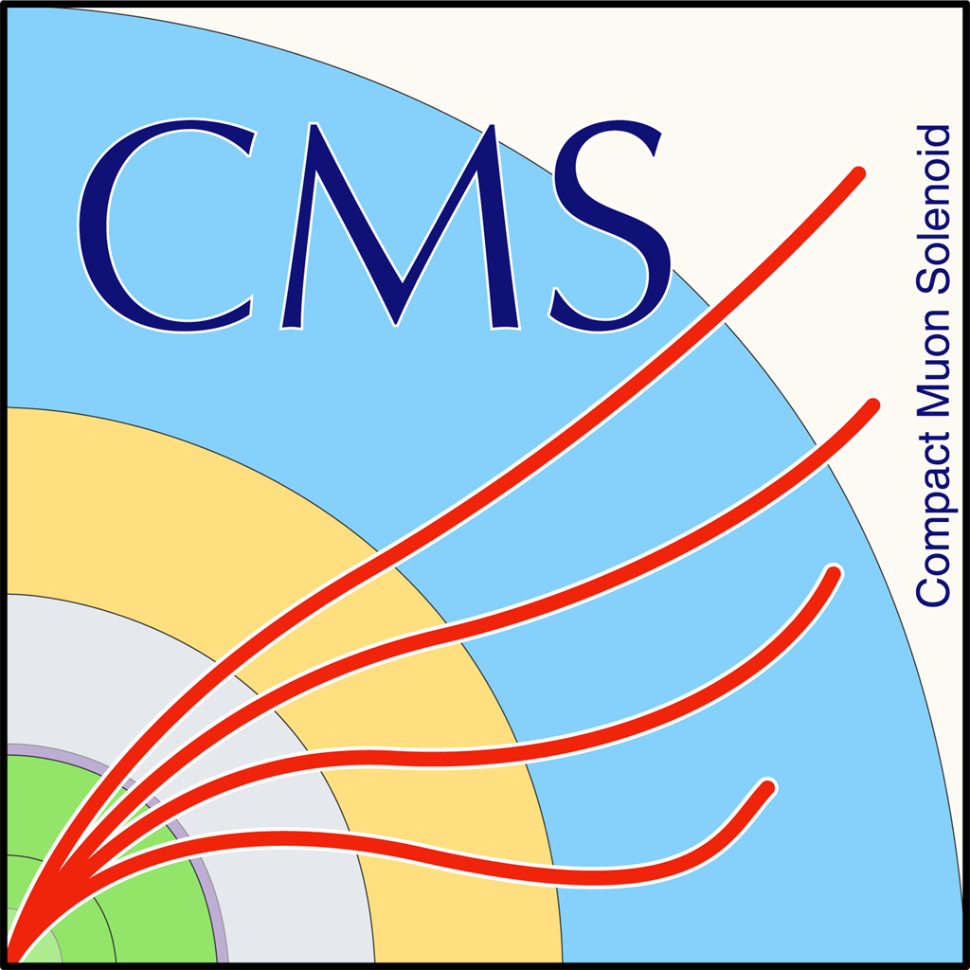


Progress on Thermal Studies of Mockup Modules
Arthur Campello, Neil Minet, Jose Monroy, Yadira Bordlemay Padilla (Cornell University: Testing)
Matthew Jones, Andy Jung, Souvik Das (Purdue University: Mockup production)
March 14, 2019

Slide 2
Aim and Scope of Studies
Build and validate experimental procedure for thermal testing of mockup modules (with and without CO₂ cooling)
Determining the relationship between supplied power, minimum, maximum and average temperatures
Comparing the effects of cooling materials and structural application to regulate heat on a module
March 14, 2019 A. Campello 1

Slide 3
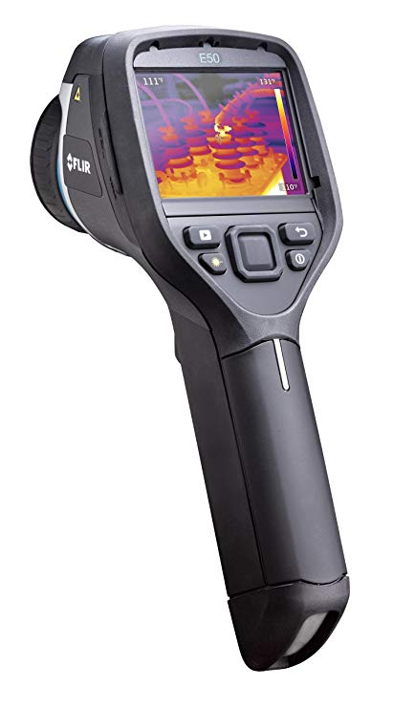
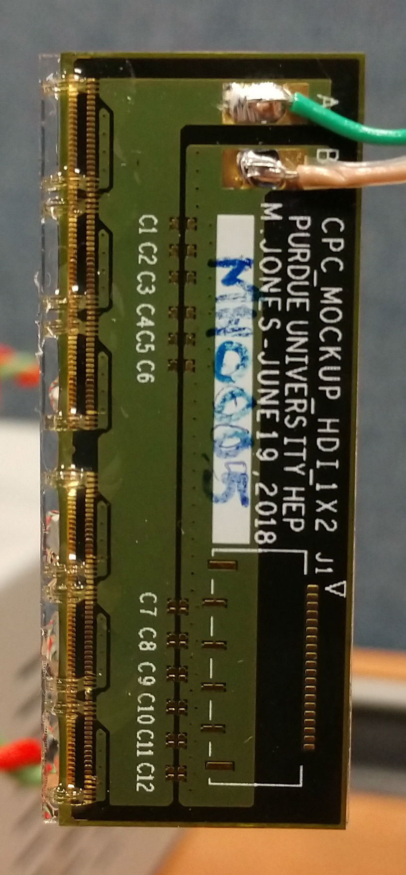
Materials and Methods
Mockup-modules were made by Purdue (Mathew Jones), wire bonds sealed at Cornell
Thermal measurements performed using FLIR E50 infrared camera (0.1C precision and +/- 0.13C measured accuracy, last calibrate 2014)
Thermal analysis performed using FLIR Tools® software
Power supplied to modules using KEYSIGHT U8001 single output DC power supply
March 14, 2019 A. Campello 2

Slide 4
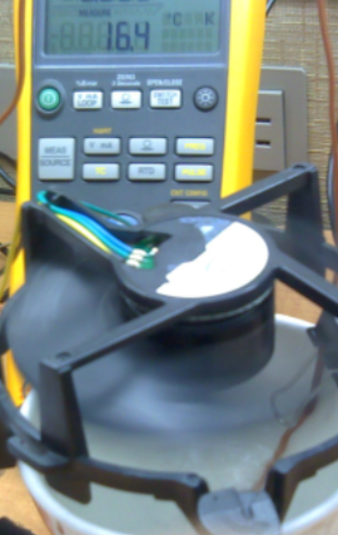
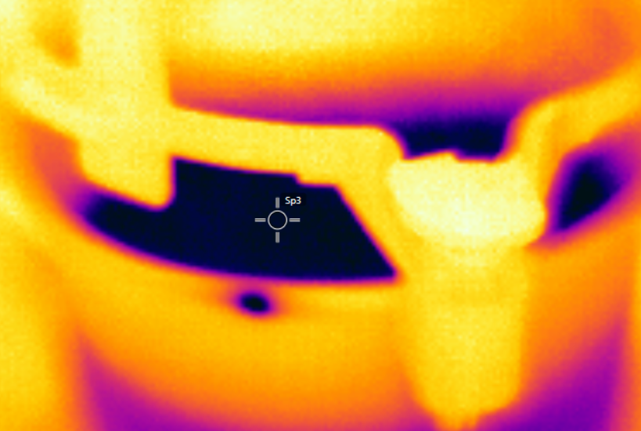
Verification of Camera Accuracy
Fan
Camera readings verified against thermocouple reading of water in thermal equilibrium
Performed for eight measurements between 0ºC and 25ºC
Difference between TC and camera:
Mean: -0.04ºC, STD: 0.08ºC
Camera was calibrated in 2012 and 2014, FLIR claims +/-2ºC accuracy after five years
Cup
Stir
rod
TC
16.4
March 14, 2019 A. Campello 3

Slide 5
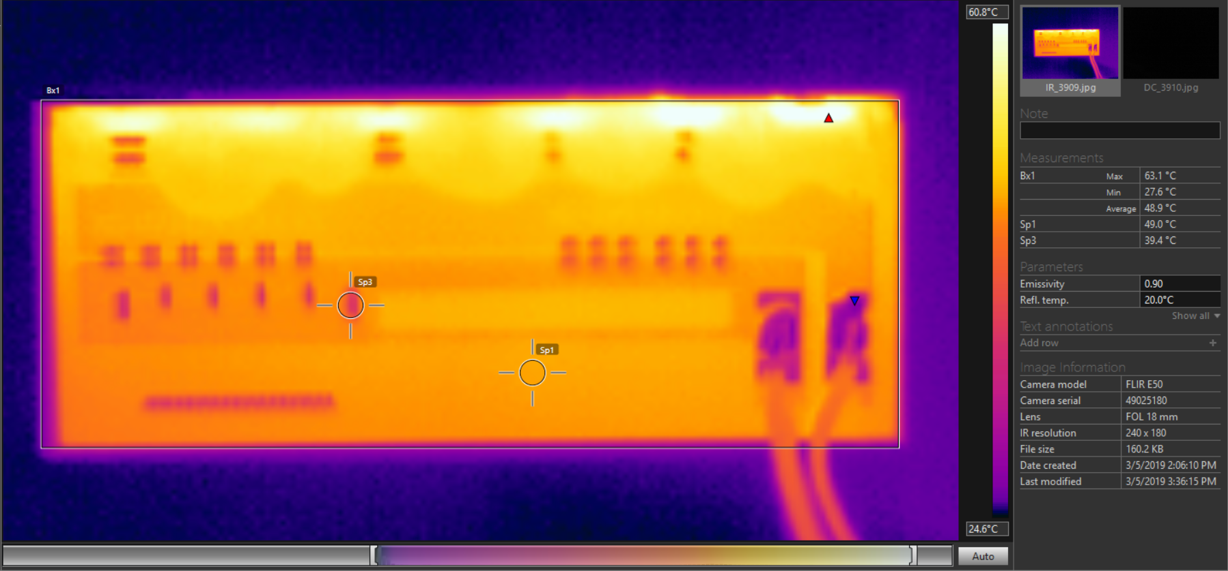
Thermal Analysis Software
Thermal analysis software reports
Maximum, minimum, and average Temp and temps. At any point of the 240x180 size infrared image
March 14, 2019 A. Campello 4

Slide 6
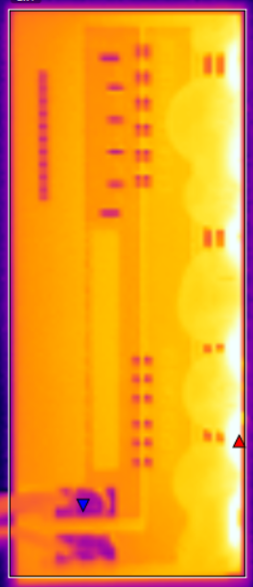
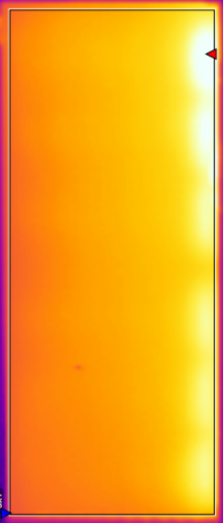
IR Maps of Front and Back of Module Suspended in Air
Front
Back
Both images taken at 2.5W for 40 minutes from 4 inches using IR camera
Modules positioned vertically
Temperature comparisons:
 | Front | Back
Minimum | 26.1ºC | 46.1ºC
Maximum | 64.0ºC | 67.3ºC
Average | 48.5ºC | 53.7ºC
March 14, 2019 A. Campello 5

Slide 7
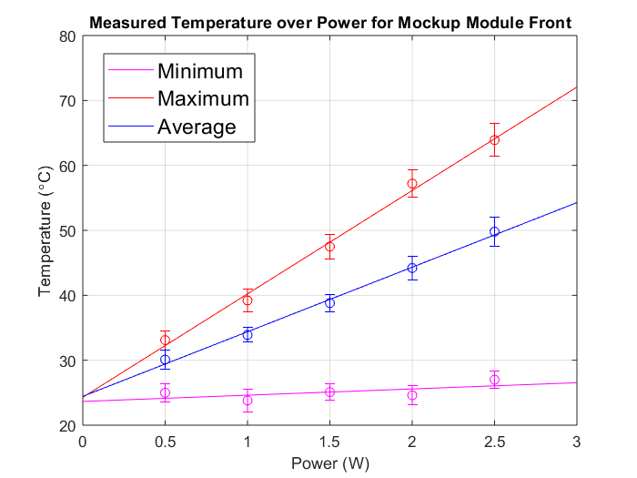
Temperature over Power of Module Front Suspended in Air
Min, max, and avg T of the front of one module, recorded three times for 0.5, 1, 1.5, 2, and 2.5 watts
Error bars show 95% confidence intervals
ΔT/ΔW Slopes (Y=mx+b) allow for temperature extrapolation
Min: 0.96
Max: 15.92
Avg: 9.94
March 14, 2019 A. Campello 6

Slide 8
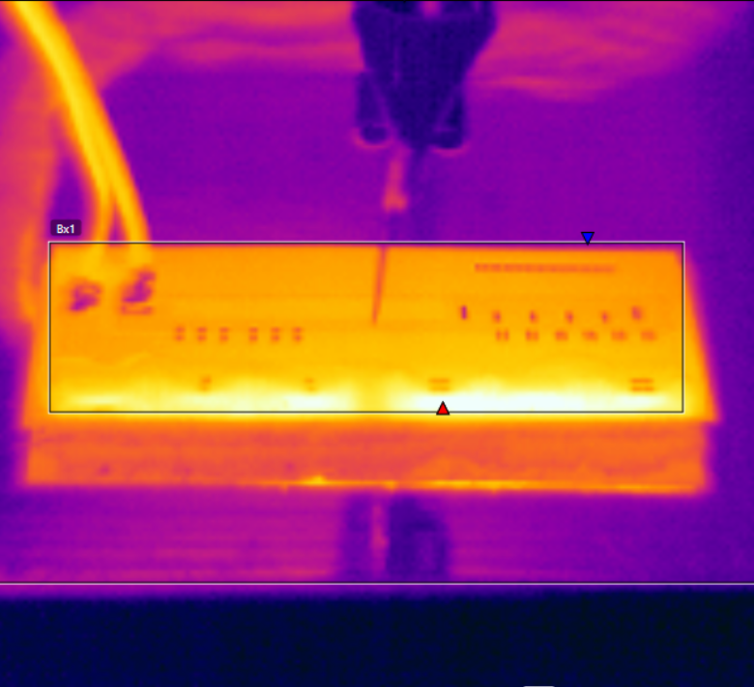
Heat Dissipation Study Approaches
Developing a mechanism to secure a module (and a backing) to a heat sink (aluminum block)
IR analysis can measure steady-state T in different heat dissipation configs
Temperature to be measured with RTD array to provide quantifiable results
Will compare with simulations
March 14, 2019 A. Campello 7

Slide 9
Future Steps
Further thermal measurements of module in air to yield a complete thermal profile
Development of a thermal simulation for the mockup modules
Development of a heat dissipation test-bed to cool module using CO₂
Measurements of heat dissipation through various backing materials
March 14, 2019 A. Campello 8

