Slide 1
Thermal Runaway & TFPX
Jim Alexander
weekly TFPX Mechanics mtg
16 April 2019

Slide 2
Part I:
Dark Currents in depleted silicon devices

Slide 3
Temp dependence of dark current
We don’t know the constant, but can “calibrate”:
→
→ Heat generated in silicon grows exponentially with temp

Slide 4
Temp dependence (cont’d)
Clarify “Heat generated in silicon grows exponentially with temp”
T_{A} ≃ E_{g}/2k_{B}
where E_{g} ≃ silicon band gap = 1.12 eV (but increases with damage)
k_{B} = Boltzman’s const
So T_{A} ≃ 7000K >> T, T_{ref} → approximations are handy
I use Eg=1.2 eV throughout
some algebra…
→
T_{1/2} ≃ 6.5 ºC doubling temp
depends on E_{g}, T_{ref}!!
handy for mental calculations but I use the real formula throughout this doc

Slide 5
Radiation Damage
Expected Fluence for TFPX
based on FLUKA studies, innermost edge of our ring-1 sensors will see about 2x10¹⁶ neq/cm² by end of HL-LHC.
Allowing for uncertainties in FLUKA (30% according to the TDR) and uncertainty in ultimate integrated luminosity (maybe 4000/fb in some plans/dreams) we need to plan for about 3x10¹⁶. [These numbers need to be firmed up.]
Silicon detector dark current grows linearly with fluence
heavy particle (n,p) collisions with Si nuclei damage the crystal lattice, creating new quantum levels between valence and conduction band
Michael Moll’s PhD thesis is the bible of this field

Slide 6

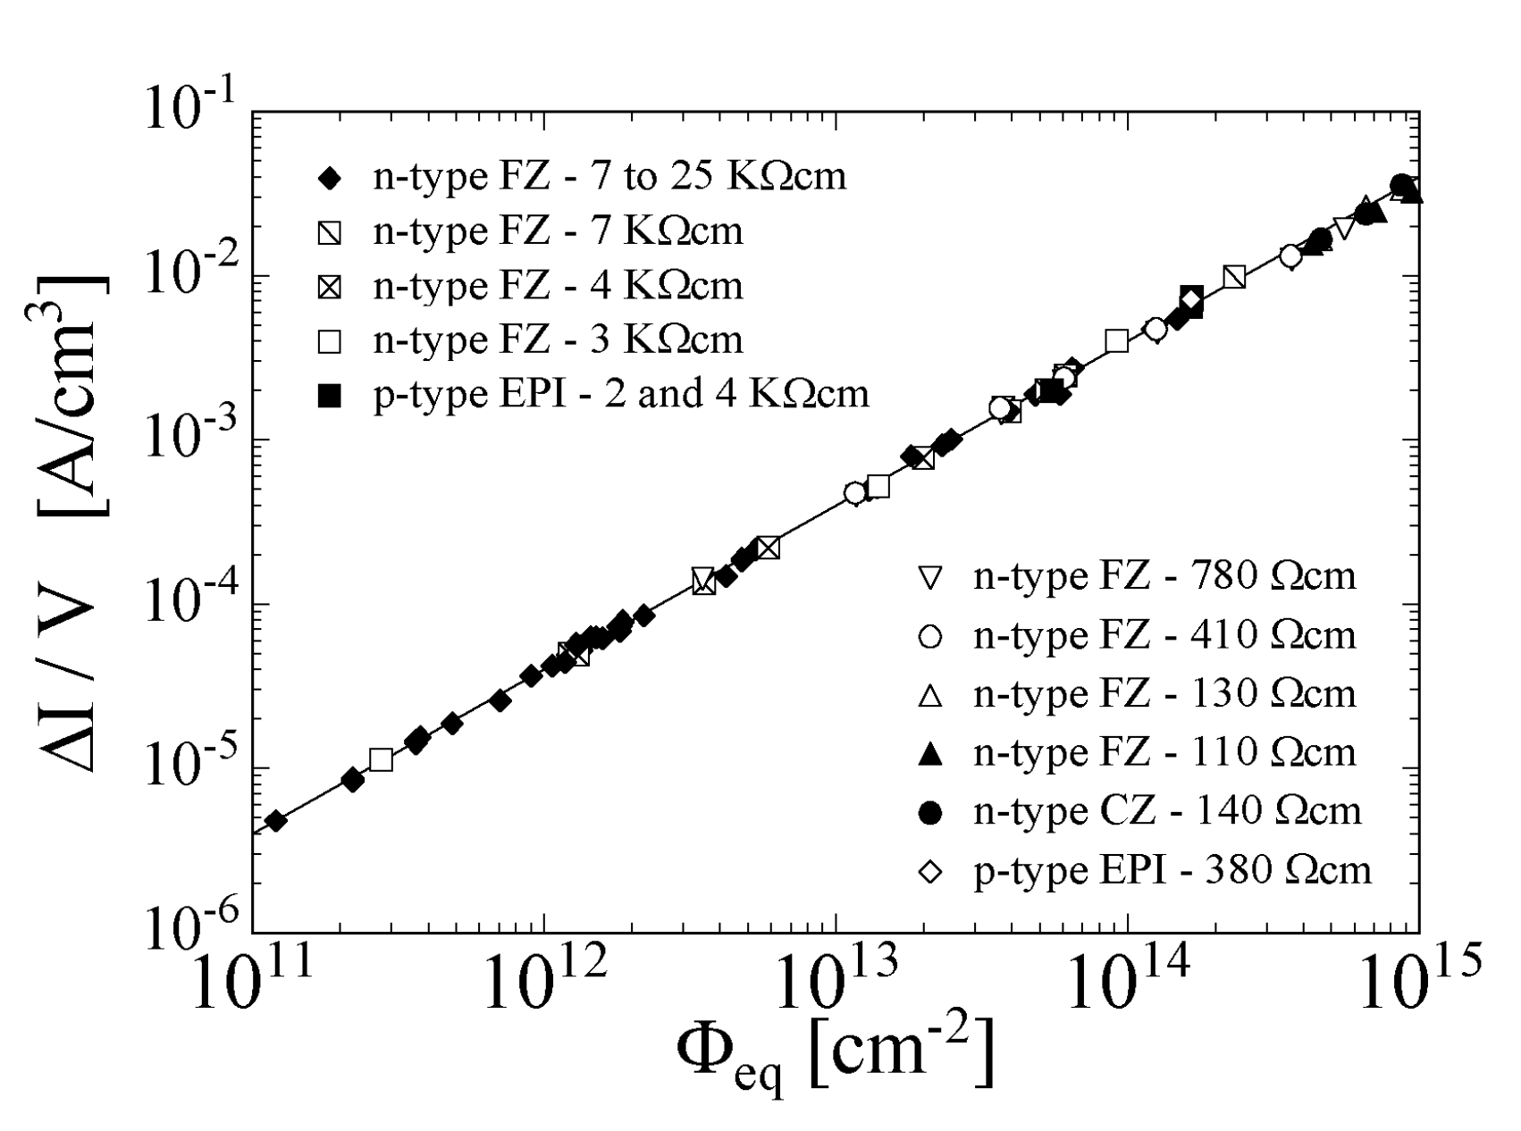
Dark Current density vs Fluence
data are scaled to currents at +20 ºC
1.3A/cm³
Note: ATLAS data need clarification)
ATLAS pixel
CMS Phase 1 BPIX
B-layer
Layer 1
Layer-1
Layer-2
Layer 2
Layer 3
Layer 4
slope=4.28x10⁻¹⁷ A/cm
uncertainty in sensor temp
included in size of red dot
Michael Moll
PhD thesis
current at 20 degC
3E16
CMS BPIX source: Finn Feindt, indico=769192, Feb 2019
ATLAS Source: S. Seidel, indico=777112, Feb 2019

Slide 7
Consequences: I x V = power
1.3A/cm³ @20C translates to 1.6mA in a 1x2 module operating at -20C.
At the anticipated 800V operating bias, the sensors in a 1x2 module will generate 1.3 W.
sensor volume
Fluence
Summary: For 1x2 sensor @…
Fluence = 3e16
Sensor temp = -20C
Depletion depth = 100um
Vbias = 800
heat output = Q = 1.3W

Slide 8
Exponential Heat Load (Q vs T)
8 W
Q
T
direction of radiation damage
4 W
2 w
T_{ref} = 0 ºC
Q_{ref} = 2,4,8 W

Slide 9
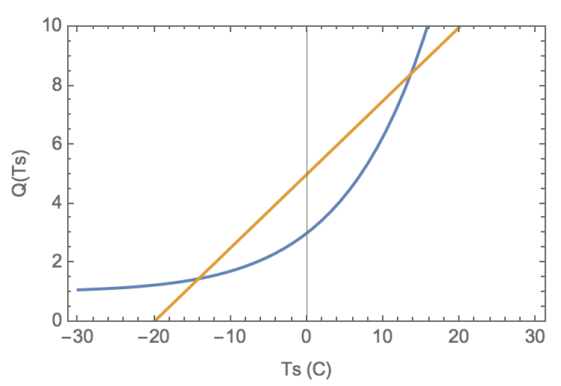
Cooling is a linear process
better cooling
(lower R)
worse cooling (higher R)
Q
T
R_{th}
T₀
Stable Operating Point
T₀=-20C

Slide 10
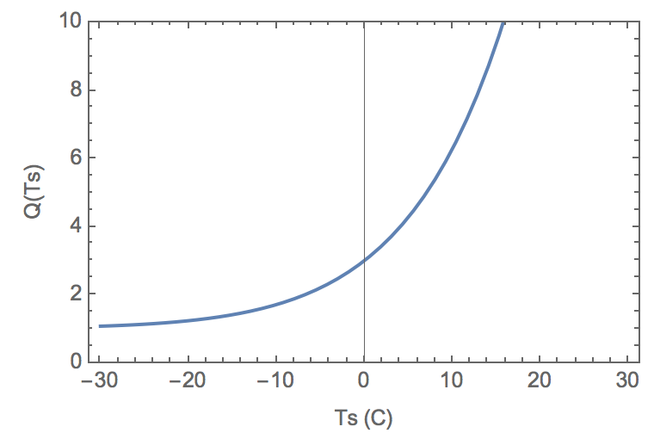
Cooling a nonlinear system…
For a given heat load Q, there is a minimum thermal resistance R needed to maintain a stable temp.
Unstable Equilib
No equilibrium at all—
total runaway…
disaster.
In both cases, R_{th} is too high:
bad design / bad implementation
Note: T₀ is same in both cases: this will be our situation since T₀=-33C is fixed already by cooling experts.

Slide 11
Part II:
Runaway calcs & estimates in T(B/F)PX

Slide 12
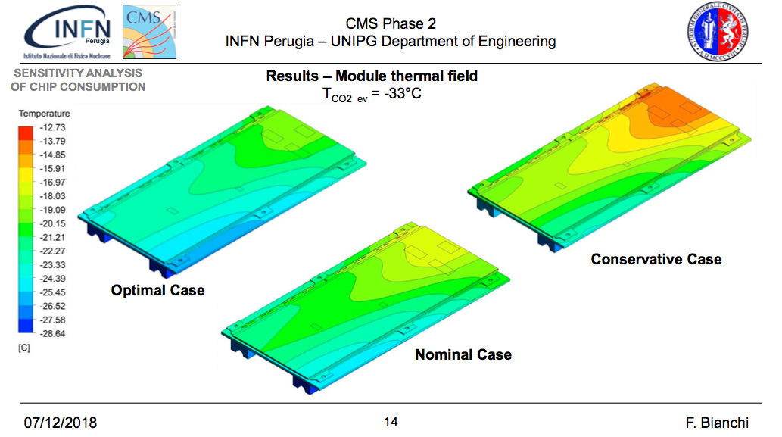
Some numbers from TBPX
Use Perugia thermal studies to estimate their total R from heat source (ROC) to sink (CO2), indico 770283
Q=2x2.06+0.6W
Q=2.91W
ΔT ≃ |33-20|=13ºC
ΔT ≃ |33-16|=17ºC
→ R ≃ 13/2.06=2.8ºC/W
Q=2.43W
→ R ≃ 17/2.91=2.7ºC/W
ΔT ≃ |33-18|=15ºC
Conclusion: R_{eff} ~ 3 ºC/W
→ R ≃ 15/2.43=2.8ºC/W

Slide 13
More on TBPX numbers…
Replace ANSYS with a simple model that focusses on key design parameters
Sensor
Q(T)
2.43W nom.
2.43W nom.
ROC
ROC
0.57W nom.
sensor temp
T
HDI
R ~ 0
R ~ 0
R_{eff} ~ 3 C/W
inferred effective thermal resistance, R_{eff}
CO₂ Temp == -33 ºC
T₀

Slide 14
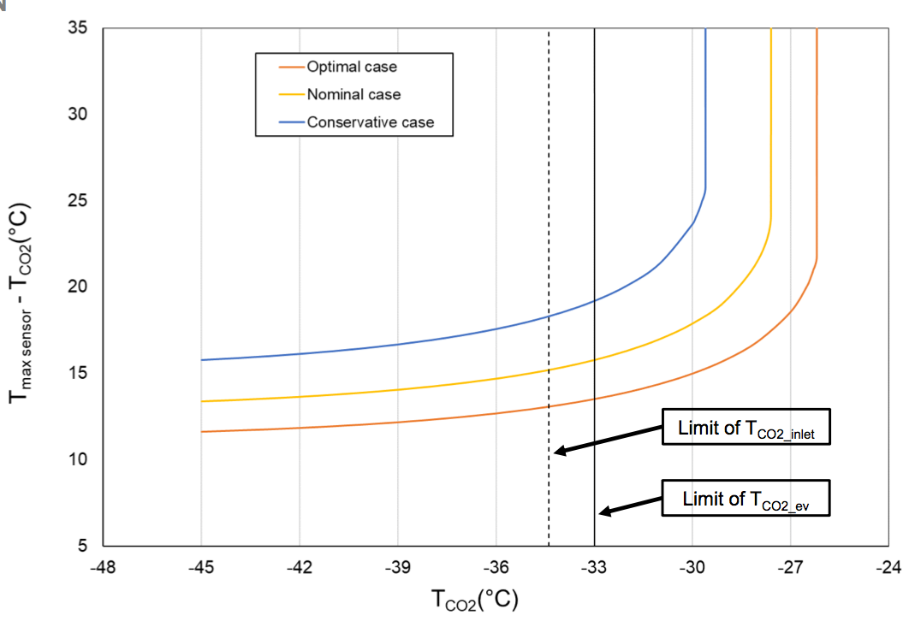
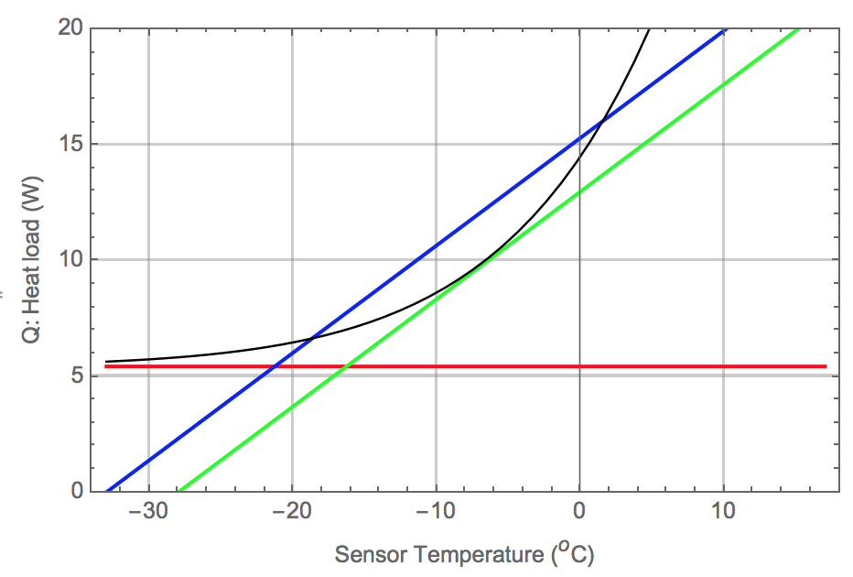
How far is TBPX from runaway?
Francesco is asking: “If the CO₂ temp changes by X, when do we hit runaway?”
His answer: X=5ºC.
5ºC
R=2.15 ºC/W
T_{sens}=T_{CO2} + 15ºC
Bianchi
indico 770283
T_{sens}=T_{CO2} + 15ºC
Fluence 2.1E16
0.109cm³ sens volume
600V bias
Baseline heat load due to ROCS and HDI = 5.43 W
5ºC

Slide 15
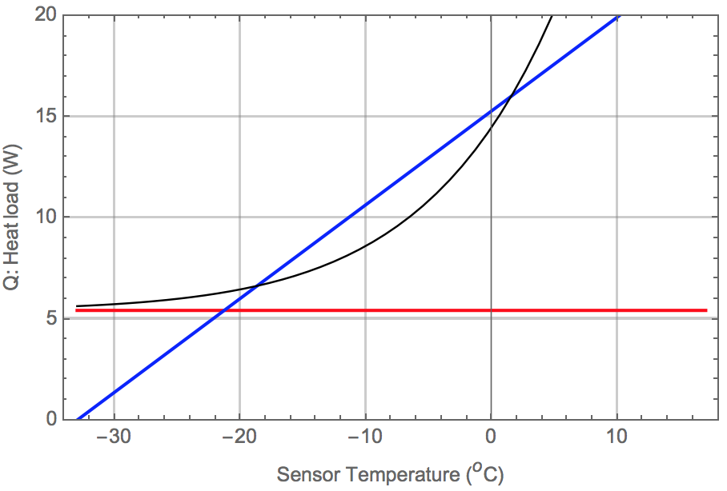
How far is TBPX from runaway?
But this is the wrong question. He is asking “if we get into trouble, by how much do we have to turn down the CO2 temperature?”
The right question is: “What value of R do we have to design to to ensure adequate margin of safety against runaway?”
T_{CO2} is already fixed and outside our control
25% worse R
R=2.15 C/W in current TBPX design
R*=2.15x1.25 C/W puts you in runaway
(for fixed T_{CO2})
Fluence 2.1E16
0.109cm³ sens volume
600V bias
T_{CO2}=-33

Slide 16
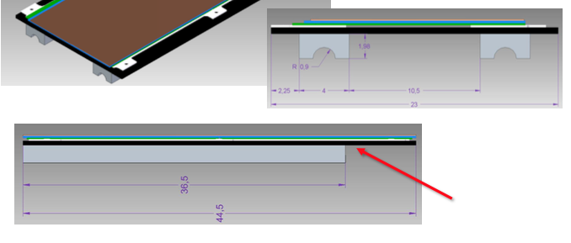
Bottom-up estimate of TBPX R_{eff}
use dimensions the k-values taken from TBPX slides
TBPX simplified model
bilateral symmetry
Silicon (sensor)
Silicon (ROC)
Alum-Nitride
Carbon Fiber
Alum-CarbFib
SS pipe
CO2
adhesives etc are included but not shown in this diagram

Slide 17
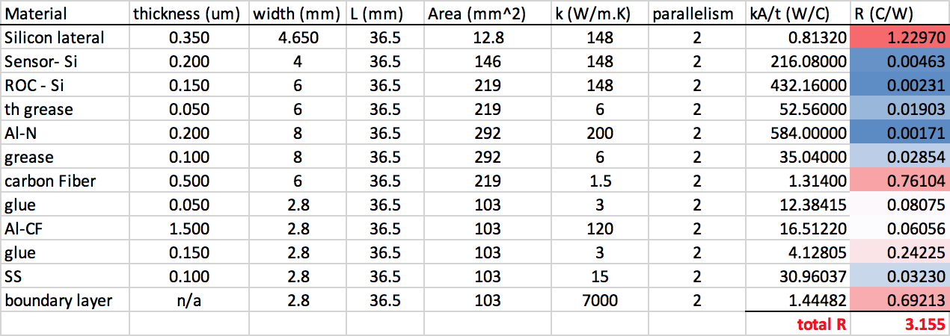
Bottom-up Estimate: Numbers
Use dimensions the k-values taken from TBPX slides to compute approximate effective thermal resistance, R_{eff} in this crude model:
Bottom-up model gives R_{eff} in right ballpark but a bit high.
(could fine-tune inputs, but…)
May be reliable, however, in identifying main culprits.
Result (ºC/W)

Slide 18
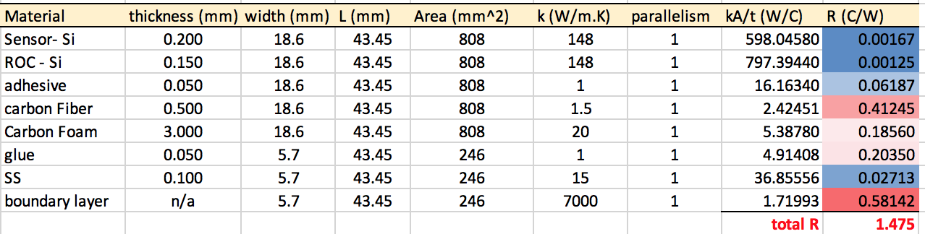
TFPX geometry is a bit different
At least in the context of these highly simplified models, it looks like TFPX geometry offers more parallelism in thermal paths
TFPX simplified model
Silicon (sensor)
Silicon (ROC)
adhesive/alternative
Carbon Fiber
Carbon Foam
epoxy
SS pipe
CO2
Result (ºC/W)

Slide 19
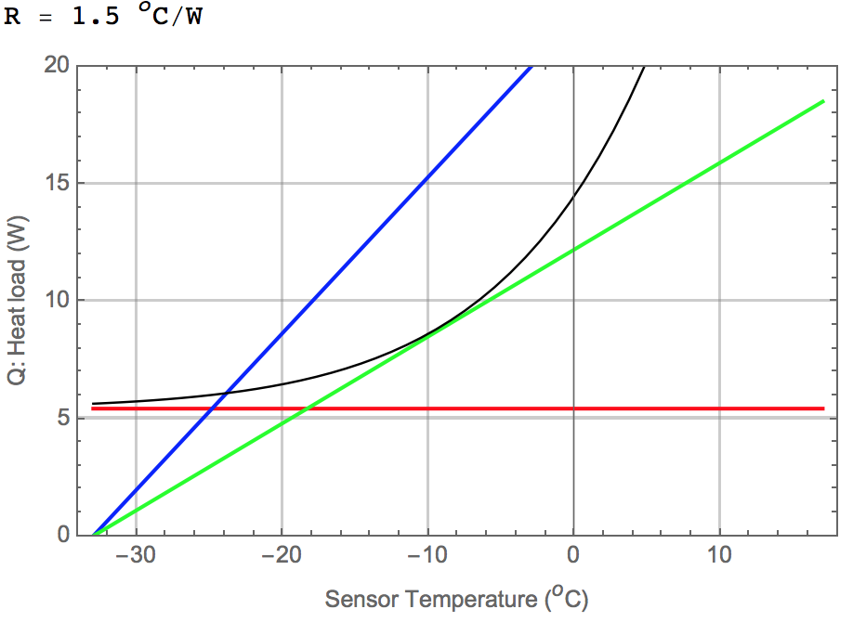
Implications of R_{eff} = 1.5ºC/W
Thermal performance of TFPX estimated from the crude model of previous slide
Fluence 2.1E16
0.109cm³ sens volume
600V bias
(to match TBPX calcs)
R=1.5 C/W
1.8 x R
R*=1.75x1.8 C/W puts you in runaway
(for fixed T_{CO2})
Baseline heat load due to ROCS and HDI = 5.43 W
T_{CO2} = -33

Slide 20
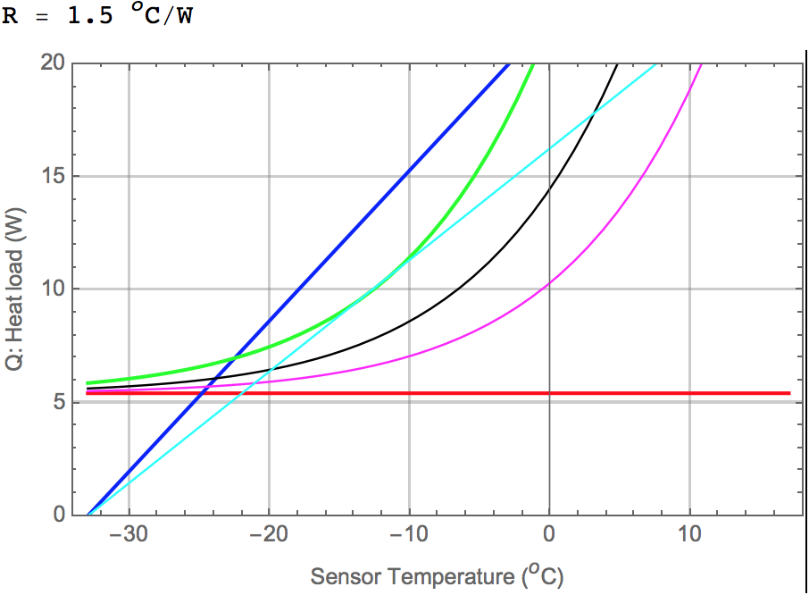
Consider temp variations over sensor
Perugia temp maps suggest T(x,y) = T_{avg} +/- 6 ºC
Implications for TFPX shown below; still some margin of safety
Tavg+6ºC
Tavg-6ºC
Tavg
R=1.5 C/W
R= 1.35 * 1.5 C/W
T_{CO2} = -33

Slide 21
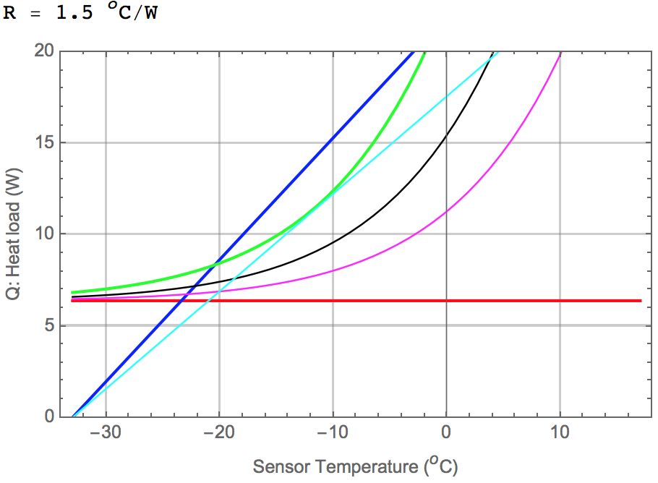
Include variations in ROC power
Consider also “worst” case for ROC power output → 2.91W
Implications for TFPX shown below; still some margin of safety
Tavg+6ºC
Tavg-6ºC
Tavg
R=1.5 C/W
R= 1.25 * 1.5 C/W
Increase ROC to 2.91W/chip
T_{CO2} = -33

Slide 22
Consider ROC failure scenarios
significant increase in heat load if one ROC fails?
details to be filled in….

Slide 23
Observations
TBPX looks marginal (25% safety factor). This is based on the R_{eff} derived from their ANSYS study.
For TFPX we can crudely estimate R_{eff} by adding up rough values of R for each layer. The same procedure applied to TBPX overestimated R by about x1.5 compared to the ANSYS-implied value… but it’s hard to know how good/bad this crude model is.
For TFPX, the crude model gives R=1.5 C/W.
Applying this to the runaway calculation, we find an 80% safety factor… for uniform sensor temps & nominal ROC power
Including nonuniform temps and worst-case ROC power, margin decreases to 25%. Yet worse cases can and should be explored. Note that Fluence assumed is worst case (inner radius) already.
Simple geometric differences between TBPX and TFPX thermal pathways strongly suggest that TFPX should have lower R than TBPX.
The ANSYS-derived plots that TBPX shows do not seem to be a transparently useful tool for setting design specs. But they can be translated into one.

Slide 24
Where do we go from here
Continue the experimental studies in G14 to obtain empirical measurements of R_{eff} under various design options
Pair those studies with ongoing ANSYS simulations to develop skills and confidence in this powerful tool
Apply ANSYS to the full dee design (perhaps one module at a time…) with latest parameters from Yadira. (Yadira started training me on this; I’m gonna need helpers.)
Perugia….
At all points in this process, assess safety margin in R_{eff}:
what are the dominant factors that determine R_{eff}?
what design modifications are likely to be profitable?
do experimental tests of those alternatives confirm expectations of improvement? If not, why not?

