Slide 1
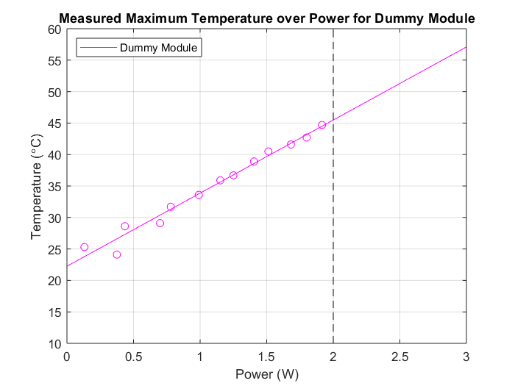
Dummy Temperature over Power
At 2Watts, dummy module heats to 45.7C
Measured absolute thermal resistance is 11.6K/W
Absolute thermal resistance much smaller than comparable-resistance ceramic resistors

Slide 2
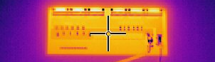
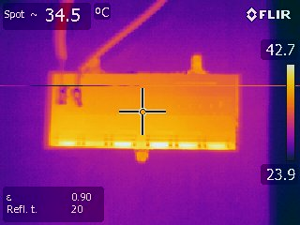
Temperature Profile
Image above shows high-resolution of dummy module relative heat distribution
Image below shows module over .0035in thick Aluminum on joined Carbon Fiber/Foam

Slide 3
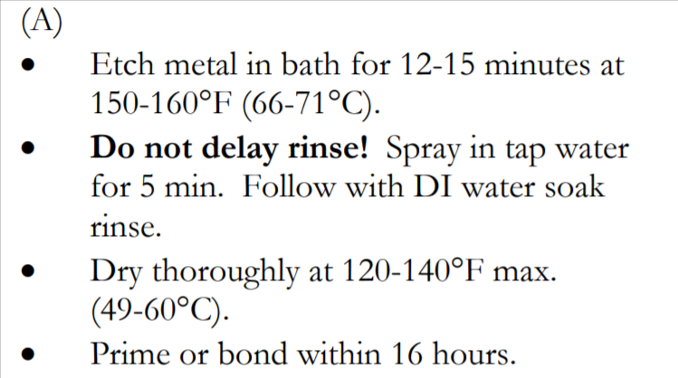
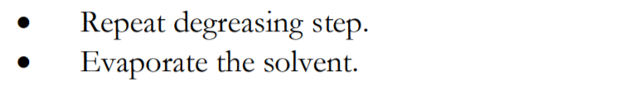
Loctite Adhesive
LOCTITE EA 9396 serves as a relatively high-thermal conducting adhesive for glass/ceramic onto aluminum
Aluminum bonding Instructions above
Glass bonding instructions below (minimal)

