Slide 1
Thermal runaway
Qref
alpha=4.28*10**-17
flu1= 1.0*10**16 #fluence
flu2= 2.1*10**16
flu3= 3.0*10**16
h=4.4 #width of the sensor
l=1.8 #lenght of the sensor
dd=130*10**-4 #depletion depth
Vb=600 #bias voltage
Tr=293 #reference Temperature
Ta=7000 #Activation Temperature
T0=253
# Qref
Qr1=alpha*flu1*h*l*dd*Vb
Qr2=alpha*flu2*h*l*dd*Vb
Qr3=alpha*flu3*h*l*dd*Vb

Slide 2
Thermal runaway numbers
Qref(T=20C, Fluence = 1e16) = 26.44 W
Qref(T=20C, Fluence = 2e16) = 55.52 W
Qrer(T=20C, Fluence = 3e16) = 79.32 W
T(K) | Q1(W) | Q2(W) | Q3(W)
240 | 0.090712 | 0.190495 | 0.272136
241 | 0.103237 | 0.216798 | 0.309711
242 | 0.117370 | 0.246478 | 0.352111
243 | 0.133302 | 0.279934 | 0.399906
244 | 0.151243 | 0.317611 | 0.453730
... | ... | ... | ...
298 | 40.836517 | 85.756686 | 122.509551
299 | 44.471055 | 93.389216 | 133.413165
300 | 48.402634 | 101.645532 | 145.207902
301 | 52.653315 | 110.571961 | 157.959945
302 | 57.246626 | 120.217915 | 171.739878
Note that at room temperature (~298K):
sensor will be in thermal runaway already
Q is too high to be extracted by cooling system

Slide 3
How to mimic thermal runaway at room temperature?
Ts | Ts_e | Q1 | Q2 | Q3
240 | 293 | 0.090712 | 0.190495 | 0.272136
241 | 294 | 0.103237 | 0.216798 | 0.309711
242 | 295 | 0.117370 | 0.246478 | 0.352111
243 | 296 | 0.133302 | 0.279934 | 0.399906
244 | 297 | 0.151243 | 0.317611 | 0.453730
... | ... | ... | ... | ...
298 | 351 | 40.836517 | 85.756686 | 122.509551
299 | 352 | 44.471055 | 93.389216 | 133.413165
300 | 353 | 48.402634 | 101.645532 | 145.207902
301 | 354 | 52.653315 | 110.571961 | 157.959945
302 | 355 | 57.246626 | 120.217915 | 171.739878
Use a heater and map Q from low T range to high T range : i.e.
Translate “original temperature range” to a “room temperature range” while keeping Q the same
This way, cooling the Si sensor at 240 K corresponds to cooling the heater at 293 K and so on. The power produced by the Si sensor and the power dissipated by the heater will be the same for the same change in T

Slide 4
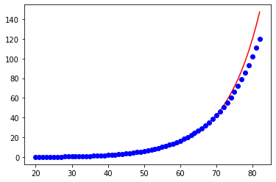
Thermal runaway mimic function
Having the dataset we can fit it and get the parameters
----------fit from curve_fit: y=exp(a+bx) b=0.1036 a=-3.5023
Ts_e | Q1 | Q2 | Q3
293 | 0.090712 | 0.190495 | 0.272136
294 | 0.103237 | 0.216798 | 0.309711
295 | 0.117370 | 0.246478 | 0.352111
296 | 0.133302 | 0.279934 | 0.399906
297 | 0.151243 | 0.317611 | 0.453730
... | ... | ... | ...
351 | 40.836517 | 85.756686 | 122.509551
352 | 44.471055 | 93.389216 | 133.413165
353 | 48.402634 | 101.645532 | 145.207902
354 | 52.653315 | 110.571961 | 157.959945
355 | 57.246626 | 120.217915 | 171.739878
Q(W)
T(C)

Slide 5
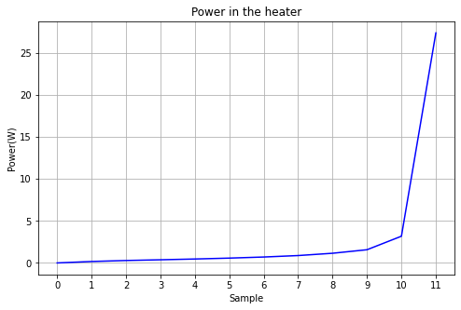
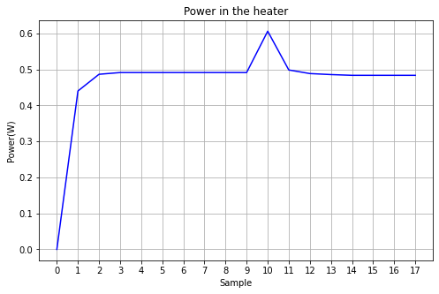
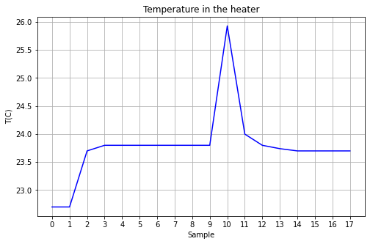
Thermal runaway reproduction
LabView controller power input: P(T)
P=exp(a+bT): b=0.1036; a=-3.5023
TIM
Heater sitting in air:
no TIM
Heater in PPE4 TIM
Heater in PPE4 TIM

