Slide 1


Jet and Jet Shapes in CMS
Rahmat Rahmat
University of Mississippi
(on behalf of CMS collaboration)
Boost 2011, Princeton
May 23 , 2011

Slide 2
Outline of the talk
Introducing Jet Shapes - definitions of observables
Measurements in previous collider experiments.
Jet shape measurements:
  Charged component structure
  Integrated jet shapes
Sensitivities to PYTHIA tunes and Jet Fragmentation
Quark / gluon shape differences
Summary
Boost 2011, Princeton
Rahmat Rahmat

Slide 3
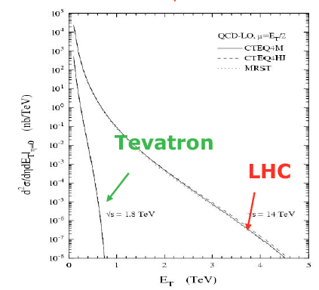
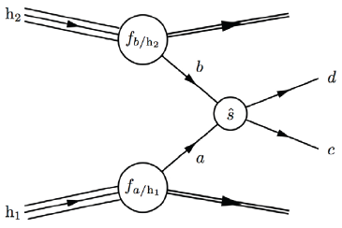
Hadronic interactions
Hadron Colliders:
Provide a broad band of energies that allow
us to scan the phase space.
Confront QCD in the new energy regimes
not explored earlier.
Hard interactions involve 2 partons.
Rest goes into underlying event
Jets
  Hadrons (or tracks or energy deposits
  in calorimeters)
  Mostly close to direction of initial parton
Boost 2011, Princeton
Rahmat Rahmat

Slide 4
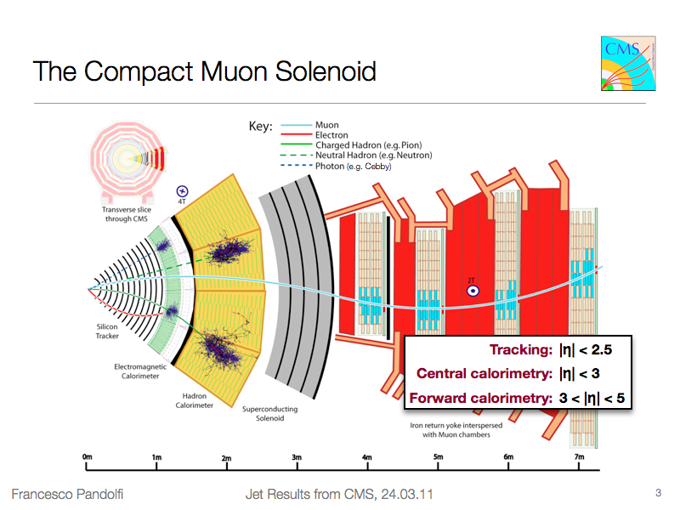
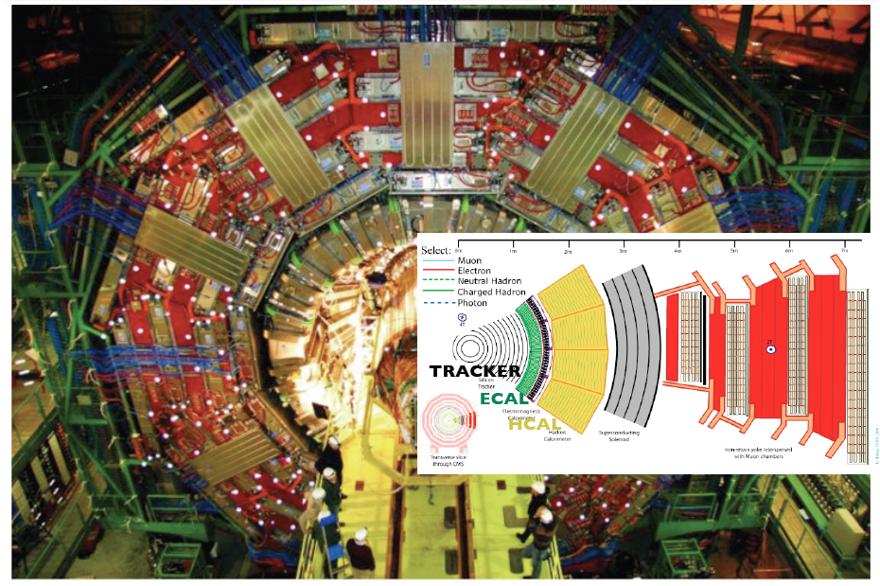
The CMS detector
Boost 2011, Princeton Rahmat Rahmat 5
Boston Jet Physics Workshop
Rahmat Rahmat

Slide 5
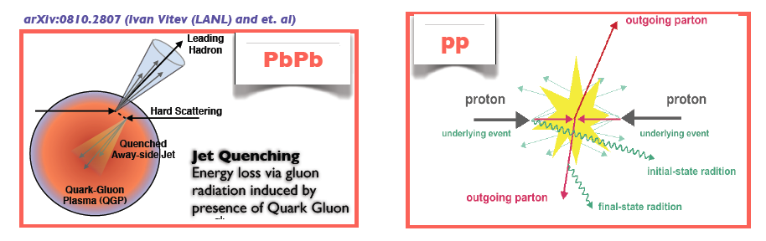
Motivation (Jet shapes)
Jet shapes measure the average distribution of energy flow as a function of the
distance away from the jet axis.
Test showering models in Monte Carlo generators.
Discriminates between different underlying event models.
Sensitive to the quark / gluon jet mixture.
Provide insight into performance of jet clustering algorithms.
Jet shapes can discriminate between competing models of jet quenching which
have all successfully described leading particle suppression in Relativistic Heavy
Ion Collider (RHIC) data.
Boost 2011, Princeton
Rahmat Rahmat

Slide 6
Jet Reconstruction at CMS
Calorimeter Jets: calorimeter towers
JET
ECAL
HCAL

Slide 7
Jet Reconstruction at CMS
Calorimeter Jets: calorimeter towers
Jet Plus Tracks: correct for tracks
JET
ECAL
HCAL

Slide 8
Jet Reconstruction at CMS
Calorimeter Jets: calorimeter towers
Jet Plus Tracks: correct for tracks
Particle Flow
JET
ECAL
HCAL

Slide 9
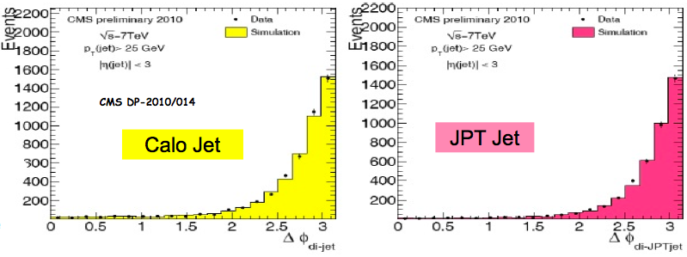
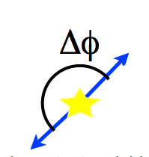
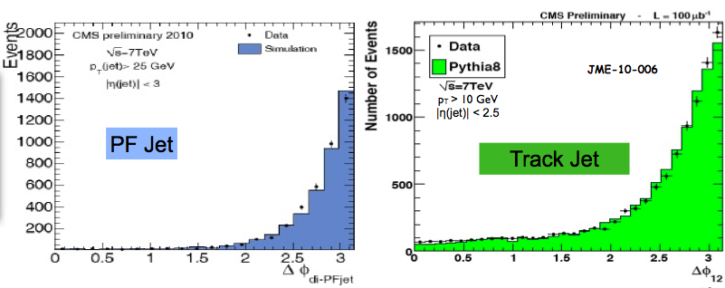
Dijet Δφ in Data and MC
dijet events are
back-to-back in Δϕ
Good agreement
for all jet types between data and MC
Boost 2011, Princeton
Rahmat Rahmat (University of Mississippi)

Slide 10
Measuring jet shapes
Two different methods have been used in CMS to measure the internal structure of jets (Jet shapes):
  Jet charged component structure at 7 TeV
  (based on the original CMS PAS QCD-08-002)
  Classical jet shape analysis at 7 TeV
  (based on the original CMS PAS QCD-08-005)
Boost 2011, Princeton
Rahmat Rahmat (University of Mississippi)

Slide 11
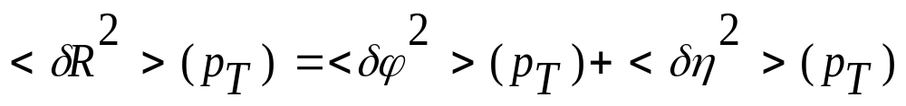
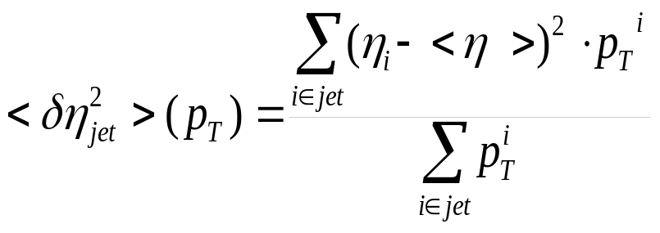
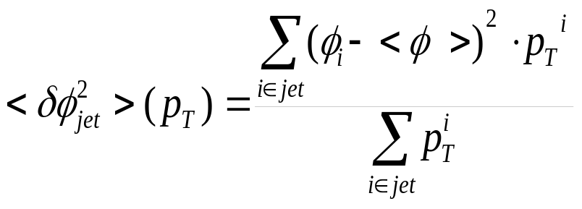
Jet charged component
The following observables are used to characterize the structure of jets.
Charged particle multiplicity in jet (N_{ch}).
Charged particle transverse shape variable (δR²)
A measure of the width of a jet in the η-Φ plane.
Boost 2011, Princeton
Rahmat Rahmat (University of Mississippi)

Slide 12
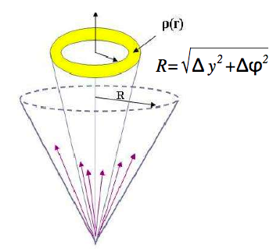
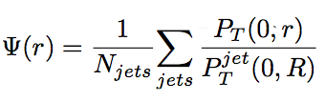
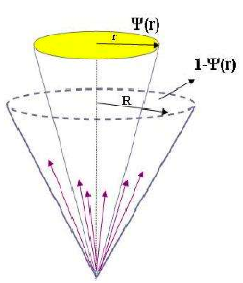

Classical Jet Shapes Measurements
Definition: Integrated jet shape is defined as the average fraction of jet transverse momentum inside a cone of radius r concentric to the jet axis.
Differential Jet Shape
Definition: The average fraction of the jet transverse momentum inside an annulus in the y-ϕ plane of inner (outer) radius r-∆r/2
(r+∆r/2) concentric to the jet axis.
Integrated Jet Shape
Boost 2011, Princeton
Rahmat Rahmat (University of Mississippi)

Slide 13
Event selections for Jet Shape
Condition on the Technical Trigger bits:
Coincidence for jets with low transverse momentum (p_{T} < 40 GeV) a minimum
bias trigger was used which requires activity in both beam scintillator
counters located at 3.23 < |η| < 4.65 in coincidence with colliding proton bunches.
Jets are reconstructed from
  using calorimeter tower information (calojets) or
  using a combination of information from the calorimeters and the tracker
  (jet+track algorithm).
Jets were selected requiring at least one of the leading jets within |eta|<1.
The two leading jets pass satisfy the jet Id criteria to get rid of the noise.
Anti-kT cone algorithm applied with cone size=0.7
After jet energy correction is applied the corrected jets satisfy: p_{T}>15 GeV.
Boost 2011, Princeton
Rahmat Rahmat (University of Mississippi)

Slide 14
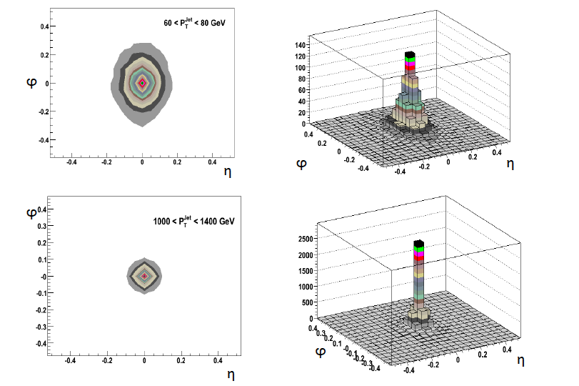
Calorimeter Jet Shapes in η-φ plane
Jet shape in ϕ direction is wider due to bending of charged particles in B field.
Boost 2011, Princeton
Rahmat Rahmat (University of Mississippi)

Slide 15

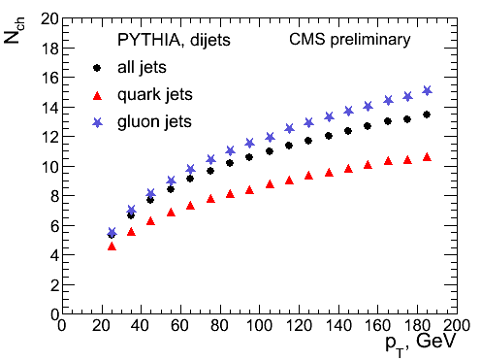
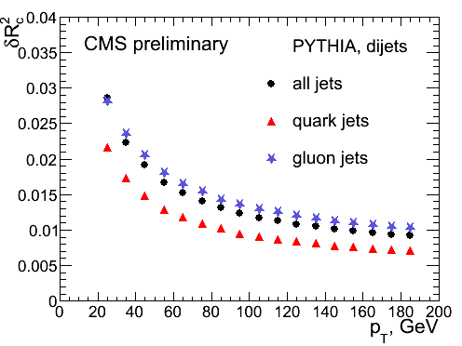
N_{ch} and δR² for jet flavors (Dijets)
The combination with minimum:
PYTHIA, |η|<1
Detector level
Simulation Simulation
The mean charged particle multiplicity increases whereas the transverse jet shape δR² drops as a function of the jet transverse momentum.
Boost 2011, Princeton
Rahmat Rahmat (University of Mississippi)

Slide 16
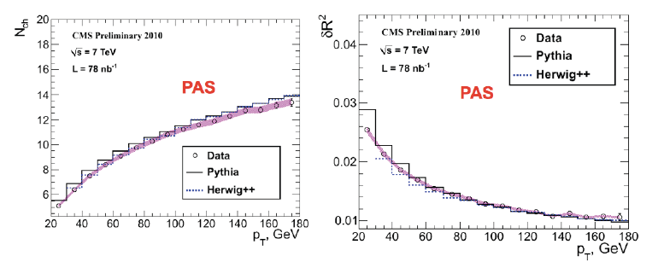
Charged multiplicity (N_{ch}) and δR² vs p_{T}^{jet}
Data, PYTHIA, HERWIG jets with |η| <1 (detector level)
Dijets
Dijets
Statistical uncertainty is assigned to data points.
Systematic uncertainty due to jet energy scale is shown with a pink band.
At low jet transverse momentum (20< p_{T} <50GeV) the measured jets are a few
percent broader than predicted by Herwig++ and narrower than predicted by Pythia D6T.
Boost 2011, Princeton
Rahmat Rahmat (University of Mississippi)

Slide 17
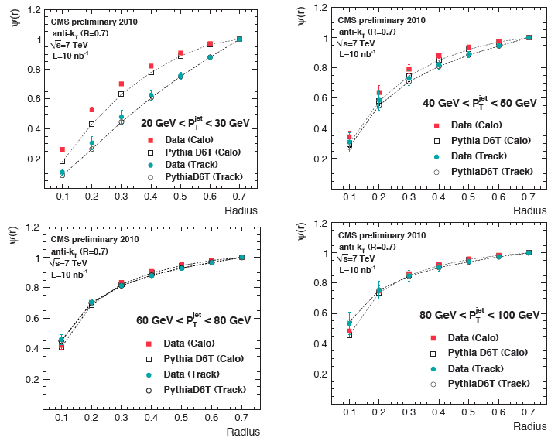
Integrated jet shapes
The integrated jet shape increase with p_{T} indicating that the constituents of the jets are more collimated at increasing p_{T}.
Boost 2011, Princeton
Rahmat Rahmat (University of Mississippi)

Slide 18
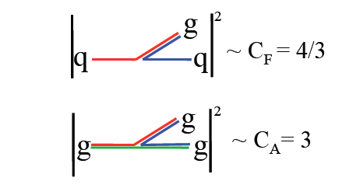
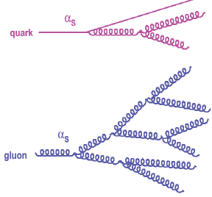
Quark and gluon jet shape differences
Jet shapes are sensitive to quark-gluon jet mixture.
  Can separate quark and gluon jets in a statistical way.
Quark and Gluons jets radiate proportionally to their color factors
  C_{F}: strength of gluon coupling to quarks.
  C_{A}: strength of gluon coupling.
In QCD, quark jets are expected to be narrower than gluon jets, but both get narrower with increasing jet p_{T}.
Jets initiated by quarks and gluons are also expected to have different average multiplicities and p_{T} spectra of constituents.
quark jets
gluon jets
Boost 2011, Princeton
Rahmat Rahmat (University of Mississippi)

Slide 19
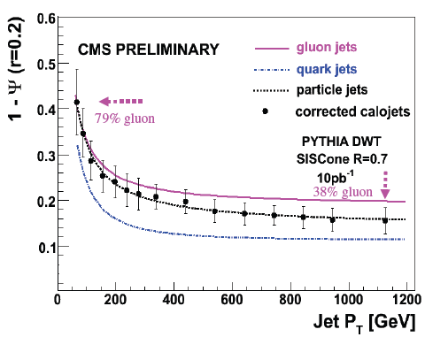
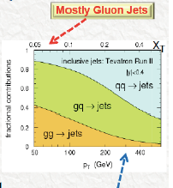
Quark and gluon jets
√s=14 TeV
PYTHIA MC
Mostly quark jets
At small p_{T}, jet production is
dominated by gg and gq
scattering due to higher
gluon probability density at low x.
Observations:
Quark jets are narrower than gluon jets.
Fraction of gluon initiated jets decreases with increasing jet p_{T}.
Mixture of quark and gluon initiated jets changes with jet p_{T}, contributing
to the jet shape dependence on p_{T}.
The constituents of the jets become more collimated with increasing jet p_{T}.
Boost 2011, Princeton
Rahmat Rahmat (University of Mississippi)

Slide 20
Summary and Outlook
The internal structure of the jet was measured in early pp collisions using CMS Detector
The data are in general in agreement with QCD-inspired event generators.
The measured data are described within the uncertainty of the measurement of a few percents by current leading order QCD Simulation event generators, Pythia and Herwig up to the highest transverse momenta observed
The differences between quark and gluon jets are studied.
Future plan includes probing the jet shapes with particle flow algorithm for more precise measurements.
An updated Physics Analysis Summary with latest data in under way.
Boost 2011, Princeton
Rahmat Rahmat (University of Mississippi)

Slide 21
Back up
Boost 2011, Princeton
Rahmat Rahmat

Slide 22
Systematic uncertainty
Jet energy scale.
Calorimeter Response and Transverse Shower Shape
  The measured jet shapes depend on the calorimeter response to hadrons and on the transverse showering. There is uncertainty due to simulation of these effects.
    Data driven approach to estimate the sensitivity of the jet shapes to the calorimeter resolution by looking track jet shapes and calorimeter level jet shapes.
    Hadrons deposit energy in several neighboring towers. This transverse showering affects the measured jet shapes.
Jet fragmentation
  The calorimeter response simulation, and hence jet shape corrections, depends on the fragmentation model.
  To determine systematic uncertainty due to the fragmentation model we compared the jet shape correction factors for Pythia D6T and Herwig++.
Boost 2011, Princeton
Rahmat Rahmat

