Slide 1
Chord Recognition from Live Audio Stream
CS 631 Project Presentation
Presented by: John Montesa

Slide 2
Presentation Overview
Introduction
Related Works
Objective
Datasets
Approach
Demo
Conclusion

Slide 3
Introduction
Recognizing chords in real-time is an important skill for musicians to learn and requires extensive ear-training and music theory knowledge.
Improvisation is important for musicians to express their creativity, but is a difficult technique.
Creating an application that can bridge that gap between difficulty and accessibility can increase musical motivation by making the learning process easier and engaging.

Slide 4


Related Works
Shazam
Recognizes audio in real time to identify songs
Creates an audio sample and compares that sample to Shazam’s database of audio files, matching frequencies and timings
Chordify
Detects chords within a uploaded audio sample, such as from YouTube.
Delivers chords for four instruments: Guitar, ukulele, mandolin, and piano.
Teaches chords to beginner players

Slide 5
Objective
Create a script that recognizes chords
User Goals:
Make it easier for musicians to identify chords in a song
Inspire musicians to play together and learn improvisation
Motivate players to learn by ear and strengthen valuable skills for musicians
System Goals:
Recognize guitar chords in real time
Identify chords with accuracy and low latency

Slide 6
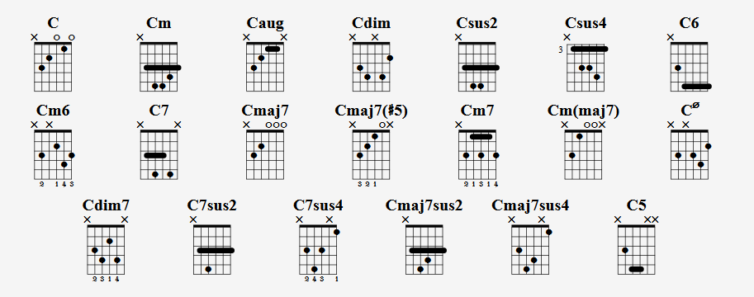
Datasets

Slide 7
Datasets (cont.)
GUITAR CHORDS V3
8 chords: Am, Bb, Bdim, C, Dm, Em, F, G
Varying guitar types, recording devices, volumes, techniques
Custom dataset
Featuring chord variations and more chords (B, Cm, D)
Recorded with integrated laptop microphone and guitars used for live demonstration

Slide 8
Approach
Train a machine learning algorithm to identify chords based on various sound files
Utilize two datasets of guitar chords:
GUITAR CHORDS V3 (https://www.kaggle.com/datasets/fabianavinci/guitar-chords-v3)
Custom dataset
Use Python to create a script that will live stream audio from a device and detect what guitar chord is heard.
Hardware: Personal laptop with integrated microphone

Slide 9
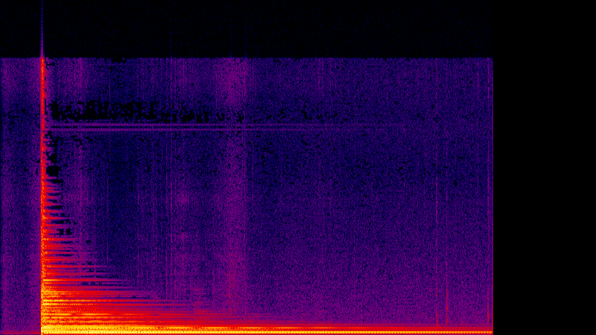

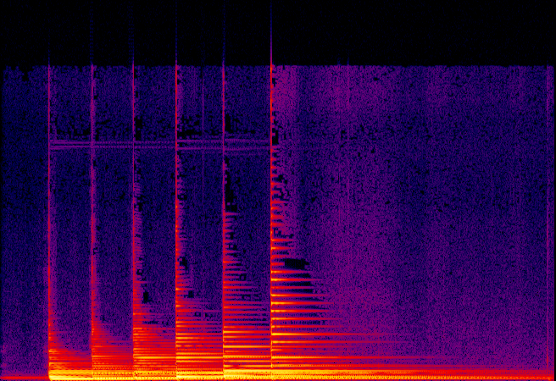
Approach (cont.)
Using a convolutional neural network (CNN), analyze each audio in Spectrogram format.
G_Classic_Miguel_1.wav
G_Classic_Miguel_4.wav
Notes:
X axis = time
Y axis = frequency

Slide 10
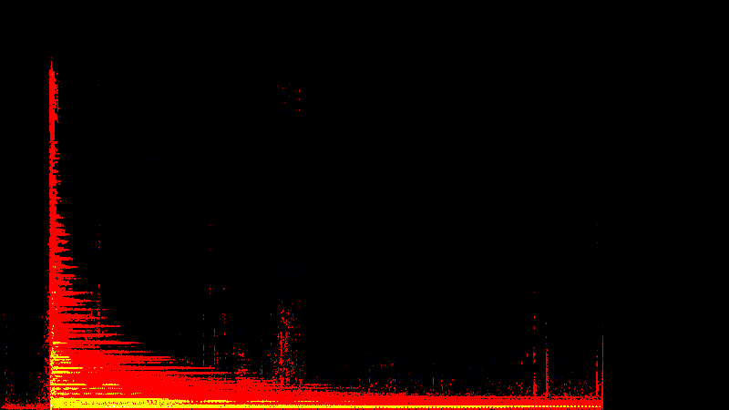
Notes:
X axis = time
Y axis = frequency

Slide 11
Demo
https://drive.google.com/drive/folders/1fGynyG0J6d0eXIDUf5pM2XEb33wevUAC?usp=sharing

Slide 12
Conclusion & Future Works
Successfully able to recognize chords from a guitar accurately and in a timely fashion.
Limitations & Future Work:
Mobile and web versions
Script is limited to guitar chord recognition
Ability to detect chord variation
Develop into full software with user interface
Encoding chords into functions

Slide 13
Questions?

