Slide 1
Exploratory Analysis to determine the factors affecting the possibility of Car Accidents:
A State level study in United States
Group 8:
Aarushi Sharma (MSBA)
Anna Grace Nimmo (MSBA)
Jeremy Mateo (MSBA)
Matthew Brimo (MBA)
Sebastian Castillo (MSBA)

Slide 2
Rationale
Understanding the cause behind car accidents taking place in various states within United States
Analyzing the possibility of environmental and other external factors playing a role in such mishaps
Evaluating if human negligence can be the probable cause of car accidents
Exploring the appropriate measures which can be taken to avoid such accidents

Slide 3
Hypothesis
Severity of the accident is correlated with environmental factors like wind speed, precipitation, temperature, humidity and pressure
Impact of the accident in terms of distance is correlated with external factors like traffic signs, bumps, amenity, no exit etc
More accidents take place in the night due to lack of visibility as compared to accidents in the day time

Slide 4
Identify your Dataset
Dataset title: Countrywide Traffic Accident Dataset (2016-2021)
Source: https://www.kaggle.com/datasets/sobhanmoosavi/us-accidents
Description:
Covers 49 states in the USA
Collected from Feb 2016 - December 2021
Utilization of multiple APIs that provide streaming traffic incident or event data
Captured by various entities such as the US and state departments of transportation, law enforcement agencies, traffic cameras, and traffic sensors
2.8m accident records in this dataset
Data will be downloaded from Kaggle
Data has 47 columns and 1048575 records

Slide 5
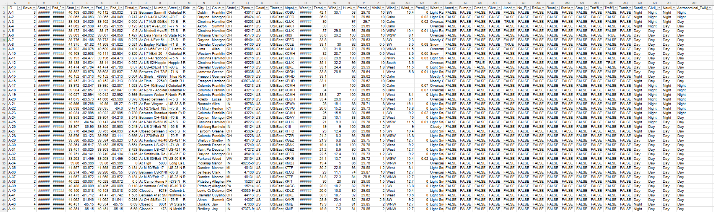
Data Description

Slide 6
Variable Description
SNO. | VARIABLE | DATA TYPE | EXAMPLE
1 | Severity | Numeric | 3
2 | Start_Time | Datetime | 2016-02-08 00:37:08
3 | End_Time | Datetime | 2016-02-08 06:37:08
4 | Distance (mi) | Numeric | 3.23
5 | Traffic_Calming | Categorical | FALSE
6 | Traffic_Signal | Categorical | FALSE
7 | Turning_Loop | Categorical | FALSE
8 | Sunrise_Sunset | Categorical | Night
9 | Civil_Twilight | Categorical | Night
10 | Nautical_Twilight | Categorical | Night

Slide 7
Variable Description
SNO. | VARIABLE | DATA TYPE | EXAMPLE
11 | Street | Alphanumeric | Outerbelt E
12 | Side | Categorical | R
13 | City | Categorical | Dublin
14 | County | Categorical | Franklin
15 | State | Categorical | OH
16 | Zipcode | Categorical | 43017
17 | Country | Categorical | US
18 | Timezone | Categorical | US/Eastern
19 | Airport_Code | Categorical | KOSU
20 | Astronomical_Twilight | Categorical | Night

Slide 8
Variable Description
SNO. | VARIABLE | DATA TYPE | EXAMPLE
21 | Weather_Timestamp | Datetime | 2016-02-08 00:53:00
22 | Temperature (F) | Numeric | 42.1
23 | Wind_Chill (F) | Numeric | 36.1
24 | Humidity (%) | Numeric | 58
25 | Pressure (in) | Numeric | 29.76
26 | Visibility | Numeric | 10
27 | Wind_Direction | Categorical | SW
28 | Wind_Speed | Numeric | 10.4
29 | Precipitation | Numeric | 0.0
30 | Weather_Condition | Categorical | Light Rain

Slide 9
Variable Description
SNO. | VARIABLE | DATA TYPE | EXAMPLE
31 | Amenity | Categorical | FALSE
32 | Bump | Categorical | FALSE
33 | Crossing | Categorical | FALSE
34 | Give_Way | Categorical | FALSE
35 | Junction | Categorical | FALSE
36 | No_Exit | Categorical | FALSE
37 | Railway | Categorical | FALSE
38 | Roundabout | Categorical | FALSE
39 | Station | Categorical | FALSE
40 | Stop | Categorical | FALSE

Slide 10
Problem Statement and Project Goals
1. Severity of the accident and it’s association with the location (state) can drill down based on county as well
Knowing if a certain state has more severe car accidents can help focus driving programs in certain areas as well as make people visiting a certain location/state aware of areas that might be more likely to have a severe accident.
2. Probable times of car accidents and the weather at that particular instant (incorporating humidity, wind, pressure and temperature factors as well)
It is important to know how much weather impacts a car accident because it provides more data to either stay off the road during those conditions or be extra cautious if you need to travel.
3. The extent to which a road is affected due to the accident and the visibility parameter on the day of accident to predict if there is a possibility of more accidents in the future
This is extremely important to governments both local and federal to know if the state of the road is having a negative impact on driving conditions causing serious car accidents. This could help fix roads or add traffic lights or signs to busy areas with frequent accidents.

Slide 11
Methodology
1. Data Gathering & Preprocessing: Will be conducted using Kaggle (download data), Excel functions and python programming
Removing missing values and selecting only relevant columns
2. Data Analysis and Predictive Modelling: Will be conducted using the SPSS tool and Excel functions
Regression model to predict the severity of accident and distance impacted
3. Data Visualization: Will be conducted using the Tableau software
Scatter plot, Line charts for predictive analytics
Donut chart, Heatmap, Bubble Chart, Treemap, Bar Chart for descriptive analytics

Slide 12
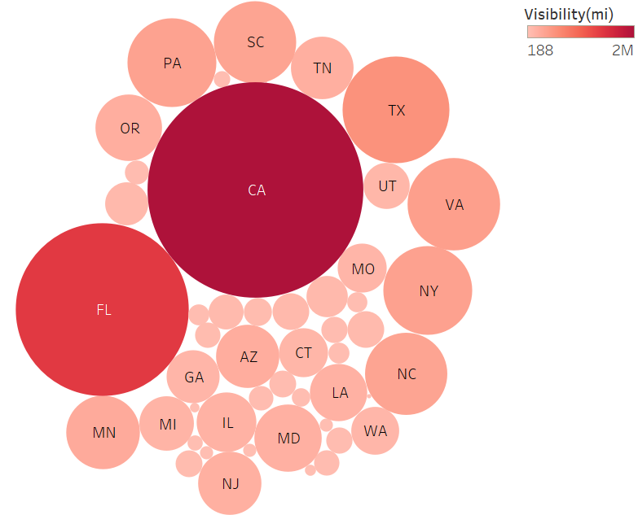
Bubble Chart for impact of Visibility on Severity of Accident

Slide 13
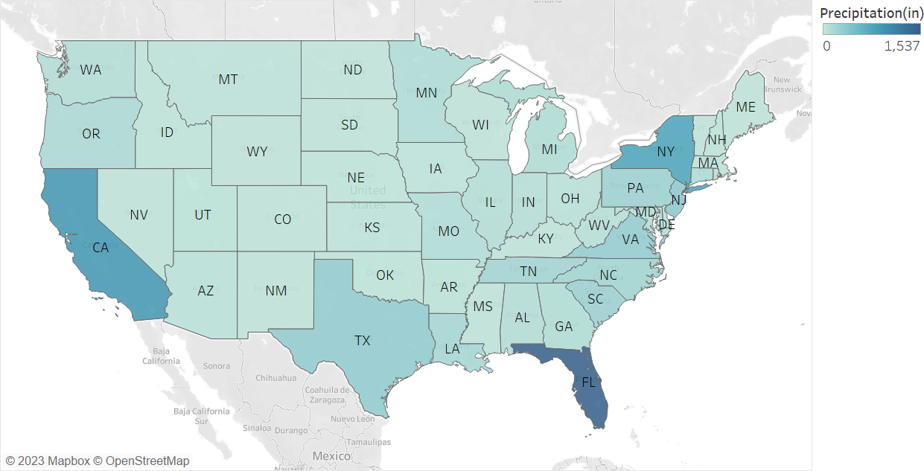
Geo Map for impact of Precipitation on Severity of Accident

Slide 14
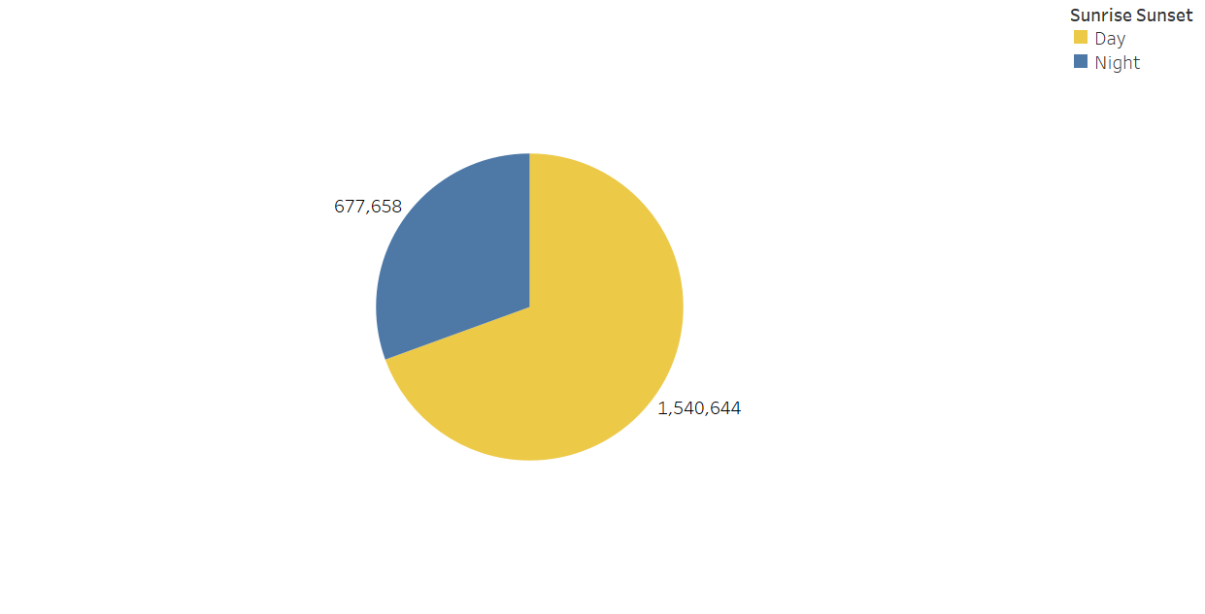
Time playing a role in the Severity of Accident

Slide 15
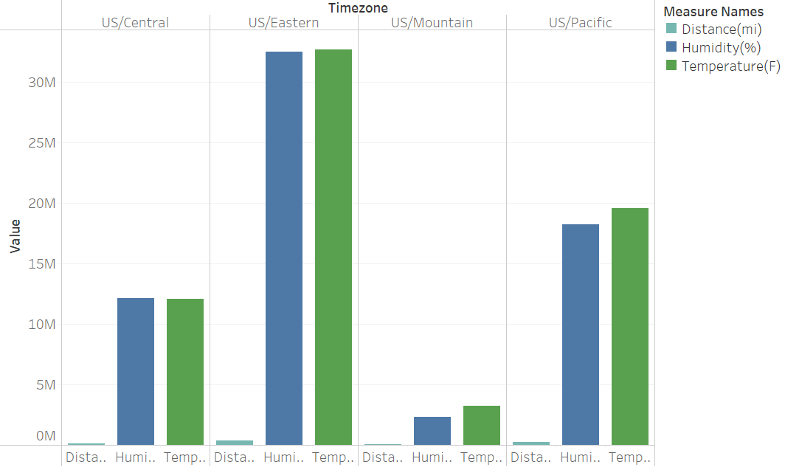
Impact of Humidity & Temperature on Length of impacted area

Slide 16
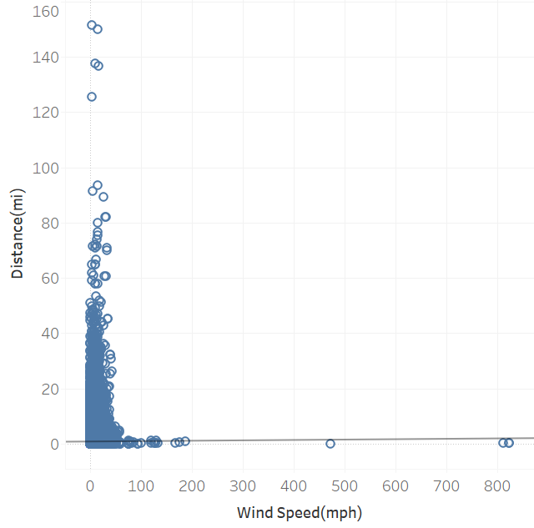
Scatter Plot for Length of accident impact with Wind Speed

Slide 17
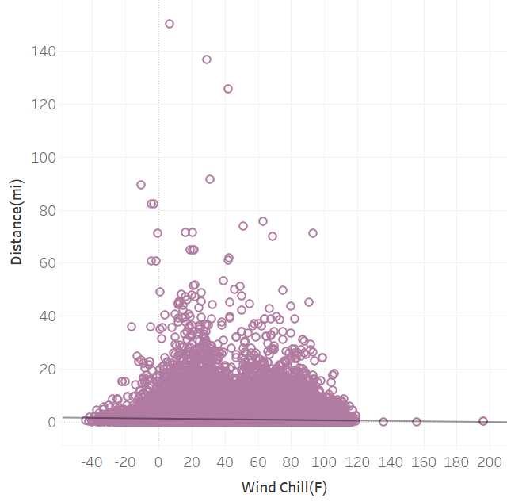
Impact of Wind Chill on Distance

Slide 18
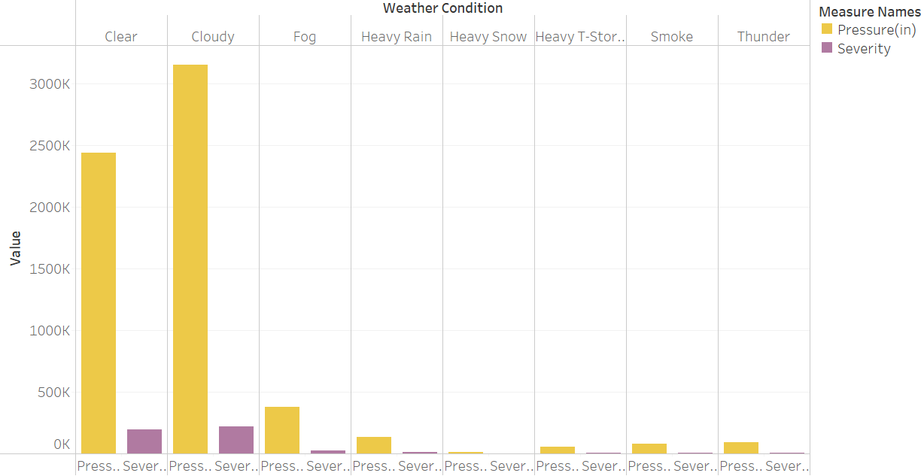
Impact of Pressure on the severity of the accident by Weather

Slide 19
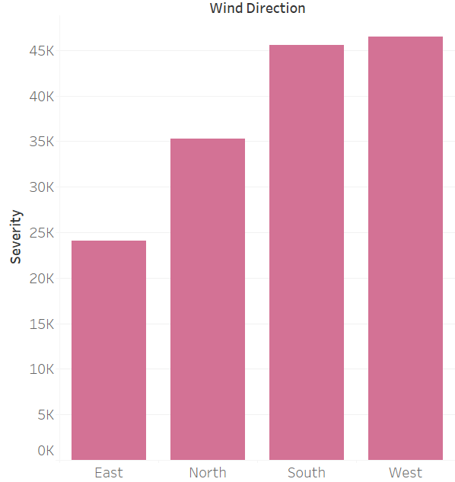
Impact of Wind Direction on Severity of Accident

Slide 20
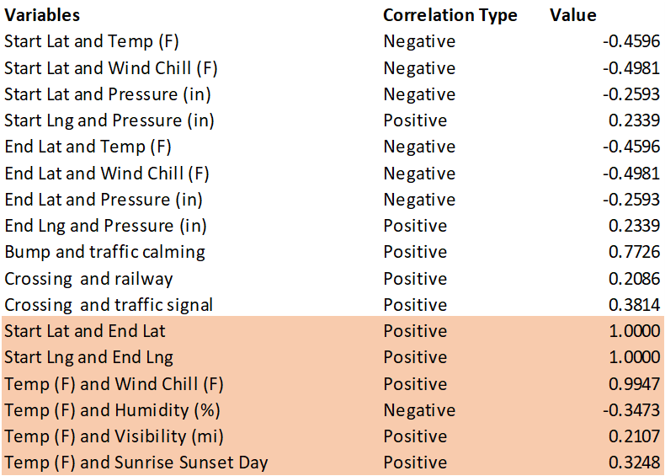
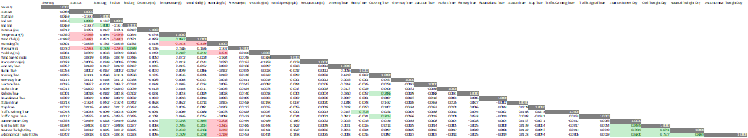
Correlation Matrix of the severity and columns C-I, V-AC, and AE-AU

Slide 21
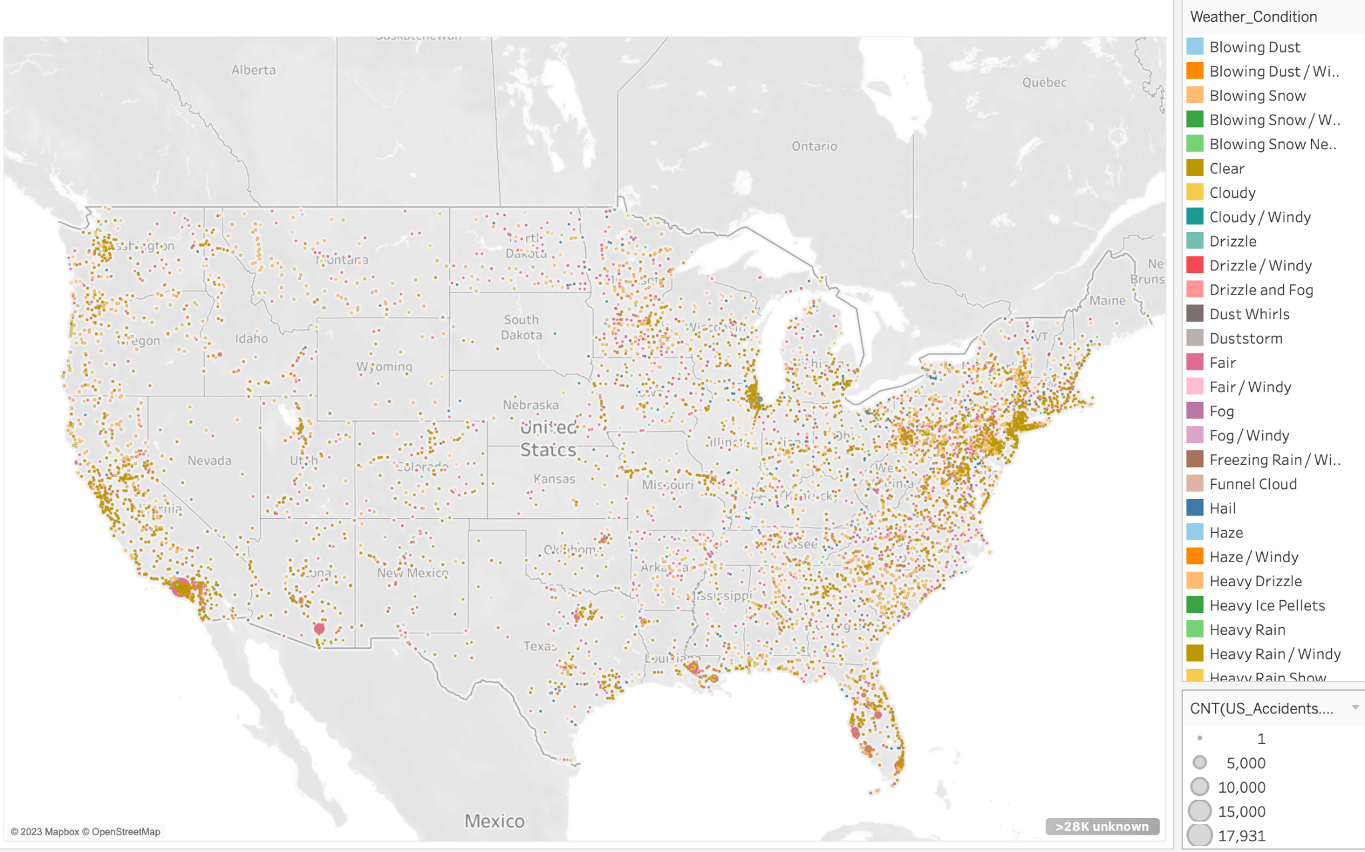
Weather Conditions Map

Slide 22
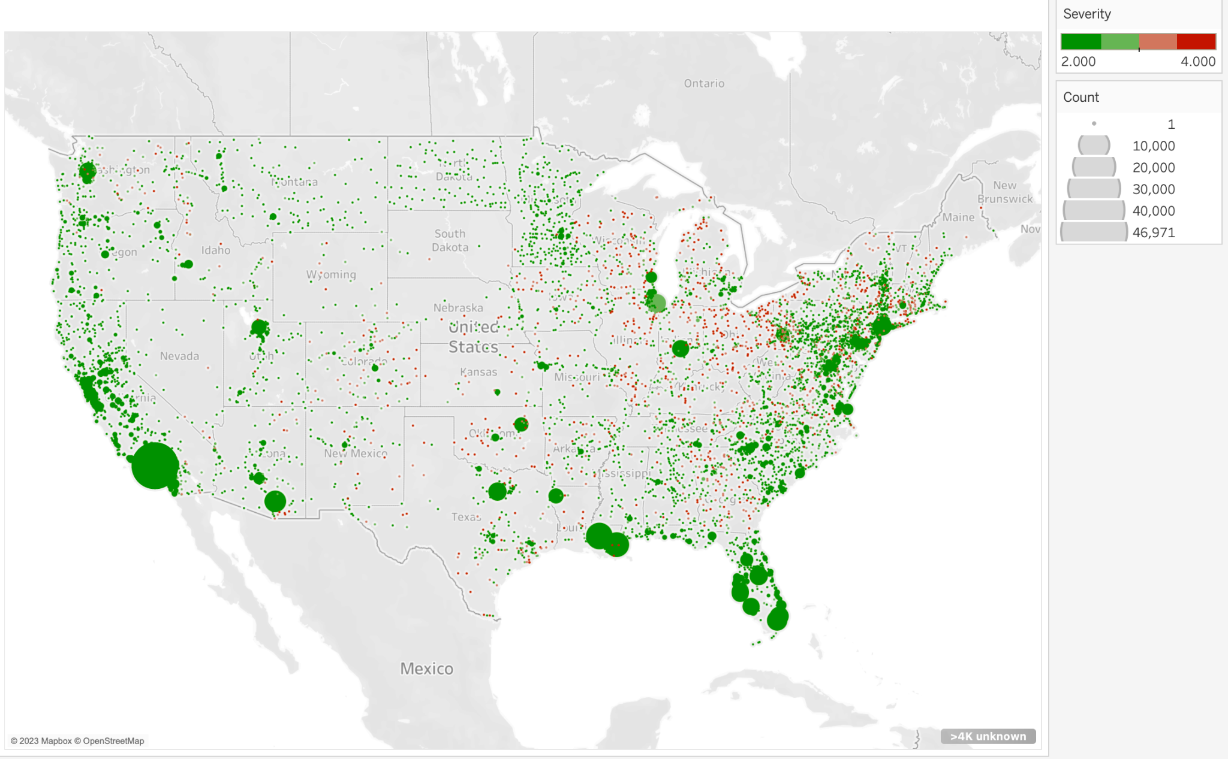
Severity Classification Map

Slide 23
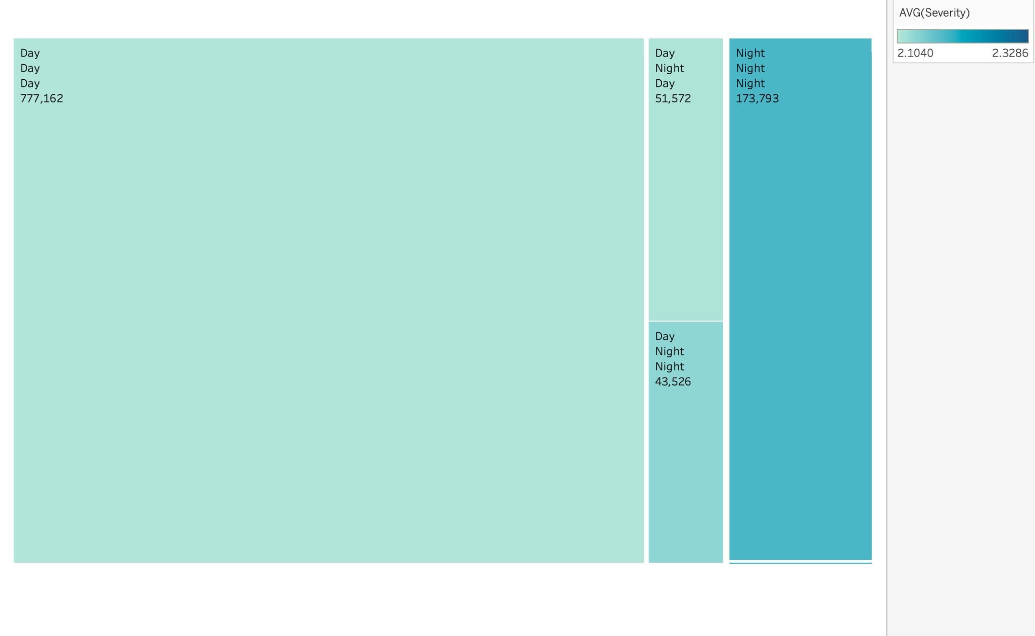
Time of Day and Severity

Slide 24
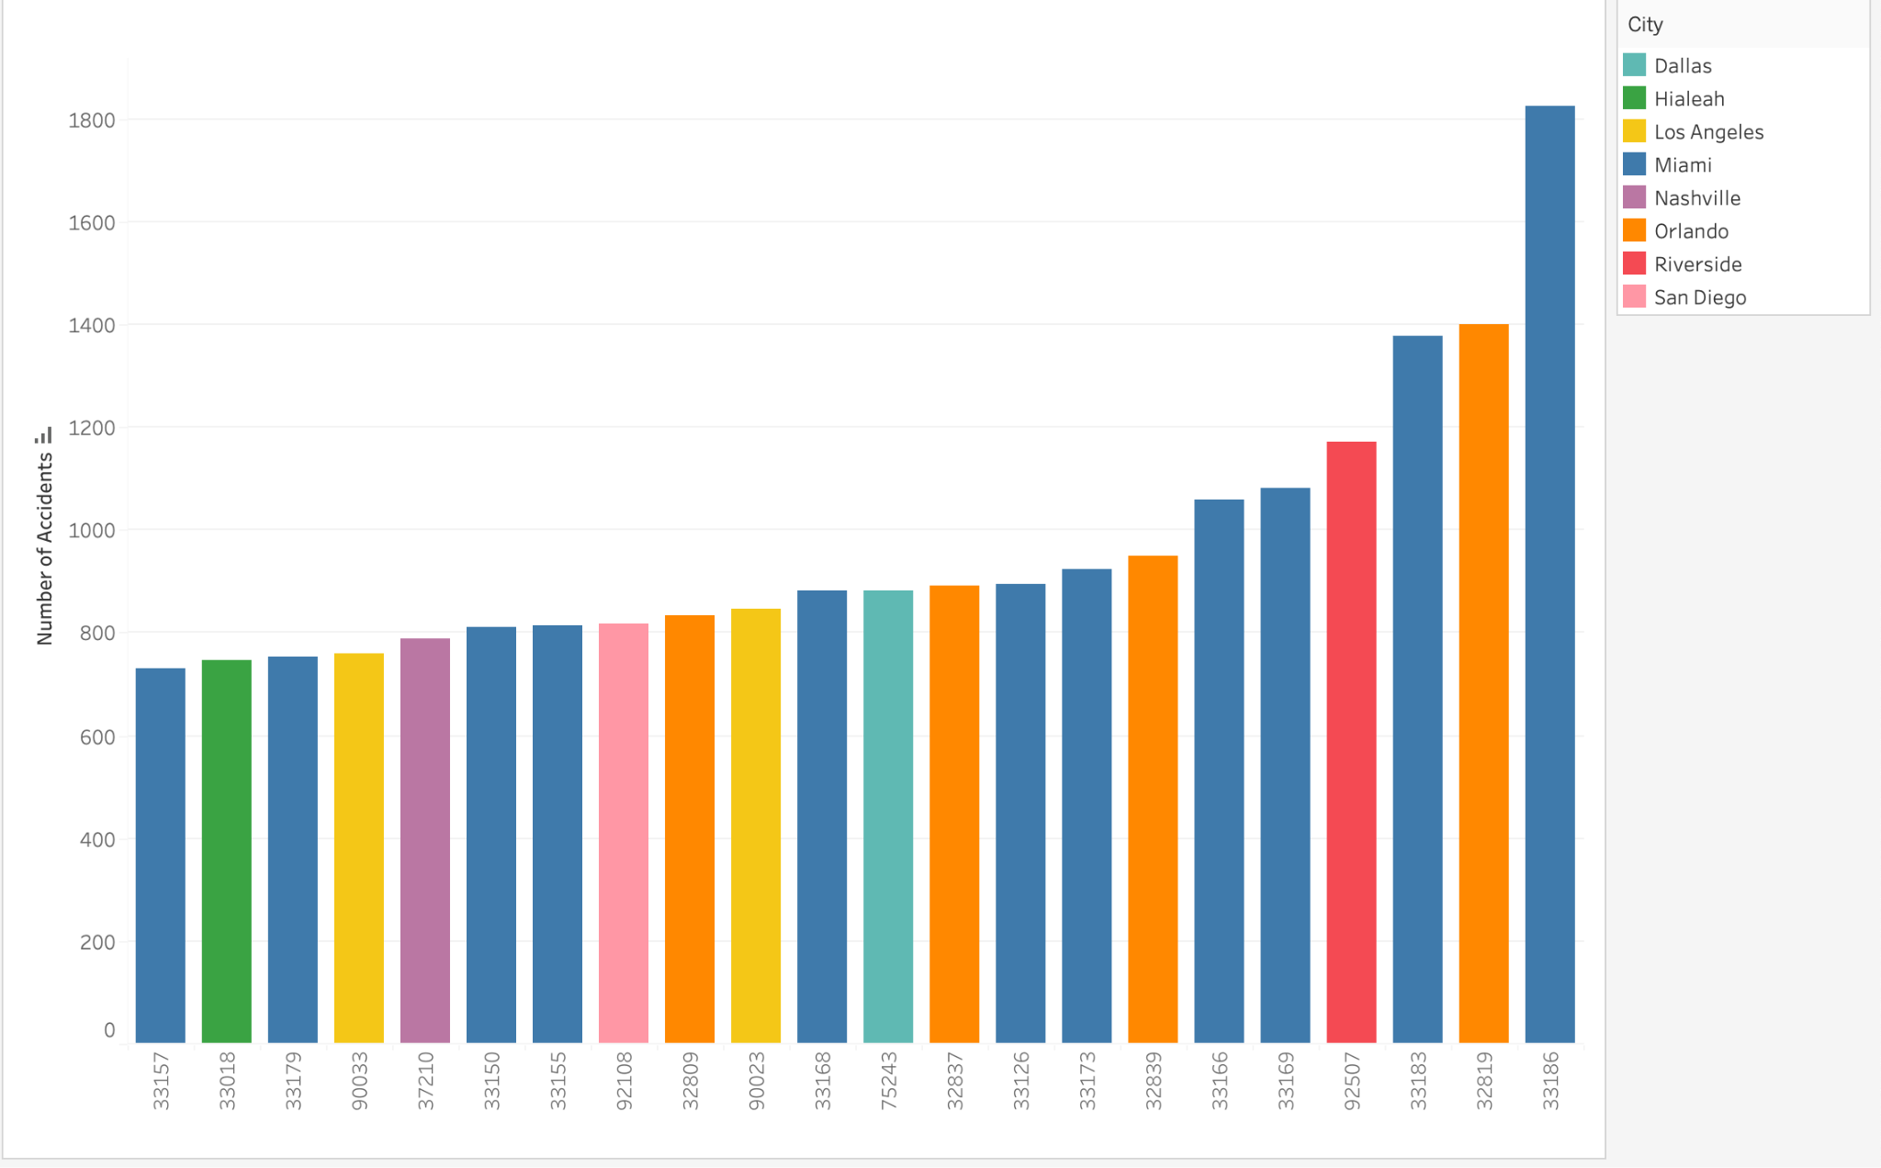
Zip codes with most number of accidents

Slide 25
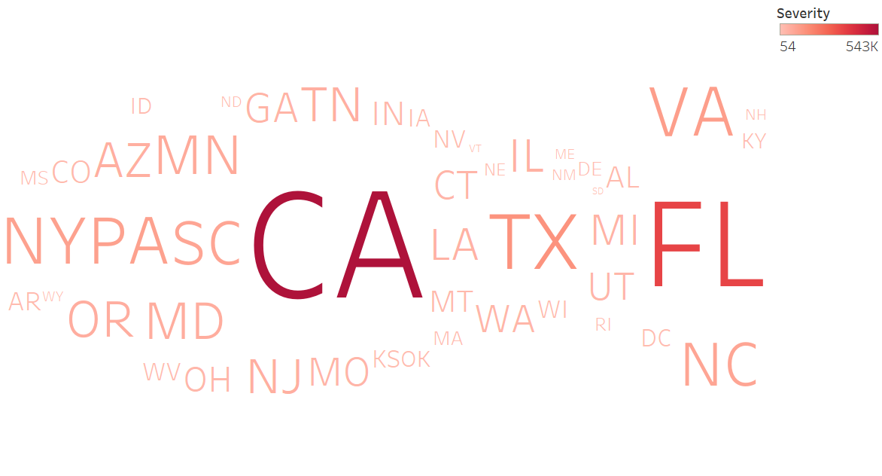
States with highest accident severity

Slide 26
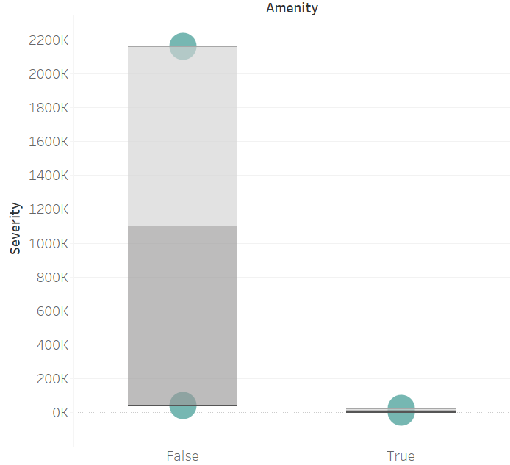
Impact of presence of amenity on severity of accident
Notes:
When amenity is available nearby - true severity of accident is less
Amenity in this case is a tag describing important facilities for visitors, such as toilets, telephones, banks, schools, etc
The presence of stop signs has no effect on accident severity

Slide 27
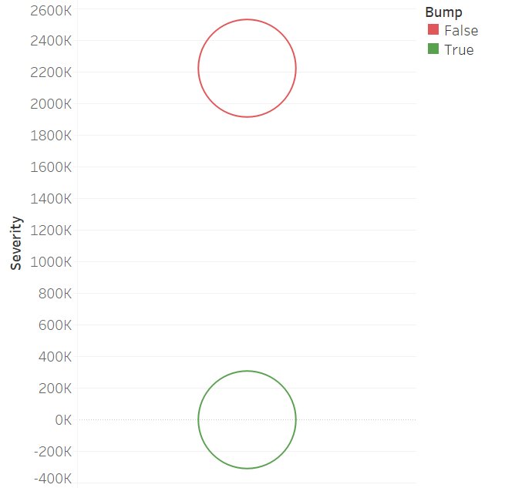
Impact of the presence of a bump on accident severity

Slide 28
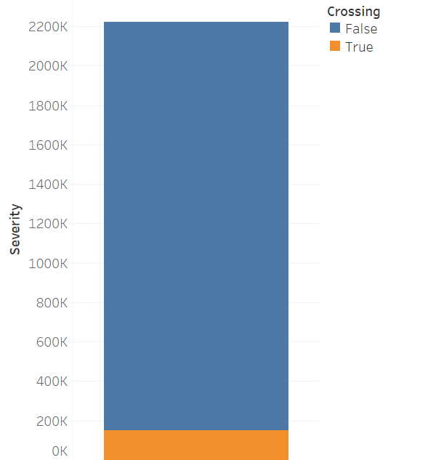
Impact of the presence of a crossing on accident severity

Slide 29
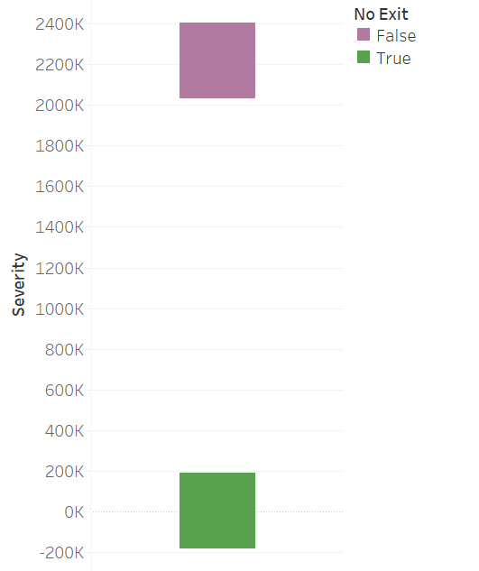
Impact of No Exit on Severity of accident

Slide 30
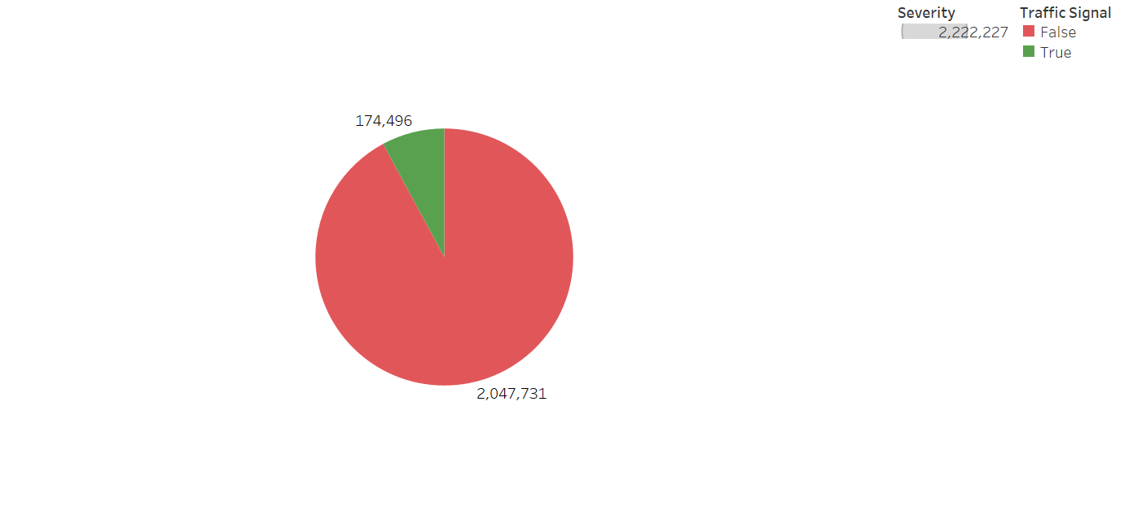
Impact of presence of traffic signal on severity of accident

Slide 31
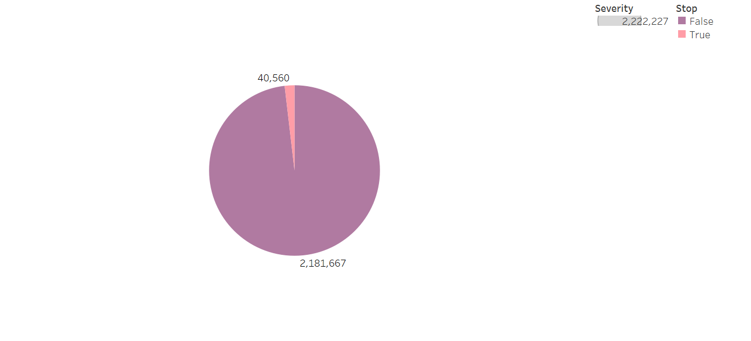
Impact of Stop sign on the severity of accidents

Slide 32
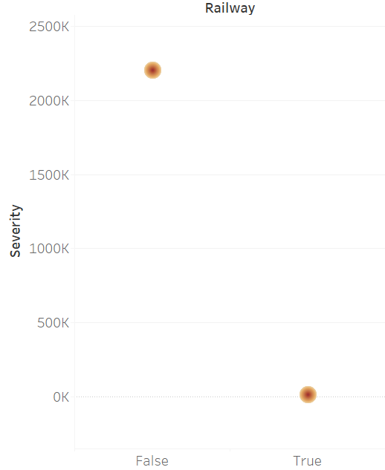
Impact of the presence of railway on severity of accident

Slide 33
Scope and Limitations
Scope:
The scope of the project is to explore and analyze these factors to see if they have an impact on car accidents and use the information to create safer driving conditions
Limitations:
Data was inconsistent consisting of missing values and other data that may have impacted accuracy and reliability of analysis
Parameters like human negligence or distraction while driving could not be captured in the analysis however it can be explored further

Slide 34
Results and Conclusions
Some states have more severe accidents than others because of the number of cars and also weather conditions in different states.
Bad weather conditions such as heavy rain and snow cause more car accidents than sunny days.
Traffic signs & boards do have an impact on occurrence of car accidents
More accidents took place during day time as compared to night time
External factors such as humidity, pressure, temperature do impact car accidents in a certain way

Slide 35
Recommendations and Suggestions
Presence of more external signs like traffic signals, bumps, amenities etc can significantly decrease the number of car accidents
Policy should be enforced in states like California and Florida to manage car accidents
Efficient weather forecast can greatly help people decide about the time of their travel thereby preventing accidents
Relief fund should be arranged for people affected by accidents

Slide 36
References
https://www.kaggle.com/datasets/sobhanmoosavi/us-accidents
Car Accident Statistics For 2023 – Forbes Advisor
The Most Common Car Accident Causes in the United States (anapolweiss.com)
Do Environmental Factors Cause Car Accidents? (ecofriend.org)

Slide 37

THANK YOU FOR BEING SUCH A LOVELY AUDIENCE!!!

