Slide 1
Bringing customers back
A product recommendation engine for the Olist marketplace
Daniel Jethro Monzada · AI/ML capstone · July 2026
Data: Brazilian E-Commerce Public Dataset by Olist (Kaggle, CC BY-NC-SA 4.0).

Slide 2
THE PROBLEM
97 of every 100 customers never come back
96.9%
of customers have placed exactly one order
3.12%
repeat-purchase rate (2,997 of 96,096 customers)
0.02%
of recommendation slots reach small sellers without intervention
• Customer acquisition spend buys, on average, exactly one order.
• Olist sells small merchants on exposure. A bestseller-only storefront quietly breaks that promise.
• Today there is no personalization: every visitor sees the same popular products.

Slide 3
THE OPPORTUNITY
Small movements in retention are worth real orders
960
additional returning customers per +1pp repeat-purchase rate (arithmetic, not a forecast)
≈ R$130k
in orders that +1pp represents, at the observed R$137 average order value
• Returning customers arrive with history, so they're exactly the ones a recommender can serve well.
• For the single-purchase majority, the win is smarter first-purchase cross-sell and regional merchandising, not personalization.
• For sellers: measurable exposure for rarely-shown products protects the marketplace's supply side.
Scope honesty: personalization applies to the ~3% with history today; the engine handles everyone, but with different tools.

Slide 4
THE PRODUCT
What the engine does (no math required)
• Step 1 builds a shortlist: products similar to what you've bought, plus what shoppers like you buy.
• Step 2 ranks the shortlist: a model scores how likely you are to buy each item.
• For a brand-new visitor, it falls back gracefully: bestsellers for your region, or overall.
• Every recommendation can explain itself in one plain sentence: "why you're seeing this".
• Runs as a small web service in a container, serving exactly the pipeline the evaluation graded.
Your history
Shortlist (hundreds)
Ranked top-10
Plain-language why

Slide 5
RESULTS
What the evaluation says, honestly
1 in 5
returning buyers get their next purchase in the top-10 shortlist, vs 1 in 32 with bestsellers
+20%
full pipeline over the shortlist alone, on a strictly past-only holdout (statistically real)
37%
of the catalog reachable in returning buyers' shortlists; a bestseller feed shows 10 products
• Two test beds, labeled honestly: shortlist quality is graded on returning buyers' held-out orders; the deployed pipeline on a strictly past-only three-month holdout.
• All numbers are offline estimates. The honest next step is a live A/B test, and the rollout plan is built around one.
For the technical appendix: shortlist hit rate 0.203 vs 0.031 popularity (leave-last-order-out, 1,949 repeat buyers); end-to-end +0.0024 [+0.0008, +0.0041] Hit@10 vs shortlist-only; shortlist coverage 0.371; live top-10 coverage 0.071 to 0.102 with the seller dial.

Slide 6
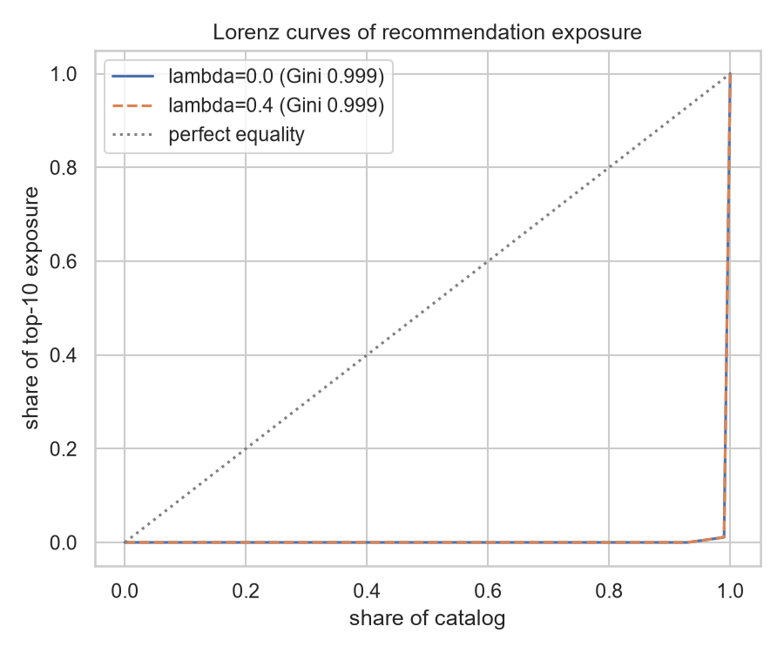
FAIRNESS & BRAND RISK
We audited the bias before anyone asked
• Recommendation quality is not uniform: Northeast customers currently get the best results. We found it, traced it to the shortlist stage, and monitor it.
• Without intervention, small sellers (5.9% of the catalog) receive 0.02% of top-10 slots, a direct risk to the exposure promise.
• We built a dial, and measured both sides of it:
◦ Keep all 10 slots for relevance: best hit rate, near-zero small-seller exposure
◦ Reserve 3 of 10 slots for under-exposed products: small sellers ×4.3, rarely-shown products ×2.1, at ~15% hit-rate cost
◦ Southern customers pay the most for that dial, quantified, so the trade-off is a decision, not an accident
Where to set the dial is a business decision. Our recommendation: validate on newer data than we tuned on, then start conservative (1 reserved slot) and measure.

Slide 7
TRUST & GOVERNANCE
Built for trust from day one
• Explainable: every score decomposes into signals; customers see a plain-language reason.
• No demographics used anywhere. Geography is audited precisely because it proxies income.
• Privacy: no customer identifiers leave our systems, including to the AI vendor that writes explanations.
• Monitored in production: customer-mix drift, score drift, live hit rate, and monthly seller-exposure checks.
• Reversible: every release is a tagged snapshot; rollback is redeploying the previous one.

Slide 8
PLAN
Rollout: prove it live before trusting it
• Phase 1, shadow mode (2 to 4 weeks): serve recommendations silently and compare against actual purchases.
• Phase 2, A/B test on returning buyers: recommendation rail vs bestseller rail; primary metric = repeat-purchase rate.
• Phase 3, regional merchandising for new visitors, measured on first-purchase cross-sell.
• Phase 4, seller-exposure dial, set with the merchant team after validating on newer data.
• Each phase has a kill switch; the offline numbers set expectations, the live numbers decide.
1 · Shadow
2 · A/B returning buyers
3 · Regional merch
4 · Exposure dial

Slide 9
RISKS & THE ASK
Risks we're carrying, and what we need
• Risks:
◦ Offline results may not transfer online, which is why phase 1 is shadow mode.
◦ Recommenders amplify what they show, so popularity feedback loops are a risk; exposure metrics watch for this monthly.
◦ Personalization reach is small today (~3%), and growing it depends on retention improving; the two compound.
• The ask:
◦ An A/B testing slot on the storefront and click/purchase telemetry for the live hit rate.
◦ A product owner for the seller-exposure dial.
◦ A decision review after phase 2 with the live numbers on the table.

