Slide 1
Two-Stage Product Recommendation for the Olist Marketplace
Capstone: Post Graduate Diploma in AI & Machine Learning
Daniel Jethro Monzada · July 2026
~100k real Brazilian eCommerce orders (2016-2018) · candidate generation + supervised re-ranking · fairness-audited
Repo: github.com/jmonzada/ecommerce-recommender-capstone
Data: Brazilian E-Commerce Public Dataset by Olist (Kaggle, CC BY-NC-SA 4.0)

Slide 2
One number, and the shape of the answer
96.9% of Olist's 96,096 customers have placed exactly one order.
• Business question: can a recommender pull customers into a second purchase, and widen exposure beyond bestsellers?
• Seller angle: Olist's pitch to small merchants is exposure, and a popularity-only feed quietly breaks it.
Architecture: two stages, like production systems
1. Candidate generation: item-item CF, content similarity, truncated SVD, popularity, hybrid blend
2. Supervised ranker: LR / RF / XGBoost scoring "will this (customer, product) pair convert?"
The ranker is feature-based, which is where SHAP, PDP/ICE and the fairness audit genuinely work.
Where it lands: on a temporally clean holdout the full pipeline beats shortlist-only by +20% (CI excludes zero); see slide 7.

Slide 3
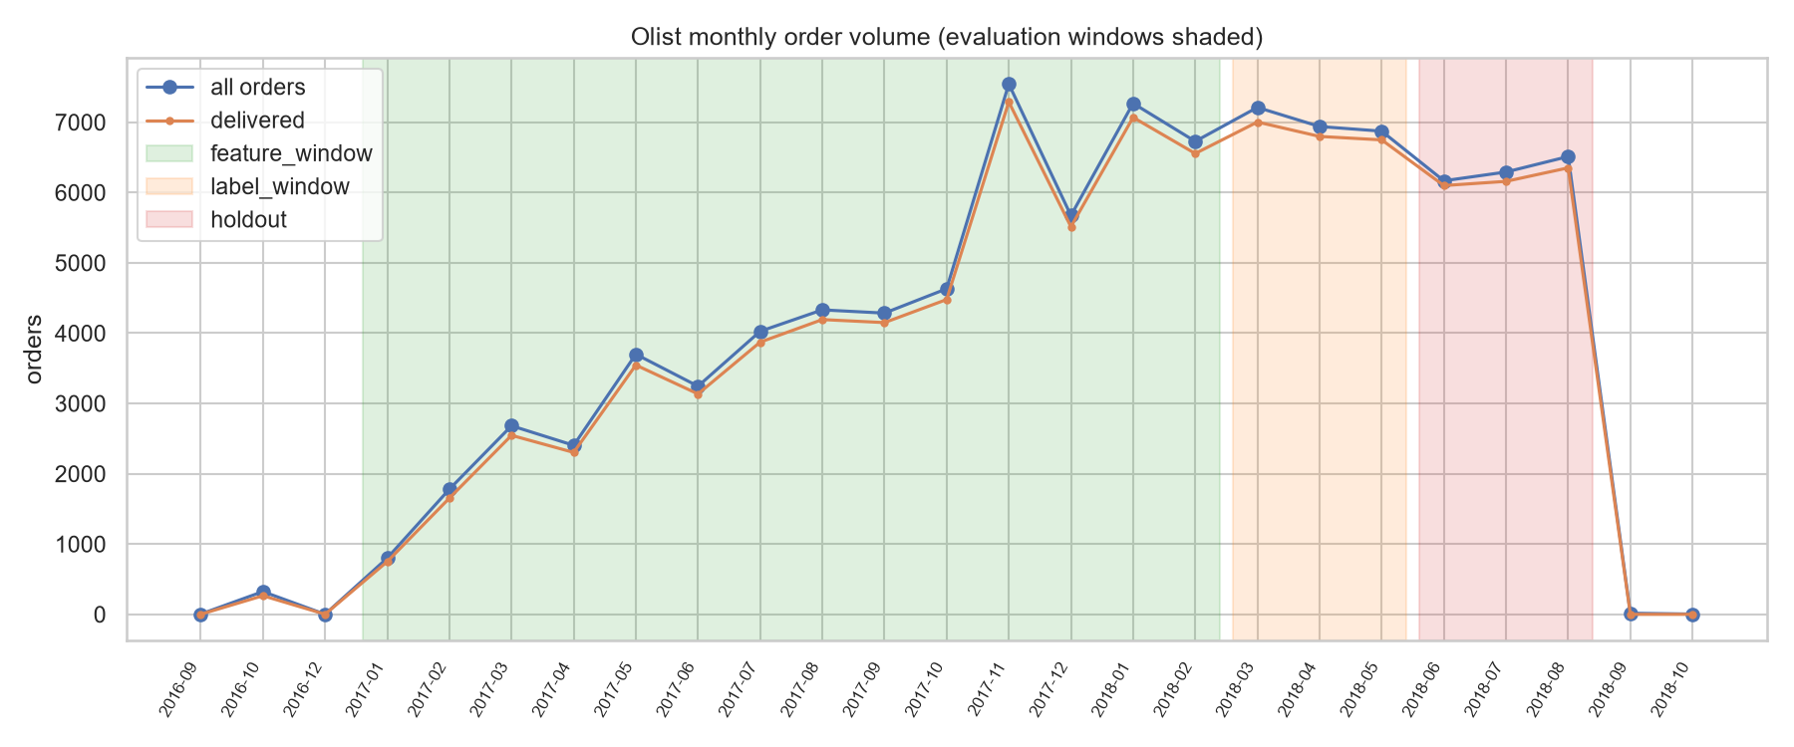
Evaluation protocol (the load-bearing part)
• Three temporal windows (configs/windows.yaml): features 2017-01 to 2018-02 · labels 2018-03 to 2018-05 · holdout 2018-06 to 2018-08 (post-Aug tail collapses, dropped)
• Every aggregate (popularity, similarities, SVD factors, RFM…) computed on the feature window only; audit cells assert max timestamps, including review creation dates (caught 6.7% leakage)
• Candidate gen: leave-last-order-out on 2,789 repeat buyers (840 tuning / 1,949 evaluated), bootstrap CIs, K = 10/50/100 + MRR
• Ranker: GroupKFold by customer; negatives 1:4, half hard (from candidate lists), half random; random-only negatives make the task popularity-easy and mismatch serving (the Step 3 random-negative screen already sat at AUC ≈ 0.81 with weaker features)

Slide 4
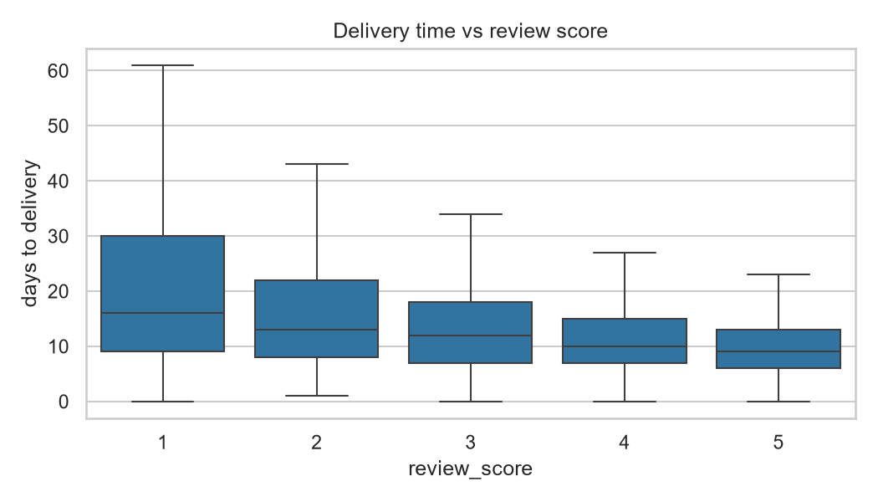
EDA that shaped the design
• Late deliveries (8%) average 2.57 stars vs 4.29 on time, which is why customer-to-seller haversine distance became a pair feature
• Only 2.09% of label-window pairs have any feature-window history, so cold-start routing is core scope, not an afterthought
• Prices heavy-tailed (median R$75, p99 ≈ R$890), so price features are winsorized
• Southeast = 68.6% of customers, North = 1.9%, which sets the minimum-group rules for the fairness audit

Slide 5
Stage 1: candidate generation (repeat buyers, leave-last-order-out)
Model | Hit@10 | 95% CI | MRR | Coverage | Long-tail
Popularity | 0.031 | [0.023, 0.038] | 0.013 | 0.0003 | 0.00
Item-item CF | 0.055 | [0.045, 0.065] | 0.037 | 0.042 | 0.83
Content-based | 0.171 | [0.154, 0.187] | 0.135 | 0.377 | 0.79
SVD (k=256) | 0.054 | [0.045, 0.065] | 0.046 | 0.019 | 0.03
Hybrid (w=0.25) | 0.203 | [0.184, 0.221] | 0.138 | 0.371 | 0.76
• Paired per-user difference, hybrid minus content: +0.032 [+0.022, +0.042], a real winner, not noise
• Honesty note: 62-69% of hits are repurchases; CF is signal-starved (co-purchase matrix has 8,710 pairs)
• Popularity's coverage is 10 products. That's the baseline the marketplace ships without ML.
• Caveat: LOO trades temporal strictness for coverage; decision-grade numbers are the end-to-end table (slide 7)

Slide 6
Stage 2: conversion rankers (sampled negatives give relative numbers)
Ranker | CV AUC | Holdout AUC | PR-AUC | F1@τ
Logistic regression | 0.697 | 0.785 | 0.414 | 0.475
Random forest | 0.852 | 0.865 | 0.619 | 0.569
XGBoost | 0.853 | 0.864 | 0.614 | 0.578
• Tuned via randomized search, GroupKFold by customer; τ picked on out-of-fold predictions
• RF train AUC 0.945 vs holdout 0.865; the overfit gap LR doesn't have; XGBoost wins on F1 with a smaller gap
• These metrics compare rankers against each other; sampled 1:4 negatives make absolute values meaningless

Slide 7
The headline table: end-to-end on 18,390 holdout customers
Pipeline | Hit@10 | 95% CI | NDCG@10
Popularity only | 0.0114 | [0.0099, 0.0130] | 0.0052
Stage 1 only (routed hybrid) | 0.0122 | [0.0105, 0.0139] | 0.0062
Two-stage + LR | 0.0061 | [0.0051, 0.0073] | 0.0032
Two-stage + RF | 0.0132 | [0.0115, 0.0150] | 0.0064
Two-stage + XGBoost | 0.0146 | [0.0128, 0.0165] | 0.0069
• Paired per-customer difference vs Stage 1: +0.0024 [+0.0008, +0.0041], i.e. +20% relative, CIs exclude zero
• Re-ranking is not free: the LR re-rank halves performance; stage 2 must earn its place
• Routing reality: 98.5% of holdout customers are cold, served regional/global popularity; warm cohort (n=277) is underpowered and slightly prefers raw hybrid, flagged as future work, not hidden

Slide 8
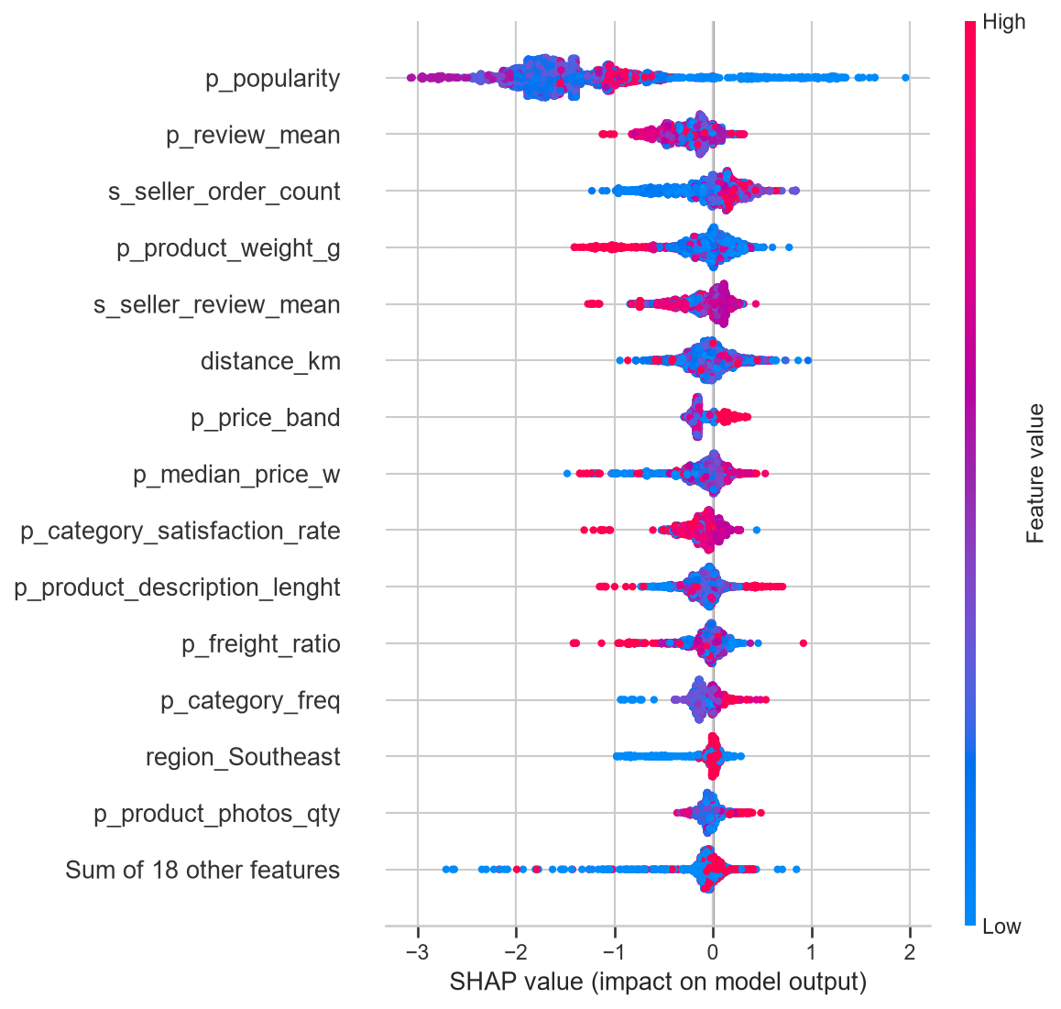
Explainability: SHAP on the ranker
• Top signals: product popularity, co-purchase signal, price/spend match, seller stats, distance
• The counterintuitive one: within candidate lists, high popularity gets a negative gradient; hard-negative training taught the ranker "popular but still not bought" (PDP peaks then collapses; LIME agrees on signs)
• Cold-start waterfall: with no customer history, product & seller features carry the score, exactly what you'd want
• This SHAP-to-plain-English pipeline later feeds the LLM explanations (Step 9)

Slide 9
Fairness audit: region as socioeconomic proxy (IBGE-cited)
Evaluation population = Stage-1 candidate lists (919,500 pairs); per-user random negatives would fake parity. Groups under n<30 positives suppressed (North).
Region | TPR@τ | AUC
Northeast | 0.222 [0.139, 0.319] | 0.825
Center-West | 0.100 | 0.679
South | 0.031 | 0.709
Southeast | 0.028 | 0.714
• TPR gap 0.194, favoring the Northeast, and it persists in final lists (NE hit@10 0.031 vs 0.010-0.014)
• Mechanism found: Stage-1 retrieval recall is already higher for NE (0.043 vs 0.025-0.032); the disparity starts at candidate generation, not the ranker
• Fairness-through-unawareness buys nothing: dropping geography features costs accuracy (AUC 0.723 to 0.713) while gaps barely move; the τ-fixed TPR-gap widening (0.194 to 0.292) is partly a calibration artifact; freight & price encode geography anyway

Slide 10
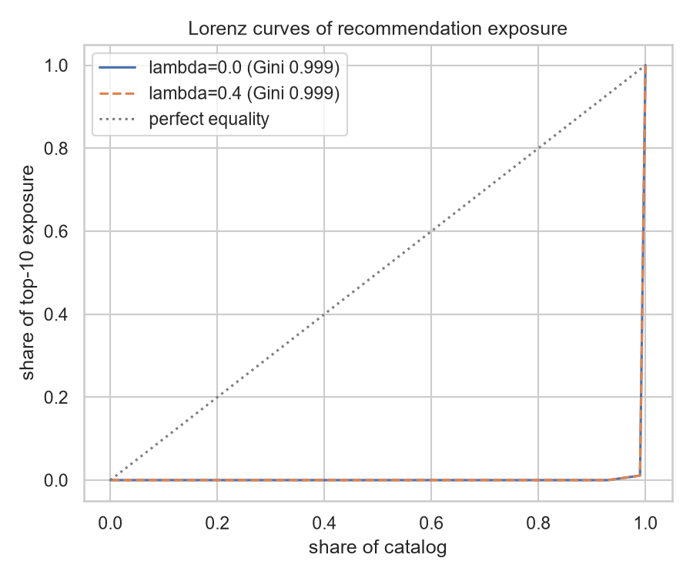
Provider-side bias & mitigations (matched before/after)
Exposure Gini 0.9986; small sellers = 5.9% of catalog, 0.02% of top-10 slots.
Mitigation | Result
ThresholdOptimizer (region) | Honest negative, didn't transfer to holdout
Score-penalty re-rank (λ sweep) | Inert; bias sits at candidate generation
Candidate-stage exploration | Backfired: -73% hits (the anti-popularity gradient punishes injected popular-ish items)
Reserved-slot injection (3 of 10) | -14.5% Hit@10 for coverage 0.071 to 0.102, long-tail ×2.1, small sellers ×4.3
South pays the most: paired Δ -0.0045 [-0.0078, -0.0021], reported and gated on fresh-window validation before serving.

Slide 11
From notebooks to a running system
• Serving: FastAPI GET /recommend/{customer_id} runs the exact evaluated pipeline (src/pipeline.py shared with the audit notebook); cold-start routing built in; Docker image bakes data + artifacts
• MLOps: configs in YAML, MLflow on every training run, CI (ruff + 38 tests) green since first push, monitoring plan (routing-share drift, then score PSI, then online hit-rate, then monthly exposure), rollback = previous git tag
• GenAI (Step 9): each recommendation's TreeSHAP signals become value-aware plain-English glosses, then one grounded Claude sentence, cached & committed; the grounding bug we caught (asserting a region for an unknown visitor) is preserved as evidence
• Demo video: docs/media/demo.mp4 (41s, all three routes + explanations)

Slide 12
Limitations & what I'd do next
Limitations (also in the report, not fine print):
• All numbers are offline proxies; validating uplift needs an A/B test
• Warm-cohort re-rank question is underpowered (n=277); route-conditional re-ranking is the obvious experiment
• Repurchase drives most personalization hits; CF is starved at 1.04 products/order
• Fairness mitigation trade-off selected on the audit window, so fresh-window validation before enabling
Next: online experiment on repeat buyers · route-conditional re-rank · richer content features (the dataset has no text/images) · category-level objectives for cross-sell
Everything reproducible: seeded runs, pinned configs, committed artifacts, one-command serving.

