Slide 1
Cannabis Use and its Effects on Measures of Mental Health
Julian Moon
Project Advisor: Dr. James McKay, Department of Psychiatry, University of Pennsylvania

Slide 2
Background
Marijuana, although an illegal substance, has been widely considered to be without significant addiction potential or major detrimental health effects. However, with the emergence of genetically engineered strains that have unprecedented potency, far more cases of people seeking help for dependency have been reported in the past decades.
With legalization becoming controversial throughout the nation, research in this area has received more widespread attention. While proponents support its potential medicinal benefits, much work is needed to evaluate and understand the negative repercussions of using cannabis.
With multiple related measures, the correlation between cannabis use and its effects on mental well-being was explored. Key aspects of the study include depression, post-traumatic stress disorder, and dependency.

Slide 3
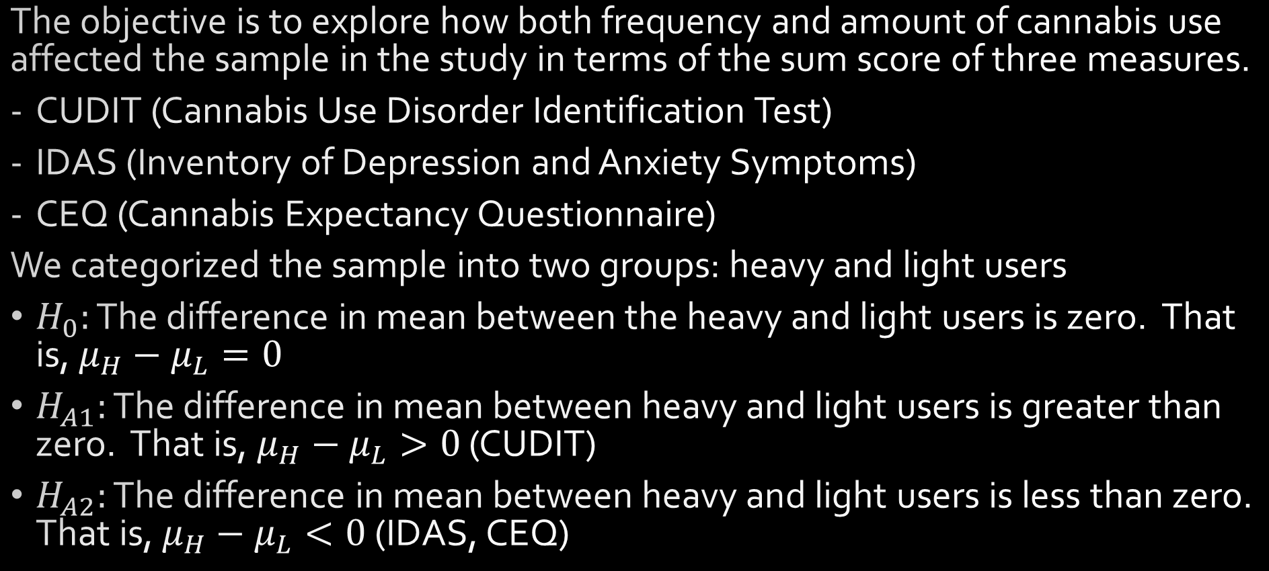
Hypothesis
The objective is to explore how both frequency and amount of cannabis use affected the sample in the study in terms of the sum score of three measures.
CUDIT (Cannabis Use Disorder Identification Test)
IDAS (Inventory of Depression and Anxiety Symptoms)
CEQ (Cannabis Expectancy Questionnaire)
We categorized the sample into two groups: heavy and light users
$H_{0}:$ The difference in mean between the heavy and light users is zero. That is, $μ_{H}−μ_{L}=0$
$H_{A1}:$ The difference in mean between heavy and light users is greater than zero. That is, $μ_{H}−μ_{L}>0$ (CUDIT)
$H_{A2}:$ The difference in mean between heavy and light users is less than zero. That is, $μ_{H}−μ_{L}<0$ (IDAS, CEQ)

Slide 4
Methods
Convert numerical data into categorical data for independent variable
Adjust dependent variables for numerical analysis
Basic descriptive statistics and data analysis
Analyze correlation between data as well as association between dependent variables
Appropriate statistical testing methods to obtain p-values

Slide 5
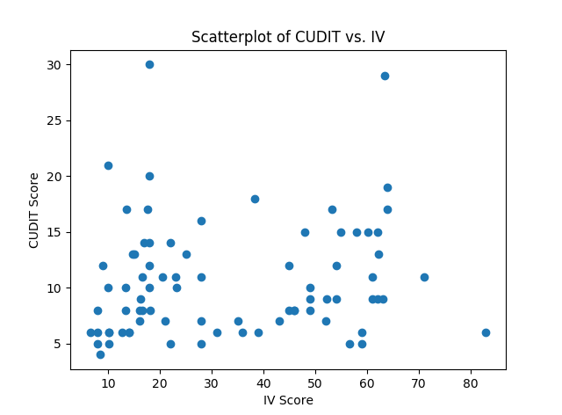
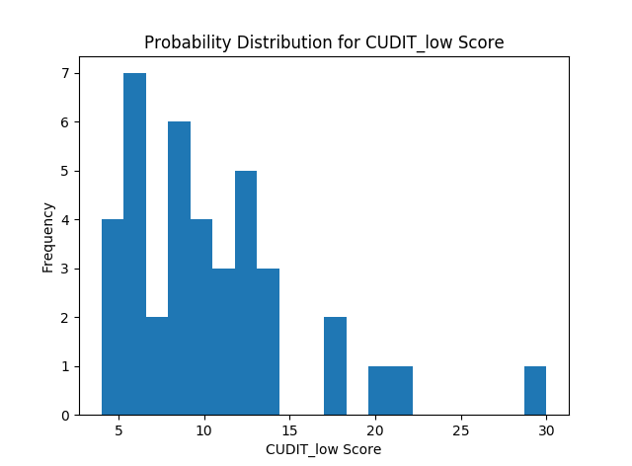
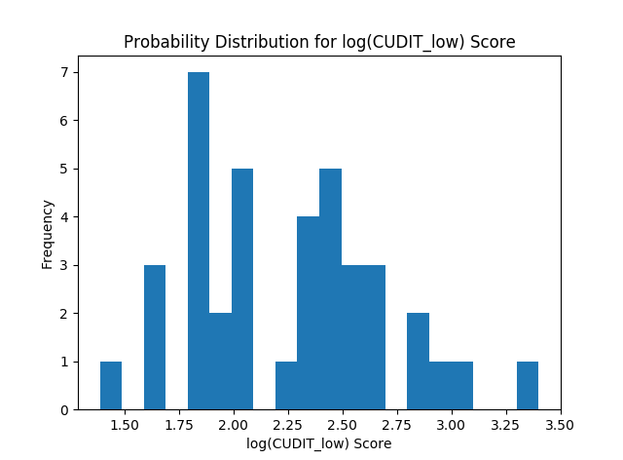
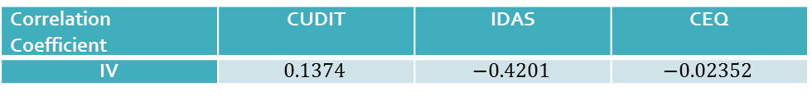
Data Analysis
(a)
(b)
(c)
Figure 1. Scatterplots and histograms were used to observe the trends of the variables. The shapes of the distribution direction for further analysis, including necessary transformations and appropriate statistical testing methods.
Correlation Coefficient | CUDIT | IDAS | CEQ
IV | $$0.1374$$ | $$−0.4201$$ | $$−0.02352$$
Table 1. Pearson’s correlation coefficient, as well as the means and variances were calculated in order to confirm trends from observations, as well as to provide further direction for selecting an appropriate testing method
 | Mean | Variance
CUDIT_low | 10.4359 | 27.1690
CUDIT_high | 10.7500 | 24.3875
log(CUDIT_low) | 2.2394 | 0.2028
log(CUDIT_high) | 2.2821 | 0.1791
CEQ_low | 50.2564 | 71.7291
CEQ_high | 48.4750 | 109.5494
Transformed CEQ_low | 3.8912 e+8 | 3.3996 e+16
Transformed CEQ_high | 3.6210 e+8 | 5.2151 e+16
IDAS_low | 152.0769 | 1510.9941
IDAS_high | 124.4500 | 904.2975

Slide 6
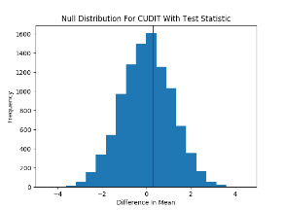
Hypothesis Testing
Welch’s t-test (with non-equal variances)
Mann-Whitney U-test
Randomization Test
With no information of the underlying population and difficult distribution shapes to work with, nonparametric methods were useful for obtaining more accurate results.
Three tests involving varying levels of standardization and power were used to gauge the variance of results.
Figure 2. The null distribution for the test statistic was generated using ten-thousand random permutations of the dependent variables. The red vertical line indicates the value of the test statistic from the original data.

Slide 7
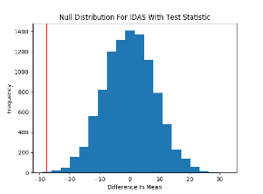
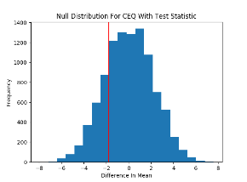
Results
 | CUDIT | IDAS | CEQ
t-test | 0.3347 | 0.0004263 | 0.2845
Mann-Whitney U | 0.3200 | 0.0014581 | 0.2943
Randomization | 0.4025 | 0.0004 | 0.2078
Table 2. p-Values indicate that the null hypothesis cannot be rejected for CUDIT and CEQ, while for IDAS, it supports the alternative hypothesis. Despite the varying results of the p-values obtained from the three methods, there doesn’t appear to be an egregious gap between the numbers, which indicates no blatant error in the choice of tests.
Figure 3. A visual representation of the null distributions generated by the randomization method. The red vertical lines indicate the original test statistics for each variables. Their positions graphically represent the p-values, with only IDAS deviating significantly from the null distribution.

Slide 8
Discussion
Statistical Analysis
The shapes of the distributions for the dependent variables were irregular, making normalizing transformations and standard parametric tests difficult to use.
Welch’s t-test: corrects for unequal variance and can be used for unequal number of samples
Mann-Whitney U-test: Rank based test. Despite differences in variance (Table 1), the shapes of distributions are similar across both groups, satisfying one of the conditions for this test.
Randomization: 10,000 random permutations of group assignment across sample to generate a null distribution. Most effective as it directly uses the given data to generate a null to compare the test statistics against.
p-values suggests we can only reject the null hypothesis for IDAS, but not for CUDIT and CEQ
Limitations
The use of a cross-sectional study rather than a longitudinal one limits the scope of time
Incomplete data, limited sample size and unknown population
Limitations of the measures: Likert scale lacks specificity and numerical conversion led to equal distribution in weight for every response

Slide 9
Conclusions and Moving Forward
Various methods indicate that there is no statistically significant difference in mean for CEQ and CUDIT scores across both groups. IDAS in contrast, displays significantly lower scores in the heavier smokers.
With increasing support for legalization across the nation, both quantity and quality of data available will concurrently increase. Despite widespread perception, contemporary research suggests that cannabis does have potential for abuse. Many studies focus on the possible medicinal benefits of the substance, but with steadily public access to cannabis products, more studies on its negative effects on both physical and mental health are equally important.
Acknowledgements
Dr. James R. McKay, Department of Psychiatry, University of Pennsylvania
Dr. Marcel Bonn-Miller, Department of Psychiatry, University of Pennsylvania
Mallory Loflin, MA, University of Albany

