Slide 1
CSC302 Final Presentation
Jacob Moore
Robert Jackson
Austin Graham

Slide 2
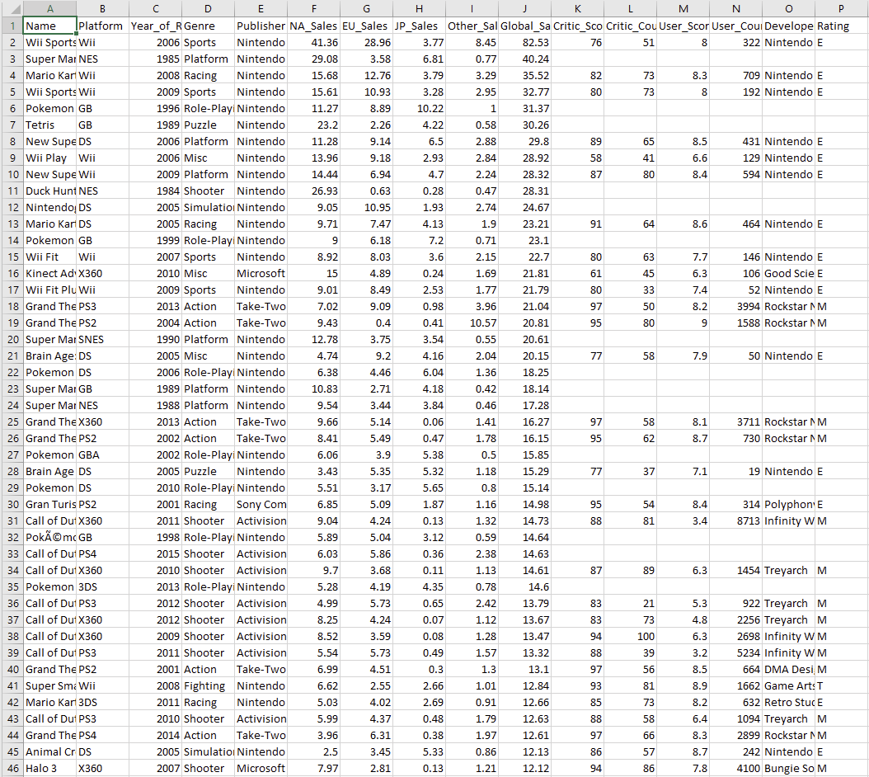
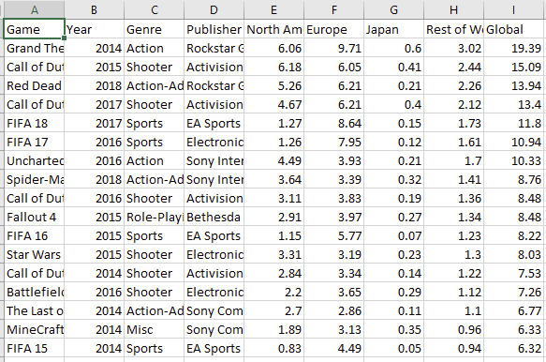
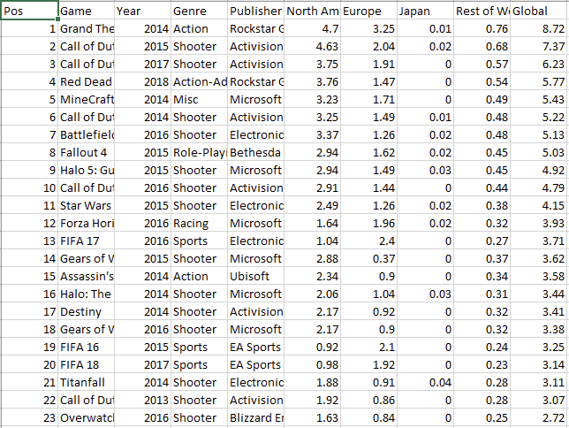
Our data sets:
Data set 1: Video Game sales
Data set 2: PS4 game sales
Data set 3: Xbox game sales
https://www.kaggle.com/sidtwr/videogames-sales-dataset

Slide 3
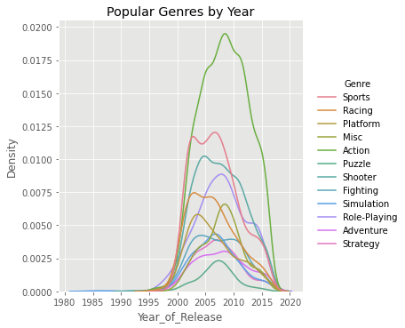
Genre by the last 40 Years
Market Saturation
Different Genres
Indicator of over saturation of certain genres.
Notes:
This graph displays market saturation for the different genres during a period of time. This can be an indicator of an over saturated market or to find what genres were selling well during a time period.

Slide 4
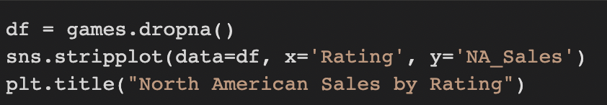
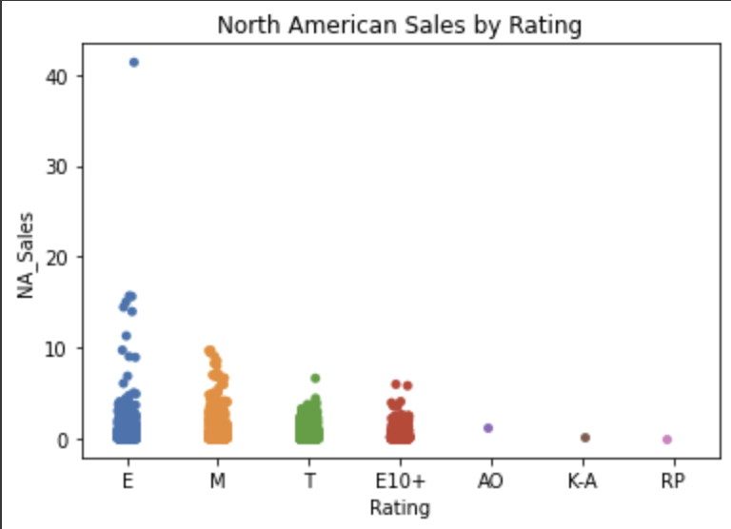
North American Game Sales by Rating
E - Everyone
M - Mature
T - Teen
E10+ - Everyone 10+
K-A - Kids to Adults
AO - Adults Only
EC - Early Childhood
RP - Rating Pending
Notes:
This graph is displaying how well games sold in North America based on Game Genre. / Jake
E - Everyone
M - Mature
T - Teen
E10+ - Everyone 10+
K-A - Kids to Adults
AO - Adults Only
EC - Early Childhood
RP - Rating Pending

Slide 5
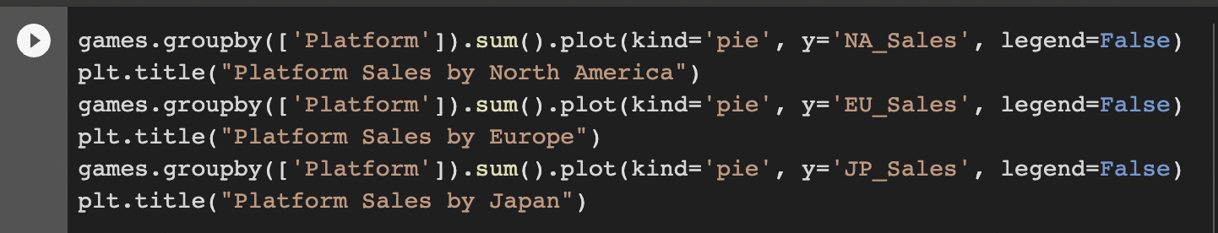
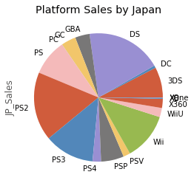
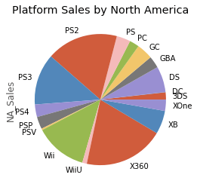
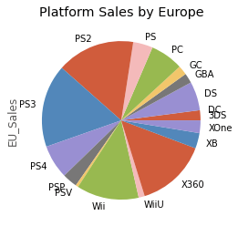
Best Selling Platforms By Region
North America
Europe
Japan
Notes:
Displaying best selling platforms by North America, Europe, and Japan

Slide 6
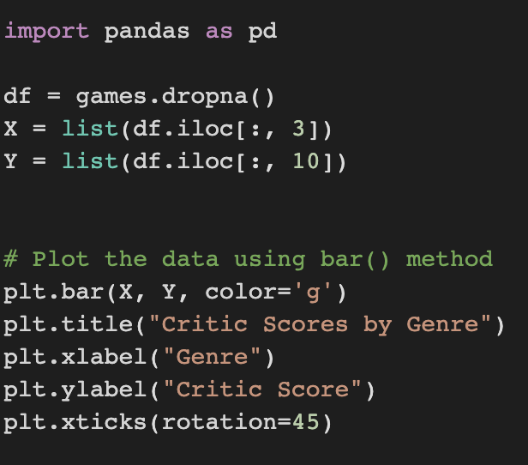
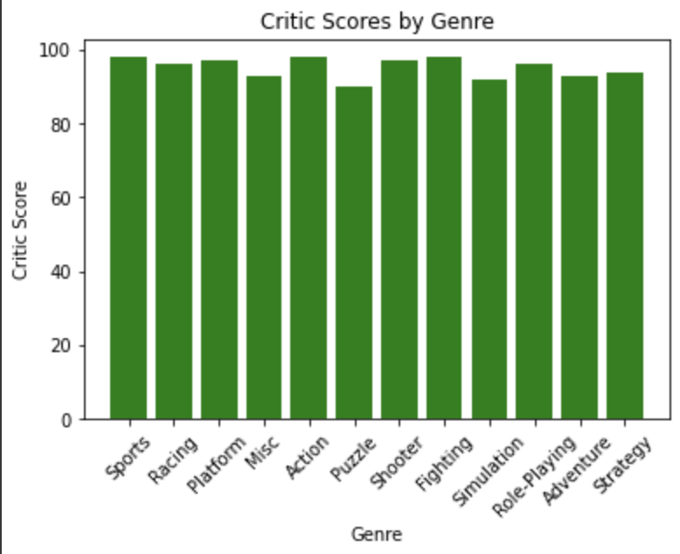
Critic Scores By Genre
Indicates best rated genres
Genre’s seem to be relatively similar in score.
No correlation of biases in genre type.
Notes:
Critic Score by Genre
We hypothesized that there would be a larger difference in critic scores between genres than there were
Shows that games can be made for any market

Slide 7
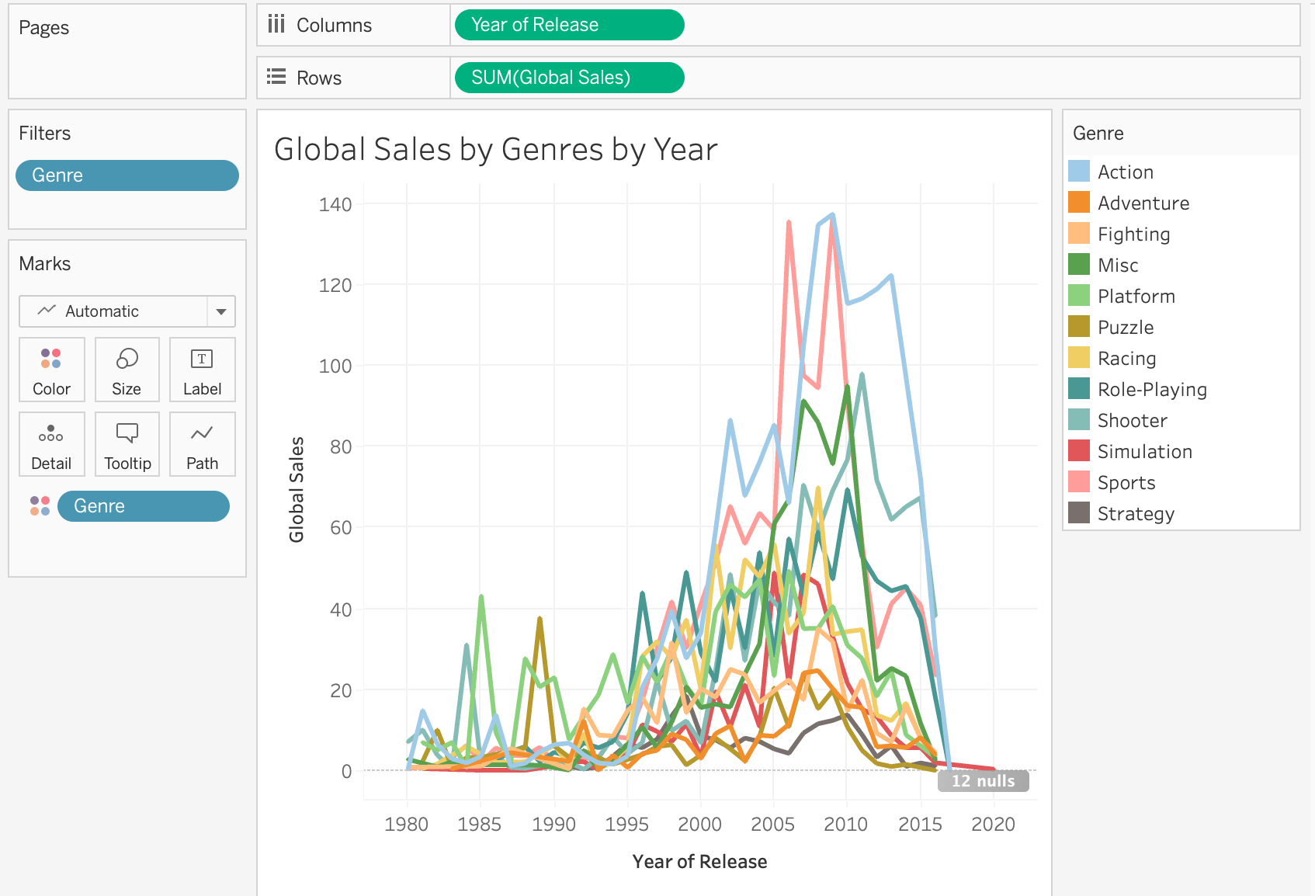
Global Sales by Genres By Year
Indicates the top game genres globally.
Over the last 10 years, Action and Sports games have been the top 2.

Slide 8
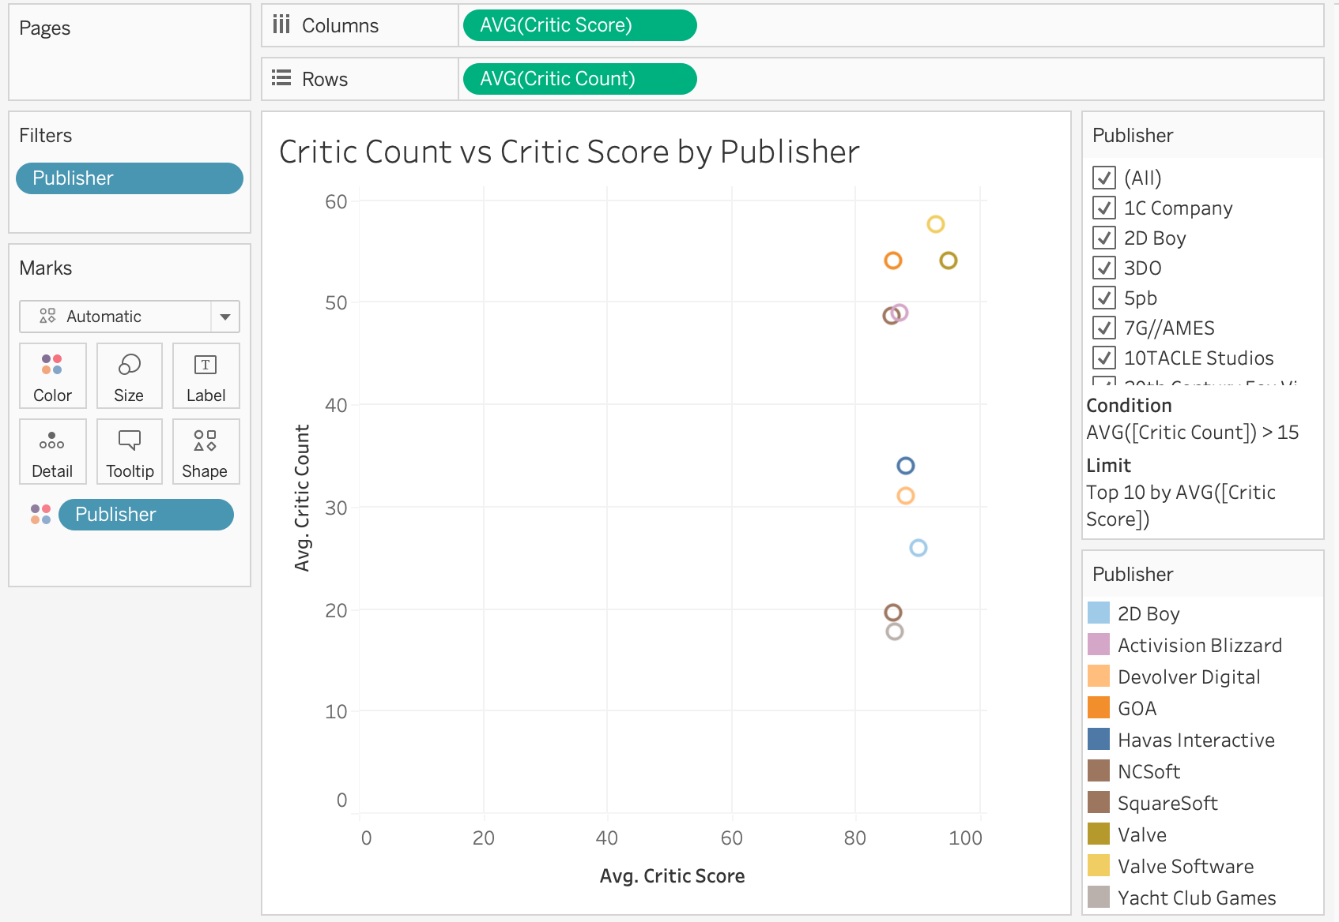
Critic Count vs Critic Score by Publisher
Average score is around 80
Wanted to test to see if the number of critics affected the score.
Did not notice a strong correlation between the critic count to the average score.

Slide 9
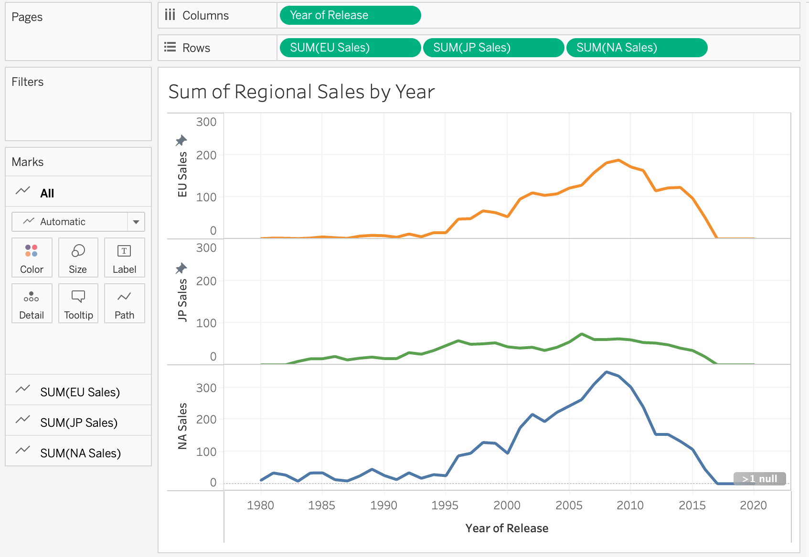
Sum of Regional Sales by Year (JAKE)
Sales (millions)
Sales increase in all markets around 1995
Sales begin to decline in all markets around 2010 (possibly disc sales)

Slide 10
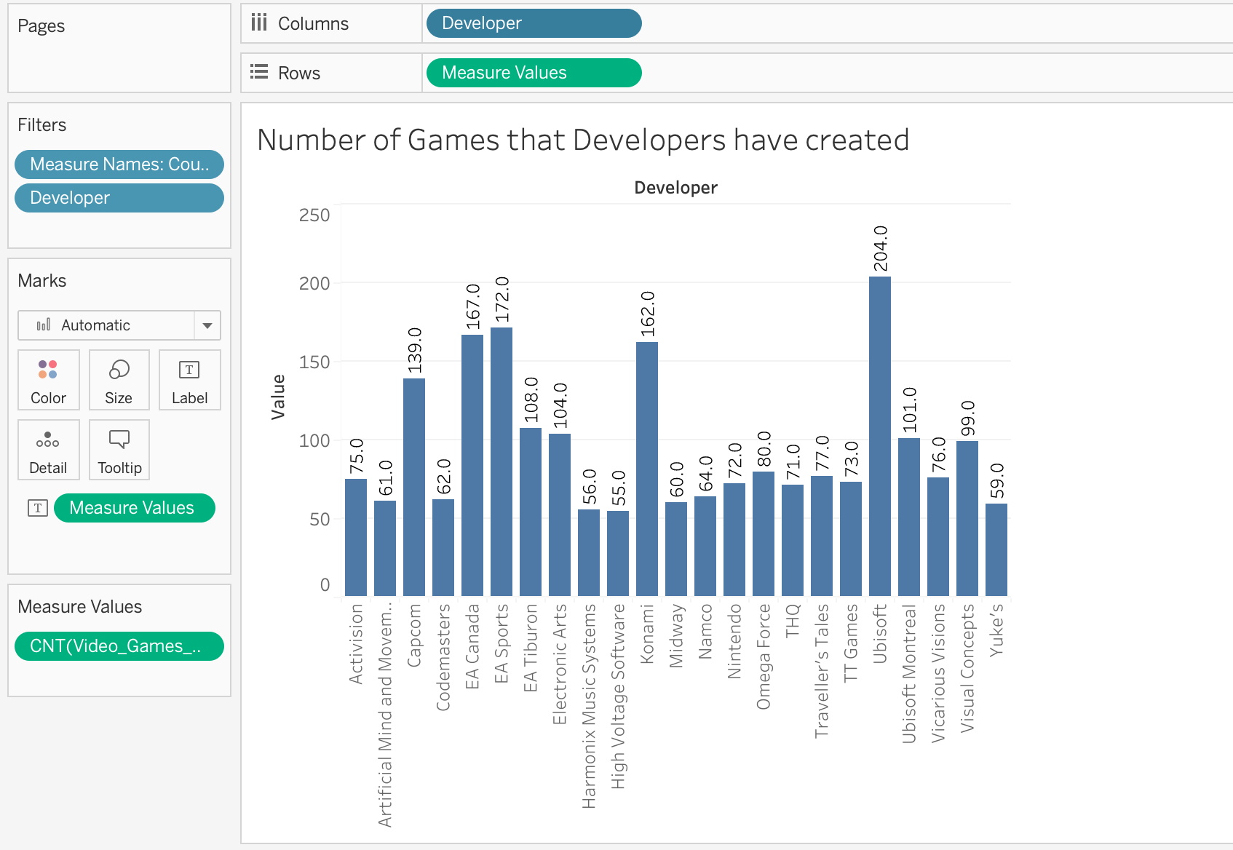
Number of Games that Developers have created
EA Sports and Ubisoft are top 3, but they also released unfinished games.
The top companies listed focus on releasing games as often as possible for profit.
The top releasers typically choose quantity over quality.
Notes:
Rehash assets
Rehash gameplay elements
Games are similar in design and concept
Not much innovation between games

Slide 11
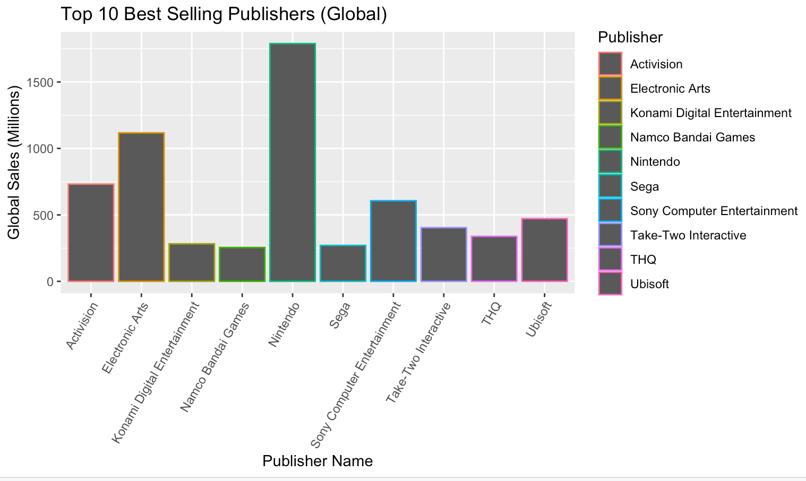
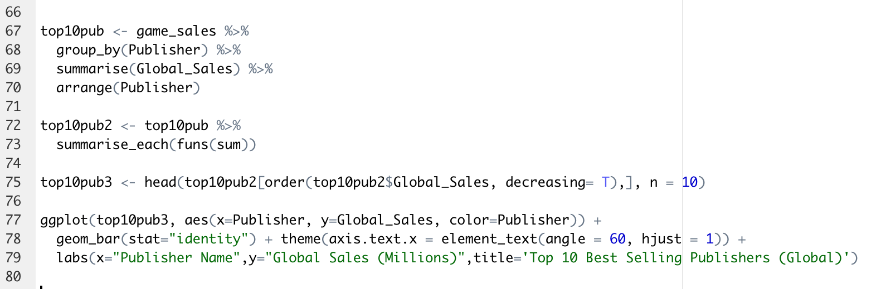
Top 10 Best Selling Publishers (Global)
Big name brands are like Nintendo and Activision are at the top.
They release games frequently, which leads to more sales.

Slide 12
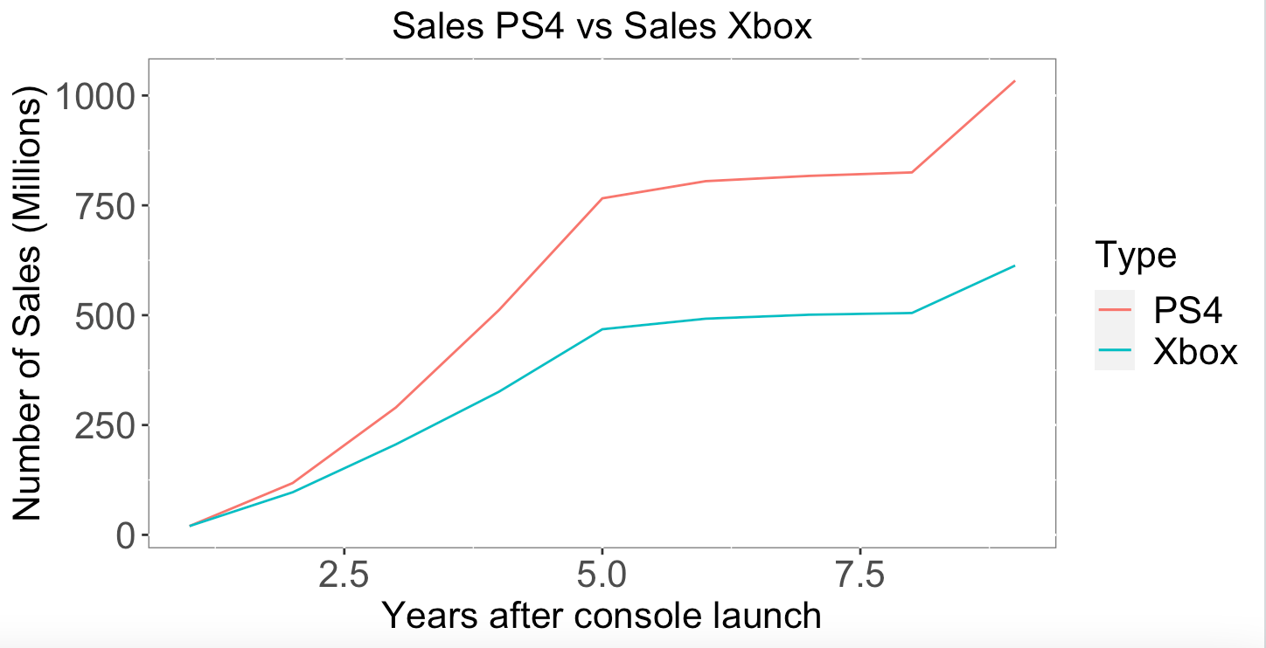
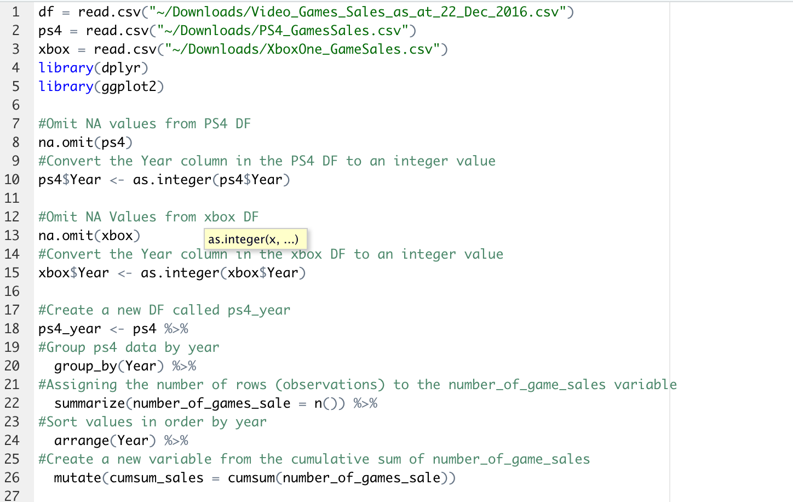
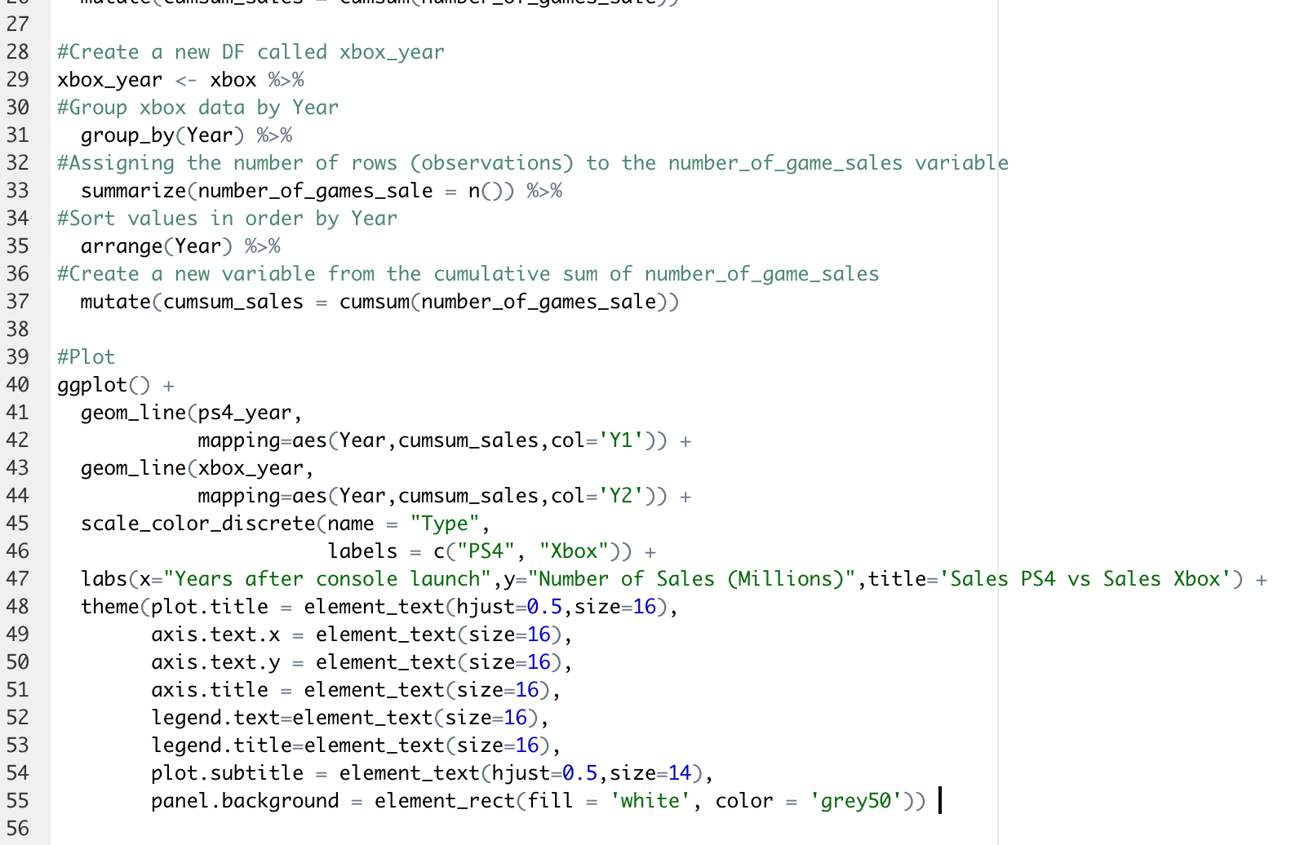
Sales PS4 vs Sales Xbox
From this graph, we can see that the number of sales for the PS4 are always more than Xbox during every year from 2013 to 2020.

Slide 13
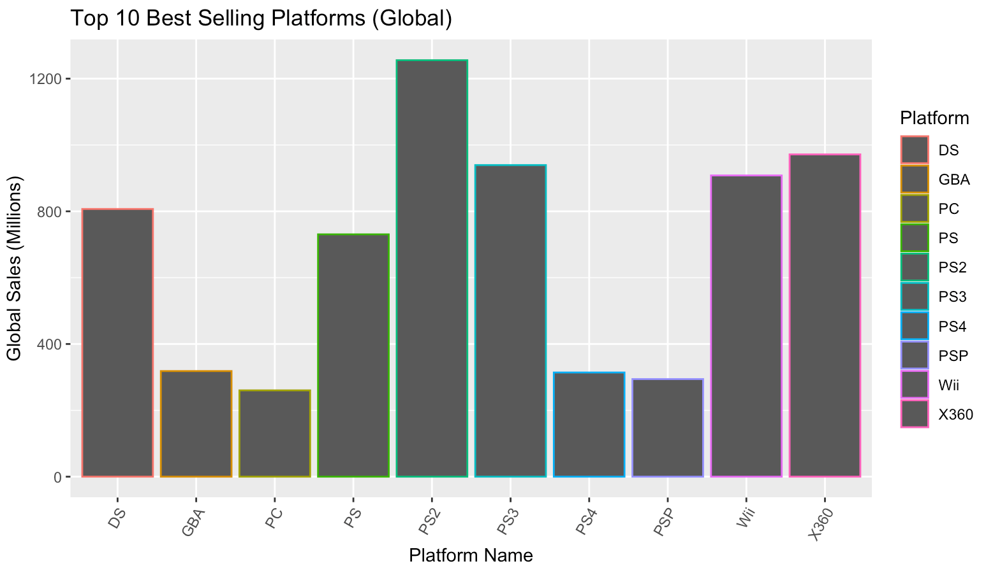
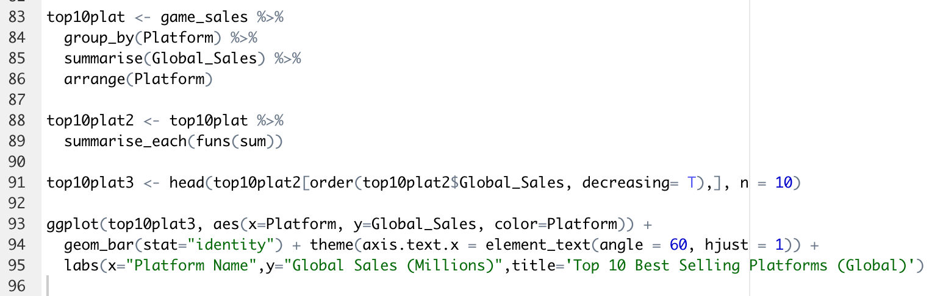
Top 10 Best Selling Platforms (Global)
Shows the best selling platforms ever.
The X360, PS3, and the Wii were released in the same generation.

Slide 14
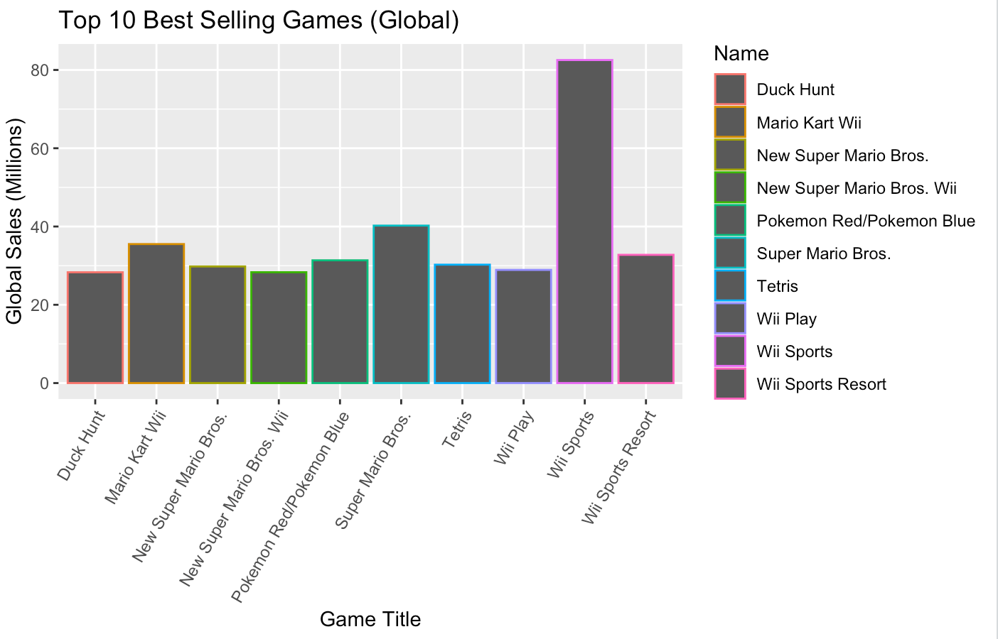
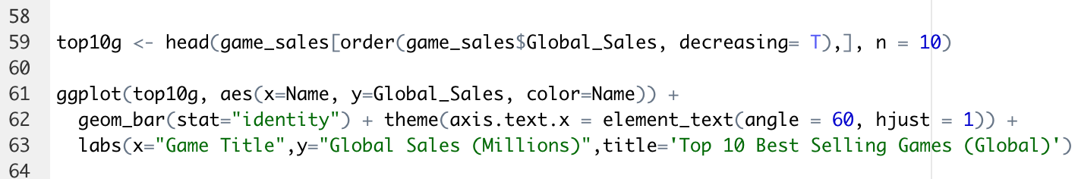
Top 10 Best Selling Games (Global)
Nintendo games dominated the market in sales.
All top 10 games are on Nintendo games.
Family-friendly games sell the best overall.

Slide 15
Conclusions For Video Game Sales
Market for games is heavily dominated by:
1. Action
2. Sports
3. Shooter
Games with ratings E and M tend to sell the most in the North American market.
Nintendo and Playstation platforms make up over half of Japan’s console market.
Playstation and Xbox dominate the North American and European markets.
PS3, X360, and the Wii is the best selling console generation.
Nintendo sells the most games.

