Slide 1
Delivery Governance Operating Layer
Deliver Faster, Drive Margin, Scale Portfolio
Notes:
My immediate priority is hands-on PMO support and building trust across our accounts .
In parallel, to work out a plan for an operating layer that enables the PMO to 1) deliver faster 2) drive margin an 3) scale portfolio.

Slide 2

The Scale vs. Control Paradox in Delivery Management
DELIVERY GOVERNANCE OPERATING LAYER
trending_up
The Scaling Reality
Volume Breaks Manual Review
Portfolio growth linearly increases weekly narrative volume.
PMO manual review capacity remains strictly fixed.
Crucial margin and milestone signals get lost inside disconnected status decks.
history
The Latency Trap
Operating as Forensic Historians
Delivery status is scrutinized long after reporting cycles conclude.
Interventions occur post-breach rather than during risk emergence.
Remediation requires costly emergency commercial write-offs.
bolt
The Operational Shift
Exception-Driven Assurance
Telemetry is ingested continuously and normalized automatically.
Governance pivots from manual status chasing to exception steering.
Frees PMO bandwidth for high-touch account turnarounds.
Confidential | ‹#›
Notes:
Manual health report reviews plus portfolio growth breaks early risk detection capacity, turning leadership into retrospective "forensic historians" who discover delivery and margin distress only after thresholds have breached.
Instead, we need an operating layer that can programmatically detect early threshold breaches so we can focus our time entirely on high-impact interventions.

Slide 3
Beyond Control: What This Unlocks for Growth
DELIVERY GOVERNANCE OPERATING LAYER
speed
1. Deliver Faster
Faster Detection, Faster Routing
Telemetry is ingested continuously instead of surfacing in status decks.
Most signals route and resolve without waiting on a review queue.
Precedent and baseline checks run automatically, not manual digging.
trending_up
2. Drive Margin
Higher-Margin Contract Types
Margin erosion is flagged at breach, not after the cycle closes.
Intervention happens during risk emergence, not after it compounds.
Smaller, earlier corrections replace costly emergency write-offs.
bolt
3. Scale Portfolio
Without Scaling Headcount 1:1
Deterministic scoring replaces reviewer-hours-per-project.
New contract types or acquired teams plug in via configuration, not headcount.
Governance cost stops growing linearly with project count.
Confidential | ‹#›
Notes:
With a Delivery Governance Operating Layer in place we can:
Deliver Faster answers the status-deck latency problem.
Drive Margin answers the forensic-historian problem: catching erosion at emergence instead of post-breach is exactly what avoids the costly emergency write-offs slide two called out.
Scale Portfolio answers the fixed-capacity-versus-linear-growth problem directly.
Deliver faster: telemetry is ingested continuously instead of surfacing in a disconnected status deck, most signals route and resolve without waiting on a review queue, and precedent and baseline checks run automatically so investigation never starts from zero.
Drive margin: this is the direct fix for the forensic-historian problem. Margin erosion is flagged the moment it breaches threshold instead of surfacing after the reporting cycle closes, intervention happens while the risk is still emerging, and that is what replaces costly emergency commercial write-offs with smaller, earlier corrections.
Scale the portfolio: this is the direct fix for the fixed-capacity problem. Deterministic scoring replaces reviewer-hours-per-project, governance cost stops growing linearly with portfolio volume, and new contract types or acquired teams plug in through configuration rather than added headcount.
Same caveat as the detailed version in the appendix: this is directionally right based on what is built today, but it is not sized. The natural next step is to attach real numbers — current PMO hours per cycle, headcount ratio, and target contract-mix shift — so this becomes a sized business case rather than a framing.

Slide 4
System Architecture: Deterministic Ledger vs. Probabilistic AI
DELIVERY GOVERNANCE OPERATING LAYER
shield
Layer 1: Governed Baseline
Contract Baselines
Baseline Excel workbooks ingested and validated into SQLite.
Governs committed milestones, margin targets, and financial baselines.
Upserted per project today — a write-once ledger is target-state.
settings
Layer 2: Deterministic Core
Python / SQL Engine
Hardcoded rule sets evaluate contract-specific thresholds.
Multi-cycle state machines increment aging and escalation counters.
Gates the top escalation tier via Human-in-the-Loop review before action.
auto_awesome
Layer 3: Generative AI
Advisory & Context Layer
Synthesizes unstructured notes, sentiment, and client context.
Retrieves historical remediation playbooks from past cases.
Produces structured escalation rationale without ever modifying core metrics.
Confidential | ‹#›
Notes:
With the growth stakes on the table, the natural next question is how we capture that upside without introducing black-box risk.
The answer lies in our architecture: we strictly separate deterministic ledger math and signed contract baselines from probabilistic AI advisory.
Layer one locks in our baseline from signed SOWs—milestones, rates, and target margins for the engine to evaluate against (today upserted per project; a tamper-evident ledger is on the roadmap).
Layer two is our deterministic engine in Python and SQL. It runs the math, scores contract thresholds, and tracks risk aging across consecutive cycles.
Layer three is our AI advisory layer. It synthesizes context and surfaces past playbooks, but escalations to the executive tier always stop at a human validation gate.

Slide 5
Target Operating Capabilities: Detect • Decide • Act • Learn
DELIVERY GOVERNANCE OPERATING LAYER
search
1. Detect
Continuous Ingestion
Tracks schedule float loss.
Monitors margin slippage.
Flags key-role staffing vacancies.
Surfaces cross-cycle aging.
gavel
2. Decide
Contract-Aware Logic
FP: Scope & float strict.
T&M: Vacancy strict, margin relaxed.
Objective weighted scores.
Zero reviewer variance.
bolt
3. Act
Closed-Loop Events
Stateful ticket lifecycles.
Playbooks with owner-assigned actions.
Human-gated executive escalations.
Full auditable records.
school
4. Learn
Institutional Precedent
Tracks turnaround time.
Catalogs recovery actions.
Identifies delivery hot spots.
Informs future threshold & SOW calibration.
Confidential | ‹#›
Notes:
Governance operates as an end-end lifecycle across four-stages: Detect, Decide, Act, and Learn.
First, it detects risk signals—tracking schedule float loss, margin erosion, and key-role staffing vacancies before they blow up.
Second, it decides severity based on the contract model: Fixed-Price tightens scope and schedule tolerance, while Time & Materials tightens staffing-vacancy tolerance but relaxes margin tolerance.
Third, it acts by creating governed events with owner-assigned playbook actions, keeping executive escalations behind a human gate today — mid-tier and operational routes run automatically.
Finally, it learns from every case, indexing resolution times and repeat patterns to build reusable organizational playbooks.
Governance operates as an end-to-end operational life cycle that catches risk signals early, evaluates severity by commercial model (Fixed-Price vs. T&M), assigns owner-driven follow-through, and indexes recovery history into institutional playbooks — with SLA-clock enforcement as a planned next step, not a built one.

Slide 6
Standardized Ingestion to Governed Action Pipeline
DELIVERY GOVERNANCE OPERATING LAYER
assignment
1. SOW Ingestion
Contract Metadata
Baseline workbook captures contract metadata.
Captures milestones & margin targets.
Establishes baseline in SQLite (upserted).
timeline
2. Telemetry
Normalized Flow
Weekly schedule, margin & staffing telemetry.
Milestone status updates.
Schedule slip tracked.
admin_panel_settings
3. Profiles
Contract Context
Applies FP vs T&M rules.
Evaluates tolerance bands.
Calculates risk severity.
verified
4. Governed Action
Closed-Loop Actions
Routes recovery playbooks.
Human-in-the-Loop review (executive tier).
Auditable ticket closure.
Confidential | ‹#›
Notes:
The foundation of scalable governance will be a clean, upstream data contract:
When we draft narrative SOWs, we convert to standard baseline workbook to be upserted into SQLite.
That data would establish our baseline in SQLite automatically, removing manual transcription overhead for our delivery leads (today, baselines are ingested from Excel workbooks and upserted per project).
From there, weekly telemetry flows directly against the baseline, trips contract-specific profiles, and routes governed events without creating administrative drag.

Slide 7
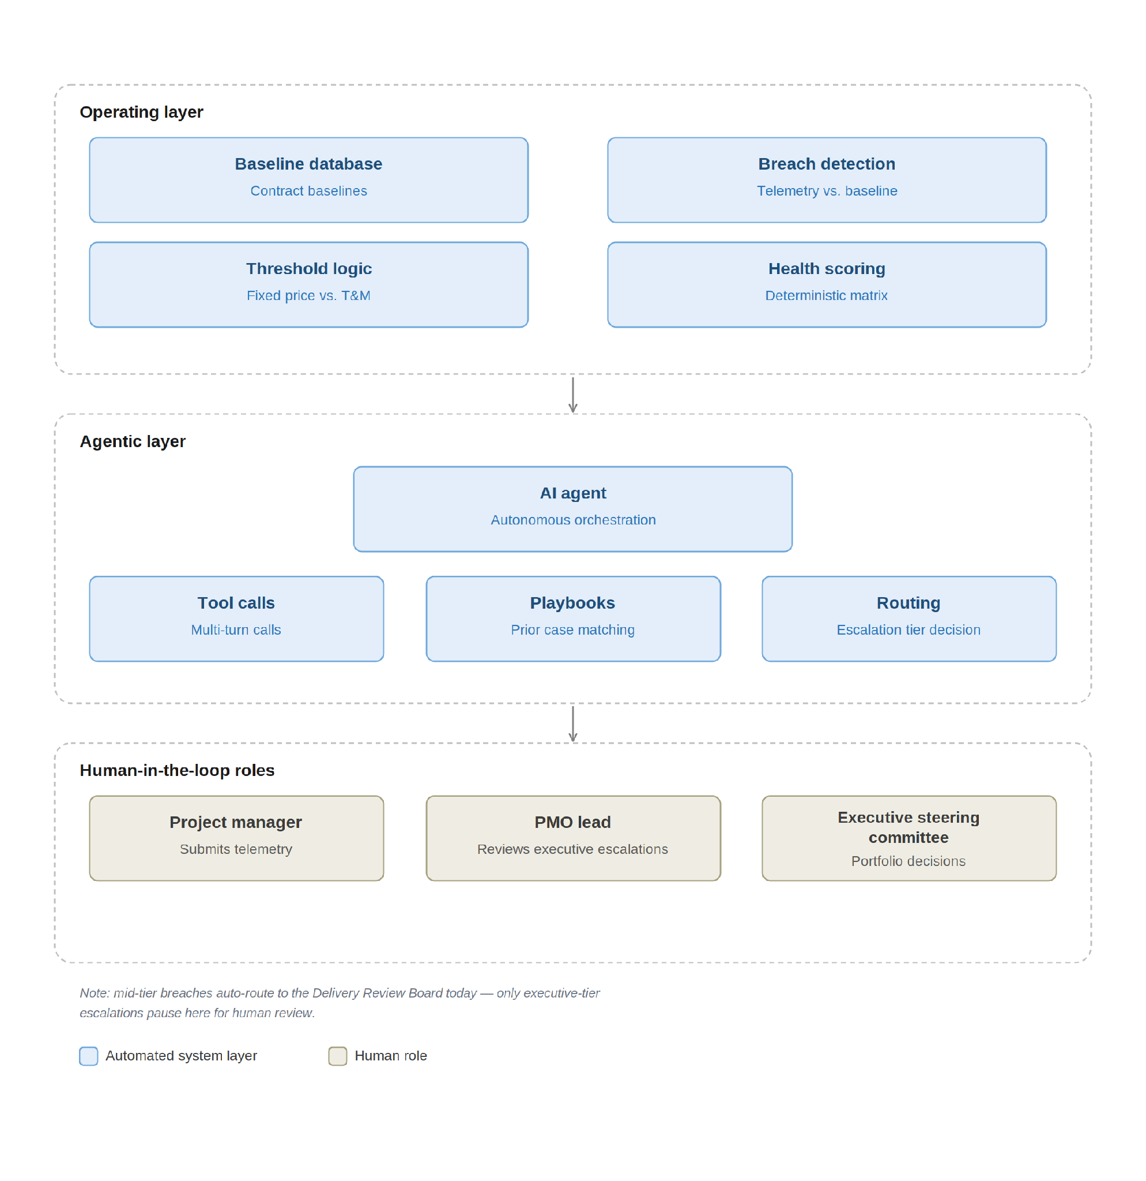
Operationalizing the Governance Stack: Signals - Governed Action
DELIVERY GOVERNANCE OPERATING LAYER
Notes:
We've looked at the boundaries between deterministic code and AI advisory on paper and capabilities.
Here is how that architecture operates end-to-end across our systems and teams.
It begins in the Operating Layer. Telemetry—schedule slip, margin actuals, staffing vacancy—is compared continuously against our baseline in the database. The deterministic engine applies contract-aware threshold rules—evaluating Fixed-Price scope strictness differently than T&M vacancy variance—to generate an objective, weighted health score.
Once a breach occurs, the signal passes to the Agentic Layer. Rather than altering metrics, an autonomous agent executes multi-turn tool calls: it independently verifies the breach against baseline and precedent, then determines the escalation tier.
Crucially, this is never a runaway black box—but today only the top tier is gated. Mid-tier breaches route automatically to the Delivery Review Board with no human checkpoint. Executive-tier breaches pause: the PMO Lead reviews and either approves the escalation or downgrades it, before the Portfolio Director & Executive Steering Committee acts on high-tier portfolio decisions.
Automation takes care of continuous detection and routing, while delivery leadership retains 100% authority over strategic intervention and decision-making."

Slide 8
The Operational Transformation: Before and After
DELIVERY GOVERNANCE OPERATING LAYER
Operational Dimension | Manual Governance (Current) | Automated Operating Layer (Target)
Telemetry Ingestion | Manual chasing across workbooks and Slack threads | Continuous, normalized ingestion directly against baselines
Threshold Profiles | Discretionary interpretation dependent on reviewer | Contract-aware rule sets mapped by commercial type
Risk Detection | Reactive in bi-weekly meetings after thresholds breach | Immediate event generation when drift logic is tripped
Corrective Action | Informal commitments tracked across email chains | Closed-loop state lifecycle with enforceable SLA tracking
PMO Role | Administrative collation and spreadsheet formatting | Strategic exception governance and high-touch turnaround
Notes:
This matrix captures the shift in how we will run governance with the operating layer in place:
First, telemetry is ingested continuously instead of chasing leads across spreadsheets.
Second, threshold rules replace subjective RAG scoring, so health ratings stay consistent across contract types.
Third, issues trigger remediation immediately upon breach rather than waiting for the next bi-weekly review.
Most importantly, the PMO stops acting as an administrative aggregator and shifts fully into strategic coaching and exception governance.

Slide 9
Pragmatic 90-Day Implementation & Pilot Roadmap
DELIVERY GOVERNANCE OPERATING LAYER
touch_app
Phase 1: Months 1–2
Manual Immersion
Run the current PMO reporting cadence manually.
Build deep trust and identify lead friction points.
Standardize baseline workbook formats across leads.
visibility
Phase 2: Month 3
Shadow Mode
Ingest workbooks into the deterministic engine in parallel.
Benchmark algorithmic scoring against human judgment.
Calibrate threshold profiles with Practice Leads.
launch
Phase 3: Launch
Closed-Loop Pilot
Pilot across 2–3 commercial contract archetypes.
Activate automated playbook SLA tracking.
Shift PMO bandwidth fully to high-touch strategy.
Confidential | ‹#›
Notes:
We earn the right to automate by proving our processes manually first through a clear 90-day rollout.
In Months 1 and 2, my focus is 100% manual: mastering our reporting cadence, unblocking leads, and standardizing baseline workbooks.
In Month 3, we run the deterministic engine in shadow mode alongside our regular reviews to benchmark algorithmic scoring against real human judgment.
We only activate the operating layer when our Delivery Leads and Practice Leads have fully validated the rules across the contract models.

Slide 11
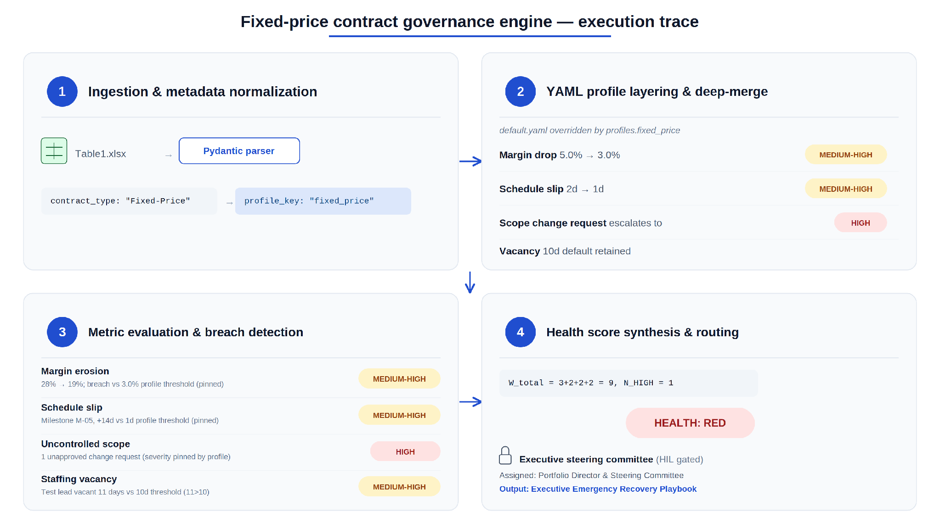
From spreadsheet to steering committee - Example
DELIVERY GOVERNANCE OPERATING LAYER
Notes:
From spreadsheet to steering committee: one contract's journey through the governance engine.
It starts with a spreadsheet. A delivery report lands — Table1 inside an Excel workbook — and the pipeline's first job is simply to figure out what kind of contract it's looking at. The Pydantic parser reads the field Contract Type: "Fixed-Price" and normalizes it into a clean internal key, profile_key: "fixed_price". That one string is the pivot point for everything that follows: it decides which rulebook the rest of the engine will hold this project to.
That rulebook isn't static. The engine loads a default set of thresholds — the baseline tolerances every project starts with — and then layers the fixed_price profile on top of it, deep-merging overrides wherever the contract type demands stricter discipline.
For this project, that means margin erosion no longer gets a 5.0% cushion; it's cut to 3.0%. Schedule slip tolerance drops from two days to one. Any unapproved scope change is pre-declared a HIGH-severity event, full stop. Staffing vacancy is left alone, still governed by the 10-day default. None of this is arbitrary — it reflects the real risk profile of fixed-price work, where margin and schedule are contractually rigid and scope creep is existential in a way it isn't on a time-and-materials engagement.
With the rulebook set, the engine turns to the actual telemetry. Four things have gone wrong this cycle: margin has eroded from 28% to 19%, a critical-path milestone has slipped 14 days, one change request went through without approval, and a key staffing role has sat vacant for 11 days. Each of these breaches its threshold — but here's the subtlety that matters: for margin and schedule, the severity isn't computed from how bad the number is. It's pinned, in advance, by the fixed-price profile itself, to MEDIUM-HIGH — a 9-point margin drop and a 90-point margin drop would be treated identically at this stage, because the contract terms said "any breach on these two metrics is MEDIUM-HIGH," not "worse breaches get worse ratings." The unapproved scope change, by contrast, is pinned straight to HIGH — fixed-price contracts have zero tolerance there. And the staffing vacancy, with no profile override to constrain it, falls through to the engine's own value-based judgment: 11 days past a 10-day threshold lands it at MEDIUM-HIGH too.
Add up the weights — one HIGH, three MEDIUM-HIGH — and the math is unambiguous: a total risk score of 9, with one signal at the highest tier. That single HIGH-severity breach is enough on its own to flip the whole project's calculated health to RED, and RED health routes, deterministically, to the Executive Steering Committee under an Emergency Recovery Playbook. No human bias, no negotiation — the arithmetic decided it before anyone read the report.

Slide 12
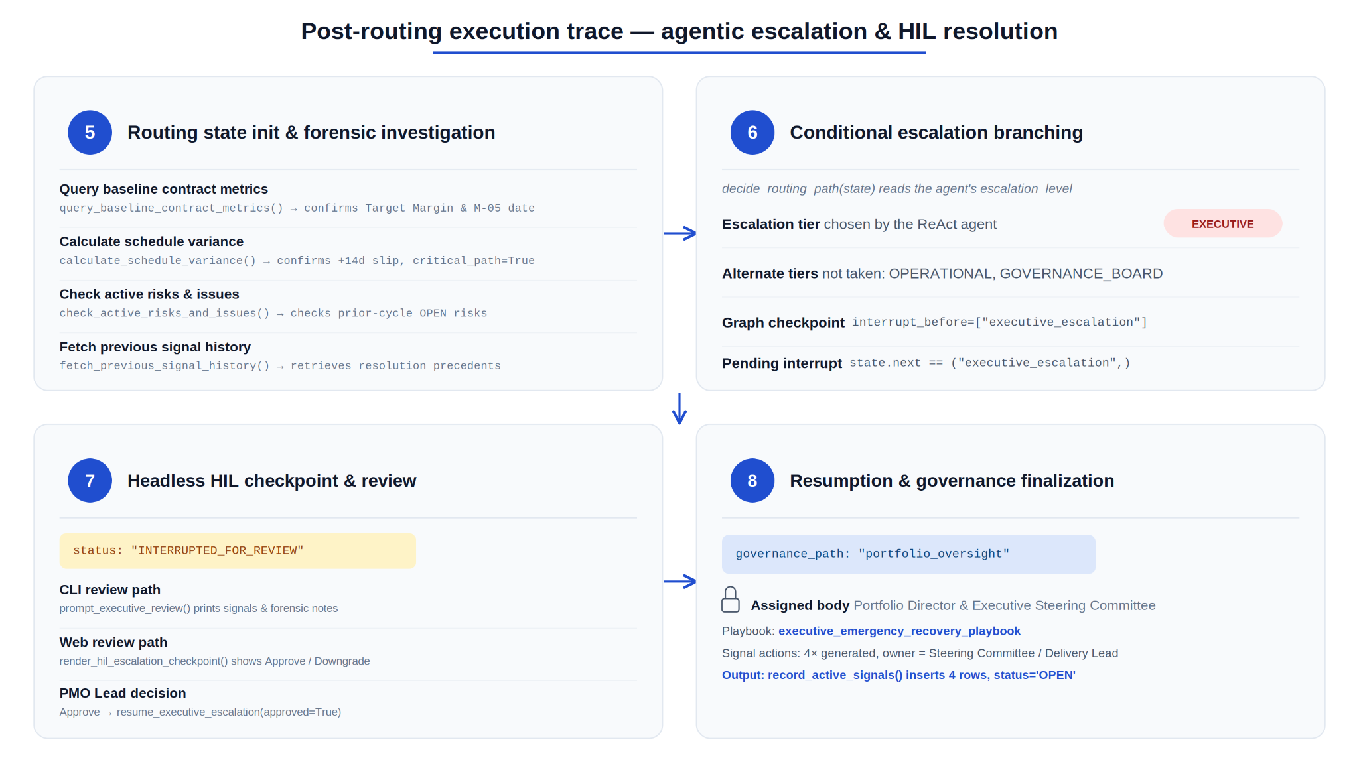
From spreadsheet to steering committee - Example
FIXED-PRICED DELIVERY EXAMPLE
Notes:
But "decided" doesn't mean "executed blindly." The four signals don't go straight to an executive's inbox — they go to an autonomous agent first, one built specifically to distrust self-reported status. Before it accepts the rule engine's verdict, it independently interrogates the project: it pulls the contractual baseline to confirm the margin target and milestone date are what the report claims; it recalculates the schedule slip itself rather than trusting the number it was handed; it checks whether this project has unresolved risk history sitting open from prior cycles; and it looks up how similar breaches were handled before, so its recommendation is grounded in precedent, not just policy. Only after that forensic pass does it commit to a verdict — EXECUTIVE escalation — and write down its reasoning.
That verdict routes the case down the executive branch of a decision graph, and the moment it does, the system checkpoints itself — the entire state of the investigation is written durably to disk — and then it stops. Deliberately. Because a decision this consequential doesn't get to happen inside a black box; it pauses and waits, however long it takes, for a person to look at it. Whether that person is reviewing it from a terminal or a browser, they see the same thing: the signals, the agent's reasoning, and a single choice — approve the escalation, or override it and send the case to the Delivery Review Board instead. When the PMO Lead approves, the paused process wakes back up exactly where it left off, finalizes the governance record — Portfolio Director and Executive Steering Committee, Emergency Recovery Playbook — and writes four new action items into the system, each with an owner and a concrete next step.
And then, critically, the story doesn't end there. Each of those four signals is now a living record, not a closed ticket. The next reporting cycle, the engine checks each one against fresh telemetry: the margin problem, it turns out, gets fixed — the number recovers back under threshold, and that signal quietly resolves itself, with the exact number of days it took to fix logged for posterity. The other three don't recover. They persist into a second cycle, a third, and by the fourth, two of them — schedule and staffing, the ones that were never HIGH to begin with — get automatically escalated, because a MEDIUM-HIGH problem that won't go away after three cycles stops being a MEDIUM-HIGH problem. The scope breach, already sitting at HIGH, doesn't need that automatic push — it was already at the top of the ladder. Even here, a human can still intervene directly, transitioning a signal's state by hand — but only along the paths the state machine allows; you cannot skip from ESCALATED straight to CLOSED and pretend the recovery never had to happen. The system remembers.
That's the shape of it: a spreadsheet's contract type silently rewrites the rules it will be judged by;
a rules engine turns raw numbers into weighted signals; the weights add up to a color and a tier; an agent double-checks the math against ground truth before anyone acts on it; a human gets the final word, but only after the system has already done the homework; and every signal that comes out the other end keeps being watched, cycle after cycle, until it's actually gone.

Slide 13
Same Engine, Two Growth Levers
DELIVERY GOVERNANCE OPERATING LAYER
Platform Capability | Standardization Framing | Growth Framing
Contract-Aware Threshold Profiles | Consistent, reviewer-independent risk scoring | Confidence to bid harder-to-govern, higher-margin contract types
Single HIL Gate (Executive Tier) | Less approval friction, lower PMO admin load | PMO hours reclaimed for account growth work
Deterministic Health Scoring | Every project judged by the same yardstick | Portfolio scales without proportional PMO headcount growth
Precedent Retrieval (Signal History) | Institutional consistency in issue resolution | Governance gets cheaper per project as the portfolio grows
YAML-Based Profile Config | One framework applied uniformly | New practices, contract types, or acquired teams plug in without a rebuild
Growth framing depends on portfolio mix and PMO capacity today — validate with real utilization, review-hours, and margin-by-contract-type data before using this as a sizing argument.
Notes:
Every capability we just walked through can be read two ways — as standardization, or as a growth unlock. Same engine, different question.
Contract-aware threshold profiles are not just consistency — they are what let us say yes to Fixed-Price and outcome-based deals with confidence, which tend to carry better margin than commodity staff-aug.
The single human gate on executive escalations means PMO time is no longer capped by review volume — those hours become available for account growth work, not just administrative throughput.
Deterministic scoring and profile-driven configuration mean the portfolio can grow without governance cost growing linearly with it, and new contract types or acquired teams plug in without rebuilding process.

