Slide 1
[Client Name]
[Project Name]
Kickoff
Aligning on outcomes, team, and how we’ll deliver.

Slide 2




What we’ll accomplish together
WHY WE'RE HERE TODAY
Meet your team
The people delivering your project, their roles, and your single point of contact.
Align on success
Confirm why we’re doing this project and what a successful outcome looks like in your words.
Agree how we’ll work
Cadence, communication, transparency, and how we handle change and escalation.
Confirm next steps
What happens in the next week, and what we’ll each own.
Notes:
Table Slides
Severity

Slide 3




The people delivering your project
YOUR TEAM
Name
Name
Name
Role
Role
Role
Location
Location
Location
Name
Name
Name
Role
Role
Role
Location
Location
Location
Notes:
Table Slides
Severity

Slide 4
Alignment

Slide 5


Why we’re here
PROJECT SUCCESS AGREEMENT
Our draft understanding — please confirm, correct, or add.
Why are we doing this?
[Pre-filled: the business initiative or opportunity driving this engagement.]
What problem are we solving?
[Pre-filled: the current pain point, risk, or opportunity being addressed.]
What does success look like?
[Pre-filled: the desired business outcomes, measurable indicators of success, and/or acceptance criteria.]
Notes:
Walk each answer aloud and ask the client to confirm or correct. Capture changes live. This is where alignment actually happens — do not rush it. Anything that shifts scope, timeline, or the exclusions gets logged; the PM codifies the final wording with the sponsor after kickoff and secures approval before Discovery.

Slide 6
Solution Overview
What we will deliver
PROJECT SUCCESS AGREEMENT
[high level summary of the work to be accomplished in business terms]
Workstream / Feature Set
Outcomes / Deliverables
[Workstream or Feature Set 1]
Deliverable 1
Deliverable 2
Deliverable 3
[Workstream or Feature Set 2]
Deliverable 1
Deliverable 2
Deliverable 3
[Workstream or Feature Set 3]
Deliverable 1
Deliverable 2
Deliverable 3
Out of Scope:
[Item]
[Item]
[Item]
[Workstream or Feature Set 4]
Deliverable 1
Deliverable 2
Deliverable 3

Slide 7
Ways of Working

Slide 8
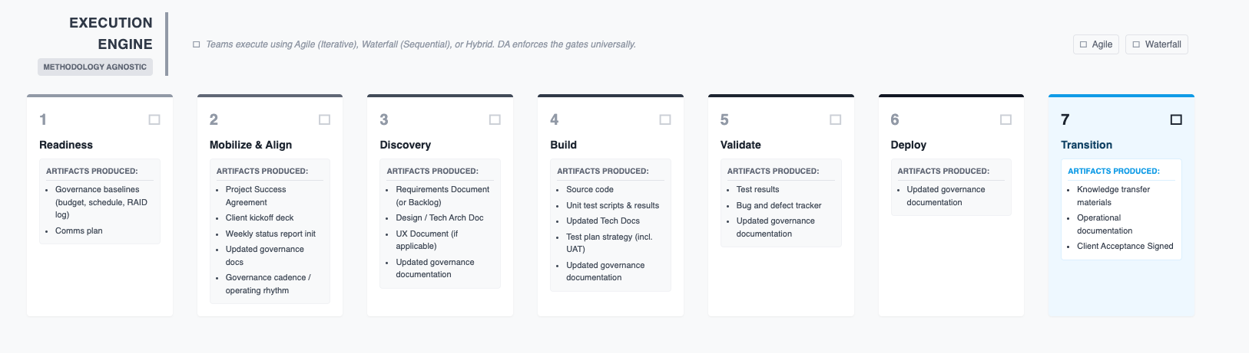
Our strategic approach that adapts to how you work
WAYS OF WORKING
Our approach meets you where you are and ensures we’re aligned at every step of the process.
Notes:
Table Slides
Severity

Slide 9
Our operating rhythm
WAYS OF WORKING
Our philosophy is no surprises by design.
DAILY
WEEKLY
MONTHLY
AD-HOC
Project team stand-ups
(15 mins)
Immediate tactical alignment, sharing of daily goals, and rapid unblocking of technical hurdles.
Status Report & Meeting (30-45 mins)
Review progress against milestones, review the RAID log, and align on cross-functional dependencies.
Steering Committee
(60 mins)
Review overall project health, approve major scope / budget changes, resolve escalated risks, and ensure continued strategic alignment.
Working Sessions / Demos
Detailed requirements gathering, technical solution design / reviews, process mapping, and targeted feedback.

Slide 10

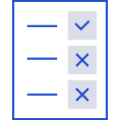

Collaboration toolstack
WAYS OF WORKING
Standardizing our digital workspace
Real-Time Comms
Work Management
Documentation Hub
Dedicated, shared collaboration channels for the joint core team for day-to-day project execution.
Single source of truth for execution (user stories, epics, tasks, bug tracking will be logged here).
Central repository for all project artifacts including signed-off deliverables, status reports, etc.
Notes:
Walk each answer aloud and ask the client to confirm or correct. Capture changes live. This is where alignment actually happens — do not rush it. Anything that shifts scope, timeline, or the exclusions gets logged; the PM codifies the final wording with the sponsor after kickoff and secures approval before Discovery.

Slide 11

Governance and escalation path
WAYS OF WORKING
Our core best practice is proactive risk mitigation rather than reactive problem-solving. Most issues resolve at the working level. When one doesn’t, we have a clear escalation path.
1
2
3
4
Working team
Delivery Manager
Delivery Director
Executive sponsors
Day-to-day questions and blockers, resolved in the flow of work.
Your single point of contact steps in when a blocker persists [24–48h].
Engages if delivery, quality, or commitments are at significant risk.
Both sponsors align on material scope, risk, or relationship matters.
Notes:
Walk each answer aloud and ask the client to confirm or correct. Capture changes live. This is where alignment actually happens — do not rush it. Anything that shifts scope, timeline, or the exclusions gets logged; the PM codifies the final wording with the sponsor after kickoff and secures approval before Discovery.

Slide 12
Initial risk register
WAYS OF WORKING
Addressing the “elephants in the room” proactively to ensure effective kickoff
Risk Description | Prob/Impact | Proposed Mitigation Strategy | Target Resolution Date
[Title] [Brief Description] | [High/High] | [Description] | [Date]
[Title] [Brief Description] | [Med/Med] | [Description] | [Date]
[Title] [Brief Description] | [Low/Low] | [Description] | [Date]
Notes:
Walk each answer aloud and ask the client to confirm or correct. Capture changes live. This is where alignment actually happens — do not rush it. Anything that shifts scope, timeline, or the exclusions gets logged; the PM codifies the final wording with the sponsor after kickoff and secures approval before Discovery.

Slide 13
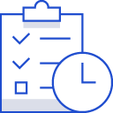

Managing Change
WAYS OF WORKING
How we handle new ideas without blowing up the budget and/or timeline.
How we keep you informed
How we handle change
A weekly status report with an honest health rating
Surface risks early and the risk and issues log is always accessible
New requirements are identified early, assessed for impact, then reviewed with stakeholders
Refinements within scope
We document and proceed — no friction, no delay.
Changes to scope, timeline, or budget
We pause, document the change and impact, then bring it to you — agreed together before any work begins.
Notes:
Walk each answer aloud and ask the client to confirm or correct. Capture changes live. This is where alignment actually happens — do not rush it. Anything that shifts scope, timeline, or the exclusions gets logged; the PM codifies the final wording with the sponsor after kickoff and secures approval before Discovery.

Slide 14
Housekeeping

Slide 15
Next Steps
PATH FORWARD
What needs to happen in the next few days.
Owner | Action | Due
[Client] | Provide access to [system / data / environment] | [Date]
[Toptal] | Finalize the Project Success Agreement with the sponsor | [Date]
[Client] | Confirm named reviewer(s) for approvals | [Date]
Notes:
Walk each answer aloud and ask the client to confirm or correct. Capture changes live. This is where alignment actually happens — do not rush it. Anything that shifts scope, timeline, or the exclusions gets logged; the PM codifies the final wording with the sponsor after kickoff and secures approval before Discovery.

