Slide 1




C# Past Present and beyond https://github.com/jwooley/CSVersions https://jwooley.github.io/
Jim Wooley
www.ThinqLinq.com
Twitter: @JimWooley

Slide 2
C# History (before Roslyn)
2002
2005
2008
2010
2012
2013
2015
C# 1/VB7
C# 2: Generics, Iterators, Anonymous Delegates, Nullable, Partial, co/contravariance
C# 3: LINQ, Lambda, Anonymous, AutoProp, Extension Methods, Expression
C# 4: Parallel, Dynamic, optional params, named arguments, embedded interop
C# 5: Async, Caller info
Roslyn
???

Slide 3
Roslyn Language Enhancements
Await in Catch/ Finally
Null propagation
#pragma
Getter only auto property
Dictionary Initializer
Nameof operator
Partial Modules
Exception Filters
Partial Interface
Auto property initializer
#Region inside methods
Using Static
String interpolation
Parameterless struct ctor
Line continuation comments
Multiline string literals

Slide 4
C# Post Roslyn
2015
12/2016
2017
2017
C# 6: Static imports, prop initializers, null propagator, string interpolation, nameof
C# 7.0: Out variables, tuples, pattern matching, local functions, ref locals and returns
C# 7.1: Async main, default literal, inferred tuple names, reference assembly gen
C# 7.2: ref semantics with value types, non-trailing named args, numeric literals, private protected
2018
C# 7.3: tuple equality, constraints, expression variables, custom fixed, ref reassignment
2019
C# 8.0: Default interface, nullable reference types, async streams, generic attributes, ranges
https://docs.microsoft.com/en-us/dotnet/csharp/whats-new/
https://github.com/dotnet/roslyn/blob/master/docs/Language%20Feature%20Status.md

Slide 5
C# Post Roslyn
2020 C# 9
Top Level Statements
Extending Partial
Code Generators
Lambda discards
Static lambdas
Module Initializers
Target Type New
Records
Skip locals init
Native ints
Attributes on local functions
Function pointers
Pattern matching improvements
Target type conditional
Covariant returns
Extension GetEnumerator
https://docs.microsoft.com/en-us/dotnet/csharp/whats-new/
https://github.com/dotnet/roslyn/blob/master/docs/Language%20Feature%20Status.md

Slide 6
C# Post Roslyn
2021 C# 10
Record structs
File-scoped namespace declaration
Extended property patterns
Constant interpolated strings
Record types seal ToString
Deconstruction assignment and declaration
AsyncMethodBuilder attribute on methods
Global Using directives
https://docs.microsoft.com/en-us/dotnet/csharp/whats-new/csharp-10
https://github.com/dotnet/roslyn/blob/master/docs/Language%20Feature%20Status.md

Slide 7
Source Generators
Docs https://docs.microsoft.com/en-us/dotnet/csharp/roslyn-sdk/source-generators-overview
Samples: https://github.com/dotnet/roslyn-sdk/tree/main/samples/CSharp/SourceGenerators
Cookbook: https://github.com/dotnet/roslyn/blob/main/docs/features/source-generators.cookbook.md

Slide 8
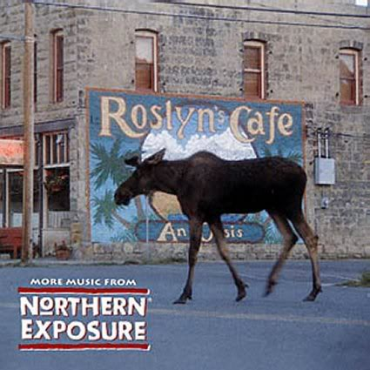
Roslyn Resources
Github: https://github.com/dotnet/roslyn
Language feature status: https://github.com/dotnet/roslyn/blob/master/docs/Language%20Feature%20Status.md
CSharpLang Proposals: https://github.com/dotnet/csharplang/tree/main/proposals
Dotnet: https://github.com/dotnet
Reference Source: http://source.roslyn.io/
https://github.com/dotnet/roslyn-sdk
http://SharpLab.io
This presentation: https://github.com/jwooley/CSVersions

Slide 9
.Net Compiler Platform (Roslyn) And You https://github.com/jwooley/CSVersions https://jwooley.github.io/
Jim Wooley
www.ThinqLinq.com
Twitter: @JimWooley

