Slide 1
Using Machine Learning to Predict “No Ambulance Events.”
Blue Collar Applications of Next Generation Technologies
You’d rather not need an ambulance, but if you need one, you’d rather have an ambulance than a no-ambulance event. Can predictive analytics help the local Fire Department balance its schedule?

Slide 2
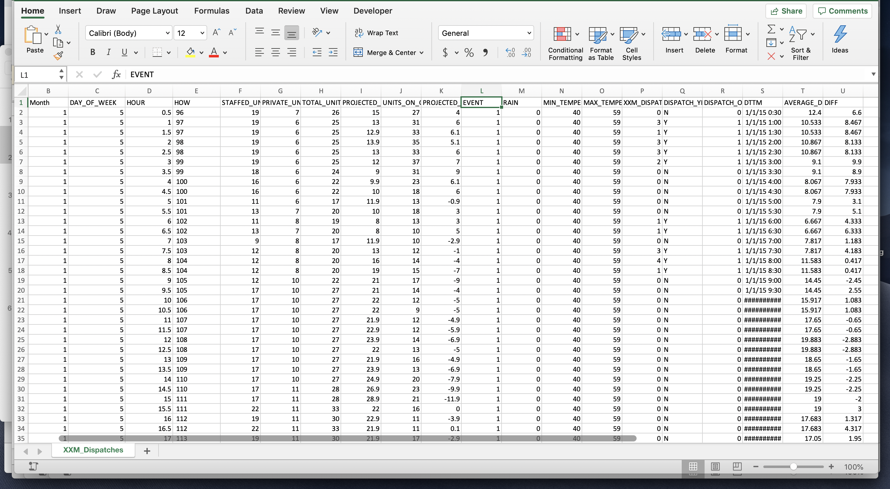
Blue Collar Applications of Next Generation Technologies
Type to enter a caption.

Slide 3
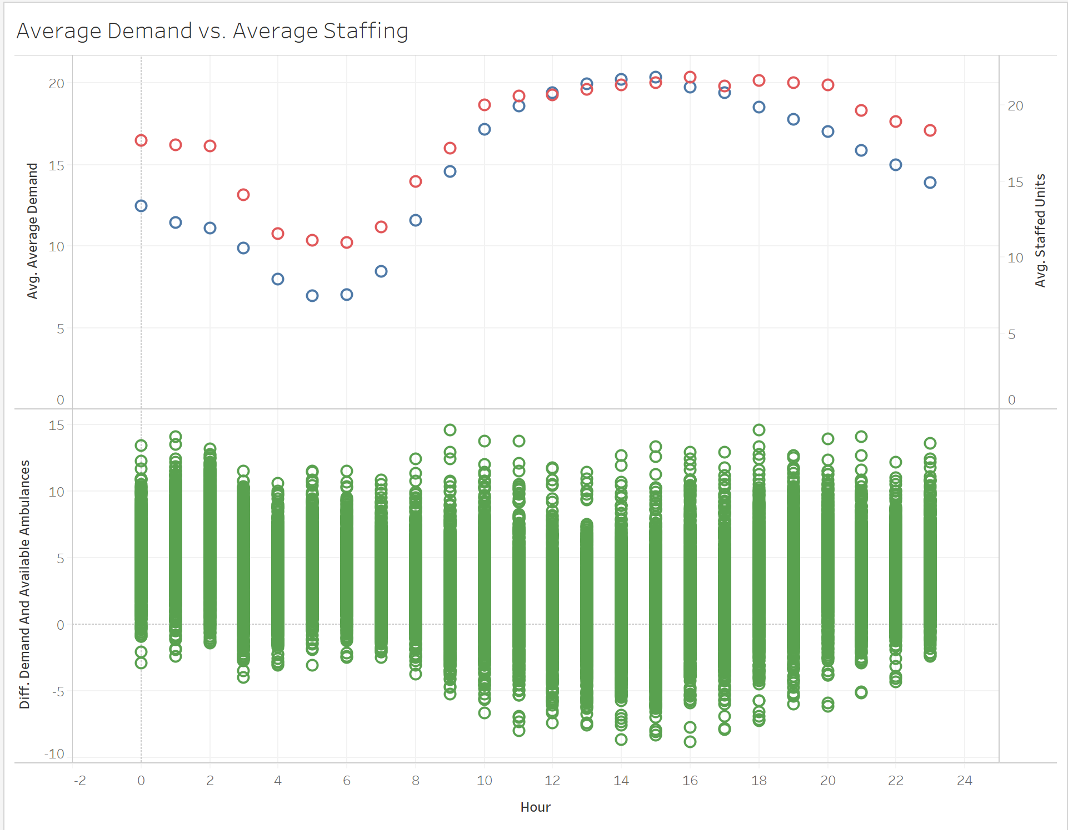

Slide 4
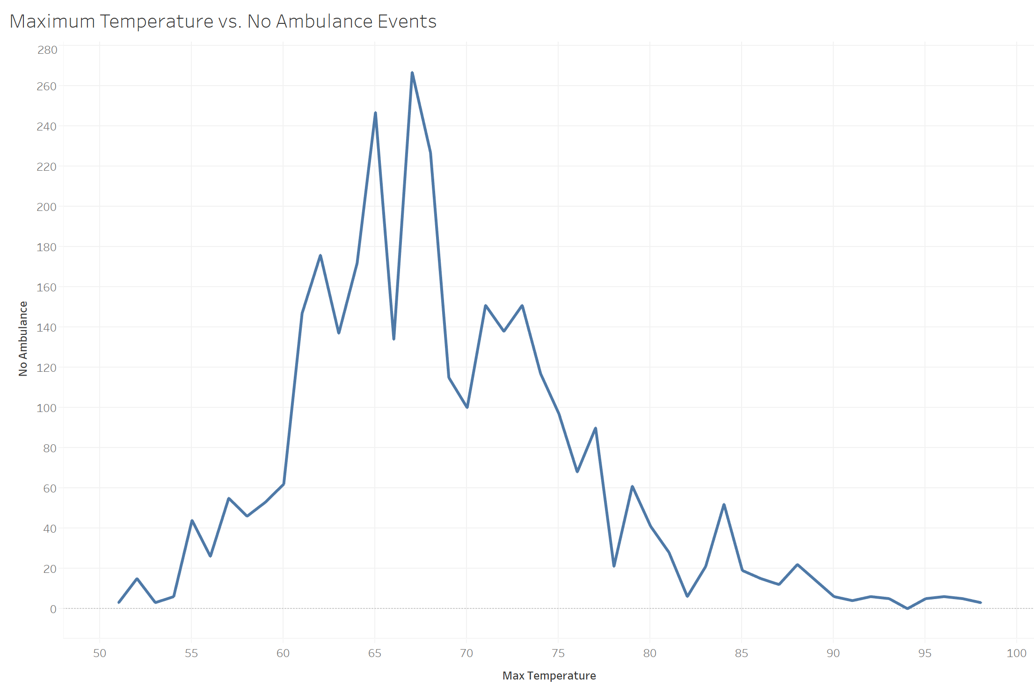

Slide 5
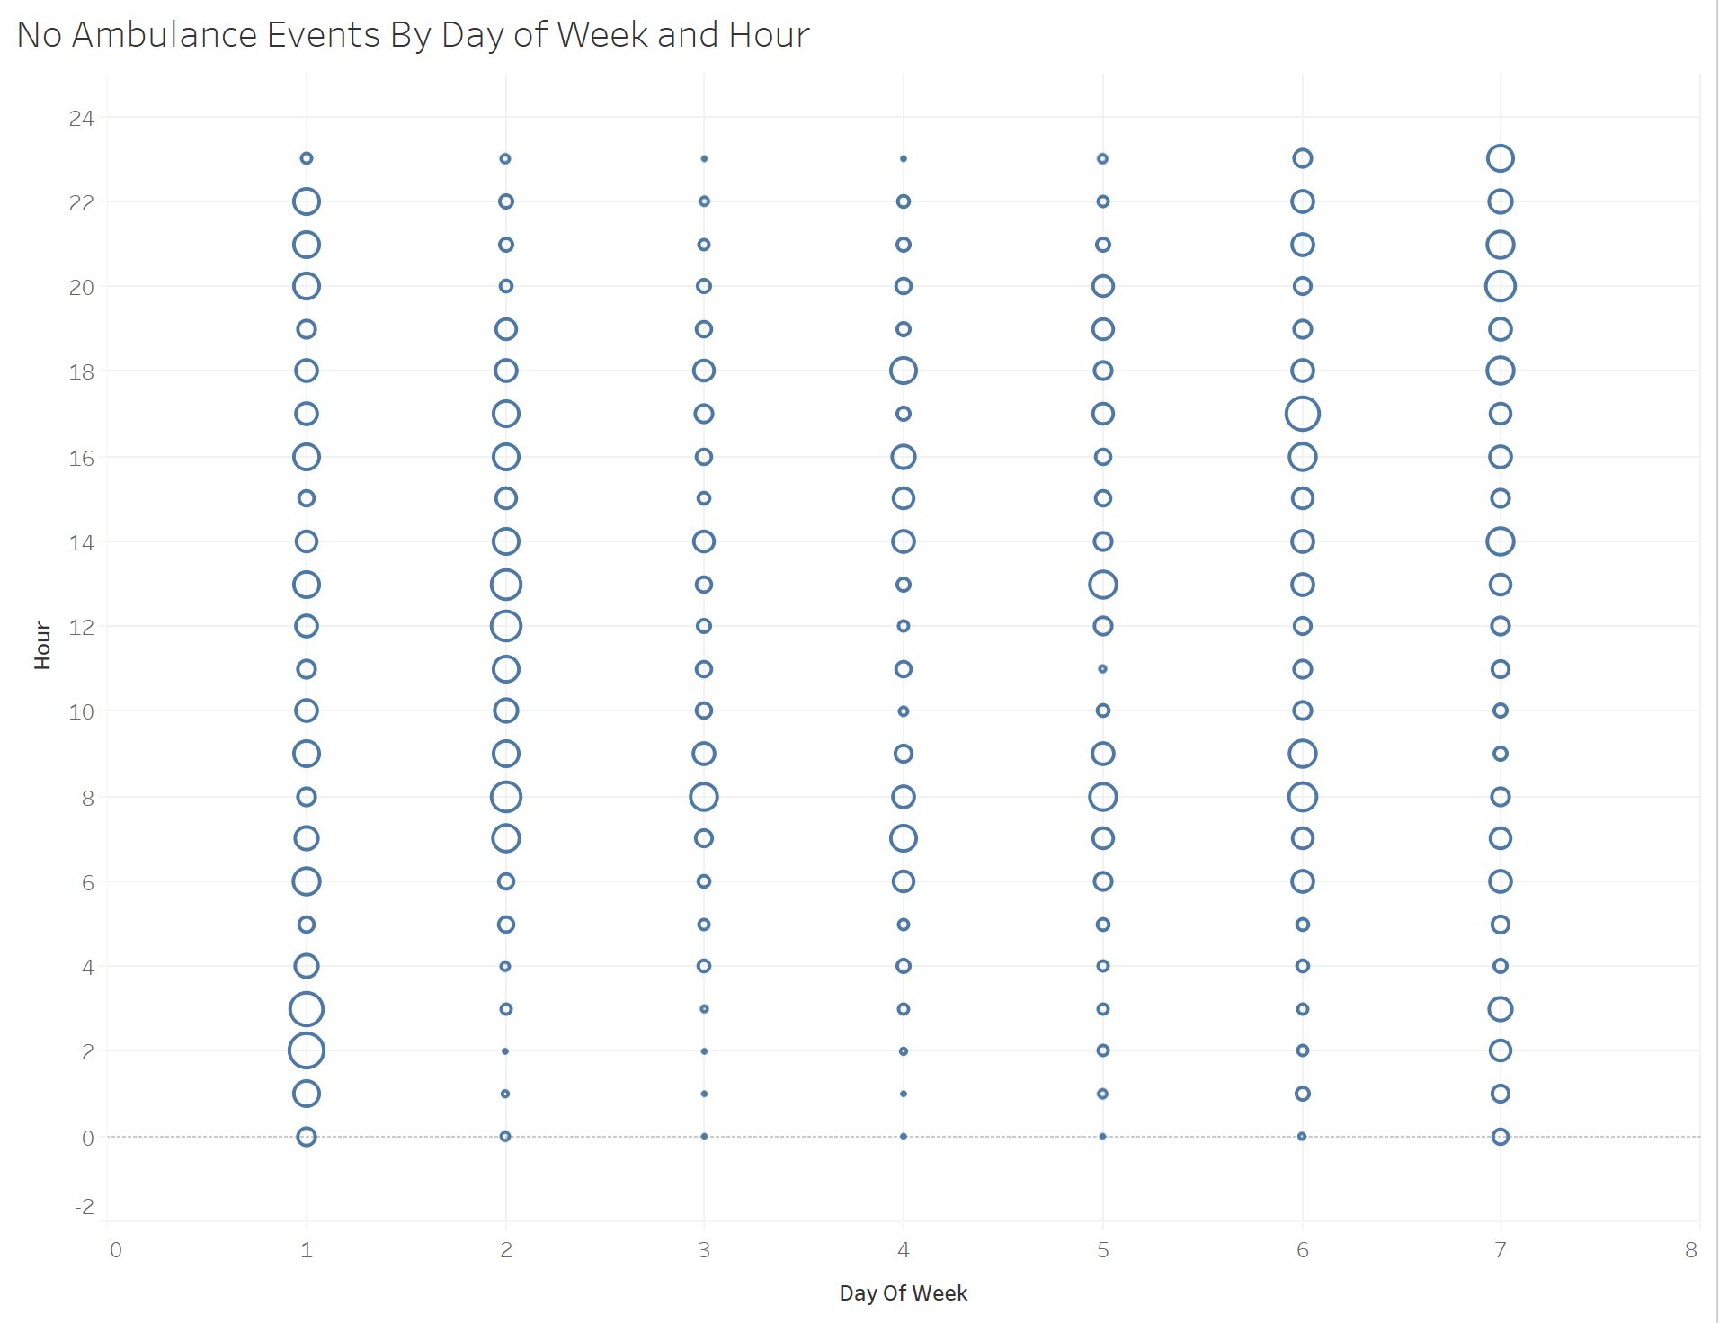

Slide 6
