Slide 1
Data Model
Jose Moreno
Team Triple J

Slide 2
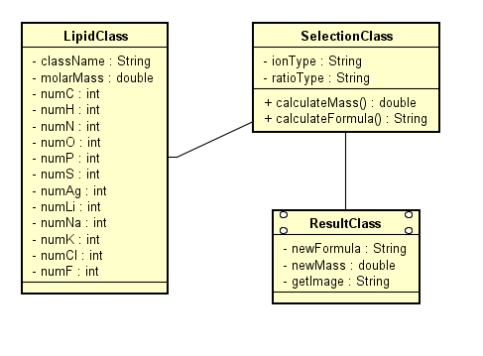
Model

Slide 3

SQLite

Slide 4
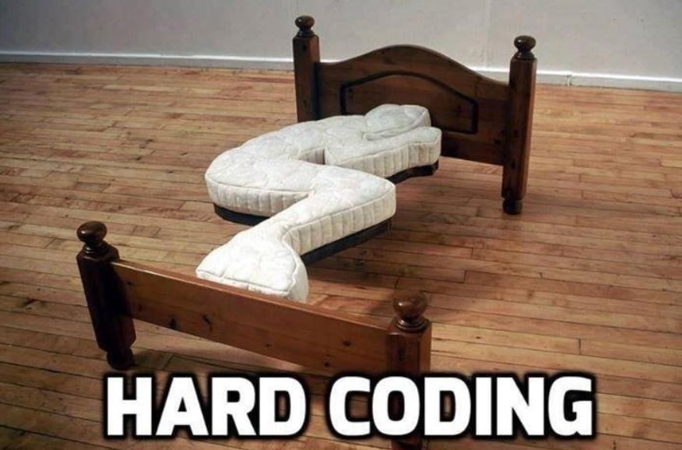

Slide 5
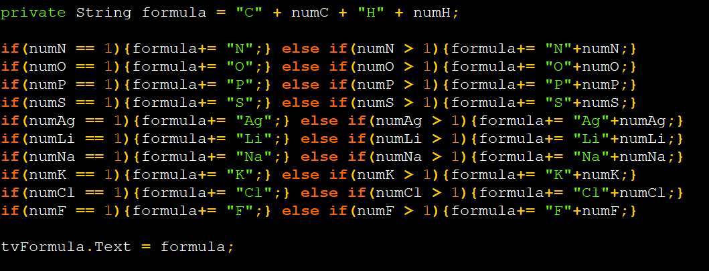

Slide 6
