Slide 1
Week 08

Slide 2
Warm-up (5 minutes)
Write a python function that accepts three numbers and returns the max.

Slide 3
Today's Activities
Warmup (10 mins)
Homework Answers/Q&A (20 mins)
Basic Statistics in Python (45 mins)
Break (15 mins)
Group Exercise (30 mins)
Work on Projects (60 mins)

Slide 4
Class Expectations
Homework assignments – each assignment needs to have 70% or higher
You are allowed to miss one assignment in the class, and if you have below 70% on an assignment that will count as your freebie.
In-class assignments – you need to have 70% average or higher at each checkpoint
So, yes… you can achieve this and still miss one or so if you do well on the rest

Slide 5
Homework Answers (20 mins)
To save some time I will discuss a subset of answers.
Voluntarily slack answers to the #datascience channel
Don't be shy!

Slide 6
Scales of Measurement
Nominal | Categories that do not have a natural order. Ex: blood type, zip code, race
Ordinal | Categories where order matters but the difference between them is neither clear nor even. Ex: satisfaction scores, happiness level from 1-10
Interval | There is order and the difference between two values is meaningful. Ex: Temperature (Celsius and Fahrenheit), credit scores, pH
Ratio | The same as interval except it has a concept of 0. There are no negative numbers. Ex: concentration, Kelvin, weight

Slide 7
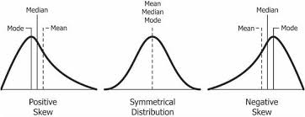
Statistics in Python
Central Tendency – represents the center point or “typical” value of a dataset

Slide 8
Variance, Covariance, Standard Deviation
Need to consider if your data set is a full population or a sample
That will change how you code works
BUT you may have to dig through the documentation to understand what arguments need to be specified to change between POPULATION and SAMPLE statistics

Slide 9
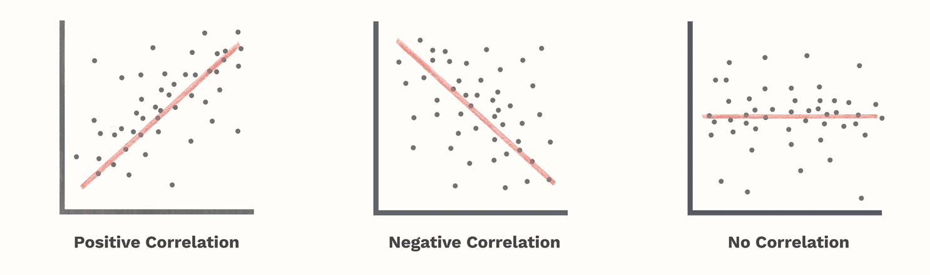
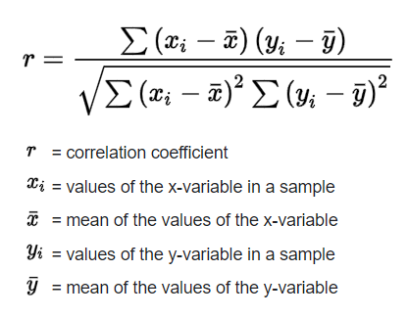
Correlation Coefficient

Slide 10
Break (15 Minutes)
Attendance word: DivineDBA

Slide 11
Week 8 Group Exercise
Once you finish and have submitted your exercise in Canvas via a github link, use the remaining time to work on your group project.

