Slide 1
Week 11

Slide 2
Warm-up (10 minutes)
What is recursion?
Write a recursive function to multiply a number by two until the square of the original number is reached or passed (only passed by a single value). Pay careful attention to where your print or return is located.

Slide 3
Today's Activities
Warmup (15 mins)
Review Homework (20 mins)
Time Series Analysis Concepts (30 mins)
Break (15 mins)
Time Series Analysis in Python (20 mins)
Fourier transform (20 mins)
Group Exercise (60 mins)

Slide 4
Review homework (20 mins)
Be brave!
Someone should share their screen
If someone has a different approach to one of the questions, that person should share their screen so you can discuss that approach
It is important to discuss your code so you can grow

Slide 5
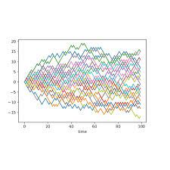
Time series Analysis
Time series data – sequence of data taken at points in time (ideally equally spaced)
Stochastic – random; processes generating timeseries data, where the values evolve in time based on laws of probability
Many statistical models for analyzing timeseries data:
SES
ARMA
ARIMA
SARIMA
ARCH
GARCH
Notes:
https://www.maths.ox.ac.uk/node/32370

Slide 6
Some things we care about
Exponential Smoothing (ES)
Autoregression (AR)
Order of integration (I)
Moving Average (MA)
Seasonality (S)

Slide 7
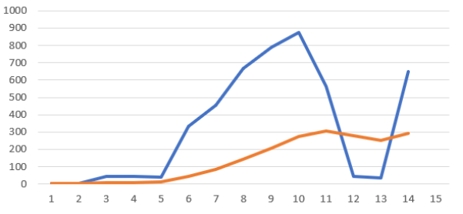
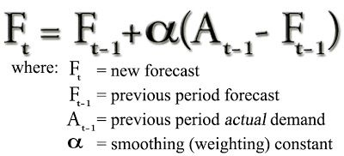
Exponential Smoothing (ES)
Used when there is no clear trend or pattern
Controls rate by which the influence of recent values decays exponentially
Damping factor (alpha) - a value from 0-1, with 1 indicating more attention is paid to recent values and 0 indicating attention is paid to the history of the series

Slide 8
Autoregression (AR)
Autoregressive models use input from previous steps in time, where the past steps are input into a regression model to predict the next step.
Assumption is that past events are useful for predicting future ones, that there is some correlation between past and future
Lag (also called “backshift”) – past series values, important to consider how many are relevant and what spacing makes sense
AR(1) looks at the most recent past value, AR(2) looks at the past two values, etc…

Slide 9
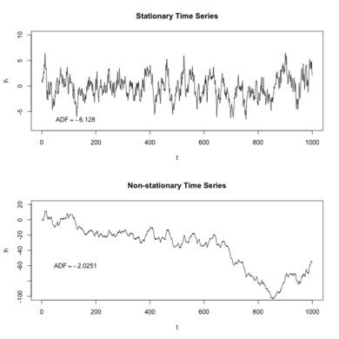
Order of Integration (I)
Used to make a series stationary
Stationarity – statistical processes that govern the way a timeseries dataset changes over time do not themselves change
How: subtract an observation from the observation at the previous time step
Notes:
https://towardsdatascience.com/stationarity-in-time-series-analysis-90c94f27322

Slide 10
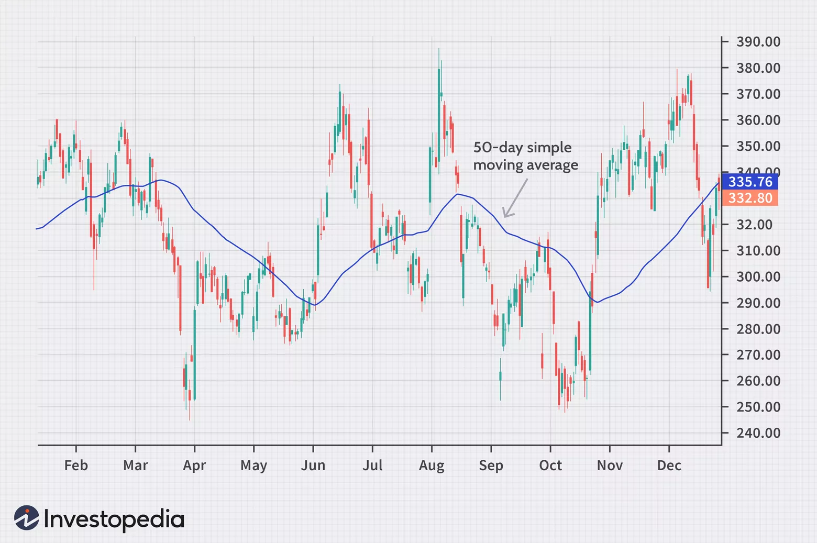
Moving Average (MA)
Helps smooth out data over a particular time period by creating a constantly averaged value.
Calculated by adding up all the values over a chosen time period and dividing by number of values.
Notes:
https://www.investopedia.com/terms/s/sma.asp

Slide 11
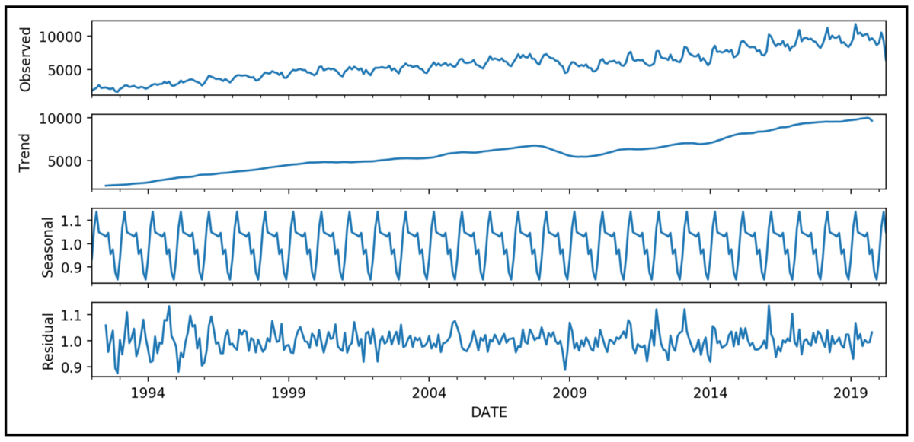
Seasonality (S)
Pattern that occurs at a regular interval
Can be additive or multiplicative
Can decompose the data to understand the seasonality component
Notes:
https://timeseriesreasoning.com/contents/time-series-decomposition/

Slide 12
Break (15 Minutes)
Attendance word: OutstandingOpsEngineer

Slide 13
Fourier Transform (10 mins)
Read this article (also in GitHub repo for week 11): https://learn.adafruit.com/fft-fun-with-fourier-transforms/background
In your own words, what does Fourier transform represent?
Why do we use Fast Fourier Transform instead of discreet?

Slide 14
Week 10 Group Exercise
Once you finish and have submitted your exercise in Canvas via a github link, use the remaining time to work on your homework.

