Slide 1
Week 13

Slide 2
Panel for This Week
Angelique Zeringue – Data Science Competency Lead at Daugherty
Brittany Minor – Medical Informaticist at WashU, LaunchCode Data Science TA
Jeromey Farmer – Global Head of Data and Analytics at Kynetec, Professor at WashU, Girl Scouts of Eastern Missouri Board Member
Michelle Lacy – Biotechnology Data Engineering Lead at Bayer
Susan King – Data and Analytics Lead at Daugherty

Slide 3
Warm-up (10 minutes)
What is the difference between supervised and unsupervised learning?
What kind of problems can you solve with supervised learning?
Identifying spam?
Recommending products?
Putting customers in segments?
Identifying fraudulent transactions?
Image recognition?
Others?

Slide 4
Today's Activities
Career Day (90 ish mins)
Warmup (15 mins)
Intro to Supervised Learning (30 mins)
Group Exercise (45 mins)

Slide 5
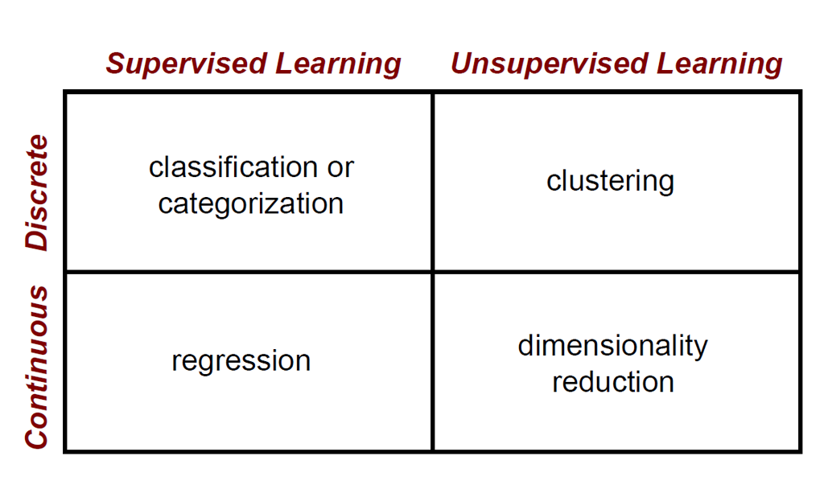

Slide 6
Linear Regression
Purpose of linear regression is to model and predict the relationship between independent and dependent variables. Univariate linear regression predicts a dependent variable from ONE independent variable whereas multiple linear regression predicts a dependent variable from MULTIPLE independent variables
y = mx + b
Use mean squared error and R² (R-squared) to validate model performance.
* Sometimes data is nonlinear and another type of regression will better model and predict what’s happening

Slide 7
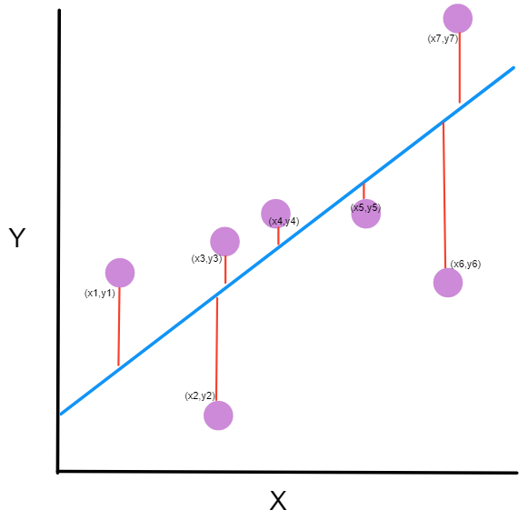
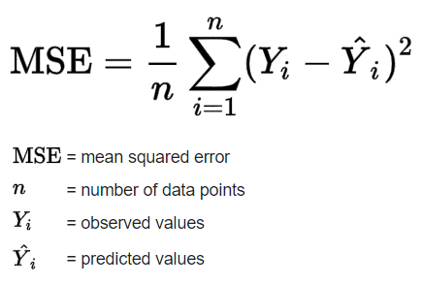
Mean Squared Error
Notes:
https://www.freecodecamp.org/news/machine-learning-mean-squared-error-regression-line-c7dde9a26b93/

Slide 8
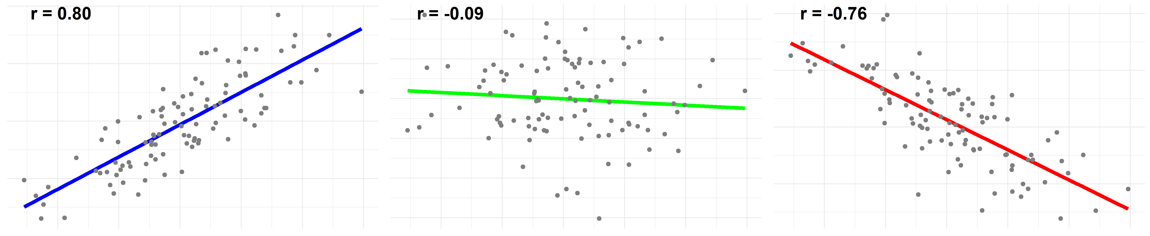
R and R-Squared
R is the correlation between two variables
R² is the square of the correlation
R² represents how close the data is to the regression line OR how well the model fits the raw data
R² is between 0 and 1, and the closer this value is to 1 the more variability is explained by the model

Slide 9
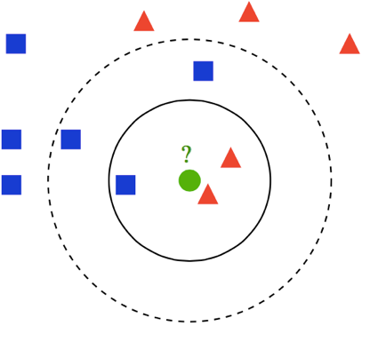
Classification - KNN
K-nearest neighbor predicts the group of a datapoint based on majority “votes” from nearest neighbors
K represents the hyperparameter which indicates how many data points any new datapoint must listen to in order to decide what class it is in.
Performance measured by accuracy
Accuracy = number of correct predictions/total predictions

Slide 10
Break (5 Minutes)
Attendance word:CSSConjurer

Slide 11
Week 13 Group Exercise
Once you finish and have submitted your exercise in Canvas via a github link, use the remaining time to work on your homework.

