Slide 1
Week 14

Slide 2
Warm-up (10 minutes)
What is linear regression? What kind of problems can you solve with it?
What is K-nearest neighbor? What kind of problems can you solve with it?

Slide 3
Today's Activities
Warmup (15 mins)
Review Homework (15 mins)
Multiple Linear Regression (25 mins)
Logistic Regression (30 mins)
Break (10 mins)
Other Ways to Evaluate Models Besides Using Accuracy (10 mins)
Group Exercise (45 mins)
Project 2 group work (30 mins)

Slide 4
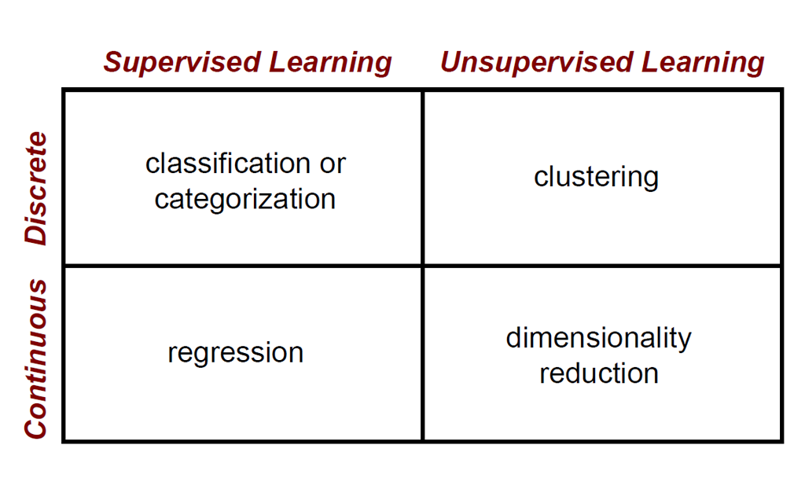

Slide 5
Multiple Linear Regression
Multiple linear regression predicts a dependent variable from MULTIPLE independent variables. “Multivariate” means the result is a vector.
How do we know which columns to choose? We look at correlations, we compare the R² values before and after a feature is added, and sklearn.feature_selection has many functions to assist with feature selection. *
y = m1x1 + m2x2 + m3x3 + … + b
Use mean squared error and R² (R-squared) to validate model performance.
*really, this depends on the shape of the data. There are other statistical models and tests like ANOVA that we won't discuss here

Slide 6
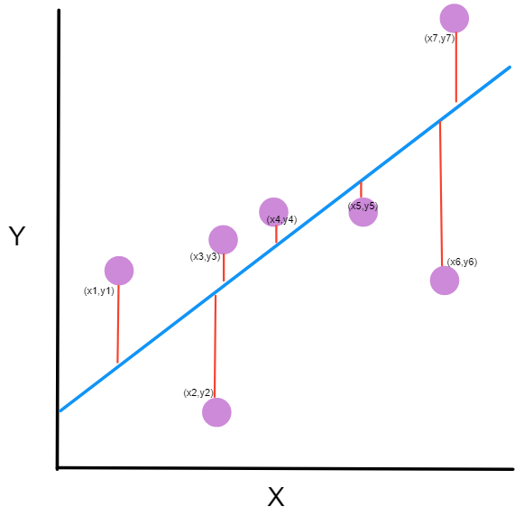
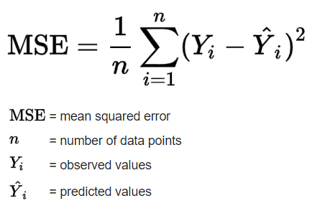
Mean Squared Error
Notes:
https://www.freecodecamp.org/news/machine-learning-mean-squared-error-regression-line-c7dde9a26b93/

Slide 7
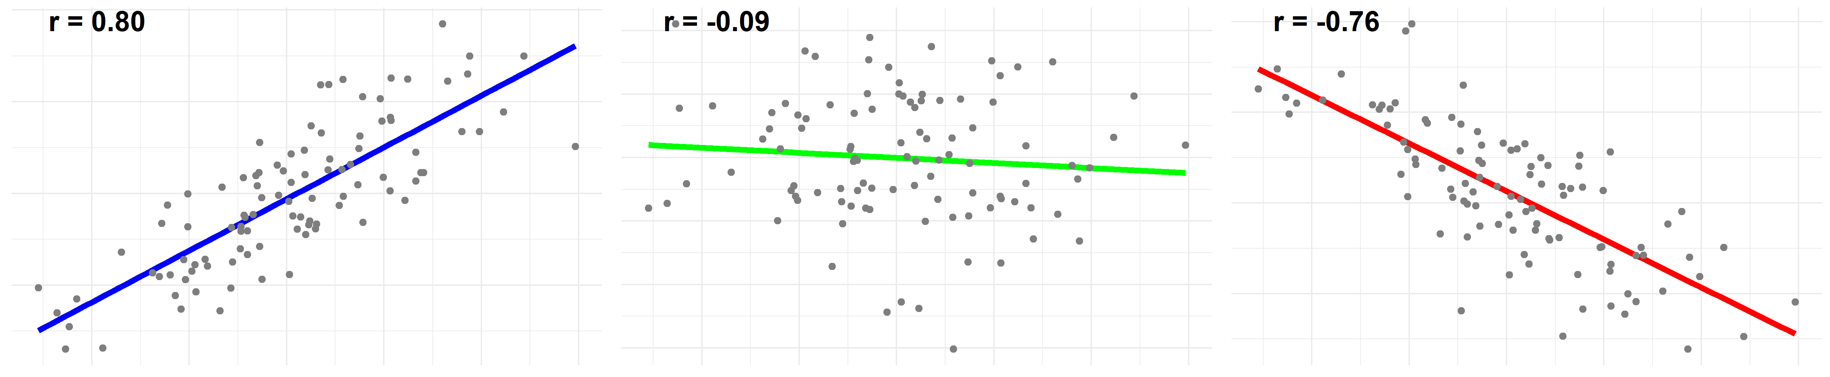
R and R-Squared
R is the correlation between two variables
R² is the square of the correlation
R² represents how close the data is to the regression line OR how well the model fits the raw data
R² is between 0 and 1, and the closer this value is to 1 the more variability is explained by the model

Slide 8
Break (10 Minutes)
Attendance word:ProdigiousProgrammingPowers

Slide 9
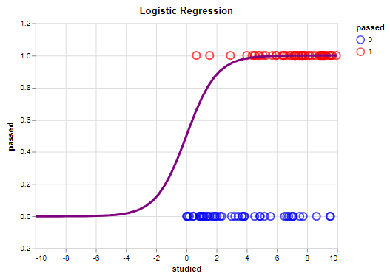
Logistic Regression
Used when trying to predict the answer to a yes/no question or any binary question
Response follows an S-shaped curve

Slide 10
Questions from the Reading
Why can’t linear regression work for the types of problems we use logistic regression for?
What is complete separation? Why is it a problem?
Notes:
https://christophm.github.io/interpretable-ml-book/logistic.html

Slide 11
Ways to Evaluate Models
Accuracy = true positives + true negatives
tp+ tn+fp+fn
Precision = tp_____
tp + fp
Recall = tp_____
tp + fn
F1score = 2* precision*recall
precision + recall

Slide 12
Week 14 Group Exercise
Once you finish and have submitted your exercise in Canvas via a github link, use the remaining time to work on your homework.

