Slide 1
Week 15

Slide 2
Warm-up (10 minutes)
Why doesn’t linear regression work for the types of problems we use logistic regression for?
Write a list comprehension that puts all the even values from 1-1000 in a list
Create a new list from that list that has only the values with an 8 in them

Slide 3
Today's Activities
Warmup (15 mins)
Review Homework ( 15 mins)
Oversampling and Undersampling (40 mins)
Break (10 mins)
Intro to Support Vector Machines (25 mins)
Project 2 group work (20 mins)
Group Exercise (50 mins)

Slide 4
Why is it so important to train/test split the data for a supervised learning model?

Slide 5
Oversampling and Undersampling
Answers to the question: what if our data is imbalanced?
They help us build models when we are trying to predict a minority case. Examples: fraud detection and medical diagnosis
Oversampling – creates new synthetic examples in a minority class you’re trying to make predictions about.
Undersampling – delete or merge examples in a majority class.
What are some examples you can think of where this would be useful?

Slide 6
Questions from reading
What is resampling?
What is the difference between oversampling and undersampling? Should you use them by themselves or together?
What does the fit_resample function do?
Notes:
https://machinelearningmastery.com/random-oversampling-and-undersampling-for-imbalanced-classification/

Slide 7
Break (10 Minutes)
Attendance word:CSSConjurer

Slide 8
Support Vector Machines
Goal: find a hyperplane that separates the data points into different groups
Hyperplane: decision boundary that allows us to separate data classified differently.
Notes:
Supervised learning algorithm. Used for classification and regression

Slide 9
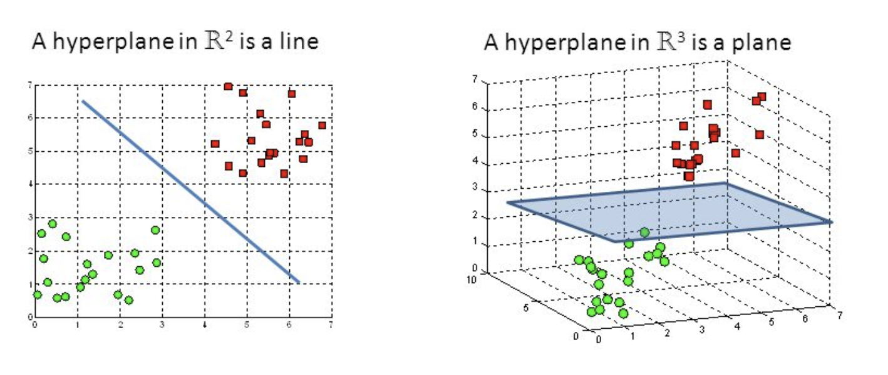

Slide 10
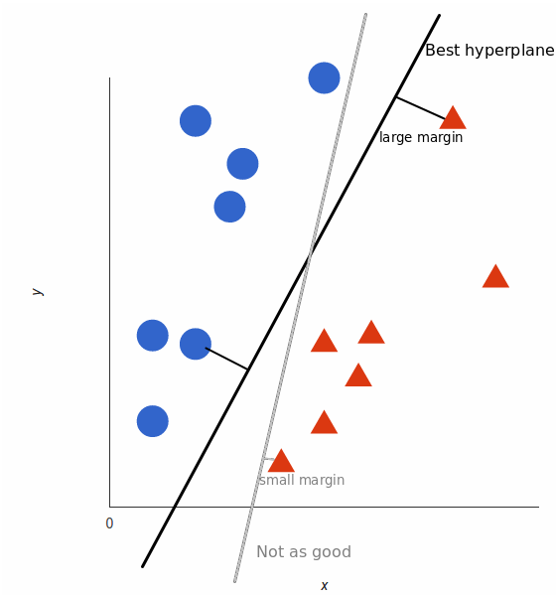

Slide 11
Questions from the Reading
What are SVMs?
How does scoring work with SVMs? Note: It is not traditional probability like the other methods we have thus far discussed.
Notes:
https://scikit-learn.org/stable/modules/svm.html

Slide 12
Week 15 Group Exercise
Once you finish and have submitted your exercise in Canvas via a github link, use the remaining time to work on your project

