Slide 1


Neural network models:
Inferring network models from (task) data
Joao Barbosa
Institute for Neuromodulation & NeuroSpin
joao.barbosa@inserm.fr
jbarbosa.org

Slide 2
Neural network models:
Inferring network models from (task) data
Motivation: Bottom up vs top-down approach
What is working memory?
Task-trained neural networks
Data-trained neural networks
Joao Barbosa
Institute for Neuromodulation & NeuroSpin
joao.barbosa@inserm.fr
jbarbosa.org

Slide 3
"The person who asks a question is a fool for a minute; the person who does not remains a fool forever."
— Chinese Proverb
Neural network models:
Inferring network models from (task) data
Motivation: Bottom up vs top-down approach
What is working memory?
Task-trained neural networks
Data-trained neural networks
Joao Barbosa
Institute for Neuromodulation & NeuroSpin
joao.barbosa@inserm.fr
jbarbosa.org

Slide 4
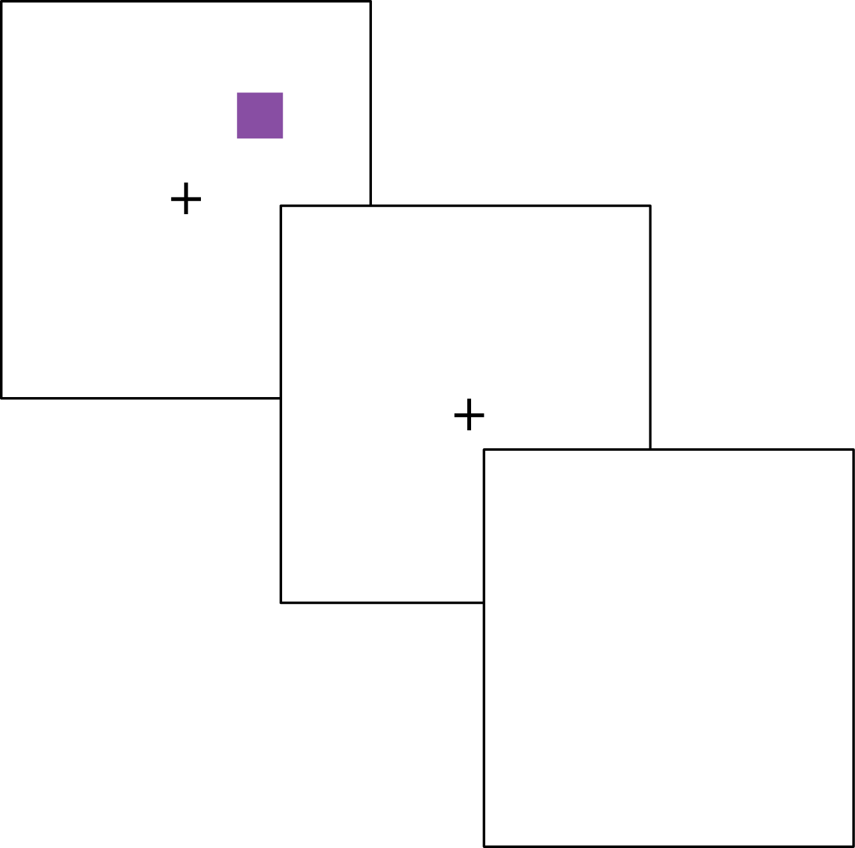
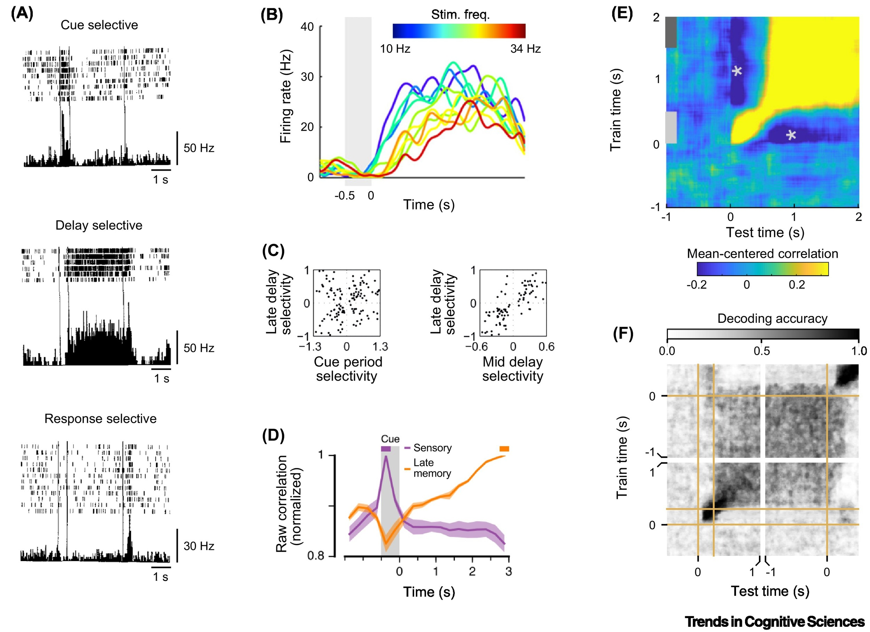
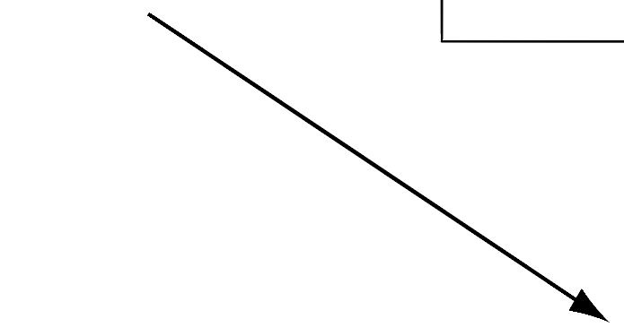


Persistent activity in PFC
saccade

Slide 5
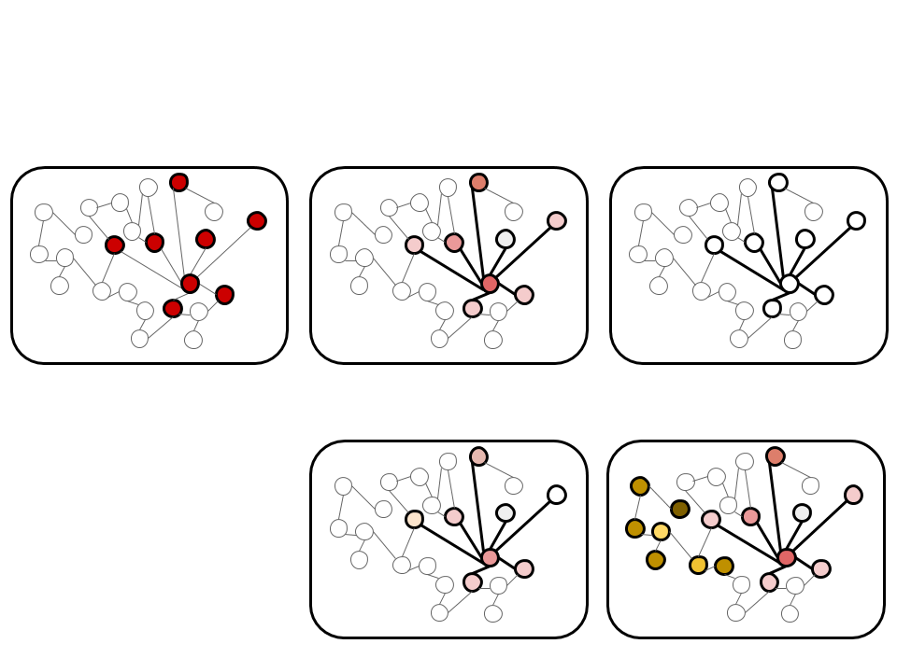
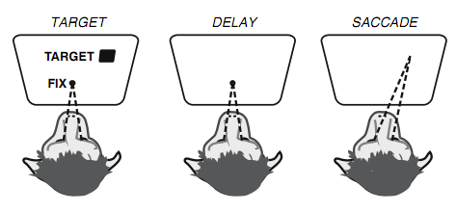
Two alternative hypothesis
memory
in synapses
activity-silent
persistent
activity

Slide 6
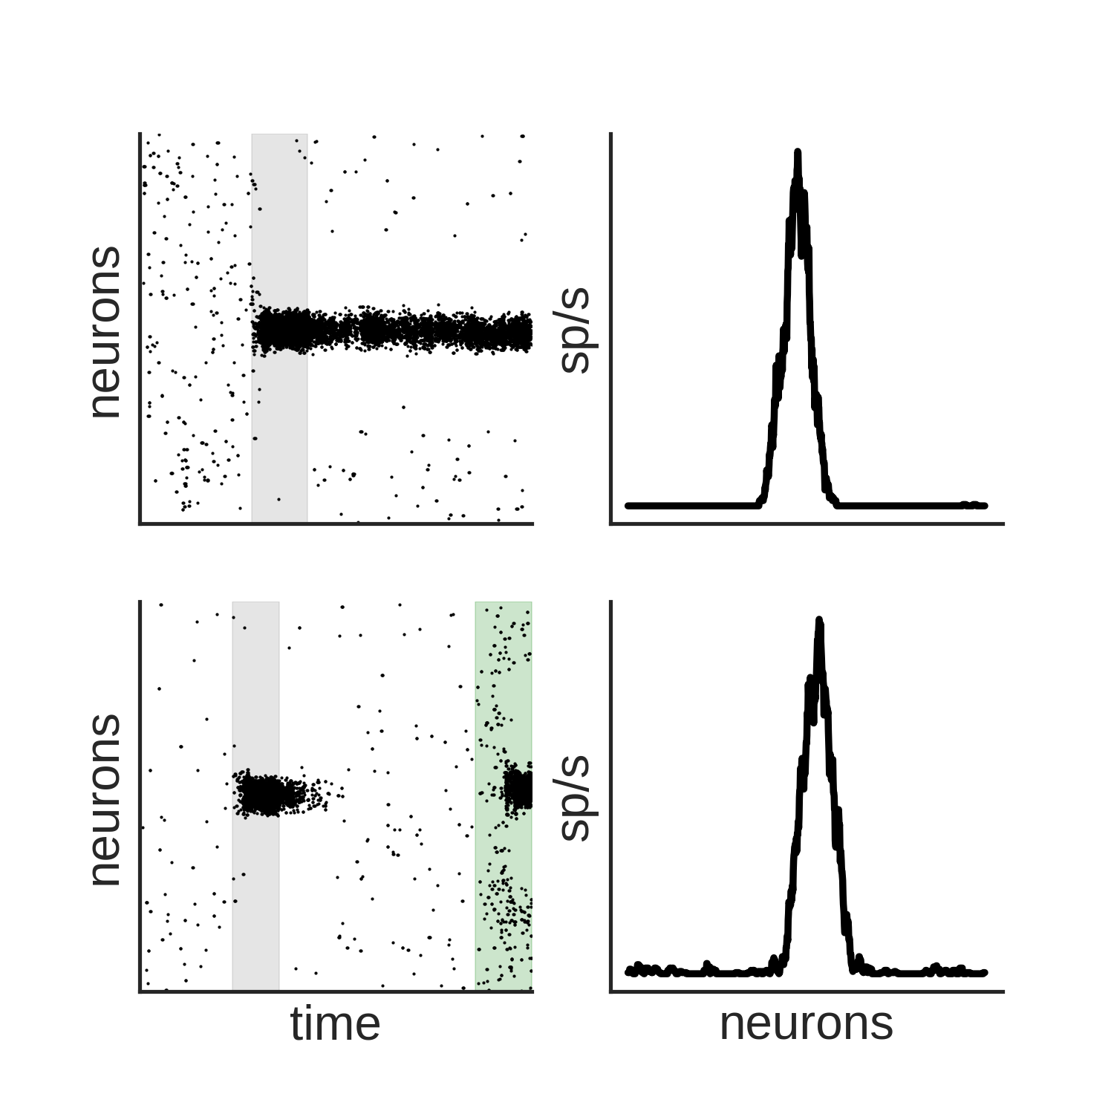
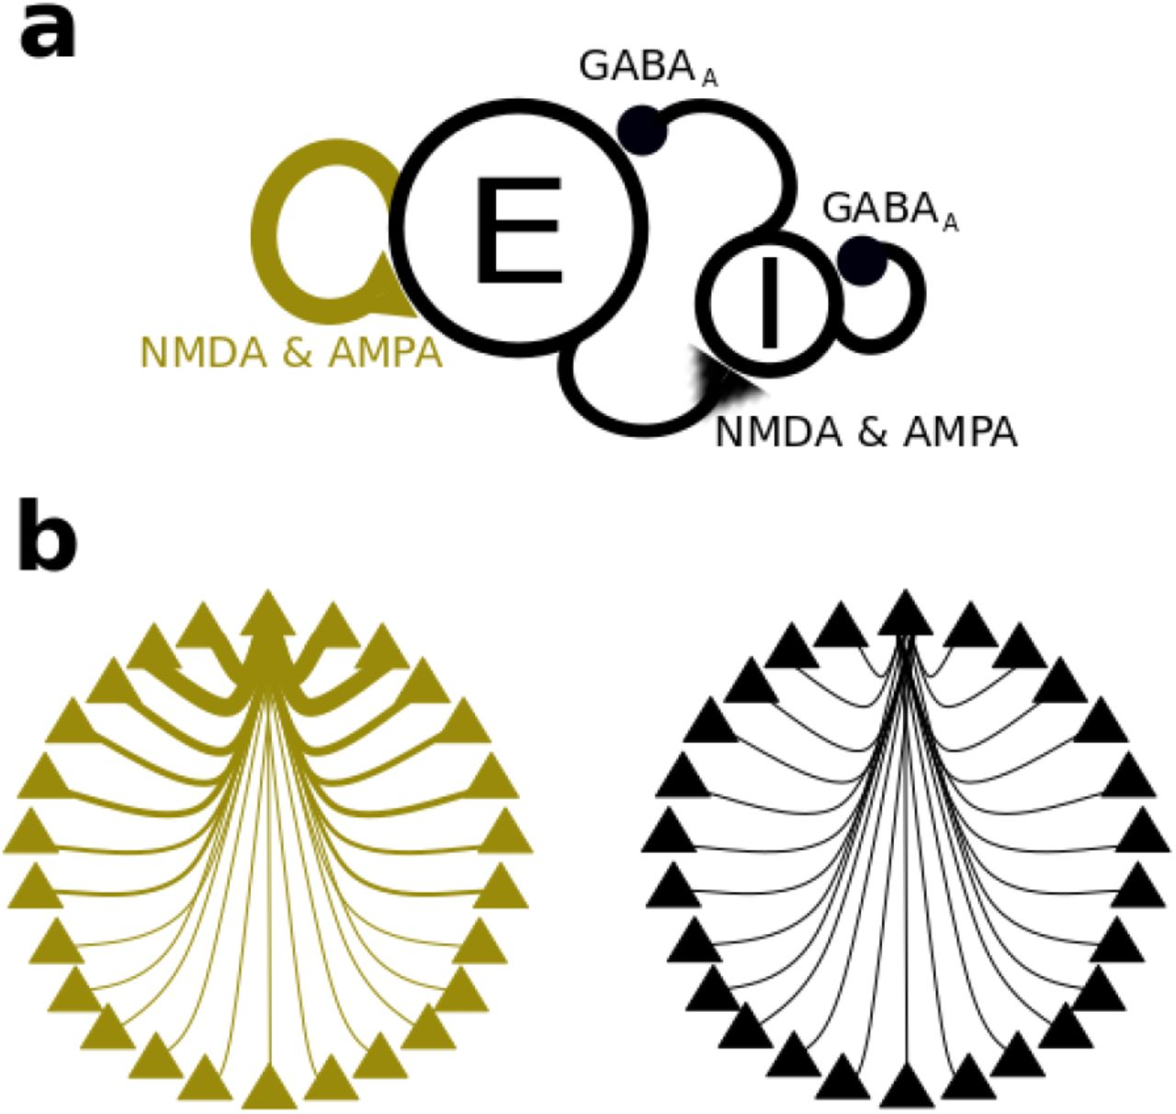
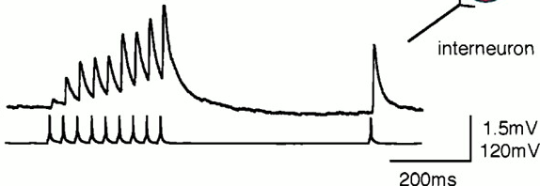
How to model working memory?
Activity-based
Activity-silent
stimulus
stimulus
time
time
Compte et al, Cerebral Cortex (2000)

Slide 7
How about more complicated tasks?

Slide 8
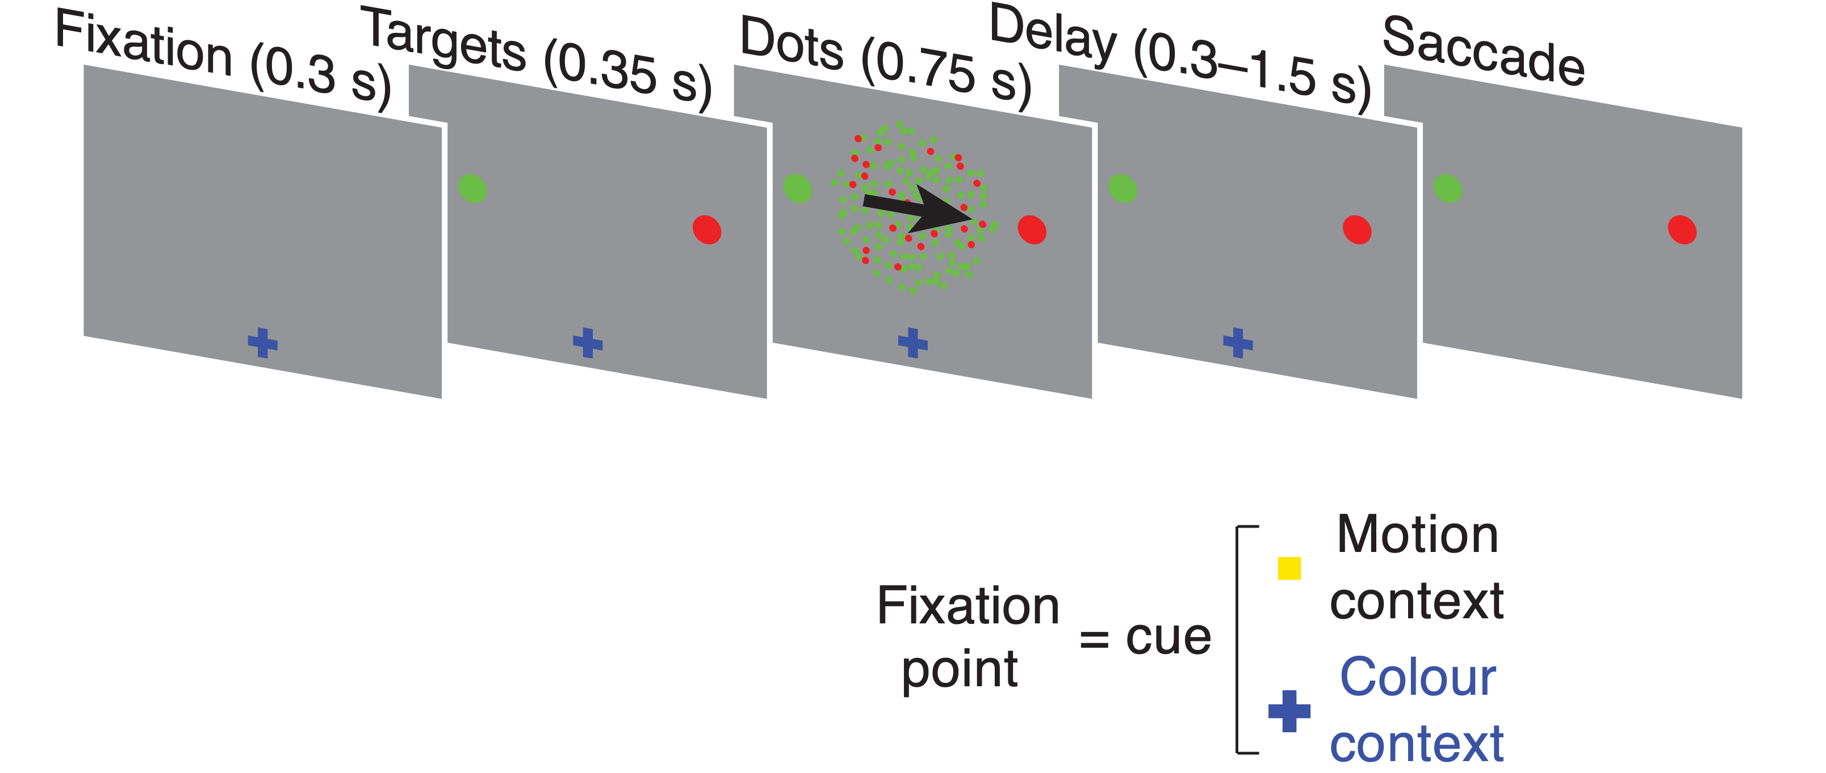
How about more complicated tasks?
Mante and Susillo et al. Context-dependent computation by recurrent dynamics in prefrontal cortex (2013)

Slide 9
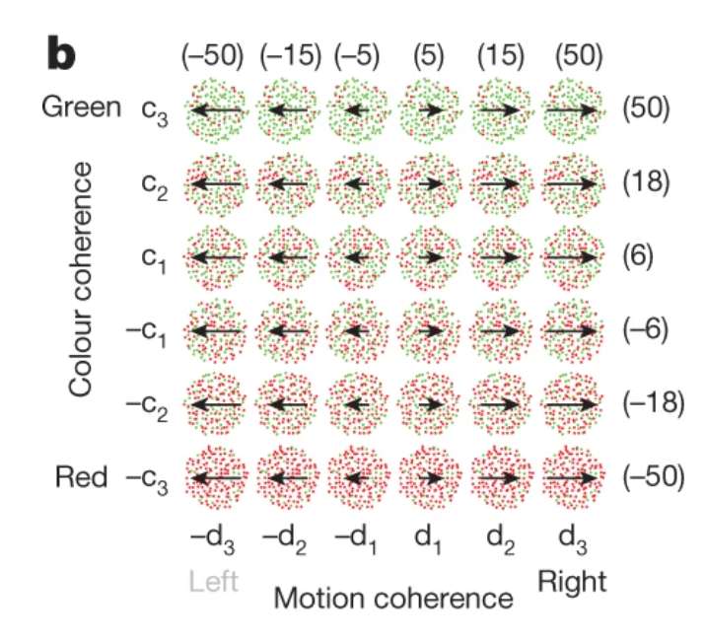
One possible model for context-dependent decision making
Ardid and Wang. A Tweaking Principle Model for Executive Control J. Neurosci (2013)
Mante and Susillo et al. Context-dependent computation by recurrent dynamics in prefrontal cortex (2013)

Slide 10
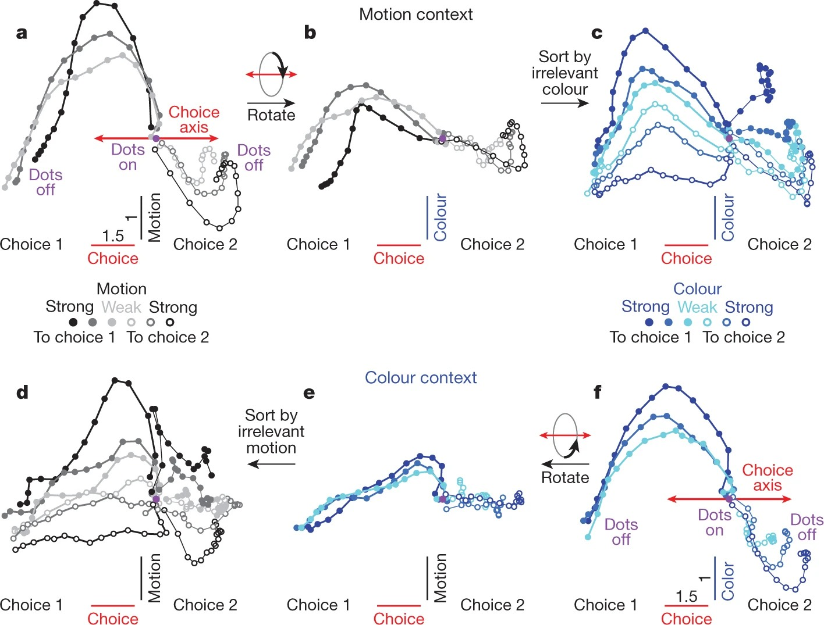
One possible model for context-dependent decision making
Ardid and Wang. A Tweaking Principle Model for Executive Control J. Neurosci (2013)
Mante and Susillo et al. Context-dependent computation by recurrent dynamics in prefrontal cortex (2013)

Slide 11
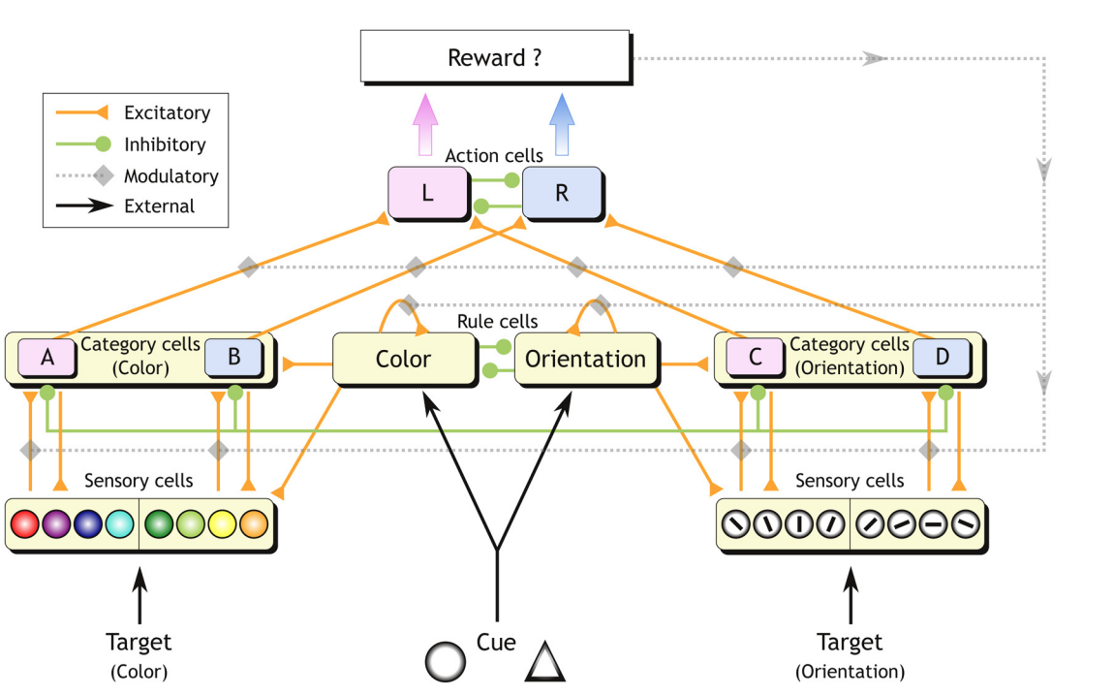
One possible model for context-dependent decision making
Ardid and Wang. A Tweaking Principle Model for Executive Control J. Neurosci (2013)
Mante and Susillo et al. Context-dependent computation by recurrent dynamics in prefrontal cortex (2013)

Slide 12
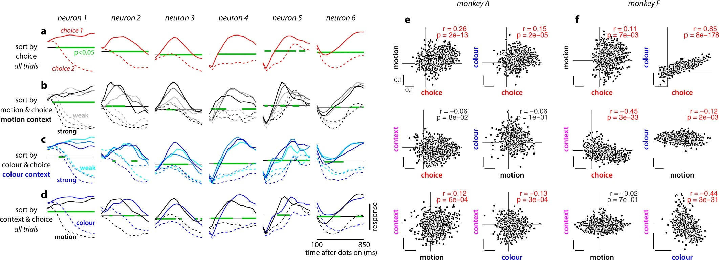
Single cells selectivity in PFC
Mante and Susillo et al. Context-dependent computation by recurrent dynamics in prefrontal cortex (2013)

Slide 13
Single cells selectivity in PFC
Mante and Susillo et al. Context-dependent computation by recurrent dynamics in prefrontal cortex (2013)

Slide 14
Single cells selectivity in PFC
Mante and Susillo et al. Context-dependent computation by recurrent dynamics in prefrontal cortex (2013)

Slide 15
Mixed selectivity in PFC
Mante and Susillo et al. Context-dependent computation by recurrent dynamics in prefrontal cortex (2013)

Slide 16
Mixed selectivity in PFC
Motion
context
Color
context
Dimensionality
reduction
Mante and Susillo et al. Context-dependent computation by recurrent dynamics in prefrontal cortex (2013)

Slide 17
Mixed selectivity in PFC
Motion
context
Color
context
Mante and Susillo et al. Context-dependent computation by recurrent dynamics in prefrontal cortex (2013)

Slide 18
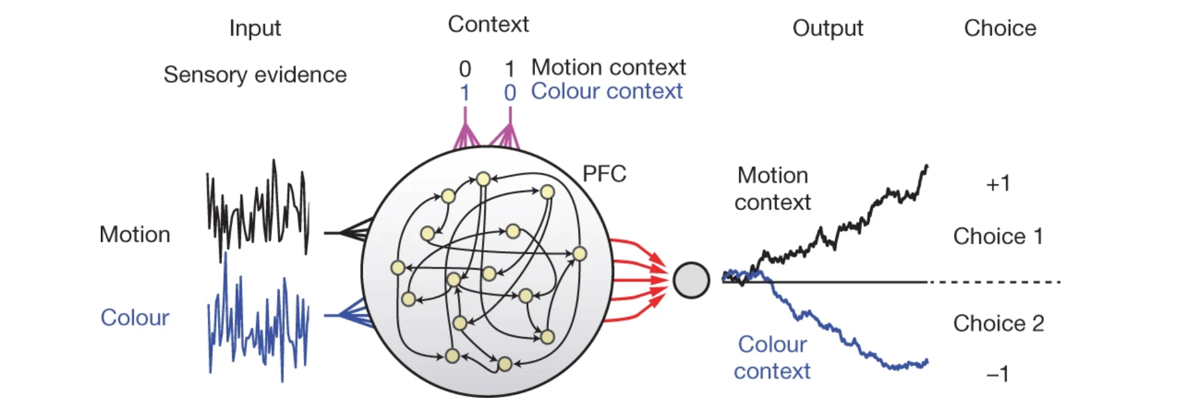
How to model complicated tasks?
$$w$$
$$x$$
$$o=x^{T}w$$
Mante and Susillo et al. Context-dependent computation by recurrent dynamics in prefrontal cortex (2013)

Slide 19
How to model complicated tasks?
$$L=(y-o)^{2}$$
$$w$$
$$x$$
$$o=x^{T}w$$
Mante and Susillo et al. Context-dependent computation by recurrent dynamics in prefrontal cortex (2013)

Slide 20
minimize with backprop!
How to model complicated tasks?
$$L=(y-o)^{2}$$
$$w$$
$$x$$
Mante and Susillo et al. Context-dependent computation by recurrent dynamics in prefrontal cortex (2013)

Slide 21
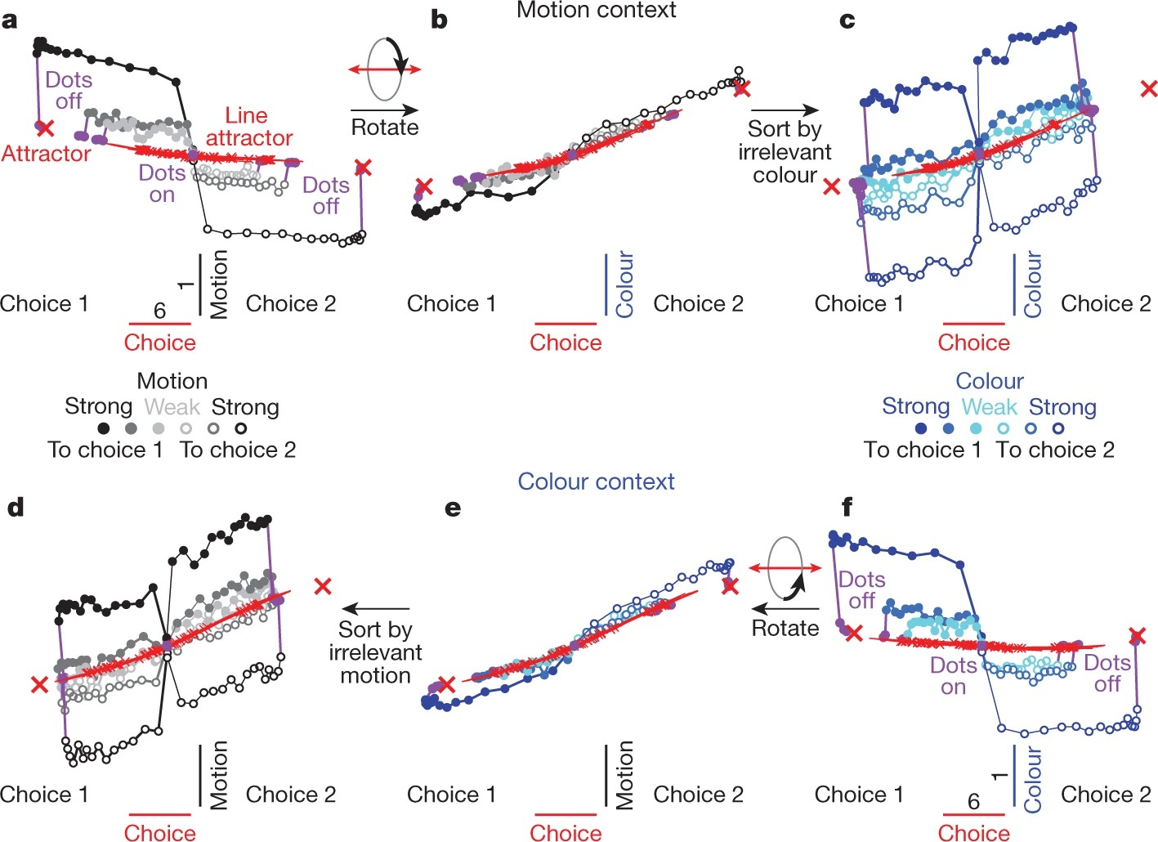
PFC
RNN
Motion
context
Color
context
Mante and Susillo et al. Context-dependent computation by recurrent dynamics in prefrontal cortex (2013)

Slide 22
RNN tutorial
Train RNN: https://shorturl.at/tn6FA
…

Slide 23
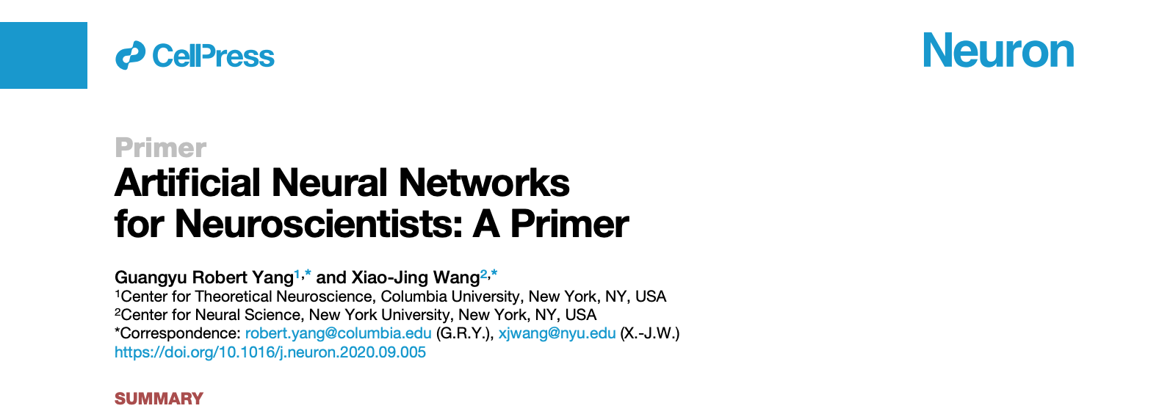
Summary and future reading

