Slide 1
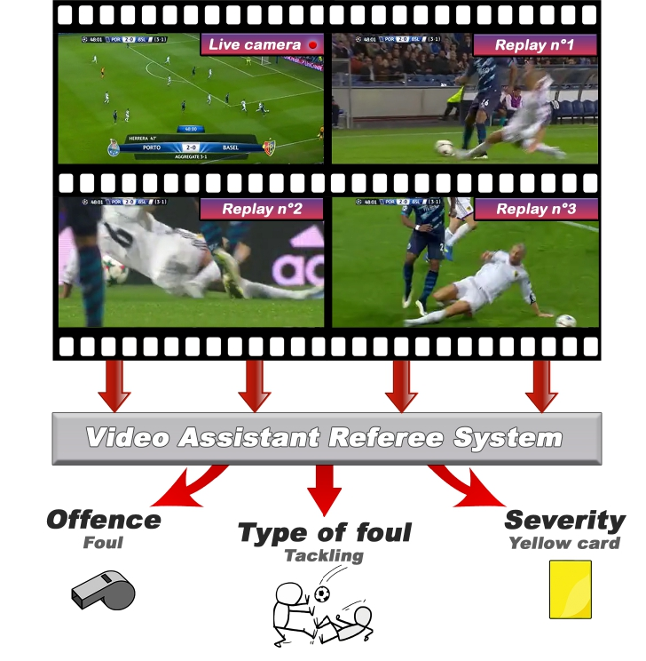
Football Foul Detection and Contact Visualization
Deep VARS recognition with replay/original-view red-box evidence
Goal: recognize football fouls and visually show the contact moment that supports the call.
This presentation uses the latest generated outputs: windowed replays + original view, challenge replays, and all rendered test videos.
01

Slide 2
Goal
What the system should achieve
Foul Recognition
Visual Contact Evidence
Body-Part Explanation
Detect whether an action is an offence and predict severity/action class using a VARS-style multi-view video model.
Render a red contact box around the likely collision/body contact so a reviewer can see why the clip was flagged.
Use pose keypoints and a body-part head to estimate whether the foul lands on upper or lower body.
02

Slide 3
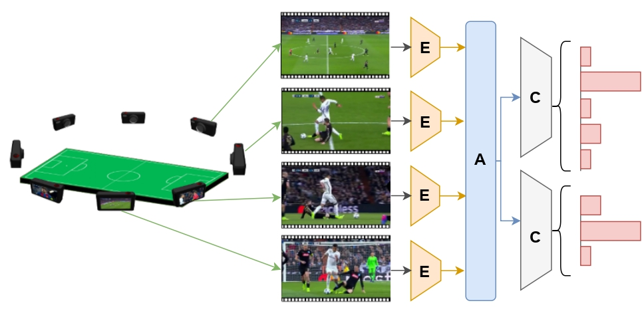
Approach and Design
Deep-first recognition; CV/pose explanation
VARS-style multi-view backbone predicts offence/severity/action class.
Prediction JSON gates visualization: only predicted fouls get red-box overlays.
View selection renders original broadcast plus replay/close-up clips for comparison.
Pose contact localization finds the closest two-player skeleton contact around the foul window.
The red box is windowed around the contact frame to avoid persistent false boxes.
04

Slide 4
Contact Localization Design
How the red box is placed
Motion and Timing
Pose Geometry
Body-Part Mapping
Optical flow and sampled frames identify where motion spikes occur near the foul. The contact-frame index controls when the red box appears.
Keypoint R-CNN detects player skeletons. The closest keypoints between two players define the contact point and the tight red box.
The contact point is mapped to the nearest body segment: head, shoulder, arm, torso, hip, leg, or foot; then collapsed to Upper/Under body.
05

Slide 5
Results – Final Video Outcome
Deep prediction: Offence, severity 1.0, action Standing tackling
06

Slide 6
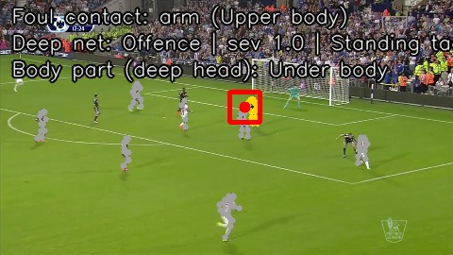
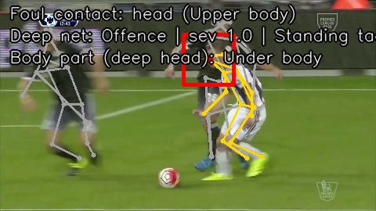
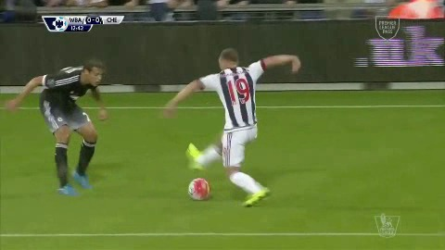
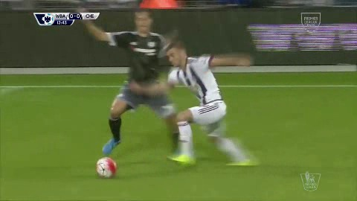
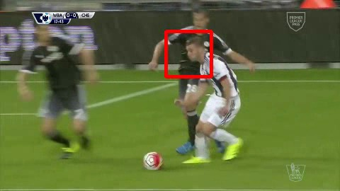
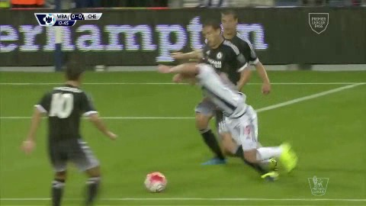
Results: Windowed Replay + Original
Test action 2: original broadcast plus replay/close-up views
Original view
Replay close-up
before
approach
contact box
after
Deep prediction: Offence, severity 1.0, action Standing tackling
06

Slide 7
Results Summary
Body-part recognition and rendered outputs
350
159
46.8%
71.5%
158
rendered Test clips
Test actions
pose/CV coarse acc.
deep body-part acc.
labelled samples
Small Windowed Test
Full Test Pattern
Deep Head Pattern
60% pose/CV and 80% deep body-part accuracy on 5 labelled examples.
Pose/CV over-predicts Upper body: many Under-body fouls are mapped to arm/head/torso when wide views or occlusion confuse the nearest-keypoint contact.
The deep body-part head is stronger overall, especially for Under-body labels, but it still confuses some Upper-body examples.
09

Slide 8
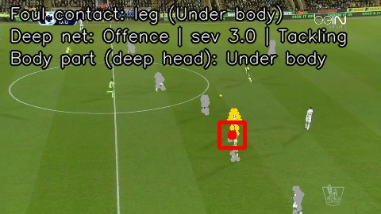
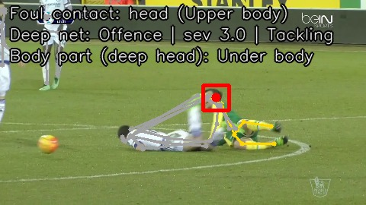
Limitations of Bird's-Eye / Wide Views
Why the original broadcast view is weaker for contact proof
Wide original / bird’s-eye-like view: strong context, weak body detail
Replay close-up: weaker context, stronger contact evidence
Players occupy few pixels, so pose keypoints are noisy and small limb contacts are easy to miss.
Perspective compression and occlusion make the closest visible keypoint differ from the actual contact point.
The wide view helps foul recognition context, but it should not be the only visual proof for body-part/contact localization.
11

Slide 9
Current Limitations
What still fails and why
Localization Noise
Model vs Explanation
Evaluation Gap
Pose can snap to a nearby visible arm/head when the true lower-body contact is occluded or too small.
The VARS model predicts the foul, while the red box is an explanation layer; the box is not yet learned end-to-end from foul labels.
Challenge outputs are qualitative. Test body-part accuracy is coarse and does not fully score contact-box spatial correctness.
12

Slide 10
One-Month Improvement Plan
Highest-impact next steps
Train/evaluate on the full GPU dataset and report official SoccerNet offence/severity/action metrics together with body-part metrics.
Tune view selection: automatically rank replay/close-up views by player scale and pose confidence.
Track pose across time instead of detecting each frame independently, so contact boxes are smoother and less jittery.
Use the deep body-part head to guide or veto pose boxes when pose predicts upper body but the model predicts lower body.
Add quantitative box evaluation with a small manually labelled contact-point set.
Use temporal smoothing across the foul window and fuse all available views before selecting the final contact frame.
Improve bird’s-eye handling with zoomed player crops, super-resolution, or detector-guided crop tracking.
Integrate the final videos into the VARS interface for side-by-side original/replay review.
13

Slide 11
Takeaway
What the project now demonstrates
The pipeline detects fouls with the VARS baseline and produces replay-aware, windowed red-box videos that make the contact moment visually inspectable.
Best evidence
Best context
Best next step
Replay/close-up views are the clearest for contact localization.
Original wide views explain play dynamics but are limited for body contact.
Fuse deep predictions, pose tracks, and view ranking over the full dataset.
14

