Slide 1
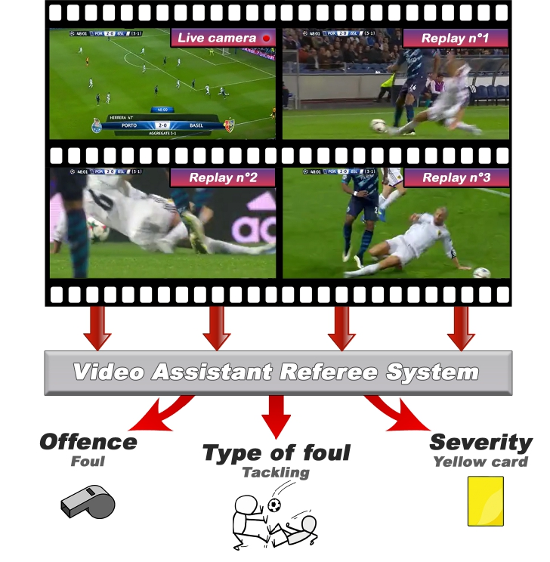
Deep-First Foul Detection
VARS baseline + computer vision contact visualization for SoccerNet-MVFoul
Goal: detect football fouls and visually show the contact moment that supports the decision.
The deep model decides whether the action is a foul; the CV pipeline creates the red-box review evidence.
01

Slide 2
Goal
What the project is trying to achieve
Recognition
Visualization
Review Support
Classify whether a multi-view football action is an offence and estimate severity/action class.
Track visible player movement and draw a red contact box at the likely collision/contact moment.
Produce clips/stills that make the model decision easier to inspect, especially on replay or close-up views.
02

Slide 3
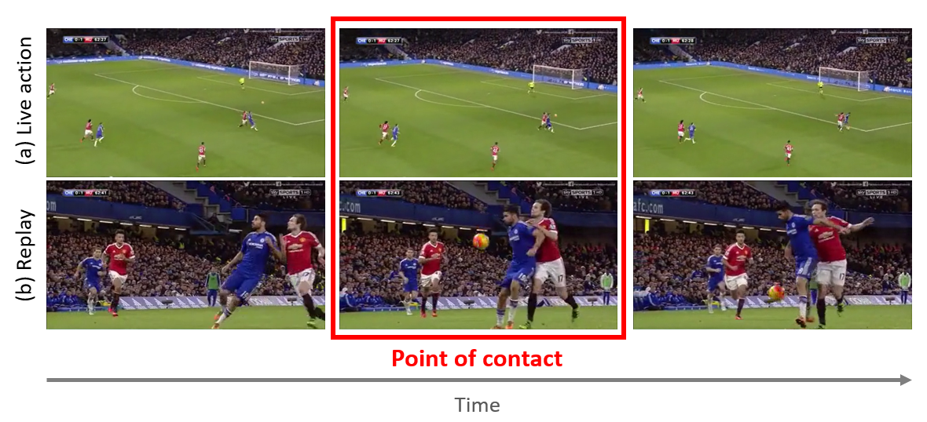
Problem Setting
SoccerNet-MVFoul multi-view foul recognition
3,901 available actions across Train, Valid, Test, and Challenge splits.
Each action has at least two synchronized views: live action plus replay/alternate camera.
Annotations include offence, severity, action class, body part, and additional referee labels.
The visible foul is usually centered near the middle of the clip, so temporal trimming is useful.
03

Slide 4
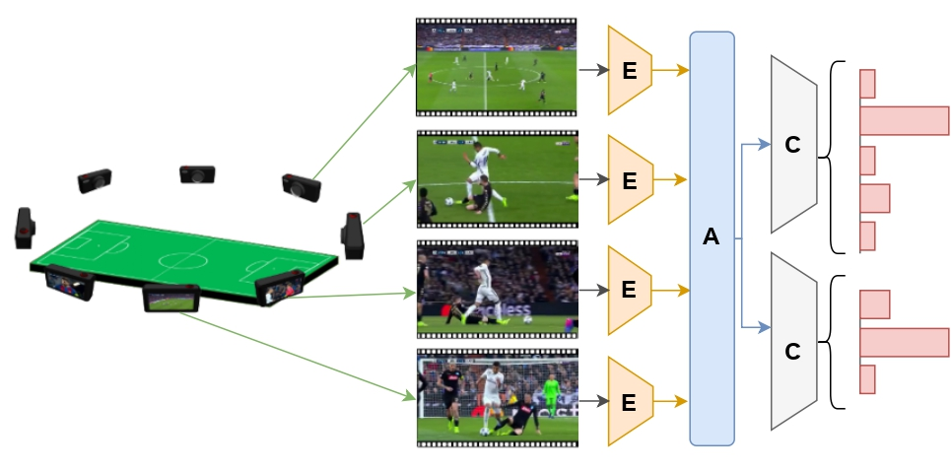
Approach
Deep-first recognition, CV-first explanation
VARS encodes each view with a video backbone such as MViT-v2-S.
View features are aggregated with attention/max/mean pooling.
Two heads predict offence/severity and action class.
The prediction JSON gates the contact visualizer: no predicted foul, no red contact overlay.
04

Slide 5
CV Contact Design
How the visualization finds contact
Motion
Tracking
Localization
MOG2 foreground regions identify moving player-like areas. Farneback optical flow measures motion intensity and collision spikes.
A centroid tracker links moving regions over time. Close moving tracks become possible contact candidates.
Pose keypoints, body-part mapping, and optional deep saliency tighten the red box onto visible player contact.
05

Slide 6
Pipeline Flow
What happens when a clip is processed
1
2
3
4
5
Run VARS
Gate clips
Choose view
Find contact
Render result
Predict offence/severity/action from multi-view video.
Keep only actions predicted as fouls.
Prefer replay/close-up clips for clearer contact.
Use motion, tracking, pose, and optional saliency.
Draw red box and pause the video at contact.
The model produces the foul decision; CV makes the decision inspectable frame-by-frame.
06

Slide 7
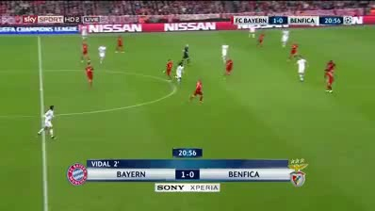
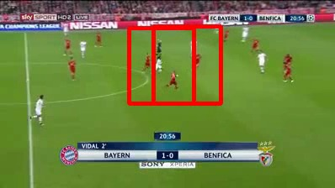
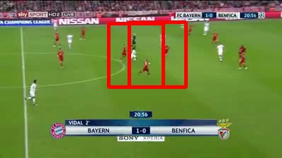
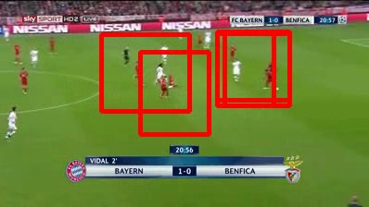
Results: Contact Sequence
Model-gated demo, live view clip 0
start
approach
contact cue
paused/after
Prediction used for gating: Offence, severity 3.0, action class Tackling.
The overlay shows red contact boxes only after a foul prediction is present, with a one-second freeze on new contact cues.
07

Slide 8
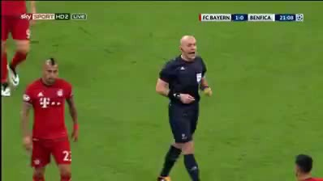
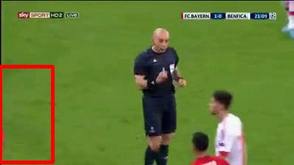

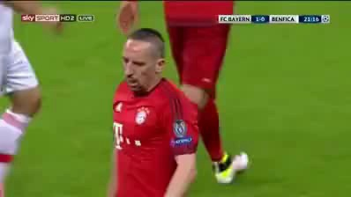
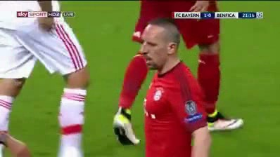
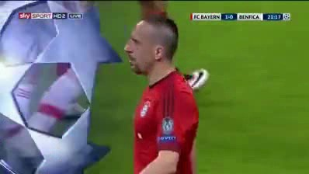
Results: Multi-View Sequences
Replay/alternate views expose different contact evidence
clip 1 early
clip 1 contact
clip 1 late
clip 2 early
clip 2 mid
clip 2 late
Clip-level contact features from the demo
Different cameras are useful because the contact can be hidden in one view and clearer in another.
Clip 0: 2.75 possible contacts/frame; 21 tracked objects.
Clip 1: 1.00 possible contacts/frame; 12 tracked objects.
Clip 2: 0.00 possible contacts/frame; 8 tracked objects.
08

Slide 9

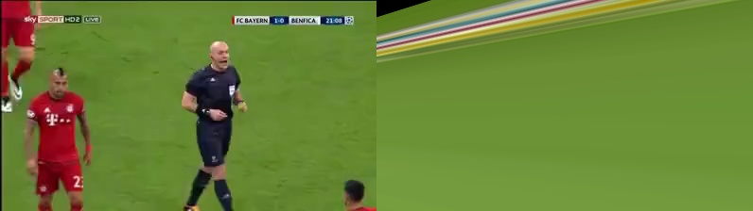
Results: Supporting CV Outputs
Earlier visual features retained for explanation and inspection
Image stitching / local feature matching
Stereo-style disparity view
These are not the final foul detector, but they help explain multi-view geometry and visual evidence around the play.
09

Slide 10
Result Status
What is proven locally vs what needs the full GPU dataset
Local Demo
Smoke-Test Metric
Full Result Needed
Existing outputs show red-box contact overlays, contact pauses, multi-view clips, stitching, disparity, and feature JSONs for action_0.
The local Random Forest report is 1.0 accuracy on one sample. This only verifies plumbing, not generalization.
The full MVFoul train/validation/test evaluation must run on the GPU machine where the dataset is stored.
10

Slide 11
One-Month Improvement Plan
How to make the result stronger
Run full VARS training/evaluation on the GPU machine and report official SoccerNet metrics.
Tune contact thresholds and pose gates on the validation split instead of one demo action.
Use replay-aware view selection and compare live vs replay contact localization quality.
Add quantitative contact-localization metrics using body-part labels and manual spot checks.
Improve contact boxes with tracked pose tubes rather than independent per-frame poses.
Use deep saliency more consistently to align the red box with the evidence driving the foul prediction.
Package the output into the VARS interface so reviewers can scrub clips and inspect the contact pause.
Create an error taxonomy: occlusion, camera angle, bad pose, non-contact foul, and model false positive.
11

Slide 12
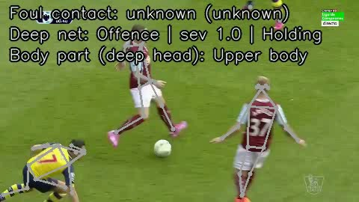
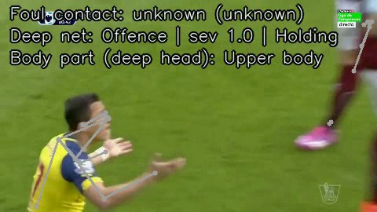
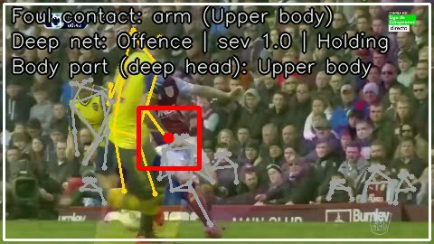
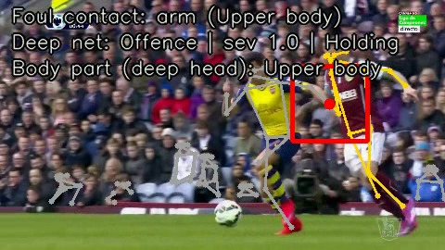
Results: Smoother Replay Contact
New output: foul_bodypart_replay_video_smoother
before replay contact
players converge
contact frame 24
overlay continues smoothly
Action 0 selected replay, close-up view (Close-up player or field referee).
Deep prediction: Offence, severity 1.0, action Holding.
Pose contact maps the red box to arm / Upper body with 8 players detected.
Why it helps
The replay/close-up view makes the contact box easier to inspect than the broadcast-wide live view.
12

Slide 13
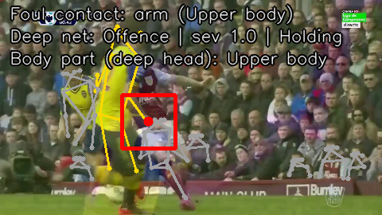
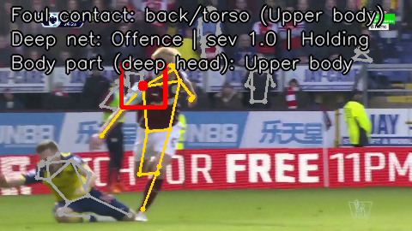
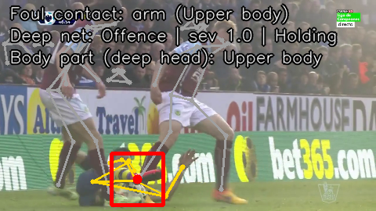
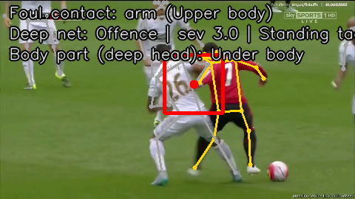
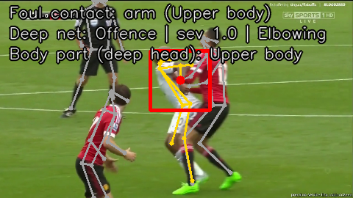
Results: Body-Part Replay Summary
Five validation replay/close-up examples with smoother foul overlays
A0: arm
A3: back/torso
A8: arm
A10: arm
A12: arm
Pose/CV Body Part
Deep Body-Part Head
Current Limitation
60% coarse accuracy on 5 validation examples. It correctly keeps all Upper-body examples, but misses two Under-body cases as Upper-body.
80% coarse accuracy on 5 examples. This improves one Under-body case while still showing class imbalance toward Upper-body.
The smoother overlay is visually clearer, but five examples are still too small for a final claim. The next step is full validation/test evaluation.
13

