Slide 1
Go4Food
CS 476 (Spring 2023)

Slide 2
The Team and Roles
Adnan – Full Stack Development
JJ – Project Manager and Full Stack
Mohammad – Project Manager and Front End

Slide 3
Project Idea – Go4Food
Traditional food ordering involves lengthy phone calls, miscommunications, and limited menu visibility, leading to inconvenience for customers and operational challenges for restaurant owners.
Develop a web-based application that allows users to order food from various restaurants. As well allow trouble-free registration and menu management for the restaurants.
Go4Food will feature user registration, menu browsing, placing orders, and order tracking. Highlight benefits like convenience, a wide range of restaurant options, and user-friendly interfaces. Lastly, our web app aims to improve overall service quality .

Slide 4
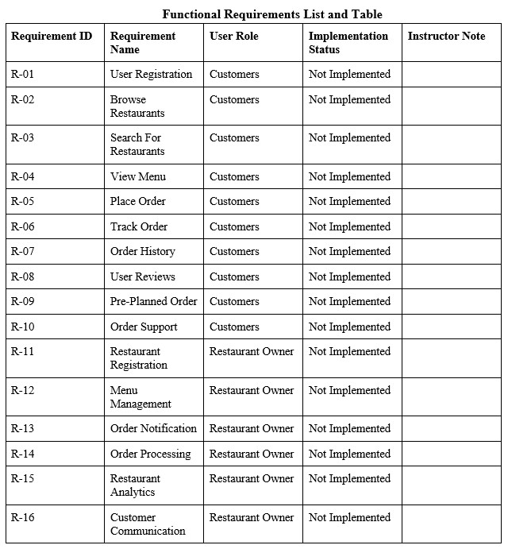
Functional Requirements

Slide 5
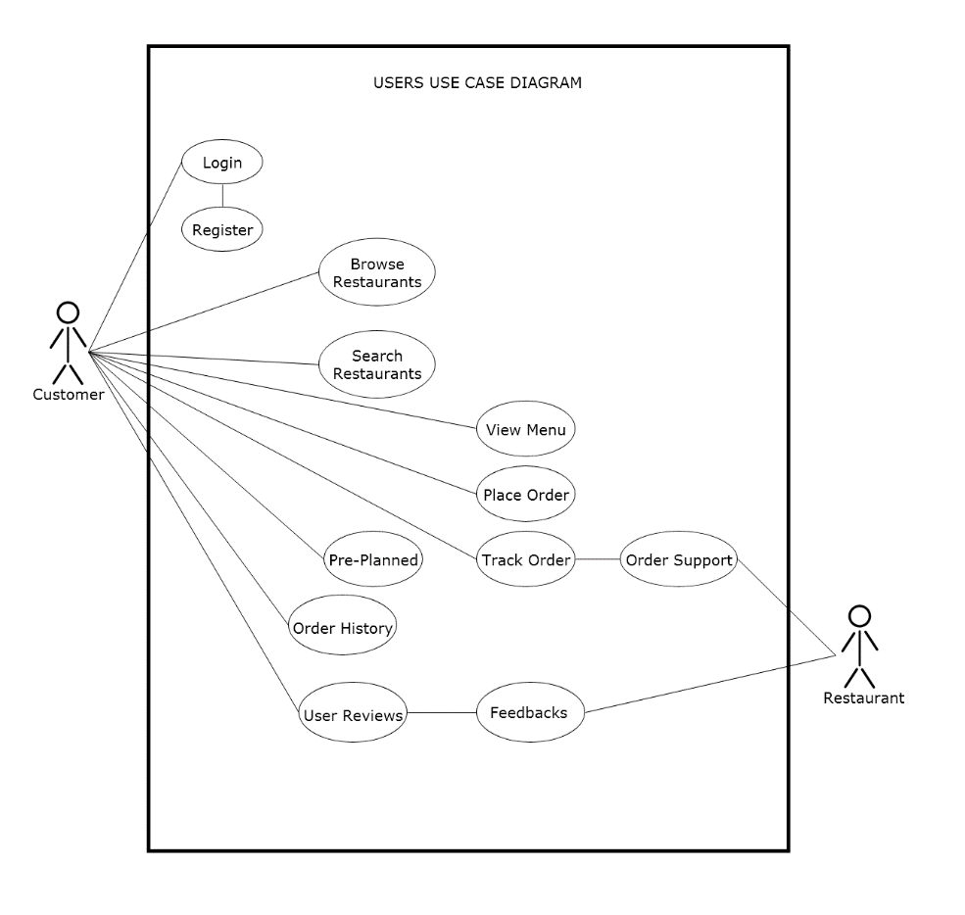
Use Case Diagram - Customer

Slide 6
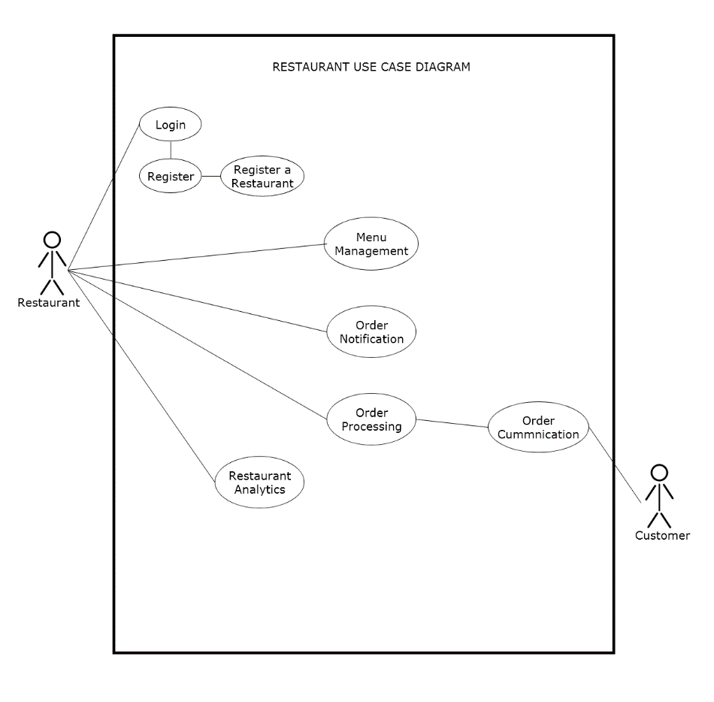
Use Case Diagram - Restaurant

Slide 7
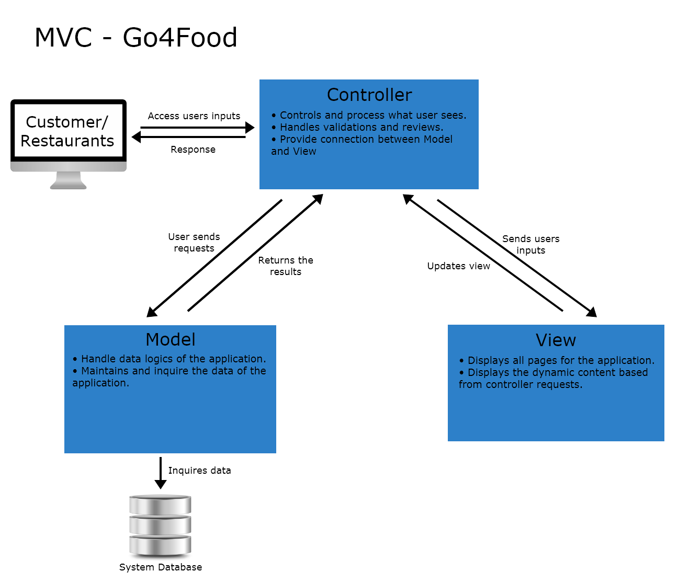
MVC Architecture

Slide 8
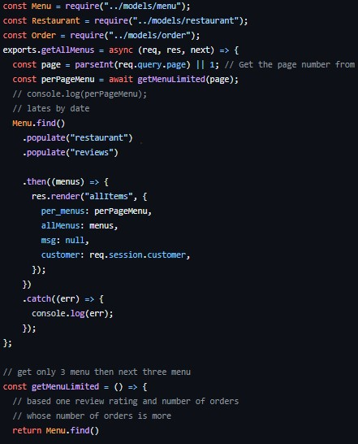
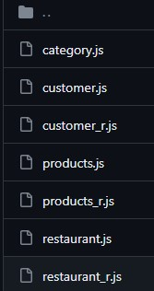
Controller
Acts as an intermediary between the Model and View.
Handles user inputs and decides how or when to update either the Model or View.

Slide 9
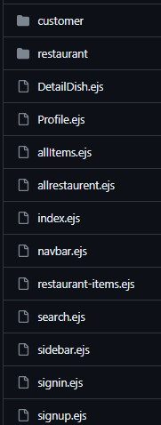
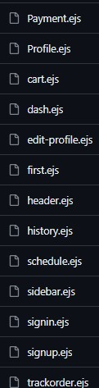
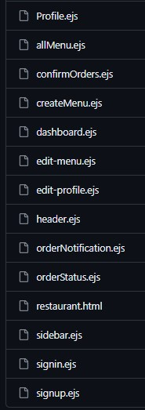
View
The presentation layer of the applications.
Customer and Restaurant users interface.

Slide 10
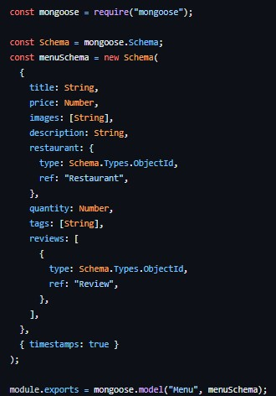
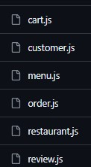
Model
It represents the application’s data management and business logics.
Responsible for defining rules and operations on the given data.

Slide 11
Class Diagram

Slide 12
Design Pattern1
Description

Slide 13
Design Pattern1
(CODE PICTURE)

Slide 14
Design Pattern2
Description

Slide 15
Design Pattern2
(CODE PICTURE)

Slide 16
Project Demo

Slide 17
Feedbacks and Q&As
Thank You!

