Slide 1
Go4Food
CS 476 (Spring 2023)

Slide 2
The Team and Roles
Adnan – Full Stack Development
JJ – Project Manager and Full Stack
Mohammad – Project Manager and Front End

Slide 3
Project Idea – Go4Food
Develop a web-based application that allows users to order food from various restaurants.
Provide convenience and security for customers and restaurant users.

Slide 4
Functional Requirements

Slide 5
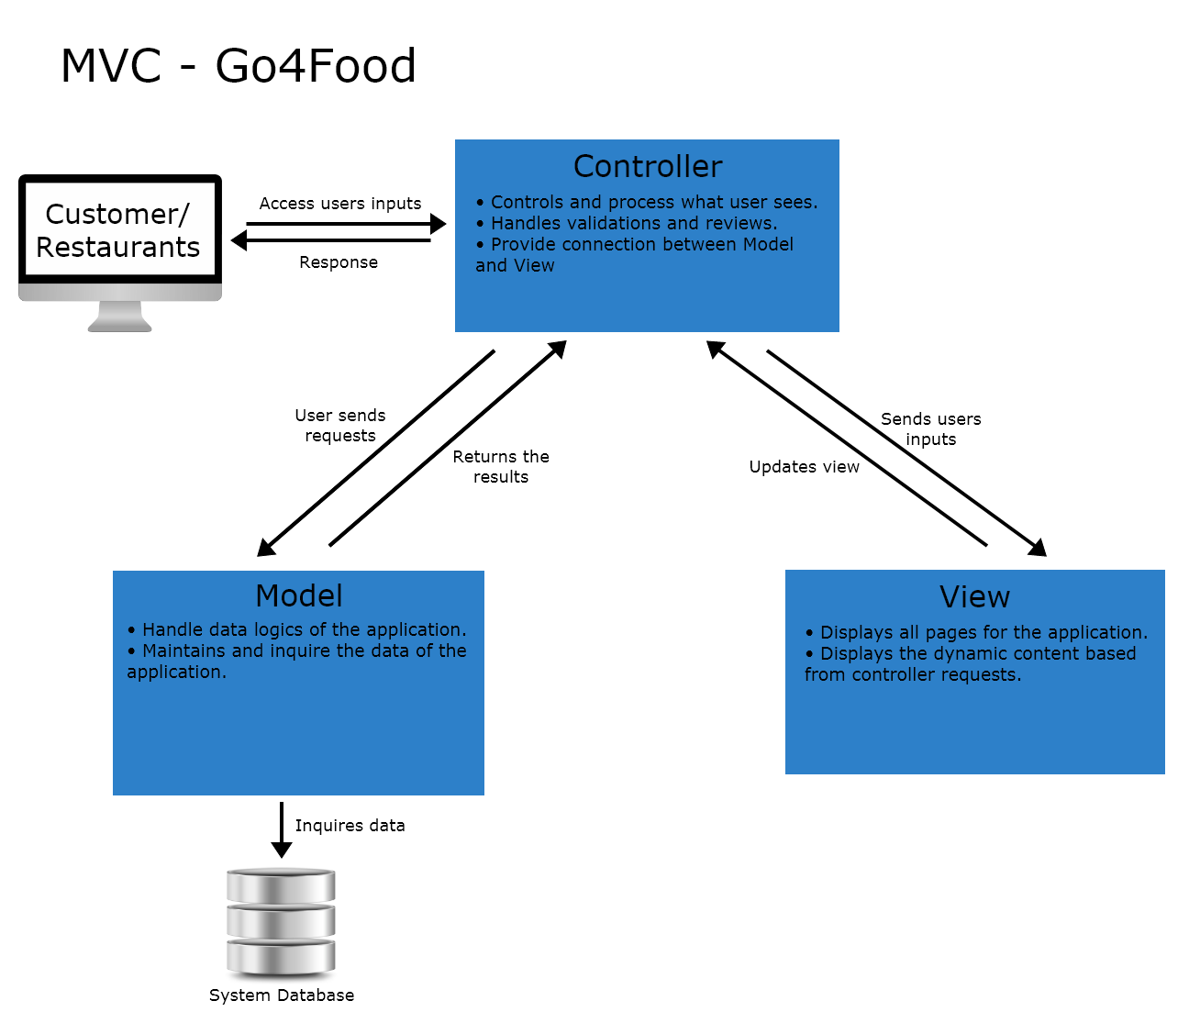
MVC Architecture

Slide 6
Controller

Slide 7
View

Slide 8
Model

Slide 9
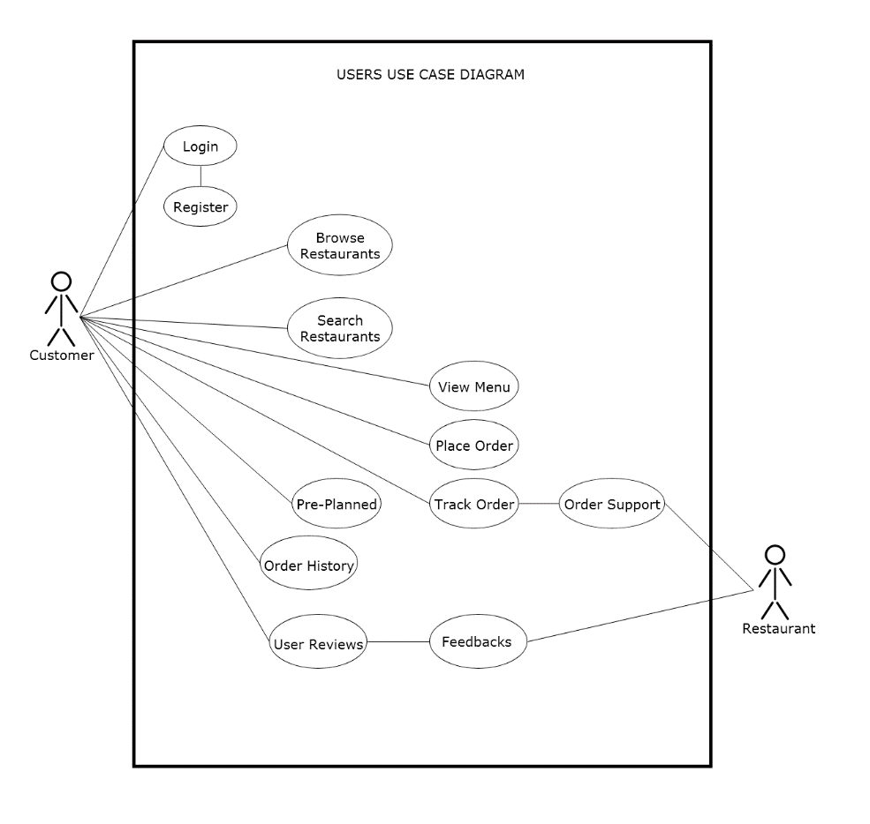
Use Case Diagram - Customer

Slide 10
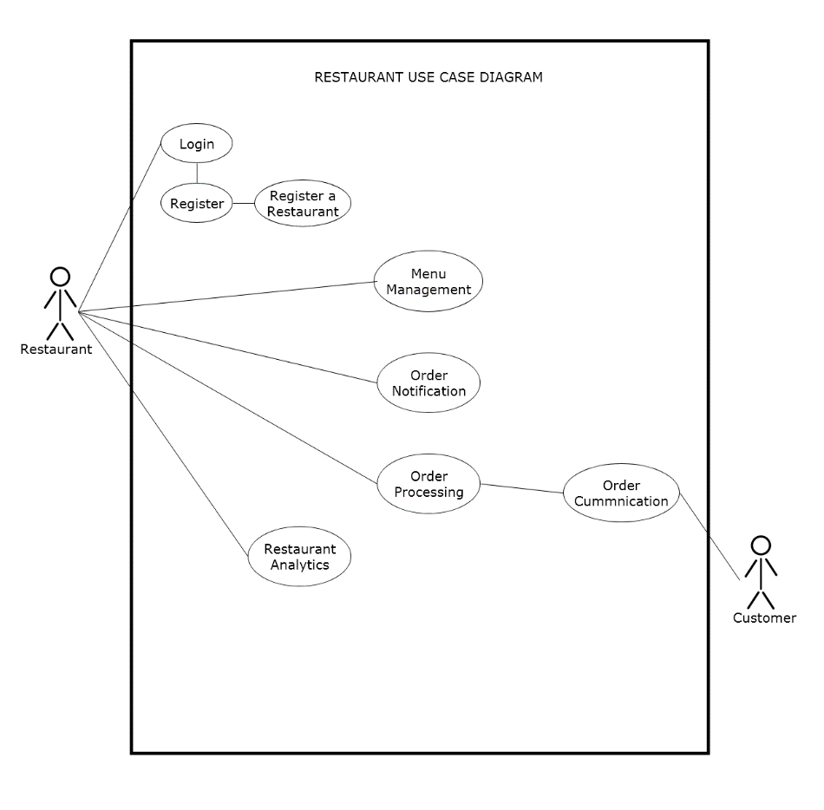
Use Case Diagram - Restaurant

Slide 11
Class Diagram

Slide 12
Design Pattern1
Description

Slide 13
Design Pattern1
Code Picture

Slide 14
Design Pattern2
Description

Slide 15
Design Pattern2
(CODE PICTURE)

Slide 16
Design Pattern
(CODE PICTURE)

Slide 17
Project Demo

Slide 18
Feedbacks and Q&As
Thank You!

