Slide 1
Go4Food
CS 476 (Spring 2023)

Slide 2
The Team and Roles
Adnan – Full Stack Development
JJ – Project Manager and Full Stack
Mohammad – Project Manager and Front End

Slide 3
Project Idea – Go4Food
Traditional food ordering involves lengthy phone calls, miscommunications, and limited menu visibility, leading to inconvenience for customers and operational challenges for restaurant owners.
Develop a web-based application that allows users to order food from various restaurants. As well allow trouble-free registration and menu management for the restaurants.
Go4Food will feature user registration, menu browsing, placing orders, and order tracking. Highlight benefits like convenience, a wide range of restaurant options, and user-friendly interfaces. Lastly, our web app aims to improve overall service quality .

Slide 4
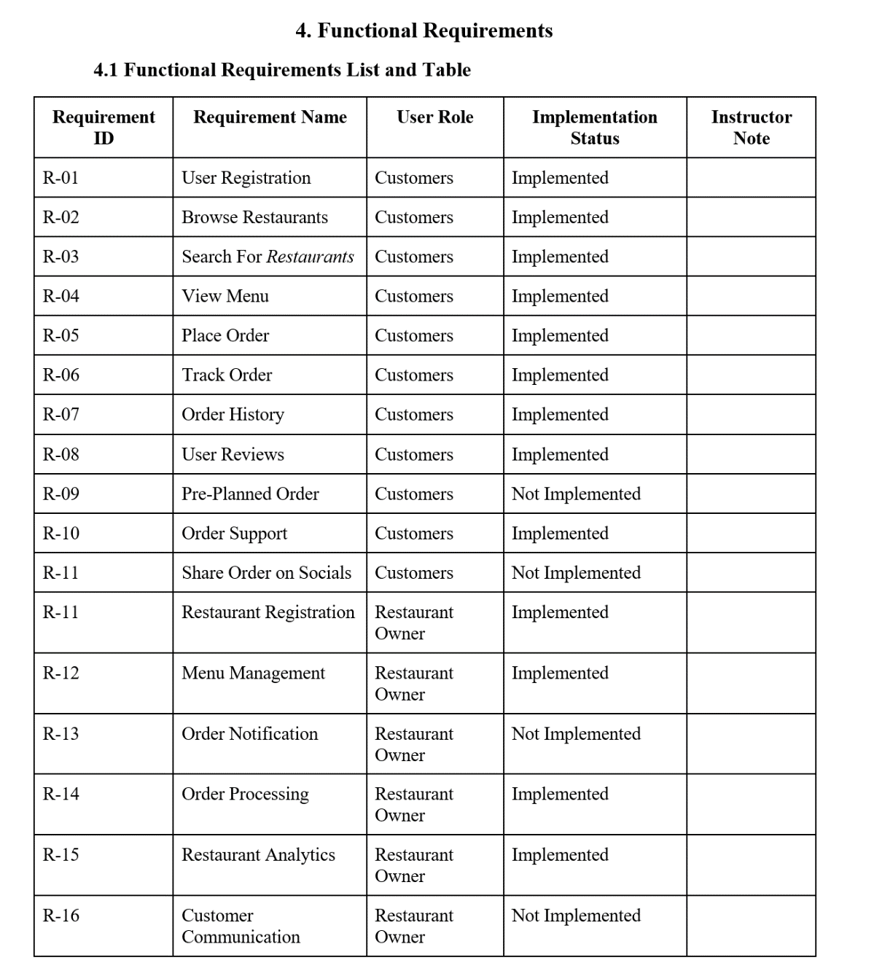
Functional Requirements

Slide 5
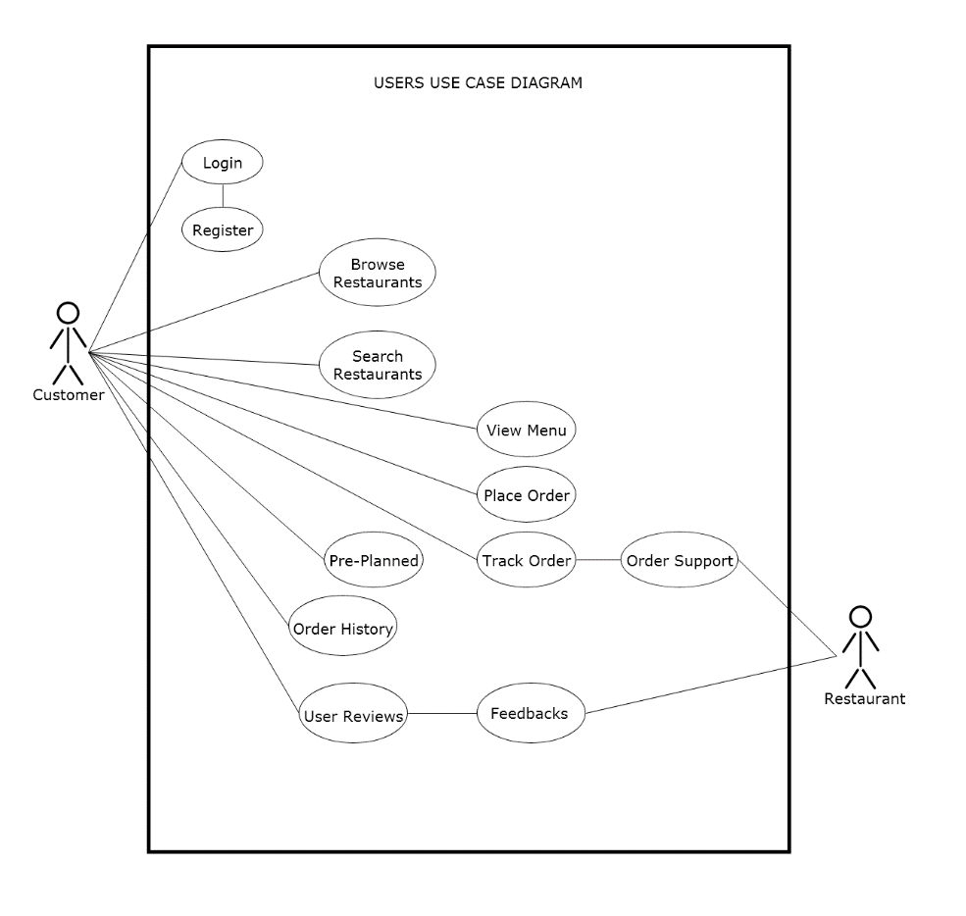
Use Case Diagram - Customer

Slide 6
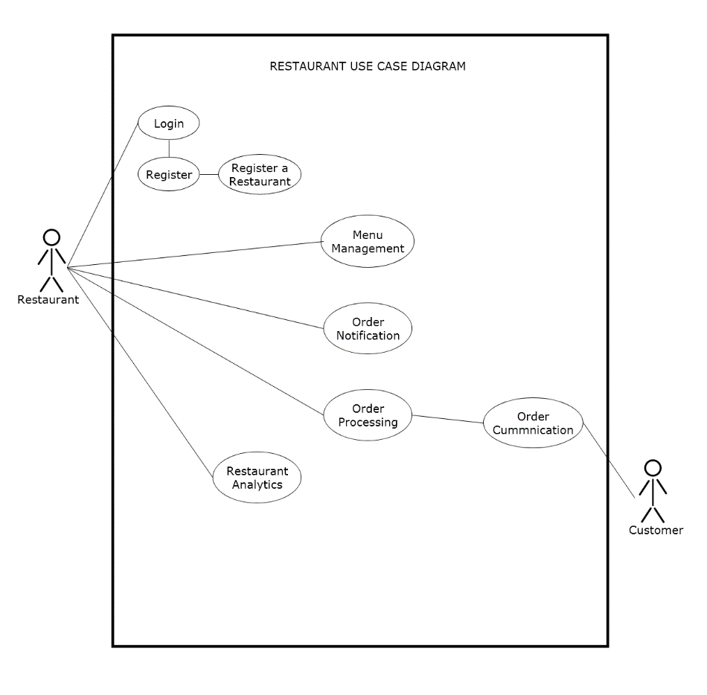
Use Case Diagram - Restaurant

Slide 7
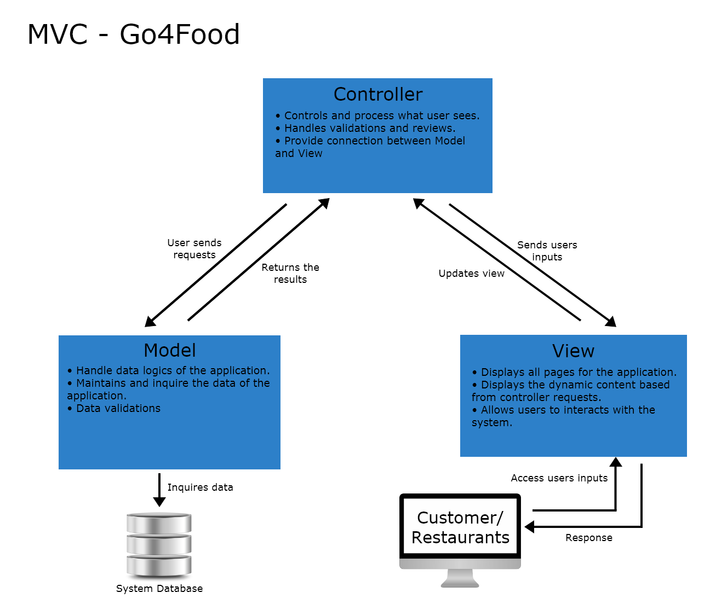
MVC Architecture

Slide 8
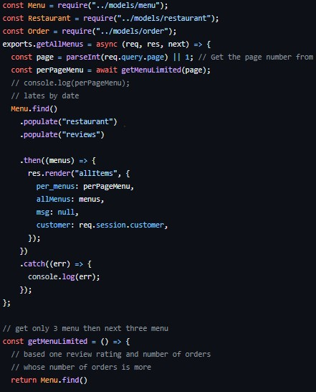
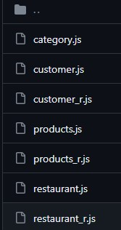
Controller
Acts as an intermediary between the Model and View.
Handles user inputs and decides how or when to update either the Model or View.

Slide 9
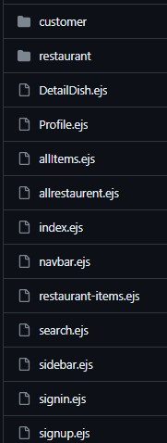
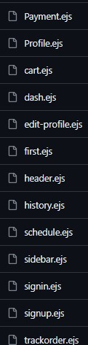
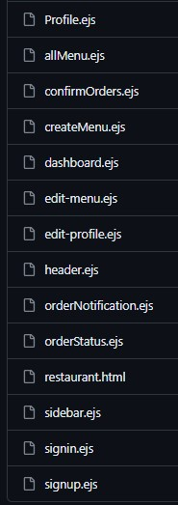
View
The presentation layer of the applications.
Customer and Restaurant users interface.

Slide 10
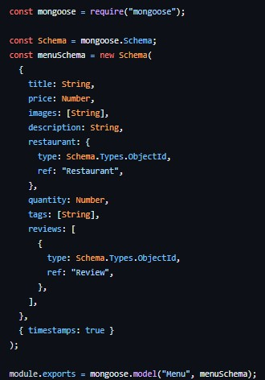
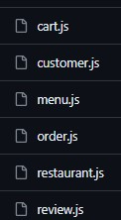
Model
It represents the application’s data management and business logics.
Responsible for defining rules and operations on the given data.

Slide 11
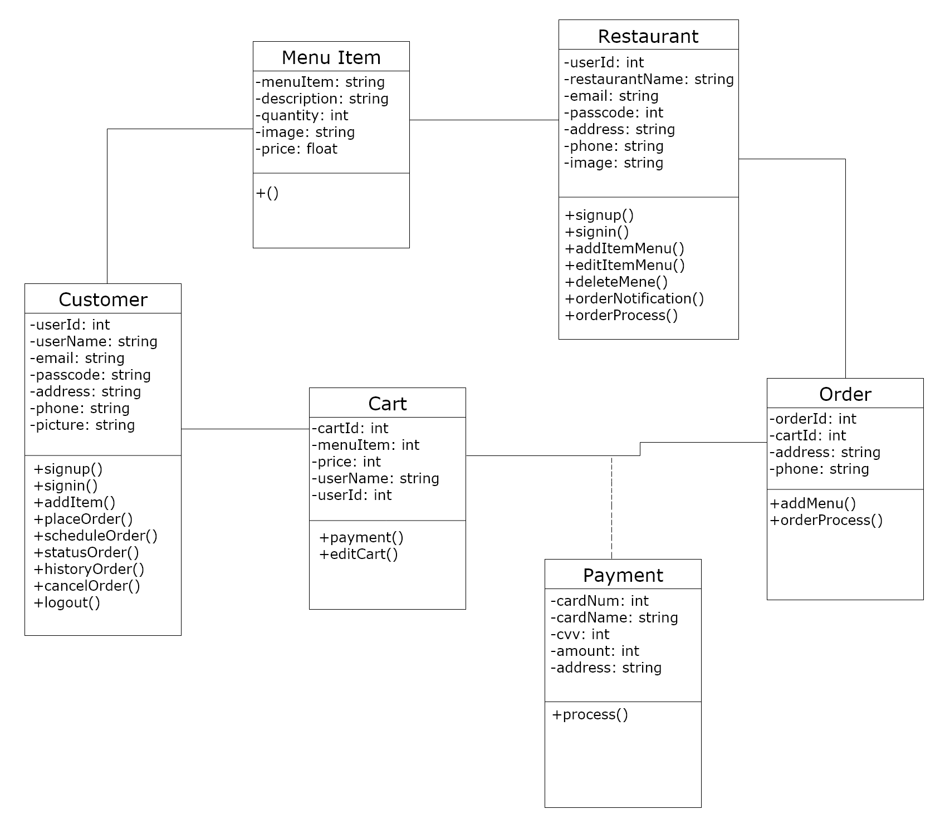
Comprehensive Class Diagram

Slide 12
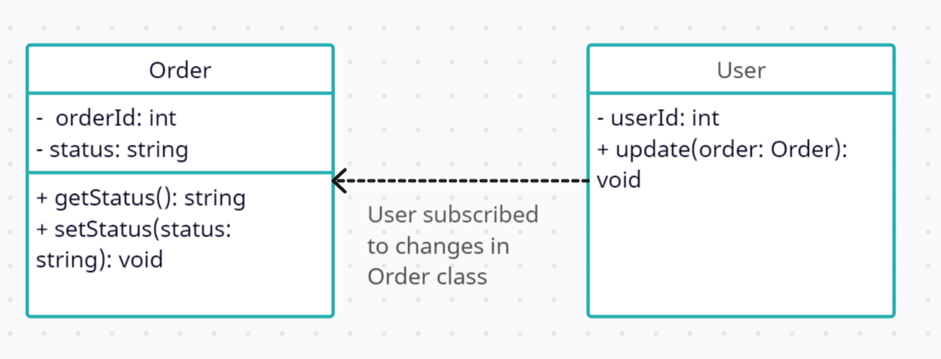
Design Pattern - Observer
The design pattern used concerning new changes to the order status.
Parties that are affected by this should therefore be notified of such changes.
Observers (in our case the users) would be notified of the order status change.

Slide 13
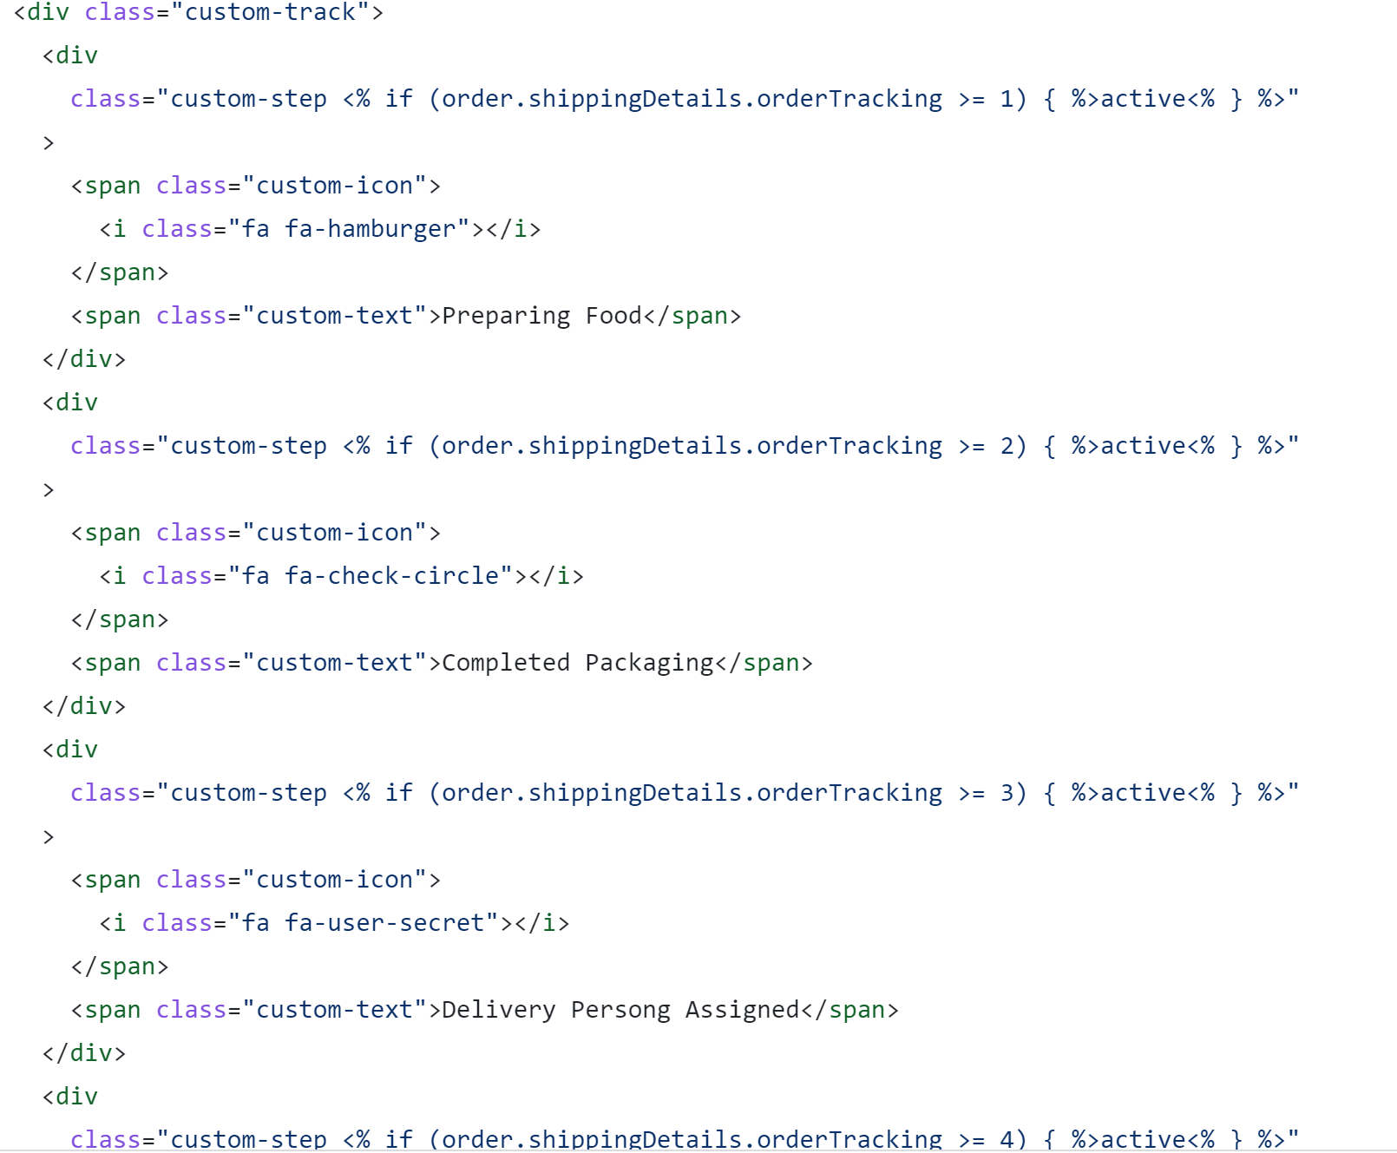
Design Pattern - Observer
Code shows the implementation of order status change through the observer design pattern.
The ‘active’ order status varies based on what the status of the order is.
More on this in the demo.

Slide 14
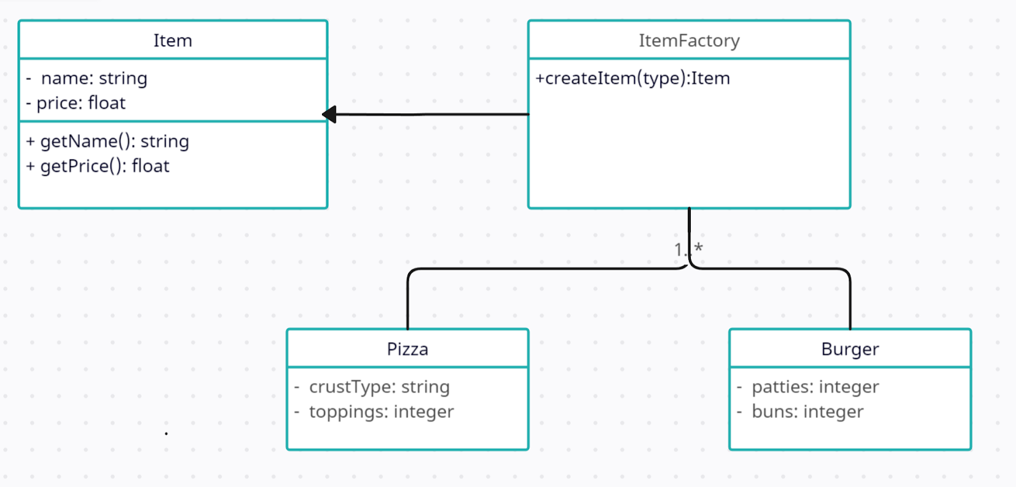
Design Pattern - Factory
Factory design pattern used to provide a functionality where restaurant can create instances of a food item.
Such instances could a pizza or burger.
The factory class is responsible for creating these instances.

Slide 15
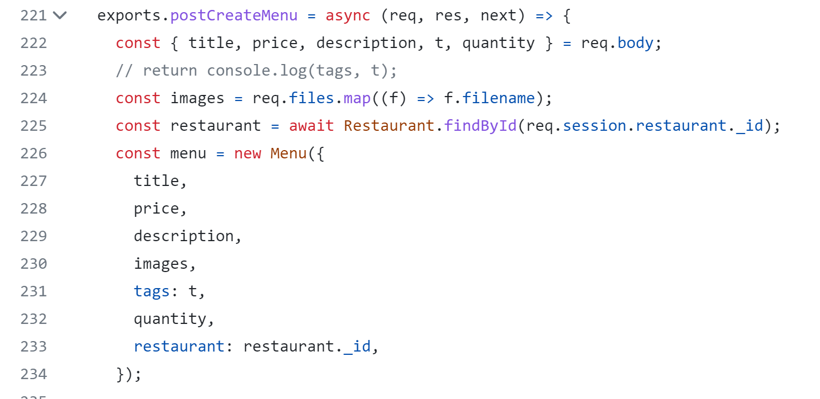
Design Pattern - Factory
Code shows the implementation of different menu items through the factory design pattern.
A new instance of an item is created with unique title, price, description, images, etc. properties.
More on this in the demo.

Slide 16
Project Demo

Slide 17
Feedbacks and Q&As
Thank You!

