Slide 1

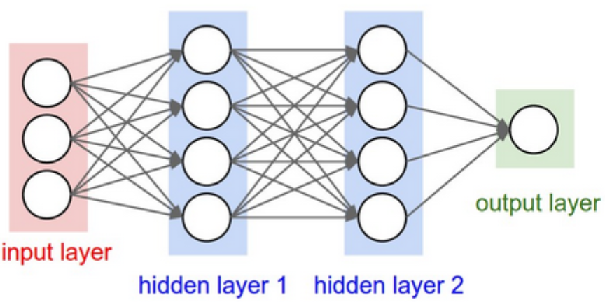
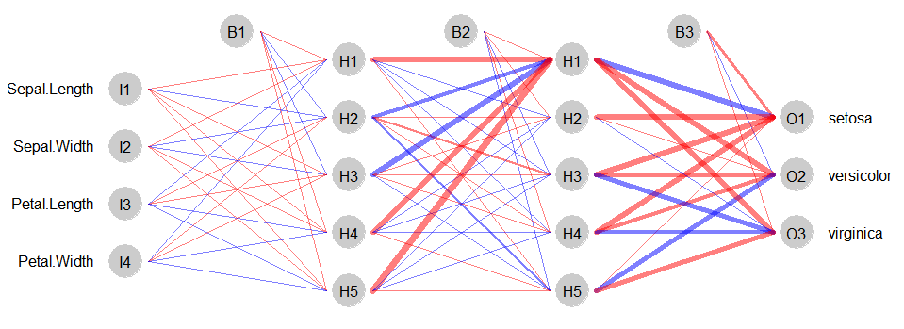
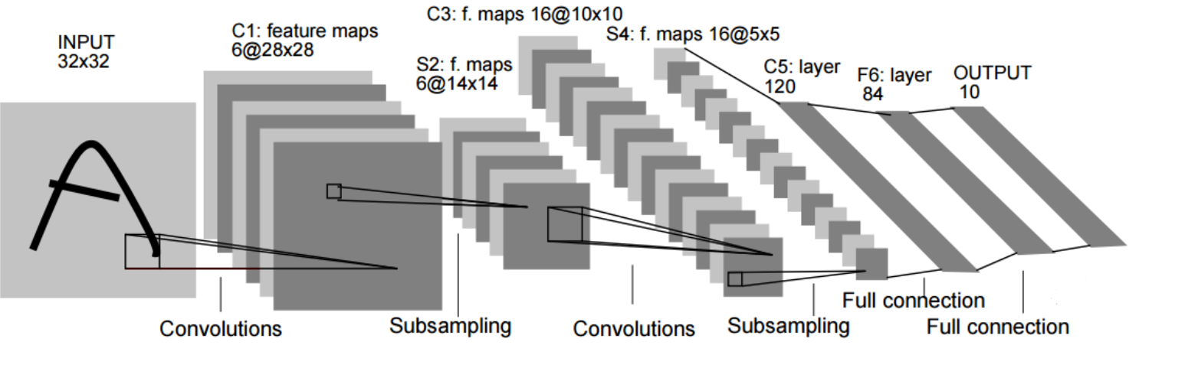
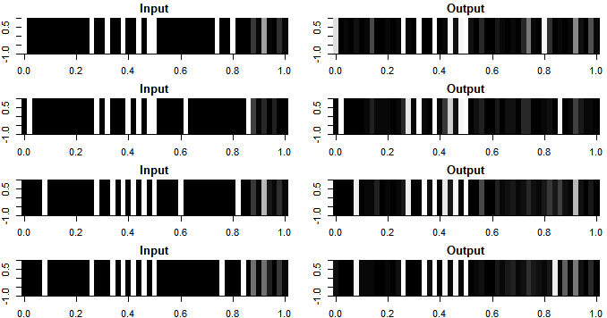
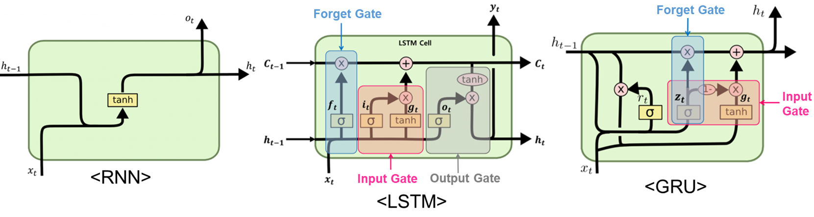
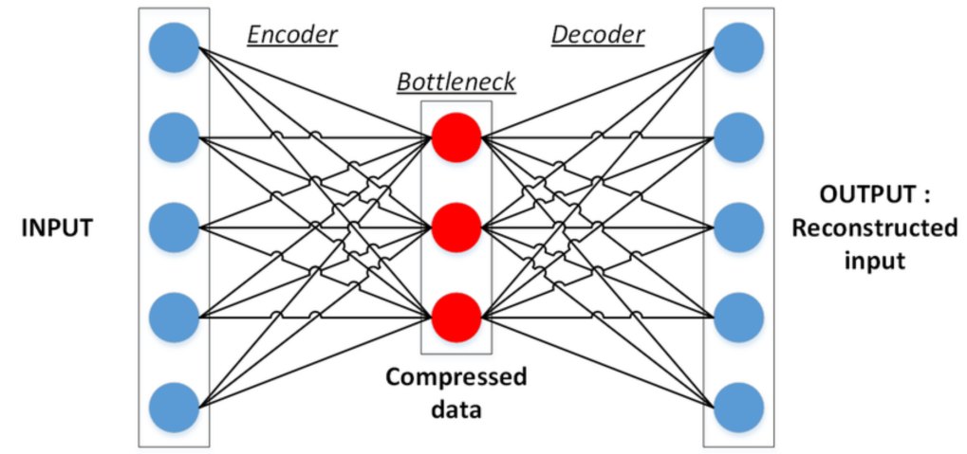
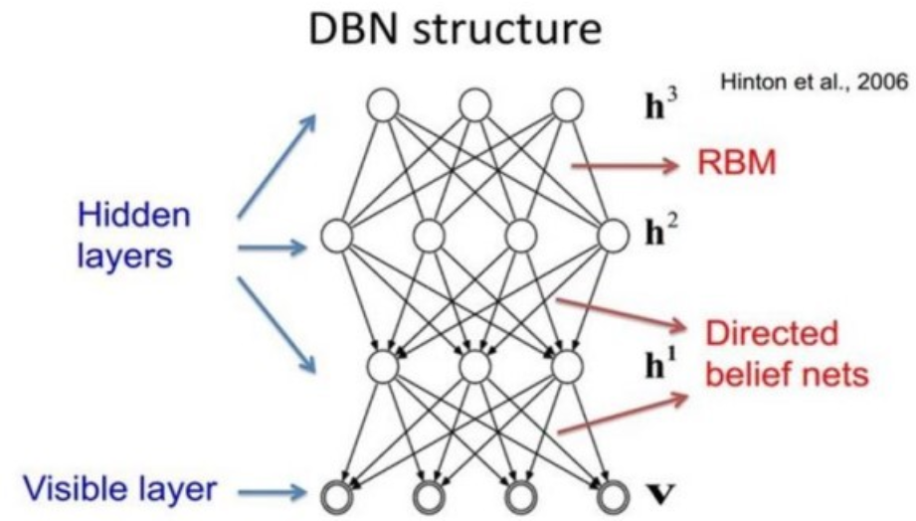
A Study on Various Deep Learning Algorithms with R
박정민, Jeong min Park, Department of Statistics, Ewha Womans University
Ⅰ. Introduction
Ⅲ. Comparison of various R packages
In recent days, deep learning is getting more popular in almost every field, such as bioinformatics, medical images, finance, and so on. Although most softwares for the deep learning algorithms are written in Python, nowadays the realization of deep learning is also possible in R. This paper provides a guideline for the users for deep learning with R among various R packages for deep learning.
First, we briefly introduce various algorithms of deep neural networks and review state-of-art softwares for deep learning with R - deepnet, NeuralNetTools, automl, autoencoder, keras, RcppDL, mxnet, h2o. Then using the Portuguese bank marketing data, we compare the performance of various R functions for deep learning.
Data Description
The data used in the paper is a bank marketing data related with direct marketing campaigns of Portuguese banking institution. The data is consisted of 45,211 observations and 17 variables. The target variable is a binary variable indicating whether the client has subscribed a term deposit or not.
DNN model
3 hidden layers with 20, 40, 10 nodes in each layer
deepnet : R-based, enable the implementation of various deep learning architectures such as RBM, DBN, and AE
NeuralNetTools
: R-based, visualization and
analysis tool for neural networks
automl : R-based, allow automatic machine learning and tunes the model within the user-specified options
autoencoder
: R-based, enable the implementation
of sparse autoencoder, visualize
features learned by autoencoder
keras : Python based, run on CPU or on GPU, use tensorflow as backend tensor calculation, provide a user-friendly API, support arbitrary network architectures, provide built-in CNN, RNN, and any combination of both networks
RcppDL : based on Rcpp, allow implementation of basic machine learning methods such as DA, SDA, RBM, and DBN
mxnet : based on Rcpp, flexible and efficient tool for computing deep learning models
h2o : based on JAVA, offer various supervised/unsupervised machine learning algorithms and deep neural networks
Ⅱ. Deep Learning Models
DBN accuracy : 72.5% computation time : 46.35 seconds
SAE accuracy : 85.2% computation time : 8 seconds
DNN (Deep Neural Network)
made up of 3 layers – input layer, hidden layer, output layer
uses fully-connected layers resulting in large amount of computation
optimized by back-propagation
CNN (Convolution Neural Network)
DNN accuracy : 80.3% computation time : 7.23 minutes
formed by a convolution layer, pooling layer, fully-connected layer
often used in analyzing visual imagery or speech recognition
significantly reduces the number of parameters; filters share same weights
tuning the model is possible by choosing optimal hyperparameters
computation time : 2.06 minutes
RNN (Recurrent Neural Network)
able to handle sequential data
the hidden state has the ability to remember
capable of handling tasks such as handwriting recognition, speech recognition, sentiment analysis, and so on
DNN accuracy : 81.2% computation time : 8.25 seconds
LSTM (Long Short-term Memory)
overcomes vanishing gradient problem in RNN
the hidden state has 3 gates; forget gate, input gate, output gate
RBM rmse : 0.3113 computation time : 13.23 seconds
GRU (Gated Recurrent Units)
deep neural network derived from RNN and LSTM
2 gates; reset gate, update gate
DNN accuracy : 59.8% computation time : 22.53 seconds
DNN accuracy : 88.6% computation time : 1.16 seconds
 | based | DNN | CNN | RNN | LSTM | GRU | AE | RBM | DBN | viz.
deepnet | R | O |  |  |  |  | O | O | O
NeuralNetTools | R |  |  |  |  |  |  |  |  | O
automl | R | O
autoencoder | R | O |  |  |  |  | O |  |  | O
keras | Python | O | O | O | O | O
RcppDL | Rcpp |  |  |  |  |  | O | O | O
mxnet | Rcpp | O | O | O |  |  |  |  |  | O
h2o | JAVA | O
AE (Auto-Encoder)
reconstructs original data
consisted of an encoder and decoder
reduce dimensionality, compress data, and finds most important features
RBM (Restricted Boltzmann Machine)
shallow 2 layer neural net; one visible layer, one hidden layer
feature extractor whose goal is to recreate the input as accurately as possible, based on KL Divergence method
Ⅳ. Results & Conclusion
DBN (Deep Belief Network)
formed by stacking RBMs
works by fine-tuning the entire input in succession; solves vanishing gradient problem
capable of detecting patterns in the data
According to the results derived from the Portuguese bank data, we were able to compare the performance of various R functions for deep learning. The h2o package showed the best performance among all the packages in terms of both accuracy and computation time.
Most of the packages support the basic DNN model and keras supports the most models. Visualization of filters or structure of the deep learning models are also provided by some packages.
Notes:
원래는 각 q에 대해 후보모델의 BIC를 비교해야하지만, q가 같을 때 BIC 차이가 그렇게 크지 않기 때문에 (100-200 정도) best일거라 생각되는 q를 먼저 정하고, 그 안에서 zero position을 바꿔가며 모델을 비교했다. C2를 만족하기 위해, 각 source마다 q-1개의 zero position을 지정했다.
이 때 position은 PMF 결과에서 profiles가 낮은 (보통 1%보다 작은 경우) P를 zero position으로 선정했다. PMF결과는 zero position을 정할때에만 이용하고, initial value로는 이용하지 않았다.
그래서 BIC가 작은 모델을 최종모델로 선택했다. 다 기재할수없어서 기본모델에 추가적으로 수정한 zero position만을 굵은 글씨로 나타냈다.
It is known that the major sources of PM2.5 in Seoul are heating/power plants, traffic, and fugitive dust.
Winter-spring의 source5는 마포구, 양천구의 상대농도가 높다. Source5는 기여율도 높고, 이는 마포구에 화력발전소(공공발전시설)와 양천, 영등포구에 지역난방 사용량이 높은 것을 보아 에너지산업연소를 뜻한다. 겨울철에 가장 높은 기여율을 보이므로 상식적으로 부합한다. 또한 summer-fall의 source 2와 비슷한 것으로 보인다.
그다음으로 기여율이 높게 추정되고 전체적으로 profiles이 높은 sf1-ws3이 교통, sf3-ws4가 비산먼지(건설공사, 도로재비산) 오염원으로 추정된다. 성북구,노원구 profiles이 높은 sf3-ws4가 비산먼지.
Ws가 source가 하나 더 많은데 아마 중국발미세먼지영향일것?

