Slide 1


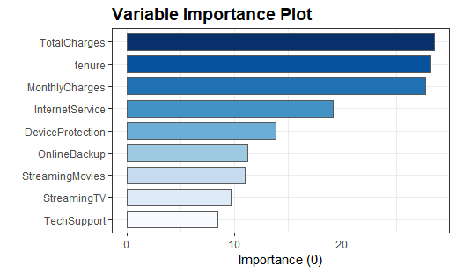
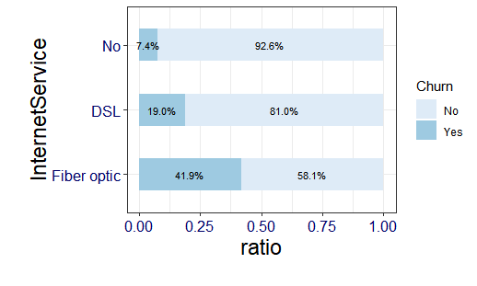
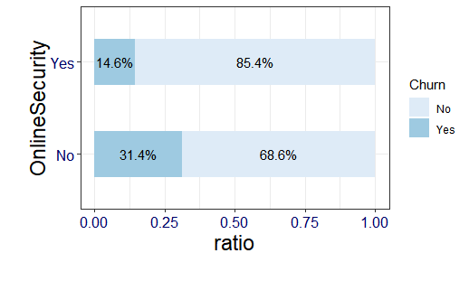
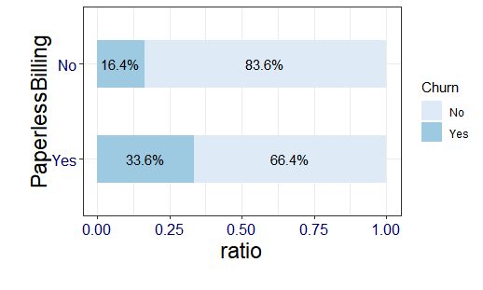
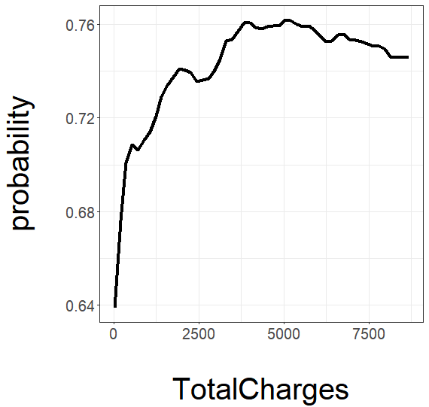
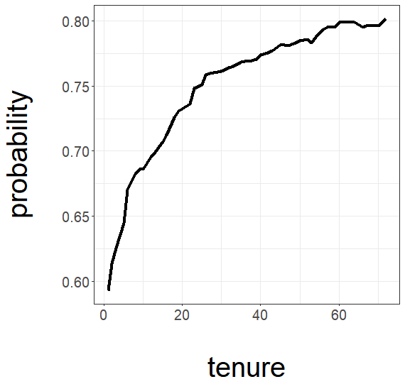
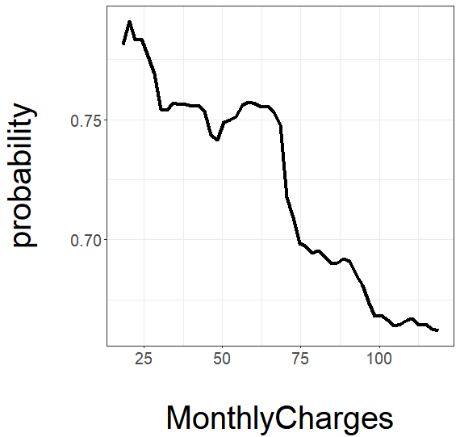
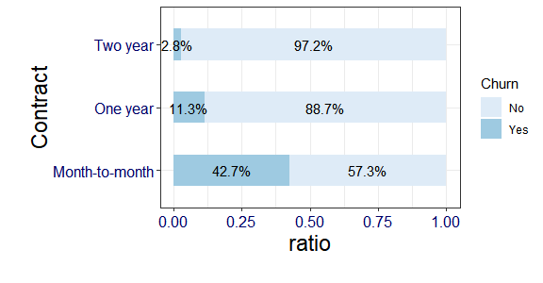
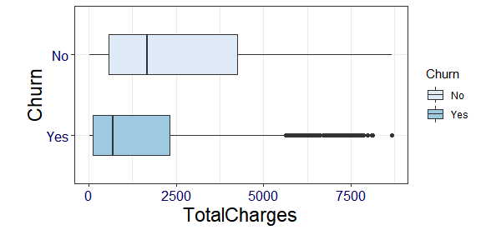
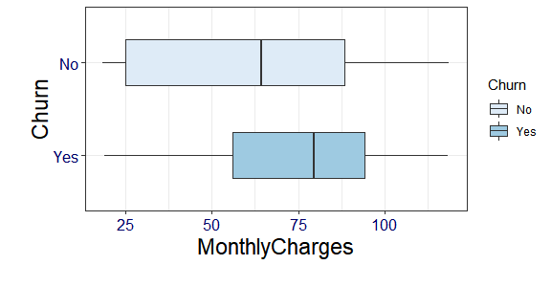
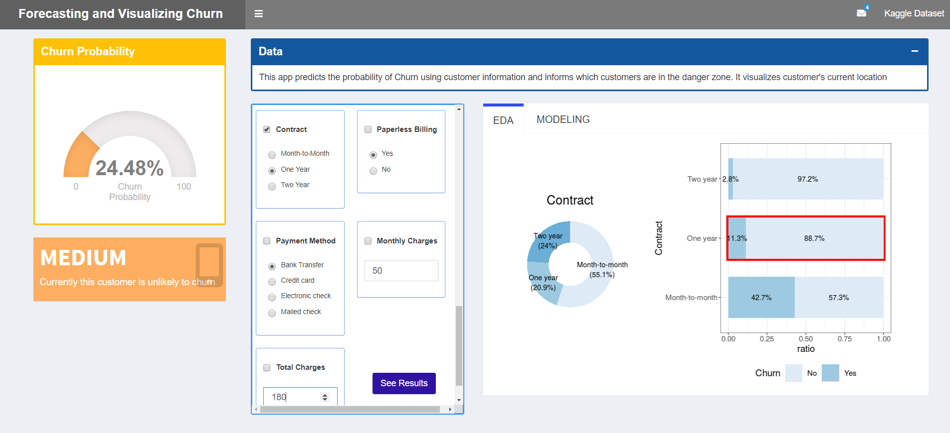
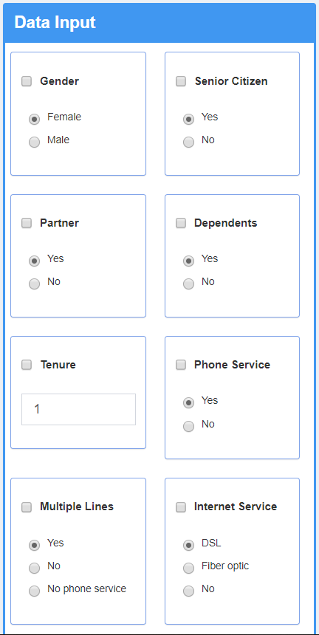
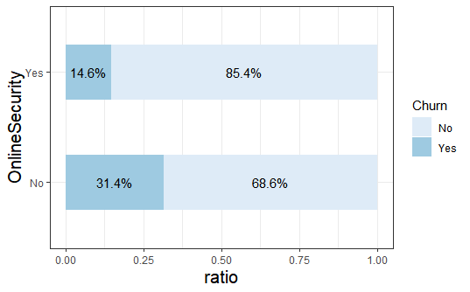
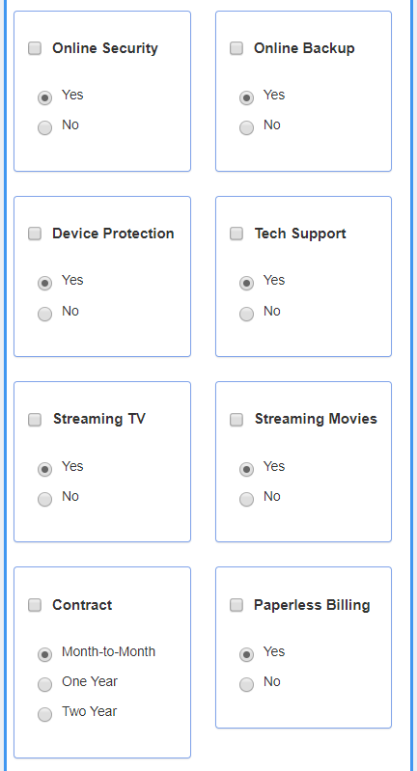
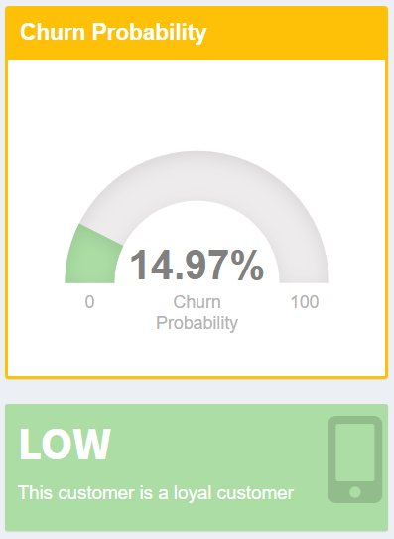
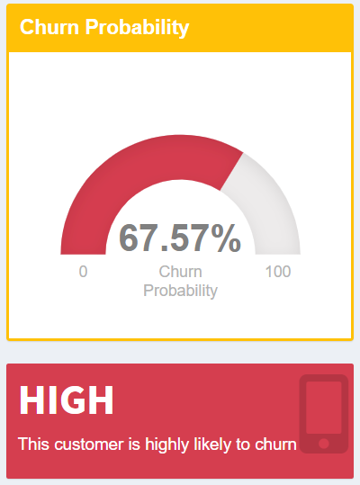
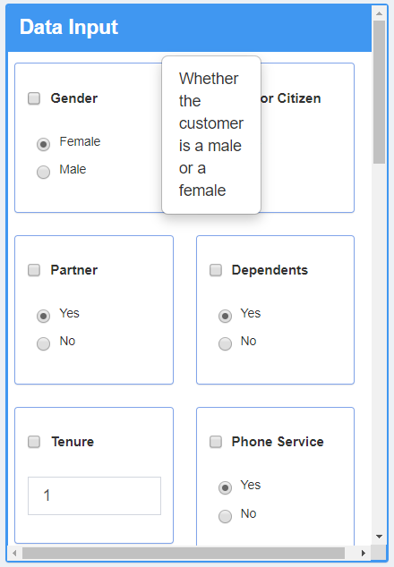
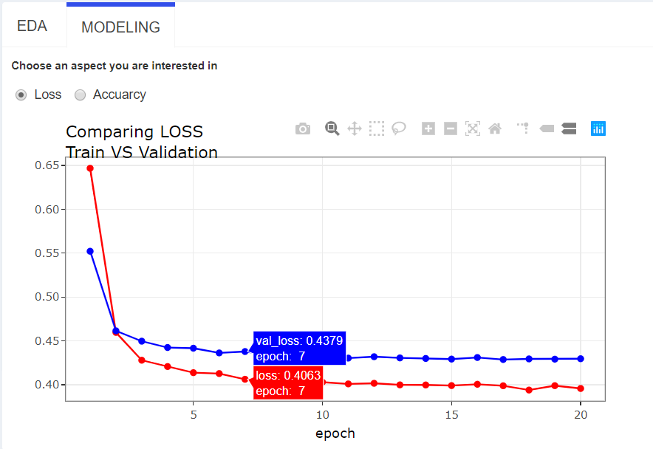
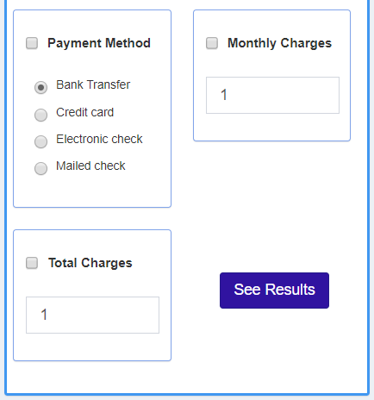

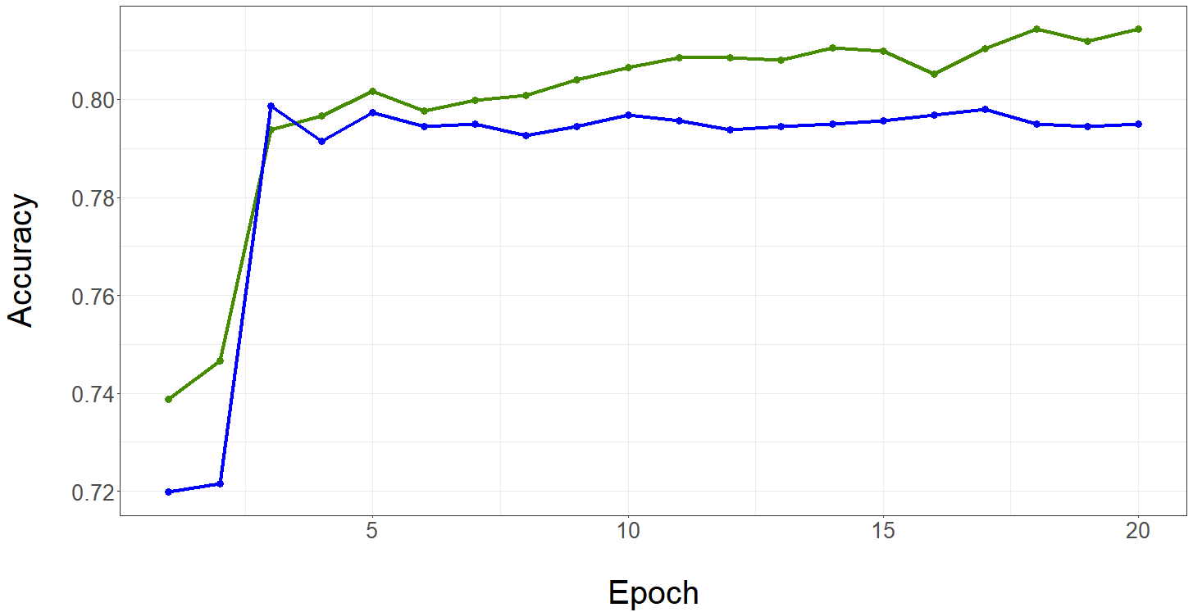
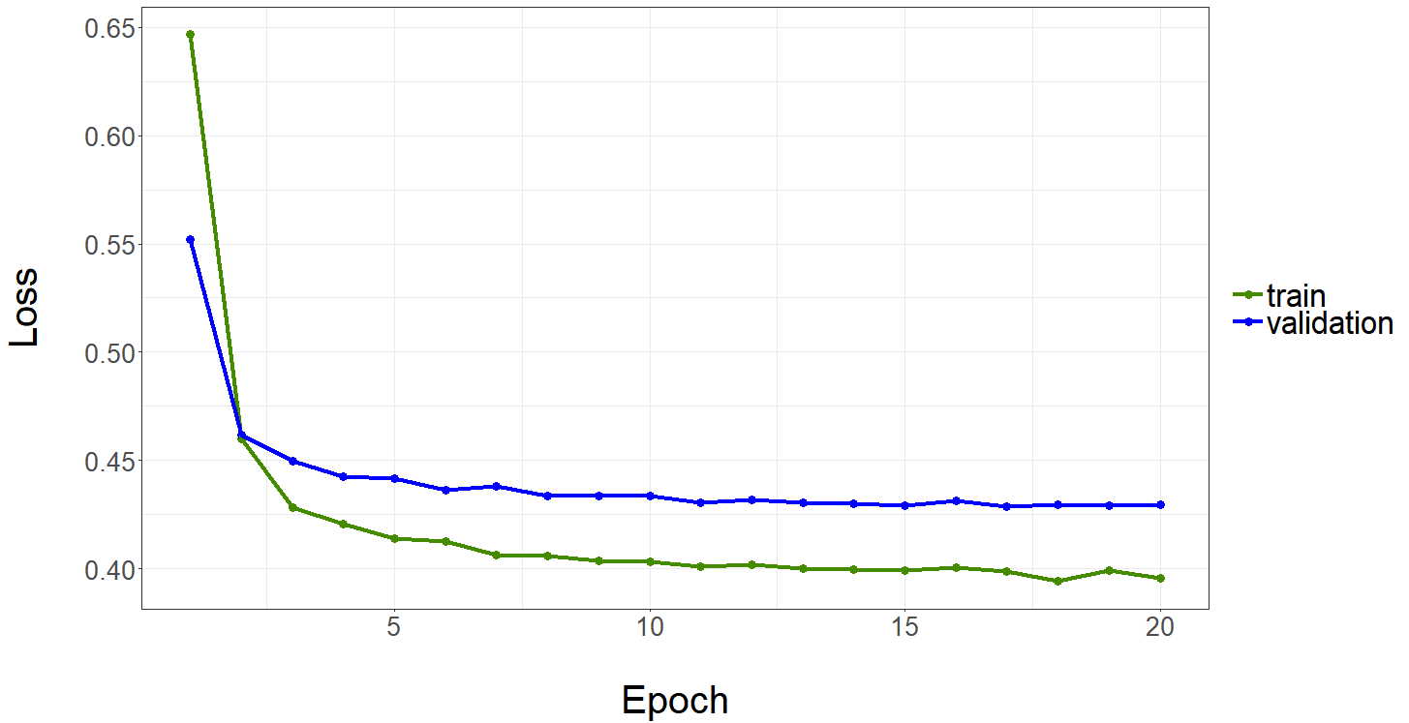
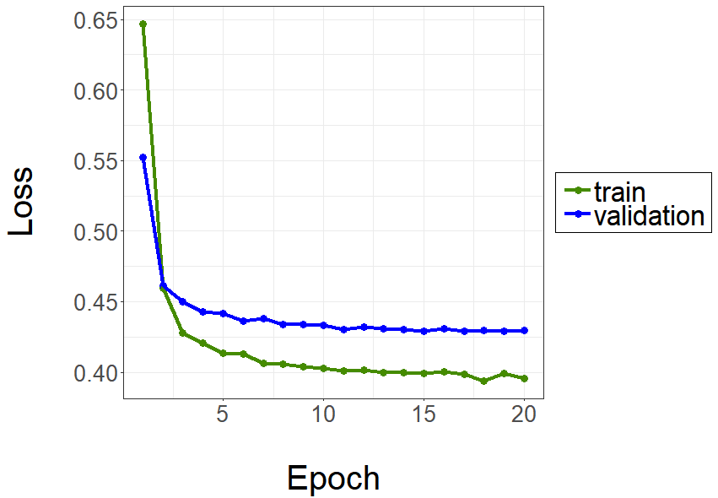



Modeling Churn using Logistic, SVM, Random Forest, DNN
And Forecasting, Visualizing with R Shiny
Yeon-Jeong Kim, Myung-Ji Ko, Jeong-Min Park, Eun-Kyung Lee
Department of Statistics, Ewha Womans University, Seoul, Korea
Churn dataset
Model visualization
Customer churn occurs when a customer does not like the service of an existing institution or feels that the service of another institution is better. From the agency's perspective, it is more economical to retain existing customers than to attract other customers, so forecasting customer churn is more important than ever. In this study, we obtained data from Kaggle and conducted visualization to identify the characteristics of variables of mobile carrier termination data. Also, we made some statistical models using R.
1. Variable Importance Plot
Explore some variables
2. Partial Dependence Plot
R Shiny visualization
Modelling
④
②
③
1. Logistic Regression
- A technique to predict the probability of an event by regressing the log odds ratio on independent variables
2. SVM (Support Vector Machine)
- Machine learning technique for (non)linear Classification
3. PPtree
- Classification tree using projection pursuit to find good low-dimensional projections revealing separations between classes
4. RandomForest
- Bootstrap aggregating by constructing a multitude of decision trees
5. DNN (Deep Neural Network)
- Neural network with more than two hidden layers
①
What is DNN?
relu
relu
sigmoid
Enter customer information and click ‘See Results’.
Click on a variable that you are interested in. Then you will be able to see the overall distribution of that feature as well as your current location.
This tab shows the training process of DNN. You can choose between ‘loss’ or ‘accuracy’ according your interest.
The gauge plot displays the churn probability of the new customer. The color of the plot changes with the size of the probability.
$$x_{1}$$
yes
Input Node
$$x_{2}$$
Hidden Node
. . .
. . .
. . .
no
Output Node
$$x_{19}$$
Dropout : | 0.1 | Kernel_initializer : | Uniform | Optimizer : | Adam
References
https://jmpark.shinyapps.io/churn/
Lee, E. K. (2018). PPtreeViz: An R package for visualizing projection pursuit classification trees. Journal of Statistical Software, 83(1), 1-30. R package version 2.0. 3. https://CRAN.R-project.org/package=PPtreeViz
Dimitriadou, E., Hornik, K., Leisch, F., Meyer, D., Weingessel, A., & Leisch, M. F. (2009). e1071: Misc Functions of the Department of Statistics, Probability Theory Group (Formerly: E1071), TU Wien. R package version 1.7-2, URL: http://cran. rproject. org/web/packages/e1071/index. html.
Wickham, H., & Chang, W. (2008). ggplot2: An implementation of the Grammar of Graphics. R package version 0.7, URL: http://CRAN. R-project. org/package= ggplot2.
Jackson, S. (2016). corrr: Correlations in R. R package version 0.2.1. R Project. URL: https://CRAN.R-project.org/package=corrr
Liaw, A., Wiener, M. (2008). randomForest: Breiman and Cutler's Random Forests for Classification and Regression. R package version 4.5-28. URL: http://CRAN.R-project.org/package=randomForest
Bailey, E. (2015). shinyBS: Twitter bootstrap components for shiny. R package version 0.61 URL https://CRAN. R-project. org/package= shinyBS.
Sali, A. (2017). Shinycssloaders: Add CSS Loading Animations to ‘shiny’ Outputs. R package version 0.2.0. https://CRAN.R-project.org/package=shinycssloaders
Chang, W., Cheng, J., Allaire, J. J., Xie, Y., & McPherson, J. (2017). shiny: Web Application Framework for R. R package version 1.0. 0. R Found. Stat. Comput., Vienna. https://CRAN. R-project. org/package= shiny
Allaire, J. J. (2016). rsconnect: Deployment Interface for R Markdown Documents and Shiny Applications. R package version 0.5. https://CRAN.R-project.org/package=rsconnect
Allaire, J. J., Ushey, K., Tang, Y., & Eddelbuettel, D. (2018). reticulate: Interface to’Python’. R package version, 1(8). https://CRAN.R-project.org/package=reticulate
Chang, W., & Borges Ribeiro, B. (2017). Shinydashboard: create dashboards with’Shiny’. R package version 0.6, 1. https://CRAN.R-project.org/package=shinydashboard
Borges, B., & Allaire, J. (2017). flexdashboard: R Markdown Format for Flexible Dashboards. R package version, 0.5, 1. https://CRAN.R-project.org/package=flexdashboard
Sievert, C., Parmer, C., Hocking, T., Chamberlain, S., Ram, K., Corvellec, M., & Despouy, P. (2017). plotly: Create Interactive Web Graphics via ‘plotly. js’. R package version 4.7. 1. https://CRAN.R-project.org/package=plotly
Kuhn, M., & Wickham, H. (2017). rsample: General Resampling Infrastructure. R package ver. 0.0. 2. https://CRAN.R-project.org/package=rsample
Model Comparison
 | accuracy | recall | precision | F1-score
Logistic | 0.790 | 0.539 | 0.601 | 0.568
SVM | 0.746 | 0.317 | 0.507 | 0.390
PPtree | 0.750 | 0.753 | 0.507 | 0.606
Random Forest | 0.792 | 0.494 | 0.616 | 0.549
DNN | 0.802 | 0.519 | 0.693 | 0.594

