Slide 1
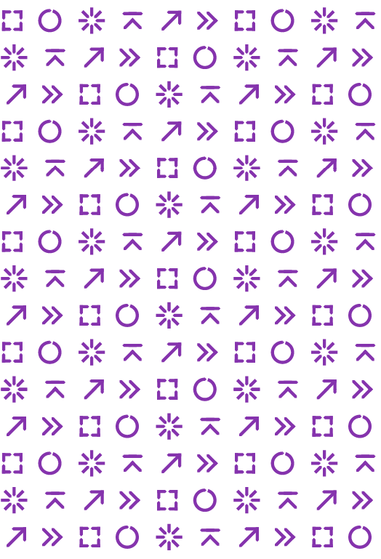

The measurement of crime Opportunities and challenges
David Buil-Gil
Senior Lecturer in Quantitative Criminology
david.builgil@manchester.ac.uk
@DavidBuil

Slide 2




Prof Ian Brunton-Smith
Dr Jose Pina-Sánchez
Dr Alexandru Cernat
Notes:
Collaborative work

Slide 3

Notes:
Our project

Slide 4
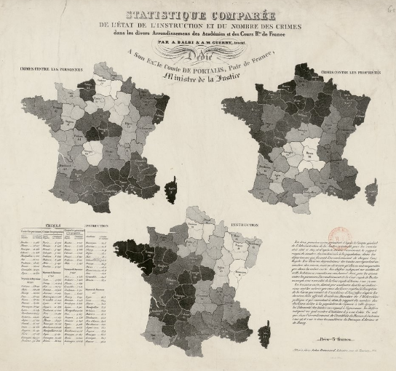
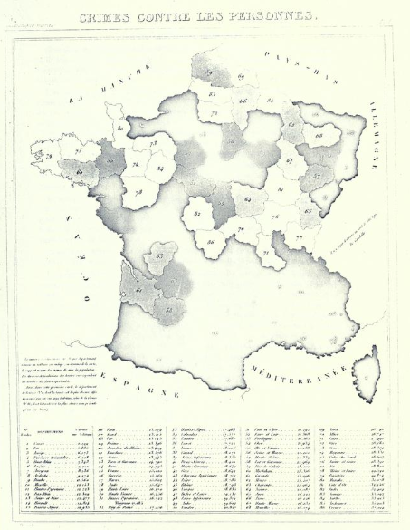
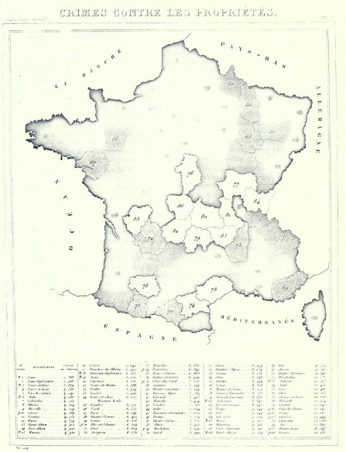
Guerry (1833)
Balbi and Guerry (1829)
Notes:
First maps of crime. Crime rates linked with education levels

Slide 5
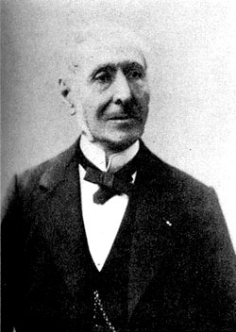
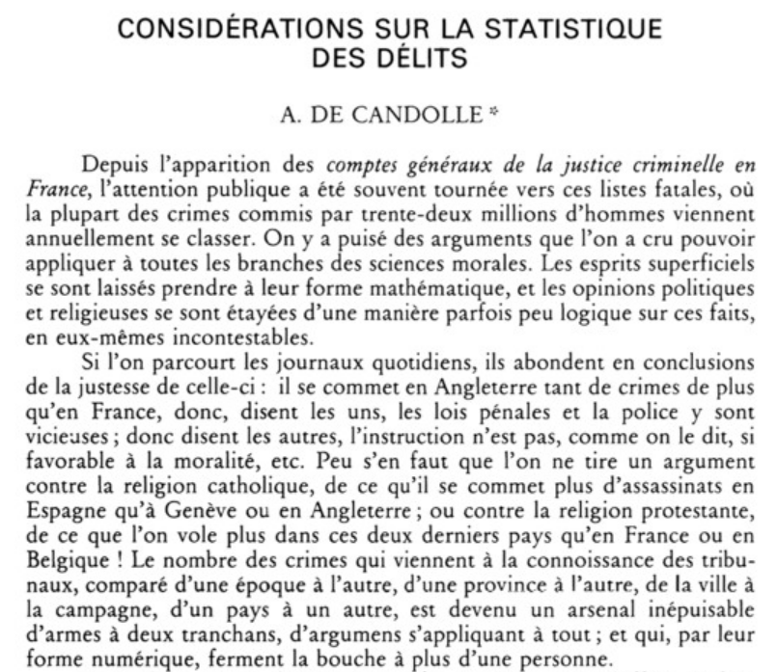
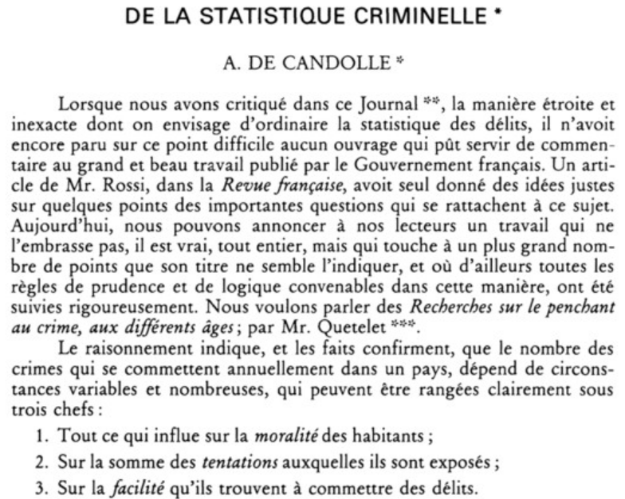
1830
1832
Alphonse de Candolle
Notes:
A few years after the publication of the first judiciary statistics in France, which recorded data of persons sentenced at the regional level, de Candolle argued that these records were affected by several factors external to crime which could vary in space and time: victims may be unaware of crime or may not report it, the police may fail to identify or arrest the offender, and the court may fail to convict the person arrested.

Slide 6
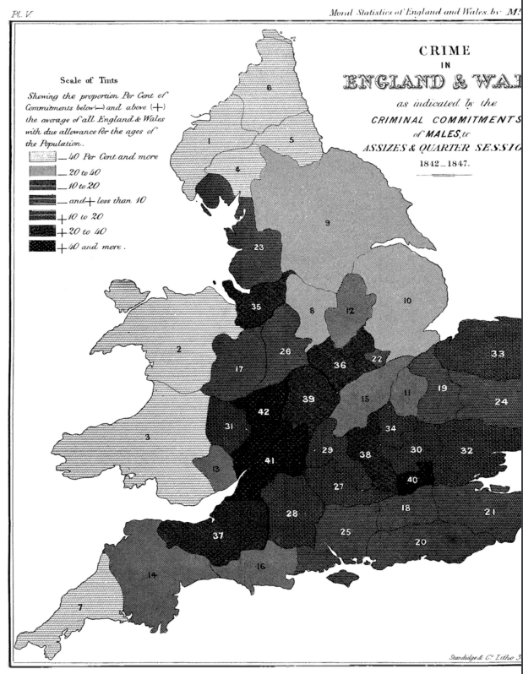
Fletcher (1849)
Notes:
First maps in England and Wales. Industrial depression (1842-1844), the moral influences of police services and others factors

Slide 7
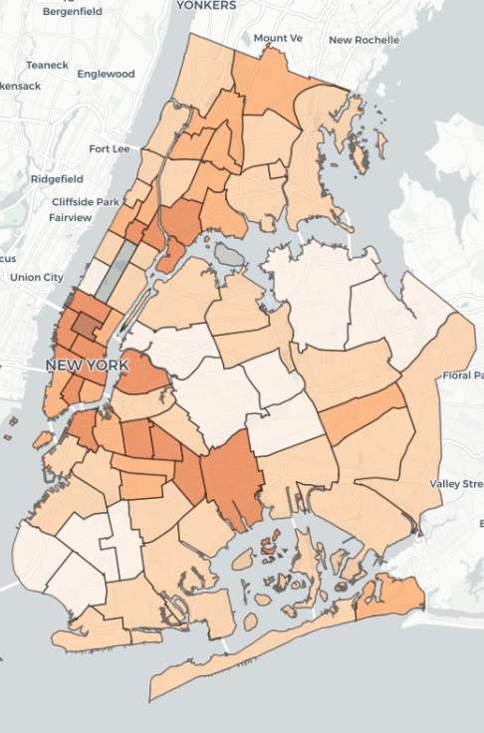
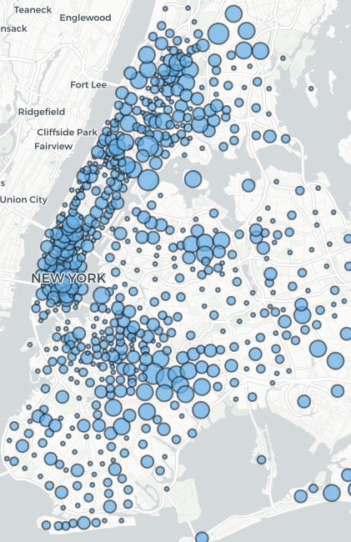
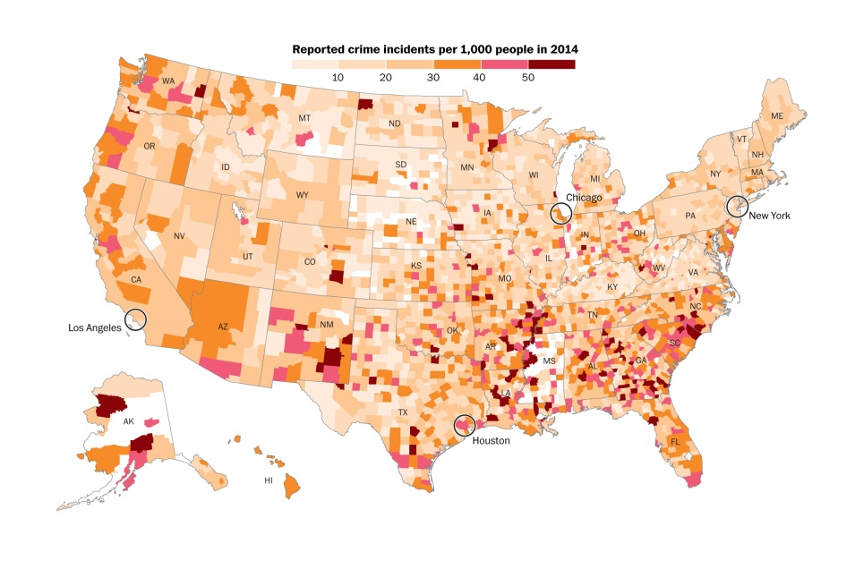
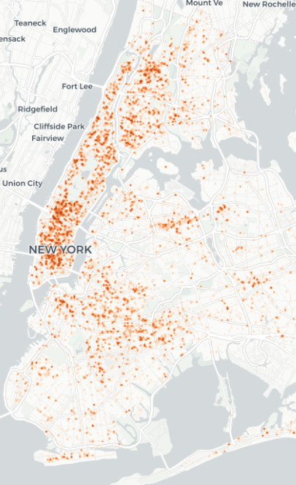
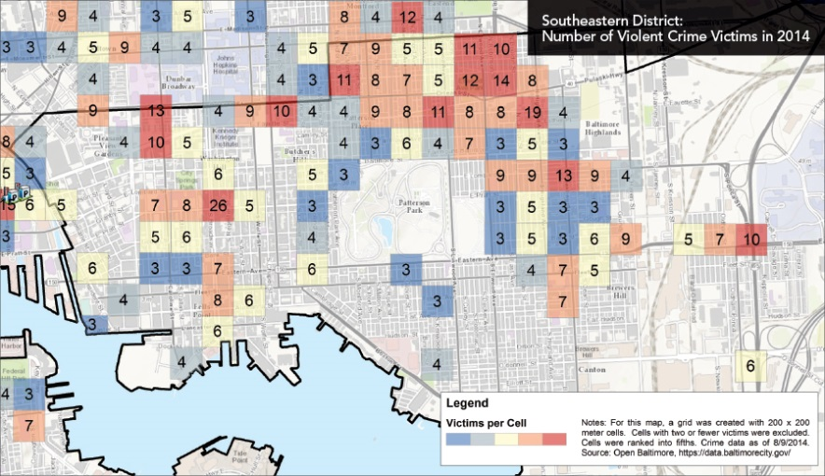
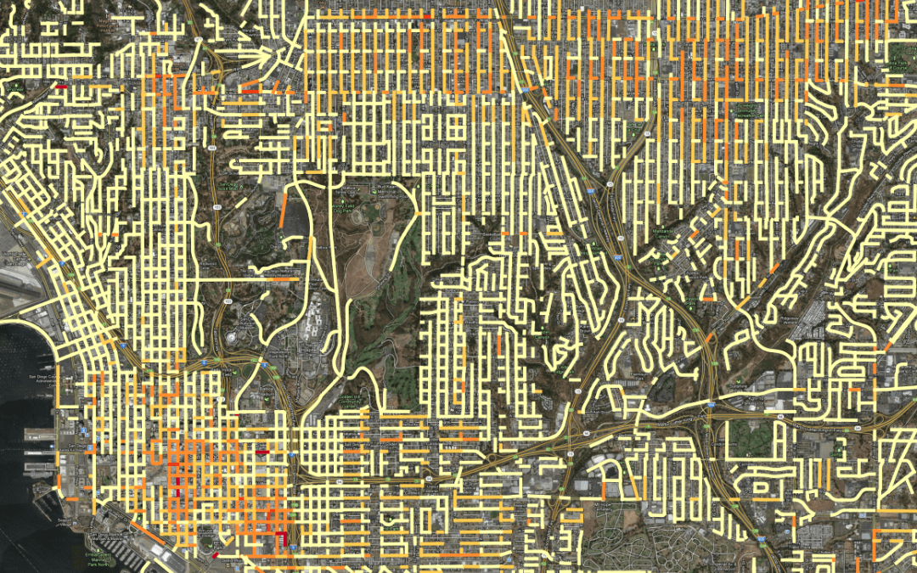
Notes:
More detailed spatial scales

Slide 8
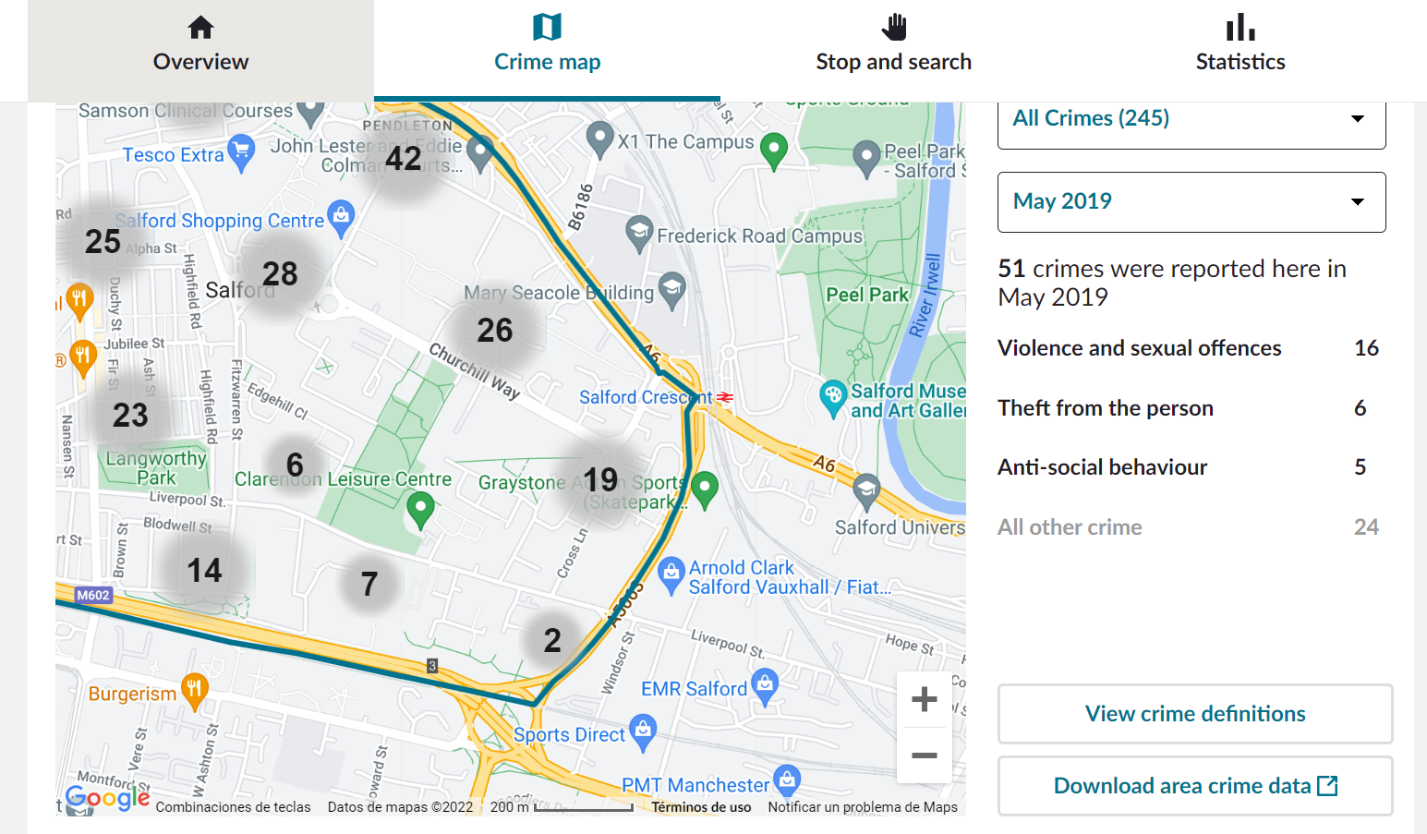
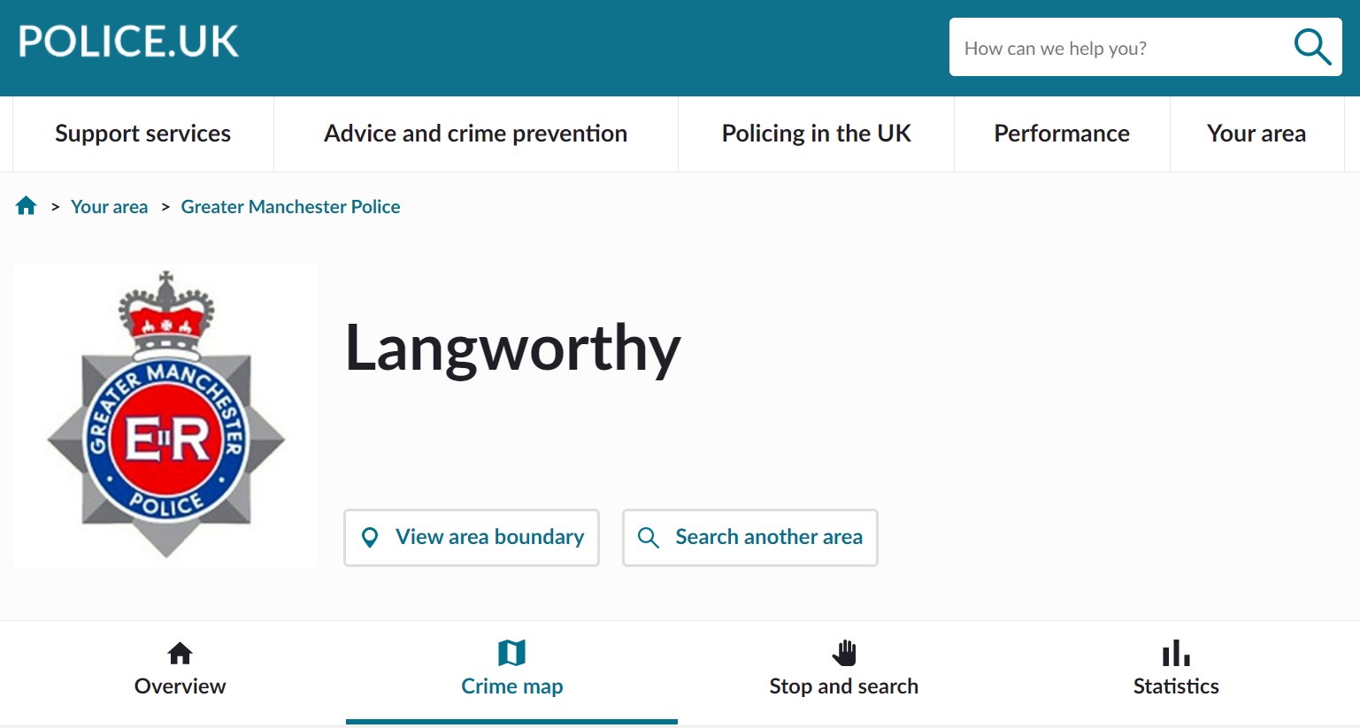
Notes:
Easy access to data

Slide 9
Police-recorded crimes are used by:
Police forces → Design and evaluate policing strategies
Policy makers → Design and evaluate crime prevention policies
Academics → Explore the causes and consequences of crime
Crime is highly concentrated in certain areas
Area-level crime rates are affected by localised social processes and dynamics
Localised crime prevention initiatives can be effective in reducing overall crime rates

Slide 10
Thus… it is key to adequately measure the prevalence and nature of crime

Slide 11
However… police statistics are affected by:
Crime reporting behaviours (varies across population groups and communities)
Police control over areas (likelihood to witness crimes)
Counting rules
Police recording practices (HMIC, 2014)

Slide 12
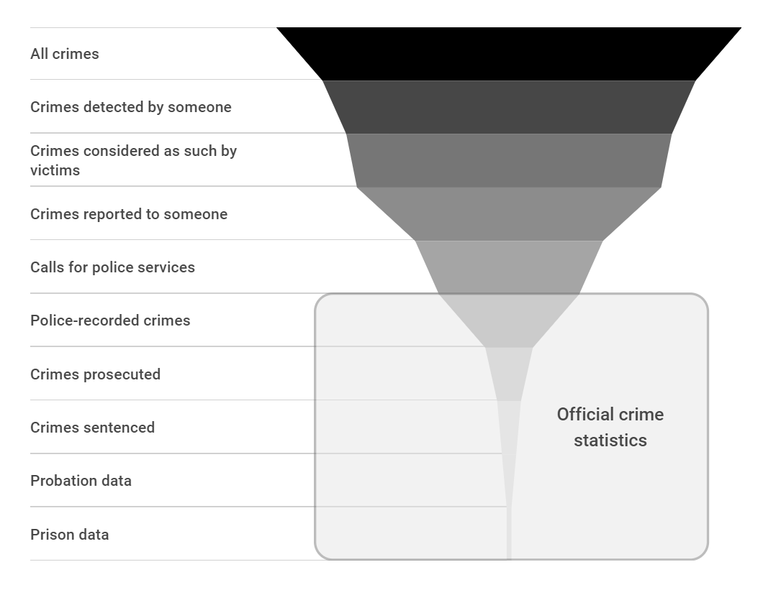
Dark figure of crime

Slide 13
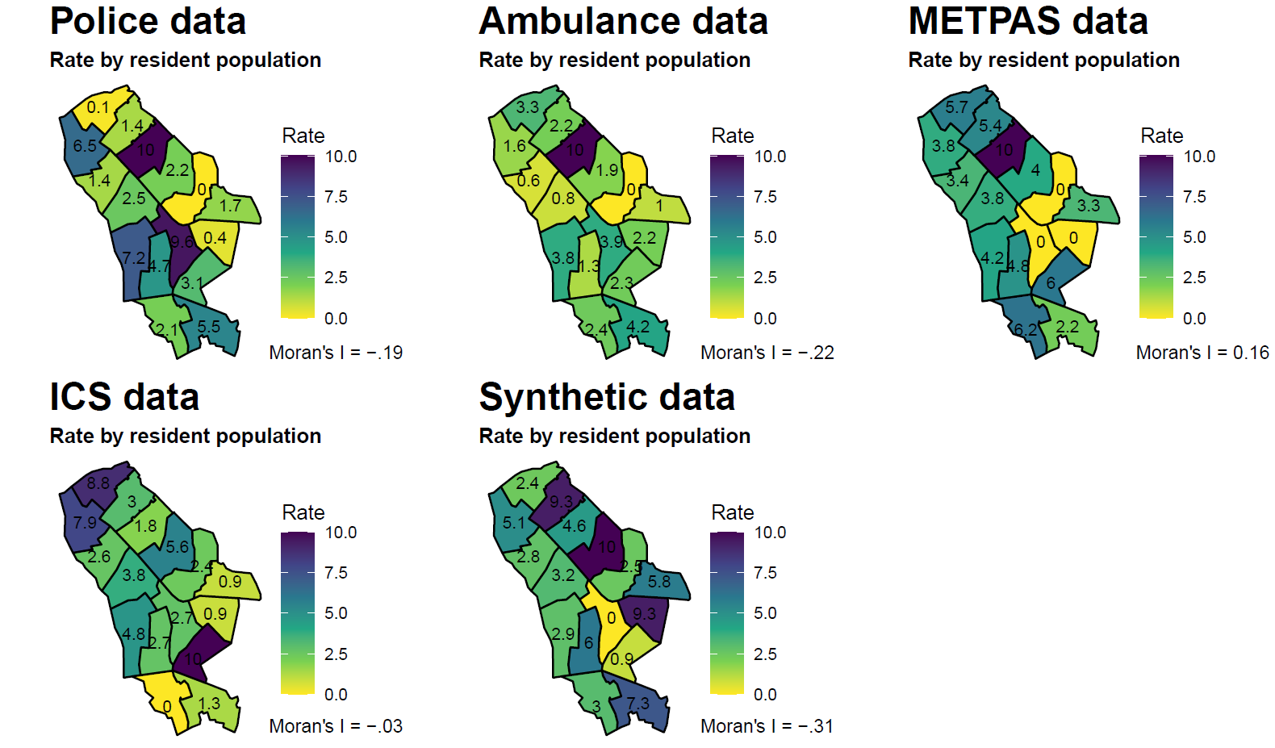
Data from multiple sources

Slide 14
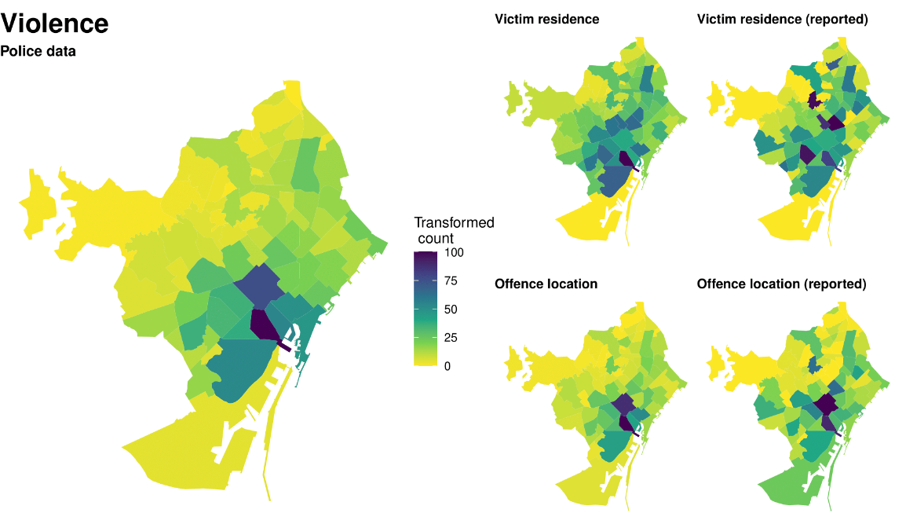
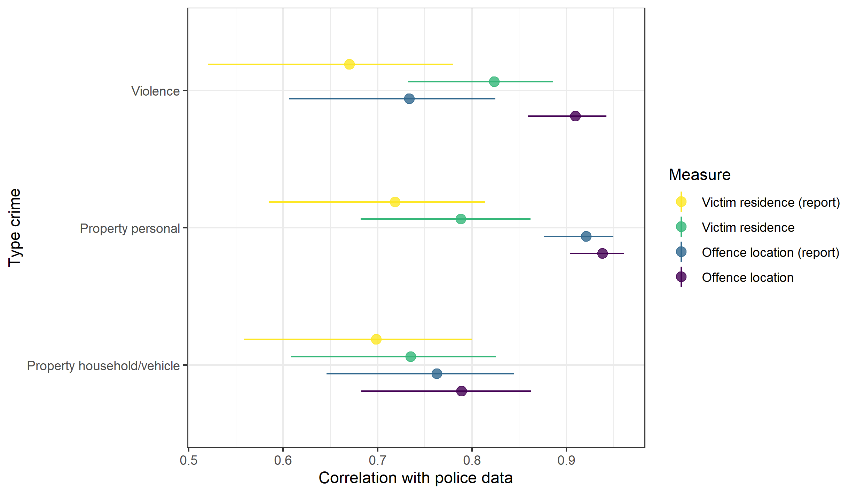
Survey data

Slide 15
“All crime data are wrong…
but some are useful”
Notes:
George Box: “all models are wrong, but some are useful”

Slide 16
Many thanks!
David Buil-Gil
david.builgil@manchester.ac.uk

