Slide 1


Greyport
Created by Owen Trueblood and Michael Senoyuit

Slide 2

Greyport? What's a greyport?
  Greyport is designed to be a digital swiss army knife for hardware hacking
  Capable of
    easily connecting to a target machine
    writing and running user-made programs with built-in editor
    storing and recalling programs
  Also designed to be
    open source
    cheap and easy to produce

Slide 3
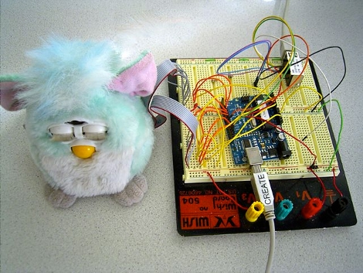
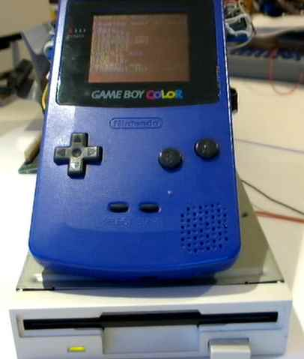
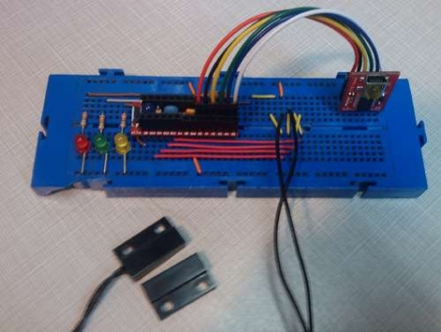
Hardware Hacking
To modify existing hardware to suit new a new purpose.

Slide 4
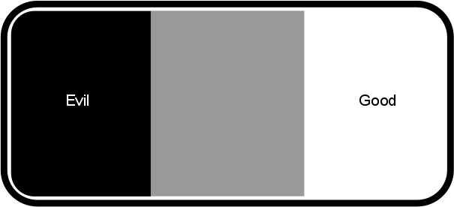
Grey-hat Hacking

Slide 5
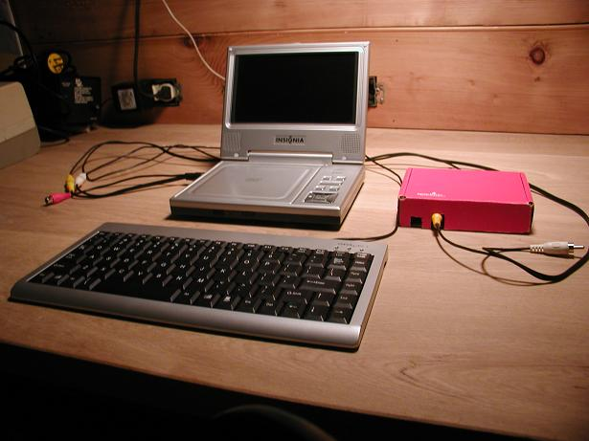

Predecessors
PropComp - 2008
Keyboarder - 2009

Slide 6
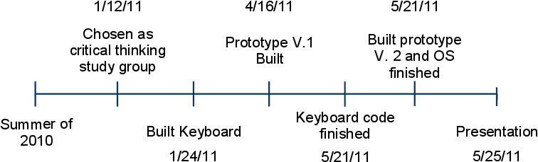
Time Line

Slide 7
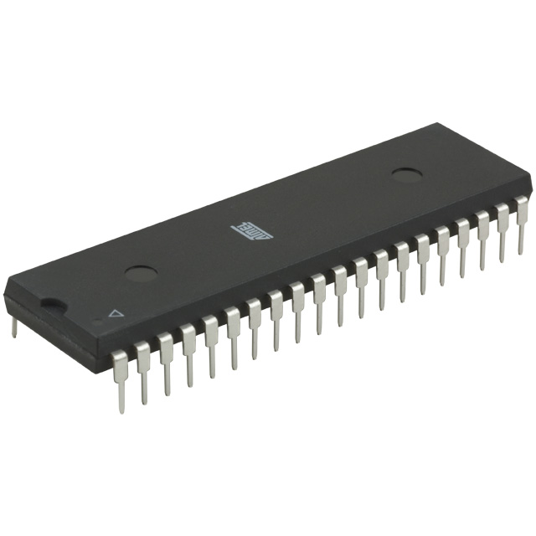
What Greyport is Made of
  AVR MCU
  LCD screen
  Keyboard
  I/O port

Slide 8
Greyport's Power
  Fully portable with small size
  Programming can happen on the device itself, no PC required
  GreyBASIC is a language designed to be fast to write
  Robust circuitry allows it to be plugged into nearly any device without worry of damage
  Huge selection of built-in functions make it easy to write programs that accomplish complex tasks
  With an online community programs can be shared, allowing access for everyone to the most useful creations
  Design is open-source, allowing improvements to be added by the community and access for everyone

Slide 9
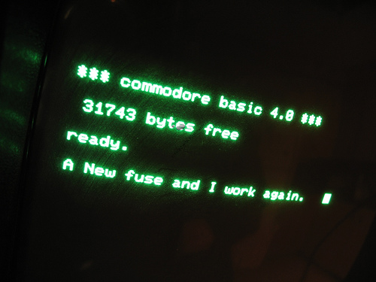
GreyBASIC
  Built-in programming language for greyport
  Designed from scratch
  Derivative of BASIC
  Specially designed editor modeled on TI-BASIC editor
  Takes full advantage of AVR architecture
  Can be used to write both simple and complex applications
  Allows programs to be combined

Slide 10
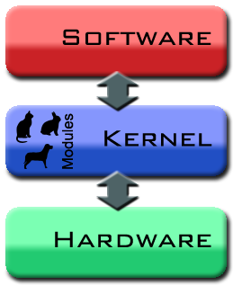
Greyport's Kernel
  Provides control routines for all the hardware
  Simplifies normally complex tasks for the user
  Transparent
  Customizable using online editor
  Contains huge selection of utility routines that execute natively for greater speed

Slide 11
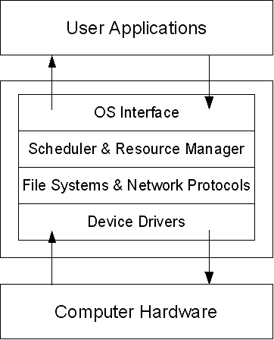
How Greyport would work...

Slide 12

...but there's a problem...
  MCUs in the AVR family cannot execute in RAM
  PROGMEM is the only place execution can occur
  PROGMEM has only 100,000 write/erase cycles before it breaks
  Loading programs into PROGMEM to run them would quickly fry the chip

Slide 13

...but there's a solution:
An interpreter!
  Allows execution in RAM
  Works by simulating a computer
  Simulated computer corrects the design flaw of only being able to execute code in PROGMEM

Slide 14

Why go through the trouble?
The AVR Family of MCUs is:
  Robust
  Widely used by hobbyists
  Good support
  Accepted as a standard in embedded engineering
  Easy to use
  RISC architecture
  Easy to obtain

Slide 15

Other Challenges
  Storing font, images, and token tables in PROGMEM
  Token system for editor
  Time-travelling keyboard
  Software SPI
  Ring-buffer UART using interrupts

Slide 16

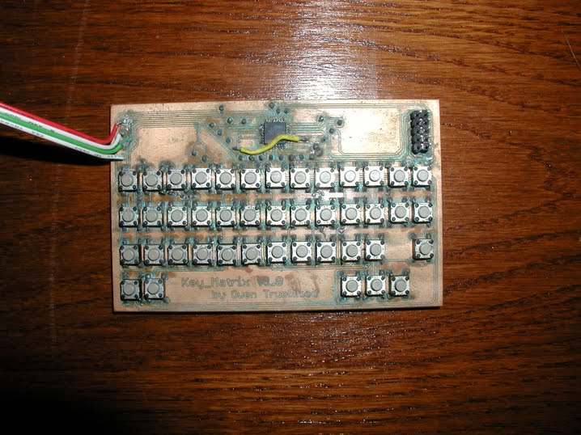
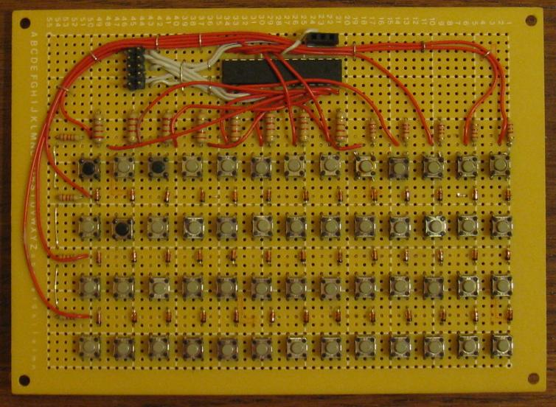
Keyboard

Slide 17
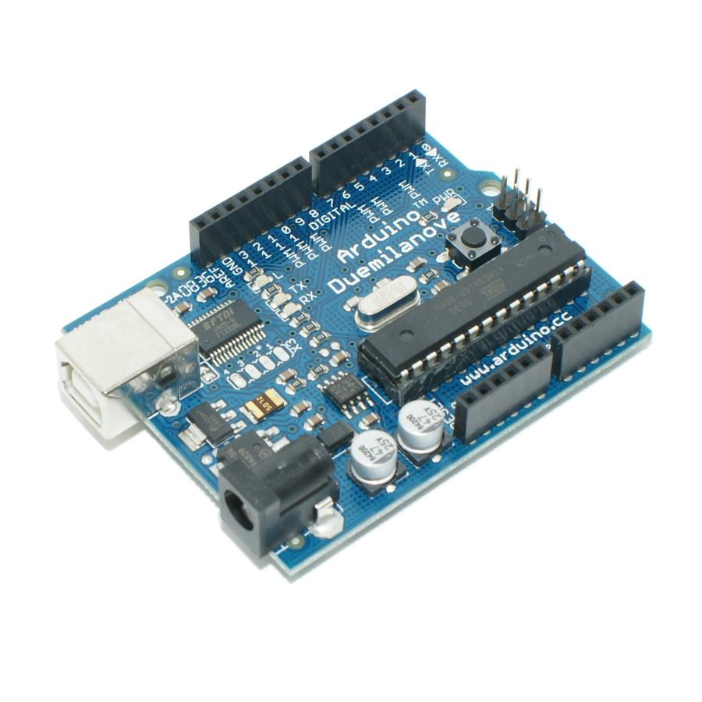
Competition
  Same family of MCU
  Requires PC to program
  Not standalone
  Slow to interface
  Huge popularity
  Easy-to-use software
  Good for beginners
  Fairly cheap to buy
Arduino

Slide 18
Prototype Cost Analysis
  Tact Switch-$.2 each x 53 = $10.4
  Resistors- $1.19 per 5 pack x 4 = $4.47
  Diodes- $1.69 per 10 pack x 4 = $6.76
  Atmega 168- $3.90 each x 1 = $3.90
  ISP header- $.49 each x 1 = $.49
  female header strip- $1.50 each x 1 = $1.50
  Nokia 3310- $9.95 each x 1 = $9.95
  Custom Header parts ~ $.5 each x 2 = $1
  Battery Holder- $1.99 each 2 = $3.98
Total cost= $42.45

Slide 19

Skills learned
Michael
  C programming
  Microprocessing architecture
  Designing digital circuitry
Owen
  Intricacies of the AVR architecture
  Combining C and assembly
  Organization of large software projects
  Advanced optimization techniques for C programming on low-resource systems

Slide 20
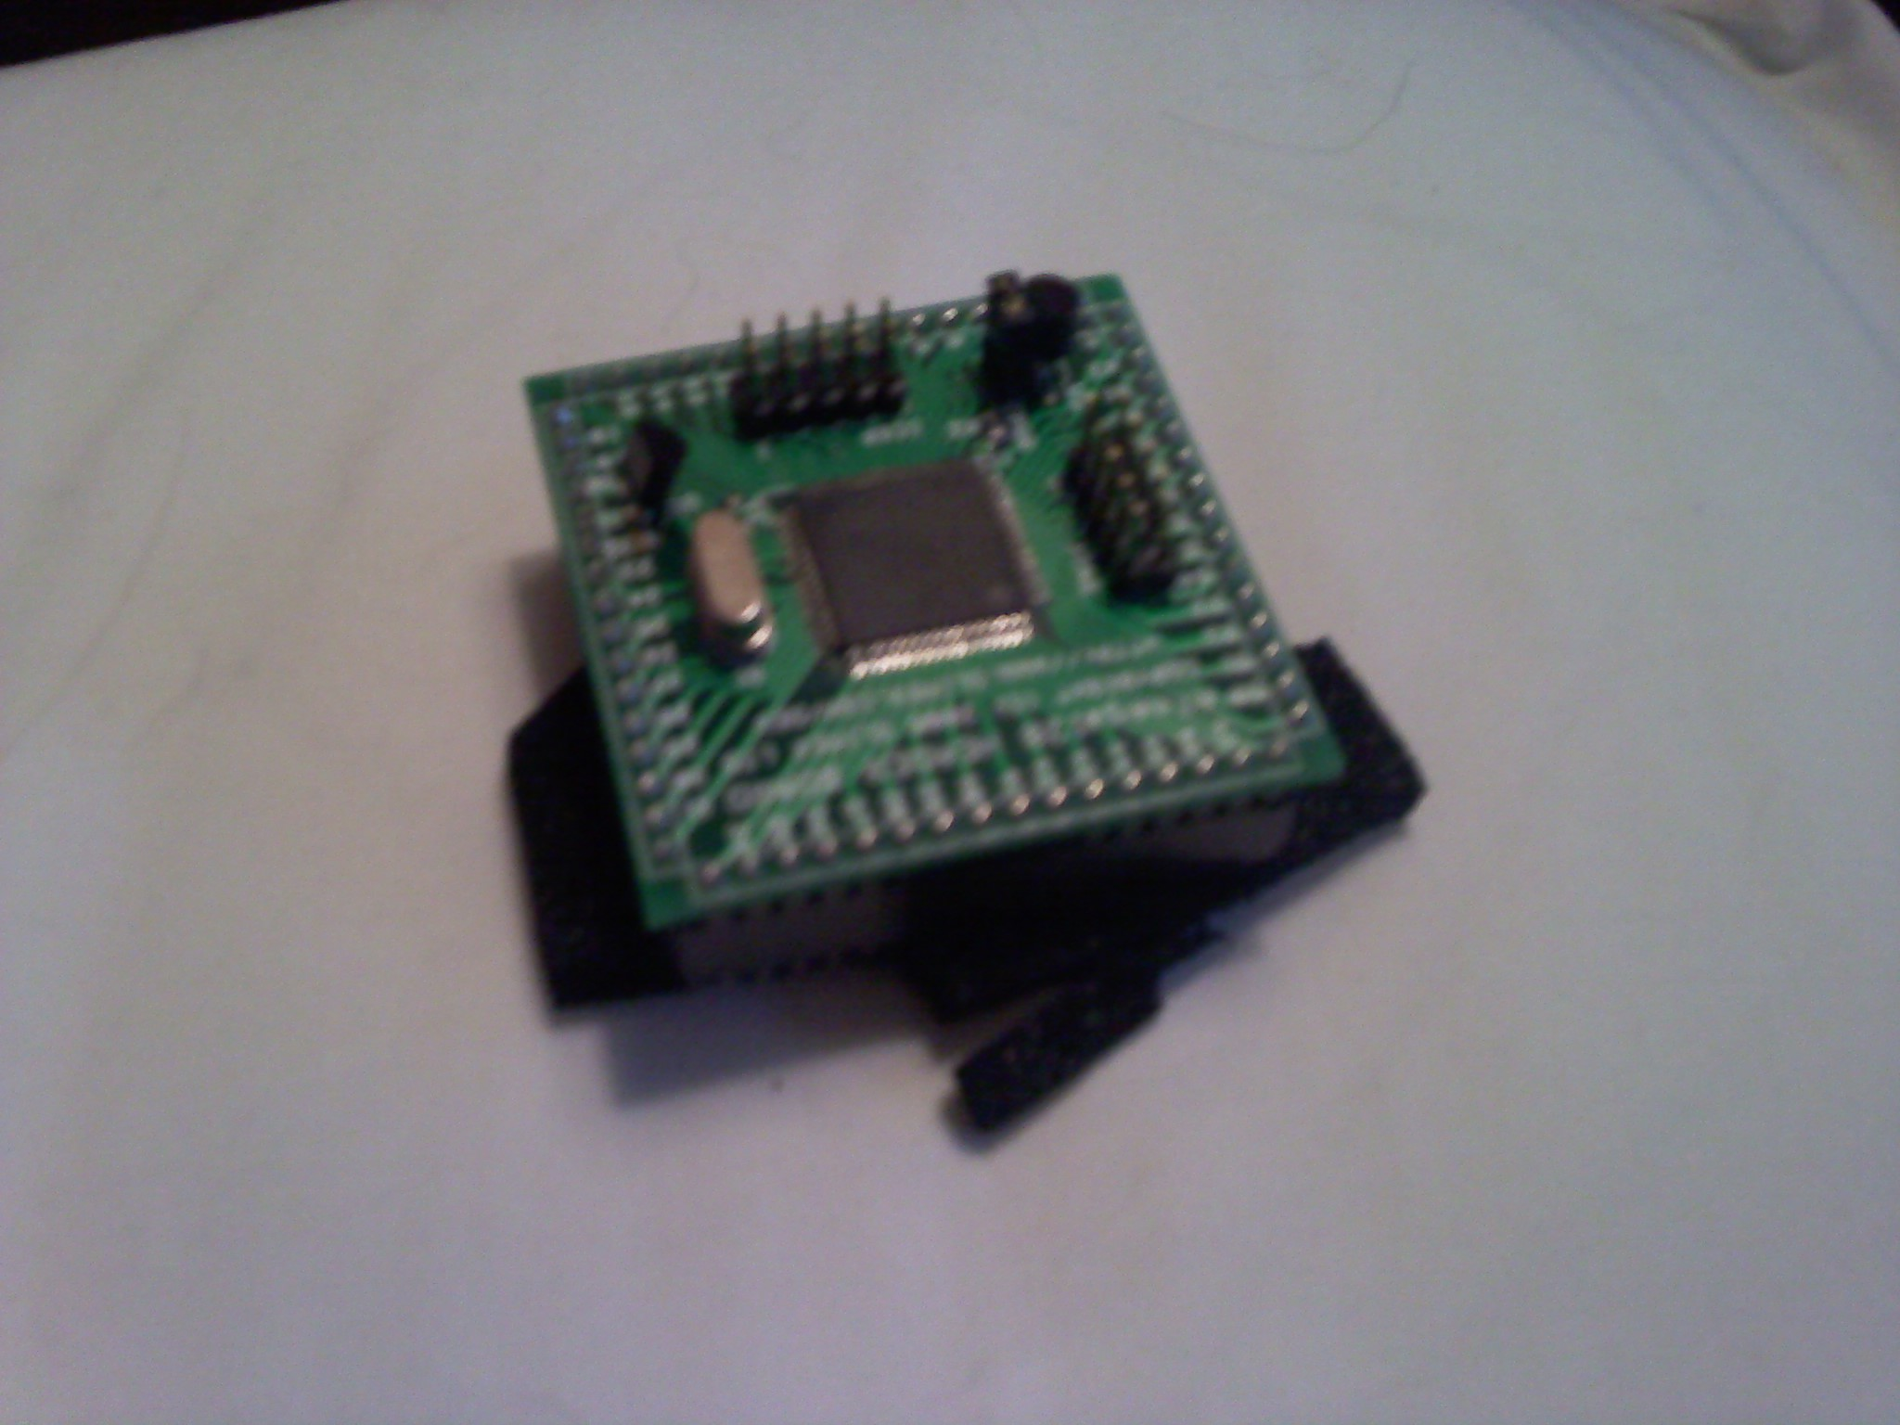
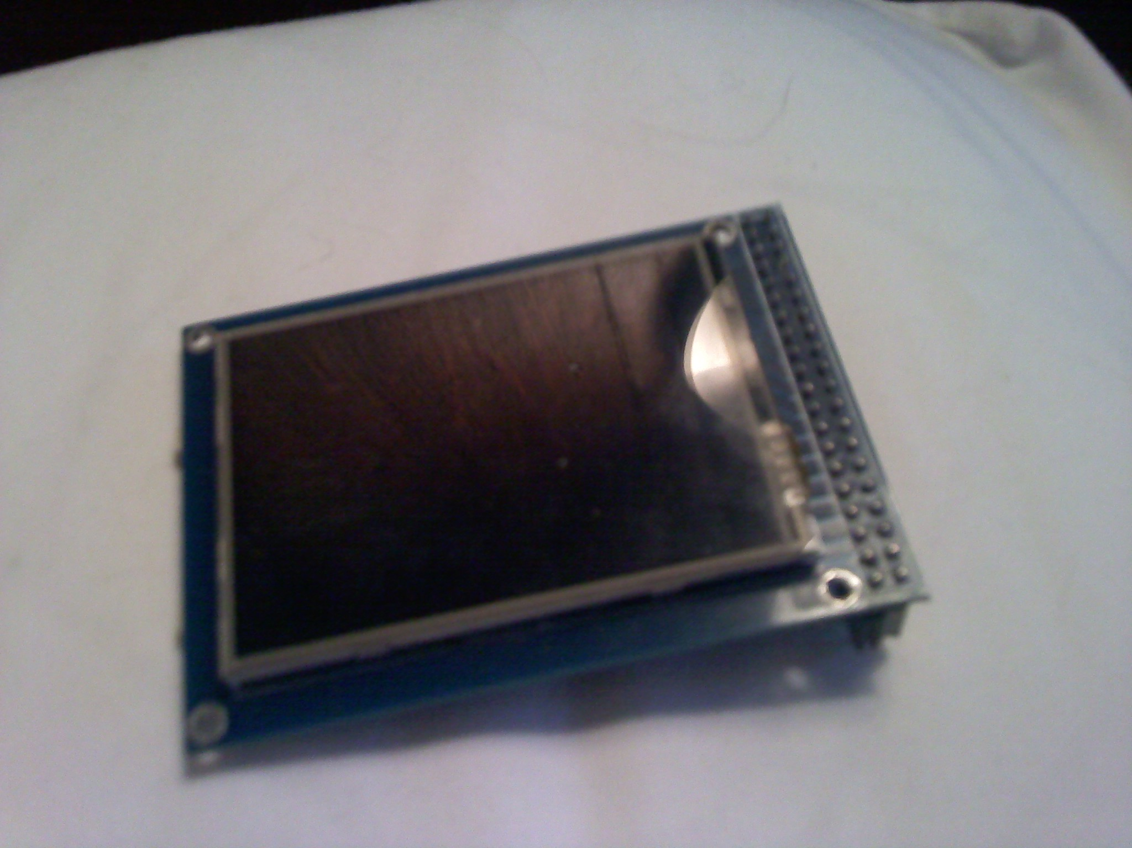
Future
  Contained in case
  Hi-res color screen
  MCU with more features
  Mass production
  Kits
  Make it open source
  Web community
  Expansion modules
  Wide range of utility functions for faster use
  More user-friendly OS
  Documentation

Slide 21
Thanks for your time!
www.greyportal.com

