Slide 1
Flood Relief Through Mapping
Jim McManus, Zhongshuai (Jonathan) Cao, and Debosmita (Deb) Das
NC Open Pass, DataJam, September 22, 2018
https://github.com/jmpmcmanus/Flood

Slide 2
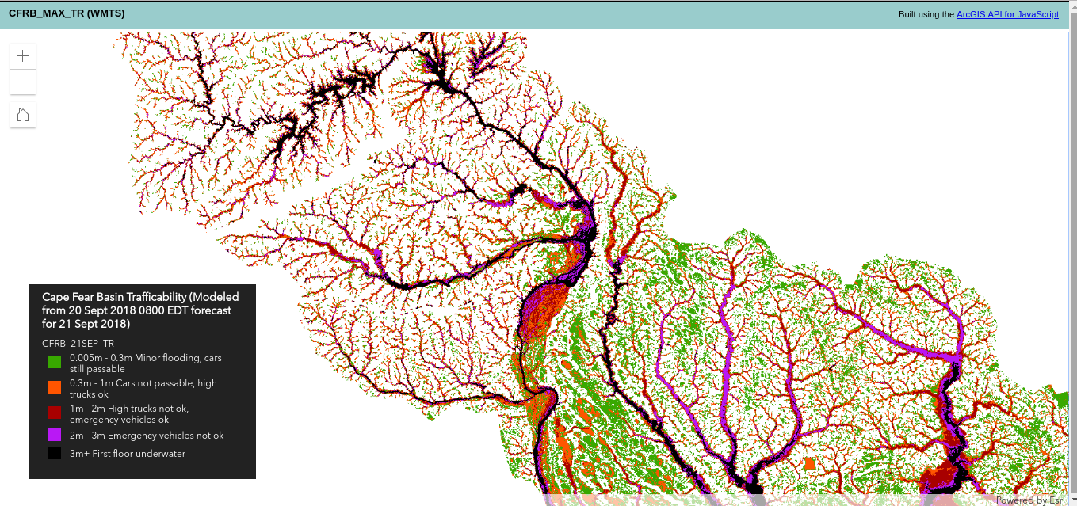
U.S. Army Corps of Engineers,
USACE Analysis Flood Maps

Slide 3
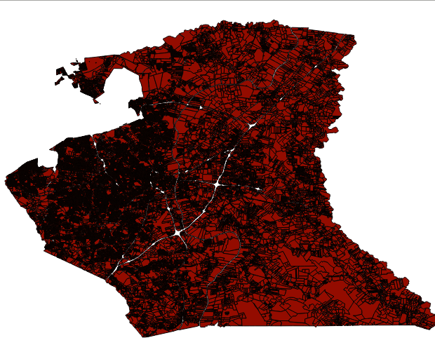
We are going to compare the USACE Analysis Flood Maps with property parcel data, to delineate residential parcels that have been flooded

Slide 4
Additional Ranking of Parcels
The flooded parcels will be ranked based on their property value
The USACE Analysis Flood Maps have five categories of flooded area, based on flood depth:
0.005m - 0.3m Minor flooding, cars still passable
0.3m - 1m Cars not passable, high trucks ok
1m - 2m High trucks not ok, emergency vehicles ok
2m - 3m Emergency vehicles not ok
3m+ First floor underwater
We will rank each flooded parcel based on these depths.

Slide 5
Online Interactive Map
We will create a map that will be accessible online, using a javascript library such as Leaflet or OpenLayers.
The map will have multiple layers including the:
Delineate flooded parcels,
USACE Analysis Flood Map
As well as additional Socioeconomic data

Slide 6
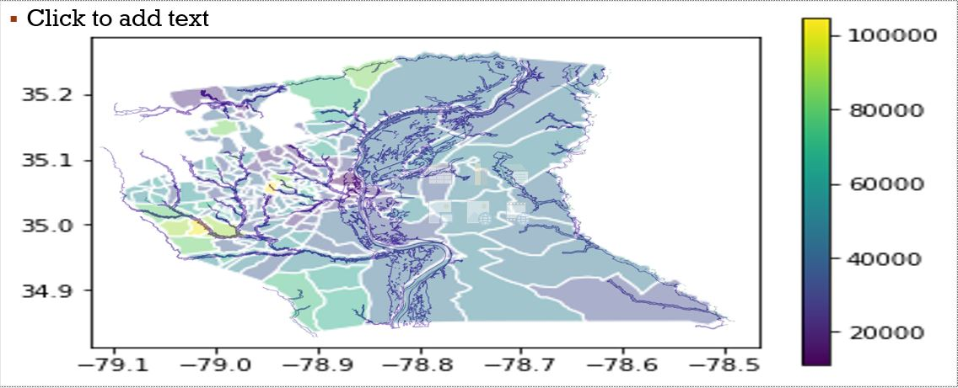
Median Household Income with Flood Map
￼

Slide 7
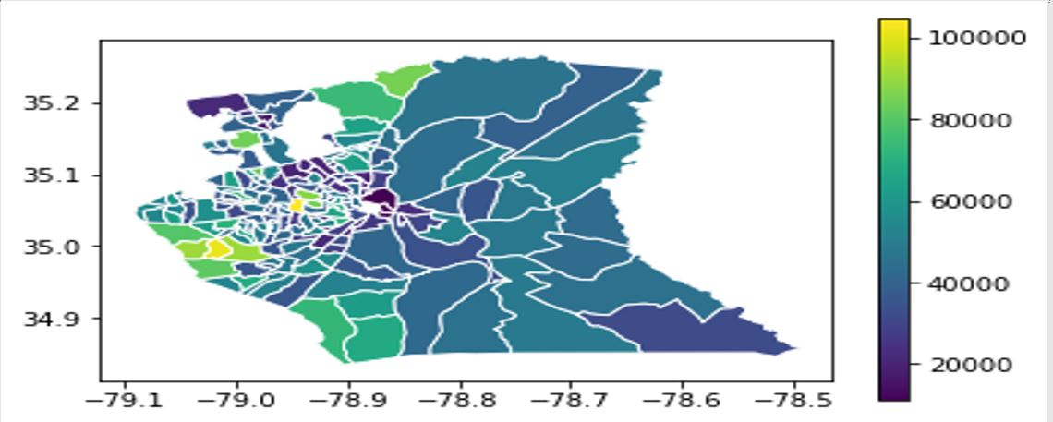
Median Household Income in 2016

Slide 8
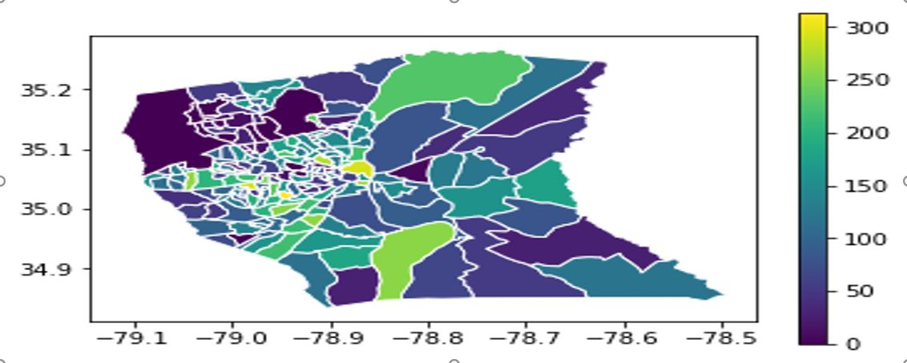
FoodStamp Availed in 2016

Slide 9
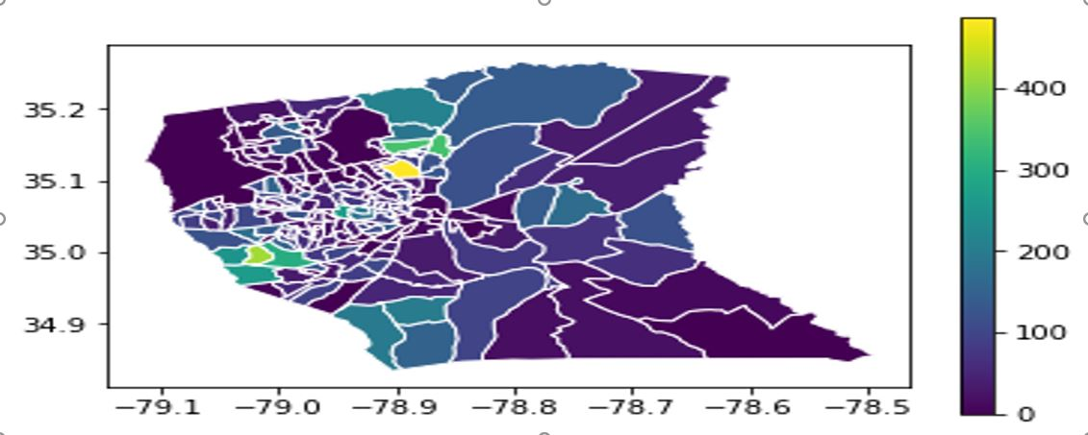
Higher Education Attainment in 2016

Slide 10
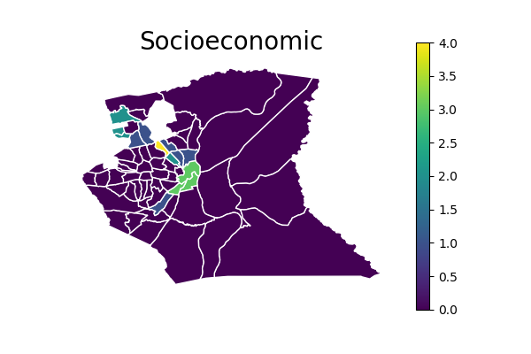
CDC Vulnerability Map
Notes:
Percentile Percentage of persons below poverty e
Unemployed
No high school diploma i

Slide 11
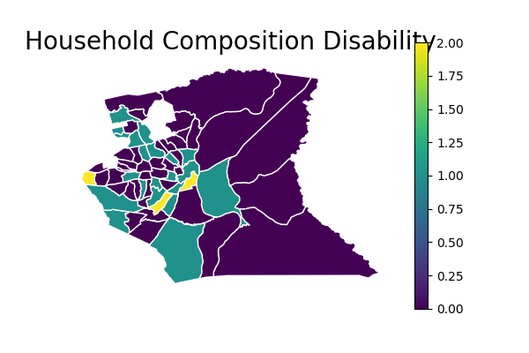
CDC Vulnerability Map
Notes:
aged 65 and older
aged 17 and younger
persons with a disability
single parent households

Slide 12
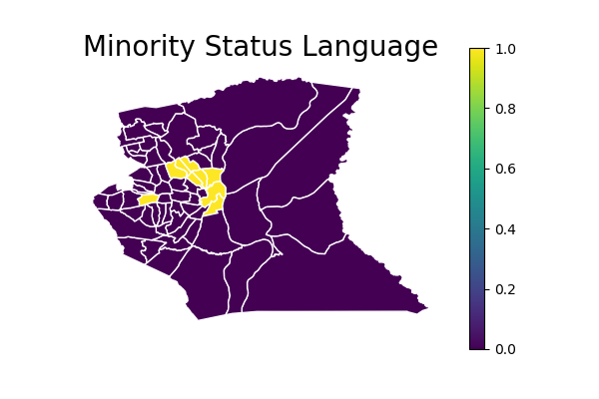
CDC Vulnerability Map
Notes:
percentage those with limited English
percentage of minority is in the 90th percentile

Slide 13
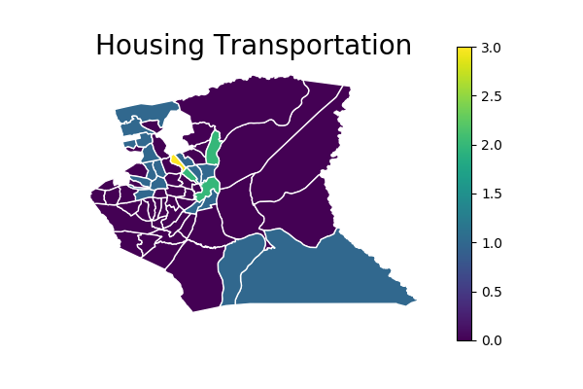
CDC Vulnerability Map
Notes:
Theme 4: Sum of flags for Housing/Transport ation theme
households in multi-unit housing
mobile homes
Crowded households
households with no vehicles

Slide 14
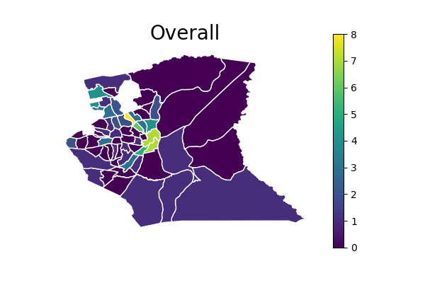
CDC Vulnerability Map

Slide 15
Contact Relief Organizations and Collaborate
After completing the map we will contact relief organizations and get the input on how useful the map is, and how we could improve it.
This will be an iterative process, where we will use information collected in the field, by the relief organizations, to improve the maps.
The list of vulnerable homes will hopefully help relief organization prioritize the order in which they help people, enabling them to focus on the most needy first.
Over a longer period of time the maps will help household apply for grants and funding, that help flooded household, by providing evidence that their household has been flooded

Slide 16
Let’s give back to the World
If not now, when?
If not us, who?

Slide 17
Questions?

