Slide 1
Database Systems: Mini-Project
By Jill Platts

Slide 2
Project Scope
A book collection database application, created with Python and using XML for data storage.
Various methods of parsing and manipulating XML are used, including ElementTree (the C implementation because it’s faster and uses less memory) and Pandas DataFrames.
ElementTree is used to perform the four basic CRUD operations (create, retrieve/read, update, and delete).
Pandas DataFrames, MatPlotLib, and Seaborn are used to generate various statistical charts based on the current XML file’s contents at any given time.
PySimpleGUI is used to add a user-friendly GUI.

Slide 3
CRUD
CRUD operations (create, retrieve/read, update, and delete) facilitate viewing, searching, and changing information stored in the XML file.
All books can be viewed at once.
A specific book can be searched for.
A new book can be added.
A book’s information can be updated.
A book entry can be deleted.

Slide 4
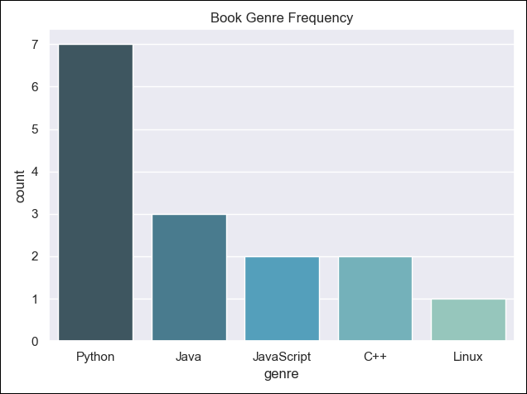
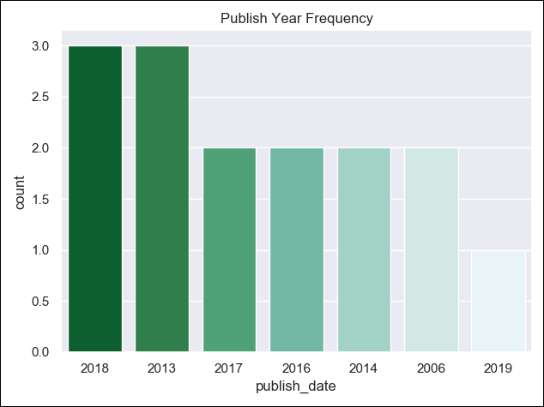
Statistical Charts/Visualizations
MatPlotLib and Seaborn (often used to develop the attractiveness of MatPlotLib graphics) are used to automatically generate charts/visualizations based on current numerical and categorical XML information.

Slide 5
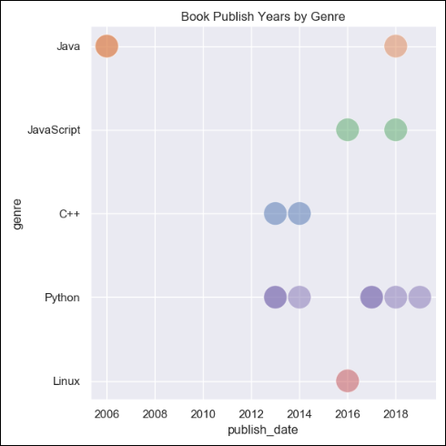
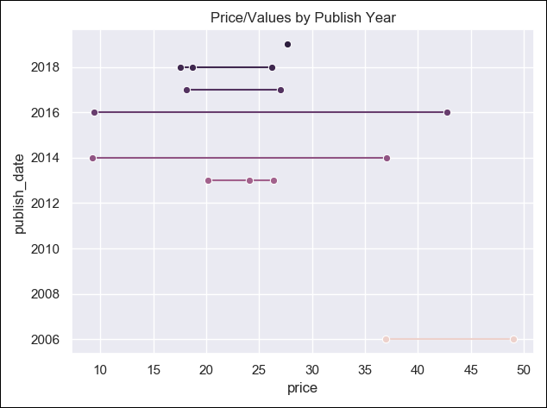

Slide 6
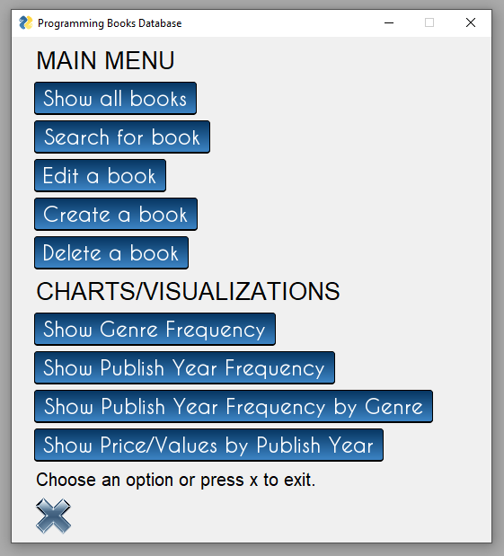
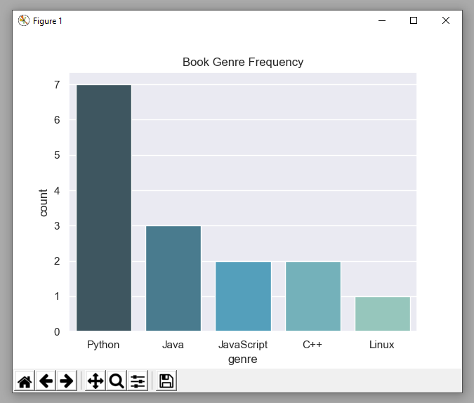
GUI
Main Menu graphical user interface (GUI).
Interactive Chart/Visualization graphical user interface (GUI).
A user-friendly GUI is added with PySimpleGUI.

Slide 7
All code, as well as a compiled version, can be viewed on the project’s GitHub page: https://github.com/jmppmj/pythonxmldatabase

