Slide 1
Algorithm

Slide 2
What is it?

Slide 3
What is it?
A sequence of instructions that takes values as input and returns other values

Slide 4
What is it?
A sequence of instructions that takes values as input and returns other values
Composed of :
Syntax

Slide 5
What is it?
A sequence of instructions that takes values as input and returns other values
Composed of :
Syntax
Data type and variables

Slide 6
What is it?
A sequence of instructions that takes values as input and returns other values
Composed of :
Syntax
Data type and variables
Arithmetic operators

Slide 7
What is it?
A sequence of instructions that takes values as input and returns other values
Composed of :
Syntax
Data type and variables
Arithmetic operators
Conditions

Slide 8
What is it?
A sequence of instructions that takes values as input and returns other values
Composed of :
Syntax
Data type and variables
Arithmetic operators
Conditions
Loops

Slide 9
What is it?
A sequence of instructions that takes values as input and returns other values
Composed of :
Syntax
Data type and variables
Arithmetic operators
Conditions
Loops
Fonctions

Slide 10
What is it?
A sequence of instructions that takes values as input and returns other values
Composed of :
Syntax
Data type and variables
Arithmetic operators
Conditions
Loops
Fonctions
….

Slide 11
Variables

Slide 12
What is a variable ?

Slide 13
What is a variable ?
It’s like a container (usb key, garage box…)

Slide 14
What is a variable ?
It’s like a container (usb key, garage box…)
Can contain data

Slide 15
What is a variable ?
It’s like a container (usb key, garage box…)
Can contain data
You can replace the data by another

Slide 16
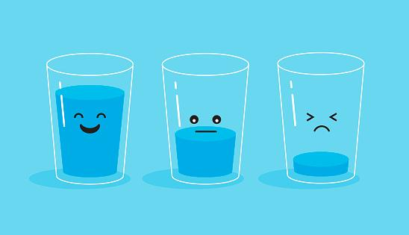
What is a variable ?

Slide 17
Data type

Slide 18
Data type
Integer (1)

Slide 19
Data type
Integer (1)
Float/Decimal (1.0)

Slide 20
Data type
Integer (1)
Float/Decimal (1.0)
Boolean (true or false)

Slide 21
Data type
Integer (1)
Float/Decimal (1.0)
Boolean (true or false)
String (one or more character)

Slide 22
Arithmetic Operators

Slide 23
Arithmetic operators
+
-
*
/
% (modulo)

Slide 24
Fonctions

Slide 25
What is a fonction
A sequence of instruction that does a specific action.

Slide 26
What is a fonction
A sequence of instruction that does a specific action.
For example :
Display/Print : Display or print functions are used to display something on the screen.

Slide 27
What is a fonction
A sequence of instruction that does a specific action.
For example :
Display/Print : Display or print functions are used to display something on the screen.
ReadLine: Ask for the user to type in something on the keyboard and save the result.

Slide 28
Syntax

Slide 29
Syntax
BEGIN Name of the Algorithm

Slide 30
Syntax
BEGIN Name of the Algorithm
START

Slide 31
Syntax
BEGIN Name of the Algorithm
START
Instruction 1
Instruction 2

Slide 32
Syntax
BEGIN Name of the Algorithm
START
Instruction 1
Instruction 2
.
.
END

Slide 33
Syntax using a variable

Slide 34
Syntax using a variable
BEGIN Name of the Algorithm
var SecretOfLife : entier
SecretOfLife = 42

Slide 35
Syntax using a variable
BEGIN Name of the Algorithm
var SecretOfLife : entier
SecretOfLife = 42
START
.
.
.
END

Slide 36
Syntax using a variable
BEGIN Name of the Algorithm
var SecretOfLife : entier
SecretOfLife = 42
START
SecretOfLife = 60
DISPLAY(‘SecretOfLife’)
END

Slide 37
Syntax using a variable
BEGIN Name of the Algorithm
var SecretOfLife : entier
SecretOfLife = 42
START
DISPLAY(SecretOfLife - 5)
END

Slide 38
Questions ?

