Slide 1
NVL HX THC ES1 Results 1 Load Topology 42.67MHz
Juan Luis Lopez Padilla
Jesus Mauricio Quintero Cruz
WW4 2026

Slide 2
Test Conditions/Setup
IFWI Version:
NVL_HR11_A1A0-ODCA_RPRF_SEP0_115F0418_2025WW48.3.01.bin
THC 1-Load (for Touch Panel) Topology.
Synthetic content.
Power supply 1.8V.
Frequency at 42.67MHz.
BOM6.
11” in cable.
Platform used:
RVP01-NVL Hx_UL DDR5 SODIMM 1DPC T3.
6 parts tested:
Token: UPM_4205_HPHVT2FIN2LEGNES7DG_FULLDIE_NOM_MED (Sigma)
PVT conditions.
PCD-H VID | Skew
U538G12400977 | 1S
U548C31700201
U538G12400463
U544D00300422 | 1F
U546F72500726
U548C31700538

Slide 3
Test conditions
5 VT Corners
Temperature
90°C
Slow
High
50°C Nominal
Typical
-5°C
Low
Fast
-5%
1.8 V
Nominal
+5%
Voltage

Slide 4
Executive Summary
All electrical measurements are within spec.
Tested on Quad Mode at 42.67MHz.
BOM6.
Synthetic content.
Rx AC measurements not available.

Slide 5
Results
Description | Specification |  |  |  | Data
 | Industry / EDS | Min | Max | Units | Min Measured | Max Measured | Measurement location
Frequency | EDS | 41.82 | 43.52 | MHz | 41.91E+6 | 43.41E+6 | 50%
Data in Setup of SPI MISO and SPI I/O | EDS | 4.5 | n/a | ns | 9.08E-9 | 11.36E-9 | 50%
Data in Hold of SPI MISO and SPI I/O | EDS | 2.5 | n/a | ns | 12.75E-9 | 14.41E-9 | 50%
Setup of SPI CS# assertion | EDS | 30 | n/a | ns | 57.98E-9 | 58E-9 | CS ↓ 50% - CLK ↑ 50%
Hold of SPI CS# assertion | EDS | 20 | n/a | ns | 23.41E-9 | 24.24E-9 | CLK ↓ 50% -CS ↑ 50%
SPI CLK High time | EDS | 9.37 | 14.06 | ns | 11.54E-9 | 12.64E-9
SPI CLK Low time | EDS | 9.37 | 14.06 | ns | 10.92E-9 | 11.93E-9

Slide 6
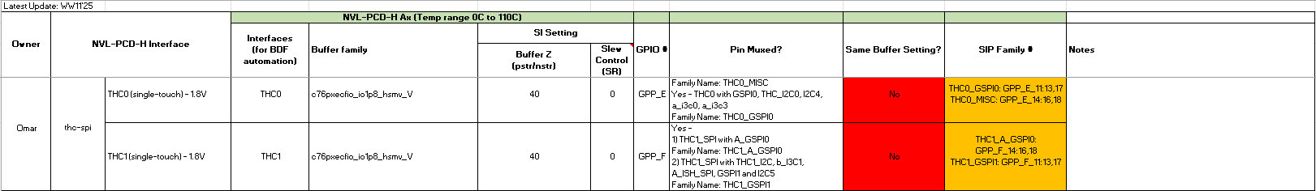
Buffer settings
Recommended values
From: NVL-PCD-H_GPIO_Buffer_Setting_2025WW12
Reading values
THC0
1.8v
pcd.gpio.com1.sb.gpio_mem_1.fam_cfg_thc0_gspi0.strsel | 0x0
pcd.gpio.com1.sb.gpio_mem_1.fam_rcomp_a_dw0_thc0_gspi0.pdstrval | 0x3
pcd.gpio.com1.sb.gpio_mem_1.fam_rcomp_a_dw0_thc0_gspi0.pustrval | 0x3
BDF
0x3 = 40 ohm

Slide 7
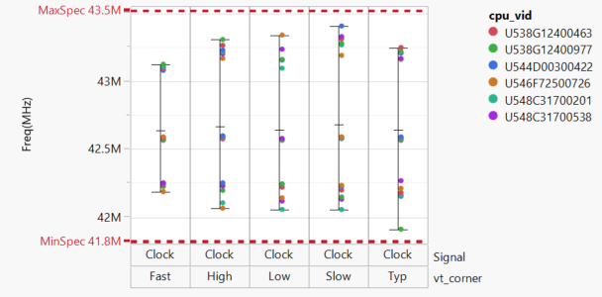
Frequency
EDS:
Min Spec: 41.82MHz
Max Spec: 43.52MHz
 | Minimum | Maximum
Mean | 41.91E+6 | 43.41E+6

Slide 8
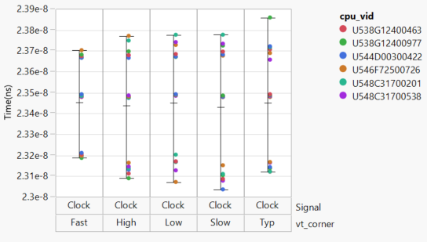
Period
 | Minimum | Maximum
Mean | 23.04E-9 | 23.86E-9
Specification:
N/A

Slide 9
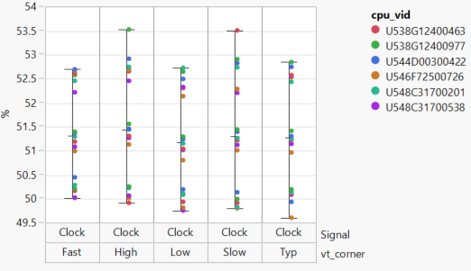
Duty cycle
 | Minimum | Maximum
Mean | 49.61 | 53.53
Specification:
N/A

Slide 10
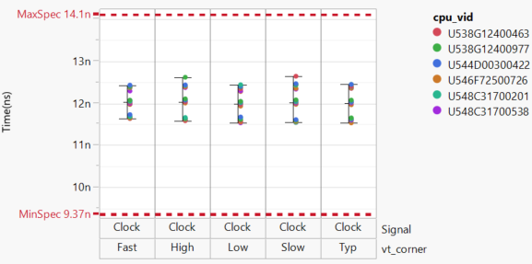
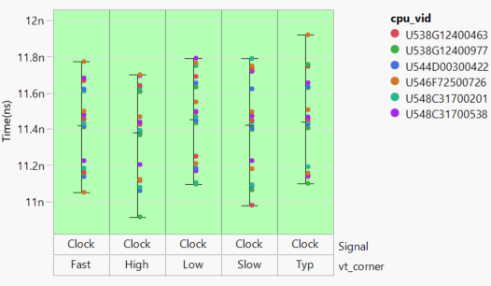
CLK High/Low Time
High time
Low time
 | Minimum | Maximum
Mean | 11.54E-9 | 12.64E-9
 | Minimum | Maximum
Mean | 10.92E-9 | 11.93E-9
Specification:
Min Spec: 9.37ns
Max Spec: 14.06ns

Slide 11
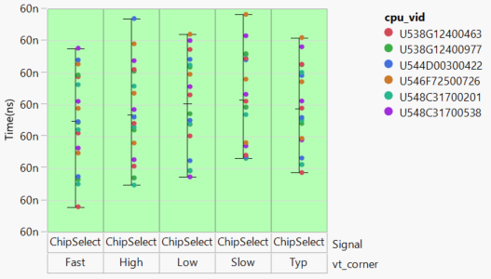
Setup Time CS
 | Minimum | Maximum
Mean | 57.98E-9 | 58E-9
Specification:
Min Spec: 30ns

Slide 12
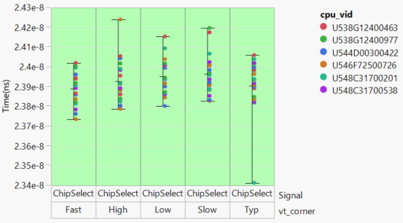
Hold Time CS
 | Minimum | Maximum
Mean | 23.41E-9 | 24.24E-9
Specification:
Min Spec: 20ns

Slide 13
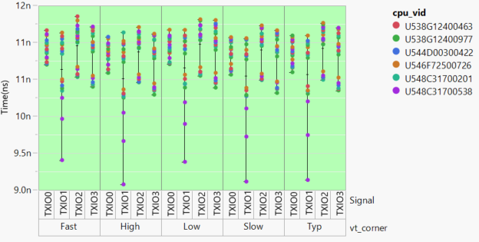
Setup time Tx
 | Minimum | Maximum
Mean | 9.08E-9 | 11.36E-9
Specification:
Min Spec: 4.5ns

Slide 14
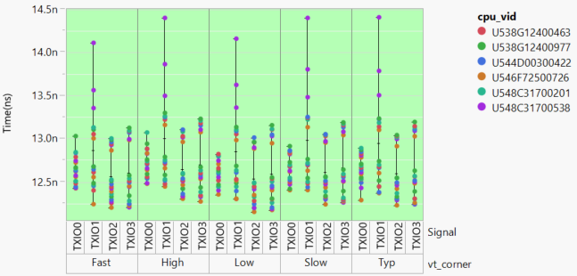
HOLD time Tx
 | Minimum | Maximum
Mean | 12.75E-9 | 14.41E-9
Specification:
Min Spec: 2.5ns

Slide 15
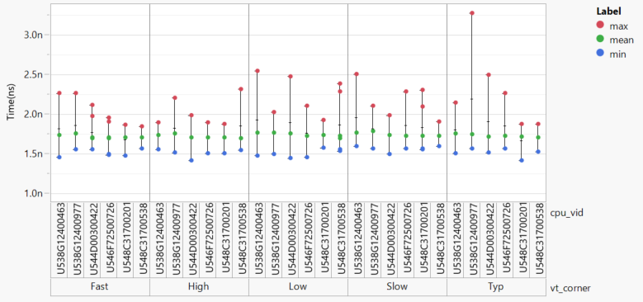
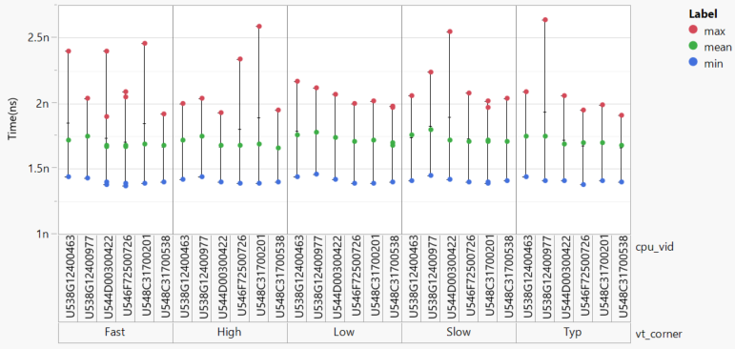
Rise time Tx
CLK
TXIO_0
 | Minimum | Maximum
Mean | 1.42E-9 | 3.28E-9
 | Minimum | Maximum
Mean | 1.37E-9 | 2.64E-9
Specification:
N/A

Slide 16
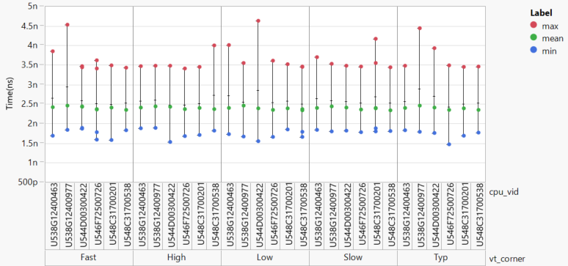
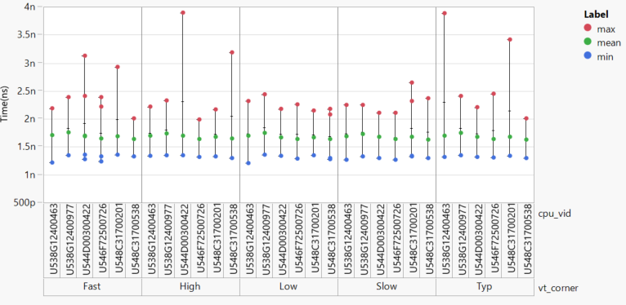
fall time Tx
CLK
IO_0
 | Minimum | Maximum
Mean | 1.47E-9 | 4.63E-9
 | Minimum | Maximum
Mean | 1.21E-9 | 3.9E-9
Specification:
N/A

Slide 17
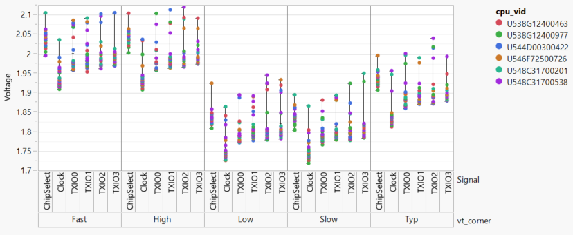
Vmax
 | Minimum | Maximum
Mean | 1.72 V | 2.12 V
Specification:
N/A

Slide 18
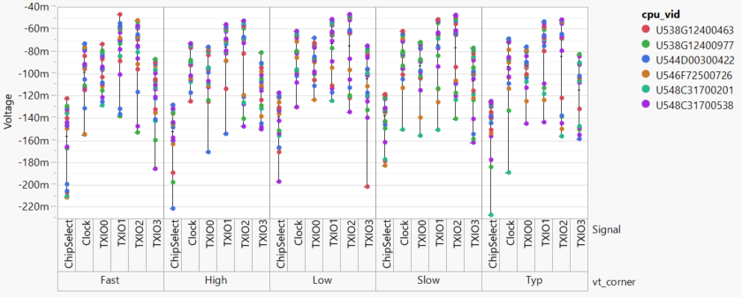
vmin
 | Minimum | Maximum
Mean | -226.89 mV | -46.68 mV
Specification:
N/A

Slide 19
Reviewers
Here list the people attending and signing up the results review from the different teams:
Name | Group/responsibility | Go/no-go?
 | Design/Integration | N/A
 | Signal integrity | ?
 | EV | go
 | DV
 | HVM

Slide 20
Backup

Slide 21
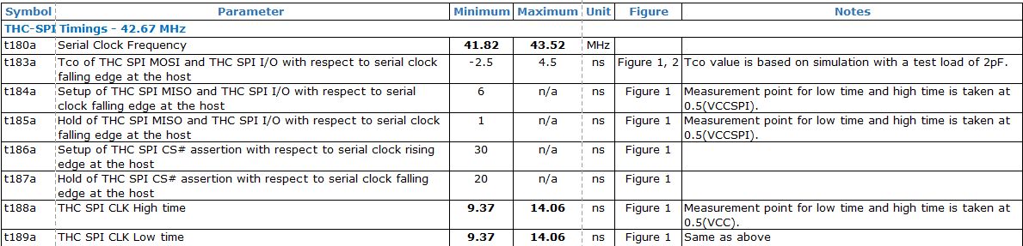
External Design Specification
Notes:
Wrong Data, this specification has 48 frequency reference.

Slide 22
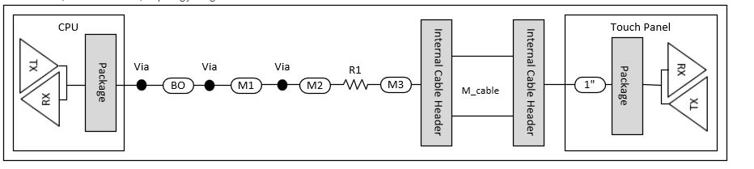
Test points
CLK, MOSI, MISO, CS,IO2,IO3
SPI0_CLK
SPI0_CS
SPI0_IO0
3.9 Ohm
SPI0_IO1
SPI0_IO2
SPI0_IO3
All probes were collocated at end of cable (TP connector)
Go back

Slide 23
Trace length
Signal | Total Board Length
IO_0 | 222.4785
IO_1 | 220.6482
CLK | 220.1755
CS0 | 221.3482
IO_2 | 218.6481
IO_3 | 218.5231
Cable length 11in
Signal | Total Trace Length with cable
IO_0 | 281.3751
IO_1 | 281.5366
CLK | 281.5642
CS0 | 282.1022
IO_2 | 281.5702
IO_3 | 281.3218
PCH
Flash 1
Flash 2
TPM

Slide 24
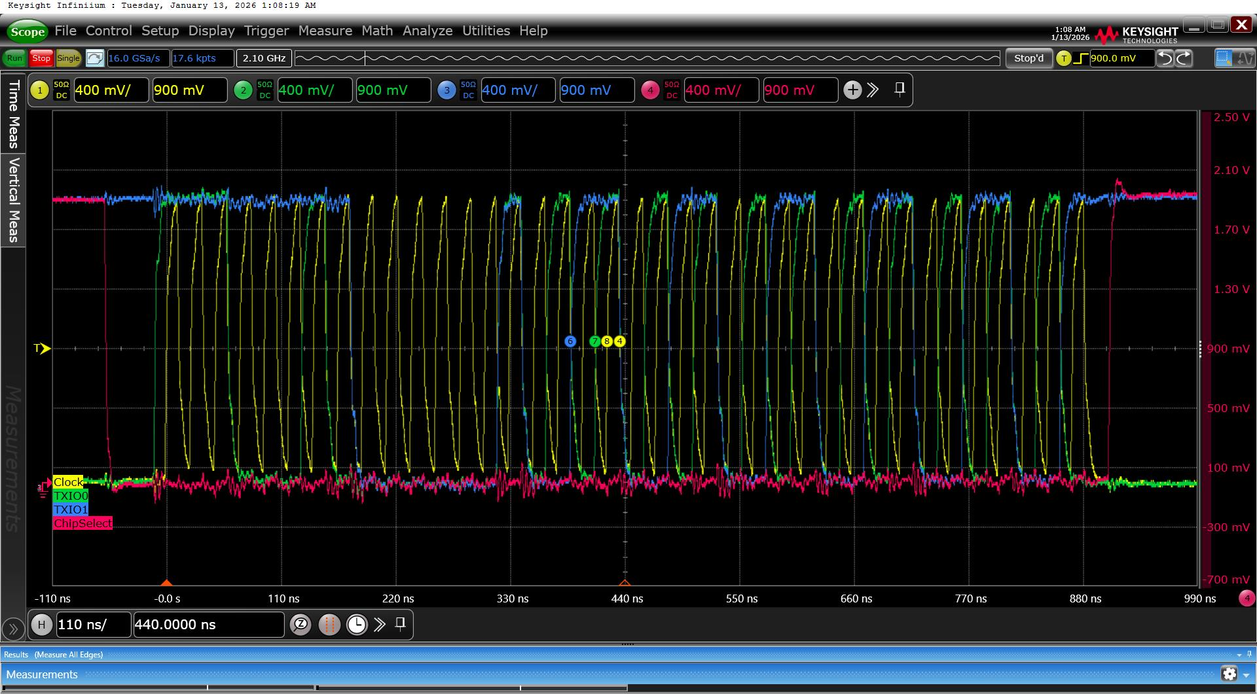
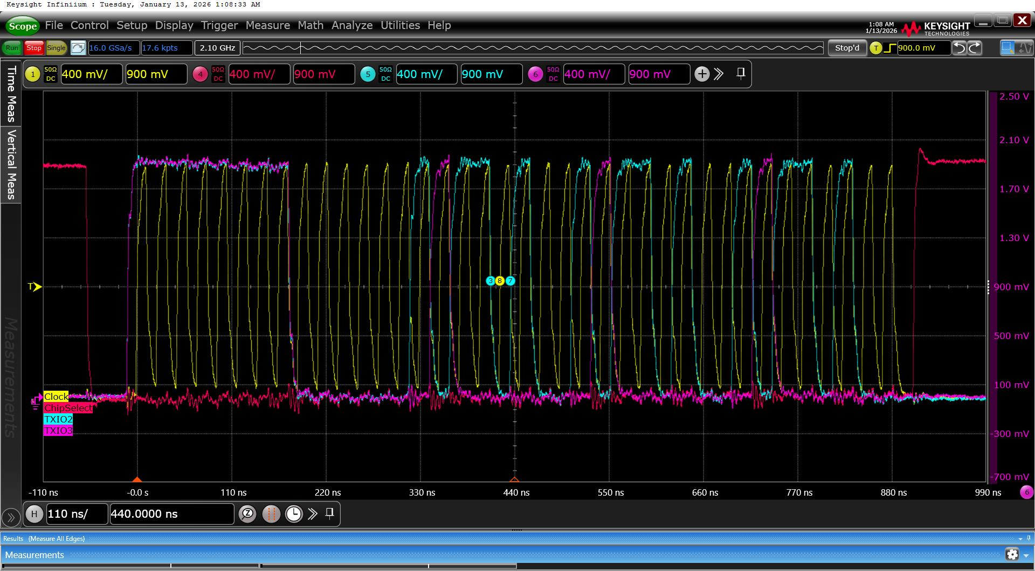
Waveform
Signals on Tx
(CLK,CS,MISO,MOSI)
Signals on Tx
(CLK,CS,IO2,IO3)

