Slide 1
EWARS Local PC Installation Guide

Slide 2
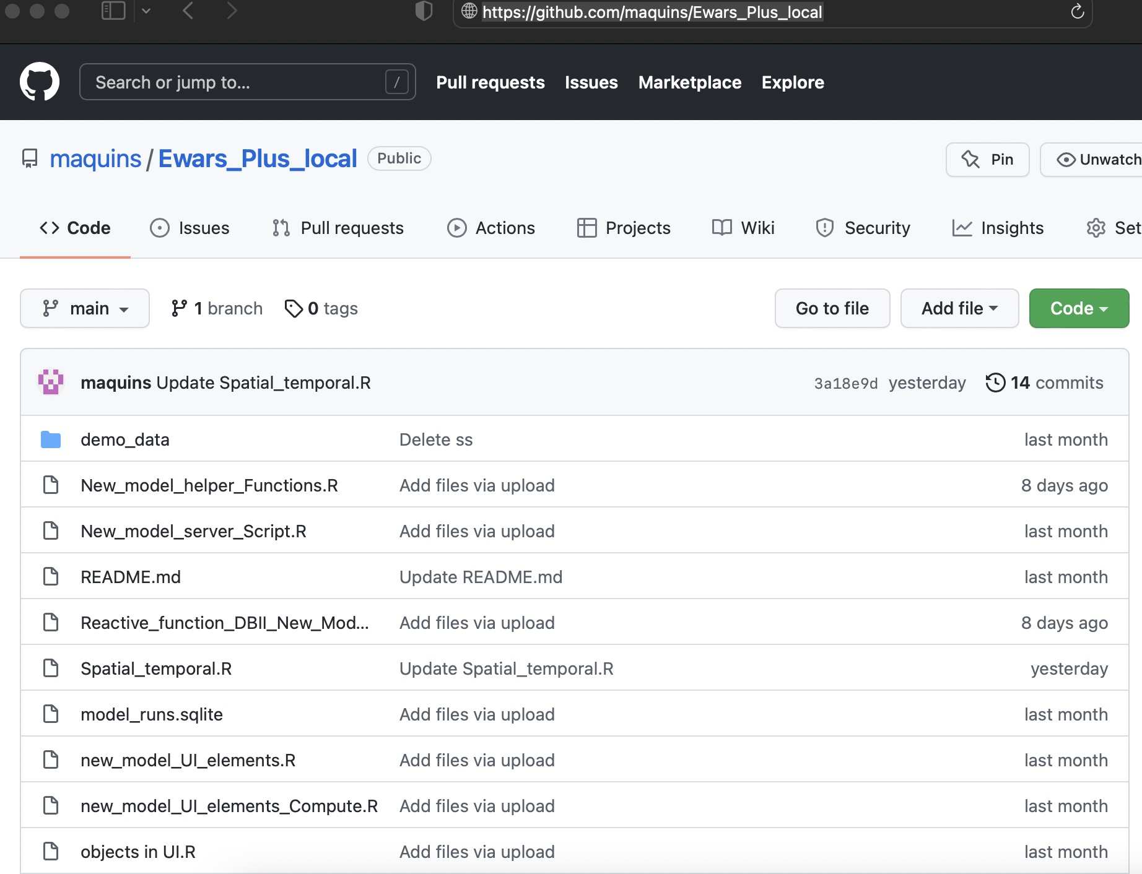
This is a guide on how to download and install the EWARS+ R shiny dashboard scripts hosted on github.There are two links:
for local PC installation :
https://github.com/maquins/Ewars_Plus_local
for shiny server / Linux server /Shinyapps.io :
https://github.com/maquins/ewars_Plus

Slide 3
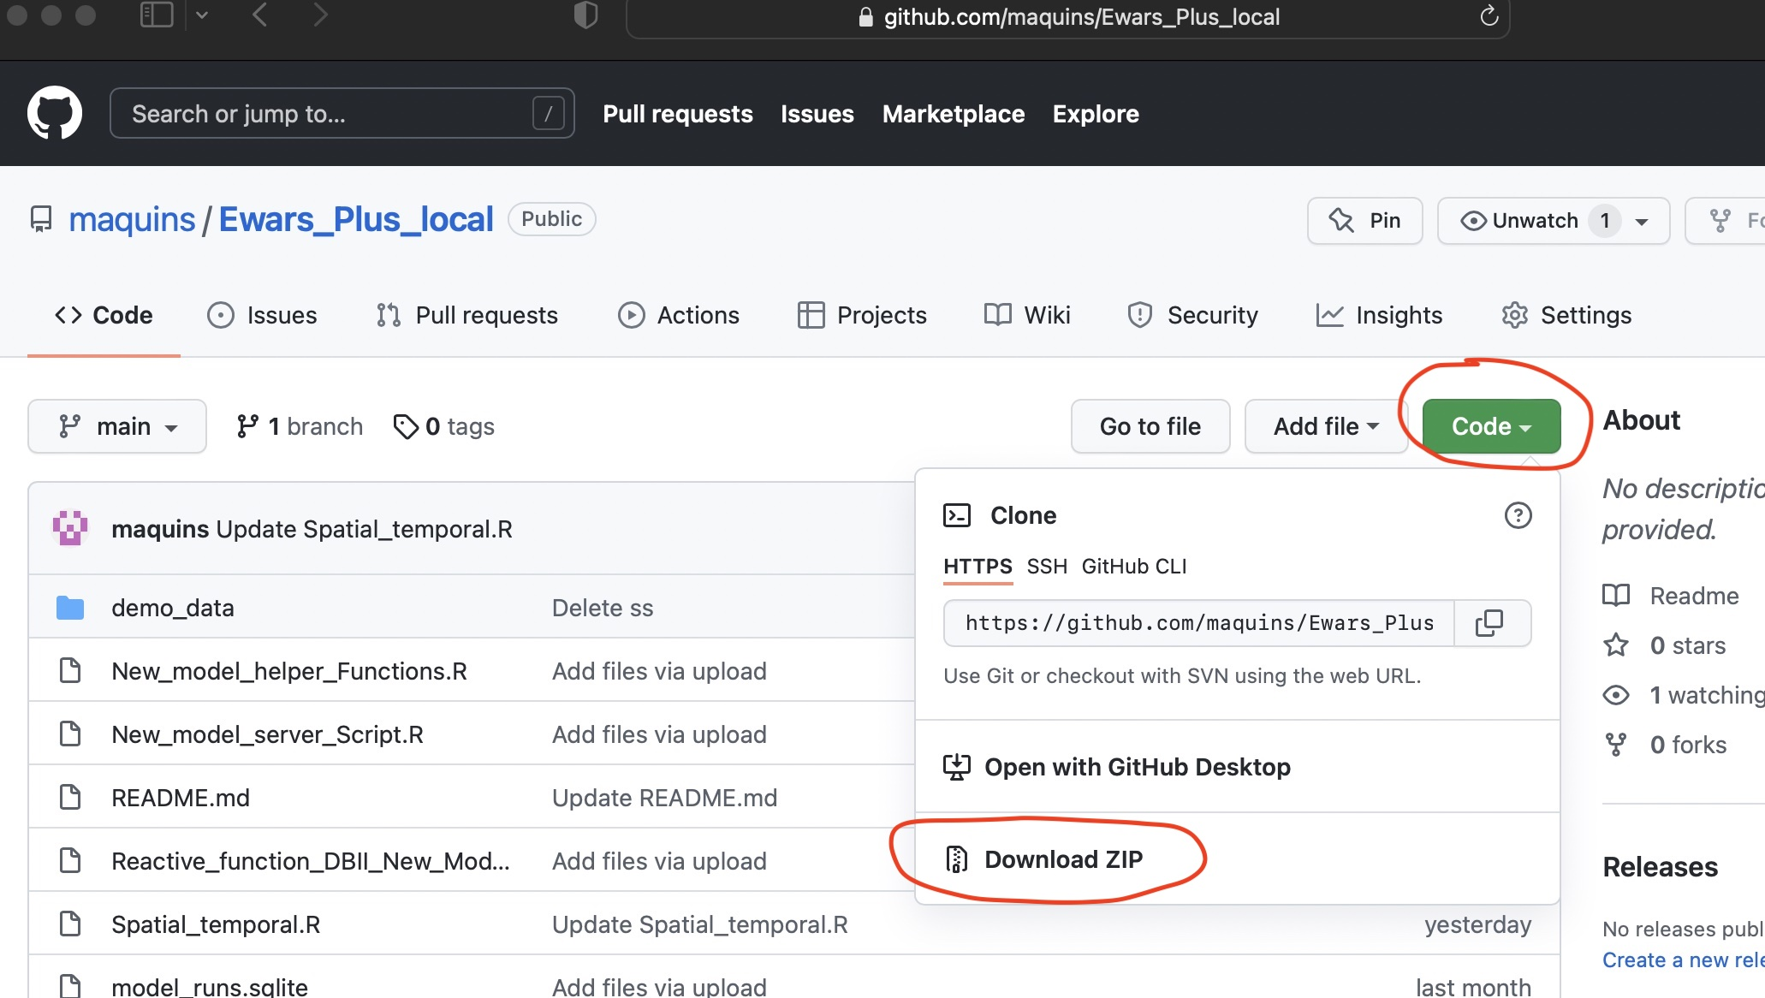
Local installation
Download /clone the github repository to local folder on PC
Click on the code tab and download the zipped folder

Slide 4
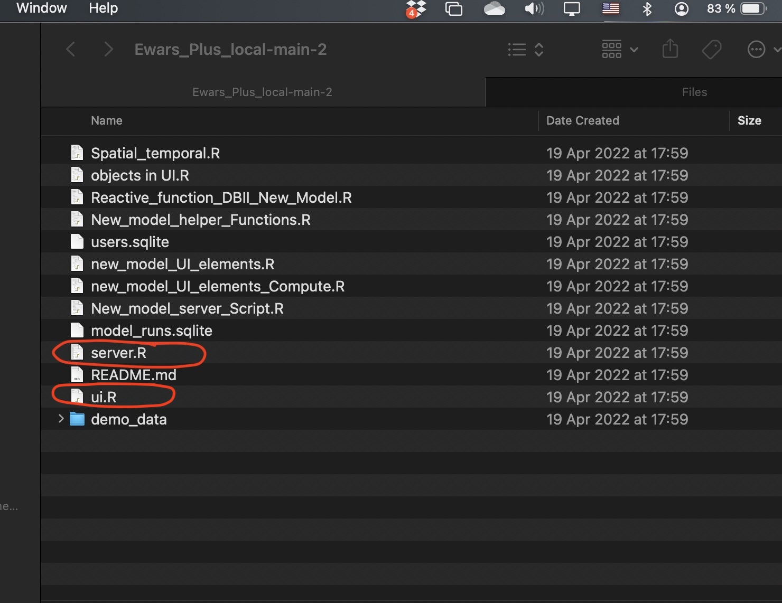
Navigate to the downloaded/cloned folder on PC

Slide 5
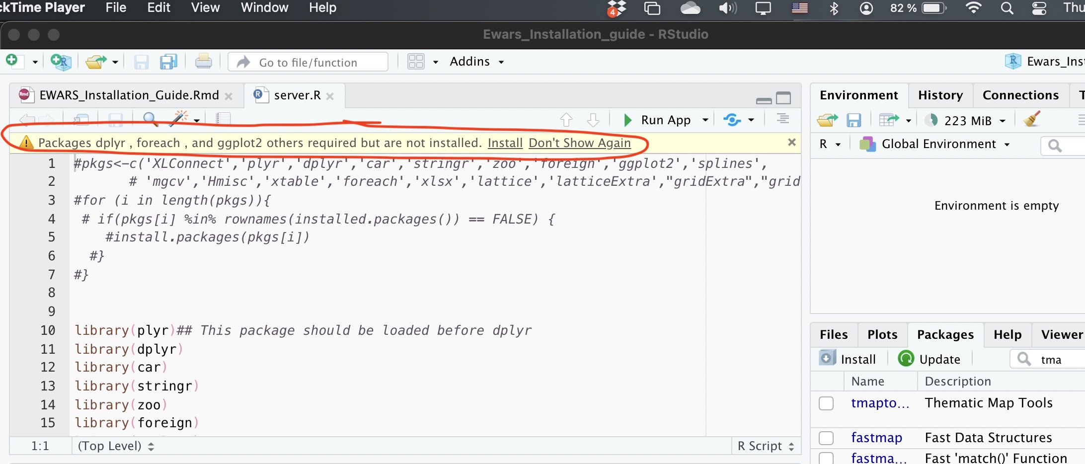
Click and open the server.R file on Rstudio
Ensure you have latest versions of R and R studio installed
The server.R files contains most of the packages that need to be installed
You will be prompted to install missing packages, click yes to install
Wait until all the packages are installed

Slide 6
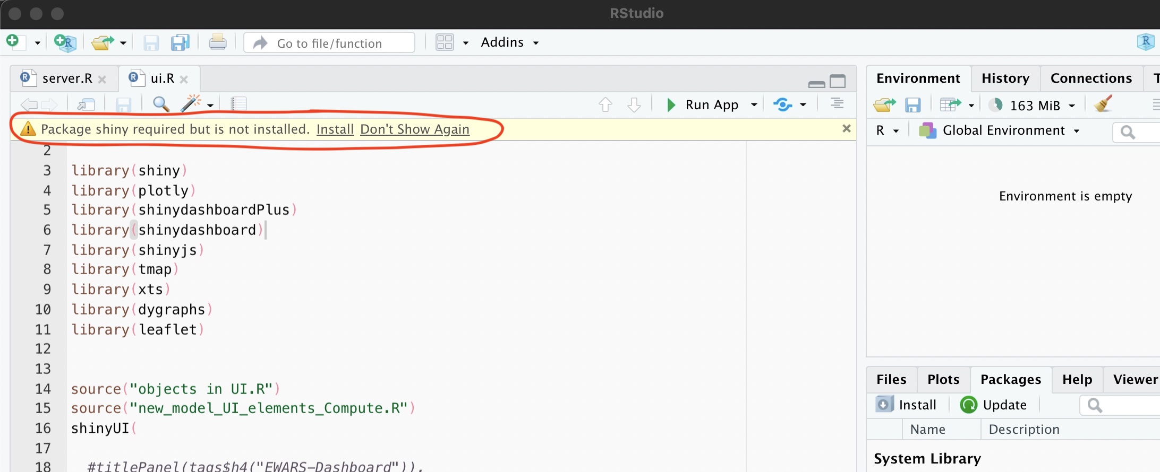
Next click of the UI.R file
This file contains additional dashboard specific packages that need to be installed
When prompted please click install

Slide 7
In case R studio does not prompt you to install
You can install directly running the commands below in Rstudio
install.packages(c('XLConnect','plyr','dplyr','car','stringr','zoo',"grid","shiny"))

Slide 8
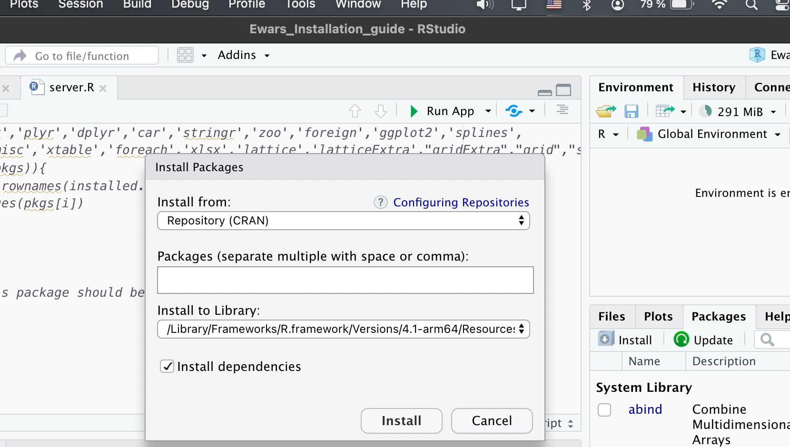
Or alternatively use the drop down menu on Rstudio
click on tools tab in Rstudio and click on install packages
Install all the required packages

Slide 9
Installation of INLA
INLA package is used for the Bayesian inference
INLA package is not hosted on CRAN
We download it following guidelines on https://www.r-inla.org/download-install

Slide 10
Copy paste the two commands and run on Rstudio to install INLA
if (!requireNamespace("BiocManager", quietly = TRUE)) install.packages("BiocManager") BiocManager::install(c("graph", "Rgraphviz"), dep=TRUE) install.packages("INLA",repos=c(getOption("repos"),INLA="https://inla.r-inla-download.org/R/stable"), dep=TRUE)

Slide 11
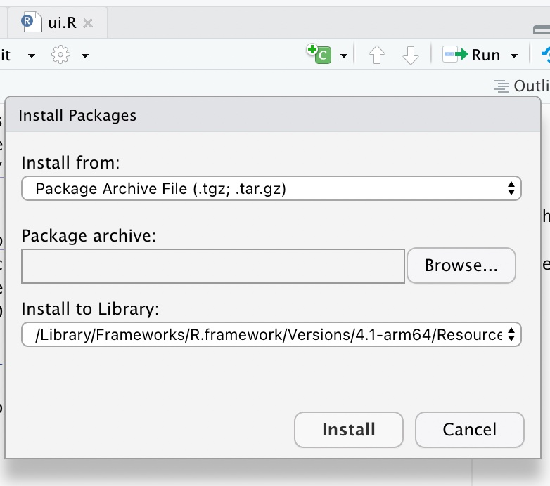
A note on INLA installation on windows platform
If INLA fails to install successfully following the steps above, you can downlaod the package zipped file from (https://inla.r-inla-download.org/R/stable/src/contrib/INLA_20.03.17.tar.gz).
In windows, to install packages from source, you need the Rtools software, download this from (https://cran.r-project.org/bin/windows/Rtools/) and install
Open R studio,on the tools tab click install packages.In the install from menu, choose install from ‘Package Archive file’
Choose the downloaded ‘INLA_20.03.17.tar.gz’ file and install.

Slide 12
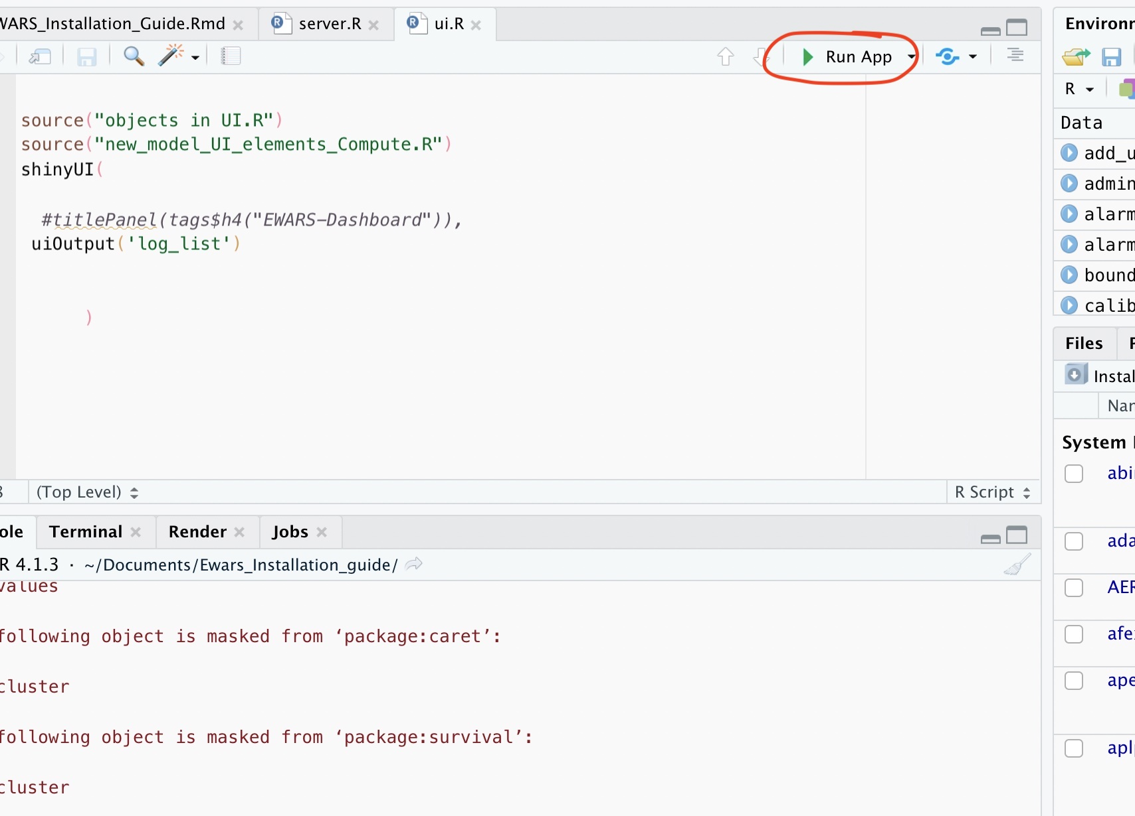
You can test the dashboad if all packages are installed
Open UI.R/ server.R in rstudio
Click the run app button

Slide 13
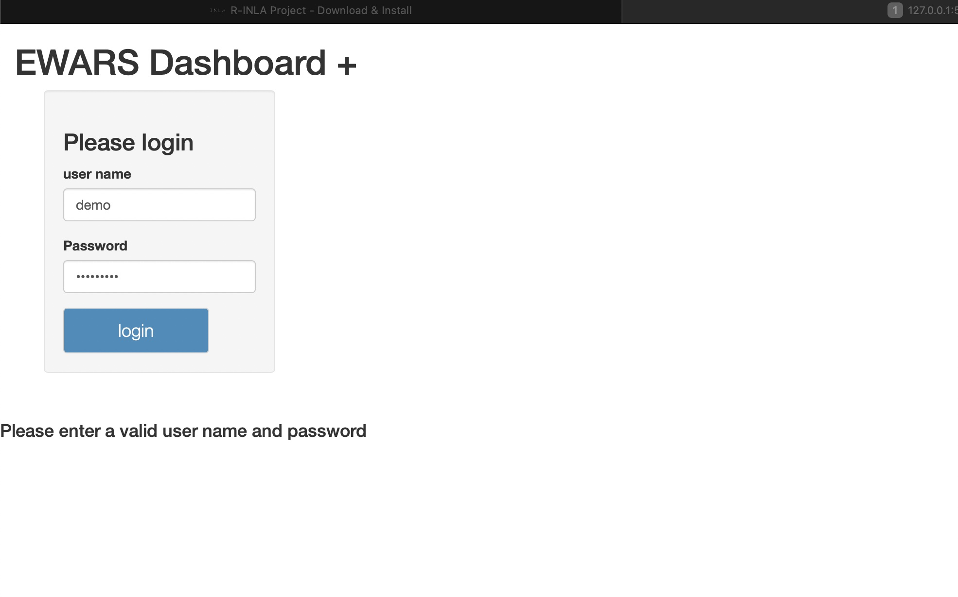
Dashboard Interface
When all the needed packages are installed, you should see the dashboard login screen

