Slide 1

Welcome to the
LoneStar College, Montgomery Campus
Spring, Texas

Slide 2

Welcome! Follow the link below to the materials repository and agenda:
http://bit.ly/Azure2016

Slide 3
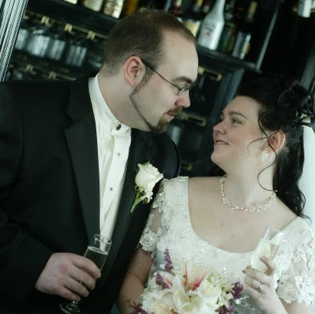
Introductions
Michael Willett
Director of Business Development CODE Consulting
Contact:
mwillett@eps-software.com
mwillett@codemag.com

Slide 4
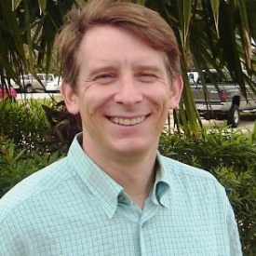
Introductions
Mike Yeager
Senior Developer and Manager EPS Software Corp. Houston, TX
Writer and Speaker
VSX “Insider”
MS SDR Member
CODE Framework Contributor

Slide 5







About CODE & EPS Software Corp.
“Helping People Build Better Software”
Custom Software, Consulting, Training, Mentoring,…
Windows, Web, Mobile
Cloud
Databases
User Interface and Interaction Design
Project Rescue
Legacy Conversions

Slide 6











2015 Global Sponsors
Make sure to ask the organizers for the “Stuff We All Get” information!

Slide 7



Stuff We All Get
Sponsor | Offering
CODE Magazine http://www.codemag.com/magazine/ | CODE Magazine is offering a free 1 year subscription to all attendees and a special Anniversary edition of their magazine.
Zudio https://zud.io/ | Zud.io provides a free six-month personal subscriptions to all attendees.
Cloud Portam http://www.cloudportam.com/ | Cloud Portam is offering a complimentary 3 month Personal subscription to anyone interested and attending GAB. Please see the see the separate info.
CloudBerry Lab http://www.cloudberrylab.com | Cloudberry Lab is offering a CloudBerry Lab license of choice for every attendee. Please see the see the separate info.
Cloudmonix https://cloudmonix.com/ | Every attendee gets $100 off their paid subscription.
Barracuda http://www.barracuda.com | Barracuda is offering their NextGen Firewall F-Series for an extended 60-day free trial through the Azure marketplace and this for every attendee.
SQL Sentry http://www.sqlsentry.com/ | SQL Sentry offer an extended evaluation for every attendee.
EventDay http://www.eventday.com | EventDay, one of our Global Sponsors, has graciously offered a community account for any local organizer who wants to use their registration system for the Global Azure Bootcamp event.
Make sure to ask the organizers for the “Stuff We All Get” information!

Slide 8
Raffle Prizes
1 Winner: One license choosen from ReSharper, dotTrace Memory, dotTrace Performance, dotCover, dotPeek, PhpStorm, PyCharm, IntelliJ IDEA, AppCode, WebStorm, RubyMine)
You’ll receive a voucher with a code from the organizers.
Blue Syntax is offering an Unlimited license of their Enzo Cloud Backup 3 software with all the backups you want, no limits! They raffle one Unlimited License per location, valued at $1,499.99 per license!
You’ll receive a voucher with a code from the organizers.
MyGet is offering a free Starter subscription for 1 year for 5 attendees per location.
Give your Full name and email to the Organizers

Slide 9


Raffle Prizes
1 Winner: a 1 year license of Performance Advisor for Azure SQL Database ($1079.40 value) for raffle per location.
Give your Full name and email to the Organizers
2 Winners: They are giving away 2 licences per location.
Give your Full name and email to the Organizers
They offer 3 1-month subscriptions per GAB Location.
Give your Full name and email to the Organizers
2 Winners: They are giving away 2 licences per location.
Give your Full name and email to the Organizers

