Slide 1
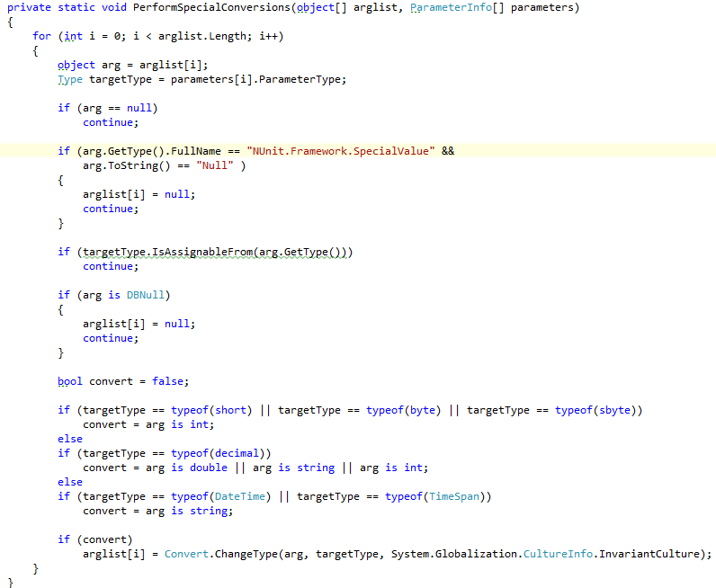
NUnit.Core.Builders.TestCaseParameterProvider
PerformSpecialConversions will inspect the TestCaseAttribute’s arguments, match them to the test method’s parameter types, and perform a conversion.

Slide 2
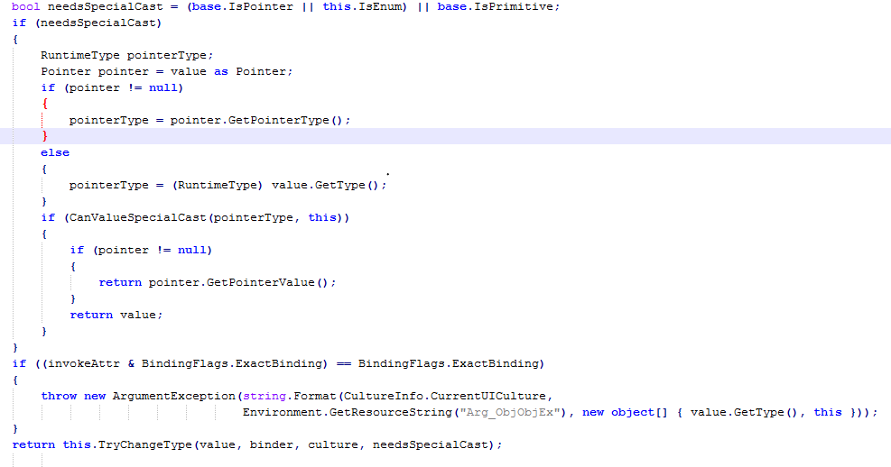
System.RuntimeType.CheckValue
If a value fails to convert via the TestCaseParameterProvider, Nunit simply passes the unchanged value in and assumes a Runtime error will occur when reflecting on the MethodInfo during method invocation. Except…

