Slide 1
NOVA SBE · DEGO 2606 · MSc Business Analytics
Group TXB · 14
NovaCred
Credit Application
Governance Analysis
Data Quality
Fairness & Bias
Privacy & Compliance
Eda Pürsün (Product Lead) · João Roque (Data Engineer) · Maddalena Manfredi (Data Scientist) · Lucas Galilei (Governance Officer)
Notes:
Good morning. We are Team 14, TXB. This is our governance audit of NovaCred — a fintech company under regulatory scrutiny for potential discrimination in its credit scoring system

Slide 2




Team
Group TXB · Team 14 · DEGO 2606, Nova SBE
Product Lead
Data Engineer
Data Scientist
Governance Officer
P
D
D
G
Eda Jülide Pürsün
João Marques Roque
Maddalena Manfredi
Lucas Galilei
ID: 74935
ID: 73047
ID: 71946
ID: 70270
Project coordination, presentation, README, final integration
Data loading, JSON flattening, cleaning pipeline, repository structure
Bias metrics, statistical testing, proxy analysis, subgroup analysis
PII inventory, GDPR mapping, EU AI Act classification, pseudonymisation demo
Team 14 — TXB | NovaCred Credit Governance | DEGO 2606, Nova SBE
2
Notes:
Our team had four roles: I worked as Product Lead, João focused on data quality, Maddalena led the bias and fairness analysis, and Lucas covered governance and compliance.

Slide 3
Context & Objective
NovaCred is under regulatory inquiry for potential discrimination in lending — we act as the Data Governance Task Force
01
02
03
Audit Data Quality
Bias & Fairness Analysis
Privacy & Compliance
Assessed 502 raw records across four quality dimensions. Resolved duplicate IDs, five-variant gender encoding, four date formats, and an undocumented income field merge. Output: 500 records, 34 columns.
Assessed lending decisions for discriminatory patterns. Gender DI = 0.77 breaches the 0.80 four-fifths threshold. ZIP code is a strong gender proxy (AUC = 0.864). Age and intersectional disparities confirmed.
Catalogued PII across four risk categories. Identified 8 GDPR and EU AI Act gaps. Confirmed Annex III High-Risk classification. Demonstrated SHA-256 pseudonymisation and right-to-erasure simulation.
Team 14 — TXB | NovaCred Credit Governance | DEGO 2606, Nova SBE
3
Notes:
Since NovaCred is under regulatory scrutiny, our task was to audit the data, detect bias, and identify compliance gaps.
I will hand over to João, who begins with the data quality findings.

Slide 4
Data Quality — Findings & Remediation
Notebook 01 | João Marques Roque — Data Engineer
1.1 COMPLETENESS
1.3 VALIDITY
Missing Values
Invalid numeric values → NaN
processing_timestamp 87.6% · loan_purpose 90.0% · rejection_reason 58.2% — structural gaps with GDPR audit trail implications
Negative credit_history_months (2) and negative savings_balance (1) — domain impossibilities. Flagged and set to NaN; non-sensitive fields median-imputed.
annual_salary → annual_income merge
Invalid email addresses → NaN (11, 2.2%)
Duplicate income field — annual_salary merged into annual_income, original column dropped, dtype corrected.
Regex pattern applied (11 records flagged: missing @, invalid domain, blank). Coerced to NaN — PII not imputed.
1.2 CONSISTENCY
ZIP code format violation (1 record, 0.2%)
One record with non-standard ZIP format — flagged for review, not silently overwritten.
Duplicate _id rows — 2 records (0.4%)
app_001 and app_042 each appeared twice with conflicting field values. Most complete record retained per ID.
1.4 ACCURACY & PLAUSIBILITY
Gender — 5 distinct values
Cross-field consistency — 0 violations
Five variants across 113 records (M, F, Male, Female, blank). Standardised to Male/Female/Unknown — not imputed.
All approvals carry a positive approved_amount; all rejections carry a rejection_reason. No cross-field violations found.
Date of Birth — 4 formats
Spending behaviour — strong integrity
Four formats coexisted across all 500 records. Each parsed individually via regex and standardised to ISO 8601.
No empty lists, missing categories, or negative amounts. All 15 spending categories present across all 500 records.
Governance-sensitive fields — NOT imputed
PII, decision outcomes, and rejection reasons were excluded from imputation
✓ Clean dataset: 500 rows × 34 columns | 502 → 500 after de-duplication | Primary key uniqueness restored | Governance-sensitive fields protected from imputation
Team 14 — TXB | NovaCred Credit Governance | DEGO 2606, Nova SBE
4
Notes:
“To conduct this analysis, we assessed the dataset across four data quality dimensions: completeness, consistency, validity, and plausibility. We addressed missing data and merged the redundant annual_salary field into annual_income. Duplicate application IDs were resolved by keeping the most complete record. We also standardized gender and date formats, flagged invalid values, and confirmed there were no cross-field inconsistencies.”

Slide 5
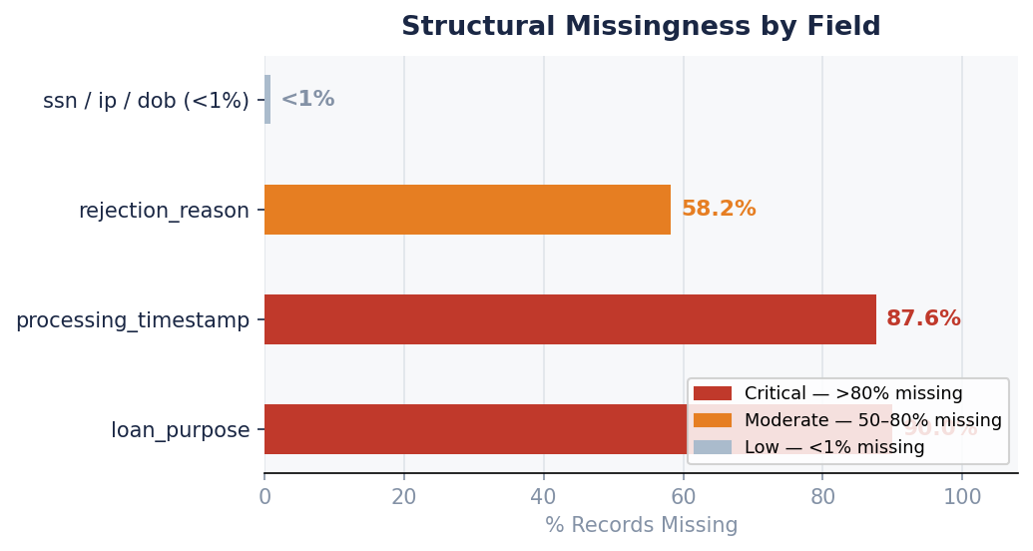
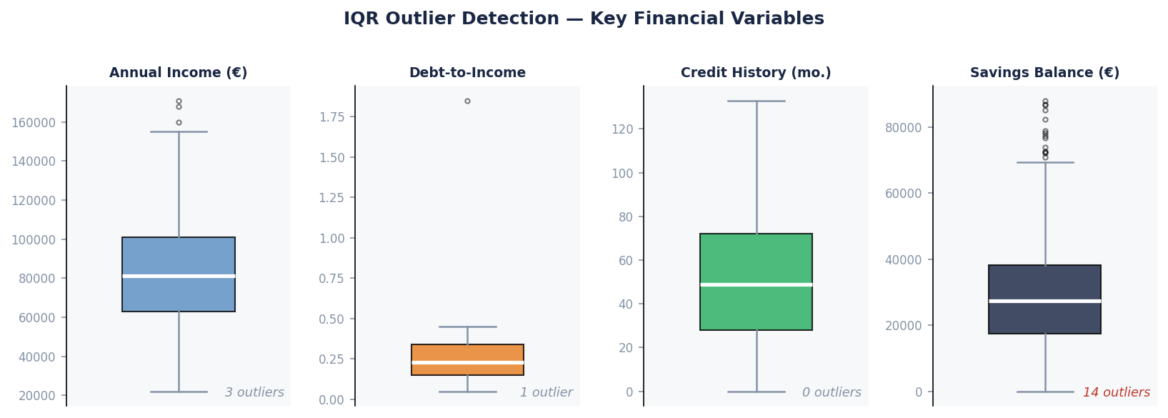
Data Quality — Missingness & Outlier Analysis
Notebook 01 | João Marques Roque — Data Engineer
loan_purpose — 90% missing
No record of why applicants applied. Cannot assess purpose-based risk. Governance gap: no collection policy documented.
processing_timestamp — 87.6% missing
Cannot reconstruct the decision audit trail. GDPR Art. 5(1)(e) retention obligations cannot be verified.
rejection_reason — 58.2% missing
Over half of all rejected applicants received no documented reason. Of those with a reason, 170 cite algorithm_risk_score only.
Team 14 — TXB | NovaCred Credit Governance | DEGO 2606, Nova SBE
4b
Notes:
“Three variables had extremely high missingness—above 90%—and were dropped after consolidating useful information into annual_income. However, processing_timestamp was retained because it is critical for auditability and GDPR compliance. Over half of rejected applications lacked a documented reason. Finally, IQR analysis showed only a few outliers, mainly in savings balance.”

Slide 6
Data Quality — Issues Summary & Remediation
Notebook 01 | João Marques Roque — Data Engineer
# | Issue | Dimension | Field(s) | Count | % | Remediation
01 | High missingness — notes | Completeness | notes | 500 | 99.6% | Dropped (≥90%); documented as optional context field
02 | High missingness — annual_salary | Completeness | financials.annual_salary | 497 | 99.0% | Dropped (≥90%); merged into annual_income before exclusion
03 | High missingness — loan_purpose | Completeness | loan_purpose | 452 | 90.0% | Dropped (≥90%); document collection policy for future audits
04 | High missingness — processing_timestamp | Completeness | processing_timestamp | 440 | 87.6% | Retained; restore field — required for GDPR Art. 5(1)(e) audit trail
05 | Duplicate application IDs (conflicting values) | Uniqueness | _id | 2 | 0.4% | Retained most-complete record per _id
06 | Gender encoded 5 inconsistent ways | Consistency | gender | 113 | 22.5% | Normalised to Male/Female/Unknown — not imputed
07 | Date of birth in 4 different formats | Consistency | date_of_birth | 500 | 100% | Parsed by regex; standardised to ISO 8601
08 | Invalid email addresses | Validity | email | 11 | 2.2% | Coerced to NaN — PII not imputed
09 | Negative credit history / savings balance | Validity | credit_history_months, savings_balance | 3 | 0.6% | Domain impossibilities → flagged and set to NaN
7 issues catalogued
2 critical gaps
Governance-sensitive fields
Clean output
across 4 dimensions
completeness — GDPR risk
never imputed
500 rows × 34 columns
Team 14 — TXB | NovaCred Credit Governance | DEGO 2606, Nova SBE
4c
Notes:
On this slide, we summarise the eight data quality issues identified and the remediation actions applied.
The most severe problems relate to completeness and Duplicate application IDs were resolved by keeping the most complete record per ID.
Consistency issues included five different gender encodings and multiple date-of-birth formats, which were standardized.
Finally, small validity issues—such as invalid emails and negative financial values—were flagged and set to missing, while governance-sensitive fields were intentionally not imputed.

Slide 7
Gender Disparate Impact
Notebook 02 | Maddalena Manfredi — Data Scientist
0.77
DI Ratio
Below 0.80 — legally significant
── 4/5 threshold (52.8%)
15.1 pp
Approval Gap
Absolute gap (male vs female)
V = 0.149
Effect Size (Cramér's V)
Small but statistically significant
p < 0.001
Chi-square test
Pattern is real, not random
A DI ratio of 0.77 constitutes legally significant adverse impact under the four-fifths rule. Chi-square (p = 0.0009) and Cramér's V = 0.149 confirm the result is statistically robust.
Team 14 — TXB | NovaCred Credit Governance | DEGO 2606, Nova SBE
5
Notes:
We analyzed gender disparities in loan approvals. The results show a gap of 15 percentage points between women and men. Through the disparate impact ratio of 0.77, we assess the presence of potential discrimination, which was later confirmed by the chi-square test
To assess whether this represents potential discrimination, we applied the Disparate Impact (DI) ratio, that showed a value of 0.77, since it falls below the 0.80 threshold, this indicat a potential gender bais. To test the statistical significance we used a chi-square test, the results indicated a statistically robust gender disparity in approval outcomes.

Slide 8
Age-Based Discrimination Patterns
Notebook 02 | Maddalena Manfredi — Data Scientist
Statistical Evidence
Chi-square (18–35 vs 36–65)
p = 0.0004
Age-approval disparity is highly significant
Overall rate: Young vs Middle
47.8% vs 64.6%
Young (18–35) overall vs Middle (36–65) overall
Gender gap — Young cohort
20.3 pp
Female 38.1% vs Male 58.4% (p = 0.0088)
Gender gap — Middle cohort
10.6 pp
The 18–25 and 26–35 cohorts record the lowest approval rates — both below 50% and significantly behind peak (36–45)
Female 59.1% vs Male 69.7% (p = 0.0697)
⚠ Intersectional finding (Young 18–35):
Female 38.1% vs Male 58.4% in the Young (18–35) cohort — a 20.3 pp gap, statistically significant (p = 0.0088). Aggregate metrics mask where disparity concentrates.
Team 14 — TXB | NovaCred Credit Governance | DEGO 2606, Nova SBE
6
Notes:
We analyzed approval patterns across age groups. The results show that younger applicants those from 12-35 have the lowest approval rates, around 46% and 48%.
In contrast, applicants between 36 and 65 years old have approval rates above 60%.
The difference between the young and middle-age groups is statistically significant, suggesting that age plays an important role in the approval process.”

Slide 9
Intersectional Bias: Gender × Age
Notebook 02 | Maddalena Manfredi — Data Scientist
Age Group | Female Rate | n | Male Rate | n | Gender Gap (pp) | χ² test
Young (18–35) | 38.1% | 97 | 58.4% | 89 | 20.3 ✗ | p = 0.0088 *
Middle (36–65) | 59.1% | 149 | 69.7% | 155 | 10.6 | p = 0.0697
Senior (65+) | 33.3% | 3 | 66.7% | 3 | 33.3 | n < 6 — inconclusive
Detailed age breakdown (6 cohorts) — approval rate by group
45.8%
48.1%
65.8%
63.5%
62.5%
50.0%
18–25 (n=24)
26–35 (n=162)
36–45 (n=164)
46–55 (n=85)
56–65 (n=56)
65+ (n=6)
Key Finding:
The Young (18–35) cohort shows the only statistically significant gender gap (20.3 pp, p = 0.0088). The Middle (36–65) gap of 10.6 pp does not reach significance (p = 0.0697). Aggregate DI metrics mask where disparity is concentrated — subgroup monitoring is required for High-Risk AI under EU AI Act Annex III.
Team 14 — TXB | NovaCred Credit Governance | DEGO 2606, Nova SBE
7
Notes:
We also examined the intersection between gender and age. The results show that among younger applicants, the gender gap is about 20 percentage points. This difference is statistically significant, as indicated by the p-value. In the 36–65 age group, the gap decreases to 10.6 percentage points and is no longer statistically significant. Overall, this shows that aggregate metrics can hide disparities, which makes subgroup analysis essential

Slide 10
Proxy Variable Analysis
Notebook 02 | Maddalena Manfredi — Data Scientist
zip_code x loan_approval
⚠ PROXY DETECTED
What is a Proxy Variable?
AUC (zip only): 0.864
AUC (approval only): 0.576
A variable that is not itself a protected attribute but correlates strongly with one (gender, age) and with the outcome. Including it in a model can reproduce discriminatory patterns indirectly.
Two combinations were tested as potential gender proxies:
AUC (zip only): 0.864
AUC (approval only): 0.576
Mean CV AUC (combined): 0.849
Mean CV AUC (combined): 0.849
Main findings: zip_code alone has strong gender proxy — it predicts gender with AUC = 0.864, well above the 0.7 risk threshold. This reflects geographic segregation patterns encoded in residential areas. loan_approval alone has weak predictive power — (AUC = 0.576) proxy effect is driven by geographic information. Must be excluded or transformed before model use.
zip_code × loan_approval and spending_behavior × income.
Legend:
spending_behavior × income
✓ NOT A PROXY
Gender proxy test
Statistical test
Not significant
Binomial test: p > 0.05
Combined result
Not significant (—)
Not significant
All pairs: n.s.
Spending habits × income tested as gender proxy. Gender distribution per spending category and income group examined via binomial tests. No statistically significant associations found (all p > 0.05) — spending behavior does not reliably predict gender in this dataset.
Team 14 — TXB | NovaCred Credit Governance | DEGO 2606, Nova SBE
8
8
Notes:
Finally, Two potential proxies were tested.The first is zip code combined with loan approval. This suggests that geographic information may act as a proxy for gender.The second test examines spending behavior and income, which does not show any significant association with gender.Therefore, the main risk comes from zip code, which should either be removed or transformed before using the model to avoid unintended bias.

Slide 11
PII Identification & Classification
Notebook 03 | Lucas Galilei — Governance Officer
Direct Identifier
Field | Category | Risk | Key Finding & Action
full_name, ssn, email | Direct Identifier | ● High | Stored in plaintext — pseudonymise SSN; remove name and email from the analytical layer
ip_address | Technical Identifier | ● High | No analytical value — delete from dataset (GDPR Art. 4(1))
gender | Protected Attribute | ● High | DI = 0.77 confirmed — exclude from all model inputs
zip_code | Quasi-Identifier | ● High | Gender proxy AUC = 0.864 — transform to NUTS-2 region or exclude
date_of_birth | Quasi-Identifier | ● High | Exceeds data minimisation — generalise to age_group (GDPR Art. 5(1)(c))
annual_income | Quasi-Identifier | ◐ Med | Merged from annual_salary; reconciliation not documented
healthcare / gambling spend | Sensitive Behavioural | ◐ Med | Collection purpose undocumented — Art. 9 special-category risk applies
loan_approved | Decision Output | ◐ Med | Automated decision output — Art. 22 and Annex III obligations apply
Uniquely identifies a person alone
e.g. full_name · ssn · email
Quasi-Identifier
Re-identification risk when combined
e.g. date_of_birth · zip_code
Technical ID
Identifies a device or session
e.g. ip_address
Non-Personal
System outputs — no direct link
e.g. loan_approved
5 High Risk
3 Medium
2 Low
Team 14 — TXB | NovaCred Credit Governance | DEGO 2606, Nova SBE
9
Notes:
Now lets jump into the NovaCred credit application dataset from a governance perspective. The dataset contains several types of personal data, including direct identifiers like names, emails, and Social Security Numbers, as well as quasi-identifiers such as date of birth and ZIP codes.
These elements create GDPR risks related to data minimization, confidentiality, and automated decision-making under Article 22. Since the system is used for credit approval decisions, it also qualifies as a High-Risk AI system under the EU AI Act.

Slide 12
Governance Gaps & Recommendations
Notebook 03 | Lucas Galilei — Governance Officer
No lawful basis or consent tracking
No audit trail — EU AI Act Art. 12 breach
01
GDPR Art. 6 · Art. 7
05
EU AI Act Art. 12 · Art. 13
Add consent_timestamp. Document lawful basis per processing activity prior to any model reuse.
Introduce decision_id, model_version, and decision_timestamp. Maintain an append-only audit log.
PII stored in plaintext — no encryption
169 automated rejections — no human review
02
GDPR Art. 5(1)(f) · Art. 32
06
GDPR Art. 22 · AI Act Art. 14
Apply SHA-256 pseudonymisation (demonstrated in Notebook 03). Encrypt data at rest; enforce role-based access.
Require human review for all automated rejections. Establish a formal contestability pathway.
No data retention policy or timestamps
No explainability or appeal mechanism
03
GDPR Art. 5(1)(e) · Art. 17
07
GDPR Art. 22(3) · AI Act Art. 13
Restore processing_timestamp. Define and automate a data retention and deletion schedule.
Deploy SHAP/LIME explanations for all decisions. Provide plain-language rationale and a documented appeal route.
Behavioural data — no documented purpose
High-Risk AI system — conformity to improve
04
GDPR Art. 5(1)(b)(c) · Art. 22
08
AI Act Annex III · Art. 6 · Art. 10
Document purpose per spending category. Confirm applicant notification. Remove fields with no modelling value.
Complete DPIA and EU AI Act conformity assessment. Appoint a Data Protection Officer. Deploy a fairness monitoring dashboard.
Team 14 — TXB | NovaCred Credit Governance | DEGO 2606, Nova SBE
10
Notes:
In the second step, I evaluated the governance and regulatory compliance of the system. Several important gaps emerged. For example, personal identifiers are stored in plaintext without encryption, there is no clear data retention policy, and automated loan rejections occur without evidence of human oversight.
Additionally, the system lacks transparency mechanisms, such as explanations or appeal processes for applicants, which are required under GDPR Article 22 and the EU AI Act.
Since credit scoring systems are classified as high-risk AI systems, the platform must implement stronger governance controls, including audit logging, human review mechanisms, data minimization, and proper risk management procedures.
Overall, the analysis shows that while the dataset can support credit decision modeling, significant improvements in privacy protection, transparency, and AI governance are required to meet GDPR and EU AI Act standards.
Now lets jump into key findings and conclusions

Slide 13
Key Findings & Conclusion
NovaCred requires fundamental governance redesign before its credit scoring system can be considered fair, compliant, and safe to deploy
01 Data Quality
02 Algorithmic Bias
03 Privacy & Compliance
04 Recommended Actions
502 → 500 records: app_001 and app_042 removed as conflicting duplicates
Gender DI = 0.77 — breaches 0.80 four-fifths threshold (p = 0.0009)
SSN, full name, email, IP all in plaintext — critical re-identification risk
Pseudonymise SSN; remove name, email, IP from analytical layer
Gender field had 5 encoding variants across 113 records — normalised
ZIP code: strong gender proxy (AUC = 0.864, mean CV AUC = 0.849)
No lawful basis, consent mechanism, or retention policy in place
Exclude gender and ZIP from model inputs — both confirmed discriminatory
Date of birth stored in 4 formats — standardised to ISO 8601
Young (18–35) vs Middle (36–65): p = 0.0004 — statistically significant
169 algorithmic rejections: no explanation, no review, no appeal pathway
Generalise date_of_birth to age_group prior to any further use
annual_salary and annual_income were duplicate fields — silently merged
Female 38.1% vs Male 58.4% in Young cohort — 20.3 pp gap (p = 0.0088)
EU AI Act Annex III: High-Risk classification with zero conformity controls
Require human review for all rejections; add contestability mechanism
11 invalid emails, 2 negative credit months, 1 negative savings balance — all flagged
Only Young (18–35) gender gap statistically significant — Middle: p = 0.0697
8 GDPR / AI Act compliance gaps — each requiring concrete action
Complete DPIA and AI Act conformity assessment; appoint DPO
NovaCred's credit scoring pipeline exhibits statistically confirmed gender and age disparities, stores PII in plaintext, and operates with zero compliance controls under the EU AI Act.
Team 14 — TXB | NovaCred Credit Governance | DEGO 2606, Nova SBE
11
Notes:
To conclude: the results across all three analyses point in the same direction. NovaCred's system combines data quality weaknesses, statistically significant bias like the gender Disparate Impact ratio of 0.77 — and serious governance gaps.

Slide 14
Recommendations Roadmap
15 remediation actions across three implementation horizons — sequenced by legal urgency
Day 0
Day 30
Day 90
Day 180
15
Immediate
(0–30d)
5 actions
TOTAL ACTIONS
Short-term
(30–90d)
6 actions
Medium-term
(90–180d)
4 actions
Immediate (0–30 days)
Short-term (30–90 days)
Medium-term (90–180 days)
Pseudonymise SSN; remove name, email, IP
Implement decision audit log
Conduct DPIA + AI Act conformity assessment
Exclude gender + ZIP from model
Mandate human review for all rejections
Deploy fairness monitoring dashboard
Generalise date_of_birth to age_group
Build right-to-erasure API
Implement SHAP/LIME explanation layer
Add consent capture + lawful basis docs
Define and automate retention schedule
Appoint Data Protection Officer
Mask IP; transform ZIP to NUTS-2 region
Implement role-based access control
Deploy right-to-explanation mechanism
Team 14 — TXB | NovaCred Credit Governance | DEGO 2606, Nova SBE
12
Notes:
Our roadmap translates these findings into 15 actions across three time horizons. Overall, NovaCred can move toward a defensible and compliant system — but only if governance is treated as a core design requirement. Thank you.

