Slide 1


Slide 2
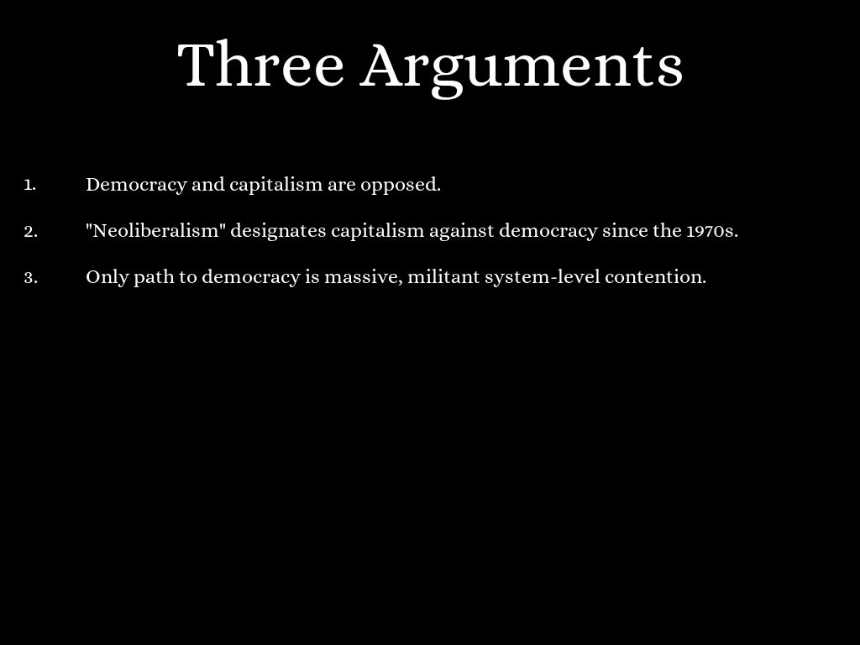

Slide 3
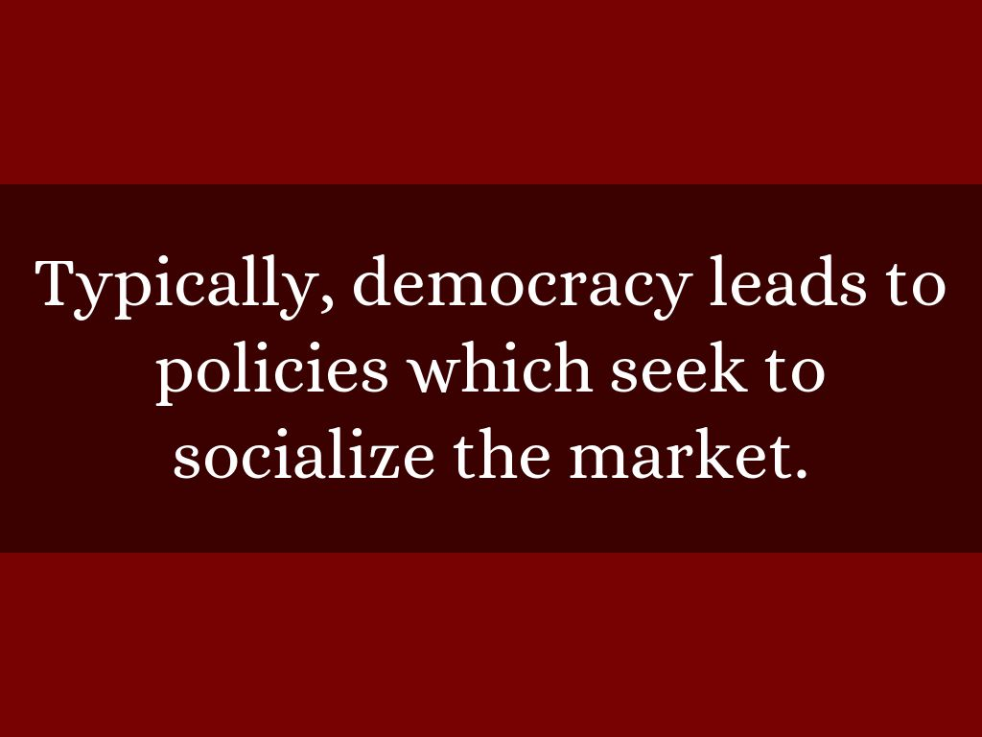

Slide 4
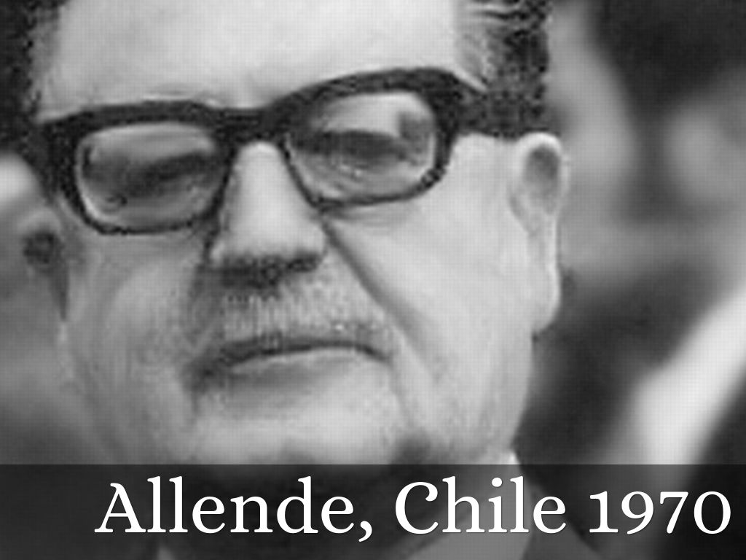

Slide 5
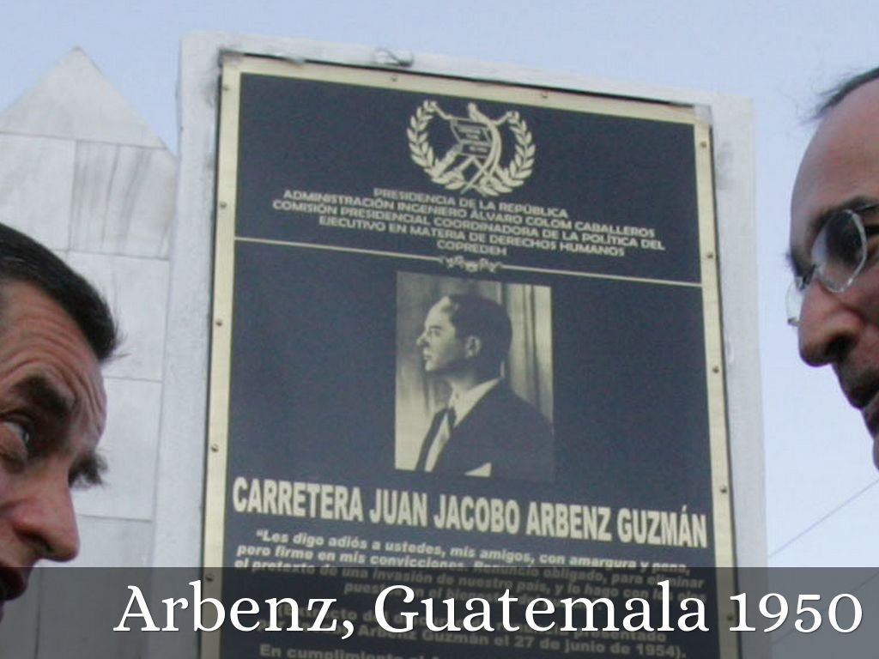
Photo by Gobierno de Álvaro Colom, Guatemala 2008-2012 - Creative Commons Attribution-NonCommercial-ShareAlike License https://www.flickr.com/photos/40856688@N04

Slide 6
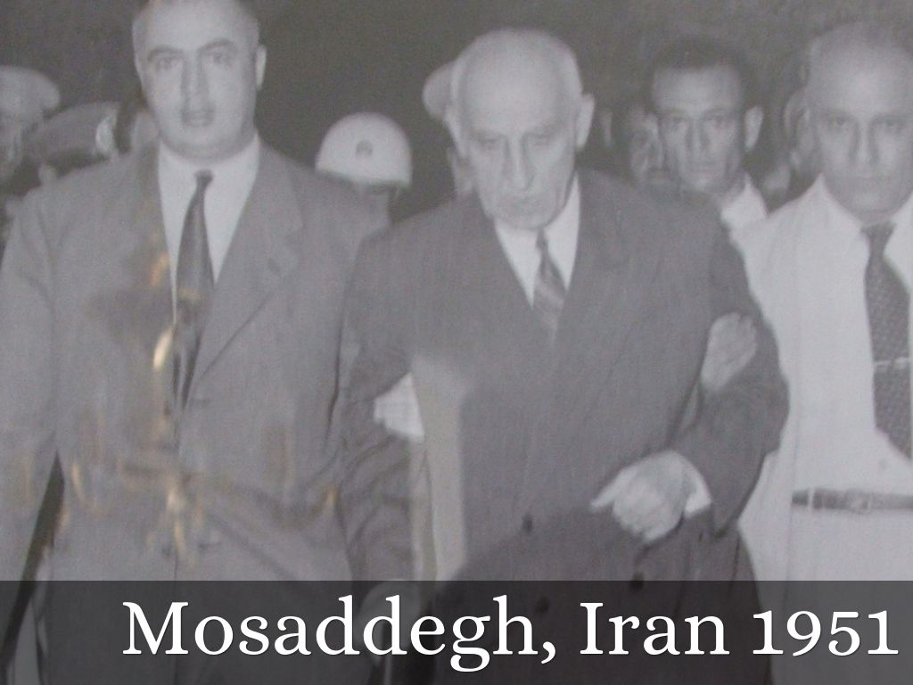
Photo by cfarivar - Creative Commons Attribution-NonCommercial-ShareAlike License https://www.flickr.com/photos/57082570@N00

Slide 7
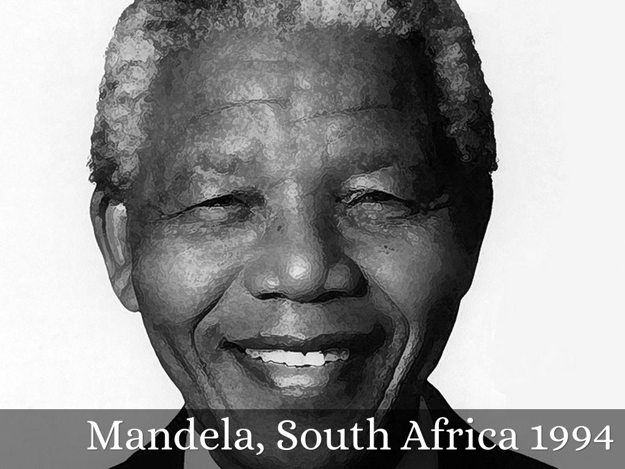
Photo by Ashish Lohorung - Creative Commons Attribution-NonCommercial-ShareAlike License https://www.flickr.com/photos/8800209@N04

Slide 8
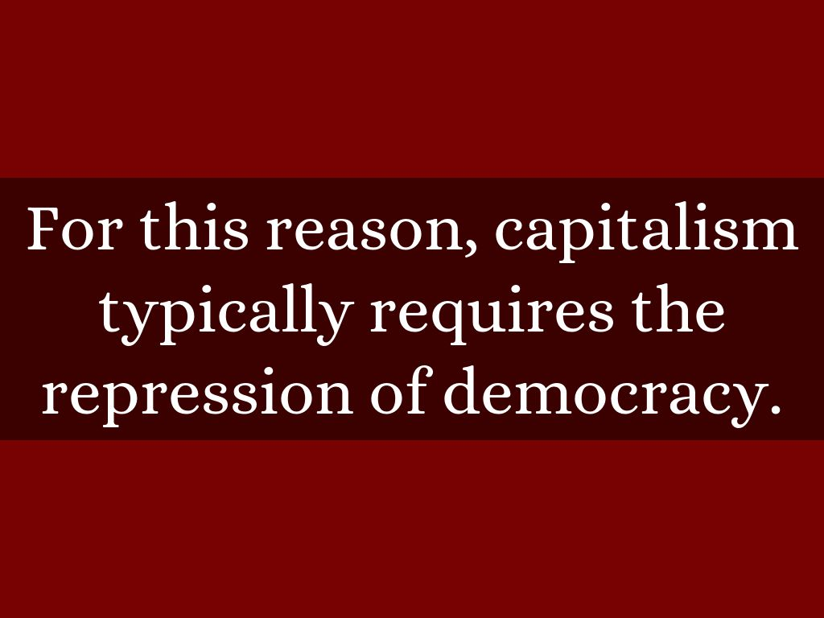

Slide 9
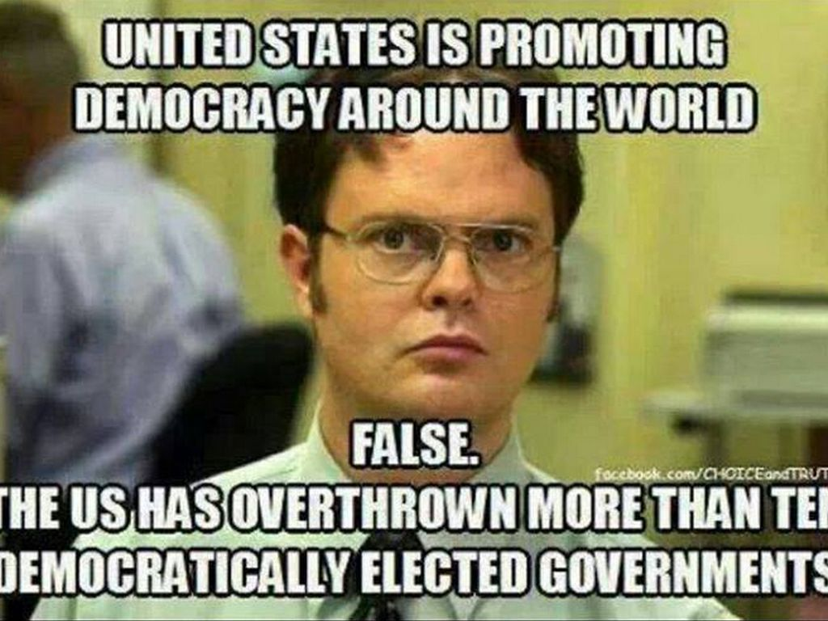

Slide 10
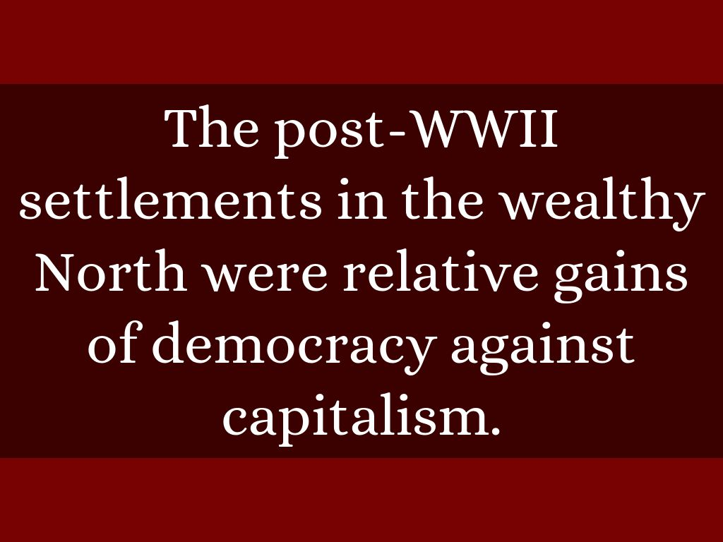

Slide 11
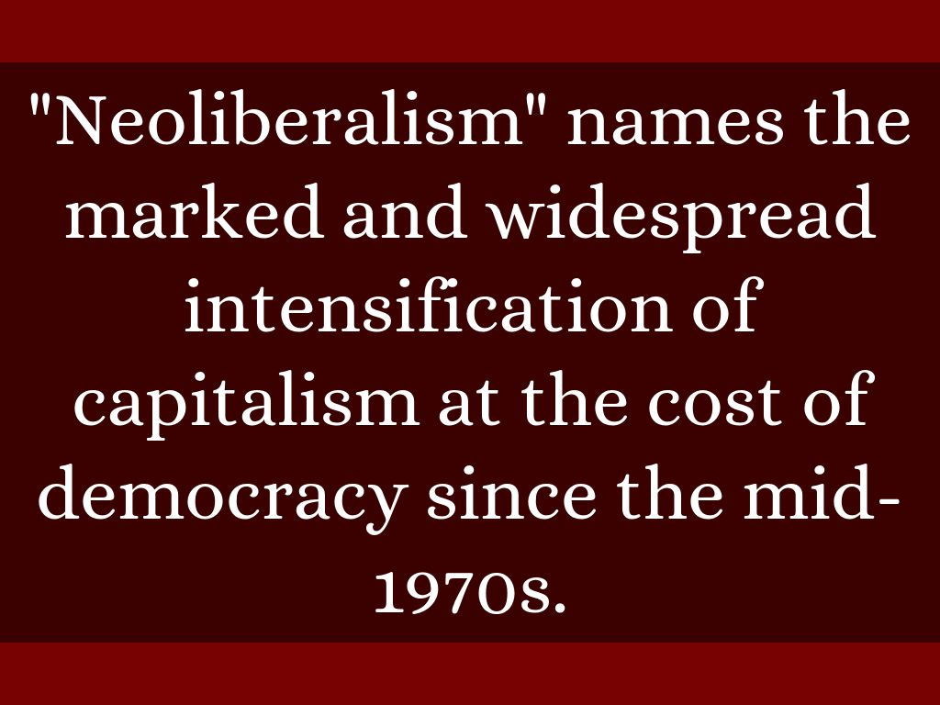

Slide 12
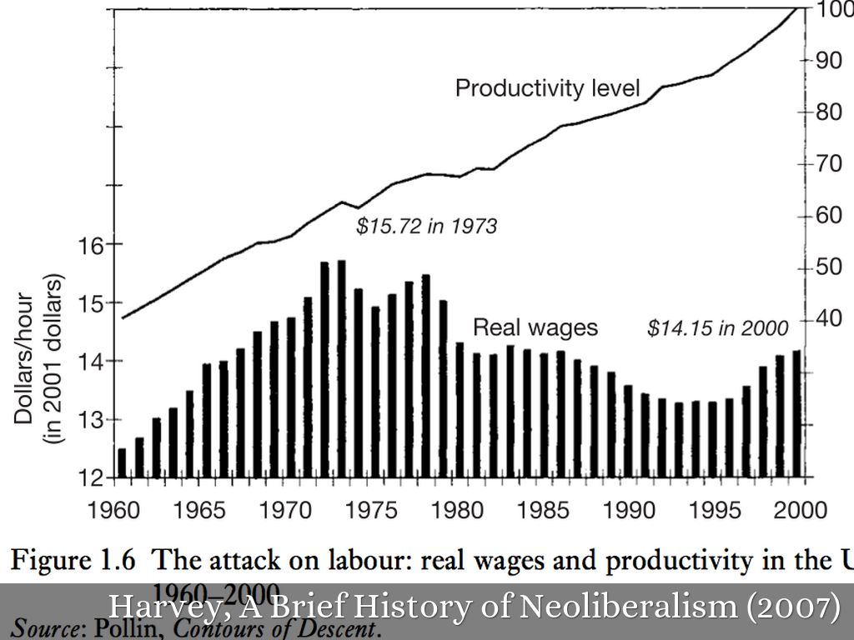

Slide 13
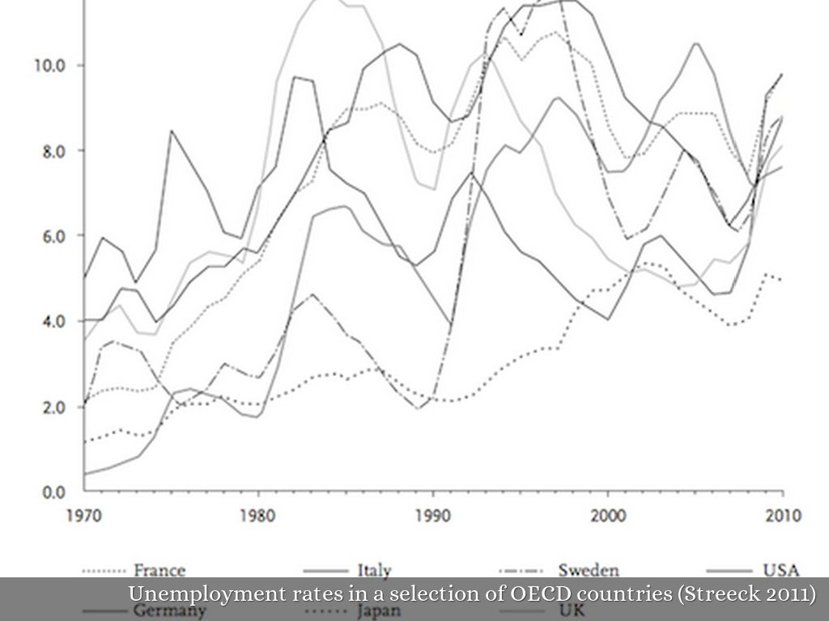

Slide 14
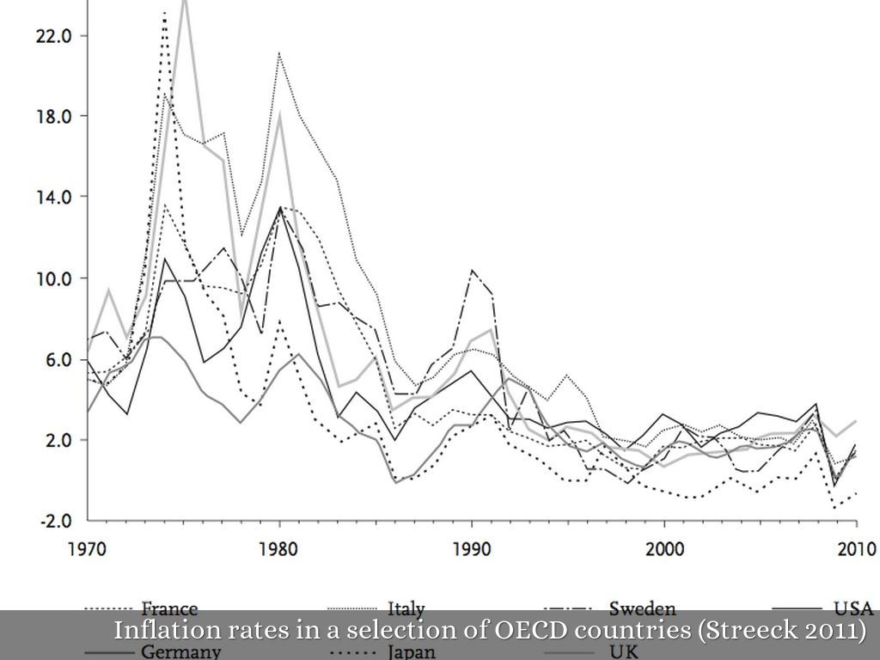

Slide 15
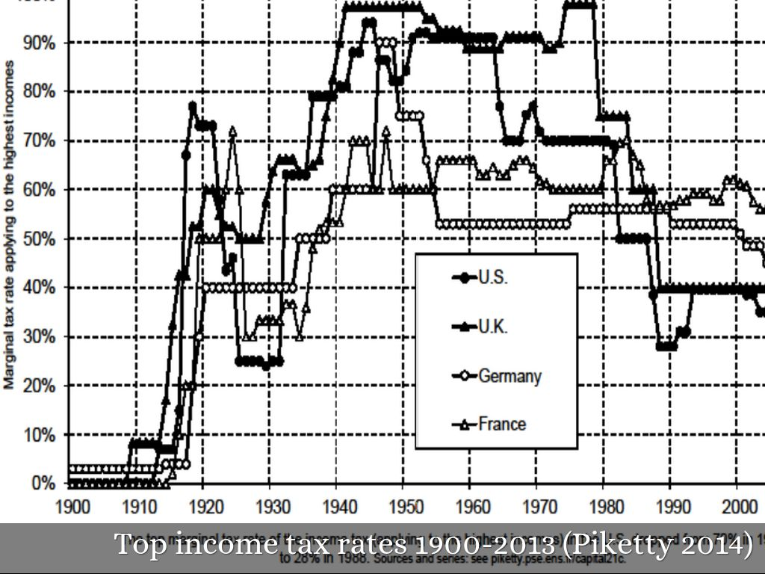

Slide 16
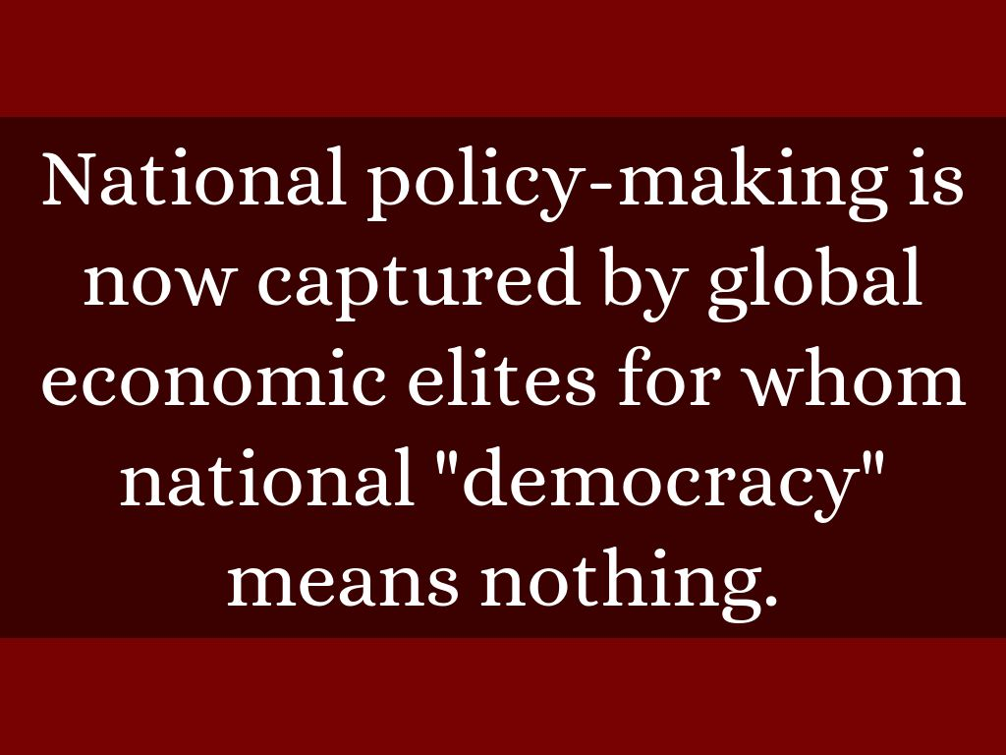

Slide 17
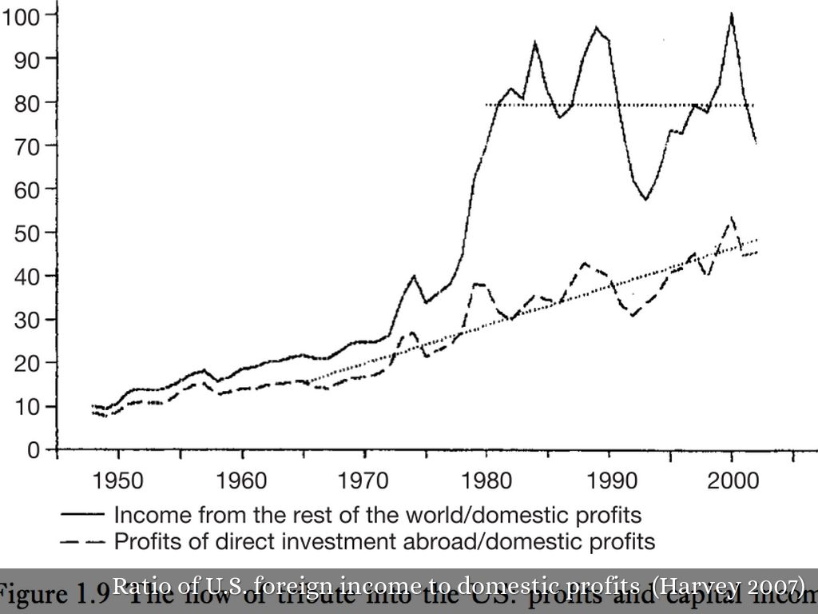

Slide 18
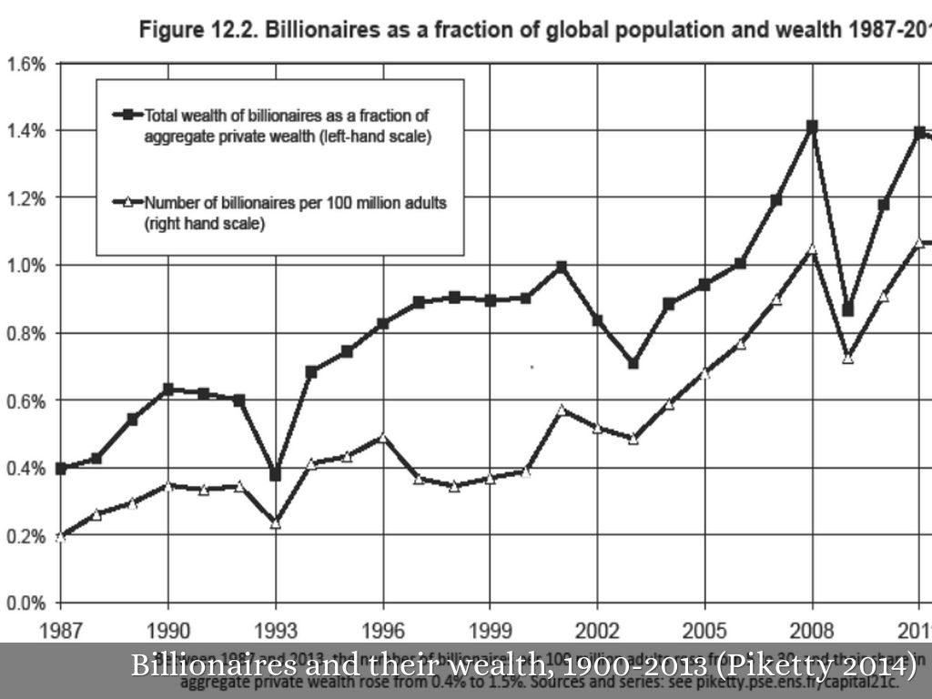

Slide 19
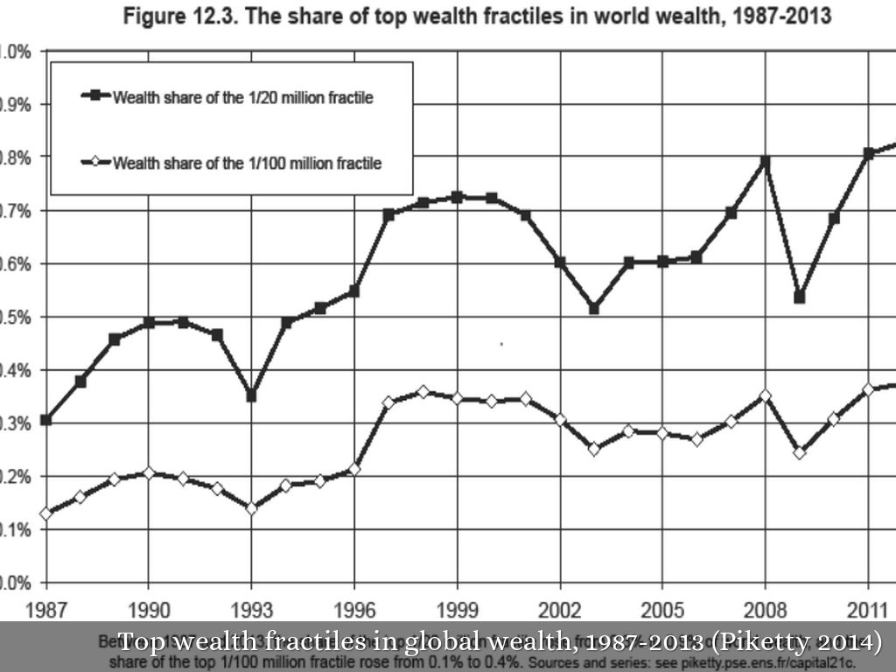

Slide 20
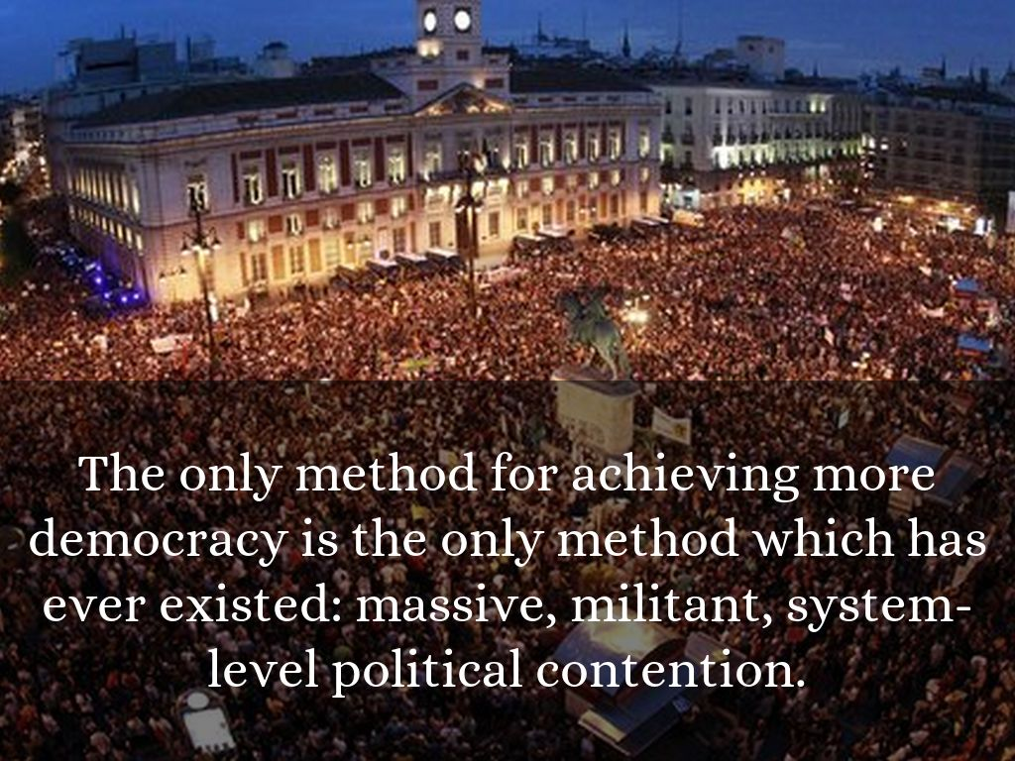

Slide 21
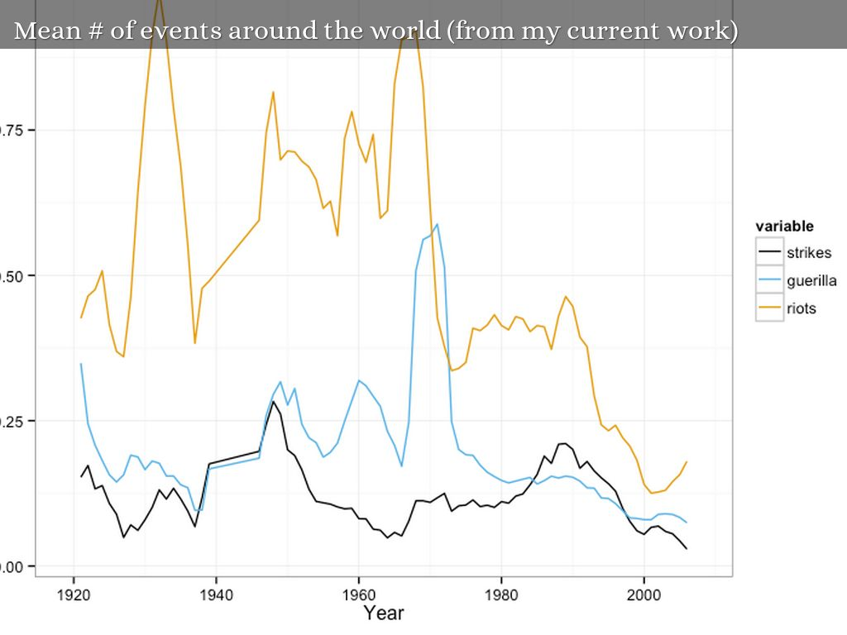

Slide 22


